Slide 1
Advanced
Developmental
Psychology
PSY 620
Messinger, PhD

Slide 2
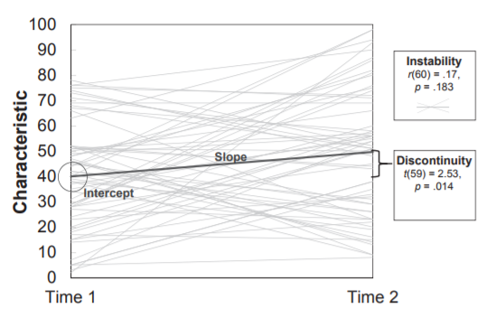
Questions?

Slide 3
Development defined:
Individual change over time that:
Reorganizes
  Multiple systems (entire person)
Successive, sequential
  Crawl before you walk
Non-reversible (stable)
  You can’t go back
Normative
  Everyone’s doing it
Continues over lifespan

Slide 4
Genetics overview
Behavioral genetics
  Twins
  A critique
Molecular genetics
  Common and rare variants
  Limitations
Epigenetics
  Maternal depression
  Adolescent perceived rejection
  Limitations and implications

Slide 5
2 perspectives on gene*environment interface
Quantitative
  The influence of genetic and environmental factors be distinguished and the influence of each can be quanitified using behavioral genetic methods (Plomin)
Transactional
  “It is not nature vs. nurture, but the interaction of nature and nurture that drives development.” Urie Bronfrenbrenner
Notes:
2

Slide 6
Sources of Variance in Behavior
Genetic (heritability)
Environmental
Gene x environment interaction
Error

Slide 7
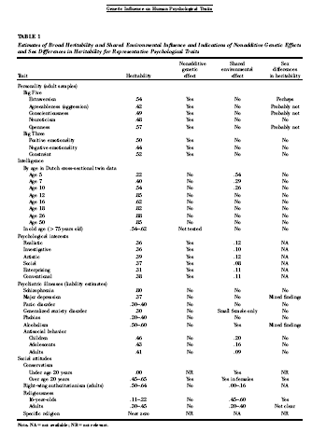
“Most, if not all, reliably measured psychological traits, normal and abnormal, are substantively influenced by genetic factors.”
Bouchard, T. J. (2004). "Genetic Influence on Human Psychological Traits: A Survey." Current Directions in Psychological Science 13(4): 148-151.

Slide 8
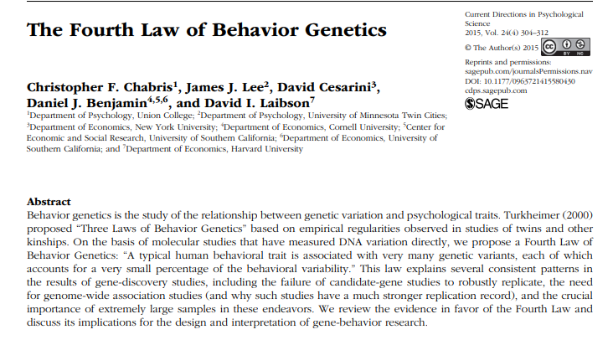
‘A typical human behavioral trait is associated with many genetic variants, each accounts for a very small percentage of behavioral variability.’
(2015)

Slide 9
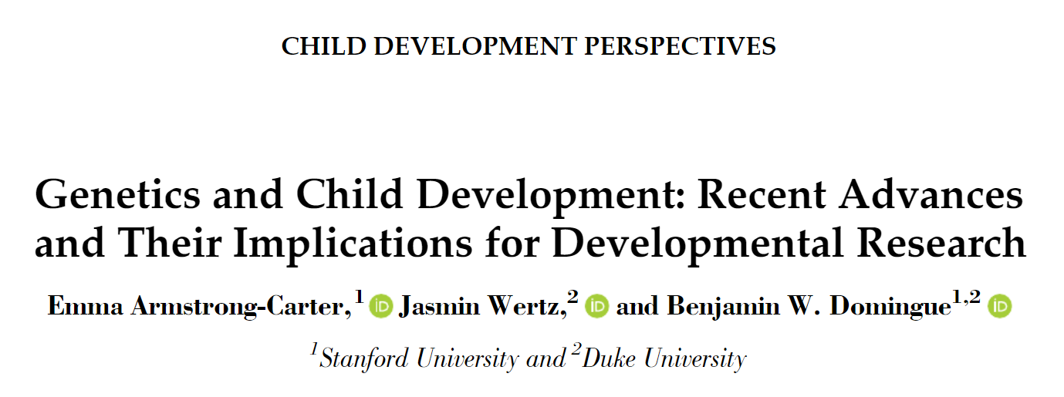
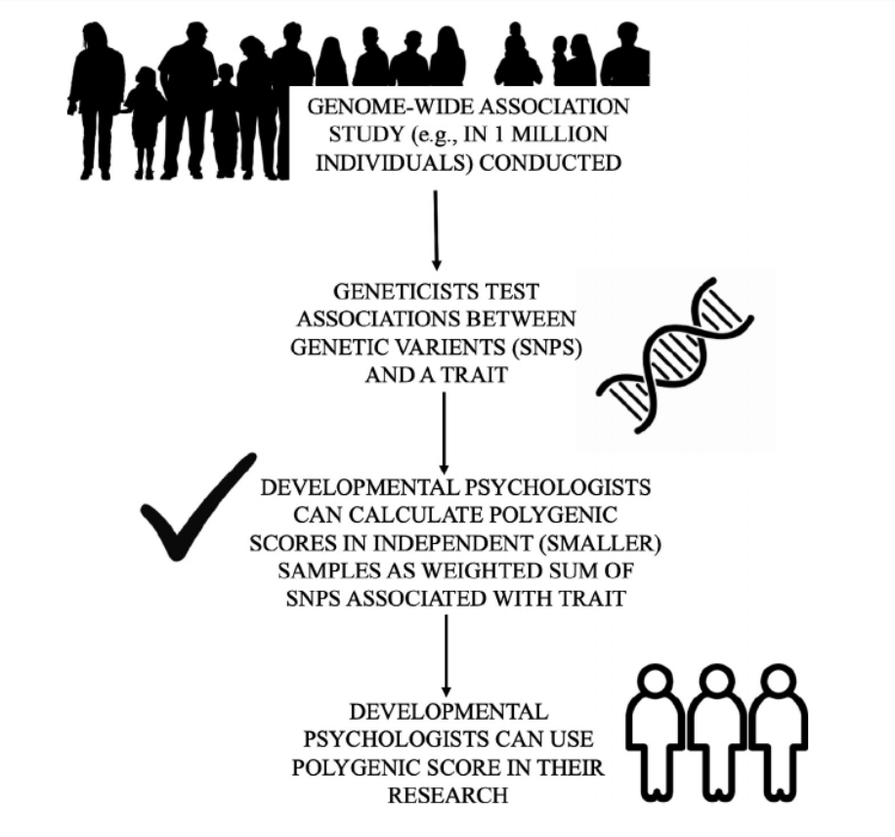
What is the phenotype we’re predicting?
Focus on the genetic basis of behaviors relevant to ASD may be productive

Slide 10
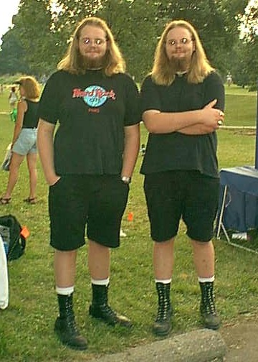
Twin studies
Identical (MZ) twins share 100% of their genes
  genetic duplicates.
Fraternal (DZ) twins share 50% of their genes
  on average
Both types of twins have similar environments . . .
Greater behavioral similarity of identical twins indexes greater genetic influence
      http://www.psych.umn.edu/psylabs/mtfs/special.htm

Slide 11
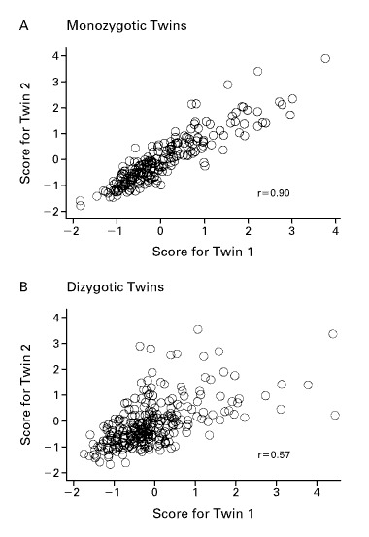
Behavior genetics logic

Slide 12
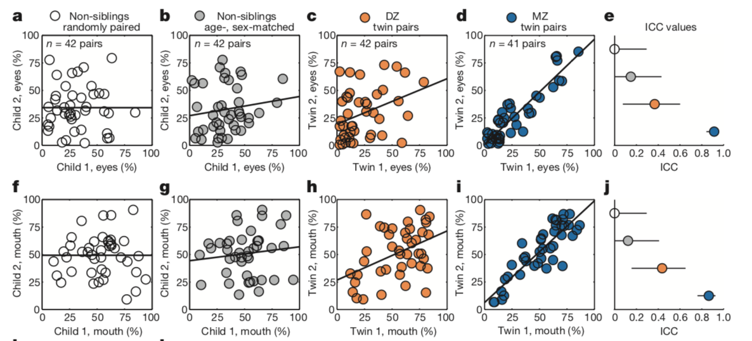
Gaze time associated with genetic relatedness
Aim: measure macro-level social visual engagement, calculating percentages of time spent looking at eye and mouth regions
Concordance in eye (0.91) and mouth (0.86) looking were incredibly high for MZ twins
DZ twins showed much lower correlations for eye (0.35) and mouth (0.44) looking.
Non-siblings showed no significant correlations for either matching
Notes:
e, j: interclass correlation coefficient and 95% confidence interval
When seen for follow-up 15 months after initial testing, at 36.8 ± 1.7) months (mean ± s.d.), monozygotic twins again demonstrated pairwise concordance in eye-looking of 0.93 (0.75–0.98), while dizygotic concordance was 0.25 (0.00–0.60) (Extended Data Fig. 4a–l and Extended Data Table 2b, see Methods), indicating strong preservation of genetic influence on social visual engagement over development (Extended Data Fig. 4m, n). Moreover, longitudinal within-subject stability—from 21 until 36 months—was high in both groups: equal approximately to 0.70 (Extended Data Fig. 5a–e).

Slide 13
A (additive genetics) C (common environment) and E (unique environment)—ACE Model
Correlation between MZ twins provides an estimate of r_{mz} = A + C
Dizygous (DZ) twins share common environment & mean 50% of genes:
  correlation between DZ twins is an estimate of r_{dz} = ½A + C
Twice the difference between MZ and DZ twins gives us A:
  additive genetic effect
  difference between the MZ and DZ correlations is half the genetic similarity…
C is simply the MZ correlation minus our estimate of A.
  C = r_{mz} – A = 2 r_{dz} – r_{mz}
The random (unique) factor E is estimated by how much the MZ twin correlation deviates from 1. E = 1 – r_{mz}
  A = 2 (r_{mz} – r_{dz})
Variance estimates depend on relative genetic and environmental variation.
http://en.wikipedia.org/wiki/Twin_study

Slide 14
Estimates of genetic and environmental influence
Proportional in samples
  Greater environmental variation
    Will minimize genetic variation
      E.g. Poverty
  Greater genetic variation
    Will minimize environmental variation
      E.g. Downs Syndrome

Slide 15
2 perspectives on gene*environment interface
Quantitative
  The influence of genetic and environmental factors be distinguished and the influence of each can be quanitified using behavioral genetic methods (Plomin)
Transactional
  “It is not nature vs. nurture, but the interaction of nature and nurture that drives development.” Urie Bronfrenbrenner
Notes:
2

Slide 16
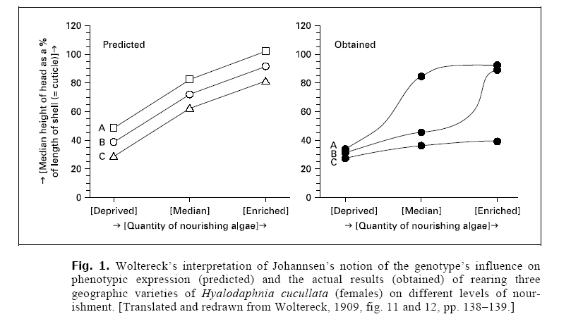
Gene*Environment Interaction
What does this mean for our calculations?

Slide 17
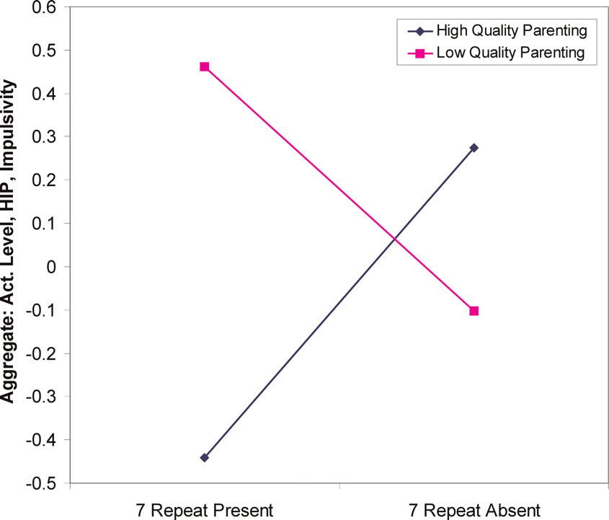
Genes influence relation between parenting and temperament
18-21 month olds
DRD4 48 (7-repeat, “long” allele present) increased sensitivity to environmental factors such as parenting.
  Lower quality parenting→ higher sensation seeking.
  Higher quality parenting→ lower sensation seeking
  Parenting quality interacts with genetic variation in dopamine receptor D4 to influence temperament in early childhoodSheese BE, et al. Dev Psychopathol 2007 19(4):1039-46

Slide 18
Initial Evidence: Gene * Environment Interaction
Caspi et al., 2003

Slide 19
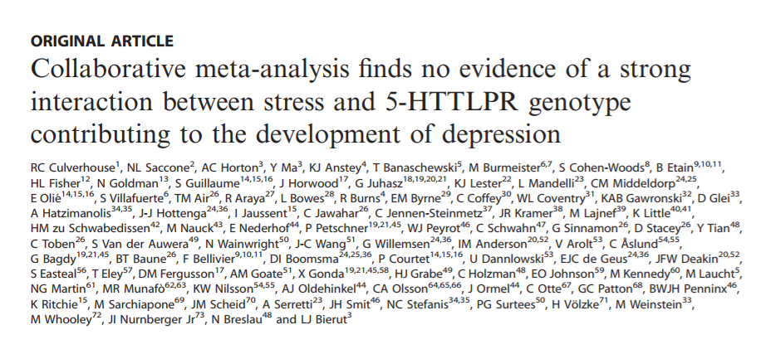
Not (always) supported

Slide 20
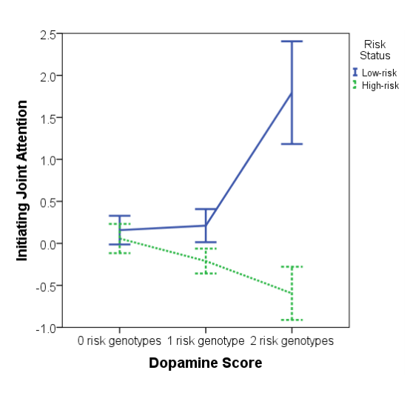
Dopaminergic genes & joint attention
Gangi et al., 2016

Slide 21
“What will it take to make behavioral genetics truly developmental?”
Analysis of the bi-directional relations from gene action to the external environment over the life course, including the prenatal period. Gottlieb, G. (2003). Human Development 46(6): 337-355.

Slide 22
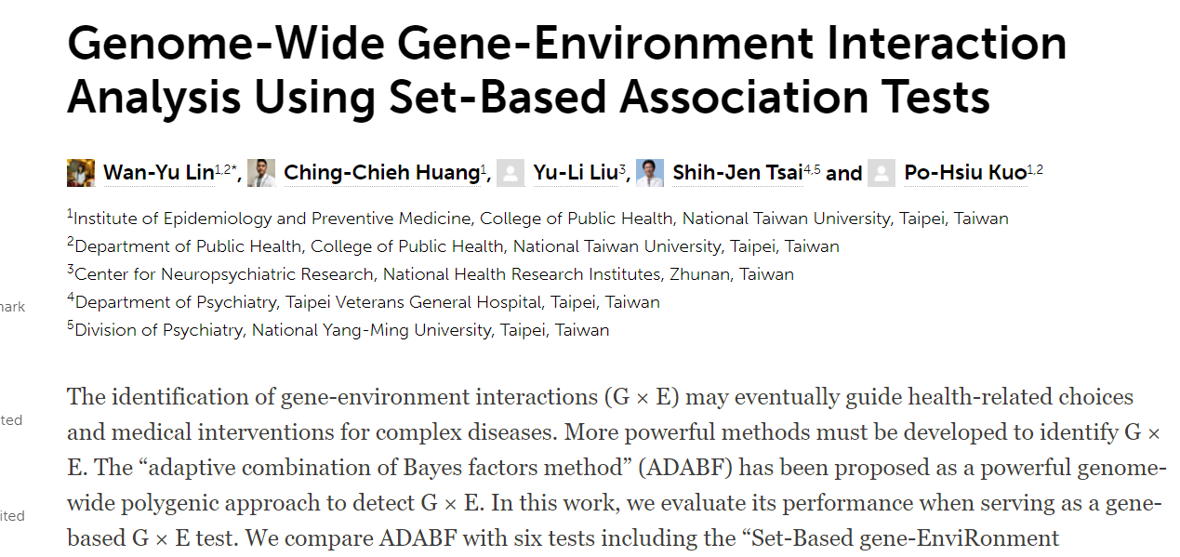

Slide 23
Contextual Determinants of Gene Function
Gene = sequence of DNA
Transcription = enzymes “read” DNA
Environment around DNA makes it possible to “read” DNA
Epigenetic – “in addition to genetic”
  Influences that determine expression without altering the DNA
Notes:
“Epigenetics refers to modification of genetic information not encoded in the DNA sequence of genomes.
Epigenetics marks can change a gene expression pattern without a change in primary nucleotide sequence - without changing an A, C, G or T.
Changes in gene expression often correspond with epigenetic changes such as methylation of DNA, changes in chromatin conformation (methylation, acetylation), and expression of non-coding RNAs.”
http://www.sickkids.ca/Research/Weksberg-Lab/Research-focus/BWS/Genetic-Imprinting-and-Epigenetics/index.html

Slide 24
Molecular genetics
In vitro
Genes
  Sequences of DNA in each cell
  Information on cell functioning & reproduction
Chromosomes
  Larger groupings of DNA
  All non-gamete cells have 23 pairs of chromosomes
  Half of each pair came from each parent
Ordered by karotyping

Slide 25
Human genome project
identify the ~30,000 genes in human DNA,
determine the sequences of the 3 billion chemical base pairs that make up human DNA,
99% (of nucleotide bases) are the same in all people

Slide 26
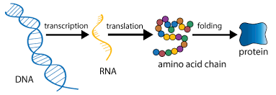
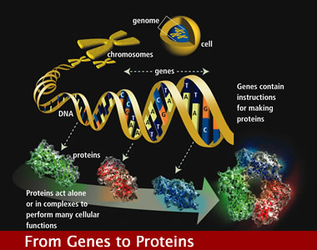
Proteomics
Identify the protein machines that carry out critical life functions and the gene regulatory networks that control these machines

Slide 27
Rare variants (autism example)
Rare variant mutations with a minor allele frequency < 1%
  Associated with ASD:
  CHD8, CNTNAP2, NLGN4, NRXN1, and CNTN4
But no specific gene accounts for a majority of ASD cases
  In fact, among siblings both diagnosed with ASD, most do not share the same ASD risk genes.
    D’Abate, et al. 2019

Slide 28
Common variants
Polymorphisms occurring in > 1–2% of the population
May comprise a substantial portion of the risk heritability of ASD
However, identified common variants that in combination or alone influence ASD susceptibility have not been well replicated
What is the phenotype we’re predicting?
Focus on the genetic basis of behaviors relevant to ASD may be productive

Slide 29
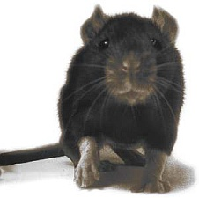
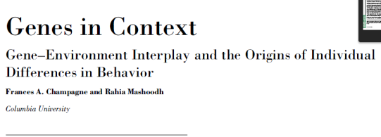
Epigenetics in Rodents
Extension to later mothering
  Less mothering attention -> Greater methylation
    Less mothering attention in the next generation
Roth and Sweatt (2009)
  Stressed mothers spend less time nurturing
  Lower BDNF hormone -> Greater methylation - > Lower neural growth
    Linked to anxiety in mice, responds to antidepressants
    Miller and Sweatt (2007)- Inhibition of methylation →detrimentalto memory
Nestler et al. (2010) Cocaine exposure
  Higher acetylation and methylation of histones
    Stimulates reward circuitry

Slide 30
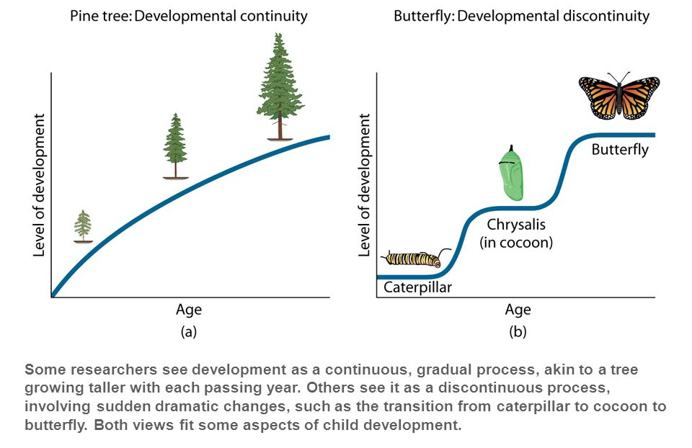
Continuity versus Discontinuity: Example

Slide 31
Genetics and epigenetics
Why epigenetics?
  Genome-wide associations point to certain rare alleles associated with psychopathology
  However, “structural variations in sequence have accounted for only a small fraction of human phenotypic variation and human disease” (Szyf & Bick, 2012)
DNA function determined not only by variation in sequence, but also by manner in which it is stably programmed

Slide 32
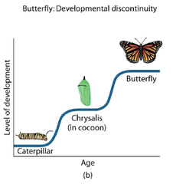
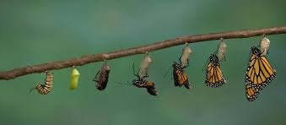
Epigenetics: A clue
How can an organism have different cell types yet one genome?
“The idea that DNA function could be stably diversified without changing the sequence comes from the study of cellular differentiation during embryonal development.” (Szyf & Bick, 2012)
Do caterpillars and
butterflies have the
same DNA?

Slide 33
Unexplained patterns
“Mothers who were pregnant during a 1944 famine in the Netherlands, for example, were more likely to have children—and grandchildren—prone to heart disease, diabetes, and obesity.
Female mice that are underfed during pregnancy give birth to pups that are more likely to develop diabetes—and their male offspring have epigenetic changes in their sperm. The offspring of those males are also prone to diabetes.
        http://www.sciencemag.org/news/2015/12/weight-gain-and-loss-can-alter-men-s-sperm
Notes:
Male rats that are overfed, when mated with healthy females, also had offspring that were prone to developing diabetes.”

Slide 34


DNA transcription: the process of DNA being read by an enzyme called RNA polymerase > leading to the production of mRNA > which is then translated into a protein
DNA methylation: one type of epigenetic mechanism; reduces accessibility of DNA, can lead to “silencing” of the gene
Epigenetic influences do NOT alter the sequence of DNA
(Champagne & Mashoodh, 2009; Syzf & Bick, 2012)
Rumper
(Champagne & Mashoodh, 2009; Syzf & Bick, 2012)
Notes:
Former belief: individual differences result from differences in sequence/structure of DNA
Transcriptome: what is transcribed from the genome
Former belief: once DNA methylation patterns are generated during embryogenesis, they remain “fixed” throughout life

Slide 35
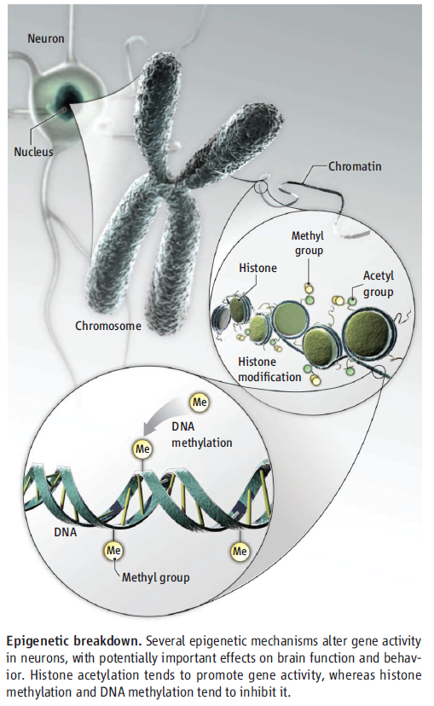
Epigenetic mechanisms
Histone acetylation tends to promote gene activity
Histone methylation and DNA methylation tend to inhibit it.

Slide 36
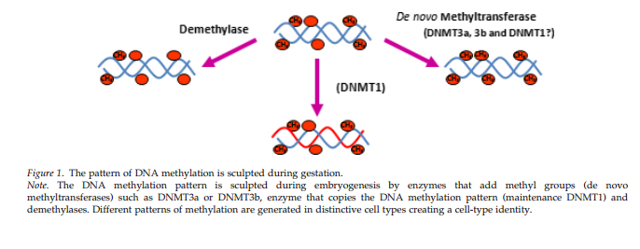
Methylation and demethylation during gestation → tissue types
demethylation
De novo
methylation
Maintenance
methylation
Szyf & Bick, 2012

Slide 37

Imagine you have access to a library…
1 DNA Sequence = 1 Book
Epigenetics influence book availability
(Champagne & Mashoodh, 2009; Syzf & Bick, 2012) Rumper

Slide 38
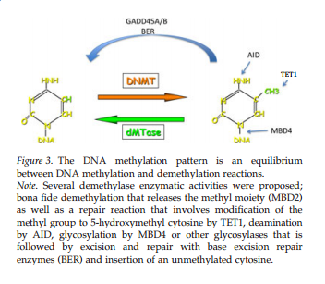
Dynamic DNA methylation
Szyf & Bick, 2012

Slide 39
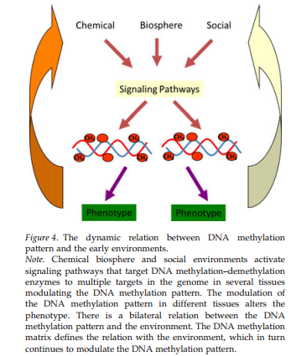
DNA methylation adaption are system wide and involve multiple gene circuitries

Slide 40
Global Epigenomic Reconfiguration During Mammalian Brain Development (Lister et al., 2013)
Background
Early postnatal burst of synaptogeneis → activity-dependent pruning of excess synapses during adolescence
  This process forms the basis for experience-dependent plasticity
  Disruption leads to behavioral alterations & neuropsychiatric disorders
Epigenome: Network of chemical compounds surrounding DNA that modify genomic expression without altering DNA sequences
  Dynamic epigenetic changes occur during brain development, maturation, & learning
  DNA METHYLATION PLAYS KEY ROLE
    Major transcriptional changes → adult electrophysiological characteristics in neocortical neurons

Slide 41
Goals of the Article
Better understand the unique role of DNA methylation in brain development and function → Unravel the genetic program and experience-dependent epigenetic modifications leading to a fully differentiated nervous system
Methods: Integrate empirical data of genome-wide composition, patterning, cell specificity, and dynamics of DNA methylation at single-base resolution in human & mouse frontal cortex at different developmental stages
Offer framework for testing the role of epigenome in:
Healthy function vs. Pathological disruptions of neural circuitry

Slide 42
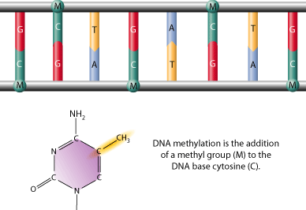
Global Epigenomic Reconfiguration During Mammalian Brain Development (Lister et al., 2013)
DNA methylation is a stable covalent modification that persists in post-mitotic cells throughout their lifetime, helping define their cellular identity
Types
1. mCG
2. mCH
(where H = A, C, or T)

Slide 43
Widespread methylome reconfiguration during fetal to young adult development is coincident with synaptogenesis.
CH methylation accumulates in neurons through early childhood & adolescence – becoming the dominant form of DNA methylation in mature human neurons
  Demonstrates large-scale reconfiguration of neuronal epigenome
Global Epigenomic Reconfiguration During Mammalian Brain Development (Lister et al., 2013)
Notes:
Widespread methylome reconfiguration occurs during fetal to young adult development, coincident with synaptogenesis.
Fig. 1. Methylcytosine in mammalian frontal cortex is developmentally dynamic and abundant in CG and CH contexts
(C) Synaptic density (for mouse, per 100 μm2; for human, per 100 μm3) and mC level in CG and CH contexts through development in mouse and human frontal cortex. †Synaptic density quantitation from De Felipe et al. (27) and Huttenlocher and Dabholkar (28). (E) Fraction of cytosine base calls with each modification in fetal and adult mouse frontal cortex.

Slide 44
Inaccessible genomic regions are protected from de novo methylation
  A2:Timing matters!
Example: Central nervous system deletion of Dnmt3a
If during late gestation → Motor deficits, premature death ☹
If during second postnatal week → Plays critical role in establishing normal brain methylation profile and allowing healthy brain development ☺
Notes:
Figure 1: (G) Transcript abundance, chromatin accessibility [8-week mouse cortex ChIP input and DNaseI hypersensitivity (HS) normalized read density], and mC levels in 5-kb bins at the mouse immunoglobulin VH locus. (H) Density (z) plot of 10-week mouse frontal cortex mCH level (x) versus 8-week mouse cortex ChIP-input normalized read density (y) for all 10-kb bins of the mouse genome.
Note: Although mCG is unaffected in these regions, lower chromatin accessibility appears to be highly inhibitory to deposition of mCH and hmC, potentially via inaccessibility to de novo methyltransferases and Tet mC hydroxylases. Furthermore, this indicates that accumulation of mCH and hmC during mammalian brain development occurs via processes that are at least partly independent from methylation at CG dinucleotides.

Slide 45
Neurons and glia show cell type-specific DNA methylation patterns
  Suggests a role for DNA methylation in distinguishing these 2 broad classes of cortical cells!
Notes:
During this period, highly conserved non-CG methylation (mCH) accumulates in neurons, but not glia, to become the dominant form of methylation in the human neuronal genome.
Fig. 2. mCH is positionally conserved and is the dominant form of DNA methylation in human neurons
(A) Browser representation of mCG and mCH in NeuN+ and NeuN− cells. Human NeuN+/ NeuN− samples: R1, 53-year-old female; R2, 55-year-old male. Mouse NeuN+/NeuN− samples: R1, 7-week males; R2, 6-week females; R3, 12-month females (not shown). (B) Percentage of methylated base calls in each sequence context throughout the genome.

Slide 46
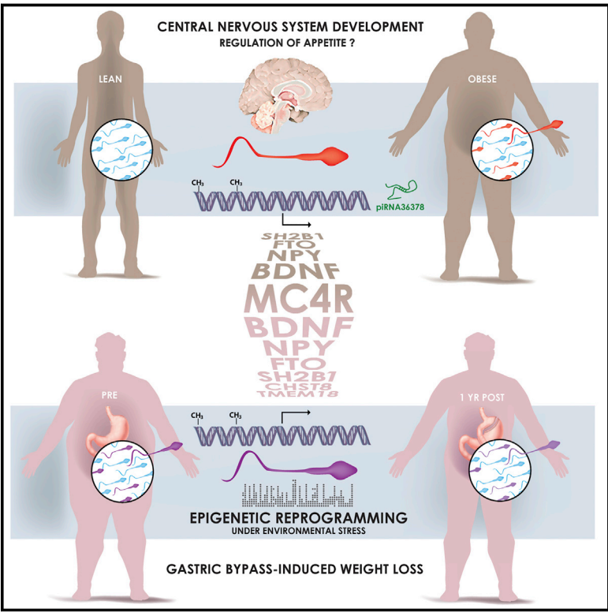
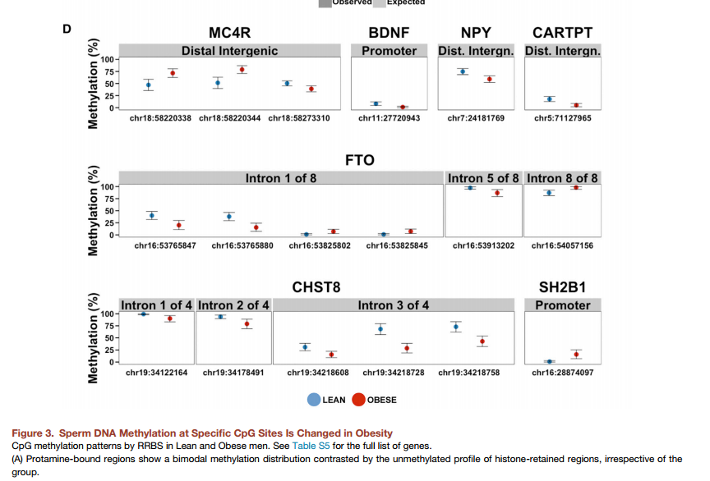
“[S]urgery-induced weight loss was associated with a dramatic remodeling of sperm DNA methylation, notably at genetic locations implicated in the central control of appetite.”
Donkin, I., Versteyhe, S., Ingerslev, L. R., Qian, K., Mechta, M., Nordkap, L., . . . Barres, R. (2015). Obesity and Bariatric Surgery Drive Epigenetic Variation of Spermatozoa in Humans. Cell Metab. doi: 10.1016/j.cmet.2015.11.004
Notes:
Obesity is a heritable disorder, with children of obese fathers at higher risk of developing obesity. Environmental factors epigenetically influence somatic tissues, but the contribution of these factors to the establishment of epigenetic patterns in human gametes is unknown. Here, we hypothesized that weight loss remodels the epigenetic signature of spermatozoa in human obesity. Comprehensive profiling of the epigenome of sperm from lean and obese men showed similar histone positioning, but small noncoding RNA expression and DNA methylation patterns were markedly different. In a separate cohort of morbidly obese men, surgery-induced weight loss was associated with a dramatic remodeling of sperm DNA methylation, notably at genetic locations implicated in the central control of appetite. Our data provide evidence that the epigenome of human spermatozoa dynamically changes under environmental pressure and offers insight into how obesitymay propagate metabolic dysfunction to the next generation.

Slide 47
Environmental Influences on Gene Activity
In rodents:
  Prenatal exposure to chronic stress → hi methylation
  Low maternal care → high methylation
Less nurturing mothering leads to poorer stress response in rat pups
    Fewer corticosterone receptors
    Linked to DNA methylation
    Enzymes reverse methylation, improve receptor numbers
      Szyf & Meany (2004)

Slide 48
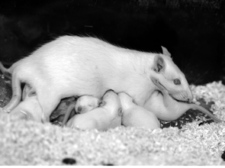
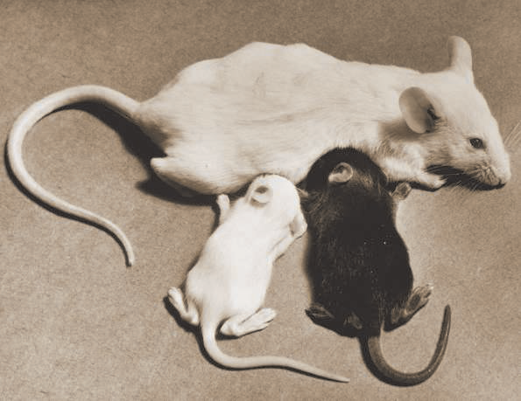
Environmental Influences on Gene Activity in Rodents
Prenatal exposure to chronic stress → hi methylation
  Low maternal care → high methylation
Less nurturing mothering → poorer pup stress response
    Fewer corticosterone receptors
    Linked to DNA methylation
    Enzymes reverse methylation, improve receptor numbers
      Szyf & Meany (2004)

Slide 49
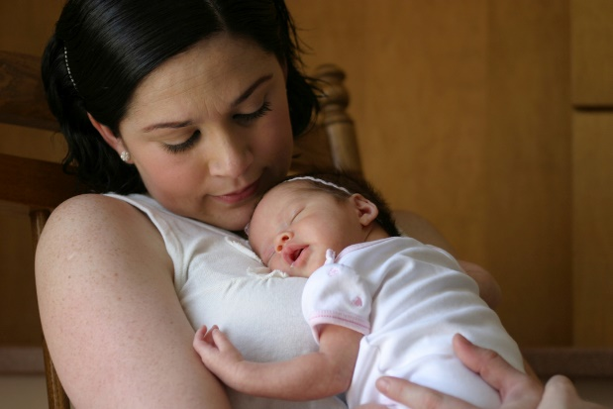
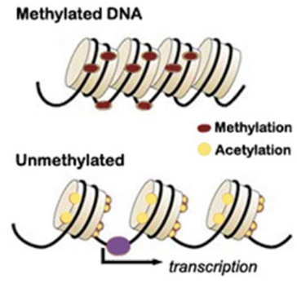
Conradt, E., Hawes, K., Guerin, D., Armstrong, D. A., Marsit, C. J., Tronick, E., & Lester, B. M. (2016). The contributions of maternal sensitivity and maternal depressive symptoms to epigenetic processes and neuroendocrine functioning. Child development, 87(1).

Slide 50
Maternal depression can lead to negative child outcomes
Maternal
Depression
Greater
Methylation?
NR3C1 fewer receptors present for binding
11B-HSD-2 no longer converts maternal cortisol into cortisone
Maternal Sensitivity and Responsiveness?
Through what mechanisms does maternal depression affect children’s genetic expression?
Previous studies examined the process in rodents
Conradt et al., 2016
Milrad
Edited by Pester

Slide 51
NR3C1 Function
Limbic brain region (Hypothalamus) stimulate the release of Corticotropin Releasing Factor (CRF)
CRF activates Pituitary Gland to release Adrenocorticotropic Hormone (ACH)
Individual perceives stress
ACH activates Adrenal cortex to release cortisol
Cortisol binds to glucocorticoid receptor (GR), NR3C1
H
DNA Methylation of NR3 C1, which is a GR results in fewer GRs for binding cortisol, resulting in higher levels of cortisol in the blood.
Negative feedback loop inhibits release of CRF and shuts down HPA axis.
P
A

Slide 52
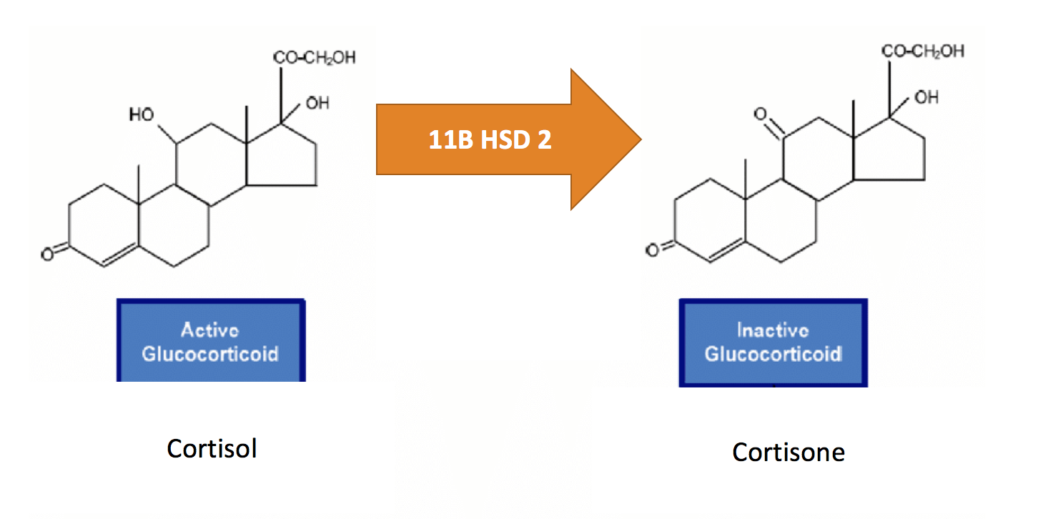
11B HSD2 Function

Slide 53
Overall goal of study
Whether maternal depressive symptoms, sensitivity, and/or responsiveness are related to DNA methylation of genes involved in neuroendocrine functioning and response to stress

Slide 54
Aim 1: Main effects of maternal sensitive behaviors and
responsiveness and depressive symptoms on DNA methylation
Maternal Sensitivity and Responsiveness
Infant’s DNA Methylation
Maternal depressive symptoms
Conradt et al., 2016
Rumper
Edited by Pester

Slide 55
Aim 2: Main effects of maternal sensitive behaviors and
responsiveness and depressive symptoms on prestress
cortisol and cortisol reactivity
Maternal Sensitivity and Responsiveness
Infant’s cortisol levels
(Pre and post-stress)
Maternal depressive symptoms
DNA Methylation
Conradt et al., 2016
Milrad
Edited by Pester

Slide 56
Aim 3: Social Buffering Hypothesis
Maternal Sensitivity and Responsiveness
DNA Methylation
Maternal depressive symptoms
Infant’s pre-stress cortisol levels
Infant’s cortisol reactivity
Milrad
Conradt et al., 2016
Edited by Pester

Slide 57
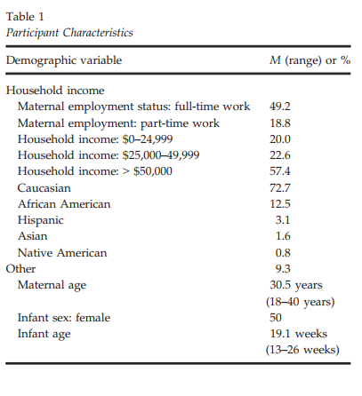
Methods: Demographics, Measures, Study Design
Mother:
  Anxiety (covariate)
  Depression (CES-D)
  Sensitivity and Responsiveness: [2 factors]
    Acceptance /Nondemanding
    Responsiveness/
    Appropriate Touch
Infant:
  Cortisol x 3
  Buccal Sample Collection for DNA
Rumper
Conradt et al., 2016
Edited by Pester

Slide 58
Aim 1 Results: Main effects of maternal sensitive behaviors and responsiveness and depressive symptoms
Maternal Sensitivity and Responsiveness (accepting/
nondemanding factor only)
Infant’s DNA Methylation
of 11b-HSD2 CpG 1
NOT
NR3C1 CpG
Maternal depressive symptoms
Conradt et al., 2016
Rumper
Edited by Pester

Slide 59
Aim 2 Results: No main effects
Maternal Sensitivity and Responsiveness
Infant’s cortisol levels
(Pre and post-stress)
Maternal depressive symptoms
DNA Methylation
Conradt et al., 2016
Milrad
Edited by Pester

Slide 60
Aim 3 Results: Social Buffering Hypothesis
Maternal Sensitivity and Responsiveness
(Responsive/appro touch factor ONLY)
DNA Methylation
(11b-HSD2 CpG 3 & 4, NR3C1 CpG 2
ONLY)
Maternal depressive symptoms
Infant’s pre-stress cortisol levels
Infant’s cortisol reactivity
Conradt et al., 2016
Milrad
Edited by Pester

Slide 61
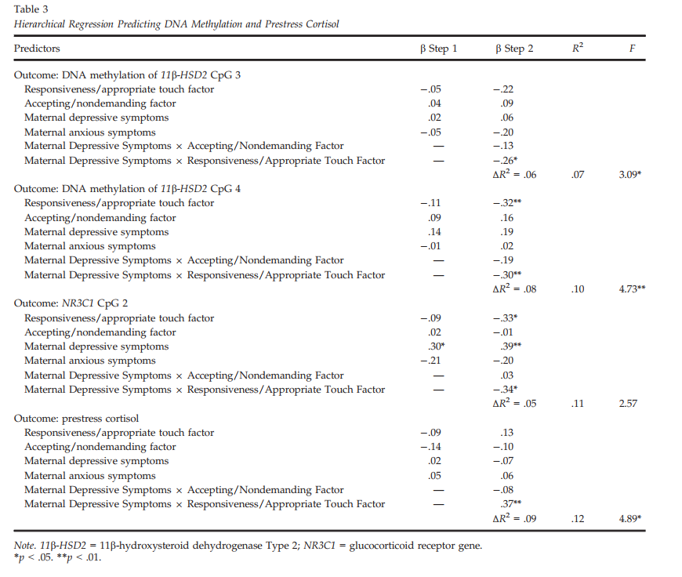
Results of Regression Analyses
Rumper
Conradt et al., 2016

Slide 62
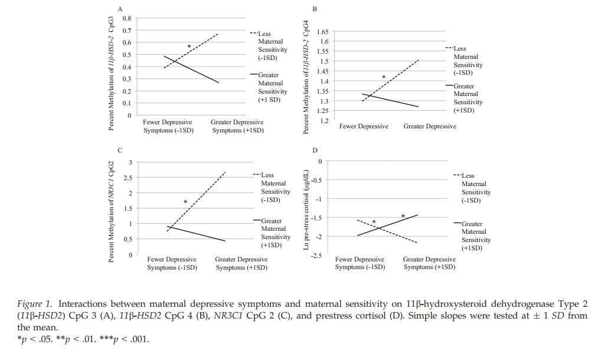
Figures for significant interactions
Milrad
Conradt et al., 2016
Edited by Pester

Slide 63
Results of Regression Analyses
Rumper
Conradt et al., 2016

Slide 64
Figures for significant interactions
Milrad
Conradt et al., 2016
Edited by Pester

Slide 65
Results of Regression Analyses
Rumper
Conradt et al., 2016

Slide 66
Figures for significant interactions
Milrad
Conradt et al., 2016
Edited by Pester

Slide 67
Major Take-Aways
Aim 1: Increased levels of accepting/nondemanding factor correlated with greater 11β-HSD2 CpG1methylation. [not expected]
Aim 2: No main effects of maternal sensitive behaviors (responsiveness/appropriate touch and accepting/nondemanding factor), maternal depression, and DNA methylation on pre-stress cortisol and cortisol reactivity
Edited by Pester

Slide 68
Aim 3: Buffering by responsiveness?
  Interaction between maternal depressive sx and maternal responsiveness/appropriate touch predicted 11β-HSD2 CpG3
    highest methylation among mothers who were less responsive and had high depressive sx (otherwise no differences)
  Main effect for maternal depressive sx and responsiveness/appropriate touch on DNA methylation of 11β-HSD2 CpG4 and NR3C1 CpG2, with a significant interaction
  No main effects for pre-stress cortisol but interaction with maternal responsiveness and depressive sx,
  Infants with high depressive sx and low responsiveness had lowest pre-stress cortisol levels
  Infants whose mothers had high depressive sx and responsiveness had highest pre-stress cortisol levels.

Slide 69
Discussion Questions
Is it possible to disentangle effects of maternal depressive symptoms on infant in utero versus post natally? Was this done successfully in the present study?
Thoughts on the heterogeneous nature of depression presentation? Or the comorbidity between depression and anxiety/other mental health conditions? Were these factors well-addressed by the investigators?
Given study findings and the prevalence of PPD, what next steps may be taken related to interventions, with consideration of the social buffer and appropriate touch findings?
Were you surprised by any of the results?
Given the dynamic and evolving nature of the variables investigated in this study, what are some future research directions?
Created by Pester
Notes:
FOLLOW UP QUESTION related to QUESTION 1: could there be something unique about the presentation of depressive symptoms with higher responsiveness/sensitivity that may alter presentation of depression altogether when mother is pregnant, and subsequently affect infant in utero? How could the current (or future) investigators have better accounted for this?

Slide 70
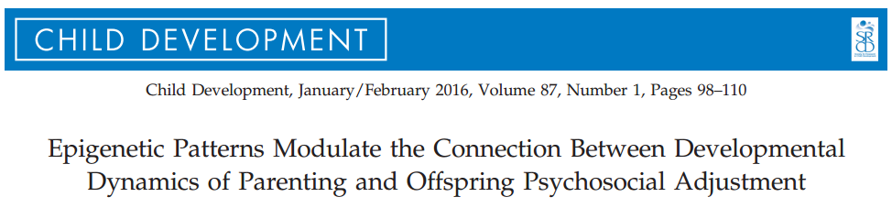
Epigenetic modulation?
Naumova, O. Y., Hein, S., Suderman, M., Barbot, B., Lee, M., Raefski, A., Dobrynin, P. V., Brown, P. J., Szyf, M., Luthar, S. S., & Grigorenko, E. L.
Societal factors: amount & quality of child care
Parenting
Parental stress and mental health
Neurobiology: low stress reactivity; PFC function
Child adjustment
Mechanisms?

Slide 71

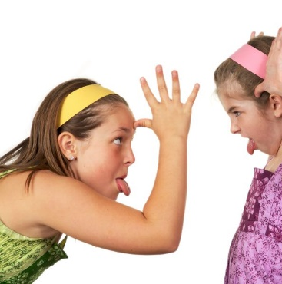
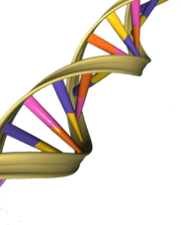
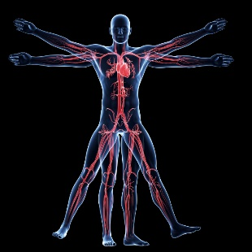
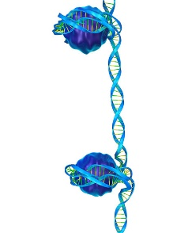
Epigenetic mechanisms
Naumova, O. Y., Hein, S., Suderman, M., Barbot, B., Lee, M., Raefski, A., Dobrynin, P. V., Brown, P. J., Szyf, M., Luthar, S. S., & Grigorenko, E. L
Emerging research
  Mechanisms of epigenetic regulation (e.g., DNA methylation)
  Types of social experiences that may impact epigenome reactivity

Slide 72
Hypotheses
Indicators of parenting across three developmental periods (middle childhood, adolescence, and adulthood) are sensitive to capturing an association with changes in methylome
Impact of parenting over time on epigenome influenced by
  Stability of parenting
  Type of parenting

Slide 73
Methods
35 offspring from sample of 361 low-income, ethnically diverse urban mother-offspring dyads
  Controlled for age, gender, Substance Use Disorders (SUD), psychopathology
  All African American; 19 female
Assessed 3x over course of 15 years
  Parental Acceptance-Rejection Questionnaire (PARQ)
  Parenting Stress Index (PSI)
  Behavior Assessment System for Children – College Version (BASC-CV)
  Genome-Wide DNA Methylation Profiling (T3 only)
Notes:
Sud—substance use disorder

Slide 74
Analyses
Regressed methylation levels of the 480,172 autosomal fragments with the most variance (ME markers) on the covariates and one of the 4 parenting indicators
Regressed BASC composite scores on methylation levels of parenting-associated ME markers and covariates
Related parenting-associated ME markers to genes and functional genomic regions

Slide 75
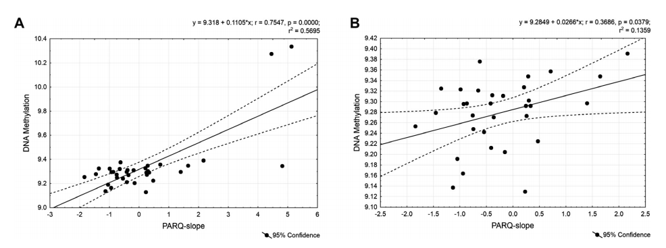
(with outliers without outliers)
Slope of perceived parental rejection across 3 time points related to increase in methylation (potential downregulation) of 565 genes
Parental Acceptance-Rejection Questionnaire (PARQ)
Notes:
the slope of perceived parental rejection across the 3 time points was related to an increase in methylation, or a potential downregulation, of 565 genes thought to be involved in the control of a broad spectrum of biological functions generally related to cellular signaling

Slide 76
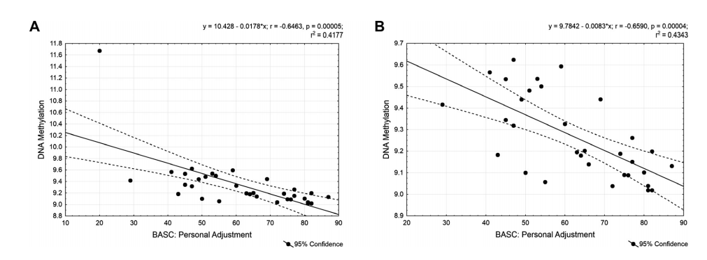
  Subset of epigenetic marks, clustered in 23 genes, some active in the development and functioning of the CNS, were associated with interpersonal relationships and emotional self-evaluation.
  Behavior Assessment System for Children – College Version (BASC-CV), psychosocial adjustment
Notes:
A subset of these epigenetic marks, clustered in 23 genes, some of which participate in the development and functioning of the CNS, were in turn associated with psychosocial adjustment as captured by interpersonal relationships and emotional self-evaluation.

Slide 77
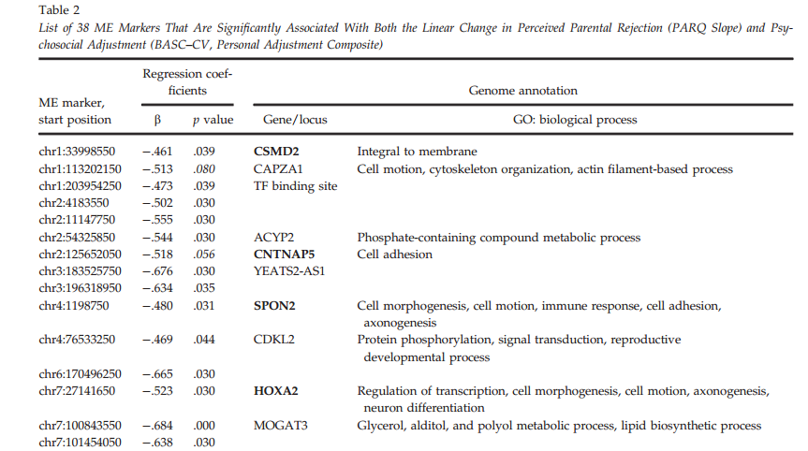
Methyl markers associated with perceived rejection and adjustment

Slide 78
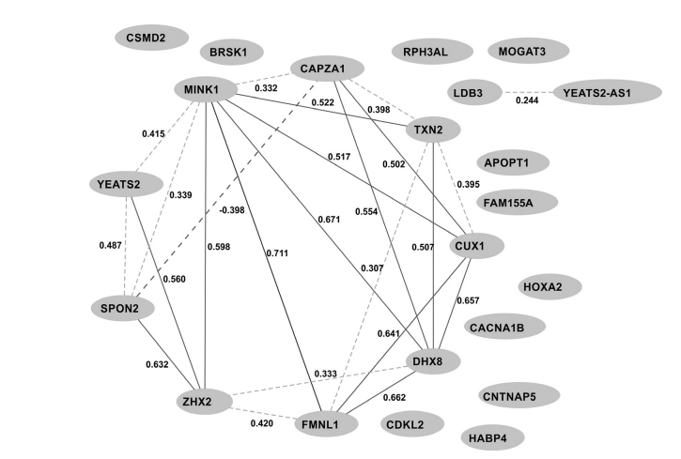
Methyl marker gene co-expression network
Making sense of correlated methyl markers
Figure 3. The tissue (blood)-specific coexpression network for the 23 genes associated with both the Parental Acceptance–Rejection Questionnaire slope and the college version of the Behavior Assessment System for Children Personal Adjustment Composite Personal Adjustment, constructed based on Genotype–Tissue Expression (GTEx) project database (Lonsdale et al., 2013) via a WebQTL resource (http://www.genenetwork.org). Interactions for absolute correlations above .50 are shown; Pearson pairwise correlations are represented. The nodes contain the symbols of genes. Notably, 12 of these 23 genes are known to be expressed in blood cells, and 9 of 12 active genes showed a high covariability in their expression levels among individuals.

Slide 79
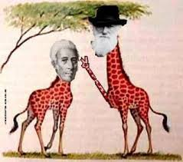
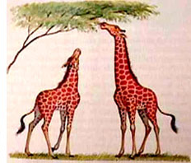
Epigenetics and Lamark
Structural inheritance. In ciliates such as Tetrahymena and Paramecium, genetically identical cells show heritable differences in the patterns of ciliary rows on their cell surface. Experimentally altered patterns can be transmitted to daughter cells. It seems existing structures act as templates for new structures. The mechanisms of such inheritance are unclear, but reasons exist to assume that multicellular organisms also use existing cell structures to assemble new ones.^{[80][81][82]}
https://en.wikipedia.org/wiki/Epigenetics
increasing irreversibility of cell type differentiation

Slide 80
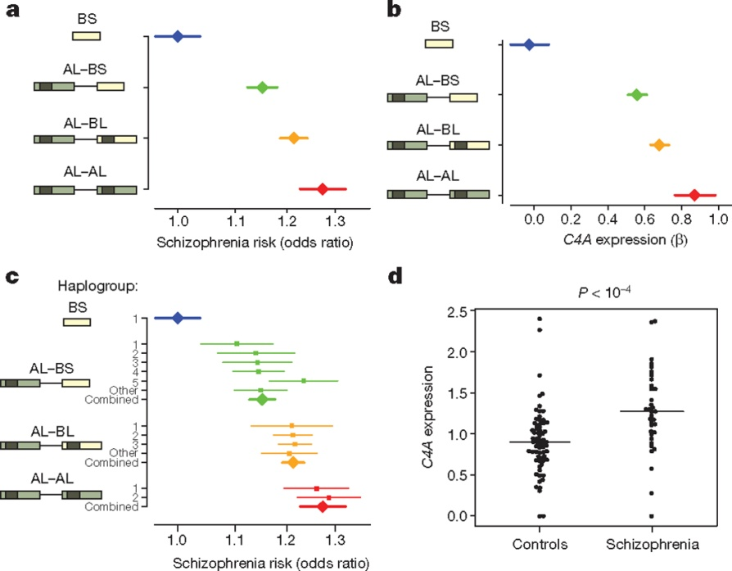

Schizophrenia risk from complex variation of complement component 4
schizophrenia is increased with inheritance of specific variants in a gene related to "synaptic pruning“
http://www.sciencedaily.com/releases/2016/01/160127141400.htm risk
C4 structures, C4A expression, and schizophrenia risk
A Sekar et al. Nature 1–6 (2016) doi:10.1038/nature16549

Slide 81
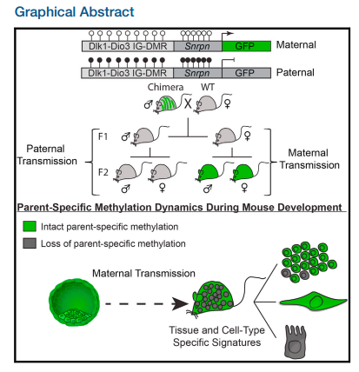

Parent-specific DNA Methylation in mice
Using a recently established DNA methylation reporter, Stelzer et al. study parent-specific methylation dynamics at the Dlk1-Dio3 imprinted control region. Reporter activity uncovered tissue- and cell-dependent signatures through mouse development and in adult tissues, suggesting that dynamic methylation changes regulate imprinted gene expression in pre- and postnatal animals.
Parent-of-Origin DNA Methylation Dynamics during Mouse DevelopmentYonatan Stelzer, Hao Wu, Yuelin Song, Chikdu S. Shivalila, Styliani Markoulaki, Rudolf Jaenisch
Cell Reports
Volume 16, Issue 12, Pages 3167-3180 (September 2016)
DOI: 10.1016/j.celrep.2016.08.066
Copyright © 2016 The Authors Terms and Conditions

Slide 82
Infant viewing of social scenes is under genetic control and is atypical in autism
Constantino, J.N., et. al.., 2017

Slide 83
background
Autism is broadly defined by behavioral irregularities in social development, that result social and communicative impairments
  Within the first 6 months, children who are later diagnosed with ASD show atypical social visual engagement
Authors aimed to explore the genetic structure of factors affecting normative social development – specifically visual social engagement
  Hypothesizing that typical genetic variation in the population influence individual social development, and are disrupted in autism

Slide 84
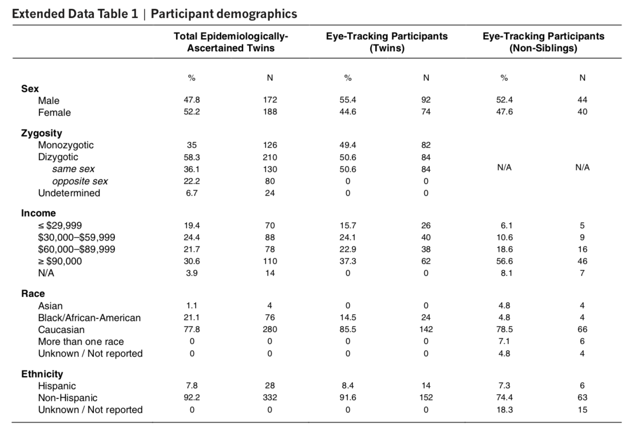

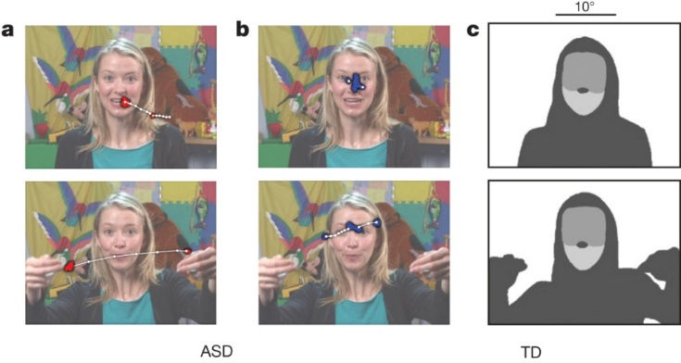
Participants
338 toddlers, 18-24 months
  82 monozygotic twins (MZ)
  84 dizygotic twins (DZ),
  84 non-sibling (42 randomized pairs age & sex matched)
  88 non-twins diagnosed with ASD
coinciding with large shifts in language, cognition, and adaptive behavior , and affording wide variation in our trait of interest
Eye-tracking (using ISCAN) on 27 video based stimuli for ~20 minutes
  Adult female speaking directly into camera (didactic interaction with caregiver)
  Children playing in a child care setting
Notes:
Non-siblings had no familial biological relationship to one another, lived apart, and were compared with twins in two ways: individually matched in sex and age and randomly matched in 10,000 re-samplings without replacement
We restricted analyses to same-sex twin pairs (inclusion of opposite-sex dizygotic pairs yielded either no change or accentuation of monozygotic–dizygotic differences).

Slide 85
Methods
Each twin or non-sibling tested individually
Eye-tracking (using ISCAN) on 27 video based stimuli for ~20 minutes
  Adult female speaking directly into camera (didactic interaction with caregiver)
  Children playing in a child care setting

Slide 86
Gaze time associated with genetic relatedness
Aim: measure macro-level social visual engagement, calculating percentages of time spent looking at eye and mouth regions
Concordance in eye (0.91) and mouth (0.86) looking were incredibly high for MZ twins
DZ twins showed much lower correlations for eye (0.35) and mouth (0.44) looking.
Non-siblings showed no significant correlations for either matching
Notes:
e, j: interclass correlation coefficient and 95% confidence interval
When seen for follow-up 15 months after initial testing, at 36.8 ± 1.7) months (mean ± s.d.), monozygotic twins again demonstrated pairwise concordance in eye-looking of 0.93 (0.75–0.98), while dizygotic concordance was 0.25 (0.00–0.60) (Extended Data Fig. 4a–l and Extended Data Table 2b, see Methods), indicating strong preservation of genetic influence on social visual engagement over development (Extended Data Fig. 4m, n). Moreover, longitudinal within-subject stability—from 21 until 36 months—was high in both groups: equal approximately to 0.70 (Extended Data Fig. 5a–e).

Slide 87

To test specificity of social engagement measurements, they compared eye-looking with 1) time spent looking at non-social content and 2) time spent attending to task
MZ twins, eye-looking (0.91) was significantly more concordant than non-social object-looking (0.66) and more concordant than time spent attending to task (0.46)
DZ twins, eye-looking (0.35) was not more concordant than either object-looking (0.09) or attention to task (0.34), and Non-siblings, showed no significant correlations
While heritable effects of domain general visual attention are likely to be observable in other contexts, these analyses indicate effects that are differentially social.
Notes:
To test the specificity of these measurements to social engagement, they compared eye-looking concordance with 1)time spent looking at non-social content (inanimate objects and/or background) and time spent attending to task (maintaining stable onscreen fixation).

Slide 88

Experiment 2
Aim: to measure moment-by-moment micro-level instances of social visual engagement, testing (in tens of milliseconds) concordance in timing and direction of eye movements, and location of visual fixation
Example of MZ (top, blue) and DZ (bottom red/orange) eye position data
Notes:
testing for concordance—on timescales of tens of milliseconds—in timing of eye movements, in direction of eye movements, and in the collocation of contemporaneous visual fixations.
We also tested whether observed concordance could be partitioned into variation reflecting either stimulus response17 (responding to specific features of the exact stimulus presented) or goal-directed action18 (individual differences in seeking social information).
In the next experiment, we measured moment-by-moment, micro- level concordance (Fig. 2a, b). Macro-level concordance observed in the first experiment does not guarantee micro-level concordance; similarly, micro-level concordance could be present but present too weakly to yield global similarities. Comparison of the two creates an opportunity to test how genetic variation might influence social visual engagement across varying phenomenological timescales.

Slide 89

To analyze the concordance in timing of eye movement, they used schematic peristimulus time histograms to show probability of co-occurring eye movements
DZ show a slight increase in the probability for time-locked instances of eye-movement concordance
MZ twins show a larger increase
Notes:
Higher the peak, the more co-occurnace
We first analyzed concordance in timing of eye movements (Fig. 2c). moment-to-moment monozygotic concordance—weakened substantially in dizygotic twins—when viewing social scenes. Number and rate of eye movements did not differ significantly by group
However, monozygotic twins demonstrated greater probability of moving their eyes at the same times: for each saccadic eye movement by twin 1 (rapid eye movement between fixations), within 350 ms, there was an 18.6% increase in twin 2’s probability of also making an eye movement (Fig. 2d, e).

Slide 90

Then analyzed time-locked initiation of eye-movement
  DZ twins showed no significant changes
  MZ twins showed a 21.1% increase in the probability of time-locked movements within +/_ 16.7 ms
Notes:
More surprisingly, when analyses were restricted to moments of motor initiation of a saccade (Fig. 2f), we observed a 21.1% increase in probability of time-locked eye movements: within ±16.7 ms, monozygotic twins, but not dizygotic twins, initiated saccades at the same moments (Fig. 2g, h). These results suggest that monozygotic toddlers, freely viewing naturalistic social stimuli, may synchronize not only the timing of overt eye movements, but also the activity of neuronal ensembles commonly associated with those movements: activity connecting areas of cortex to brainstem and cranial nerves, ultimately resulting in time-locked shifts of gaze.
21.1%

Slide 91

Next they tested for concordance in the direction of eye movements
First finding when twins were looking at the same location at the same time then testing probability of twins subsequent eye movements in same or different directions
MZ twins were more likely than DZ to shift eye movements in more similar subsequent directions
Notes:
i, Schematics showing the probability of saccades shifting in the same or different directions (angular difference, twin 1 − twin 2).
j, k, Polar histograms measuring the distribution of differences in saccade directions for dizygotic and monozygotic twins, in relation to the upper bound (95% confidence interval) of results expected by chance, measured by permutation testing. l, Across all comparisons, monozygotic twins shift saccades in more similar subsequent directions than dizygotic twins.
We mined the eye movement data to identify contemporaneous collocated fixations: instances when both twins fixated on the same approximate locations at the same moments. In such cases, twins not only share an approximate fixation location, but also share an approximate pattern of retinal irradiance (stimulation of retinal photoreceptors). By identifying these instances, we could then test the probability—given initially shared retinal stimulation—of twins subsequently moving their eyes in the same or different directions.
Across all comparisons (Fig. 2l), monozygotic twins were more likely than dizygotic twins to shift saccades in more similar subsequent directions (see Methods).

Slide 92

MZ > DZ co-occurring collocated visual engagement
Twins’ probability of fixating on the same social content at the same moment
If twin 1 and twin 2 both looked at the eyes (or mouth) at the same time, this counted as a ‘hit’ for shared fixation; if twin 1 looked at the eyes when twin 2 looked at the mouth (or vice versa), this counted as a ‘miss’.
Both DZ AND MZ groups showed significant co-occurring collocated visual engagement
  MZ twins exhibited greater concordance
Notes:
m, Schematics showing probability of fixating on the same semantic content at the same moment. Left, collocated, co-occurring eye and mouth fixations. Right, non-collocated, non- co-occurring fixations. n, o, Collocated, co-occurring fixations for dizygotic and monozygotic twins, plotted as z scores relative to results expected by chance, measured by permutation testing. p, Collocated, co-occurring fixations (diagonals from n and o); data are shown as mean ± s.e.m. from individual variation.
Next, we compared twins’ probability of fixating on the same social content at the same moments (Fig. 2m). If twin 1 and twin 2 both looked at the eyes (or mouth) at the same time, this counted as a ‘hit’ for shared fixation; if twin 1 looked at the eyes when twin 2 looked at the mouth (or vice versa), this counted as a ‘miss’. While both groups show more co-occurring, collocated fixations than chance (Fig. 2n, o), monozygotic twins exhibited greater concordance than dizygotic twins

Slide 93

Over different videos….
Finally (for typically developing twins), they found that MZ twins exhibited high eye-looking concordance when twins were watching the same or different video stimuli
DZ ad MZ showed significant when twins watched different videos of same content (children playing)
MZ showed significance when watching videos of different content.
Suggesting biological mechanisms may relate to systems behind goal-seeking and social information valuation
Notes:
Monozygotic twins exhibit high twin–twin concordance in eye-looking, whether watching the same or different video stimuli, evidence of active niche-picking in the goal-directed seeking of social information. a–d, Paired measurements of eye-looking in monozygotic twins for all video stimuli presenting dyadic interaction (a), measurements collected when both twins watched the same dyadic interaction videos (b), measurements collected when each twin watched different dyadic interaction videos (c), or measurements collected when each twin watched different content categories, showing either dyadic caregiver interaction (twin 1) or triadic peer interaction (twin 2) (d). See Extended Data Fig. 6 for stimuli examples. e, Intraclass correlation coefficients (ICCs) and 95% confidence intervals for a–d. f–j, Measurements in dizygotic twins for the same comparisons in a–e. k–o, Measurements in age- and sex-matched non-siblings for the same comparisons in a–e.

Slide 94

ASD comparisons
Compared previous results to two independent cohorts of toddlers diagnosed with ASD
  N=42 and N=45
Children with ASD showed significant reductions in the same measurements of social visual engagement
Potentially providing a robust diagnostic index for ASD membership
  Figures d, e, f
Notes:
Comparison of social visual engagement in epidemiologically ascertained toddlers from the general population relative to two cohorts of toddlers diagnosed with autism spectrum disorder.
a, Raw data marking individual levels of eye- and mouth-looking in
250 epidemiologically ascertained toddlers watching video scenes of
peer interaction. b, Population density contours for the data in a.
c, Comparison with data from 43 toddlers diagnosed with autism spectrum disorder (ASD). The black line marks classification boundary from linear discriminant analysis. d, Classification based on individual levels of social visual engagement. Threshold for the receiver-operating characteristic (ROC) curve varied by extent of eye- and mouth-looking. CI, confidence interval. e, Data from the replication cohort of 45 toddlers with ASD. Classification boundary as in c. f, Classification based on individual levels of social visual engagement. As in d, threshold for the ROC curve varied by extent of eye- and mouth-looking. Black diamond on red empirical ROC marks true-positive and false-positive rates observed in replication cohort using the optimal threshold identified in C and d

Slide 95

A word on identity
“Cells from a fetus pass through the placenta and establish cell lineages within the mother.” Wikipedia
Amy M. Boddy, Angelo Fortunato, Melissa Wilson Sayres, Athena Aktipis. Fetal microchimerism and maternal health: A review and evolutionary analysis of cooperation and conflict beyond the womb.BioEssays, 2015; DOI: 10.1002/bies.201500059
J Oral Maxillofac Pathol. 2019 May-Aug; 23(2): 311.
doi: 10.4103/jomfp.JOMFP_85_17 PMID: 31516258
Microchimerism: A new concept
We report that 63% of the females (37 of 59) tested harbored male microchimerism in the brain. Chan et al., (2012) https://www.ncbi.nlm.nih.gov/pmc/articles/PMC3458919/

