Slide 1
Advanced Developmental Psychology
PSY 620P

Slide 2
Adulthood/Parenting overview
Emerging adulthood
Transition to parenthood
Parenthood and happiness
Pregnancy –
lasting changes in brain structure
Hoekzma et al. Mollie_R
Biology of parenting
Father’s brain is sensitive to caregiving
Dopamine and bonding
Oxytocin, neuroimaging, and fathers
Development?
Coparenting in Lesbian, Gay, & Heterosexual Couples : Adopted Children's Outcomes
Farr & Patterson. Katie

Slide 3
Development defined recap: Individual change over time that:
Reorganizes
Multiple systems (entire person)
Successive, sequential
Crawl before you walk
Non-reversible (stable)
You can’t go back
Normative
Everyone’s doing it
Continues over lifespan

Slide 4
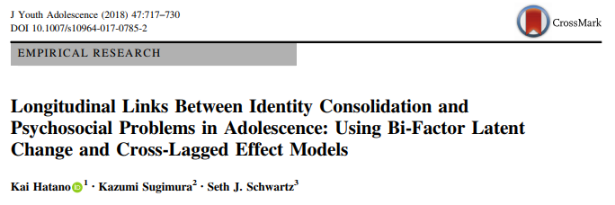
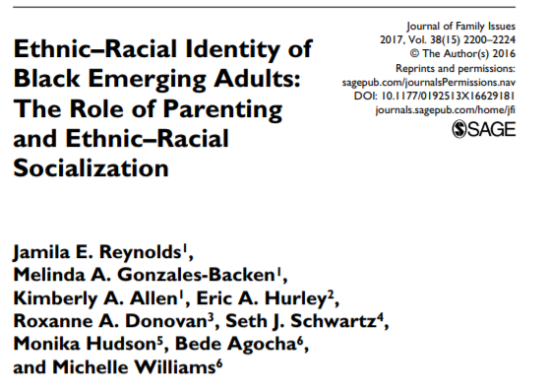
Schwartz, S. J. (in press). Turning point for a turning point: Advancing emerging adulthood theory and research. Emerging Adulthood. Download

Slide 5
Emerging Adulthood
The age period from the late teens through at least the mid-20s (approximately age 18 – 25)
Previously “young adulthood,” “transition to adulthood”
Erikson conceptualized “young adulthood” as lasting from the late teens to age 40!
More appropriate when most people were married and in a stable job by the early 20s—no longer the case in industrialized societies.
Arnett (2007)
Why do we need a new paradigm?
E. Prince

Slide 6
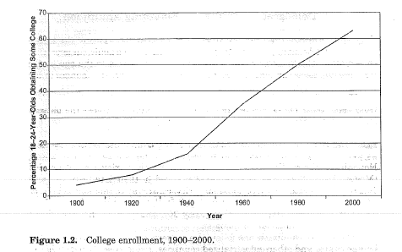
Postponing the adult role…?
68% of high school grads → college

Slide 7
Emerging Adults are now…
Getting married later
Changing jobs frequently
Pursuing postsecondary/graduate education
Having sex before marriage
Living together before marriage
But, they are still…
Accepting responsibility for oneself
Making independent decisions
Becoming financially dependent (eventually)

Slide 8
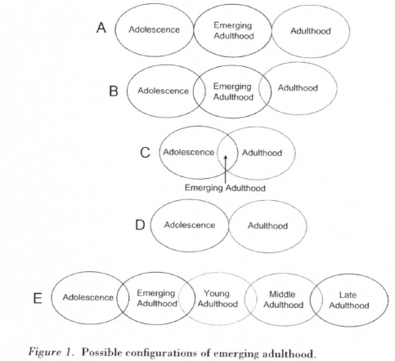
5 features & 5 conceptualizations
The age of identity exploration
The age of instability
The self-focused age
The age of feeling in-between
The age of possibilities

Slide 9
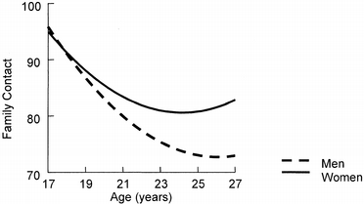
The Psychology of Emerging Adulthood (Arnett)

Slide 10
Emerging Adults & Society
Ambivalence toward taking on adult roles
Adults are boring, have no new possibilities in life
Adults have too many responsibilities
Emerging adults have very high expectations
True love, amazing job
Emerging adults engage in riskier behaviors
Very few fail to grow up
By age 30….. 75% Married, 75% 1+ Child, nearly all employed and financially independent, living alone from their parents
Extended time to pursue education and job training
E. Prince

Slide 11
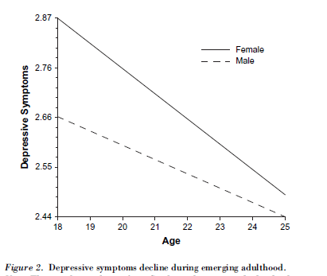
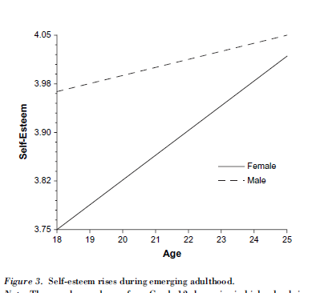
The Psychology of Emerging Adulthood (Arnett)
Generally a positive experience – on average, well-being increases

Slide 12
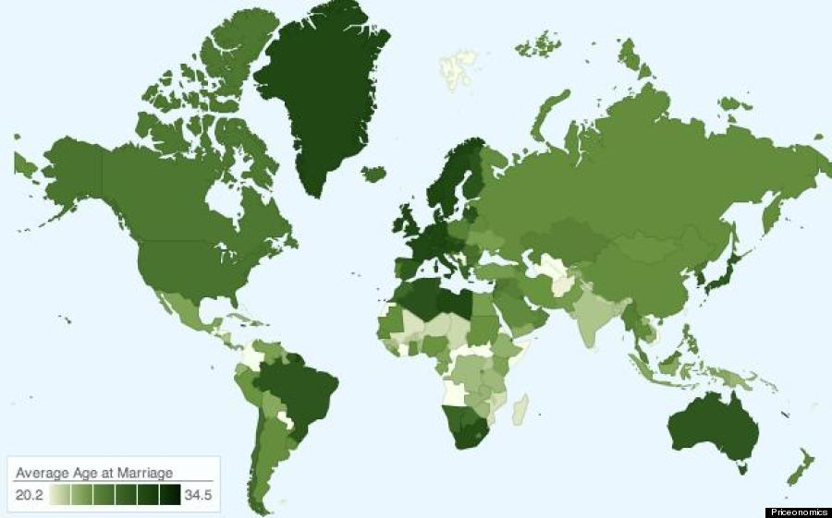
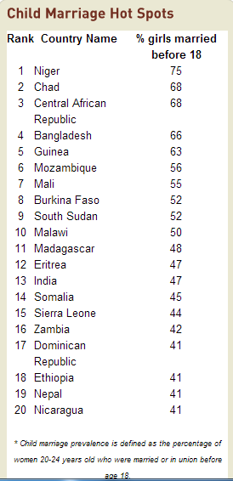
Average age at marriage
http://www.huffingtonpost.com/2013/11/22/marriage-map_n_4326504.html
http://www.un.org/en/development/desa/population/publications/pdf/popfacts/PopFacts_2011-1.pdf
http://www.icrw.org/child-marriage-facts-and-figures

Slide 13
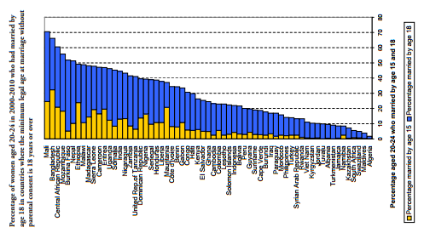
% married by 15 & 18 Societal variability

Slide 14
Is parenting a developmental transition? For females? For males?
How can this information be applied to our understanding of developmental concepts like maternal sensitivity, coparenting, etc.?
Are we doomed by our upbringings?

Slide 15
The Effect of the Transition to Parenthood on Relationship Quality: An 8-Year Prospective Study
(Doss et al., 2009)
Parents and nonparents generally show similar amounts of decline in overall relationship functioning over the first 8 years of marriage but these changes tend to occur suddenly following the birth of the baby for parents and more gradually over time for nonparents.

Slide 16
Background
How does the transition to parenthood impact marital functioning?
Little agreement
Different methodologies have been used
Cross-sectional studies of parenthood
Longitudinal studies beginning in pregnancy
Inclusion of nonparents in longitudinal samples
Interrupted time-series (ITS) design
Isolates change that can be attributed to birth from change that was expected based on ongoing changes in the couples’ relationship.

Slide 17
Predictors of relationship changes over the transition to parenthood
Vulnerability-Stress-Adaptation (VSA) model (Karney & Bradbury, 1995)
Enduring vulnerabilities (e.g., family of origin, cohabitation before marriage, religiosity)
Stressful event (e.g., unplanned pregnancy, timing of birth after marriage, income at birth, child’s gender)
Adaptive processes (e.g., relationship qualities)

Slide 18
Method
Relationship Variables | Marital satisfaction Observed negative communication Relationship confidence Relationship dedication Poor conflict management Problem intensity
Enduring Vulnerabilities | Demographic information (e.g., income, religiosity) Family of origin Premarital cohabitation history
Nature of Stressful Event | Child’s gender Timing of pregnancy Planned or unplanned pregnancy Financial stress
Other variables that are likely important to relationship functioning after birth?
T1
T2
T3-T10
Premarital education
Marriage
Notes:
Couples had participated in a larger investigation of relationship development and the effectiveness of pre-marital education. Recruited before marriage through religious organizations that would perform their weddings.
Study 1 (Parents): 132 couples who had their first child during first 8 years of the study
Study 2 (Nonparents): 86 couples who did not have children before or during the first 8 years of the study
-- same measures used in study 1 and study 2
Study 1: 3 couples divorced, 3 withdrew
Study 2: 18 couples divorced, 22 withdrew (this is consistent with previous research of nonparents that begins just after marriage)
Religious organizations were randomly assigned to require couples using their wedding services to receive either naturally occurring premarital education services within the religious organization or the Prevention and Relationship Enhancement Program (PREP)
At each time point completed questionnaires individually and completed a videotaped 10-15 min problem-solving discussion together
Parents were more confident about their relationships and had more years of education than nonparents (at initial assessment)
T1: Before married and before premarital education, T2: Just after education, T3-10: Yearly thereafter

Slide 19
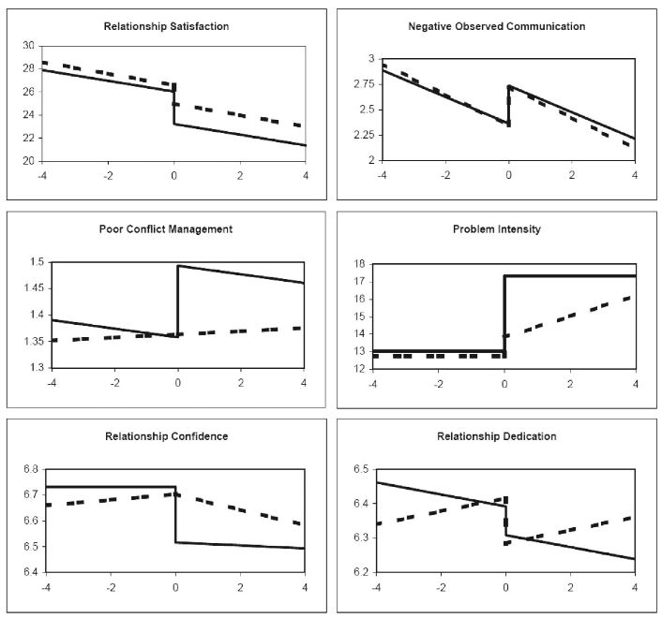
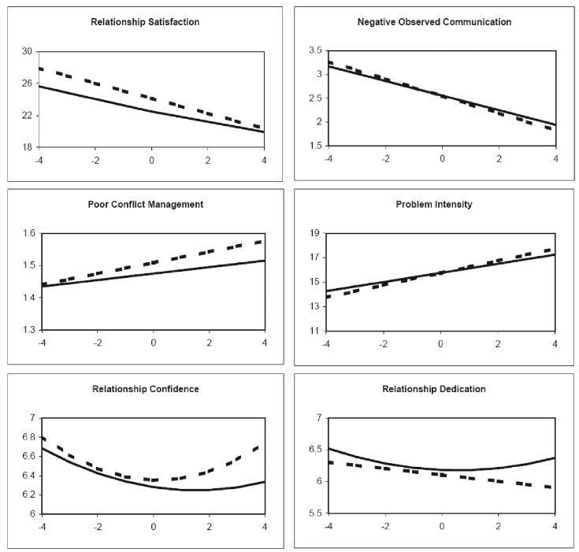
Change Patterns
Parents: dotted = fathers, solid = mothers
Nonparents: dotted = males, solid = females
Parents
Nonparents
dotted = males, solid = females
Notes:
Parents: dotted = fathers, solid = mothers
Nonparents: dotted = males, solid = females

Slide 20
Evidence of change in relationship functioning following baby’s birth?
The majority of the relationship constructs demonstrated patterns of change consistent with an immediate or delayed impact of the transition to parenthood.
distinct from change occurring before birth
All relationship constructs that demonstrated effects of the transition to parenthood showed significant and sudden worsening of the relationship in either mothers or fathers.

Slide 21
Sudden change for parents, gradual for nonparents
Parents and nonparents generally show similar amounts of decline in overall relationship functioning over the first 8 years of marriage but these changes tend to occur suddenly following the birth of the baby for parents and more gradually over time for nonparents.
Parents showed clear increases in negativity, conflict, and problem intensity following the birth of a child, whereas nonparents did not show such changes at the same point in time, nor did they show such declines over time more generally.

Slide 22
Variability in individuals’ reactions to transition to parenthood
For mothers and fathers, sudden changes in marital satisfaction, problem intensity, and relationship dedication varied significantly between individuals.
Mothers’ sudden changes in poor conflict management and relationship confidence showed significant between-individual variability.
YES, In addition to mean changes in relationship functioning after birth, there was also significant between-individual variability in many of the variables examined.

Slide 23
Predicting variability in relationship functioning after baby’s birth
Enduring vulnerabilities
History of parental divorce or conflict → larger decreases in marital satisfaction [mothers]
Living together before marriage → greater observed negative communication [mothers and fathers]
*Not predictive: ethnicity, level of religiosity
Nature of stressful event
Female children → larger decreases in marital satisfaction [mothers] and larger increases in problem intensity [fathers]
Having a child quickly after marriage → greater decreases in marital satisfaction [fathers]
Lower income (but not more financial stress) at birth → larger decreases in marital satisfaction [fathers]
* Not predictive: planned or unplanned pregnancy, financial stress before birth

Slide 24
Relationship adaptive processes
Higher marital satisfaction at birth → larger decreases in marital satisfaction after birth [mothers and fathers]
Higher relationship confidence at birth → smaller decreases in marital satisfaction after birth [fathers]
Higher relationship confidence at birth and/or higher reported poor conflict management at birth → larger increases in problem intensity after birth [mothers and fathers]
Higher relationship confidence at birth and/or higher observed negative communication at birth → larger increases in poor conflict management after birth [mothers]
Nonparents showed no sudden changes
Gradual deterioration in marital satisfaction; Men reported sig decreases in relationship dedication over time
Negative observed communication sig improved over time

Slide 25
The Transition to Parenthood
Predictors of change:
High negative communication
Difficulties in mothers’ family of origin
Shorter duration of marriage at birth
Giving birth to a girl
Many instances where better pre-birth functioning predicted more severe negative change
e.g., better marital satisfaction

Slide 26
Danzi

Slide 27
Are parents happier?
Study 1. Large, nationally representative survey to assess if parents are happier overall than nonparents
World Values Survey (n = 6,906; ages 17 – 96)
Single-items: happiness, life satisfaction, thinking about meaning in life
Study 2. Experience-sampling to see if parents feel better moment-to-moment than nonparents
329 adults (ages 18 – 94)
Participants paged 5 times daily over 7 days to complete questionnaire
Rated how much they were feeling 19 emotions on 7-point scale
Study 3. How do positive feelings derived from parenting compare to other daily activities
Danzi

Slide 28
Study 1: Parents happier overall…
Parents reported higher levels of life satisfaction, happiness, and meaning in life than nonparents
Having more children was correlated with life satisfaction and meaning in life (but not happiness)
Large, nationally representative World Values Survey (n = 6,906; ages 17 – 96), single-items
Danzi
Potential factors that could affect these relationships?

Slide 29
Parents reported more happiness, positive emotion, meaning in life, & fewer depressive symptoms
Parent’s gender, age, race, and SES did not moderate relationship for any variables
Study 3. Parents reported more positive emotions and more meaning when taking care of children than when not
Experience-sampling, 329 adults (ages 18 – 94), paged 5 times daily over 7 days to rated 9 emotions on 7-point scale
Danzi

Slide 30
Study 1: Are parents happier overall?
Parent gender as a moderator
Parenthood associated with increased life satisfaction and happiness only for fathers
Marital status as a moderator
Married parents did not differ in satisfaction or happiness from married nonparents
Unmarried parents reported less satisfaction and happiness than nonparents
Parent age as a moderator
Young parents (ages 17 – 25) had less life satisfaction than young nonparents
Mid-age parents (ages 26 – 62) had more life satisfaction than mid-age nonparents
Older parents did not differ from older nonparents in life satisfaction
No moderating effects for happiness or meaning in life
Danzi

Slide 31
Study 2: Are fathers and mothers happier moment-to-moment?
Fathers scored better than childless men on all variables
Mothers had fewer depressive symptoms than childless women
Other variables were not significantly different (trend for positive emotion)
Danzi

Slide 32
Study 3: Happiness higher while parenting than in other daily activities
Parents reported more positive emotions and more meaning when taking care of children than when not
Not moderated by gender
Intended to address selection effects (e.g., people who become parents might be different from people who don’t)
Within-subjects design
186 parents (76% women; 24% men)
Day reconstruction method – described previous day, episode by episode, and rated emotions and meaningfulness for each episode
Calculated two positive emotion/meaningfulness scores – one score for episodes involving childcare and one for other activities
Danzi

Slide 33
Parental (father-favoring) conclusions
Overall, parents are happier, more satisfied, and thinking about meaning in life more than nonparents
For fathers and mid-age parents—not for mothers, young or single parents
Young parents and single parents less happy than nonparents
No difference between mothers and childless women
Parents had more positive emotions and meaningfulness from moment-to-moment
Fathers had more positive scores than childless men
Mothers only showed less depression than childless women
Parents reported more positive emotions and more meaningfulness during childcare than other daily activities
Discuss!
Danzi

Slide 34
Pregnancy Brain: Real or Myth?
Women often report cognitive declines during pregnancy
Animal studies highlight the adaptive advantages in response to the demands of pregnancy
Why are pregnant women reporting pronounced cognitive declines?
Anderson & Rutherford (2012). Evolutionary Psychology
Notes:
Baby brain…
While human studies mainly focus on the decline of memory and attention in pregnant women, animal studies highlight…
In fact there is actually an increase in neural plasticity in pregnancy…
So why are women…
Anderson & Rutherford (2012) Evo Psych

Slide 35
Is pregnancy/birth a developmental transition?
Cognitive trade-offs of Pregnancy Brain
Pregnant women may have declines in specific aspects of cognition, but cognitive advantages in other areas.
Reallocation of cognitive resources to social safety?
Anderson, M. V., & Rutherford, M. D. (2012). Evolutionary Psychology. Crawley, R., Grant, S., & Hinshaw, K. I. M. (2008). Applied cognitive psychology.
Christensen, H., Poyser, C., Pollitt, P., & Cubis, J. (1999). Journal of reproductive and infant psychology.
Maylott
Notes:
New perspective suggests… cognitive trade-offs… Pregnant women may experience a decline in some areas of cognition because resources are being devoted to other areas more important for the fitness of the mother and infant

Slide 36
Pregnancy leads to long-lasting changes in human brain structure
S. Gabe Hatch

Slide 37
Pregnancy is common
Most women undergo pregnancy once in their lives
Little is known about how this process affects the brain
Animal studies indicate that changes happen physiologically as well as in the endocrine system
Followed by a flood of estrogens that typically exceeds the estrogen exposure of a woman’s entire nonpregnant life
Other endocrine events involving less extreme fluctuates in hormone levels are known to render structural and functional alterations in the brain (e.g., puberty)
Even small hormonal changes have resulted to neural alterations

Slide 38
We know something about the brain during pregnancy
Women
1909 – Enlargements of the pituitary gland was first observed in deceased pregnant women (2x as large)
The ventricles and outer border of the brain have been contoured
Increases in ventricular size and decreases in brain size during late pregnancy
Men
Despite the review on brain changes for women, the introduction is completely lacking on any physiological changes among men

Slide 39
Study Goals
These authors performed a prospective neuroimaging study (before versus after pregnancy) involving first-time mothers (and fathers) and compared this group to women that have never given birth (or fathers without children)
Five ways:
These authors wanted to see whether pregnancy is associated with change in the gray matter structure of the human brain
The authors also tested the discriminative power of the gray matter volume changes
Examined the gray matter volume of first-time fathers and control men without children
Investigated a potential link to maternal attachment
Tested the long-term persistence of pregnancy effects with a 2-year post-pregnancy follow-up session

Slide 40
Results

Slide 41
Assessment Structure
Brain Scans were Obtained Before Pregnancy (Pre-conception)
If Successful, Brain Scans were Obtained After Completion of Pregnancy
Brain Scans were Obtained 2-Years Post-Pregnancy

Slide 42
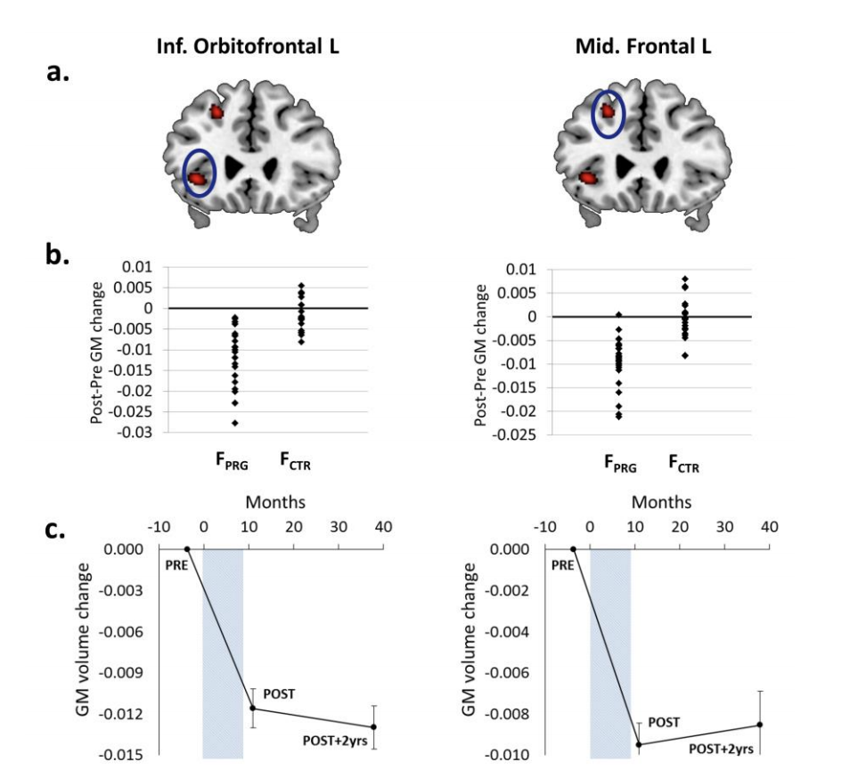
Goal 1 – Gray Matter Volume Changes Before and After Pregnancy
Ni pre-existing difference in gray matter volume between the two groups
Within/between group, greater gray matter volume reductions located in the anterior and posterior midline, the bilateral lateral prefrontal cortex, and the bilateral temporal cortex
Within/between group differences were observed in cortical surface area and thickness
Null Findings
No significant changes in white matter volume across time points
Results did not differ by means of conception
Changes did not result in differences in cognitive performance

Slide 43
Goal 2 – Discriminative Power
Support vector machine
All women could be correctly classified as having been pregnant or not in between these sessions on the basis of gray matter changes in the brain
Changes in the right middle temporal gyrus, inferior frontal gyrus, and posterior cingulate cortex as the regions of greatest predictive power. These factors alone contributed to over 50% of the decision function

Slide 44
Goal 2 – Discriminative Power, continued.
All discriminate analyses involving average surface area and cortical thickness indicated that 84.4% of women could be correctly classified as having undergone pregnancy or not
Nearly 70% could be classified on the basis or cortical thickness change
And 95.6% of women could be classified using measures of average gray matter volume change

Slide 45
Goals 3 and 4 – Father’s Gray Matter Changes, Maternal Attachment
Goal 3: Father’s Gray Matter Changes - Null Finding
No changes in neural gray matter volumes between the two groups
Goal 4: Maternal Attachment
Using the three dimensions of the Maternal Postnatal Attachment Scale, gray matter volume changes of pregnancy predicted the quality of mother-to-infant attachment and the absence of hostility towards their newborns in the postpartum period

Slide 46
Goal 4 – Mother Attachment
The strongest neural activity in response to the women’s babies corresponded to the regions that lost gray matter volume across pregnancy

Slide 47
Goal 5 – 2-year follow up – are these changes maintained?
Animal models suggest that these alterations are evidence even in old age…
All the findings except for the left hippocampal cluster were maintained over the two-year follow-up period

Slide 48
Discussion: Pregnancy Changes the Brain Among Women
Goal 1 Implications (Gray Matter Changes): Pregnant women undergo a symmetrical pattern of gray matter volume reductions across pregnancy
Goal 2 Implications (Classification): Women can be accurately classified (i.e., pregnant versus not pregnant) based off of this information
Goal 3 Implications (Fathers): First-time fathers saw no difference in gray matter changes compared to men without children
Goal 4 Implications (Attachment): Gray matter reductions appear to be associated with attachment
Goal 5 Implications (Follow up): These results appear to be maintained over time

Slide 49
Consistencies with Other Stages of Life
During adolescence, reductions in gray matter also occur. This is regarded as a fine-tuning of connections into functional networks which corresponds to healthy cognitive, emotional, and social development
Because pregnancy is associated with similar reductions in gray matter volume, and the observed reductions are not randomly distributed but take place in higher order regions associated with social processes, the authors speculate that the female brain undergoes a further maturation or specialization. This could include enhanced emotion and face recognition

Slide 50
Conclusions
Pregnancy is associated with substantial and long-lasting alterations in brain structure. This may serve an adaptive purpose for pending motherhood.

Slide 51
Discussion Questions
There were several null findings throughout this manuscript: white matter volume analyses indicated that there were no significant changes in white matter volume across time points, these results did not differ by means of conception, these changes did not result in differences in cognitive performance, no fluctuations in father’s gray matter. If any, which null finding surprised you the most and why?
The machine learning algorithm applied in this study resulted in stunningly accurate classification of pregnant versus non-pregnant women. What implications could accurate predictions from an fMRI have on other areas of psychology (e.g., diagnoses, treatment outcomes, etc.).
Perhaps one weakness of the current study is its sample size (~ 20 individuals); however, the effects seem to be large (Cohen’s d = 0.80-2.00) and result in accurate classification.
Are concerns about sample size warranted in the psychological/medical sciences if it results in large effects?
Do we think that these results are reproducible?

Slide 52
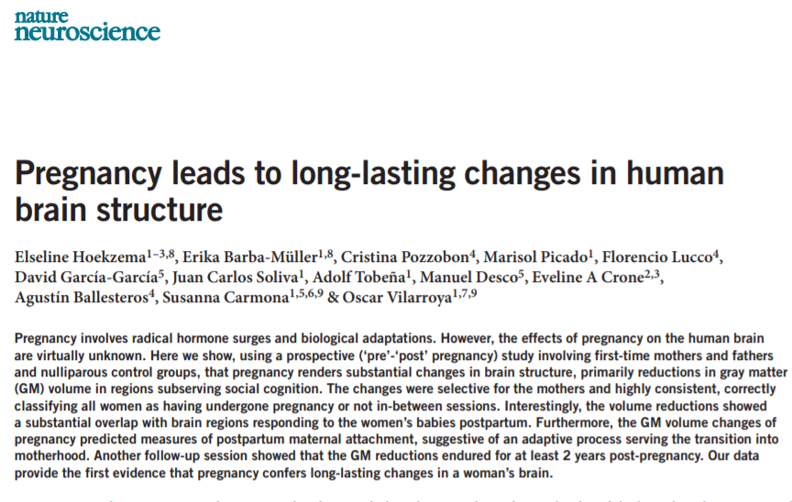

Slide 53
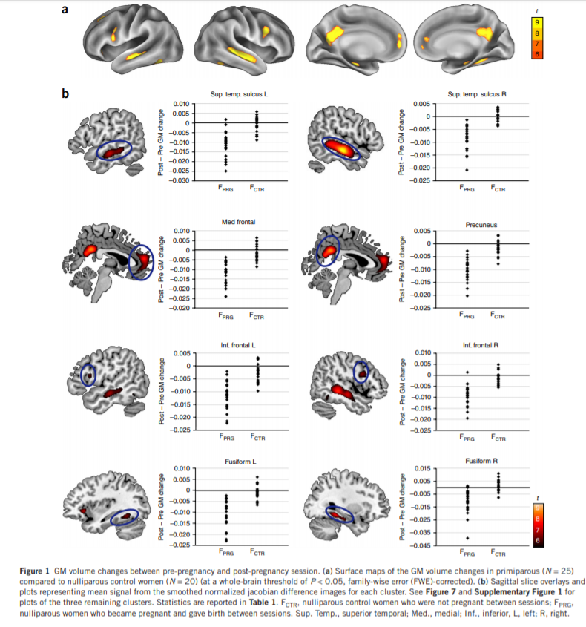
“Substantial changes in brain structure, primarily reductions in gray matter (GM) volume in regions subserving social cognition.
The changes were selective for the mothers and highly consistent, correctly classifying all women as having undergone pregnancy or not in-between sessions.”

Slide 54
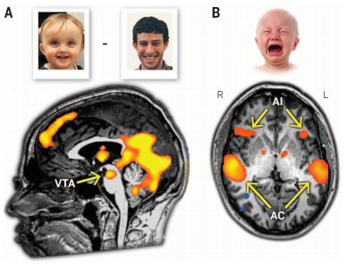
Human Moms and Dads
Infant crying triggers neural responses
Mesolimbic dopamine system
from ventral tegmental area (VTA) to ventral striatum, including nucleus accumbens (NAcc)
Anterior insula (empathy)
Prefrontal cortex (emotion regulation)
Notes:
Empathic overarousal can lead to interfering distress. Fathers with MODERATE anterior insula activation are most involved in instrumental care giving
Prefrontal cortex associated with increased sensitivity, decreased stress hormones at separation, more secure attachment

Slide 55
Socio-cultural changes have led to increased paternal involvement in childrearing, including gay male parents raising children without maternal care
Do fathers’ brains adapts to the parental role through active involvement in childcare

Slide 56
Background
Socio-cultural changes have led to increased paternal involvement in childrearing, including gay male parents raising children without maternal care
It has been suggested that the human father’s brain adapts to the parental role through active involvement in childcare
Prior findings suggest distinct brain-hormone-behavior pathways may underpin maternal and paternal care, although mechanisms for human fathers’ brain adaptation are largely unknown
No study has examined the brain basis of human fatherhood when fathers are the primary care providers

Slide 57
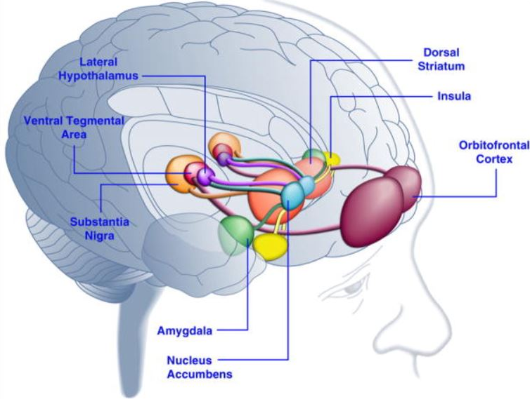
Emotional Processing Network
Ventral anterior cingulate (vACC)
Subcortical and paralimbic structures
Phylogenetically ancient network
Emotional processing, vigilance, motivation, and reward
Survival-related cues
Interior frontal gyrus
Abraham et al. (2014) - Walsh

Slide 58
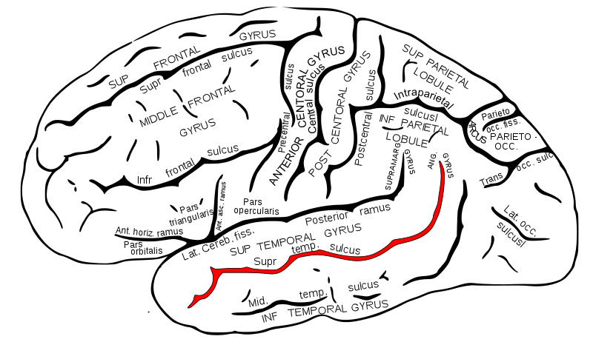
Mentalizing Network
Abraham et al. (2014) - Walsh
Medial prefrontal cortex
Frontopolar cortex
Frontopolar-medial-prefrontal-temporo-parietal structures
Involved in upper-level social understanding, cognitive empathy, and theory of mind
Important in ability to infer mental states
Allows parents to cognitively infer and predict infant needs
Bilateral temporal poles
Superior temporal sulcus

Slide 59
Parental Neural Networks
Emotional Processing Network
Subcortical and paralimbic structures
Bilateral amygdala, ventral anterior cingulate (vACC ), left insula and inferior frontal gyrus (IFG), ventral tegmental area (VTA)
Rapidly detects motivationally salient and survival-related cues,
enables parents to automatically identify and immediately respond to infant distress
Associated with vigilance, affective salience, reward and motivation
Phylogenically ancient
Mentalizing Network
Cortical regions
Bilateral superior temporal gyrus (STG), lateral frontopolar cortex, ventromedial prefrontal cortex (vmPFC), and temporal poles
Involved in social understanding, theory of mind, and cognitive empathy
Plays role in parents’ ability to infer mental states from behavior, cognitively represent infant states, predict infant needs, and plan caregiving
Activated in parents’ first weeks of parenting
Notes:
Animal studies demonstrate mammalian mothering is supported by evolutionary ancient structures. Human studies: similar areas, also paralimbic insula=cingulate structures imbue infants with affective salience, ground experience in the present moment, enable maternal simulation of infant states
Implicate a phylogenetically ancient network of emotional processing that rapidly detects motivationally salient and survival related cues
Enables parents to automatically identify and respond to infant distress → maximizing survival
In humans, this emotional processing network is complimented by:
Network of frontopolar-medial-prefrontal-temporo-parietal structures involved in social understanding, theory of mind, cognitive empathy, including the medial prefrontal cortex (mPFC), frontopolar cortex, superior temporal sulcus (STS), and temporal poles
Plays role in individuals ability to infer mental states from behavior, already activated in parents first weeks of parenting, enables parents to cognitively represent infant states, predict infant needs, plan future caregiving

Slide 60
Neural networks implicated in parenting
Cortical: Bilateral superior temporal gyrus (STG), lateral frontopolar cortex, ventromedial prefrontal cortex (vmPFC), and temporal poles
Subcortical and paralimbic structures: Bilateral amygdala, ventral anterior cingulate (vACC), left insula and inferior frontal gyrus (IFG), ventral tegmental area (VTA)
Notes:
Animal studies demonstrate mammalian mothering is supported by evolutionary ancient structures. Human studies: similar areas, also paralimbic insula=cingulate structures imbue infants with affective salience, ground experience in the present moment, enable maternal simulation of infant states
Implicate a phylogenetically ancient network of emotional processing that rapidly detects motivationally salient and survival related cues
Enables parents to automatically identify and respond to infant distress → maximizing survival
In humans, this emotional processing network is complimented by:
Network of frontopolar-medial-prefrontal-temporo-parietal structures involved in social understanding, theory of mind, cognitive empathy, including the medial prefrontal cortex (mPFC), frontopolar cortex, superior temporal sulcus (STS), and temporal poles
Plays role in individuals ability to infer mental states from behavior, already activated in parents first weeks of parenting, enables parents to cognitively represent infant states, predict infant needs, plan future caregiving

Slide 61
Aims
To examine the brain-basis of human fatherhood, its comparability with the maternal brain, its relationship with oxytocin and parent-infant synchrony, and sensitivity to caregiving experiences
Utilizing a “natural experiment”, afforded for the first time in human history (i.e., two-father families raising children without maternal involvement)

Slide 62
Experiment in nature
Participants: 89 first-time parents
41 heterosexual biological parents
20 Primary Care (PC) heterosexual Mothers
21 Secondary Care (SC) heterosexualFathers
48 Primary Care (PC) homosexual fathers
Child through surrogacy
Researchers visited families at home between 4-8 pm
Videotaped each parent interacting with infant
Coded for parent-infant synchrony
Parent’s careful adaptation of caregiving behavior to infants’ social signals
Coding Interactive Behavior (CIB) manual
Salivary samples collected for oxytocin measurement
Within a week, parents went in for fMRI scanning in response to watching video of themselves interacting with their infant
Notes:
Not clear why both PC father’s considered primary, while hetero couples father’s considered secondary

Slide 63
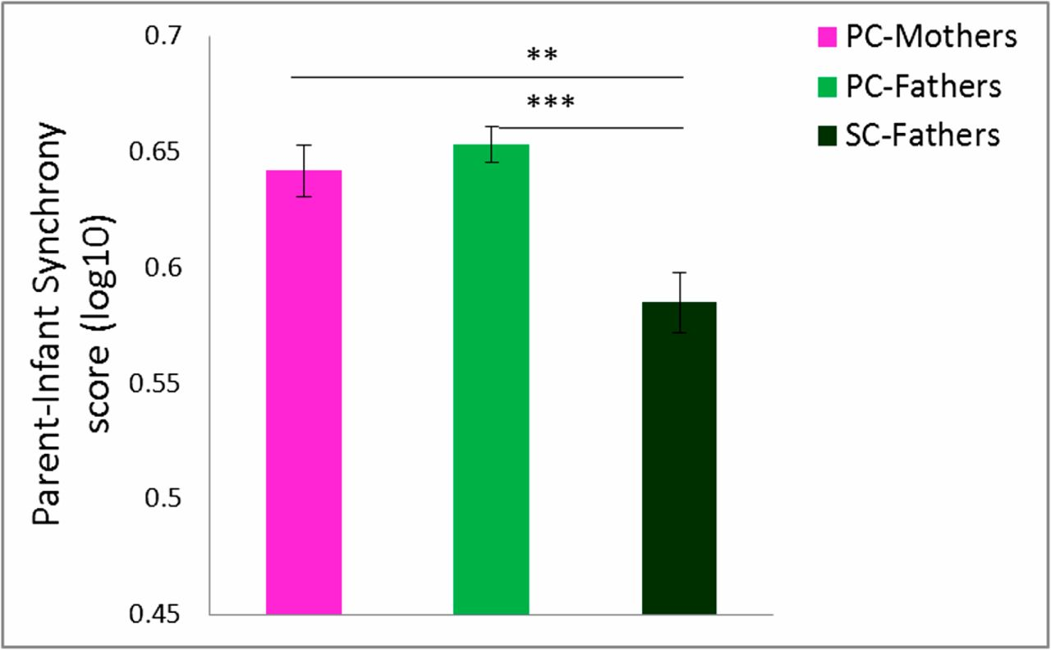
Group Differences in Parent-Infant Synchrony: PC>SC

Slide 64
Patterns of Neural Activation— Similar with differences
Activation of a “parental caregiving” network
Across all parents, regardless of group, fMRI indicated similar patterns of activation, mapping on to both the emotional processing and mentalizing networks
Group differences in ROI activation
“Although activity in most brain areas was comparable across parents, two areas showed group differences”
Amygdala
STS

Slide 65
PC-Mothers greater amygdala activation than SC-Fathers
SC-Fathers greater STS activation than PC-Mothers
PC-Fathers high amygdala activation similar to PC-Mothers,
with high STS activation similar to SC-Fathers
Notes:
Whole-brain conjunction analysis (Self–Infant Interaction > Self ∩ Self–Infant Interaction > Unfamiliar Parent–Infant Interaction) revealed two brain systems: the emotional processing network (yellow line around activation) included bilateral amygdala, vACC, left insular cortex and IFG, and VTA, and the mentalizing network (purple line around activation) included bilateral STS, lateral frontopolar cortex, vmPFC, and temporal poles. Random, n = 87, P < 0.05 FDR-corrected, cluster size > 3 × 3³. (B) Bar plots present averaged percent signal change for Self–Infant Interaction minus Unfamiliar parent–infant interaction contrast for PC-Mothers (pink, n = 20), PC-Fathers (bright green, n = 47), and SC-Fathers (dark green, n = 20). (Tukey post hoc comparisons; *P < 0.05). vmPFC, ventromedial prefrontal cortex; vACC, ventral anterior cingulate cortex; IFG, inferior frontal gyrus; VTA, ventral tegmental area; L, left; R, right.
STS = superior temporal culcus

Slide 66
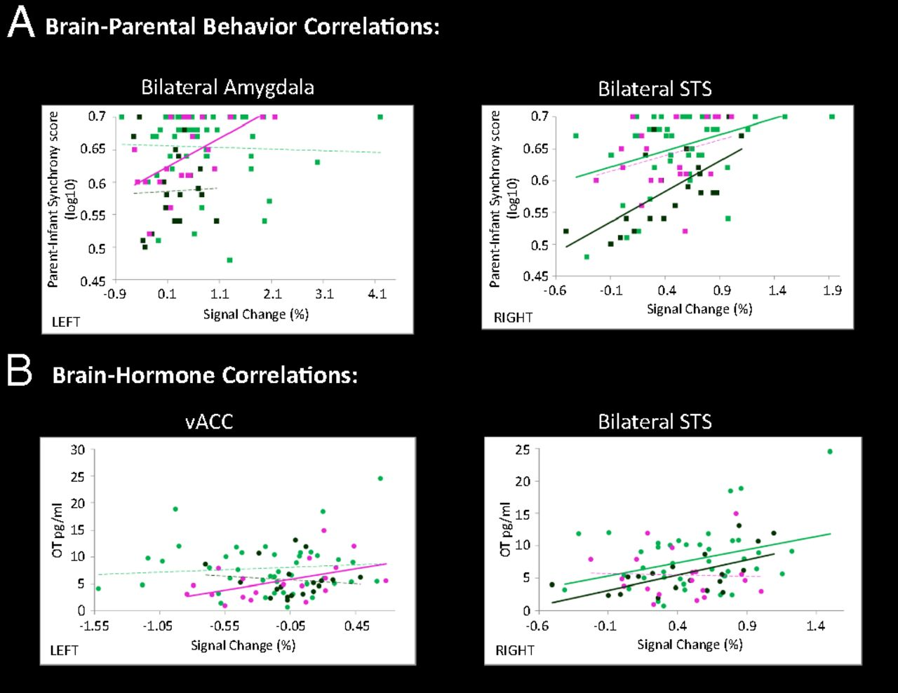
Regional Associations with Parent-Infant Synchrony and Oxytocin
PC-Mothers
PC-Fathers
SC-Fathers
Notes:
-Significant correlations between brain activity and parent–infant synchrony scores for PC-Mothers in bilateral amygdala, but not for PC-Fathers or SC-Fathers
-For both PC-Fathers and SC-Fathers, significant correlation was found in the bilateral STS but not for PC-Mothers
-Maternal oxytocin did not correlate with the amygdala but
-PC mothers showed correlation between oxytocin and the vACC ; no such association was found in PC or SC fathers
-Oxytocin correlated with PC-Fathers and SC-Fathers in bilateral STS but not for PC-Mothers (
Overall, there are notable mother versus father diffs. While the authors discuss these regional differences as reflecting network diffs, caution is prob warranted

Slide 67
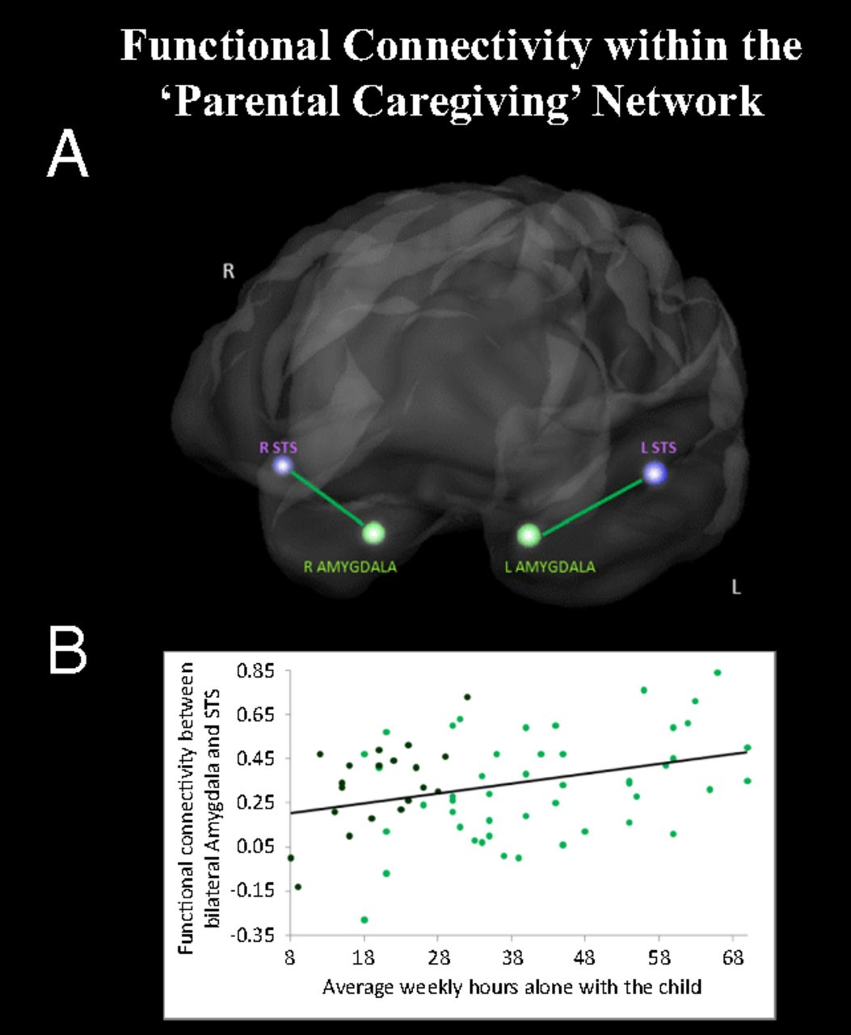
Functional connectivity in relation to primary caregiving experience
Amygdala and STS were significantly interconnected during Self–Infant interaction, only among PC-Fathers (not PC mothers or SC fathers)
For ALL fathers, time spent in direct childcare correlated with amygdala-STS connectivity during viewing of the Self-Infant interaction

Slide 68
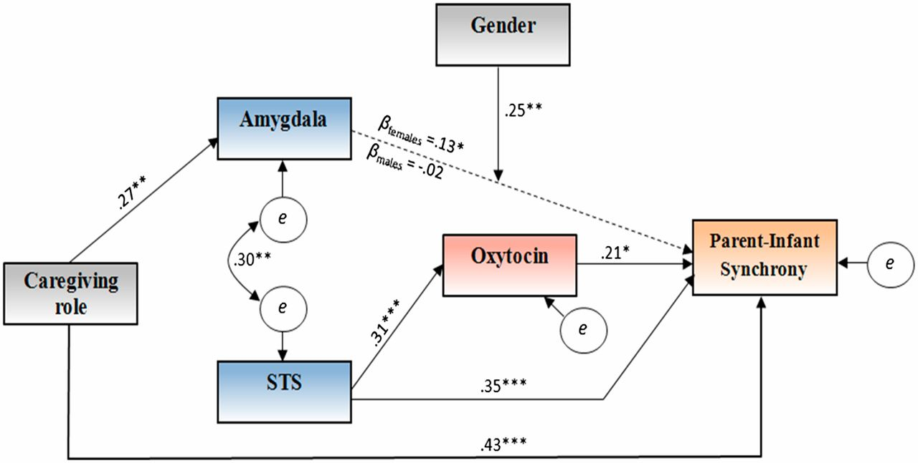
2 paths to synchrony
*P < 0.05; **P < 0.01; ***P < 0.001.
Path model leading from the parents' role in caregiving to parent–infant synchrony as mediated by brain activation and oxytocin levels.
Notes:
Path model leading from the parents' role in caregiving to parent–infant synchrony as mediated by brain activation and oxytocin levels. *P < 0.05; **P < 0.01; ***P < 0.001.
Parent-infant synchrony is parent’s careful adaptation of caregiving behavior to infants’ social signals
-The caregiving role had a direct path to synchrony, primary caregivers exhibiting greater synchrony
-Caregiving role had a sig. indirect effect on synchrony via amygdala activation, moderated by sex
Indirect effects of the primary caregiving role on synchrony through increased amygdala activation were significant for females, but not males
-Amygdala and STS activity were bidirectionally correlated
-STS had a sig. direct effect on synchrony
-STS indirectly associated with parent-infant synchrony via higher levels of oxytocin

Slide 69
Conclusions
PC mothers showed greater activation in subcortical emotion processing structures (i.e., amygdala), while SC fathers showed greater activation in cortical socio-cognitive circuits (i.e., STS).
These differing patterns of activation were each correlated with higher levels of oxytocin and parent-infant synchrony.
PC fathers exhibited high amygdala activation (like PC mothers), alongside high STS activation (like SC-fathers).
Only PC fathers demonstrated functional connectivity between amygdala and STS, suggesting recruitment/integration of both the emotional processing and mentalizing networks to enable a full range of parenting behaviors.
Among ALL fathers, time spent in direct childcare was linked with degree of amygdala-STS connectivity, suggesting malleability of fathers’ brains to caregiving activities.
Overall, findings indicate a neural basis of parental care (alloparenting substrate) that can flexibly activate through responsive caregiving via brain-hormone-behavior pathways, even among fathers lacking the neurobiological cues associated with pregnancy and childbirth.

Slide 70
Father’s brain is sensitive to childcare experiences
Eyal Abraham, Talma Hendler, Irit Shapira-Lichter, Yanic Kanat-Maymon, Orna Zagoory-Sharon, & Ruth Feldman
Emily Walsh
April 15, 2021

Slide 71
Primary Caregiving & Brain Structure
Socio-cultural changes have led to increases in paternal childrearing involvement in heterosexual and male same-sex couples
Studies offer evidence for distinct brain-hormone-behavior pathways that govern caregiving in mothers and fathers
Animal and human models exist to demonstrate the pathway in primary caregiving mothers
Yet no study has examined the brain basis of primary caregiving in fathers
Abraham et al. (2014) - Walsh
Notes:
It is more common in recent decades for men to be the primary caregiver either in a heterosexual or same sex male relationship

Slide 72
Study Hypotheses:
1. All parents would express activation in both brain networks.
2. Mothers would have greater amygdala activation and fathers would have greater neural-cognitive activation
3. Maternal care would center on the emotional processing network and paternal care would center on the socio-cognitive network
4. Fathers would express greater variability in brain response, mediated by actual caregiving behaviors, and would include both neural networks in primary caregiving fathers
5. Oxytocin levels and brain activation would mediate the relationship between the parental primary caregiving role and infant-synchrony
Abraham et al. (2014) - Walsh

Slide 73
Methods
Participants: 89 first-time parents
20 Primary care heterosexual mothers (PC-Mothers)
21 Secondary care heterosexual fathers (SC-Fathers)
48 Primary care homosexual fathers (PC-Fathers) - child through surrogacy
Researchers visited families at home between 4-8 pm
Videotaped each parent interacting with infant and the infant interacting with a stranger
Coded for parent-infant synchrony (Coding Interactive Behavior manual)
Salivary samples collected for oxytocin measurement
Within a week, parents went in for fMRI scanning in response to watching video of themselves interacting with their infant (neutral to positive affective videos)
Abraham et al. (2014) - Walsh
Notes:
Authors note several novel aspects of this work – methodology, direct comparison, naturalistic approach

Slide 74
Results: Descriptive Group Differences
Coded parent-infant synchrony was greater among PC-mothers and PC-fathers than SC-fathers
Oxytocin levels did not vary by group
Abraham et al. (2014) - Walsh
Notes:
Parent-infant synchrony was greater among PC-mothers and PC-fathers than SC-fathers
Oxytocin levels did not vary by group
No differences in oxytocin between biological and adoptive PC-fathers

Slide 75
Finding 1: As hypothesized, all parents express activation in both brain networks
Abraham et al. (2014) - Walsh
Notes:
All parents would express activation in both brain networks.
STS: Superior temporal sulcus

Slide 76
Finding 1: As hypothesized, all parents express activation in both brain networks
Emotional
Processing
Network
Mentalizing
Network
Abraham et al. (2014) - Walsh
Notes:
All parents would express activation in both brain networks.
STS: Superior temporal sulcus

Slide 77
Finding 2: As hypothesized, mothers would have greater amygdala activation and fathers would have greater neural-cognitive activation
Abraham et al. (2014) - Walsh
Notes:
1. All parents would express activation in both brain networks.
2. Mothers would have greater amygdala activation and fathers would have greater neural-cognitive activation

Slide 78
Finding 2: As hypothesized, mothers would have greater amygdala activation and fathers would have greater neural-cognitive activation
Abraham et al. (2014) - Walsh
Notes:
1. All parents would express activation in both brain networks.
2. Mothers would have greater amygdala activation and fathers would have greater neural-cognitive activation
3. Maternal care would center on the emotional processing network and paternal care would center on the socio-cognitive network
4. Fathers would express greater variability in brain response, mediated by actual caregiving behaviors, and would include both neural networks in primary caregiving fathers
5. Oxytocin levels and brain activation would mediate the relationship between the parental primary caregiving role and infant-synchrony

Slide 79
Finding 2: As hypothesized, mothers would have greater amygdala activation and fathers would have greater neural-cognitive activation
Abraham et al. (2014) - Walsh
Notes:
1. All parents would express activation in both brain networks.
2. Mothers would have greater amygdala activation and fathers would have greater neural-cognitive activation
3. Maternal care would center on the emotional processing network and paternal care would center on the socio-cognitive network
4. Fathers would express greater variability in brain response, mediated by actual caregiving behaviors, and would include both neural networks in primary caregiving fathers
5. Oxytocin levels and brain activation would mediate the relationship between the parental primary caregiving role and infant-synchrony

Slide 80
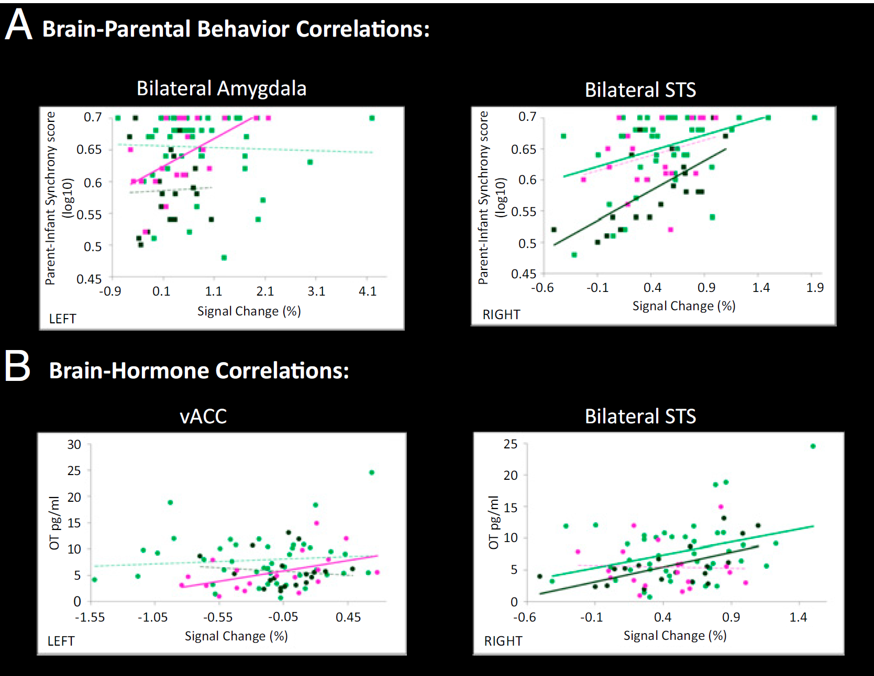
Finding 3: Amygdala Activity
Abraham et al. (2014) - Walsh
Brain activity in the amygdala and parent-infant synchrony scores correlated for PC-mothers but neither father group
PC-Mothers
PC-Fathers
SC-Fathers
Notes:
1. All parents would express activation in both brain networks.
2. Mothers would have greater amygdala activation and fathers would have greater neural-cognitive activation
3. Maternal care would center on the emotional processing network and paternal care would center on the socio-cognitive network

Slide 81
Finding 3: Amygdala Activity
Abraham et al. (2014) - Walsh
Brain activity in the amygdala and parent-infant synchrony scores correlated for PC-mothers but neither father group
PC-Mothers
PC-Fathers
SC-Fathers
Notes:
1. All parents would express activation in both brain networks.
2. Mothers would have greater amygdala activation and fathers would have greater neural-cognitive activation
3. Maternal care would center on the emotional processing network and paternal care would center on the socio-cognitive network

Slide 82
Finding 3: Superior Temporal Sulcus (STS) Activity
Abraham et al. (2014) - Walsh
STS brain activity and parent-infant synchrony correlated in both father groups but not for PC-mothers
PC-Mothers
PC-Fathers
SC-Fathers
Notes:
1. All parents would express activation in both brain networks.
2. Mothers would have greater amygdala activation and fathers would have greater neural-cognitive activation
3. Maternal care would center on the emotional processing network and paternal care would center on the socio-cognitive network
4. Fathers would express greater variability in brain response, mediated by actual caregiving behaviors, and would include both neural networks in primary caregiving fathers
5. Oxytocin levels and brain activation would mediate the relationship between the parental primary caregiving role and infant-synchrony

Slide 83
Finding 3: Oxytocin and Ventral Anterior Cingulate Cortex (vACC)
Abraham et al. (2014) - Walsh
vACC brain activity and OT correlated for PC-mothers, neither father group
PC-Mothers
PC-Fathers
SC-Fathers
Not shown: PC-mothers OT did not correlate with amygdala
Notes:
1. All parents would express activation in both brain networks.
2. Mothers would have greater amygdala activation and fathers would have greater neural-cognitive activation
3. Maternal care would center on the emotional processing network and paternal care would center on the socio-cognitive network
4. Fathers would express greater variability in brain response, mediated by actual caregiving behaviors, and would include both neural networks in primary caregiving fathers
5. Oxytocin levels and brain activation would mediate the relationship between the parental primary caregiving role and infant-synchrony

Slide 84
Finding 3: Oxytocin and Ventral Anterior Cingulate Cortex (vACC)
Abraham et al. (2014) - Walsh
STS brain activity and OT correlated for both PC and SC fathers, not PC-mothers
PC-Mothers
PC-Fathers
SC-Fathers
Not shown: PC-mothers OT did not correlate with amygdala
Notes:
1. All parents would express activation in both brain networks.
2. Mothers would have greater amygdala activation and fathers would have greater neural-cognitive activation
3. Maternal care would center on the emotional processing network and paternal care would center on the socio-cognitive network
4. Fathers would express greater variability in brain response, mediated by actual caregiving behaviors, and would include both neural networks in primary caregiving fathers
5. Oxytocin levels and brain activation would mediate the relationship between the parental primary caregiving role and infant-synchrony

Slide 85
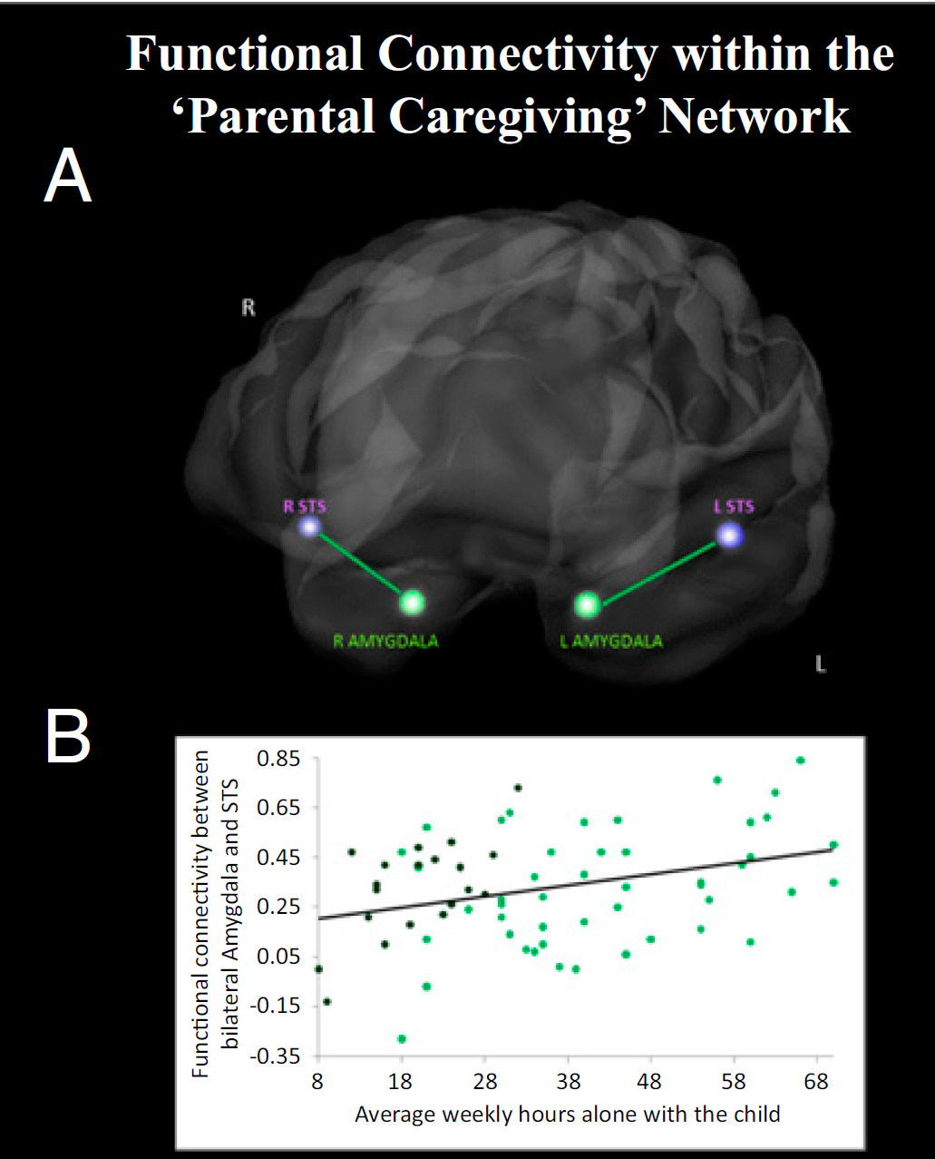
Finding 4: The PC-Father Brain
Abraham et al. (2014) - Walsh
Only PC-Fathers had significant connectivity of the amygdala (emotional network) and STS (mentalizing network) while watching self- infant interaction videos
Notes:
1. All parents would express activation in both brain networks.
2. Mothers would have greater amygdala activation and fathers would have greater neural-cognitive activation
3. Maternal care would center on the emotional processing network and paternal care would center on the socio-cognitive network
4. Fathers would express greater variability in brain response, mediated by actual caregiving behaviors, and would include both neural networks in primary caregiving fathers
5. Oxytocin levels and brain activation would mediate the relationship between the parental primary caregiving role and infant-synchrony
-Significant correlations between brain activity and parent–infant synchrony scores for PC-Mothers in bilateral amygdala, but not for PC-Fathers or SC-Fathers
-For both PC-Fathers and SC-Fathers, significant correlation was found in the bilateral STS but not for PC-Mothers
-Maternal oxytocin did not correlate with the amygdala but
-PC mothers showed correlation between oxytocin and the vACC ; no such association was found in PC or SC fathers
-Oxytocin correlated with PC-Fathers and SC-Fathers in bilateral STS but not for PC-Mothers (
Overall, there are notable mother versus father diffs. While the authors discuss these regional differences as reflecting network diffs, caution is prob warranted

Slide 86
Finding 4: The PC-Father Brain
4. Fathers would express greater variability in brain response, mediated by actual caregiving behaviors, and would include both neural networks in primary caregiving fathers
5. Oxytocin levels and brain activation would mediate the relationship between the parental primary caregiving role and infant-synchrony
Abraham et al. (2014) - Walsh
Connectivity of these two networks was positively correlated to time spent alone with their child
Notes:
-Significant correlations between brain activity and parent–infant synchrony scores for PC-Mothers in bilateral amygdala, but not for PC-Fathers or SC-Fathers
-For both PC-Fathers and SC-Fathers, significant correlation was found in the bilateral STS but not for PC-Mothers
-Maternal oxytocin did not correlate with the amygdala but
-PC mothers showed correlation between oxytocin and the vACC ; no such association was found in PC or SC fathers
-Oxytocin correlated with PC-Fathers and SC-Fathers in bilateral STS but not for PC-Mothers (
Overall, there are notable mother versus father diffs. While the authors discuss these regional differences as reflecting network diffs, caution is prob warranted

Slide 87
Finding 5: Role and Synchrony Mediation
Abraham et al. (2014) - Walsh
Primary caregivers had greater synchrony

Slide 88
Finding 5: Role and Synchrony Mediation
Abraham et al. (2014) - Walsh
Indirect effect of role on synchrony via amygdala activation, moderated by gender – only mothers
Notes:
1. All parents would express activation in both brain networks.
2. Mothers would have greater amygdala activation and fathers would have greater neural-cognitive activation
3. Maternal care would center on the emotional processing network and paternal care would center on the socio-cognitive network
4. Fathers would express greater variability in brain response, mediated by actual caregiving behaviors, and would include both neural networks in primary caregiving fathers
5. Oxytocin levels and brain activation would mediate the relationship between the parental primary caregiving role and infant-synchrony

Slide 89
Finding 5: Role and Synchrony Mediation
Abraham et al. (2014) - Walsh
Amygdala (emotional network) and STS (mentalizing network) were correlated
Notes:
1. All parents would express activation in both brain networks.
2. Mothers would have greater amygdala activation and fathers would have greater neural-cognitive activation
3. Maternal care would center on the emotional processing network and paternal care would center on the socio-cognitive network
4. Fathers would express greater variability in brain response, mediated by actual caregiving behaviors, and would include both neural networks in primary caregiving fathers
5. Oxytocin levels and brain activation would mediate the relationship between the parental primary caregiving role and infant-synchrony

Slide 90
Finding 5: Role and Synchrony Mediation
Abraham et al. (2014) - Walsh
STS indirect effect on synchrony via increases in OT
Notes:
1. All parents would express activation in both brain networks.
2. Mothers would have greater amygdala activation and fathers would have greater neural-cognitive activation
3. Maternal care would center on the emotional processing network and paternal care would center on the socio-cognitive network
4. Fathers would express greater variability in brain response, mediated by actual caregiving behaviors, and would include both neural networks in primary caregiving fathers
5. Oxytocin levels and brain activation would mediate the relationship between the parental primary caregiving role and infant-synchrony

Slide 91
Finding 5: Role and Synchrony Mediation
Abraham et al. (2014) - Walsh
No differences found in femininity and masculinity between homosexual and heterosexual fathers
Notes:
1. All parents would express activation in both brain networks.
2. Mothers would have greater amygdala activation and fathers would have greater neural-cognitive activation
3. Maternal care would center on the emotional processing network and paternal care would center on the socio-cognitive network
4. Fathers would express greater variability in brain response, mediated by actual caregiving behaviors, and would include both neural networks in primary caregiving fathers
5. Oxytocin levels and brain activation would mediate the relationship between the parental primary caregiving role and infant-synchrony

Slide 92
Conclusions: Adaptation of the Paternal Brain
Abraham et al. (2014) - Walsh
Findings support distinct maternal and paternal brain-hormone-behavior networks
PC fathers exhibited high amygdala activation (like PC mothers), alongside high STS activation (like SC-fathers)
Among all fathers, time spent caregiving was linked with the degree of neural network overlap (more time, more connectivity between networks)
Overall, findings indicate a neural basis and adaptation of parental care that can be activated through responsive caregiving via brain-hormone-behavior pathways
Notes:
Authors note several novel aspects of this work – methodology, direct comparison, naturalistic approach

Slide 93
Discussion
Abraham et al. (2014) - Walsh
The present study lacked a control group (e.g., male non-fathers). How might this have improved the study? What other groups might you add to enhance the study?
The authors use the Bem Sex Role inventory to measure feminine and masculine traits of all fathers, and no differences were found between groups. What other life experiences are the authors missing that could have contributed to the parenting synchrony or brain activity results found?
How might the results look in two-mother families? Adoptive versus biological mothers?
How generalizable are the results to all “fathers”?
Only first-time parents were included; how might the results change if the couples had more children or twins?

Slide 94
Dopamine in the medial amygdala network mediates human bonding
Atzil et al. (2017)

Slide 95
Bonding Network
Mother-child Synchrony – Dopamine level in Striatum
Atypical maternal behavior – attenuated striatum responses
Atypical maternal behavior – disrupted amygdala & PCC
Amygdala

Slide 96
Current Study
Participants: 19 mother (21-42 yr) - infant (4-24 mo) dyads
Procedures:
2-min interactions at home: coded for mother-infant synchrony
Vocalization, gaze ,affect, touch
Scanning: own infant vs. unfamiliar infant play (twice)
PET: Dopamine responses
fMRI: functional connectivity

Slide 97
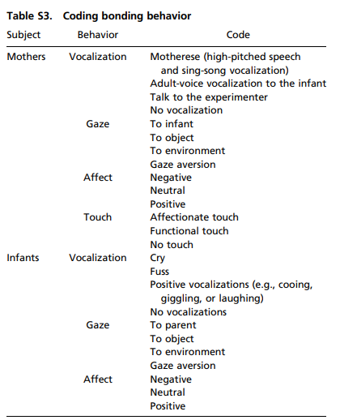
Mother–Infant Synchrony
Vocalization Synchrony
Maternal Attunement

Slide 98
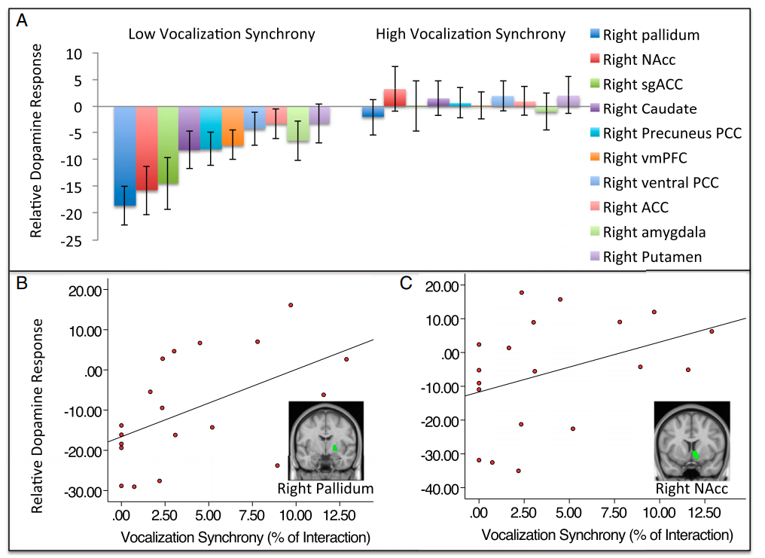
Vocalization Synchrony - Dopamine

Slide 99
Maternal Attunement - Connectivity

Slide 100
Dopamine – Connectivity (own infant)

Slide 101
Main Findings
Dopamine is involved in mother-infant bonding positively.
NAcc and pallidum serve the regulatory function of dopamine of bonding behavior.
Regions work as a network for bonding.

