Slide 1
Advanced Developmental Psychology
PSY 620P

Slide 2
Overview
Childrearing and testosterone (parenting)
Aggression and development
Relational and overt
Reconciliation
Video game effects
Adolescent adult activities declining
Adolescent risk-taking
Adolescent effect (ventral striatum & cortex)
Emotional stroop effect (Botdorf). Hannah
Adult presence mitigates

Slide 3
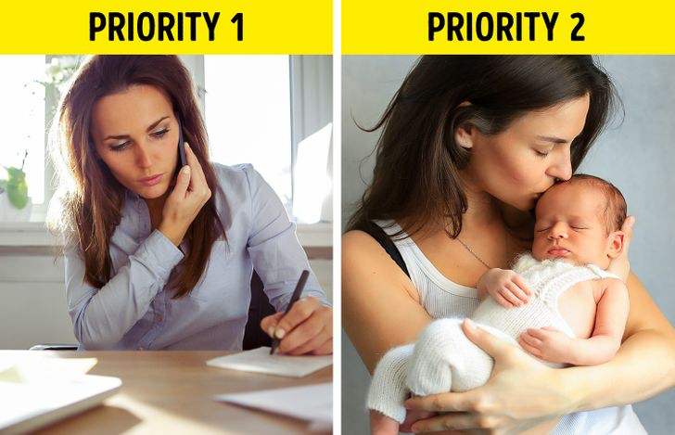
Childbearing and parenting?
Suleiman, A. B., Galván, A., Harden, K. P., & Dahl, R. E. (2017). Becoming a sexual being: The 'elephant in the room' of adolescent brain development. Dev Cogn Neurosci, 25, 209-220. doi:10.1016/j.dcn .2016.09.004
Clear negative social and neurodevelopmental effects
of early parenthood (< 15)
What about late parenthood?
Neural flexibility peaks in 30s
Men have different levels of testosterone based on relationship/parenthood status regardless of age
What if you decouple typical neurobiological development trends from parenthood?
Overwhelming majority of people in the US and Europe have sexual and romantic relationships before committing to a single partner; similar trends beginning in Africa
Differences between those who have multiple, high-intensity relationships and those who do not?
Differences between those who have children at different ages?
Woodard

Slide 4
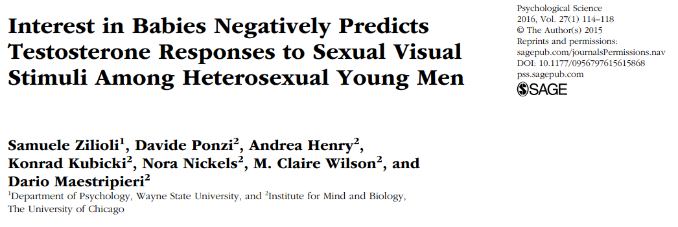
Testosterone (& sociality)

Slide 5
Human aggression
Overview
Reactive and proactive aggression
Overt and covert anti-social behavior

Slide 6
Processes
Under-socialized aggressive conduct disorder associated with weak inhibition system (BIS)
Impulsivity a key (Quay)
Information Processing
Real-time processes
Somebody bumps into you at a party

Slide 7
Stability of aggression
The earlier aggression starts, the more intense the form of aggression and the longer it lasts
Stability of aggression can be as high as .76
Remarkably stable over up to 10 years
The aggressive remain so
One of the more stable psychological characteristics
But developmentally variable
Highest among 2-year-olds?
In decline by 25

Slide 8
Behavior genetics
One inherits a propensity toward anti-sociality which interacts with an environment in its (non)emergence
Genetic effects greater for self-reported than adjudicated measures of aggression
Environmental, genetic, and interactive effects evident in petty crime

Slide 9
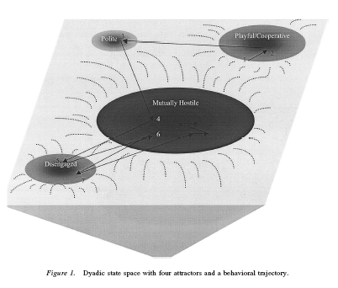
Parent-child real-time coercion
As mutual positivity declines in early adolescence, existing habits of withdrawal will constrain the interactions that emerge next.
A parent–child dyad with two main interaction patterns:
A cooperative, mutually positive pattern and a hostile–withdrawn pattern in which the parent berates the child and the child ignores the parent.
A repertoire of distance and disengagement may characterize the adolescent period, leading eventually to complete estrangement and alienation in adulthood.
(Granic & Patterson, 2006).

Slide 10
Disregard for conduct rules to parental power assertion to antisocial behavior in early preadolescence: Interplay with child’s skin conductance level
GRAZYNA KOCHANSKA, REBECCA L. BROCK, AND LEA J. BOLDT

Slide 11
Provocation → (relational) aggression
Physically aggressive children exhibited hostile attributional biases and reported relatively greater distress for instrumental provocation situations
Getting pushed into the mud
Relationally aggressive children exhibited hostile attributional biases and reported relatively greater distress for relational provocation contexts
Not getting invited to a birthday party.
662 third- to sixth-grade children
Crick et al., 2002. CD.

Slide 12
Relational aggression
“Attempts to harm the victim through the manipulation of relationships, threat of damage to them, or both” (Crick et al, ’02 p.98)
Associated with internalizing/externalizing problems and later peer rejection
Preschool
Direct, face-to face behaviors
Exclusion from party
Middle Childhood
More sophisticated, direct and indirect behaviors
Direct: refuse to choose as a team member
Adolescence
Sophisticated and focused on opposite-sex relationships
Indirect: spread a rumor
Stealing a boyfriend

Slide 14
Background
Aggression- behavior intended to hurt, harm, or injure another person
Forms:
Physical
Relational
Functions:
Proactive
Reactive
Most measures confound function and form

Slide 15
Purpose of Study
Goal 1: Test developed measurement and analysis system in early childhood
Goal 2: Examine stability of aggression subtypes
Goal 3: Examine whether risk factors for aggression predicted subtypes and increases of subtypes over time

Slide 16
Hypotheses
1: young children will show four distinct forms and functions
Associations between forms and functions would be higher in early childhood than older samples
2: Forms stable but functions unstable over time
Hypothesis 3:
Girls → Relational; Boys → Physical
Older → Relational and Proactive
Social Dominance → Physical, Relational, and Proactive
Peer Exclusion → Relational and Reactive

Slide 17
Methods
Participants (N=101)
61 Girls
45.09 months (3.75 years)
Middle-Class families
Longitudinal design
2 time points
4-5 months apart

Slide 18
Measures
Observer Ratings
Teacher report
Observations of Aggression
Ratings of Aggression
Preschool Social Behavior Scale- Observer Form
Ratings of Form and Function of Aggression
Preschool Proactive and Reactive Aggression- Observer Report
Report of Exclusion
Child Behavior Scale
Report of Social Dominance and Resource Control

Slide 19
Forms and Functions of Aggressive Behavior (Murray-Close & Ostrov, 2009)
Measures (T1 & T2)
Observations of aggression
Problem?
Observer ratings of aggression
Teacher reports
Exclusion
Social Dominance
Notes:
Hypothesize more overlap in early childhood (principle of increasing differentiation with development)
Hypothesize less stability of functions than forms; expect stability in physical aggression, though
Predictors=gender, age, social dominance, experienced exclusion

Slide 20
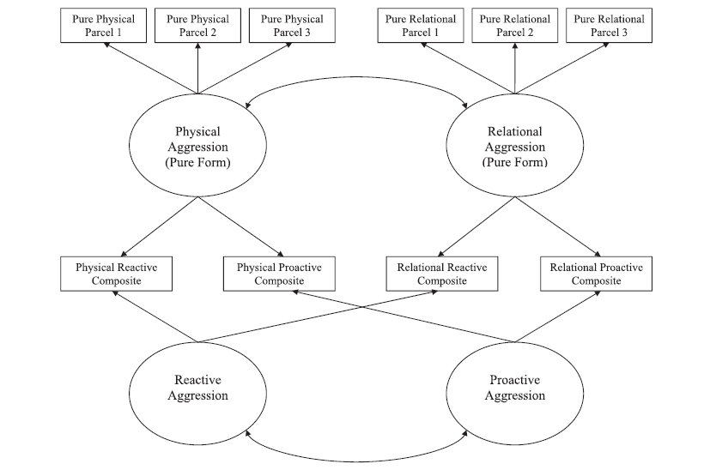
Forms and Functions of Aggressive Behavior (Murray-Close & Ostrov, 2009)
Notes:
Moderate association between physical and relational aggression
Proactive and reactive were positively associated
Overall structure supports relatively distinct forms and functions of aggression
Same structure at T1 and T2

Slide 21
Forms and Functions of Aggressive Behavior (Murray-Close & Ostrov, 2009)
Physical aggression
Less related to relational vs. older kids
Decreases with age
Forms – stable but functions – not stable
Lack of gender differences in physical
Fewer age-related changes than expected
Notes:
Longitudinal analyses control for initial levels
Therefore interpreted as change
Concurrent
Girls more relationally aggressive at T1; but boys not more physically aggressive
Older children less likely to use physical aggression
Social dominance predicted relational aggression; but not physical aggression; not proactive aggression
Exclusion associated with proactive aggression
Longitudinal Analyses
Social dominance predicted decreases in physical aggression
Exclusion predicted increases in relational

Slide 22
4 latent aggression factors: Physical, relational, proactive, & reactive
Physical, relational, proactive, and reactive
Proactive and reactive positively correlated
Physical and relational moderately associated
Over time, forms (physical/relational) stable
but functions (reactive/proactive) unstable
Proactive associated with increase in physical
Notes:
Relational marginally associated with decrease in physical and increase in proactive

Slide 23
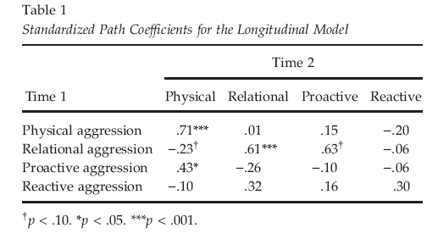
Stability over 1 year
Notes:
Both forms of aggression (physical/relational) stable over time
BUT functions (proactive/reactive) were not: WHY?

Slide 24
Predictors of aggression at 4.5 years

Slide 25
Conclusion
Distinct forms and functions of aggression emerged by early childhood
Child-level risk factors that are associated with aggression
Intervention work may benefit from tailoring programs based on forms and functions of aggression and considering these child-level risk factors

Slide 26
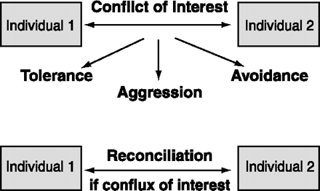
Aggression iarger context: Relational model
Other possible ways are tolerance (e.g., sharing of resources), or avoidance of confrontation (e.g., by subordinates to dominants).

Slide 27
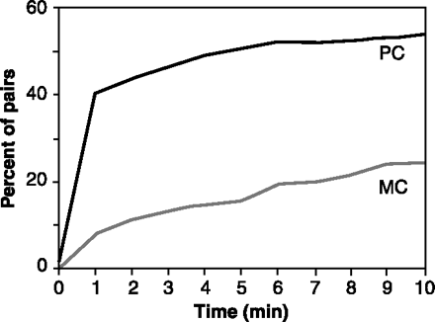
Most primates show a dramatic increase in body contact between former opponents during post conflict (PC) compared to matched-control (MC) observations
The cumulative percentage of opponent-pairs seeking friendly contact during a 10-min time window after 670 spontaneous aggressive incidents in a zoo group of stumptail macaques

Slide 28
Reconciliations allow rhesus monkeys to maintain tight kinship bonds despite frequent intrafamilial squabbles
Shortly after two adult sisters bit each other, they reunite sitting on the left and right of their mother, the alpha female of the troop, each female holding her own infant. The sisters smack their lips while the matriarch loudly grunts.

Slide 29
If there is a strong mutual interest in maintenance of the relationship, reconciliation is most likely.
Parties negotiate the terms of their relationship by going through cycles of conflict and reconciliation.

Slide 30
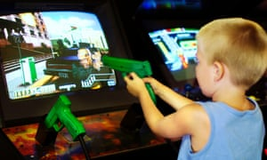
24 studies that assessed the link between VGV and later overt physical aggression
Over 17,000 participants
9 to 19 years
Time lags ranging 3 months to 4 years
Prospective effect of VGV on subsequent aggression, controlling for baseline aggression.
for fixed [β=0.113, 95% CI=(0.098, 0.128)] and random effects models [β=0.106 (0.078, 0.134)].
Even after available covariate inclusion
Fixed, β=0.080 (0.065, 0.094)
Random, β=0.078 (0.053, 0.102), respectively]
“Self-reports of real-world aggressive behavior were acceptable aggression measures, as were similar ratings provided by parents, teachers, or peers.”

Slide 31
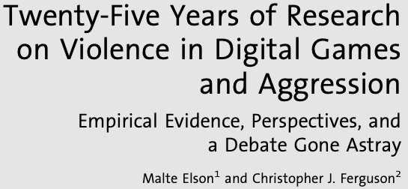
Controversy surrounding VGV-aggression link
Previous studies and metaanalyses have reported a relationship between VGV and aggression.
Some researchers argue that there are fundamental issues with these studies.
Measures of “nonserious aggression”
Lack of statistical controls
Publication bias
Weak effect sizes
Leung

Slide 32
VGV-aggression link
Prospective effect of VGV on subsequent aggression, controlling for baseline aggression.
fixed [β=0.113, 95% CI=(0.098, 0.128)]
random effects models [β=0.106 (0.078, 0.134)].
Even after available covariate inclusion
Fixed, β=0.080 (0.065, 0.094)
Random, β=0.078 (0.053, 0.102)

Slide 33
VGV is associated with later overt physical aggression.
Consideration of moderators
Ethnicity
Age
Time lag
Ethnicity=White
Ethnicity=Asian
Ethnicity=Hispanic
0.4
0.2
0
-0.2
Stratified analyses indicated the effect was largest among Whites, intermediate among Asians, and nonsignificant among Hispanics.
-0.4
Leung

Slide 34
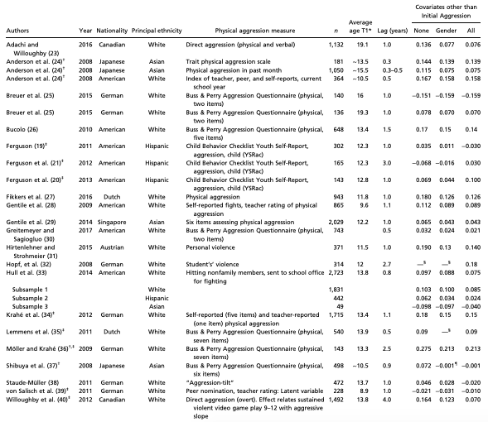
Characteristics of included studies

Slide 35
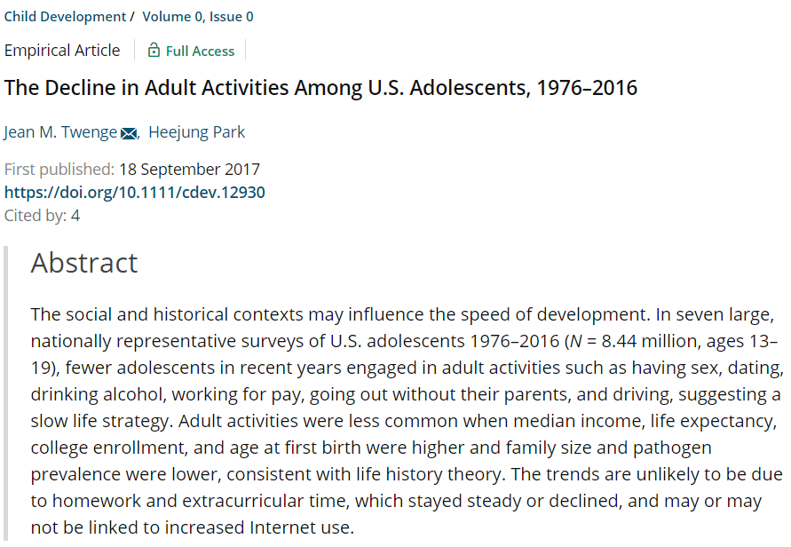

Slide 36
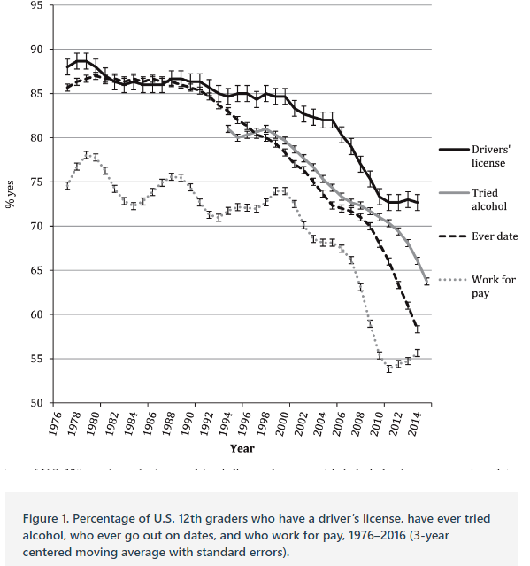

Slide 37
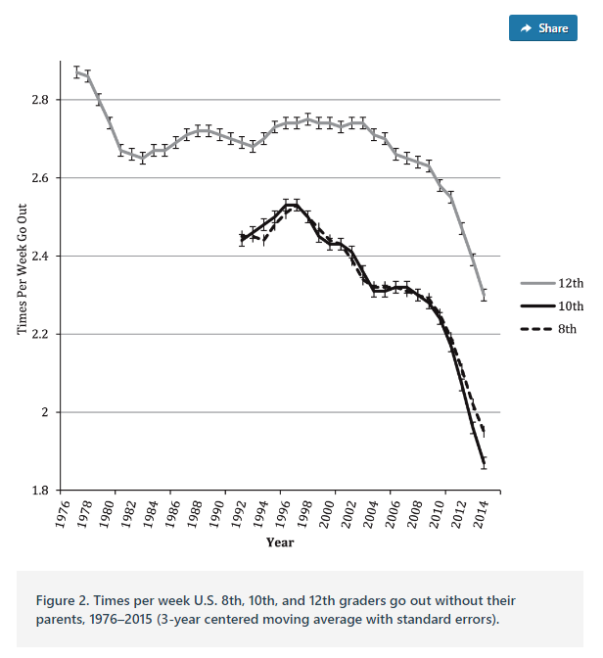
Go out

Slide 38
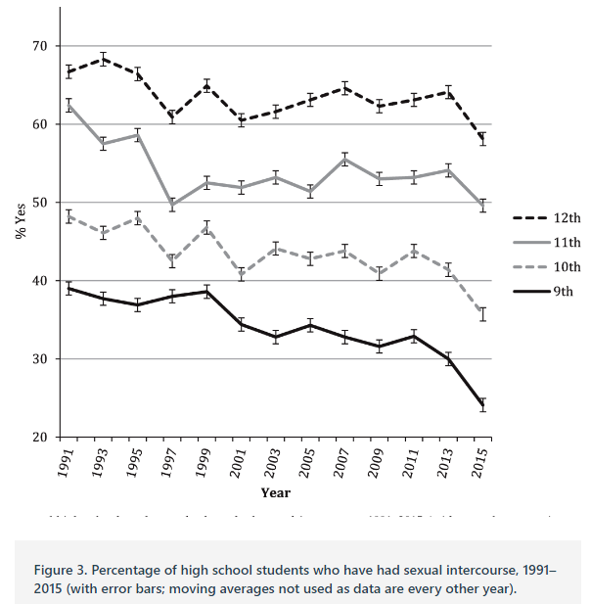
sex

Slide 39
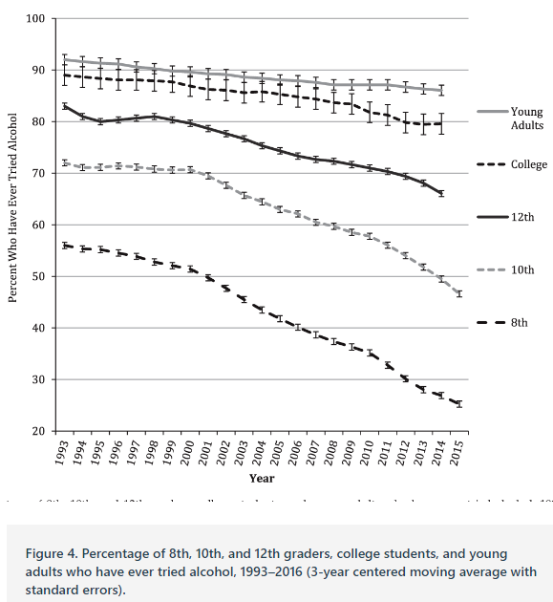
Tried alcohol

Slide 40
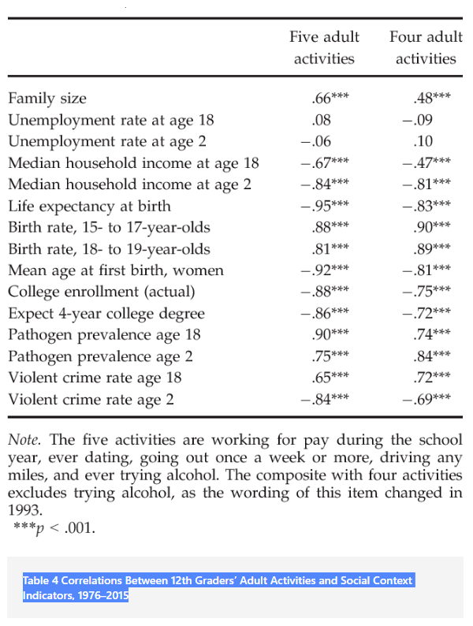

Slide 41
When is an adolescent an adult? Assessing cognitive control in emotional and nonemotional contexts
Cohen et al., 2016
puccetti
Notes:
https://www.rch.org.au/studentorientation/Differences_between_children_and_adults/

Slide 42
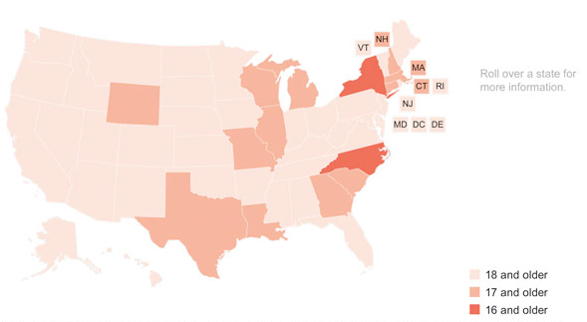
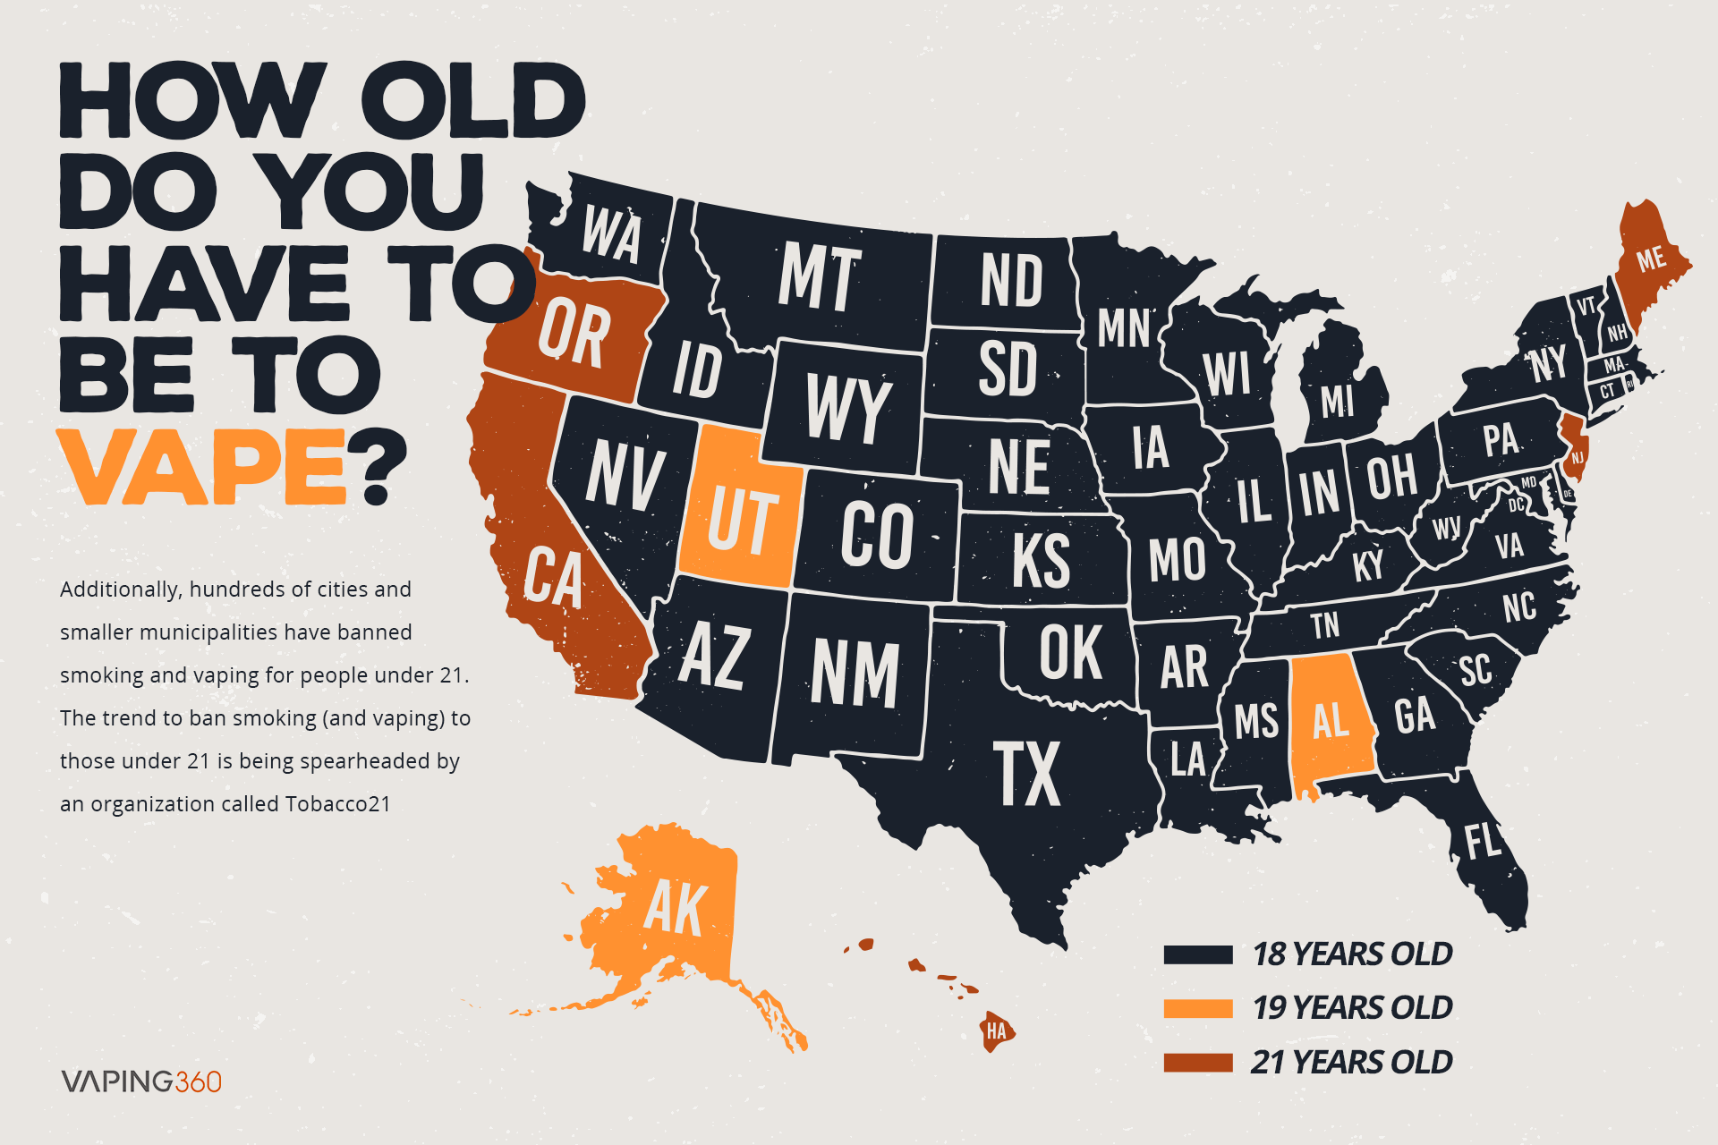
Background
Adolescents (13-17yrs) display heightened sensitivity to motivational, social, and emotional information
Cognitive control in adolescents sometimes matches adults...
But susceptible to incentive, threat, and peer influence
Cognitive performance within emotional contexts is especially relevant for policy (*18-21)
Juveniles tried as adults in US
puccetti

Slide 43
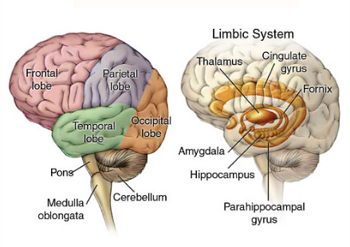
Background
Should consider both behavioral and neural maturation to inform policy
Risky and impulsive adolescent behavior can be attributed to ‘dynamic and asymmetric’ brain development:
Subcortical limbic structures: nonlinear trajectory with sensitization in adolescence
PFC: linear trajectory of functional ‘growth’ that stabilizes in the 20’s
puccetti

Slide 44
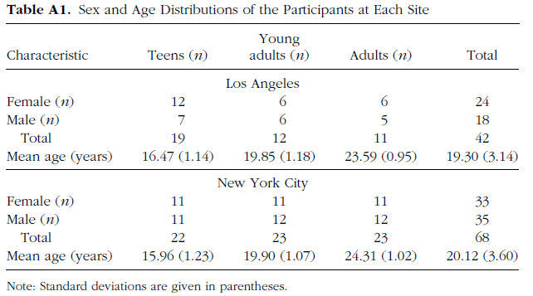
Hypothesis
Young adults (18-21) would A) differ from adults (>21) in cognitive control in emotional conditions and B) this shift would correlate with brain function in PFC
Sample
110 subjects: N(13-17)= 41
N(18-21)=35, N(22-25)=34
32.7% Caucasian 27.3 African American 24.6% Hispanic 12.7% Asian
puccetti

Slide 45
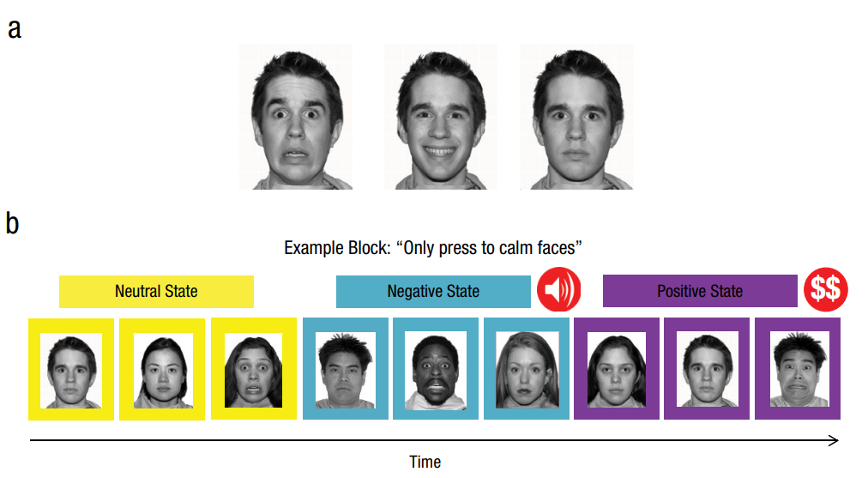
Behavioral paradigm
Fearful Happy Calm
~50 minutes
~10sec
per trial
CUES
STATES
GO/NO GO=Press button when you see the TARGET
2 cues per state/block (GO stim/NO GO stim or TARGET/NONTARGET)
TARGET changed every block
Calm=GO Fearful=NO GO
Fearful=GO Happy=NO GO
Etc. with all pairwise combos used
puccetti

Slide 46
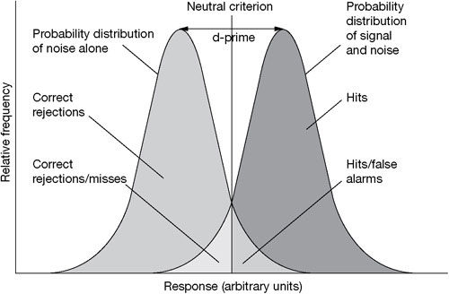
Data analysis
Behavioral: d’ is a sensitive accuracy measure=Z(H) - Z(FA)
H=correctly GO on a GO cue
FA=incorrectly GO on a NO GO cue
Larger d’ indicates BETTER cognitive control or better discrimation between GO and NO GO
Proposed behavioral ANOVAs:
Age
Age X Cue (happy,fearful,calm faces) within neutral state only
Age X State (sad,happy,neutral) with calm cue faces only
Whole-brain Analysis: Group linear mixed effects
Effects of CUES on GO and NO GO trials
Effects of STATES on GO and NO GO trials
NO GO
GO
Task-dependent functional connectivity:
2 PFC ‘seed’ regions
puccetti

Slide 47
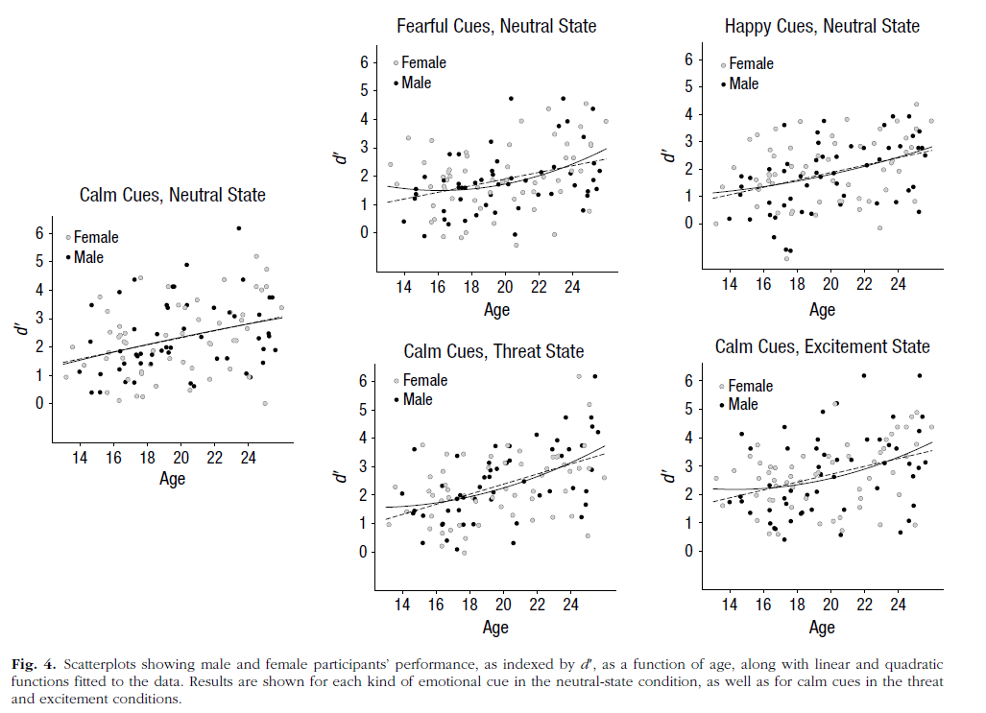
Results
Age and increased performance in different emotion conditions (by gender)
puccetti

Slide 48
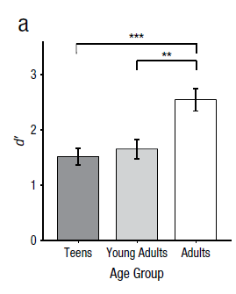
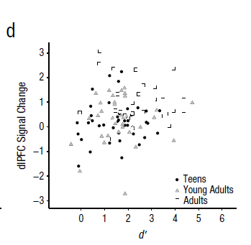
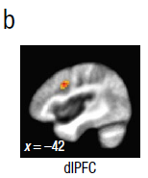
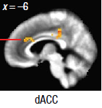
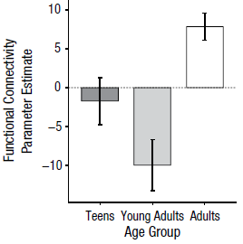
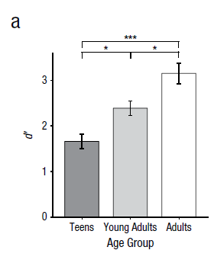
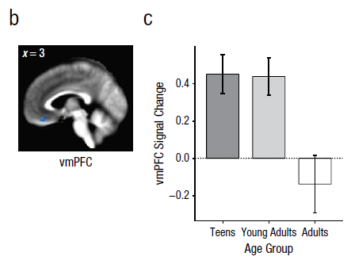
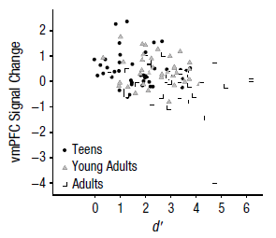
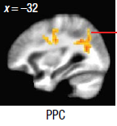
Results
d’ in response to fearful cues in the neutral state: Age differences : A > YA and T
*did not survive when controlling for age
d’ in response to calm cues in the threat state: age differences: A > YA > T
*no regions survived whole brain correction
puccetti
Notes:
neutral state FEAR: (A > YA and T) HAPPY: (A and YA > T) CALM: (A > T)
threat state CALM: (A > YA > T)
excitement state: CALM: (A > T)
Fig 1 set – take away DLpfc significantly diff by age but NOT robustly related to performance; dACC and Pariental related to age AND d’ thus important for task performance
Fig 2 set – take away PFC corrected: greater vmPFC activation related to poorer behavioral performance

Slide 49
Conclusions
Young adults (YA) cognitive control indeed differs from adults in brief and prolonged emotional conditions
Related to % signal change and poorer functional connectivity in PFC
dlPFC in YA- implicated in cognitive and affective regulation
vmPFC in YA- implicated in affective integration/regulation and self-referential thought
-greater sensitivity to threat
-less coupling w/ dACC and parietal regions*
Differences are primarily in negative relative to neutral and positive conditions
Individual differences in pos. perhaps related to risk for mania?
Potential advantage of emotional sensitivity: meeting socioemotional pressures
Disadvantage: vulnerable to poor decision-making
Courts: immature cognitive functioning plays a role in determining culpability*
puccetti
Notes:
Disclaimer – I found the discussion to be lacking!

Slide 50
Adolescent Risk Taking
Messinger & Halliday, 2021
Notes:
-What is the unique message of the article
-presentations should cover the article’s unique contribution, integrative themes across the readings (particularly for that day), the pros and cons of different research methods for addressing the topic, and ideas regarding potential future directions/applications of the findings
-Stronger presentations often focus on key strengths and results.

Slide 51
Adolescent Risk Taking
Fewer adolescents engaging in adult behaviors (Twenge & Park, 2019) – maybe not inherently good or bad, but its not uniform
”An economically rich social context with higher parental investment in fewer children, greater life expectancy, fewer dangers from pathogens, and the expectation of tertiary education and later reproduction has produced a generation of young people who are taking on the responsibilities and pleasures of adulthood later than their predecessors”
Halliday, 2021

Slide 52
Adolescent Risk Taking
Teens and young adults’ cognitive control differs from adults in brief and prolonged emotional conditions (Cohen et al., 2016)
Lower SES/less supported teens and YAs experience more adult life stressors/ “pleasures” and have less cognitive control, especially under threatening and emotional situations
Halliday, 2021

Slide 53
Botdorf et al., 2017: Background
Teens take risks more often than children and adults
Engaging in behaviors that may be high in subjective desirability (i.e., associated with high sensation, novelty, or perceived reward) but exposes the individual to potential injury or loss (Geier & Luna, 2009)
The Dual Systems Model
Incentive processing system (socio-emotional rewards) reaches peak reactivity during adolescence, while the cognitive control system (self-regulation, working memory and inhibitory control) matures more gradually
Messinger & Halliday, 2021
Notes:
-Asynchronous maturation
U shaped vs linear
-individual differences
In addition to limitations in incentive processing, basic cognitive control abilities, including working memory and inhibitory control, continue to mature during adolescence. Consequently, adolescents may be limited, relative to adults, in their abilities to inhibit impulsive behaviors and reliably hold ‘on-line’ comparisons of potential rewards/punishments during decision-making.
Geier, C., & Luna, B. (2009). The maturation of incentive processing and cognitive control. Pharmacology, biochemistry, and behavior, 93(3), 212–221. https://doi.org/10.1016/j.pbb.2009.01.021
Behaviorally, adolescents are more ‘reward-driven’ (i.e., respond more strongly to rewards than adults)

Slide 54
Botdorf et al., 2017: Background
Limited abilities to inhibit impulsive behaviors and weigh potential rewards/punishments during decision-making (Geier & Luna, 2009)
Heightened reward-seeking in the context of under-developed cognitive control=risk-taking
Vital implications for accidents, substance-use, suicide, etc.
Previous studies examining the association between cognitive control (impulsivity) and risk-taking in adolescents have yielded mixed results
In adolescents, the cognitive control system may function adequately under affectively neutral (cold) conditions, but becomes overwhelmed under affectively arousing (hot) conditions
Messinger & Halliday, 2021
Notes:
Really important for substance use and

Slide 55
Botdorf et al., 2017: Aims
Aim 1: Examine whether a task measuring cognitive control under an emotionally arousing condition could serves as a better predictor of individual differences in adolescent risk-taking than a non-emotional cognitive task.
Aim 2: Examine gender (sex) differences.
Based on data showing that males are more risky than females in real-world situations, and females process emotional information more quickly and accurately than their male counterparts.
Messinger & Halliday, 2021

Slide 56
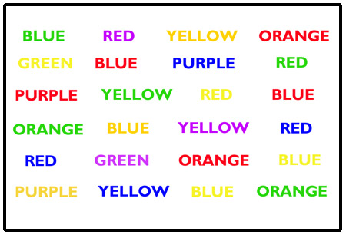
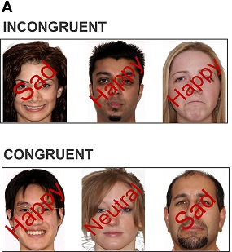
Methods
Participants
104 adolescents aged 13-17 (M=15.44)
Recruited from a large metropolitan area
42.3% males, 57.7% females
63.5% African American, 11.5% Caucasian, 16.3% Asian, 1% American Indian, 7.7% Other/Not determined
Measures
Cognitive Stroop task
Emotional Stroop task
NOTE: In contrast to the Cognitive Stroop, the Emotional Stroop did not have a time limit
Risk-taking: Stoplight task
Messinger & Halliday, 2021

Slide 57
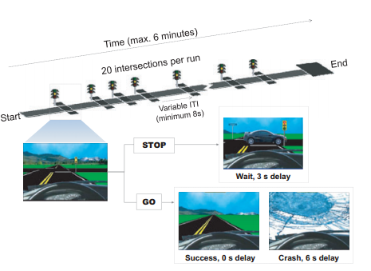
The Stoplight driving task
As you approach intersection, light turns yellow
Risk-taking=not braking for yellow light
Messinger & Halliday, 2021
Notes:
Ecological validity it a strength
Goal is to complete as fast as possible

Slide 58
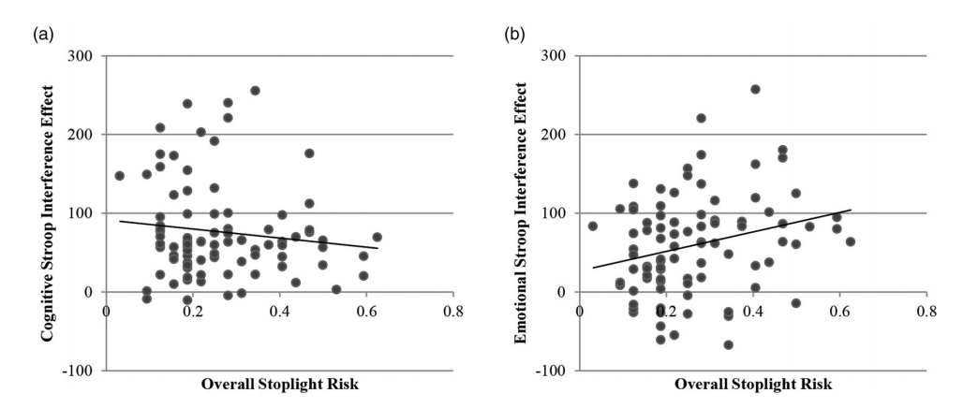
Results: Cognitive vs. Emotional
Stroop Interference Effect
Participants responded more quickly (and accurately) on congruent than non-congruent trials, across the cognitive and emotional conditions – as expected
Emotional Stroop interference effect was significantly associated with risk-taking on the stoplight test (b), whereas Cognitive Stroop interference effect was not (a)
Only Emotional Stroop interference effect was significantly associated with risk taking when simultaneously examined with Cognitive Stroop interference effect in regression model
Messinger & Halliday, 2021
Notes:
Correlation were sig different

Slide 59
Results: Gender Differences
No gender differences on Cognitive Stroop (speed, accuracy, interference)
Emotional Stroop
Males were significantly less accurate and slower than females on incongruent trial
No difference in interference effect
Risk taking on the Stoplight task
No statistically significant difference
Males were slower and less accurate than females on the Emotional Stroop task, but comparable to females on Cognitive Stroop
Male’s Emotional Stroop performance more robustly predicted Stoplight risk- taking (r=.39, p < .02) than did females’ performance (r=.13, p=.37).
However, gender did not moderate the relationship between performance on the emotional Stroop task and the Stoplight task
Messinger & Halliday, 2021

Slide 60
Conclusions
Individual differences in performance on the Emotional Stroop task, but not the Cognitive Stroop task, predicted risk taking in the Stoplight task
Lower performance=more risks
Findings suggest, for the first time, that measuring cognitive control under affective arousal (“hot” conditions) may be a better predictor of individual differences in risk-taking than a task measuring cognitive control in a non-emotional context (“cold” conditions)
Results support the dual systems model and the idea that emotional context is vital to understanding the link between cognitive control and risk-taking in adolescents
Gender differences on the Emotional Stroop task support the notion that males exhibit a greater propensity to take dangerous risks, especially in the context of heightened emotional arousal.
HOWEVER, no significant gender difference in Emotional Interference effect or Stoplight risk-taking
Messinger & Halliday, 2021

Slide 61
Discussion Questions
Do you think this pattern of findings is unique to adolescents? How could this be tested and what would results look like in children, adults?
How are the implications of these findings more detrimental for some adolescents more than others?
Individual differences in emotion regulation or traits? Differences in level of exposure to similar risky situations?
How might future studies extend these findings to better understand adolescent risk-taking in the real-world?
Experimental design? Inclusion of a peer?
How might these findings inform efforts to reduce risky decision making in adolescents?
Unlike the Cognitive Stroop, there was no time limit for the Emotional Stroop. How might this have impacted the results?
Messinger & Halliday, 2021

Slide 62
2011

Slide 63
Hypotheses
Increase in risk taking due to two brain systems:
The ventral striatum, nucleus accumbens, and the orbitofrontal cortex: an incentive processing system
Lateral prefrontal cortex: a cognitive control system
During adolescence, changes to the incentive processing system results in heightened sensitivity to rewards while the cognitive control systems are gradually maturing
Peer presence may heighten the activation of reward valuation
Notes:
System 1: biases decision-making based on the valuation and prediction of potential rewards and punishments
System 2: supports goal-directed decision making by keeping impulses in check and by providing the mental machinery needed for deliberation regarding alternative choices
Risky decisions are seen as increased engagement of incentive processing and decreased engagement of cognitive control activity due to an immature capacity to down-regulate reward system outputs through control signaling, which biases adolescents toward risk taking

Slide 64
Background
Teenagers engage in more risky behaviors than adults
More likely to binge drink, smoke cigarettes, have casual sex, be involved in a fatal or serious car crash
Adolescents take a substantially greater number of risks when driving when observed by peers
Risk-taking related to brain systems:
Incentive processing system
Cognitive control system

Slide 65
Background
Incentive processing system
The ventral striatum, orbitofrontal cortex, and others
Decision making=valuation and predication of rewards/punishments
Re-organization during adolescence=heightened sensitivity to reward
Cognitive control system
The lateral prefrontal cortex
Decision making=goal-directed, keeping impulses in check
Gradual and protracted development until early 20’s
Adolescence=heightened sensitivity to reward and under-developed impulse control
Notes:
System 1: biases decision-making based on the valuation and prediction of potential rewards and punishments
System 2: supports goal-directed decision making by keeping impulses in check and by providing the mental machinery needed for deliberation regarding alternative choices
Risky decisions are seen as increased engagement of incentive processing and decreased engagement of cognitive control activity due to an immature capacity to down-regulate reward system outputs through control signaling, which biases adolescents toward risk taking

Slide 66
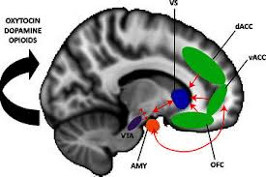
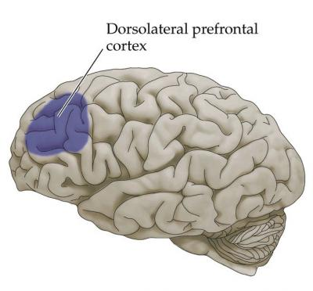
Lateral prefrontal cortex: cognitive control system
ventral striatum, nucleus accumbens, and the orbitofrontal cortex: an incentive processing system

Slide 67
Hypotheses
Maturational imbalance between competing brain systems:
During adolescence, changes to the incentive processing system results in heightened sensitivity to rewards while the cognitive control systems are gradually maturing
During a simulated driving game, teenager risky behavior will be related to:
Heightened activation of brain regions associated with reward valuation, OR
Altered activity within regions associated with impulse regulation
Peer vs. alone conditions
Adolescents vs. young adults vs. adults

Slide 68
Participants
 | n | Female | Age
Adolescents | 14 | 8 | 14-18 (M=15.7, SD=1.5)
Young Adults | 14 | 7 | 19-22 (M=20.6, SD=0.9)
Adults | 12 | 6 | 24-29 (M=25.6, SD=1.9)
TOTAL | 40

Slide 69
The Stoplight driving game
As you approach intersection, light turns yellow
Chance crash or brake and wait
Risk-taking=not braking for yellow light
Notes:
While in the scanner…
The Stoplight task (Figure 1) is a simple driving task in which subjects control the progression of a vehicle along a straight track, from a driver’s point of view.
Subjects completed four rounds of the task; two in the first social condition and two in the second social condition.
Each round used a track with 20 intersections (treated as separate trials), which took under 6 minutes to traverse (dependent on subjects’ choices and providence).
At each intersection subjects rendered a decision (by button press) about whether or not to brake as the vehicle approached a changing traffic signal (which cycled from green to yellow to red).
As the vehicle approached the intersection, the traffic signal turned yellow, and the subject decided whether to chance a possible crash in the intersection (GO decision), or to brake and wait for the light to return to green (STOP
Both the timing of the traffic signals and the probability of a crash in the associated intersections were varied so as to be unpredictable by the participant
Risk taking was encouraged by offering monetary incentives for completing the course in a timely fashion
Barratt: individual differences in impulsivity
Zuckerman: sensation seeking
RPI: resistance to peer influence

Slide 70
Methods
Manipulation of social context (peer vs. alone conditions)
All participants brought two same-age, same-sex, friends
Change of social context=“Surprise manipulation”
Self-report questionnaires:
Complete after fMRI session
Barratt Impulsiveness Scale
Zuckerman Sensation Seeking Scale
Resistance to Peer Influence (RPI) Scale

Slide 71
Adolescent risks with peers
While in the ‘Alone’ condition, self-reported…
Sensation seeking predicted greater risky driving behavior
Impulsivity did not predict risky driving behavior
Notes:
Adolescents and adults behaved comparably alone, but adolescent performance was sensitive to social context – did not reach statistical significance (they attribute to sample size)
Behavior was significantly predicted by sensation seeking, but not impulsivity
- Driven more by incentive processing system?

Slide 72
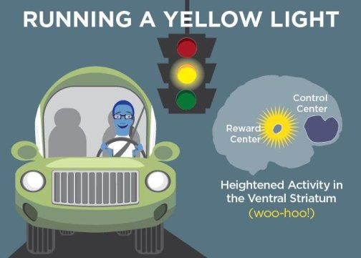
fMRI Results
Notes:
lateral prefrontal cortex activation in older group > strategic decision making
ventral striatum, orbitofrontal cortex, activation

Slide 73
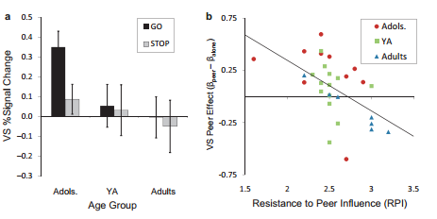
Self-reported resistance to peer influence correlated with neural peer effect
Notes:
Sensation seeking and impulsivity not predicted by fMRI data; but self-reported resistance to peer influence correlated with individual variation in the neural peer effect (Peer vs. Alone) (bigger difference between conditions associated with less resistance)
What if RPI was replaced with LPFC activity?
we treated the obtained
LPFC, VS, and OFC clusters as regions-of-interest
(ROI) and compared activity in these regions during GO
versus STOP trials (collapsing across social context).
Among adolescent subjects, greater activity in both the
VS (Figure 4a) and OFC was associated with risky
decision-making, as indicated by significantly increased
activity in these regions for GO relative to STOP trials.
No decision-dependent differences were found in these
regions for older age groups, and activity in the LPFC
was statistically equivalent for GO and STOP trials
regardless of age (additional detailing of activation in the
VS, OFC, and LPFC clusters is provided with the online
Supporting Information).

Slide 74
Discussion
Adolescents, but not adults, took more risks when being observed by peers
Can’t be explained by overt peer encouragement aka “peer pressure”
Adolescents, but not adults, had greater VS and OFC (reward system) activation in the peer condition vs. alone
Adults showed no differences in the activation of these brain regions as function of social context
Adults don’t perceive task as rewarding?
Adults don’t perceive presence of peers as rewarding?
Better able to recruit the LPFC to suppress reward system outputs
^ LPFC=greater reliance on deliberative strategies with decision making
Adults, but not adolescents, engaged multiple LPFC sites more robustly than adolescents
Not dependent on social context (i.e., presence of peers)
Notes:
“adolescents’ heightened susceptibility to peer influence is due more to the impact of peers on incentive processing than on cognitive control. Evidence that VS and OFC activation tracked with the
riskiness of subsequent decision-making (GO vs. STOP) in the driving task further suggests that the reward sensitization effect of peer presence translates into an observable increase in risky behavior.”

Slide 75
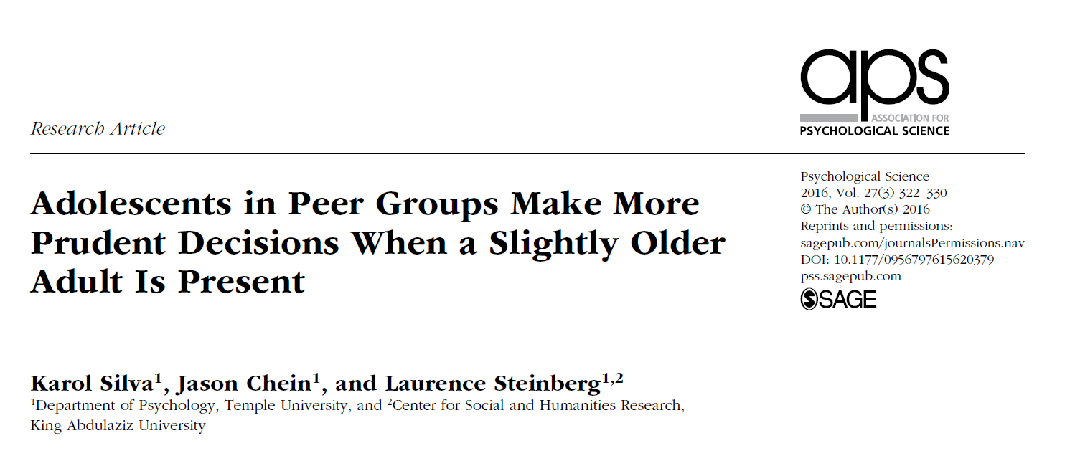
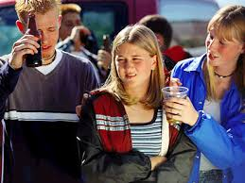
Borenstein

Slide 76
Background
Presence of peers increases risk tasking among youth
Real or illusory
Effects not observed in adults
Prior research focused on link between parental monitoring and teen misbehavior
Do non-familial adults affect risky decision making within groups?
Borenstein

Slide 77
Background
Impact of peers on adolescents’ risk taking is often unconscious
Peers heighten adolescents’ sensitivity to potential rewards
Especially true for immediately available rewards
Temporal discounting of rewards steeper when observed by peers
Could these mechanisms account for the moderating effect of adult’s presence on risky decision making?
Borenstein

Slide 78
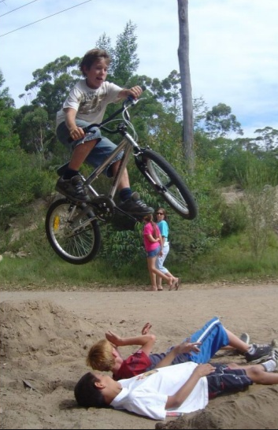
Hypotheses
The presence of a somewhat older adult mitigates the peer effect on adolescents’ risk taking
This mitigation is explained by attenuation of the impact of peers on adolescents’ preference for immediate rewards
Borenstein

Slide 79
Methods
Funded by the U.S. Army
How best to group soldiers in combat teams
Males in late adolescence recruited from colleges in Philadelphia, PA
Other subjects recruited via Temple University’s intro psychology classes
18-22 years of age
3 social-context situations
Solo- tested alone
Peer-group- observed by 3 same-age peers
Adult-present- 2 same-age peers and 25-30 year old confederate
Borenstein

Slide 80
Methods (Cont.)
Peer and adult present conditions constructed to resemble fire teams employed by the military
Testing completed in 2 phases
Recruitment and testing of solo and peer group conditions
Recruitment and testing of adult-present condition
Recruitment stopped when N=100 per condition
Effect sizes of d=.47 and d=.4 found in similar prior studies
10 subjects excluded from final analysis due to incomplete data
Borenstein

Slide 81
Procedure
Encouraged participants to recommend friends to act as peers
Phase 1: Group of 5 - four subjects randomly assigned to peer group and one to alone condition
One member from peer group randomly assigned as subject and performed test while others observed
Left in room for 10 minutes to interact naturally
Phase 2: three instead of four subjects (adult-present condition)
12 confederates took turns acting as the fourth subject
Left in room for 10 minutes to interact naturally AND share their names/year in school (confederate introduced as grad student)
56-59% of group conditions included friends
Borenstein

Slide 82
Measures
Risk Taking – Stop light computerized driving task
Goal to reach end of track as quickly as possible
32 intersections with yellow lights
Decide whether to stop vehicle via spacebar and lose time, or go through the intersection with possibility of crash
Proportion of intersections crossed w/out stopping=risk
Subjects and observers told about $15 bonus for performance
Preference for Immediate Rewards – Delay discounting task
Small immediate reward vs. large delayed reward
Delayed reward constant at $1,000
Delay interval (1wk, 1mo, 6mo, 1yr, 5yrs, 15yrs) (randomized)
Immediate reward=$200, $500, or $800 (randomized)
Nine choices presented in succession – previously chosen rewards cut in half for next choice (e.g., delayed choice= $1,000 -> next delayed option=$500)
Ending value reflects discounted value of the delayed reward (average indifference point)
Borenstein

Slide 83
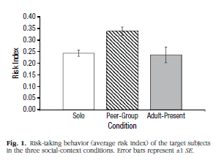
The presence of an adult mitigates risk-taking
Peer group subjects took significantly more risks in the game, when compared to solo (p<.001) and adult present conditions (p<.002)
Subjects in the adult present condition did not differ from the solo condition (p=.83)
Borenstein

Slide 84
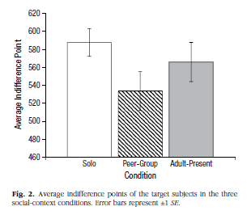
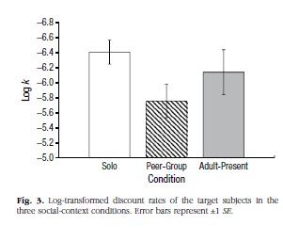
Adult presence reduces peer influence on immediate reward preference
Peer group -- lower indifference point
Significantly different than solo
Not (i.e. marginally) different than adult-present
Discount rates paralleled indifference points
Higher discount rate= greater orientation towards an immediate reward
Peer group exhibited significantly greater discount rate, compared to solo and adult-present
No differences between solo and adult-present groups for indifference points and discount rates
Borenstein

Slide 85
Discussion
Male adolescents took more risks and expressed stronger preferences for immediate rewards with same age/sex peers
Adding a male mid-late 20’s can mitigate these effects
Adults influence the effect of peers on adolescent risk taking, through dampening increased activities in the brain’s reward centers
Risky choice to express bravado among peers
Safe choice to appear more prudent in presence of adult
Under conditions of emotional arousal, late adolescents may share certain characteristics with their younger counterparts
A slightly older adult may help compensate for adolescents’ neurobiological immaturity
Borenstein

