Slide 1
Temperament
Daniel Messinger
https://www.youtube.com/watch?v=fAmyt5gRd3k

Slide 2
Emotion and Social Development
Temperament
  Definition
  Models
  Mechanisms
Emotional Capacities
  Expression
  Understanding
  Awareness
Self-Awareness
  Components and developmental change

Slide 3
Overview
Definitions and background
Reactivity and self-regulation
  Approach/withdrawal
Goodness of fit
        Differential sensitivity
Stability of temperament
  2→20 years, Schwartz et al., 2003
  4—48 months, Fox et al., 2001
  Exuberance→5 years, Degnan et al.
  Delay of gratification over 40 years, Casey et al., 2011
Associations with wealth and political ideology

Slide 4
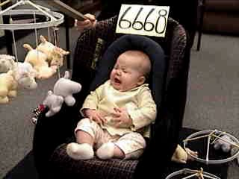
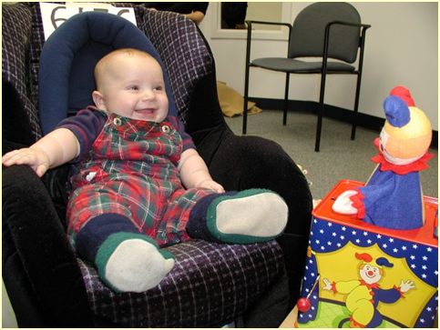
Temperament
  Biologically based individual differences in behavior tendencies that are present early in life and are relatively stable across various situations and over the course of time (Goldsmith et al., 1987; Rothbart & Bates, 2006; Wachs & Kohnstamm, 2001)
  personality in formation

Slide 5
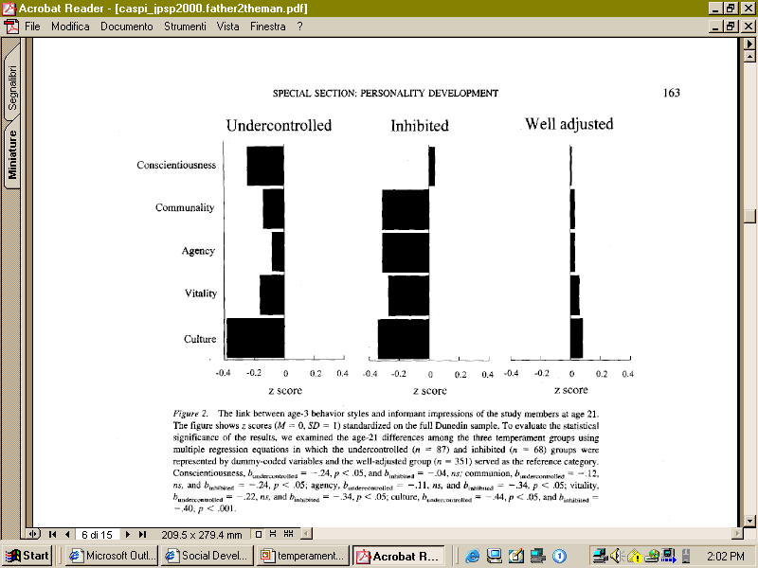
Age-3 behavior styles and informant impressions at age 21
Caspi

Slide 6
But…
Calling something temperament does not make it more ‘biological,’ inherited, or stable than any other construct
Temperament is a measured construct with particular characteristics
  Stable/Unstable
  More heritable/Less heritable

Slide 7
Evolution in our Conceptualization of the Neural Basis of Temperament
Hippocrates-Galen
  Personality types = balance of bodily humors
Pavlov & Students
  Relation of CNS to individual differences
  Interplay between cortex and subcortex
  Influence of contextual factors
Notes:
AFTER CURRENT 12

Slide 8
The Child Is Father of the Man?
My heart leaps up when I behold
A rainbow in the sky:
So was it when my life began;
So is it now I am a man:
So be it when I shall grow old,
Or let me die!
The Child is father of the Man;
And I could wish my days to be
Bound each to each by natural piety.
      William Wordsworth, "My Heart Leaps Up When I Behold"

Slide 9
Models of Temperament:
Thomas & Chess
  Parents’ descriptions of 141 infants and children based on structured interviews
  Derive 9 dimensions of responding
    Activity Level, Rhythmicity, Distractibility, Approach/Withdrawal, Adaptability, Attention Span/Persistence, Intensity of Reaction, Threshold of Responsiveness, Quality of Mood
  Dimensions cluster to describe 3 basic types
    Easy Child (40%)
    Difficult Child (10%)
    Slow-to-Warm Up (15%)
Which one are you?

Slide 10
Rothbart Temperament Model:
Reactivity & self-regulation
Reactivity = excitability or arousability of behavioral, endocrine, autonomic, & CNS responses
      speed, strength & valence of response to stimulation
        Surgency & negative affectivity
Self-Regulation = processes that modulate reactivity including attention and inhibition
  behaviors that control +/- behavioral and emotional reactions
    develops: reactive control, then active self regulation at end of 2nd year
    maps to development of brain areas involved in executive attention control
Corresponds to current brain-behavior models:
  approach/activation system and behavioral inhibition/anxiety system
  Henderson, H. A., & Wachs, T. D. (2007). Temperament theory and the study of cognition-emotion interactions across development. Developmental Review, 27(3), 396-427. doi: 10.1016/j.dr.2007.06.004
What does this sound like?
Notes:
The ego must control the id, like the rider, but at times, the rider is obliged to guide the horse where it wants to go. Likewise, the ego must, at times, conform to the desires of the id.

Slide 11
Models of Temperament:
Goldsmith & Campos
    Individual differences in the expression of primary emotions (anger, fear, joy, interest)

Slide 12
Neural bases of development of individual differences in temperament
Reactivity–
  speed, strength & valence of response to stimulation
Self Regulation –
  behaviors that control behavioral and emotional reactions to stimulation ( + or -)
    develops: reactive control, then active self regulation at end of 2nd year
    maps to development of brain areas involved in executive attention control
Corresponds to current brain-behavior models:
  behavioral approach/activation system and behavioral inhibition/anxiety system
  Henderson, H. A., & Wachs, T. D. (2007). Temperament theory and the study of cognition-emotion interactions across development. Developmental Review, 27(3), 396-427. doi: 10.1016/j.dr.2007.06.004

Slide 13
Reactivity—
BAS & BIS: motivational tendencies
Behavior Approach System (BAS)
  governs approach/appetitive motivations
  - responds to signals of reward/end of punishment
  - behavior towards goals, positive feelings
  surgency
Behavior Inhibition System (BIS)
  - inhibition, interruption of behavior , increase in arousal/vigilance
  - responds to signals of punishment, nonreward, novelty
  - underlies states of fear and anxiety
  irritability
Temperament differences: relative balance of positive affect/approach versus negative affect/inhibition behaviors

Slide 14
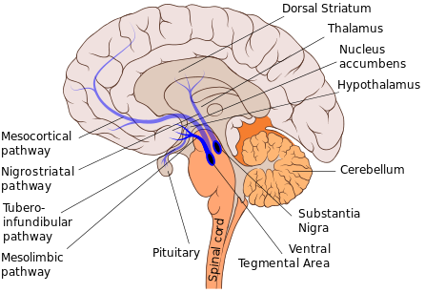
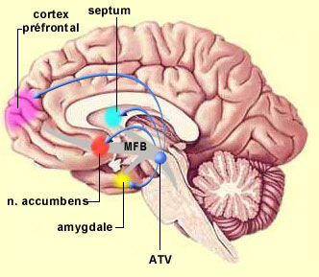
Neurophysiology of approach/withdrawal
Amygdala
- connections with brainstem nuclei—universal fear reactions
- sensitive to ambiguity and uncertainty
-
Nucleus accumbens
- anticipatory reward-related responding
- activity related to size of anticipated reward
EEG asymmetry
- resting EEG asymmetry during stressful task related to differences in dealing with novel/stressful events
right frontal EEG asymmetry discriminated among preschoolers’ levels of social play
medial forebrain bundle (MFB)
Vta—ventral tegmengtal area

Slide 15
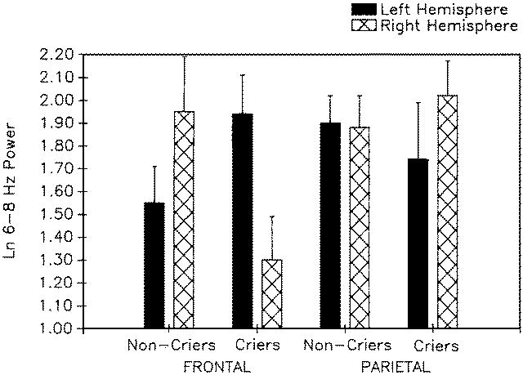
Greater right frontal power among 10-month-olds who cried in response to maternal separation

Slide 16
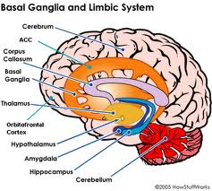
Self-regulation
Attentional and effortful processes modulating behaviors and emotions
  through voluntary inhibition, response modulation, and self-monitoring (Ahadi et al, 1993)
  form basis for well-regulated behavior and emotion
  executive system monitors and regulates reactivity
Anterior cingulate cortex (ACC) and Effortful control
  ACC facilitates voluntary control of thoughts and emotions
  ACC as neural alarm

Slide 17
Inhibited and Uninhibited Infants
“Grown Up”
“[A]dults who had been categorized in the second year of life as inhibited, compared with those previously categorized as uninhibited, showed greater functional MRI signal response within the amygdala to novel versus familiar faces.”
  N=22, M=21.8 yrs
  at two years were inhibited (n=13) or uninhibited (n = 9)
  20 JUNE 2003 VOL 300 SCIENCE Carl E. Schwartz,1,2,3* Christopher I. Wright,2,3,4 Lisa M. Shin,2,5 Jerome Kagan,6 Scott L. Rauch

Slide 19
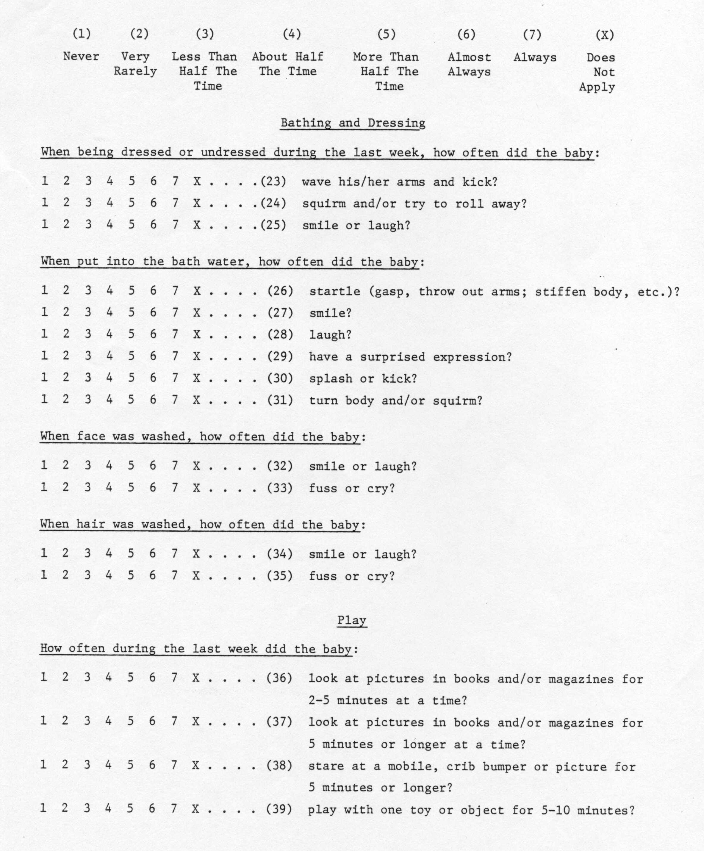
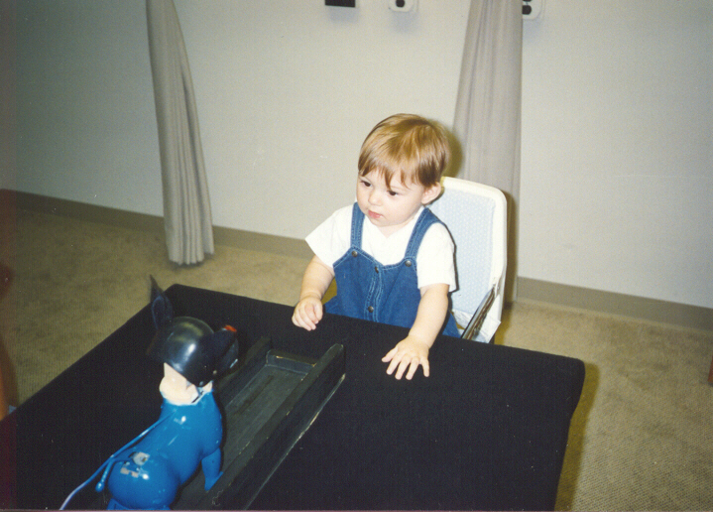
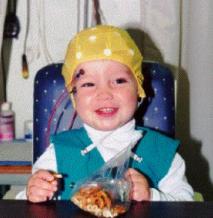
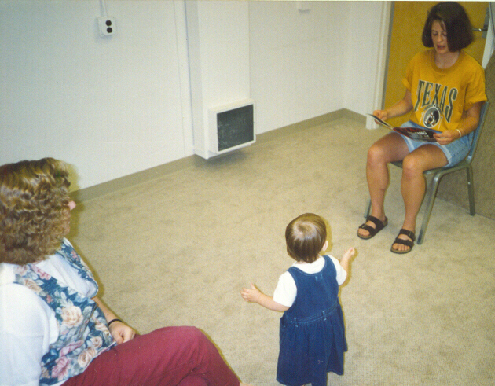
Assessment of Temperament
Parental Report
Laboratory Observations
Physiological Assessment

Slide 20
When do parents and raters agree?
When there’s non-optimal behavior
  “maternal and observer ratings of infant negativity converged when infants manifested high degrees of negative affect during routine home-based activities.
  …ratings of infant positivity converged when infants experienced low mutually positive affect during play….
      Hane et al., 2006

Slide 21
Temperament (cont)
Mechanisms through which temperament affects later development
  Direct effects
  Indirect effects
  Evocative effects (on social relationships; on perceptions of others)
  Niche picking
  Goodness-of-fit

Slide 22
Temperament mechanisms
Mechanisms through which temperament affects later development
  Direct effects
  Indirect effects
Temperament
Adjustment
Temperament
Environment
Adjustment

Slide 23
Example – Indirect effect of shyness on academic skills
Shy (M)
1.00
Shyness
Lang (K)
-.11 (.06)
1.00 (1.20)
Shy (CG)
1.50
Math (K)
Academic Skills
.94
-.82 (.20)
.04 (.01)
SPS Competence
.96
Lang (G1)
IC (M)
1.08 (.26)
.85
1.00
Inhibitory Control
.76 (.12)
Math (G1)
IC (CG)
1.47
SPS = social problem solving skills
Walker & Henderson, 2012

Slide 24
Temperament (cont)
  Evocative Effects
Actor Partner Interdependence Model

Slide 25
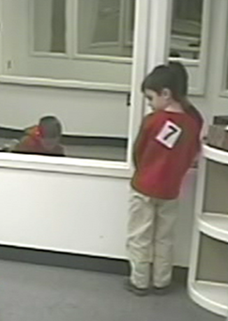

Temperament (cont)
  Niche Picking

Slide 26
Temperament (cont)
  Temperament x Environment Interactions (Goodness-of-fit)
Environment
#1
Outcome a
Temperament
Environment
#2
Outcome b

Slide 27
Goodness-of-Fit Model
The “meshing” of temperament with environmental properties, expectations, and demands
  Implications for parents and educators for creating environments that recognize each child’s temperament while encouraging adaptive functioning

Slide 28
Applications of Goodness-of-Fit
A “difficult” temperament promotes survival during famine conditions in Africa (De Vries, 1984)
    Why?
Low activity level is a risk for mental retardation among children raised in a poor institution (Schaffer, 1966)
    Why?

Slide 29
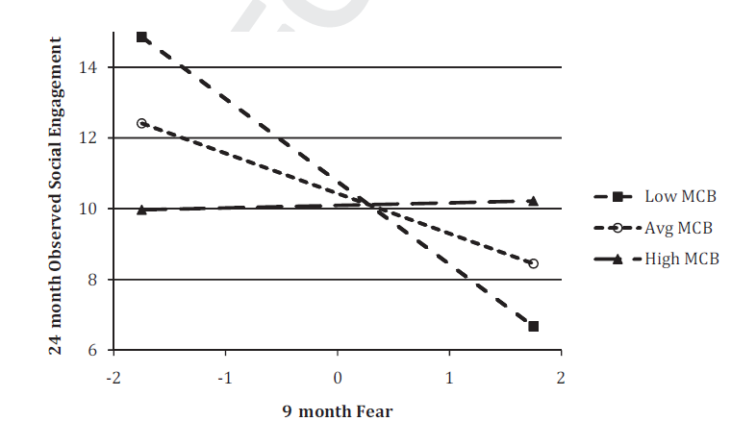
Applications of Goodness-of-fit
(or differential sensitivity…)
MCB – Maternal
Caregiving Behavior
(Quality)
Penela et al., 2012

Slide 30
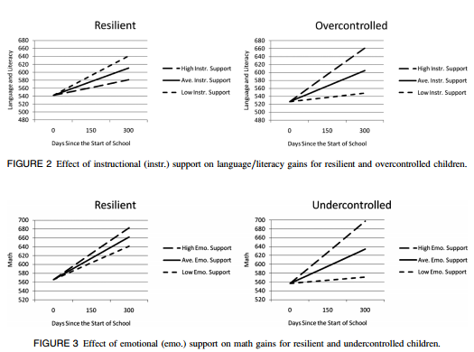
Goodness-of-fit applications:
Differential Sensitivity Model
Vitiello et al., 2012

Slide 31
Differential sensitivity/ susceptibility
Belsky & Pluess (2009)
Different from standard diathesis-stress model?
How do study designs differ based on these models?
  Range of environments?
  Range of psychological and behavioral outcomes?
Notes:
Individual differences characteristics make individual more sensitive to BOTH negative and positive aspects of environment; more plastic
Model is that person characteristics moderate the effects of environmental effects

Slide 32
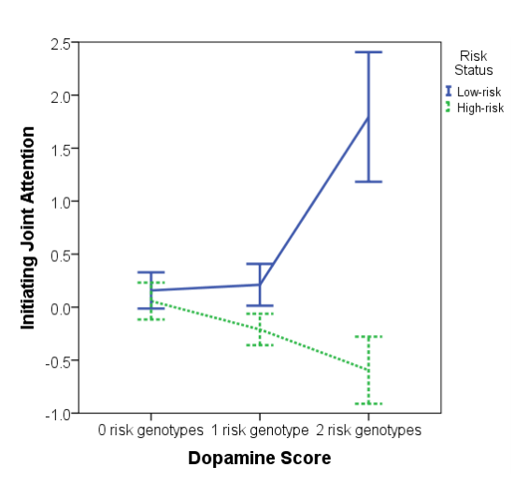
Dopamine and autism risk
Gangi et al., 2016

Slide 33
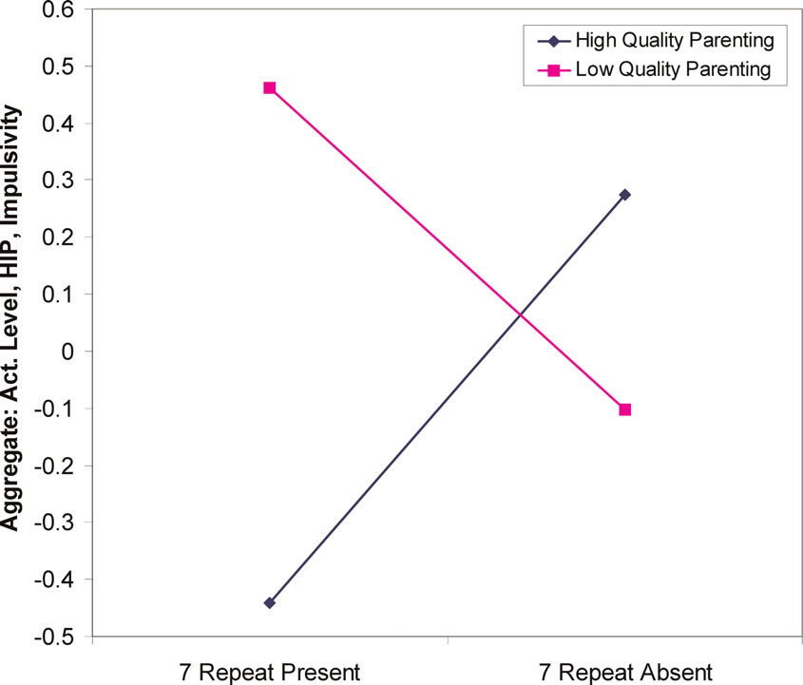
Genes influence relation between parenting and temperament
18-21 month olds
DRD4 48 (7-repeat allele) “long”
allele increased sensitivity to environmental factors such as parenting.
  Lower quality parenting→ higher sensation seeking.
  Higher quality parenting→ lower sensation seeking
  Parenting quality interacts with genetic variation in dopamine receptor D4 to influence temperament in early childhood Sheese BE, et al. Dev Psychopathol 2007 19(4):1039-46

Slide 34
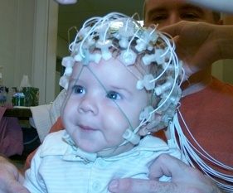
Gene-Endoenvironment Interaction
DRD4 - Long Allele
  Novelty/Sensation Seeking
  Attention Problems/Aggression
  Susceptibility to Parenting
EEG Asymmetry
  Left Frontal – “Easy” Temperament
  Right Frontal – “Negative Reactive” Temperament
  Schmidt, Fox, Perez-Edgar & Hamer (2009)
"Long" versions of polymorphisms are the alleles with 6 to 10 repeats. 7R appears to react less strongly to dopamine molecules.[8]
http://en.wikipedia.org/wiki/Dopamine_receptor_D4

Slide 35
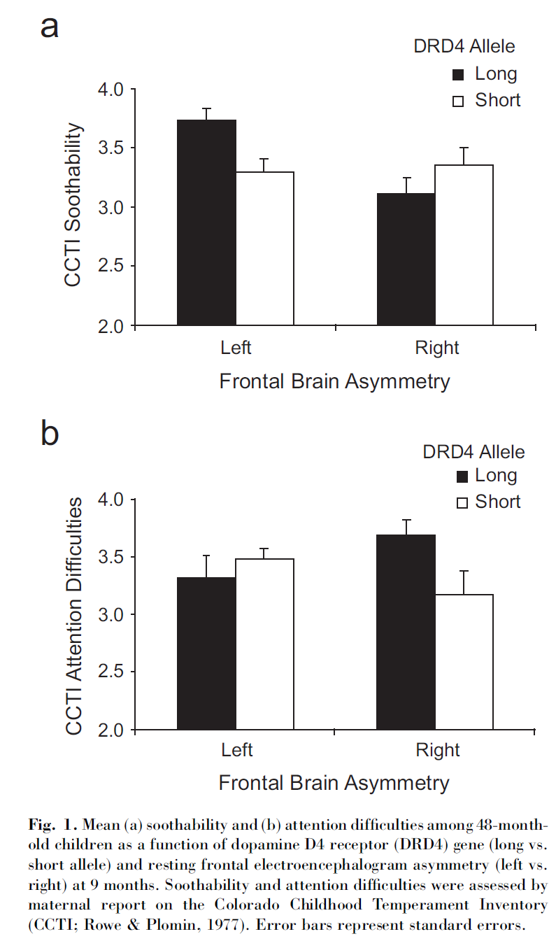
DRD4 by Asymmetry
  Susceptibility to Asymmetry
    Soothability
    Attention Difficulties
      Asymmetry unrelated to DRD4
      Complex Gene-Gene Interaction?
  Schmidt, Fox, Perez-Edgar & Hamer (2009)
Group Differences

Slide 36
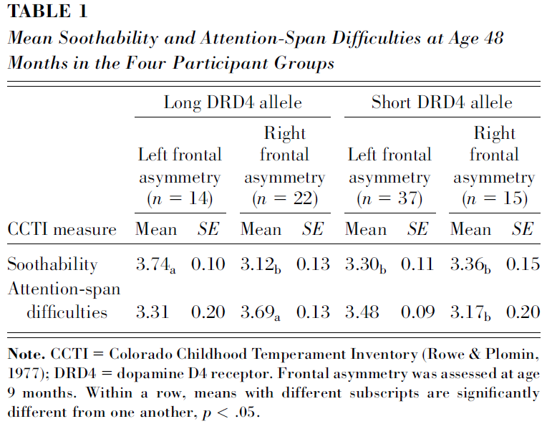
Frontal Asymmetry, DRD4, Temperament
Differential susceptibility
9 mo
  EEG, Genes
48 mo
  Temperament
CCTI – Maternal Report
  Soothability
  Attention Difficulties

Slide 37
Stability of Temperament
Is a child’s temperament immutable?
    4-month-old infants selected based on reactions to unfamiliar sensory stimuli
    3 groups of infants
      High Negative
      High Positive
      Low Reactive

Slide 38
Stability: Shyness/Inhibition by
4-month temperament group based on reactions to unfamiliar sensory stimuli
.
8
.6
.4
.
2
Standardized measure of inhibition (+/- 1 SE)
Low Reactive
0.0
High Negative
High Positive
-.2
-.4
-.6
-.8
14
24
48
Age (months)
Fox, Henderson, et al. (2001)
https://www.youtube.com/watch?v=fAmyt5gRd3k
      Kagan classic: removed
      http://www.youtube.com/watch?v=CGjO1KwltOw

Slide 39
Possible Influences on Stability?
Experience in out-of-home care

Slide 40
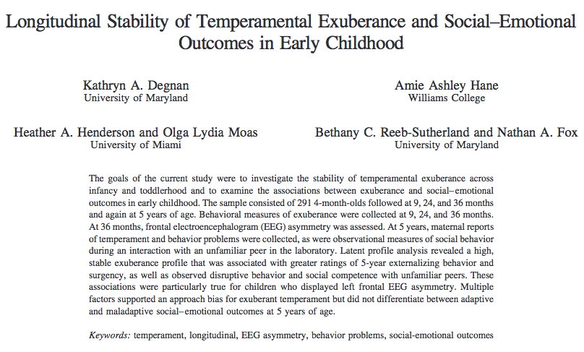

Slide 41
Background cont.
Temperamental Exuberance may interact with frontal EEG symmetry to produce outcomes
    Withdrawal motivation associated with right frontal EEG symmetry, while approach motivation associated with left frontal EEG asymmetry
    Children who show coherence between EEG left frontal asymmetry and behavioral approach may display consistent, stable exuberance across development

Slide 42
Method
291 infants selected from larger pool on basis of their classification as high negative/high motor reactive, high positive/high motor reactive, or control
Assessed at the following time points:
  4 months (initial temperament screening)
  9 months (behavioral and affective reacitvity)
  24 months (behavior & affect during BI tasks)
  36 months (behavior, affect, & EEG)
  5 years (peer dyad assessment, parent ?s)

Slide 43
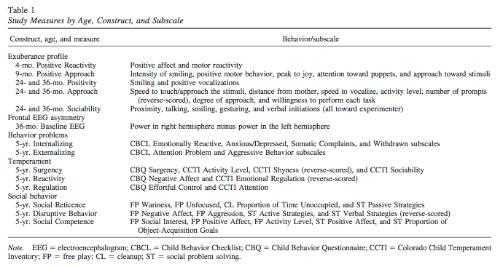
Measures

Slide 44
Results: Stability of Exuberance
ANOVAS
  Temperament group at 4 months related to 9-month Positive Approach (differences between + and – reactivity; control and – reactivity)
  Temperament group not significantly associated with any of 24-mo, 36-mo, or 5-year outcomes
Correlations
  9-mo + approach & 24-mo Exuberance (.22)
  24-mo Exuberance & 36-mo Exuberance (.31)
  36-mo Exuberance & 5-year Surgency (.29)
  36-mo Exuberance & 5-year social reticence (-.16)

Slide 45
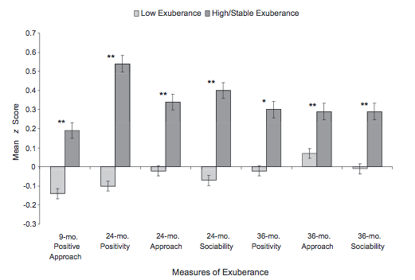
Stability of Exuberance
Longitudinal Latent Class Analysis (LCA) using all time points
→2 classes: Low Exuberance, High/Stable Exuberance

Slide 46
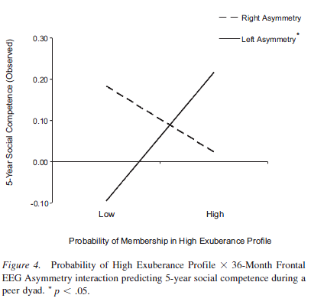
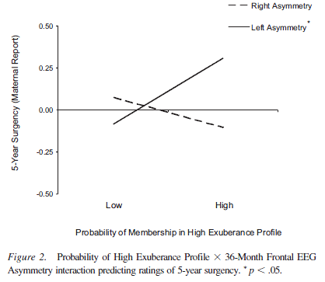
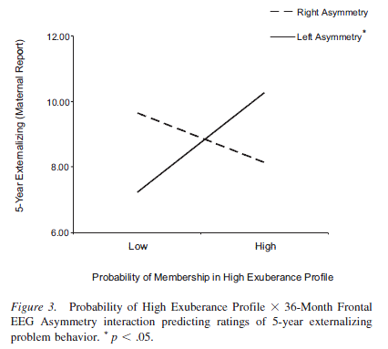
Exuberance*Asymmetry→ parent reported surgency, competence, & externalizing

Slide 47
Results: Relationship of Exuberance to 5-year Outcomes
Maternal Report
Exuberance x Assymetry→Surgency (+) | Exuberance→ Social Reticence (-)
Exuberance x Asymmetry→Externalizing (+) | Left frontal Asymmetry→Disruptive Behavior (+)
---relationship was significant only for left frontal asymmetry profile | Exuberance x Asymmetry→ Social Competence (+)
 | ---relationship was significant only for left frontal asymmetry profile

Slide 48
Infant Temperament * Mom Negativity → 7-year Social Wariness

Slide 49
Preschool Social Reticence * Mom Solicitousness →7-year Social Wariness

Slide 50
Infancy→Adulthood
At 14–17 years, more high than low reactives
  subdued in unfamiliar situations
  dour mood & anxiety over the future,
  more religious,
  sympathetic tone in the cardiovascular system,
  fast latency and large magnitude evoked potential from inferior colliculus,
  shallower habituation of ERP to discrepant visual events.
Low correlations among bio measures.
  Less association of behavior & biology at 15 than earlier
The preservation of two infant temperaments into adolescence.
By Kagan, Jerome; Snidman, Nancy; Kahn, Vali; Towsley, Sara
Monographs of the Society for Research in Child Development. Vol 72(2), Jul 2007, 1-75.

Slide 51
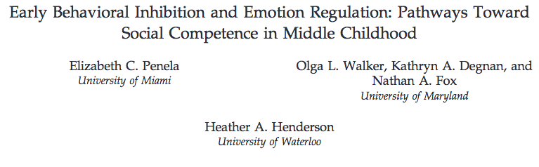
Early BI and ER: Pathways to SC
Hypothesis
Engaged ER strategies will mediate the association between early BI and future social competence
  BI and ER are independently and directly associated with SC
  Children with a history of high BI would display less SC with an unfamiliar peer (at age 7)
(Penela et al., 2015)
C.Morris, 2016

Slide 52
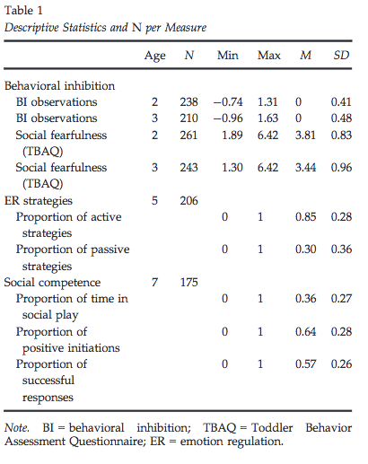
Early BI and ER: Pathways to SC
Moderated mediation model
257 children (mostly Caucasian with highly educated mothers)
Measures at
2 & 3 years (maternal questionnaires and lab presentation of stimuli)
5 years (disappointment task)
And 7 years (unfamiliar & ambiguous unstructured free play)
(Penela et al., 2015)
C.Morris, 2016

Slide 53
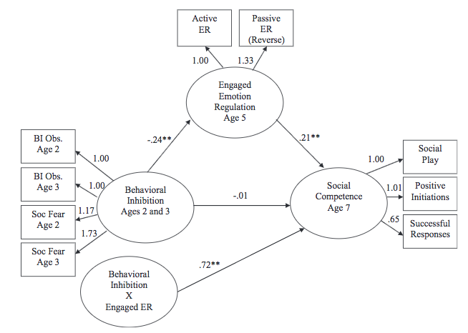
(Penela et al., 2015)
C.Morris, 2016

Slide 54
Early BI and ER: Pathways to SC
Direct relation of BI to SC was not supported
ER mediates the association between BI and future SC
Strength of ER mediation varies depending on child’s level of early BI
(Penela et al., 2015)
C.Morris, 2016

Slide 55
Revisiting the Marshmallow Test: A Conceptual Replication Investigating Links Between Early Delay of Gratification and Later Outcomes
Tyler W. Watts, Greg J. Duncan, Haonan Quan
PSY 624: Arushi Malik

Slide 56
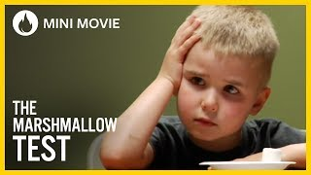
The Marshmallow Test
Notes:
https://www.youtube.com/watch?v=QX_oy9614HQ

Slide 57
Introduction
Famous study by Shoda and colleagues. Under certain conditions delaying gratification is related to better social development, health and brain structure.
Gratification delay viewed as a fundamental non-cognitive skill, which can have life long benefits.
Many studies have looked at other factors mediating this effect.
Notes:
Only small focused on How it’s developed. Became iconic study of development.
A lot of work has been done since then- how to delay, what other correlates are there

Slide 58
Methodology & Data
Explored associations between preschoolers’ ability to delay gratification and academic and behavioral outcomes at age 15.
  Focus upon non degree mothers
  Adding confounds
  Diverse sample
Participants: Recruited at birth from 10 US cities
Analysis done for children who had all data i.e. delayed gratification task at 54 months and achievement and behavioural data at age 15
  For non degreed mothers (n= 552)
Notes:
Impact for generalization and policy makers

Slide 59
Measures
Delayed gratification aka marshmallow test
Academic achievement: Woodcock-Johnson Psycho-Educational Battery Revised (WJ-R) test
Behavioural Problems: CBCL
Covariates
  Child background and home environment
  Cognitive functioning
  Temperament
  Mother’s intelligence
  Concurrent 54 month control
Notes:
Shorter cap i.e. 7 mins vs 20 mins

Slide 60
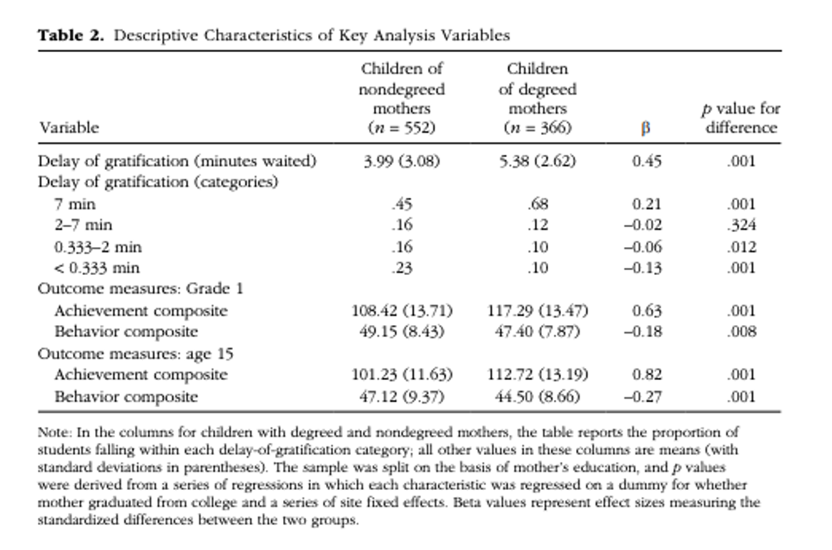
Descriptive Characteristics of Children (Non degreed vs. Degreed Mothers)
Notes:
In the lower-SES sample, 45% of children waited the maximum of 7 min, and 23% waited less than 20 s (i.e., 0.33 min). In the higher-SES sample, only 10% of children waited less than 20 s, and the average time waited was 5.38 min (statistically significantly longer than the lower-SES group, p < .001).
In both the higher- and lower-SES samples, performance on the delay-of-gratification task was highly correlated with differences on most observable characteristics considered

Slide 61
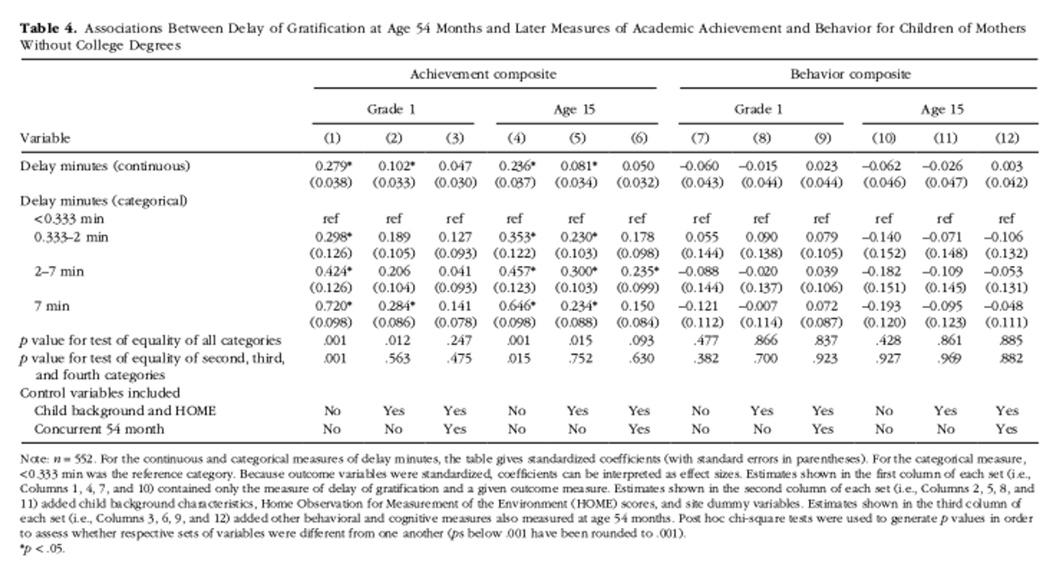
Achievement of Children of Non Degreed Mothers
Notes:
Significance much lower than original work. Children’s Grade 1 achievement would improve by approximately one tenth of a standard deviation for every additional minute waited at age 4.
Covariate prior to 54 months added it fell to .10
Concurrent added it became non significant
Similar patterns at age 15
Small significance at beh composite, contrary to original study
Gradient pattern of score which went away when added covariates: When concurrent 54-months controls were added, coefficients fell even further. At age 15, only the coefficient produced by the group describing children who waited 2 to 7 min retained statistical significance (

Slide 62
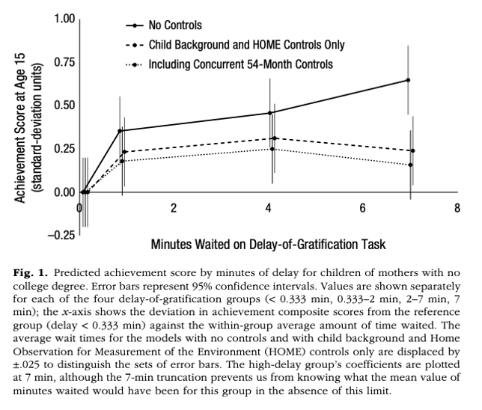
Slopes with Controls (for Children of Non degreed Mothers)
Notes:
The solid line shows coefficients drawn from the no-control model (i.e., Column 4 of Table 4), the dashed line shows coefficients from the model with early controls (i.e., Column 5 of Table 4), and the dotted line shows coefficients produced by models with the 54-months controls (i.e., Column 6 of Table 4).

Slide 63
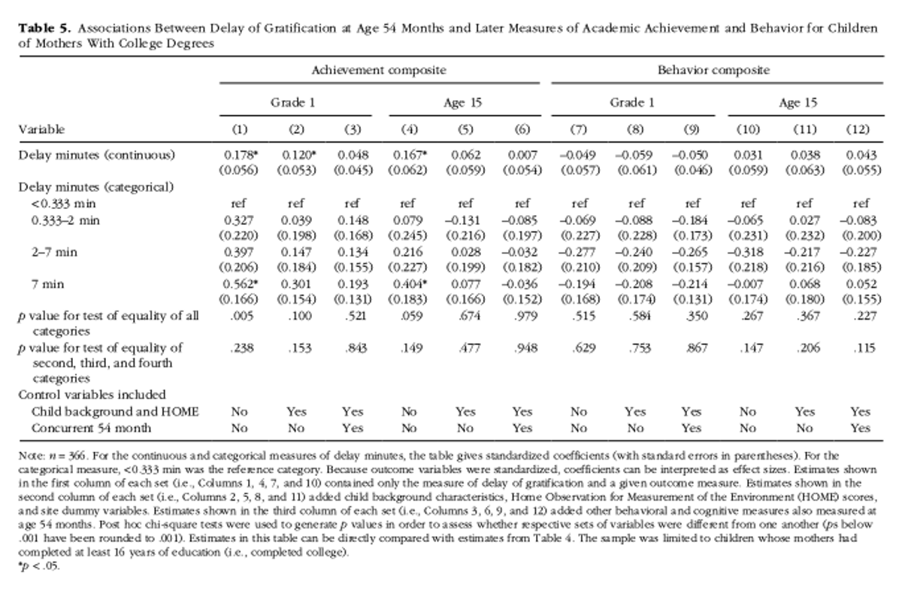
Achievement of Children of Degreed Mothers

Slide 64
Discussion
Found statistically significant, although smaller, bivariate associations between early delay ability and later achievement.
  Sensitive to control
  Lack of significance in behavioural outcomes: Although a very stable measure
Children of non degreed mothers, most of the achievement boost for early delay ability was gained by waiting a mere 20 s.
What does marshmallow test measure?
  Simply viewing delay of gratification as a component of self control may oversimplify how it operates in young children.
Thinking about intervention
  Cognitive and behavioural skills

Slide 65
Questions
Are there cultural differences in the perception and practice of delayed gratification?
How would you change/ add measures to study this association? Any covariates, other tools etc?
What are some potential limitations of this replication study?
What additional research questions or experiments could arise from the findings of this study?

Slide 66
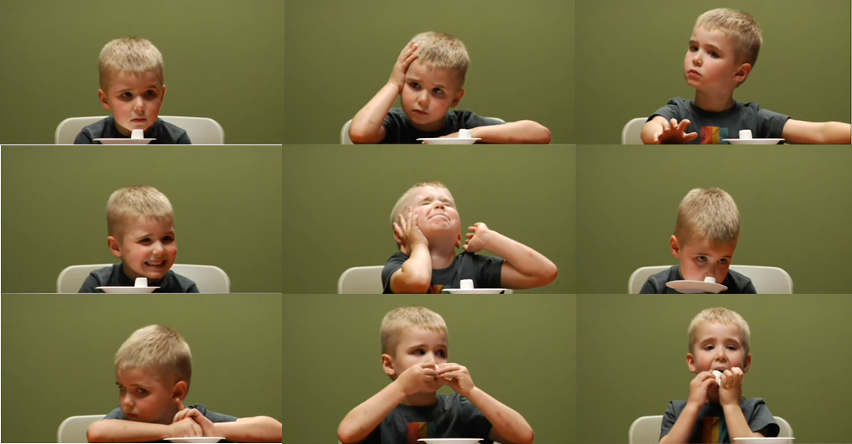

Slide 67
Revisiting the Marshmallow Test: A Conceptual Replication Investigating Links Between Early Delay of Gratification and Later Outcomes
Watts, Duncan, & Quan (2018)
Leung

Slide 68
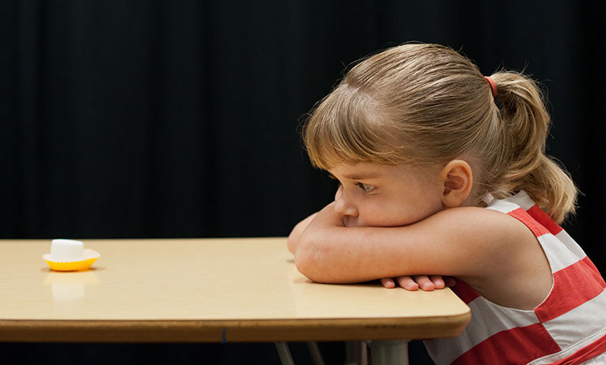
Original Study vs. Current Study
  Delayed gratification is related to later
  cognitive and social skills
  Shoda, Mischel, & Peake (1990)
  Application to children of nondegreed mothers
  Watts, Duncan, & Quan (2018)
Leung

Slide 69
Current Study
Delayed gratification task at 54 months
Outcome variables at Grade 1 and age 15
Sample split based on mother’s education
Leung

Slide 70
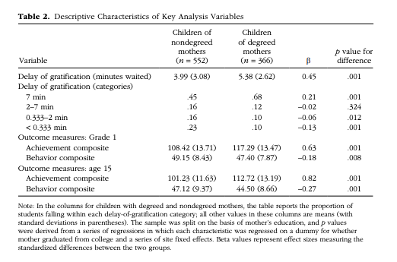
Children of Nondegreed vs. Degreed Mothers

Slide 71
Achievement of Children of Nondegreed Mothers

Slide 72
Inclusion of Controls (for Children of Nondegreed Mothers)

Slide 73
Achievement of Children of Degreed Mothers
`

Slide 74
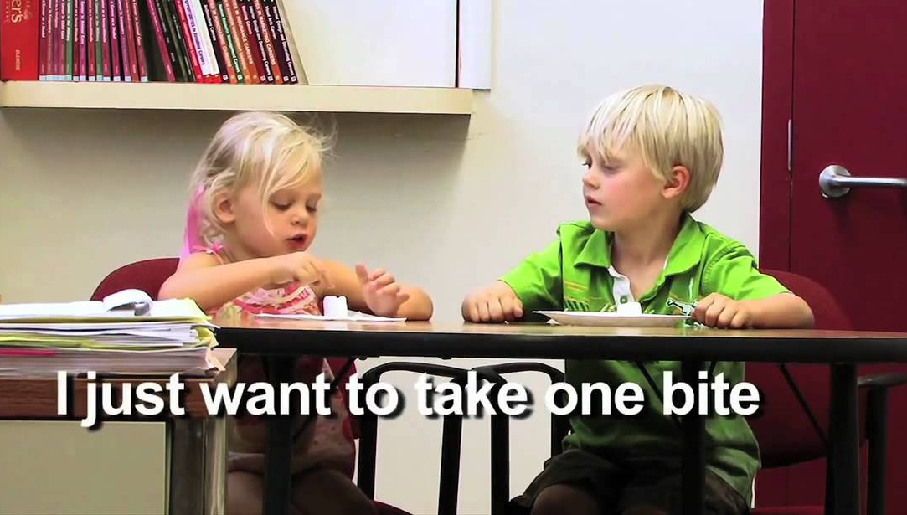
Discussion
The relationship between delay of gratification and later outcomes is complex.
Broader abilities related to delay of
gratification should be considered.
  Home environment may impact external
  factors that influence later outcomes.
  What other factors may play a role?
Leung

Slide 75
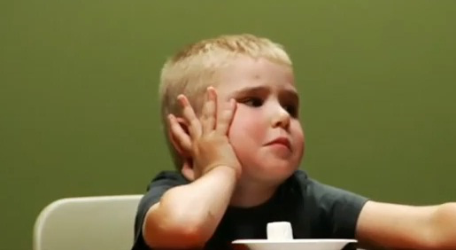
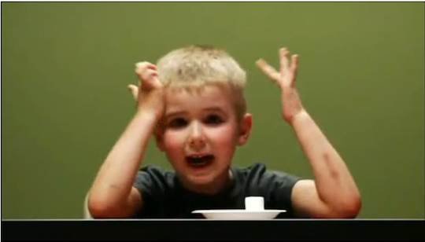
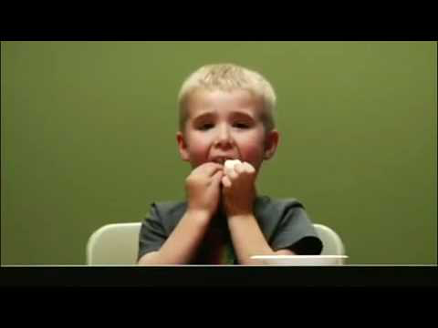
Behavioral and neural correlates of delay of gratification 40 years later
Casey, BJ, Somerville, LH, Gotlib, IH, et al. (2011)

Slide 76
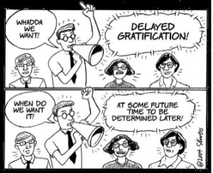
Background
Delay of gratification
  “The ability to resist immediate reward for a later, larger reward”
  e.g. Classic Marshmallow Test (video if we have time)
  Depends on cognitive control
  Tasks completed in childhood predicts performance on cognitive control tasks (go/nogo task)
Present Study
    Examine the behavioral & neural correlates of delay of gratification of individuals tested in preschool and whose self control abilities remained consisted throughout adulthood
Notes:
Examine whether differences in Delay of Gratification (measured in preschool) predict
Control of Impulses & Sensitivity to Social Cues
Behaviorally & Neurally
Delay of Gratification (DoG):
“The ability to resist immediate reward for a later, larger reward”
“Rewards” differ with age
Cognitive Control (CC):
“The ability to suppress competing inappropriate thoughts or actions for more appropriate ones”
Depends on cognitive control: ability to suppress inappropriate thoughts or actions in favor of appropriate ones
“Cool” – cognitive control-related neural circuitry
“Hot” – involving emotions that are under stimulus control and associated with emotional brain regions
to explain the dynamics of resisting temptation during the delay of gratification task with cool being invovling the cognitive control –related neural circuitry and the hot involving emotions that under stimilus control and associated with emotional brain regions.
Examine the extent to which invidivudal differences in delay of gratification in childhood and continued through adulthood predicts self-control to social cues at both a behavoiral and neural level when participants were in their 40s

Slide 77
Purpose of study
Examine whether differences in Delay of Gratification (measured in preschool) predict
    Control of Impulses & Sensitivity to Social Cues
    Behaviorally & Neurally
Delay of Gratification (DoG):
  “The ability to resist immediate reward for a later, larger reward”
    “Rewards” differ with age
Cognitive Control (CC):
  “The ability to suppress competing inappropriate thoughts or actions for more appropriate ones”
Notes:
Purpose of the study was to examine differences in people who were classified as high DoG’s versus Low DoGs in early childhood, and see if there were differences in the ability to control impulses and whether that varied based on social cues
Both behaviorally and neutrally looking at a go/nogo task
Important terms
DOG=marshmallow
Wont be as rewarding for 40 year olds
CC=inhibition of impulses

Slide 78
Background
Purpose of the study
  Examine behavioral and neural correlates of impulse control
    Do those who had difficulty delaying gratification during childhood show same pattern in their 40’s?
Previous research
  There seem to be individual differences in how much each person uses cognitive control strategies
  Inferior frontal gyrus (IFG) in prefrontal cortex highly involved in suppressing competing thoughts/action

Slide 79
Background

Slide 80
Background: Cool & Hot!
Cool
  Involves top-down control; prefrontal regions
  Inferior frontal gyrus
    Involved in resolving interference among competing actions
Hot
  Bottom-up control; limbic and emotional regions
    Emotions and desires under the control of the stimulus
In delay of gratification studies, using “Cooling” helps
Notes:
When looking at the cognitive and neurological processes involved, there's a cool versus hot dichotomy
The cool part is the ability to control or delay
The hot part is the impulse
In DOG studies, using cooling strategies like reappraisal and reframing help with the delay

Slide 81
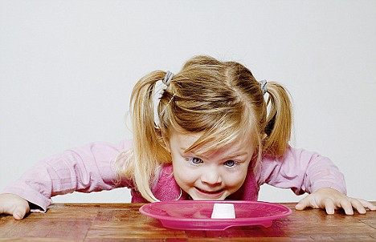
Hypotheses
Consistently low delayers would exhibit
  Lower right prefrontal cortex activation (response inhibition)
  Higher ventral striatum activity (processing positive/rewarding cues)
Notes:
The hot system would be stronger in this group
The cool system would be weaker in this group

Slide 82
Methods
Participants
  Contacted 117 individuals from 500 original participants who were above or below average on (a) delay of gratification task at age 4 and (b) self-report measures of self-control in their 20’s and 30’s
  59 agreed to participate in experiment 1 (behavioral task); 24 in experiment 2 (fMRI)
Measure of impulse control
  Comparison of (a) reaction time and (b) accuracy during “cool” and “hot” versions of go/nogo tasks
    Cool= males/females with neutral expressions
    Hot= happy and fearful/neutral faces (all go and nogo)
    For experiment 2, same impulse control task with differences in timing and # trials

Slide 83
Methods
Experiment 1:
59 participants
  Delay gratification tested at age 4
  Self control abilities remained consistent at age 20 and 30
  Classified as low or high delayers
Behavioral Task
  Go/Nogo task
    ”Cool” version – male & female stimuli with neutral expression
    “Hot” version – fearful & happy faces
Experiment 2:
26 participants
Conducted to examine what underlying brain regions are driving the difference found in experiment 1
Go/Nogo task in fMRI scanner
  “Hot” version
Notes:
Comparison of (a) reaction time and (b) accuracy during “cool” and “hot” versions of go/nogo tasks
Participants
Contacted 117 individuals from 500 original participants who were above or below average on (a) delay of gratification task at age 4 and (b) self-report measures of self-control in their 20’s and 30’s
59 agreed to participate in experiment 1 (behavioral task); 24 in experiment 2 (fMRI)
Measure of impulse control
Comparison of (a) reaction time and (b) accuracy during “cool” and “hot” versions of go/nogo tasks
Cool= males/females with neutral expressions
Hot= happy and fearful/neutral faces (all go and nogo)
For experiment 2, same impulse control task with differences in timing and # trials

Slide 84
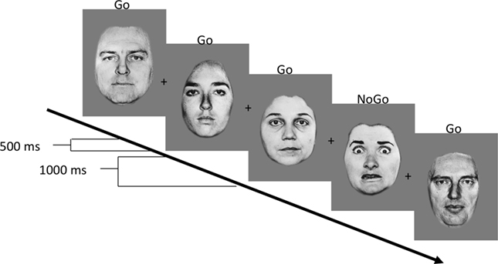

“Hot” Go/Nogo Task
NoGo

Slide 85
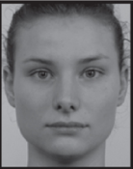
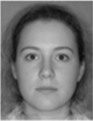
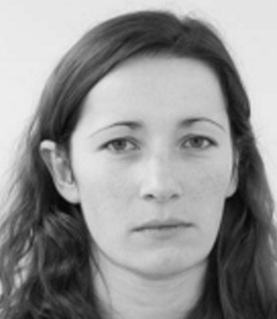
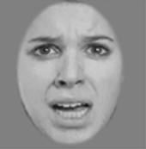
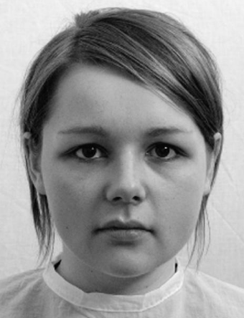

“Hot” Go/Nogo Task
Go
Go
Go
NoGo
Go
NoGo
Notes:
The “hot” version of the go/nogo task was identical to the “cool” version, except that for this task fearful and happy facial expressions served as stimuli. Both expressions were used as targets (go) and nontargets (nogo) in a 2 (trial type: go, nogo) × 2 (emotion: fear, happy) factorial design

Slide 86
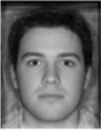
“Cool” Go/Nogo Task
Go
Go
Go
NoGo
Go
Notes:
. The “cool” version of the go/nogo task consisted of male and female stimuli with neutral expressions. Within a single run, both male and female stimuli were presented, one sex as a “go” (i.e., target) stimulus to which participants were instructed to press a button, and the other sex as a “nogo” (i.e., nontarget) stimulus to which participants were instructed to withhold a button press

Slide 87
Analyses
Experiment 1
  2 x 2 ANOVAS for reaction time and accuracy
    Type of task (hot vs cold) x Group (low vs high delayer)
    Reaction time (hot vs cold) x Group (low vs high delayers)
Experiment 2
  Same as experiment 1 plus FMRI analysis

Slide 88
Differences between groups when suppressing response to emotional or “hot” cues (happy faces)
On “go” tasks, no differences in response time or accuracy by group
    High accuracy on “go” trials for both “cool” and “hot” tasks
On “nogo” trials, there was more variability
  Only low delayers showed significant decrease in performance for “hot” relative to “cold” trials (hot=happy faces)

Slide 89
Experiment 1: Behavioral Results
2 (Group, High vs. Low Delayers) X 2 (Task, Hot vs. Cool) ANOVA
  Hot Task Emotion, Fear vs. Happy
No Go Accuracy (False Alarms)
 | Hot |  | Cool
High Delay | Fear | Happy |  | Hot = Cool
Low Delay | Fear | Happy |  | Hot < Cool
 | High > Low (trend) Fear: High=Low Happy: High> Low |  | High =Low
Notes:
On “go” tasks, no differences in response time or accuracy by group
Results in grey
In the high delay group, cool and hot didn’t really differ for NoGo Accuracy
In the low delay group, accuracy was worse in the hot trials
On Hot trials, high delayers had better accuracy than low delayers (at trend level)
Specifically, the high and low groups differed in their accuracy for happy faces, such that high was > low
Therefore, only found differences between groups ability to suppress/inhibit response to emotional or “hot” cues (happy faces)
Difficulty suppressing responses to happy faces in low delay adults
Resisting “temptation”

Slide 90
EXPERIMENT 1: RESULTS
Go Trials: no differences in response time or accuracy by group
    High accuracy on “go” trials for both “cool” and “hot” tasks
NoGo Trials (inhibition): more variability
  Differences between low/high delayers in response to emotional or “hot” cues (happy faces)
  Low delayers showed significant decrease in performance for “hot” relative to “cold” trials (hot=happy faces)

Slide 91
BEHAVIORAL RESULTS
On “hot” task, low delay group more likely to hit “go” for happy faces
NoGo

Slide 92
EXPERIMENT 2: Results
Behavioral results
  More false alarms for low delayers, but not significant
Imaging results
  High delayers: More polarization of activity in inferior frontal gyrus (IFG)
  Low delayers: More activity in ventral striatum when happy “nogo” cues

Slide 93
Experiment 2: Neural Results
  2 (delay group: high, low) × 2 (trial type: nogo, go) × 2 (emotion: happy, fear) ANOVA was conducted to identify brain regions differentially active by task conditions and delay group.
  Overall RT and Accuracy was similar to Experiment 1

Slide 94
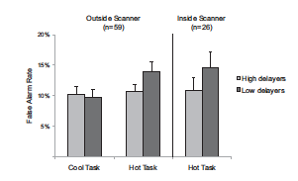
Behavioral Results
  There was a similar pattern within and outside of the scanner
Experiment 1
Experiment 2

Slide 95

Results – Experiment 1
Notes:
You don’t see a difference between cognitive control when doing the cool tasks. You do see a difference when the emotional faces are present
Greater cognitive control in high delayers
There was a similar pattern within and outside of the scanner
Behavioral results
More false alarms for low delayers, but not significant
Imaging results
High delayers: More polarization of activity in inferior frontal gyrus (IFG)
Low delayers: More activity in ventral striatum when happy “nogo” cues

Slide 96
Experiment 2: Neurological Results
  2 (delay group: high, low) × 2 (trial type: nogo, go) × 2 (emotion: happy, fear) ANOVA was conducted to identify brain regions differentially active by task conditions and delay group.
  Overall RT and Accuracy was similar to Experiment 1

Slide 97


Experiment 2
Right Inferior Frontal Gyrus Polarization (Correct Response)
 | Go |  | NoGo
High Delay | Fear | Happy | Fear | Happy | NoGo > Go
Low Delay | Fear | Happy | Fear | Happy | NoGo > Go (n.s.)
Fig. 2A Casey et al. (2011)
Fig. 3 Casey et al. (2011)
Notes:
Right IFG is a Cool zone
More IFG polarization no NoGo trials than Go trials; only significant for the High Delay group
IFG associated with accurately withholding a response
Fig. 2 The right inferior frontal cortex was associated with correct inhibition of a response (nogo) relative to making a correct response (go). Left: Activation map depicting right inferior frontal gyrus activation Right: Percentage change in MR signal for “go” and “nogo” trials in the inferior frontal gyrus
Fig. 3
Differential inferior frontal gyrus recruitment between nogo and go trials is more pronounced in high delayers than in low delayers. The right inferior gyrus (region shown in Fig. 2A) showed a significant interaction between group and trial type, with greater polarization of inferior frontal gyrus response to “nogo” relative to “go” trials for high delayers.

Slide 98




Results – Experiment 2
Notes:
Behavioral results
More false alarms for low delayers, but not significant
Imaging results
High delayers: More polarization of activity in inferior frontal gyrus (IFG)
Low delayers: More activity in ventral striatum when happy “nogo” cues
Panel A: when you are successfully able to inhibit a response during no go, you see activation in the IFG
Panel B: you see activation in motor cortex when responding correctly in go trial
Panel C:
Show A,B maybe not C

Slide 99

Results – Experiment 2
Notes:
VS is a Hot Region
When the NoGo trial was a happy face, the Low delayers had more VS activity than the high delayers.
This highlights the importance of the stimulus salience when people are required to resist.
Low delay ability in early childhood predicts greater recruitment of ventral striatum when inhibiting responses to positive social cues 40 y later. Left: Activation map for the three-way interaction of task, emotion, and delay group depicting ventral striatum activity Right: Ventral striatal response to happy “nogo” trials in high and low delayers.

Slide 100

Experiment 2: Neurological Results
Ventral Striatum Activity (Correct Response)
 | Go |  | NoGo
High Delay | Fear | Happy | Fear | Happy
Low Delay | Fear | Happy | Fear | Happy
 |  |  |  | Low > High
Fig. 4 Casey et al. (2011)
Notes:
VS is a Hot Region
When the NoGo trial was a happy face, the Low delayers had more VS activity than the high delayers.
This highlights the importance of the stimulus salience when people are required to resist.
Low delay ability in early childhood predicts greater recruitment of ventral striatum when inhibiting responses to positive social cues 40 y later. Left: Activation map for the three-way interaction of task, emotion, and delay group depicting ventral striatum activity Right: Ventral striatal response to happy “nogo” trials in high and low delayers.

Slide 101
Experiment 2: Imaging IFG
  More IFG polarization on NoGo trials than Go trials in the High Delay group
  IFG associated with accurately withholding a response
Fig. 2A Casey et al. (2011)
Fig. 3 Casey et al. (2011)
Notes:
Right IFG is a Cool zone
Fig. 2 The right inferior frontal cortex was associated with correct inhibition of a response (nogo) relative to making a correct response (go). Left: Activation map depicting right inferior frontal gyrus activation Right: Percentage change in MR signal for “go” and “nogo” trials in the inferior frontal gyrus
Fig. 3
Differential inferior frontal gyrus recruitment between nogo and go trials is more pronounced in high delayers than in low delayers. The right inferior gyrus (region shown in Fig. 2A) showed a significant interaction between group and trial type, with greater polarization of inferior frontal gyrus response to “nogo” relative to “go” trials for high delayers.

Slide 102
Experiment 2: Imaging ventral striatum
For Happy NoGo trials, the Low delayers had more VS activity than the high delayers.
Fig. 4 Casey et al. (2011)
Notes:
VS is a Hot Region
When the NoGo trial was a happy face, the Low delayers had more VS activity than the high delayers.
This highlights the importance of the stimulus salience when people are required to resist.
Low delay ability in early childhood predicts greater recruitment of ventral striatum when inhibiting responses to positive social cues 40 y later. Left: Activation map for the three-way interaction of task, emotion, and delay group depicting ventral striatum activity Right: Ventral striatal response to happy “nogo” trials in high and low delayers.

Slide 103
Conclusions
    3 Key Findings:
Individual differences in impulse control are relatively stable over time
Behavioral correlates of delay ability involve cognitive control specifically related to tempting (positive) cues
Low delayers resisting temptation (“hot” social cues) have less activation in inferior frontal gyrus and more in ventral striatum compared to high delayers
Notes:
Difficulty delaying gratification at 4 years of age + later reduced self-control abilities → difficulty in suppressing responses to positive social cues as adults
Resisting temptation → Ventral frontostriatal circuitry
IFG – less recruitment in low delayers
Ventral striatum – exaggerated recruitment in low delayers

Slide 104
Conclusions
Individual differences in impulse control are relatively stable over time
Behavioral correlates of delay ability involve cognitive control specifically related to tempting (positive) cues
  “Consistent with delay experiments on the value of ‘cooling’ the hot features of temptations” (Casey et al., 2011)
  “Behavioral correlates of delay ability are a function not only of impulse control but also of the salience of the stimulus one has to resist” (Casey et al., 2011)
Low delayers resisting temptation (“hot” social cues) have less activation in inferior frontal gyrus and more in ventral striatum compared to high delayers
Notes:
Low and high delayers continue to show differences in CC
How salient the stimulus is actually matters when thinking about controlling impulses
Neurological differences in impulse control on people with low and high DOG

Slide 105
Conclusions
Individual differences in impulse control are relatively stable over time
Behavioral associations of delay ability involve responses to “compelling” cues, not cognitive control in general
Resisting temptation is associated with less activation in inferior frontal gyrus and more in ventral striatum when low delayers are resisting “alluring cues”

Slide 106
Discussion Questions
Strengths & weaknesses on the methods?
  Thoughts on using self-report measures of self-control in their 20s and 30s to identify the low and high delay groups?
  On the go/nogo task?
Thoughts on the practical implications of their fMRI findings?

Slide 107


Slide 108


Temperament and Self-Control
(Moffitt et al., 2011)
Delay gratification
Control impulses
Perseverance

Slide 109

Temperament and Self-Control
(Moffitt et al., 2011)
Moffitt et al. (2011)

Slide 110


Slide 111

Child Self Control & Adult Health

Slide 112

Child Self Control & Adult Wealth

Slide 113
How Early Can Self-Control Predict Health, Wealth, and Crime?
We isolated staff ratings of the children’s self-control observed during 90-min data collection sessions at the research unit in the mid-1970s, when they were 3–5 y old (27).
This standardized observational measure of preschoolers’ self-control signiﬁcantly predicted health, wealth, and convictions at the age of 32 y, albeit with modest effect sizes (SI Appendix, Table S5).

Slide 114
Thus
Early childhood intervention that enhances self-control is likely to bring a greater return on investment than harm reduction programs targeting adolescents alone (30)

Slide 115
Children who became more self-controlled from childhood to young adulthood had better outcomes by the age of 32 y, after controlling for their initial levels of childhood self-control (SI Appendix, Table S3).

Slide 116
Developmental Antecedents of Political Ideology (Fraley et al., 2012)
Prospective study examining antecedents of political ideology at 18 yrs of age
  Temperament (54 months)
    Restlessness/Activity; Shyness; Attentional Focusing; Fear
  Parenting attitudes (at 1 month)
    Authoritarian parenting attitudes
    Egalitarian parenting attitudes
  Maternal Sensitivity
    Observed over first 4.5 yrs of child’s life
  DV = Conservatism
    e.g., death penalty, abortion, censorship, racial segregation

Slide 117
Developmental Antecedents of Political Ideology (Fraley et al., 2012)
Prospective study examining antecedents of political ideology at 18 yrs of age
  Temperament (54 months)
    Restlessness/Activity; Shyness; Attentional Focusing; Fear
  Parenting attitudes (at 1 month)
    Authoritarian parenting attitudes
    Egalitarian parenting attitudes
  Maternal Sensitivity
    Observed over first 4.5 yrs of child’s life
  DV = Conservatism
    e.g., death penalty, abortion, censorship, racial segregation

Slide 118

Developmental Antecedents of Political Ideology
Parenting
(Fraley et al., 2012)

Slide 119

Temperament
Fraley et al. (2012)

Slide 120
Negative Emotion and Emotion Socialization (Nelson et al., 2012)
Examination of role of ethnicity in predicting parents’
  Beliefs about negative emotion
  Self-reported responses to negative emotion
  Observed emotion teaching practices
Group differences
Beliefs mediate group differences in responses?
  Differences by emotion type?
  Differences by child gender?
  EA (n=137) and AA (n=65) mother-child dyads when children were 5 yrs old

Slide 121

Negative Emotion and Emotion Socialization (Nelson et al., 2012)

Slide 122
Development of Self
Components of self:
  Subjective self-awareness (“I-self”)
    Develops via experiences of agency in first year
    Recognition of others’ subjective entities (e.g., IJA)
  Self-representation (“me-self”)
    Objective characteristics of self
    Verbal self-reference, assertion of competence, emergence of self-conscious emotions
    Concrete, observable characteristics, rudimentary psychological characteristics

Slide 123
Development of Self
Components of self (cont):
  Autobiographical personal narrative
    Personally-significant memories bound together because of relevance to self
  Self-evaluations
    Positive bias in preschool years. Why?
    With development, more differentiated and realistic
  Social self
    Enhanced self-monitoring leads to intentional management of self-presentation in presence of others

