Slide 1
Social Networks
Social and Emotional Development (PSY624)
Daniel Messinger, PhD

Slide 2
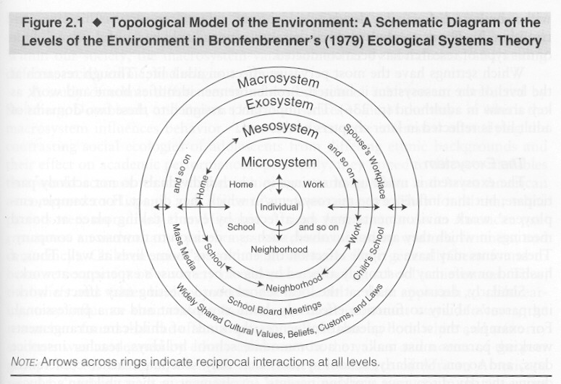
Socialization Processes
Parent-child relationships
School influences
  Classroom networks
  School effects
Peer relationships
Notes:
Children and adolescents spend more time in school than any other place outside home
Research typically conducted by educational psychologists and sociologists
Schools can promote competence or reinforce developmental difficulties

Slide 3
Gender segregation
Research on gender typing in individuals is inconclusive
  Clustering of gender-typed characteristics weak
  Relations to family characteristics weak
Same-sex groupings predominate
  From 3 – 12,
  Cross-cultural phenomenon

Slide 4
Classroom networks
Emergent group properties
Gender socialization
Network properties over time
  Observed
Social networks and disabilities
  Teacher reported homophily
Objective measures
  Social contact, language, and disabilities
    Messinger et al; Fasano et al
Network bulling interventions
Slide deck change
School belonging and school plays
Slide deck change

Slide 5
Social constructs
Interactions, relationships, and groups are mutually constitutive and have emergent properties
Concepts like popularity exist at an individual and group level
Networks are an attempt to capture the ensemble of social relationships
  Facebook
  classrooms

Slide 6
Levels of analysis
Interactions
  The braiding of two individual’s behavior
Relationships
  “succession of interactions”
    Friendship is a reciprocal, voluntary relationship based on affection
Groups – collection of interacting kids
  Defined by cohesiveness, hierarchy, heterogeneity
Networks
  The instantiation of all interactions in a group?

Slide 7
Gender segregation
Research on gender typing in individuals is inconclusive
  Clustering of gender-typed characteristics weak
  Relations to family characteristics weak
Same-sex groupings predominate
  From 3 – 12,
  Cross-cultural phenomenon

Slide 8
Peers and classrooms overview
Peer play and levels of analysis
Networks: Sex differences, processes (Martin et al)
Developmental disabilities (Chen et al)
  Homophily
Interactive Behavior In Schools (IBIS)
  Visualizations and background
  Modularity and language (Fasano)
  Movement (Banarjeee)
Intervention
Slide deck change
Slide deck change

Slide 9
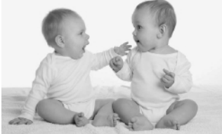
Peer Relationships
Kids are interested in kids
Preferring peers to adults early on and more dramatically with development
  Finding appropriate models for their developmental niche
    Fundamentally neglected area of research
    Unoccupied behavior
    Solitary play
    Onlooker behavior
    Parallel play
    Social Play
      Associative play
      Cooperative play
Notes:
Early interest in form of imitation of acts on objects
By toddler years se social imitation; more likely to imitate peer vs. adult
Interactive exchanges in toddlers are more predictable, more complex, more coordinated and lengthier vs. younger infants

Slide 10
Early development
Infants have rudimentary abilities (to 1 yr)
  I.e., increased gazing at peers
Toddlers
  Imitate and are aware of being imitated
  Have reciprocal relationships with specific kids

Slide 11
Early childhood
Types of play
  Unoccupied, solitary, on-looking, parallel, associative, cooperative
  Parallel play is important transitional activity
  Pretend play emerges (inter-subjectivity)
Friendship emerges
  More prosocial and aggressive behavior with friends
As do dominance hierarchies

Slide 12
Peer play examples
sandbox “making butter”, teacher queries
84 seconds https://www.youtube.com/watch?v=Gew1UXw2TGQ
slow-moving tag, three 4-year-olds
  90 s https://www.youtube.com/watch?v=32bkyszGg_c
self-organized chalk drawing outside
7 minute ttps://www.youtube.com/watch?v=ZtJ7my7RCnk

Slide 13
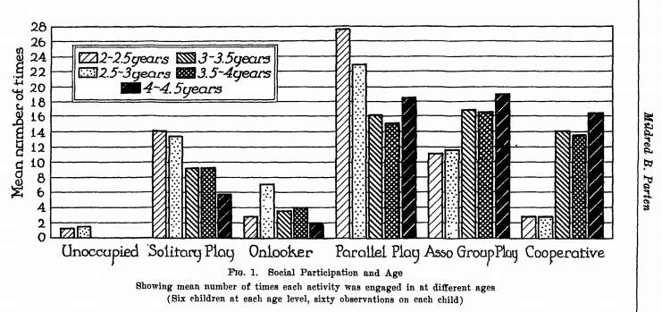
Developmental changes in nature of play behavior (Parten, 1932)
Notes:
Parten – b/w 2 and 5 years kids engage in increasing frequency of associative and cooperative play and less idle, solitary, and onlooker behavior
BUT now know that children of all ages engage in all of these behaviors; even at 5 yrs a considerable amt of time spent in solitary play
Biggest change is the cognitive maturity of different play forms
Increase in solitary construction and solitary exploratory behavs vs. solitary sensorimotor play; social interactions that increase with age include sociodramatic play and games with rules

Slide 14
Martin and Ruble
What age do infants understand gender?
How stable are gender roles?
  Maccoby (2002)
Longitudinal studies of gender role stability
  Studies suggest some level of stability
  Lack of longitudinal data with enough detail
Martin, C. L., & Ruble, D. N. (2010). Patterns of Gender Development Annual Review of Psychology (Vol. 61, pp. 353-381). Palo Alto: Annual Reviews.
Notes:
By 10 months infants able to form stereotypic associations between faces and objects (hammers and scarfs).
18 months they are actively seeking gender behavior information.
Many stereotypes developed by 2 to 3 years of age.
Maccoby argued that gender typing not very stable and it maybe more of a group phenomenon than individual difference.
She concluded examination of individual differences may not be productive.
Studies that utilized a large number of observations over the school year suggested that there is stability but no such studies have been done over a number of years. Further research necessary. This stabiliy could be due to the same classmates and no individual child characteristics.

Slide 15
Constructivist argument
Innate gender-specific proclivities
Lead to same sex segregation
Which creates gender-specific socialization
Children create themselves playing with each other
  IS THIS POSSIBLE?

Slide 16
Implications
Interactions, relationships, and groups are mutually constitutive and have emergent properties
Concepts like popularity exist at an individual and group level

Slide 17
Same-sex groupings
Boys
  Larger groups
  More conflict/competition
  Cohesiveness
  More autonomous from adults
Girls
  Smaller, more dyadic
  Less conflict, more responsive
  Less goal-oriented, more intimate
Differential exposure to these groups influences individual behavior

Slide 18
Social networks
6 minutes on slide
  https://www.youtube.com/watch?v=Pl3_4D6c8Io
(sociodramatic play – preschool children playing house, pretending to be doggies and kitties)
  http://www.youtube.com/watch?v=pdOwvZwiYwk&NR=1
(let’s play kitchen)--Preschool children making hot chocolate—teacher talk
  http://www.youtube.com/watch?v=JE9eq3mZhg0&feature=related

Slide 19
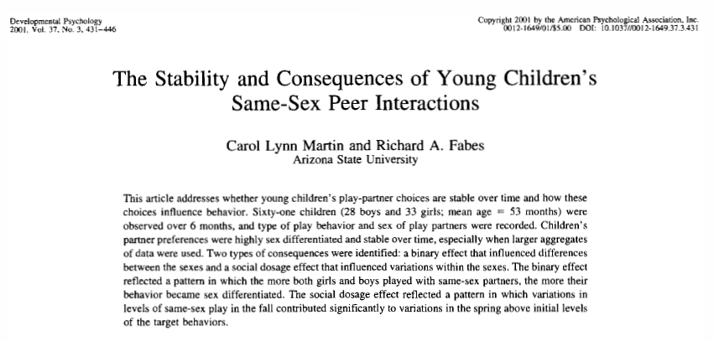

Slide 20
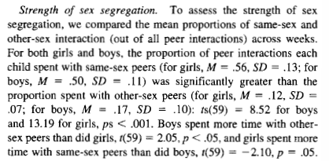
Sex segregation strength at 5 years

Slide 21
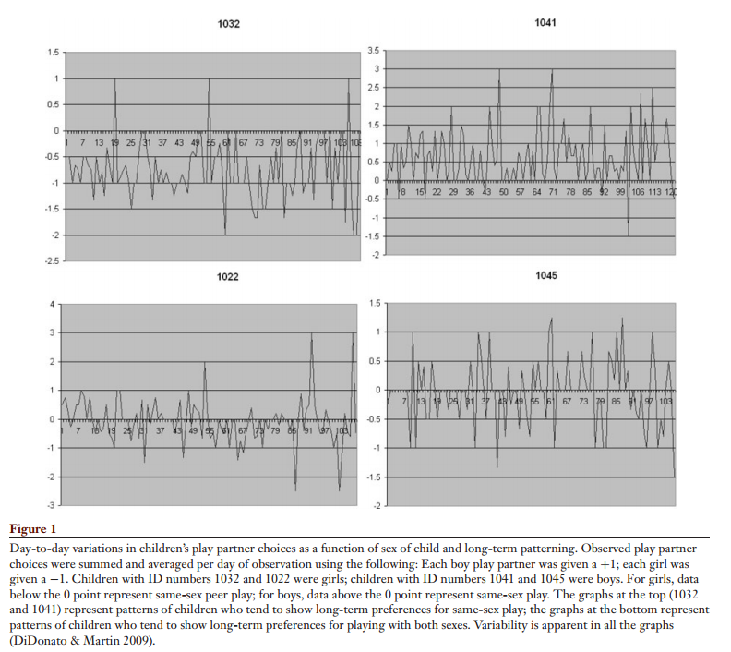
Day-to-day variability
 | Girls | Boys
Same-sex preference
Other-sex preference
Notes:
In Martin & Ruble 2010

Slide 22
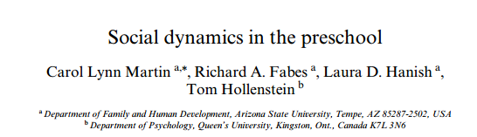
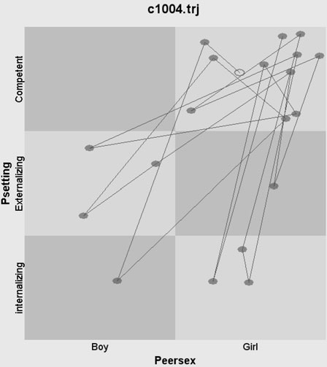
State Space Grids

Slide 23
Dynamic system approach to gender research
  Long term changes and short term interactions.
Lynn Martin, C., Fabes, R. A., Hanish, L. D., & Hollenstein, T. (2005). Social dynamics in the preschool. Developmental Review, 25(3–4), 299-327. doi: http://dx.doi.org/10.1016/j.dr.2005.10.001
Notes:
DS approach requires first to identify the variable that represents the system of interest called the collective variable. This variable must be clearly defined and observable. DS have preferred states called attractors that the systems often return to. They can be strong or weak.
Consider all factors and how they operate over time and how they operate in the short run to change the system.
A DS approach to gender segregation would examine all factors social, biological, and biosocial (like temperament). A child's choice of a playmate is limited by which children are available for play. Child form play groups which may evolve into bigger groups and become concrete routine. Small preference differences can lead to large scale segregation between genders overtime.
A socially competent girl’s state space grid, illustrating her patterns of play with
peers of different sexes and different behavioral qualities over the first 20
observed interactions. The x-axis represents the sex of the peer with whom the
target girl interacts; the y-axis represents the behavioral quality of the peers as
determined by clustering teacher ratings of children’s behavior

Slide 24
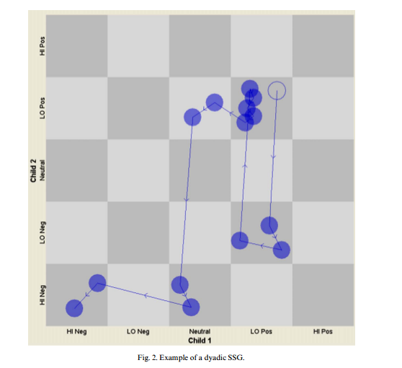
Example of Dyadic SSG

Slide 25
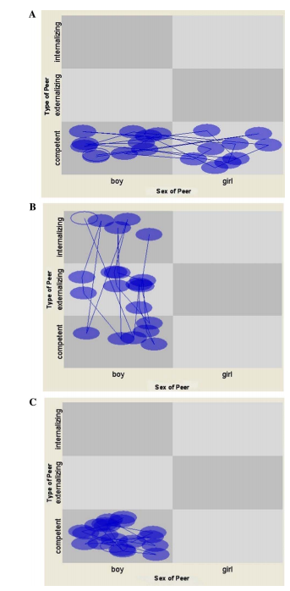
“Fig. 4A represents the state space pattern that might be seen for a socially competent boy who is solely attracted to other socially competent children. “
“Fig. 4B illustrates a pattern based on sex similarity. In this case, the events represented on this boy’s state space illustrate that he is seen interacting only with boys and it does not matter what type of social behavior they tend to display. “
“Fig. 4C depicts the landscape for a socially competent boy whose state space is shaped by both similarity on social behavior and on sex. The events cluster in the region of socially competent boys. If this pattern occurred, it would suggest that behavioral similarity matters but only in consideration for same-sex peers.”

Slide 26
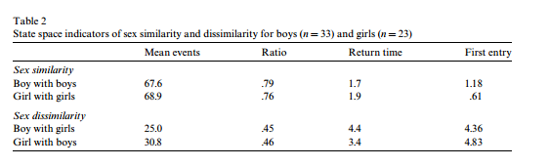
Sex-Segregated Interactions
(state space view)

Slide 27
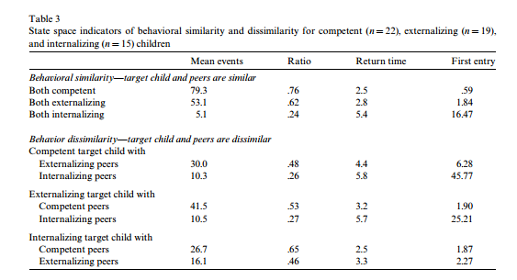
Behaviorally Similar Interactions

Slide 28
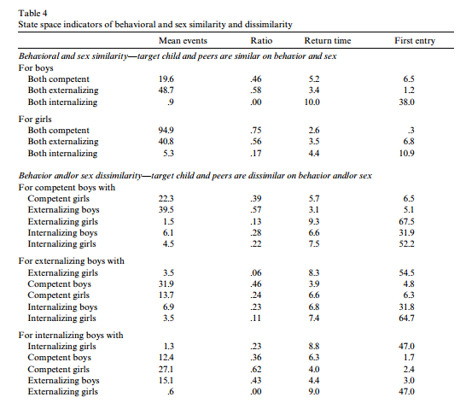
Sex by competence

Slide 29
Jutagir | Schaefer et al., 2010

Slide 30
How do social networks form?
It’s rare that strangers come together to form new relationships, especially when a researcher is observing.
Preschool presents new social opportunities for children reaching the developmental level that supports enduring peer relationships.
Hypothesis: Well-known principles of network formation, namely reciprocity, popularity, and triadic closure will vary in importance throughout the network formation period as the structure itself evolves.
  Structural Cascading: More complex structures evolve from simpler ones.
Jutagir | Schaefer et al., 2010

Slide 31
Network Processes via Siena
Reciprocity: Responding to others’ gestures of friendship with like gestures (Blau, 1964).
Popularity: When individuals with more incoming relations, or ‘ties,’ receive additional friendship initiations at higher rates than others
  through preferential attach- ment (Barabási and Albert, 1999) or prefer one another at greater rates (van den Oord et al., 2000).
Triadic Closure: Tendency toward closure, or ‘transitivity,’
  an individual’s friends are also friends with one another (Davis, 1970; Hallinan, 1974).
Jutagir | Schaefer et al., 2010

Slide 32
Methods
Participants: 195 children
  11 Head Start preschool classrooms, 15-21 children each
  Age: 3-5 years (M=4 years)
  Race/Ethnicity: Predominantly Hispanic
  SES: Low-income
Timeframe: 1 school-year
Design: Observational
  Schedule: 2–3 days per week, several hours each day
  Structure minimized order effects
Analysis: SIENA modeling framework
Jutagir | Schaefer et al., 2010

Slide 33
Results
Jutagir | Schaefer et al., 2010
Notes:
Reciprocity
As shown in Table 2 (Model 1), the positive effect of reciprocity indicated that children were more likely to form ties to alters who preferred ego as a play partner.
Reciprocity was thus an important predictor of ties from the first period onward and at about the same level throughout the school year
Popularity
In-degree related popularity captures whether children become more attractive as friends as their number of incoming ties increases.
Model 2 reveals a significant, positive main effect, indicating an increased likelihood of forming ties with popular children relative to less popular children. We expected popularity to become more important over time as relationships emerged and the network stabilized. The interaction between popularity and the linear period term is positive and the score test indicates it significantly improves model fit. Thus, popularity became increasingly important throughout the year. Because it takes time for relationships to form and for the unequal distribution of incoming ties that is the basis for popularity to form, popularity has a greater tendency to shape relationships later in the year.
Triadic Closure
Transitivity
- Transitivity produces triadic closure when (1) what was previously an indirect connection from i to k through j becomes direct through the addition of a tie from i to k or (2) i and j both have ties to k, and i adds a tie to j. The transitive triplets effect in SIENA counts the number of closed triads in which ego is in position i. The positive main effect suggests that children were more likely to select others as play partners when those ties increased the num-ber of transitive patterns in the network (Model 3). The significant positive interaction between transitive triplets and period indicates that transitivity became more important over time. Throughout the year, children became increasingly likely to form relationships with the friends of current friends.
2) Dense triads
- We measured dense triads as whether or not all six of the possible ties among three children existed. Model 4 reveals a significant positive main effect of dense triads and a significant interaction with period. The positive effect of dense triads indicated that relationships that created closed triads, where all of the relationships were reciprocal, were more likely to form than relations that did not produce dense triads. Moreover, the importance of the effect of dense triads increased over the course of the year. As the network stabilized and relationships strengthened during the year, dense triads became increasingly common.

Slide 34
Reciprocity, Popularity, Triplets
Jutagir | Schaefer et al., 2010

Slide 35
Change over year
(Density of triads = # of existing ties relative to possible #→reciprocation.)
Jutagir | Schaefer et al., 2010

Slide 36
Structural cascading observed
‘Reciprocity effects peak early, when children first enter the school and form new relationships. As children form relationships, reciprocity effects remain constant.
As relationships strengthen, children become more likely to seek and maintain relationships with popular peers. Popularity peaks in importance midway through the school year.
Unlike popularity, triadic closure increases in importance over the year, peaking in the final period. Children become increasingly likely to form strong, closed triads composed of mutual friendships.”
Children increasingly exposed to children with whom their friends are playing. …
Jutagir | Schaefer et al., 2010
Notes:
effects on relationship formation and change. However, in addi- tion, we found support for the hypothesis that structural effects “cascade” in importance over time, from the simple to the more complex. Thus, we echo Doreian et al.’s (1996) assertion that net- work processes proceed on different timescales.

Slide 37
The social networks of children with and without disabilities in early childhood special education classrooms
Chen, Lin, Justice, & Sawyer (2017)

Slide 38
Background
Interactions with peers foster social and cognitive development
Interactive peer play positively influences children’s spatial reasoning skills, self-regulation, social learning competencies, and knowledge of emotion.
Inclusive Classrooms
  Advantages
    Strengthen learning and development
    Learn from age-appropriate models
    Experience collaboration and teamwork
  Disadvantages
    Increase risk of isolation/rejection
    Increase chance of being bullied

Slide 39
Objectives and Hypotheses
To examine peer interactions within Early Childhood Special Education (ESCE) inclusive classrooms using a social network analysis approach.
Hypotheses:
  Play interactions: Children with disabilities < Typically developing
  Conflict interactions: Children with disabilities > Typically developing
  Disability homophily effect

Slide 40
Participants
Data collected from 64 Early Childhood Special Education (ECSE) inclusive classrooms
  Evenly distributed across geographical locations
  485 preschool children (Age Range: 34-70 months)
      Disability Status:
        Typically Developing (n = 293)
        Have at least one disability (n = 192)
          Language impairment, developmental delay, multiple disabilities, autism, emotional disturbance, orthopedic or other health impairment, visual or hearing impairment, specific learning disability, no diagnosis available

Slide 41
Measures
Classroom play and conflict networks
  Based on teacher ratings
    Play: (0 = Never play together, 4 = Always play together)
      Engaging in pretend play
      Giving and sharing toys
      Exploring object together
      Collaborating on building blocks
    Conflict: (0 = Never have conflict, 4 = Always have conflict)
      Quarreling/fighting
      Kicking/hitting
      Shouting
Language ability:
  Clinical Evaluation of Language Fundamentals Preschool (CELF)
  Expressive vocabulary, sentence structure, word structure

Slide 42
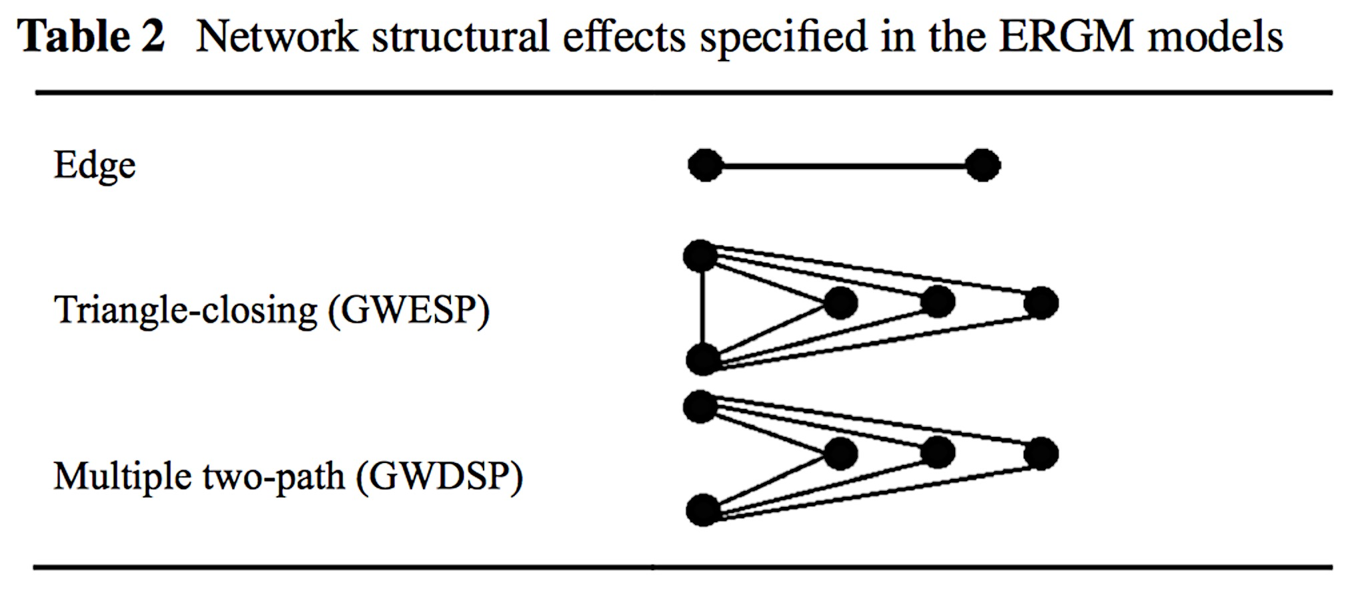
Network approach
Descriptive social network indices:
  Individual degree centrality (child-level index)
  Network density (classroom-level index)
Exponential Random Graph Models (ERGMs):
  Actor covariate effects
    Disability main effect
    Disability homophily effect
  Network structural effects
    Edge
    Triangle-closing
    Multiple two-path

Slide 43
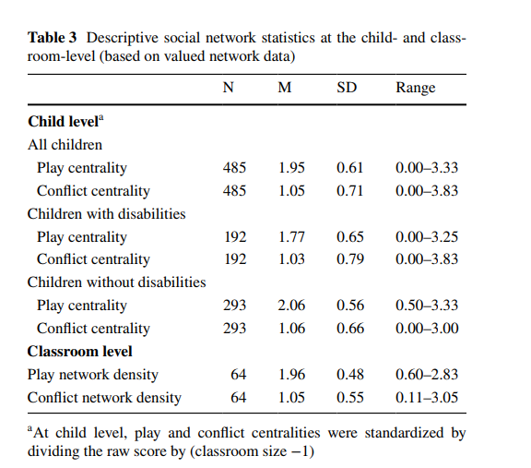
Kids with disabilities - lower play centrality. No difference in conflict play centrality
  On average, children “sometimes” played with peers and “rarely” had conflicts with peers
Children with disabilities had significantly lower play centrality. No significant difference in conflict play centrality
Notes:
0-4 scale
1 – never
1 – rarely
2 – sometimes
3 – often
4 – always
Children with disabilities formed looser play networks but similar conflict networks

Slide 44
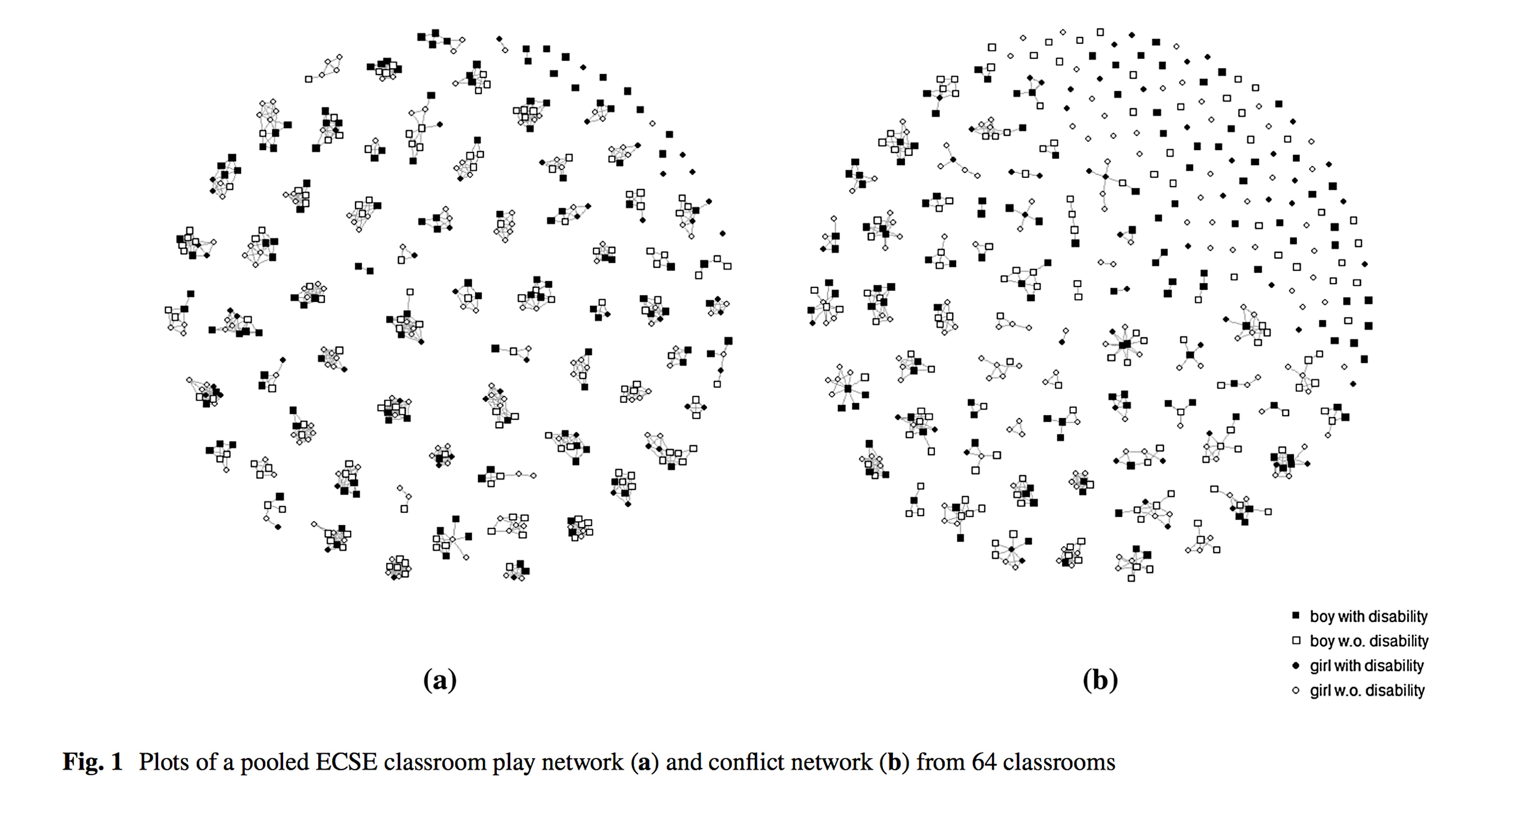
Results

Slide 45
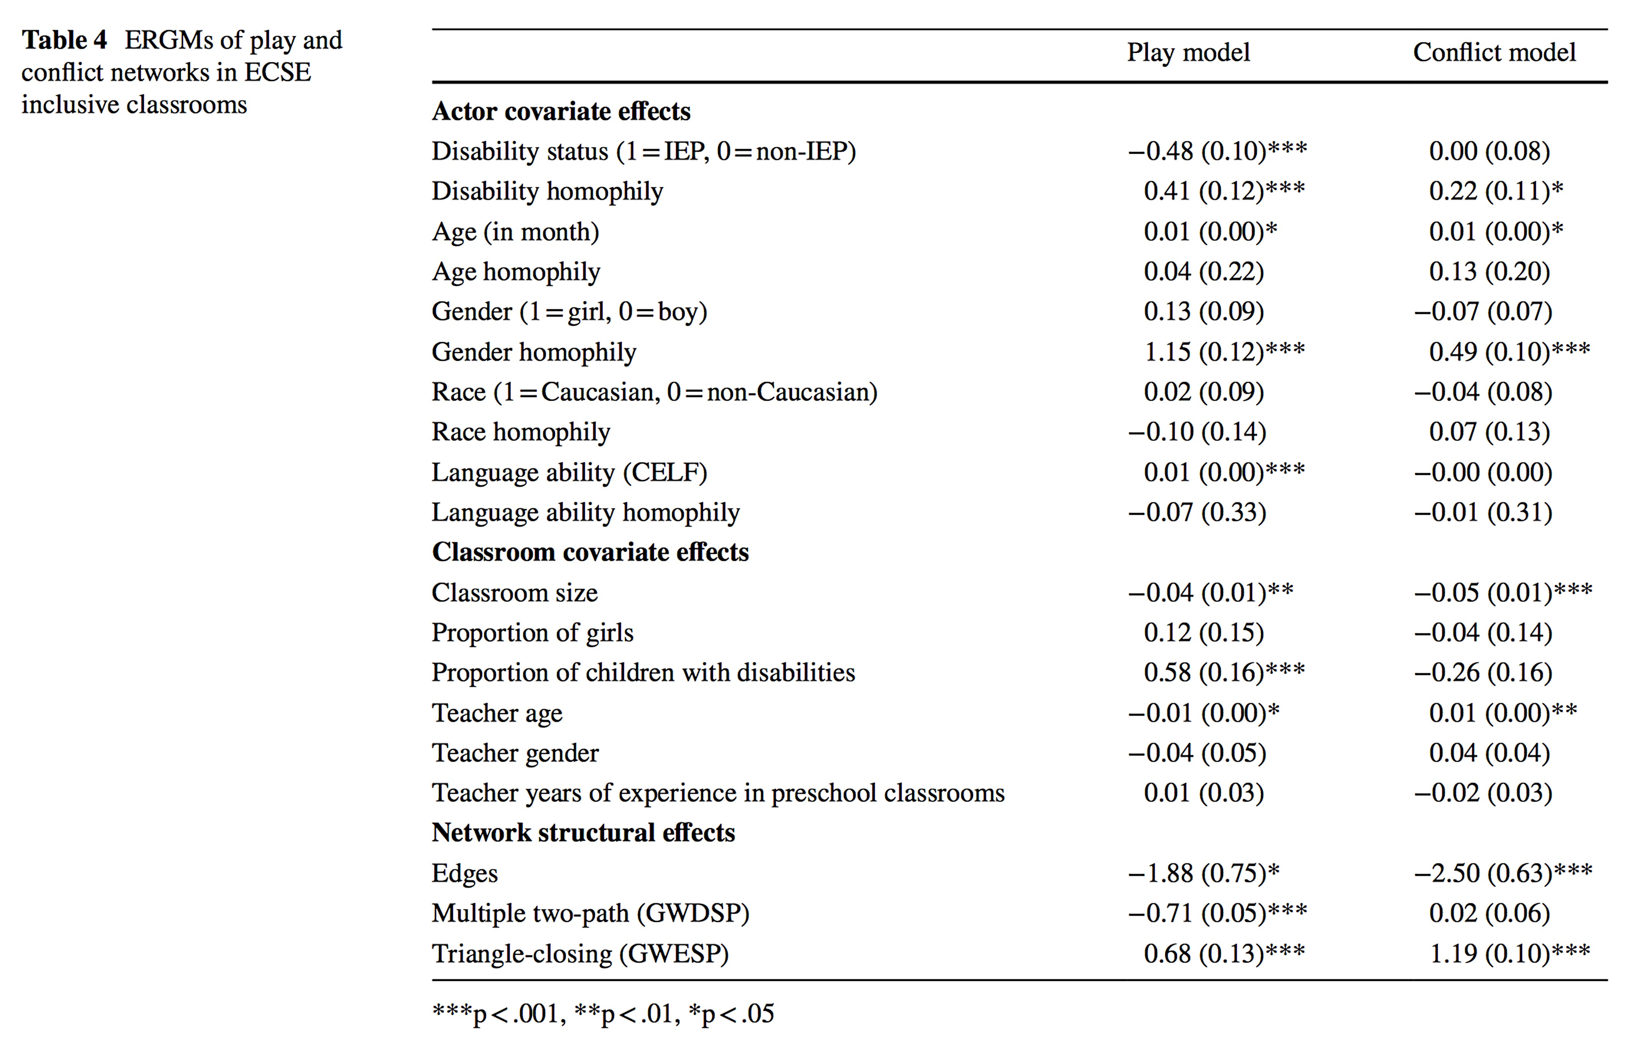
Disability: status and homophily
Children with disabilities are less likely to interact with peers in their play network but are equally likely to engage in conflict vis-à-vis typically developing peers.

Slide 46
Summary of Findings
Children with disabilities are less likely to interact with peers in their play network but are equally likely to engage in conflict vis-à-vis typically developing peers.
Evidence of segregation based on disability status in both play and conflict networks.
  May be attributable to differences in social skills, self-expectation, and competence.

Slide 47
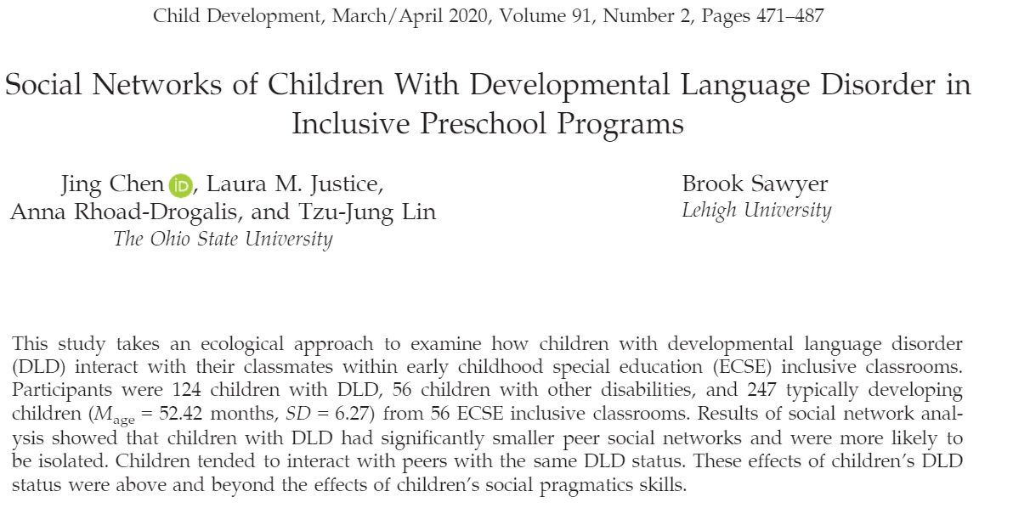
Rating scale (0 = never,1= rarely play,2= sometimes play,3= often play,4= always play)

Slide 48
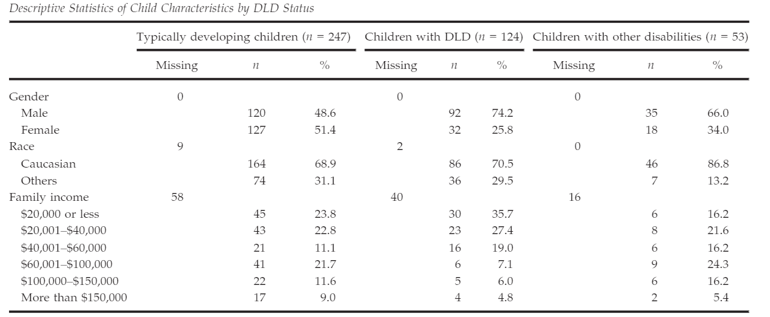
Children with DLD and children with other disabilities
Rating scale (0 = never,1= rarely play,2= sometimes play,3= often play,4= always play)

Slide 49
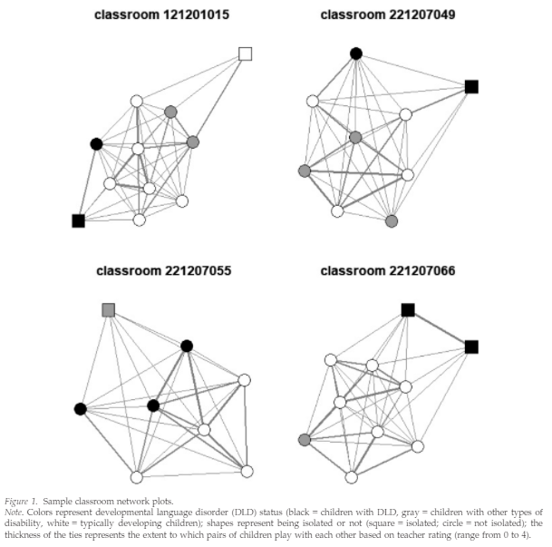
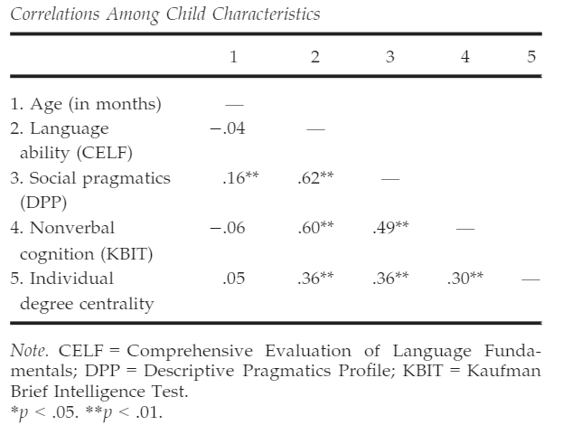
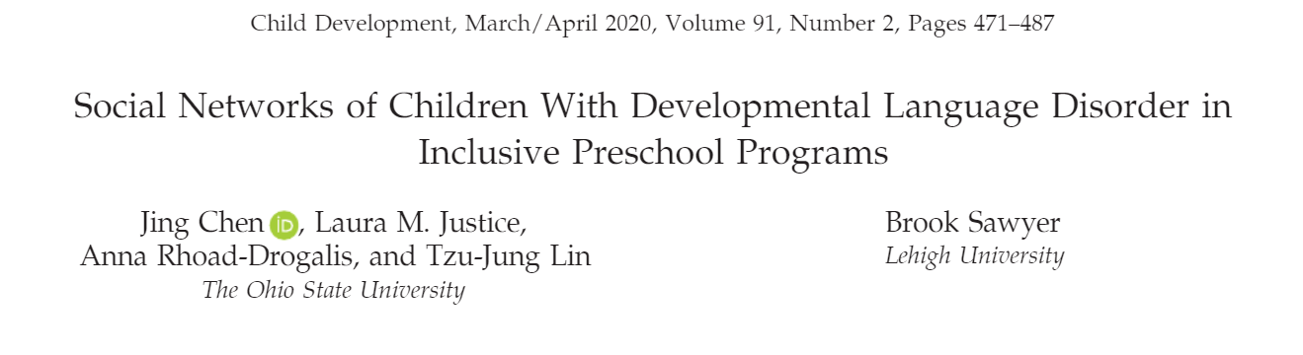

Slide 50
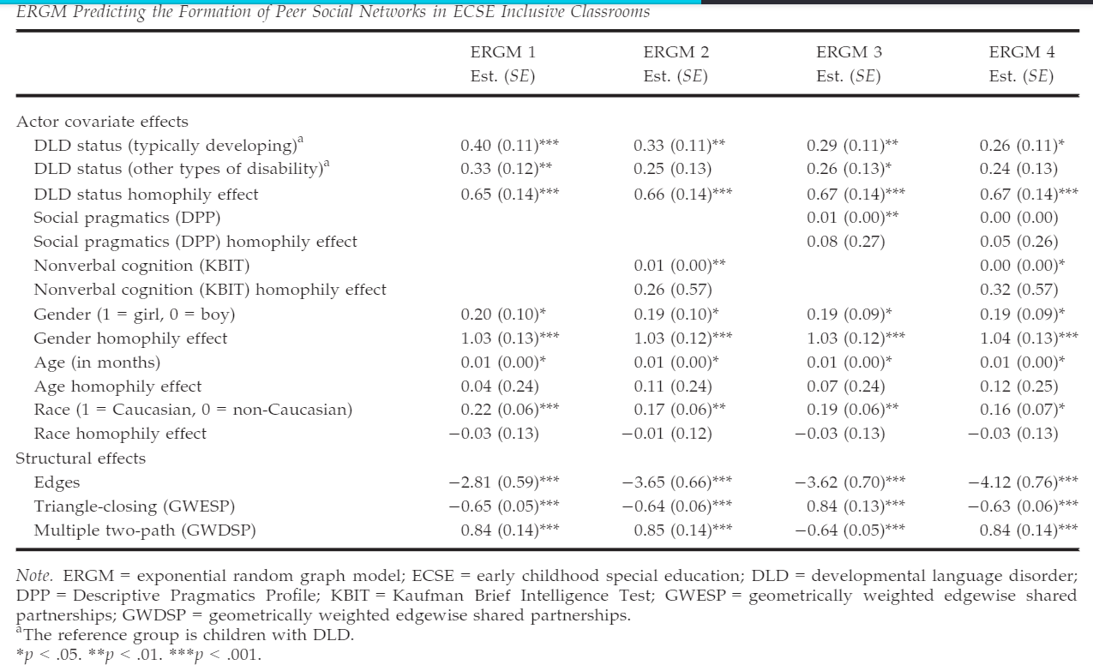
Predicting edges: Disability status and homophily, with covariates

Slide 51
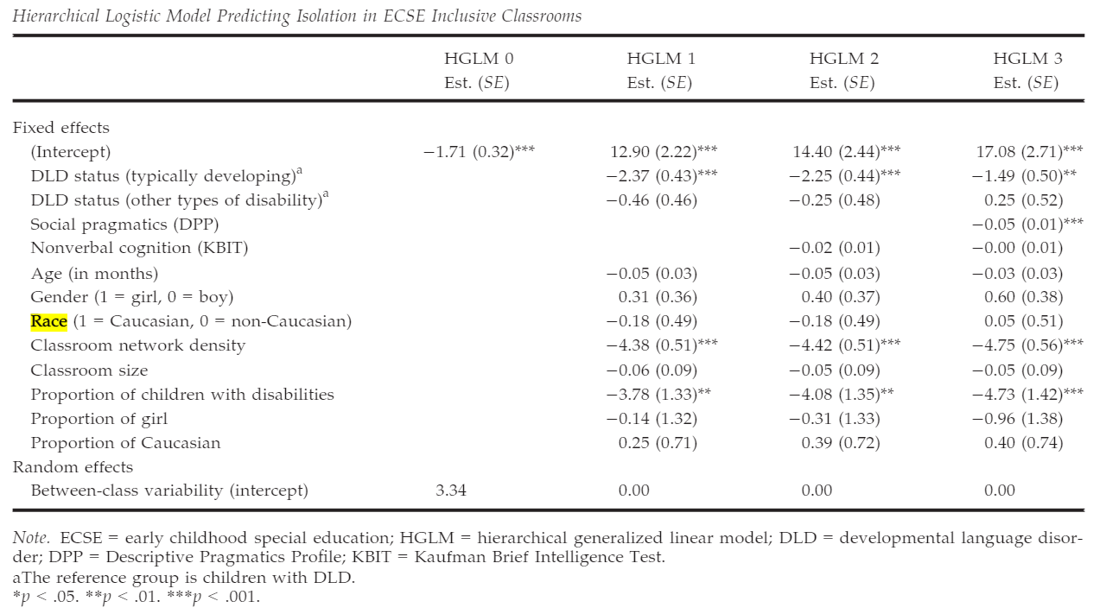
Predicting isolation: Disability status and homophily, with covariates

Slide 52
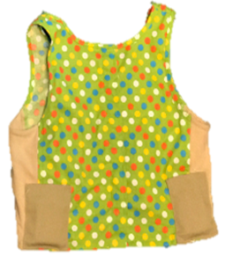
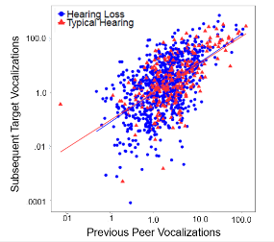
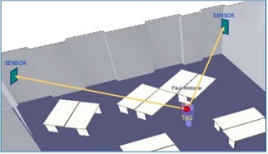
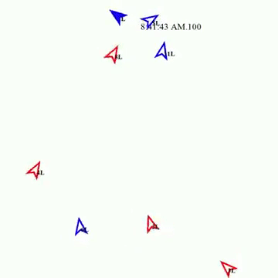

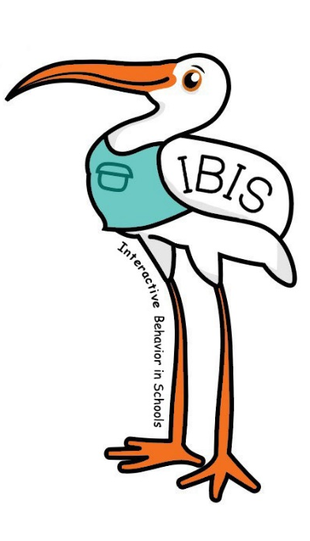
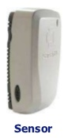

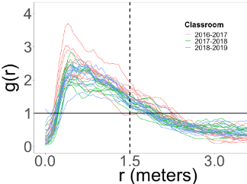
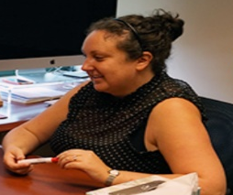
Interactive Behavior in Schools (IBIS)
What do we collect?
How do we collect this?
Hiring a data
scientist postdoc!

Slide 53
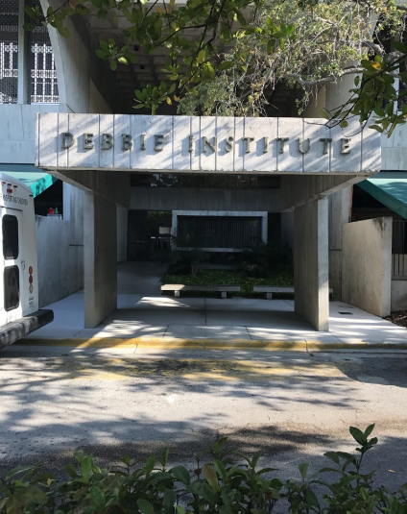

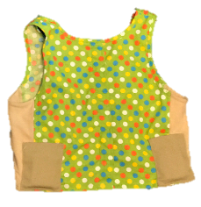

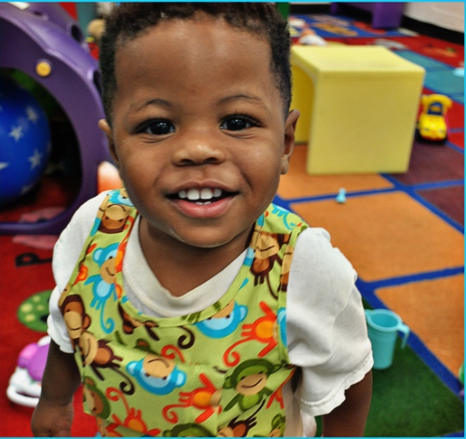
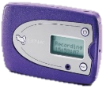

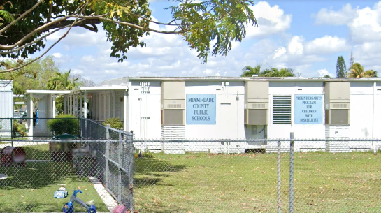
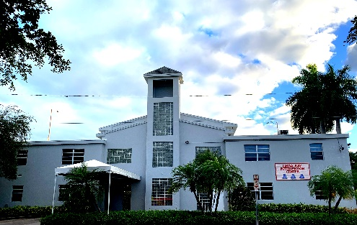
Real world preschool data/collaborations
LENA helps us know how much children talk
Ubisense helps us know where children are/who they are talking to

Slide 54
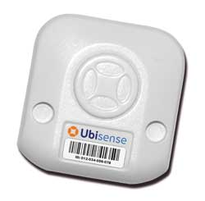

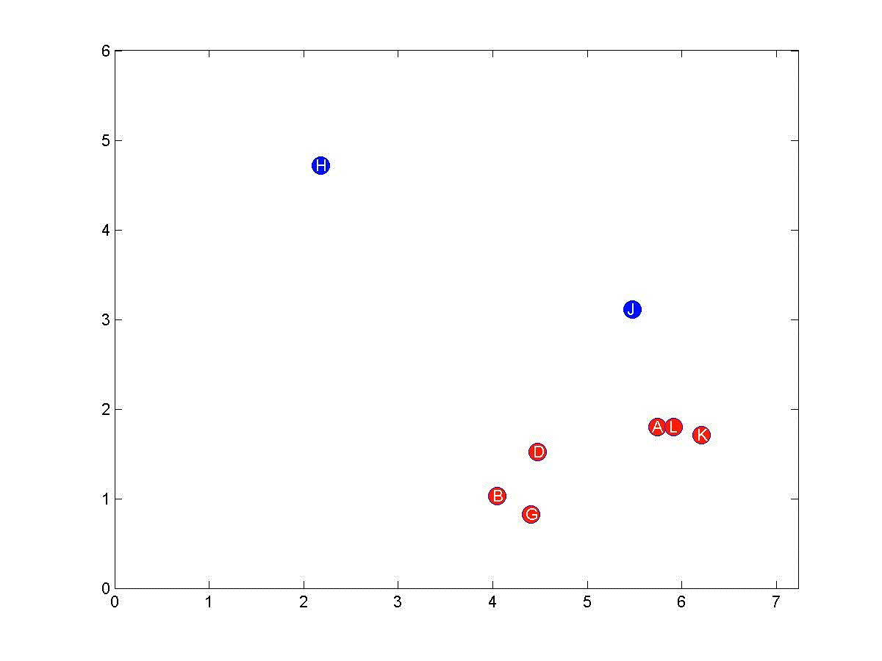
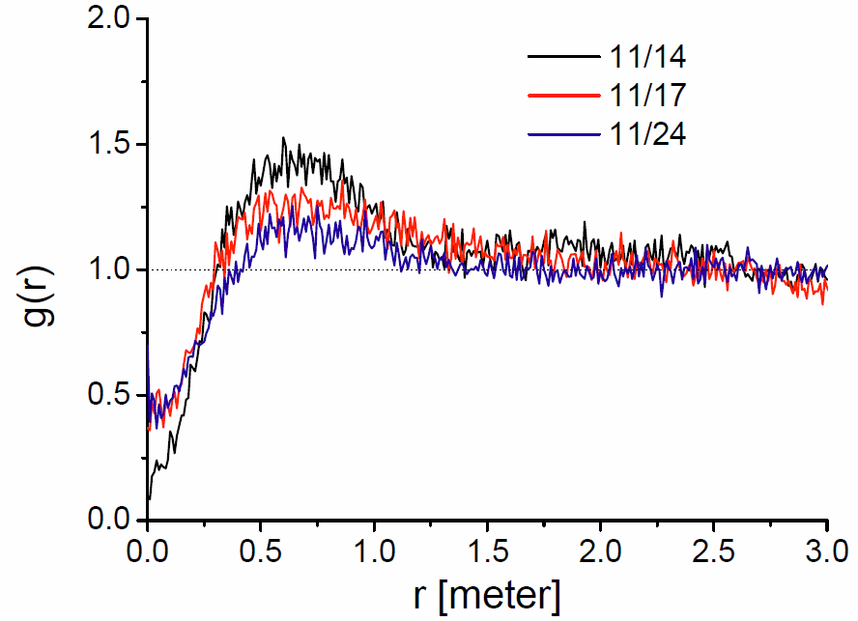


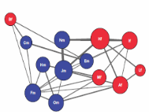
RFID location tracking (kindergarten)
Objective observation
Detecting social contact g (r)
Udo Rudolph
Chaoming Song
Messinger, Song, Perry, et al., 2019

Slide 55
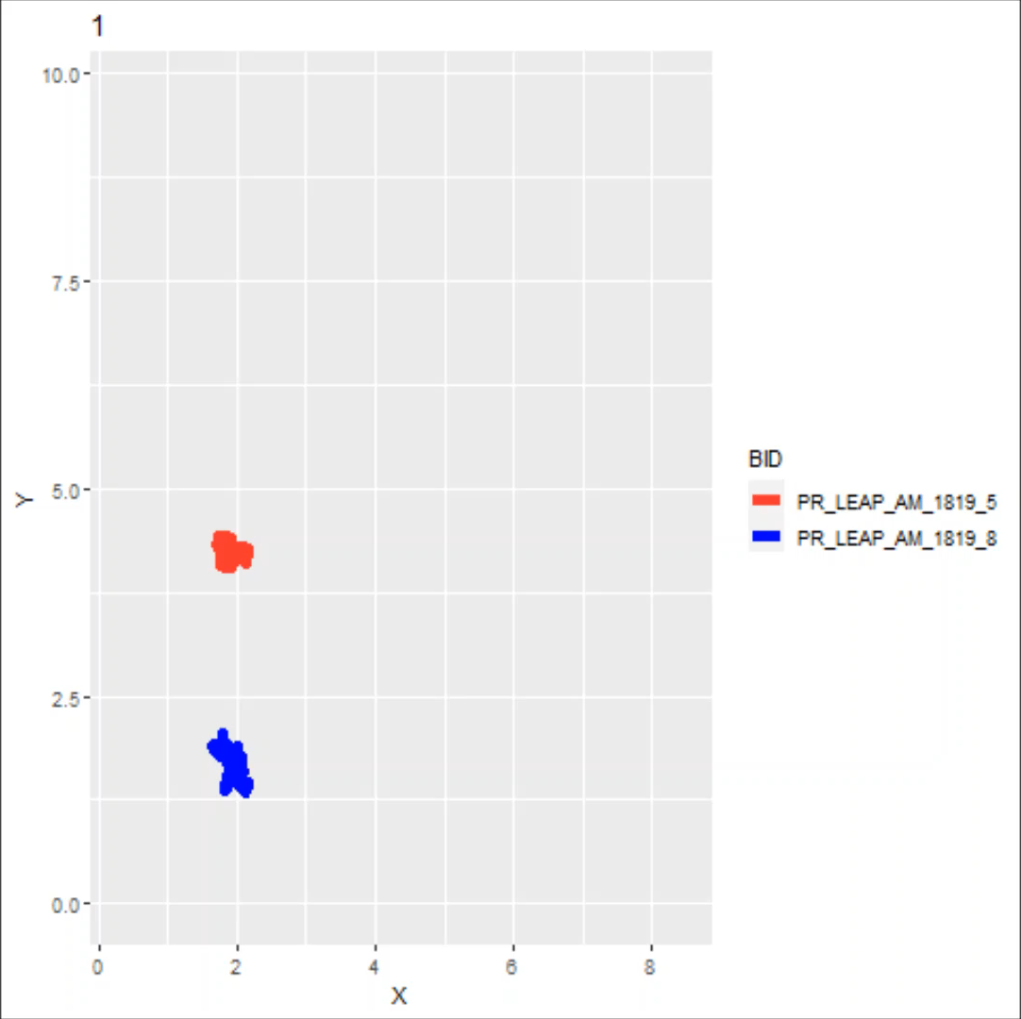
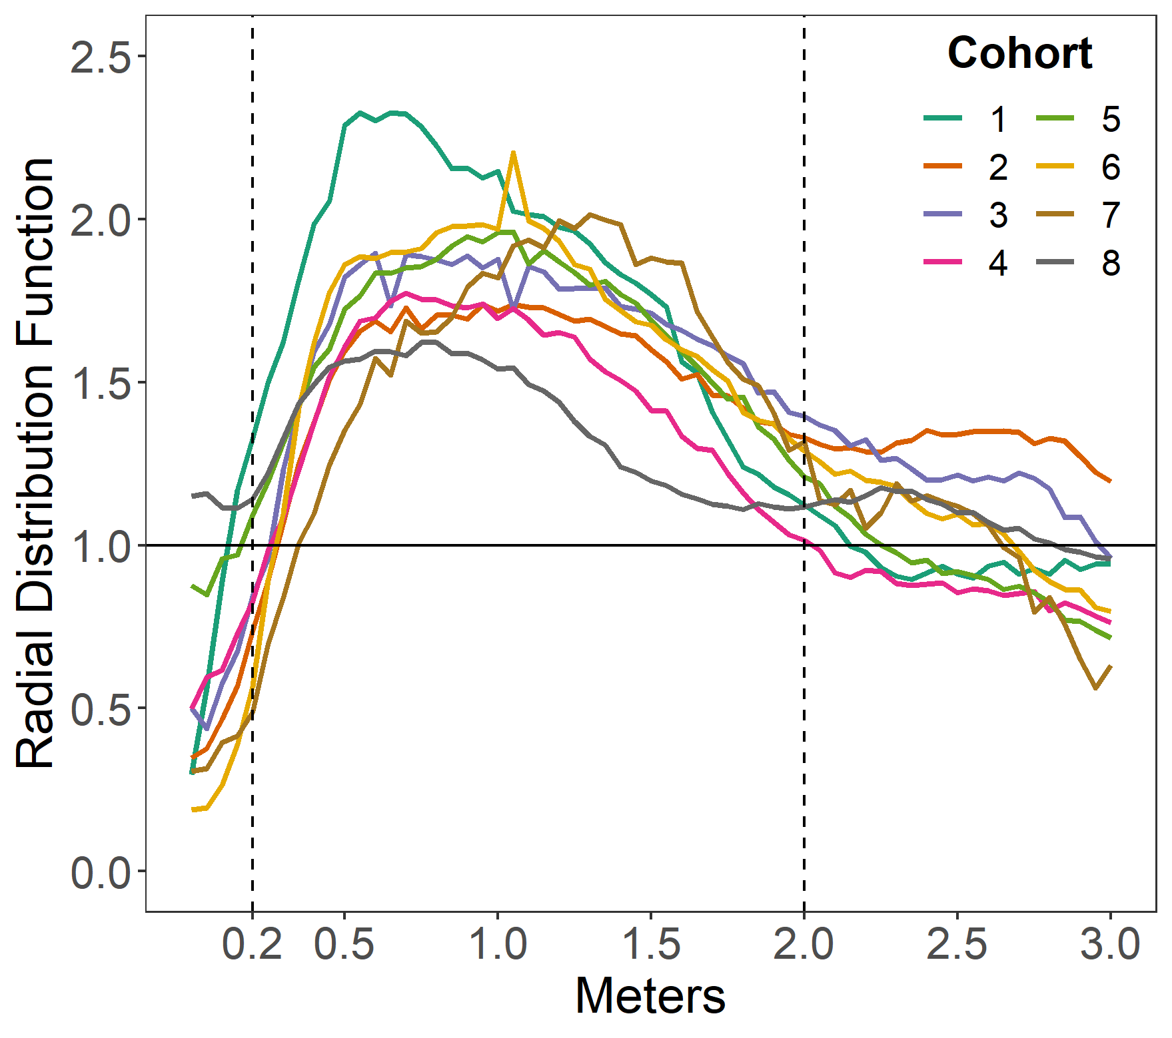
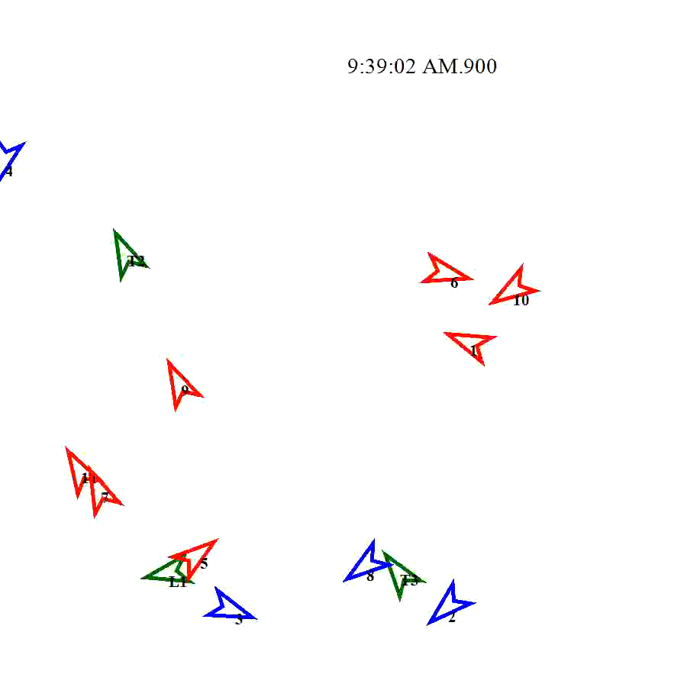
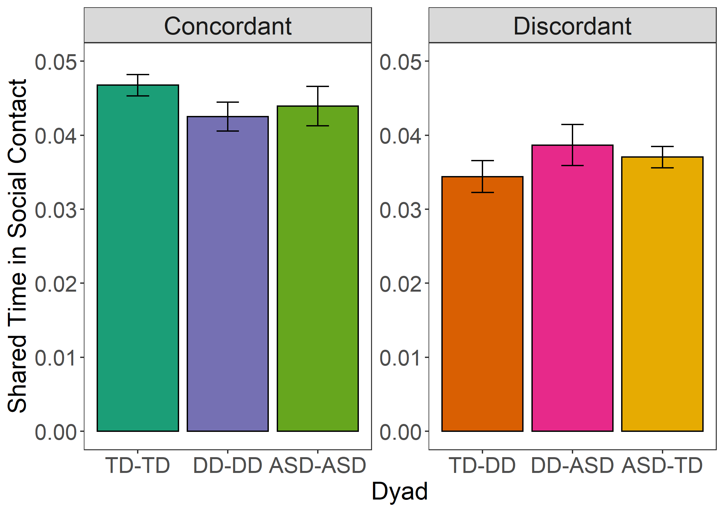
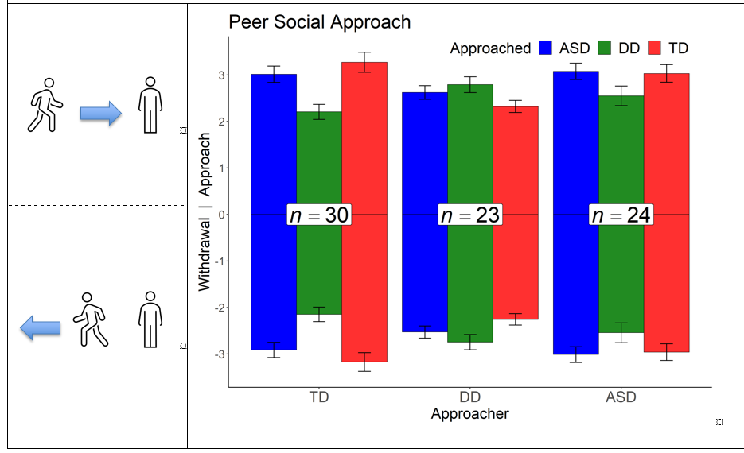

Disability Status Homophily
(TD-TD, ASD-ASD, DD-DD)
Higher social contact in concordant dyads
Faster approach in concordant dyads
77 preschoolers
24 ASD, 23 other DD, 30 TD
Banarjee, et al., 2023

Slide 56
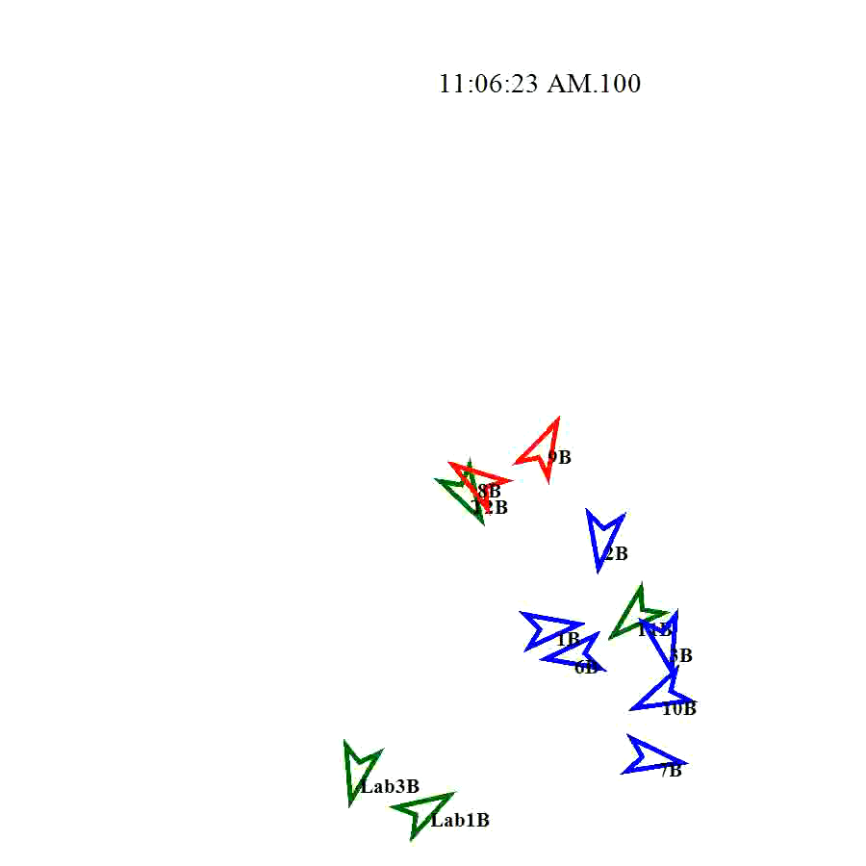
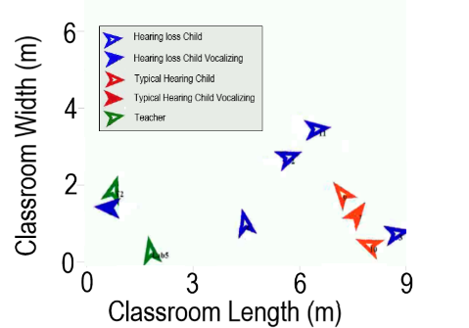
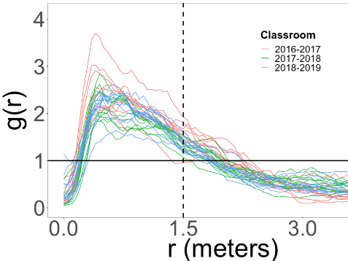


Social contact: Inferring interaction
Data
Distance
Orientation
Perry, et al. (2019)
Chaoming Song
Messinger, et al. 2018

Slide 57





Peer vocalizations predict language ability
Regardless of hearing status
Perry, et al., 2022
Peer vocalizations →
focal child vocalizations →
language abilities
Reciprocal patterns of dyadic speech
Peer vocalizations to focal child →
Focal child vocalizations to peer
B=.33, se=.08, t=4.02, X²(1)=15.71, p=.00007

Slide 58




Teacher to child phoneme transmission predicts child language ability
Phonemic diversity = 14
θ-æ-ŋ-k j-u.
aɪ l-aɪ-k g-r-eɪ-p ʤ-u-s.
Teacher phoneme → child phoneme → PLS language scores
Mitsven,
et al., 2021

Slide 59





Partner vocalizations predict child vocalizations
Deaf/Hard-of-hearing
classroom
Child to child vocalizations
Teacher to child phonemes
Perry, et al., 2021
IDSC Fellow,
Mitsven, et al., 2020
B=.33, se=.08, t=4.02, X²(1)=15.71, p=.00007
Regardless of a child’s hearing status

Slide 60
Phoneme types: Teacher → Child
Typical hearing > hearing loss
IDSC Fellow,
Mitsven, et al., 2020

Slide 61




Adult phoneme → child phoneme → child language score
Mitsven, et al., 2020

Slide 62
A granular perspective on inclusion: Objectively measured interactions of preschoolers with and without autism
Fasano et al. (2021)
Jiye Lee
PSY 624
10/17/23

Slide 63
Introduction
Children’s experiences in preschool affect their social-emotional and language development.
Particularly, peers play a big role in these developments.
Do peer interactions shape children’s language abilities? If so, how does this process differ for children with autism (ASD), relative to peers with general developmental delay (DD), and typically developing (TD) peers?

Slide 64
ASD vs. DD
ASD: neurodevelopmental disorder with deficits in communication and social interaction;
DD: delay in one or more developmental domains such as language and cognition, which can have consequences to social interactions
Both can have language delays.
However, children with ASD have additional specific atypicalities including repetitive speech, low conversational turn taking, etc.
Authors hypothesize that children w/ ASD would interact less with TD, but did not have expectations on differences between ASD vs. DD.

Slide 65
Objectives
Examine dyadic vocal interactions
  Hypothesis: # of vocalizations a child hears from a peer during one observation will predict that child’s subsequent vocal output to that peer in the next observation.
Examine group differences in social network properties including modularity and degree centrality
  Hypothesis: children with ASD will form less cohesive groups (lower modularity) with each other than will TD children and have weaker ties to peers (lower degree centrality). In addition, homophily effects anticipated (modularity will be higher within than between groups)
Examine whether children’s degree centrality is positively associated with their end-of-year assessed language abilities.

Slide 66
Participants
N=56 preschoolers (22 girls) in 5 inclusion classes with English being primary language;
Mean age: 50.14 months (SD=7.06)
16 ASD, 19 DD, and 21 TD
49 Hispanic White, 6 Non-Hispanic White, 1 Hispanic Black
27 English, 23 bilingual English-Spanish, 3 Spanish, 3 bilingual English and another language

Slide 67


Automated measures: Language
the Language ENvironment Analysis (LENA) system
Adult word count, child vocalization count, and turning taking count
Validated in both TD and atypical populations

Slide 68





Automated measures: Social interaction
Radio frequency identification (RFID) technology – child-worn Ubisense tags
They wore 2 tags (on each side of the body)
Gonzalez Villasanti

Slide 69
Classroom networks
Social network analysis examines relative strength of ties between social partners
Modularity: cohesiveness of children’s groups (i.e. AD, DD, TD)
Degree centrality: overall strength of a child’s ties to all peers (amount of “cotalk” they receive and give to another child)
Whereas modularity compares ties within and between groups, degree centrality compares a child’s ties to each other child.

Slide 70

←0.2 – 2m→

Slide 71

↓ greater exposure to peer speech predicted greater subsequent speech in social contact to those same partners
←No group effects in rates of vocalizations to other peers
↓ Children with ASD showed a stronger effect of peer input than their DD peers

Slide 72

Classroom network
The variables of interest are derived from the sum of each child’s ties to their peers (rate of vocalizations to and from those peers) during social contact.
Tie width indexes the vocalization rate between 2 children in social contact.
Ties greater than mean weight (both per observation and overall) are displayed.
Node (circle) size is proportional to total vocalization rate (both input and output) during social contact with peers.

Slide 73


Group differences in network modularity
ASD group was less modular than both the TD and DD groups.
ASD within group modularity did not differ from between group modularity.
☐

Slide 74


Group differences in network centrality and language abilities
Do children with ASD had lower classroom network centrality?
  Children with ASD had significantly lower degree centrality than TD children but did not significantly differ from children with DD.
Are children’s classroom network centrality associated with their end-of-year language abilities?
  Degree centrality was positively associated with both receptive, p = 0.006, and expressive, p = 0.025, language abilities.
←
←

Slide 75






Social Networks in Inclusive Preschool Classes
Degree centrality →
Language abilities
Lower ASD Modularity
& Between Modularity
Fasano et al.,
2021
Notes:
-This project was my master’s and it looked at the social networks among children in our inclusive preschool classes for kids with autism and other developmental delays and disabilities. So in our figure we have 3 groups, the red is kids with typical development, blue is kids with autism, and yellow is kids with developmental delays or disabilities other than autism.
-Our network was based on cotalk, so both children talking to their peers, and the input they received. So in our figure that we have shown here, the size of the circle represents a child’s total amount of co-talk, or their degree centrality. So the bigger the circle, the more that kid is talking to their peers and hearing input from their peers. And that means they are more central to their classroom network.
-The lines connecting each of the circles are edges, or the social ties that connect kids to their peers in their class. And this is how much two individual children were talking, so how closely connected they are. The thicker the line is connecting two kids, the more they interacted
-So from these measures, we are also able to calculate modularity, which is the cohesiveness of groups. So our groups were typical development (TD), developmental delay (DD), and autism (ASD), and then we also had a between group, which is looking at any pair of kids interacting who aren’t in the same group. What we found here is that the TD and DD groups are modular, or cohesive. Kids who are in these groups talk a lot to kids in their same group. However, the ASD and between groups were not modular. So there was no strong preference here for kids in the ASD group to interact with other kids in the ASD group, and kids from different groups were not cohesive either.
-Then we looked at how children’s degree centrality is related to their standardized language abilities. We used the PLS-5 to get a measure of standardized language, and we found a strong positive association. So this means that even though some kids may have weaker language abilities, these skills could be strengthened through interactions with their classmates

Slide 76
Summary/Discussion
Modularity, the cohesiveness of group ties, was lower among children with ASD than it was among TD children or children with DD.
  Why do you think children with ASD have lower modularity?
  Why do you think ASD had lower modularity than DD?
Individually, children with ASD exhibited lower total levels of vocalizations with peers (lower degree centrality) than TD children and children with DD.
Degree centrality was strongly associated with their end-of-year assessed language abilities.
  Could there be any additional factors that are affecting this relationship?

Slide 77




Autism (ASD) classrooms
Distance
  0.2m – 2m
Orientation
  +/- 45 degrees

Slide 78





Lower ASD Network Modularity
Reduced ASD
Modularity
& Between
Modularity
lmer(Modularity ~ Eligibility Group + Observation Day + (1|Class))
Fasano, et al., 2019

Slide 79



Reduced ASD degree centrality → language abilities
Centrality: ps < .026, ASD/TD: ps < .015, ASD/DD: ps > .05

Slide 80
Bullying as a classroom phenomenon
Not just an individual (the bully)
Not just a dyad (bully and victim)
“Bullying more likely in classrooms characterized by poor climate, strong status hierarchy, and pro-bullying norms.
Bystanders’ responses contribute by rewarding or sanctioning the behavior of the perpetrators.
Bullying functions not only for individual perpetrators but for the whole peer group by providing a common goal and a semblance of cohesion.
  Saarento, S., & Salmivalli, C. (2015). The Role of Classroom Peer Ecology and Bystanders’ Responses in Bullying. Child Development Perspectives, 9(4), 201-205. doi: 10.1111/cdep.12140

Slide 81

Changing climates of conflict: A social network experiment in 56 schools
Paluck, E.L., Shepherd, H., & Aronow, P.M., 2015
Roddy, 2017

Slide 82
How to influence change?
Change the individual–focus in psychology
  Mass education at community level
  Seed social networks within individuals
Social norms emerge when
  Support survival of the group
  Arbitrary historical precedent
  Once established, survive by punishment of deviants and success of followers
Paluck et al., 2015 | Roddy, 2017

Slide 83
Definitions
Conflict: “antagonistic relations or interactions, or behavioral opposition, respectively, between two or more social entities” (pg. 2, Paluck et al., 2015)
  Bullying
  Conflict among equals
Social Referent: “their behavior is observed by many other individuals” (pg. 2, Paluck et al., 2015)
  Different from popularity or friendship – not necessarily observed behavior
  More likely to date someone at the school
  Receive compliments from peers
  Have older siblings
Paluck et al., 2015 | Roddy, 2017

Slide 84
Method
Randomly selected groups of 20–32 students from randomly selected schools assigned to intervention that encouraged their public stance against conflict.
Conflict Measured via:
  Survey of students
  Administrative disciplinary reports on peer conflict
Paluck et al., 2015 | Roddy, 2017

Slide 85

Changing climates of conflict: A social network experiment
Randomly selected groups of 20–32 students from randomly selected schools assigned to intervention that encouraged their public stance against conflict.
Disciplinary reports of student conflict at treatment schools reduced by 30% over 1 year.
56 schools with 24,191 students.

Slide 86
Disciplinary reports of student conflict at treatment schools reduced by 30% over 1 year
56 schools with 24,191 students.
Paluck et al., 2015 | Roddy, 2017

Slide 87

Treatment vs. control schools by % social referent seeds
Lines ~ conditional average potential outcome with respect to the proportion of social referent seeds
2. Stronger effect when seed group contained more “social referent” students who, as network measures reveal, attract more student attention.
n.s.
Paluck et al., 2015 | Roddy, 2017

Slide 88

Mixed
Results
Predicted in graph means from L → R
  No exposure from seed or school
  Treatment school, no exposure to seed student
  Exposed to non-referent seed student
  Exposed to social referent seed student
n.s.
Paluck et al., 2015 | Roddy, 2017

Slide 89
Discussion
Alternative hypothesis for why the perceived norm against social conflict was lower in SR seed exposed students? (Figure 3 B)
Why do the results show a change in social context, but not for peer-to-peer conflict in school reported discipline? (Figure 4 D)
This study was about a negative behavior (conflict); would the results look different for positive change (e.g. healthy eating)?
Paluck et al., 2015 | Roddy, 2017

Slide 90
Changing climates of conflict: A social network experiment in 56 schools
Paluck, E.L., Shepherd, H., & Aronow, P.M., 2015
Roddy, 2017

Slide 91
How to influence change?
Change the individual–focus in psychology
  Mass education at community level
  Seed social networks within individuals
Social norms emerge when
  Support survival of the group
  Arbitrary historical precedent
  Once established, survive by punishment of deviants and success of followers
Paluck et al., 2015 | Roddy, 2017

Slide 92
Definitions
Conflict: “antagonistic relations or interactions, or behavioral opposition, respectively, between two or more social entities” (pg. 2, Paluck et al., 2015)
  Bullying
  Conflict among equals
Social Referent: “their behavior is observed by many other individuals” (pg. 2, Paluck et al., 2015)
  Different from popularity or friendship – not necessarily observed behavior
  More likely to date someone at the school
  Receive compliments from peers
  Have older siblings
Paluck et al., 2015 | Roddy, 2017

Slide 93
Method
Randomly selected groups of 20–32 students from randomly selected schools assigned to intervention that encouraged their public stance against conflict.
Conflict Measured via:
  Survey of students
  Administrative disciplinary reports on peer conflict
Paluck et al., 2015 | Roddy, 2017

Slide 94
Changing climates of conflict: A social network experiment
Randomly selected groups of 20–32 students from randomly selected schools assigned to intervention that encouraged their public stance against conflict.
Disciplinary reports of student conflict at treatment schools reduced by 30% over 1 year.
56 schools with 24,191 students.

Slide 95
Disciplinary reports of student conflict at treatment schools reduced by 30% over 1 year
56 schools with 24,191 students.
Paluck et al., 2015 | Roddy, 2017

Slide 96
4 effects in treatment & control schools
Lines ~ conditional average potential outcome with respect to the proportion of social referent seeds
2. Stronger effect when seed group contained more “social referent” students who, as network measures reveal, attract more student attention.
n.s.
Paluck et al., 2015 | Roddy, 2017

Slide 97
Mixed
Results
Predicted means from L → R
  No exposure from seed or school
  Treatment school, no exposure to seed student
  Exposed to non-referent seed student
  Exposed to social referent seed student
n.s.
Paluck et al., 2015 | Roddy, 2017

Slide 98
Discussion
Alternative hypothesis for why the perceived norm against social conflict was lower in SR seed exposed students? (Figure 3 B)
Why do the results show a change in social context, but not for peer-to-peer conflict in school reported discipline? (Figure 4 D)
This study was about a negative behavior (conflict); would the results look different for positive change (e.g. healthy eating)?
Paluck et al., 2015 | Roddy, 2017

