Slide 1
Infant Development
Messinger, PhD
PSY 430

Slide 2
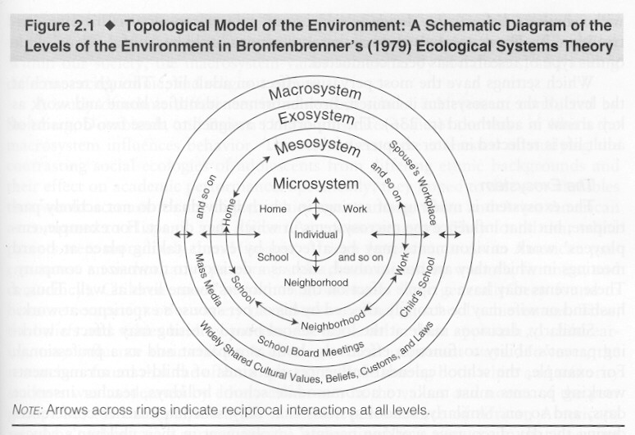
Domains of Development
Perception
Cognition
Language
Social/Emotional

Slide 3
Perceptual Development
Nativism vs. Empiricsm
  Developmental examples
Sensory system development
Visual statistics and word learning?
Parent triadic & infant object attention→word learning
  Joint attention to object—infant sustained attention
Adaptiveness…
  Efficient human face deduction
Evolution and experience in face processing
Methodology
  Paired preference
  Eye tracking
  Baby hears mom for first time: https://www.youtube.com/watch?v=-_Q5kO4YXFs

Slide 4
Is perception the foundation of cognition?
The organism’s input
Epistemology
  Origins of different forms of knowledge
Nature/Nativism
  The structure of reality is in the organism
  vs.
Nurture/Empiricism
  The structure of reality is in the environment
Your belief?
  An interface

Slide 5
The Role of Experience in Perceptual Development
Early visual deprivation and later development
  See video
  See Maurer et al., 2007
  First hearing adult
        https://www.youtube.com/watch?v=0AKod_YEok4 (2:41, tears)
Notes:
Taste not affected
Debate over cause of declines…nervous system degeneration/organ impairment vs. diminished psychological judgment
Over life span rate of change follows inverted U-shaped function with development being most active early and late in the life cycle

Slide 6
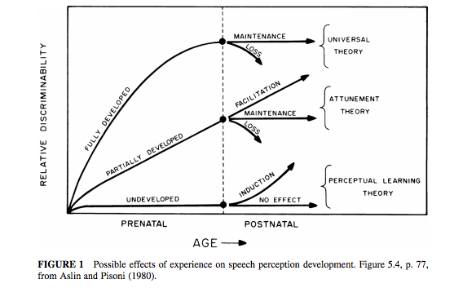
“Critical” Initial Formulation
Similarity in timing

Slide 7
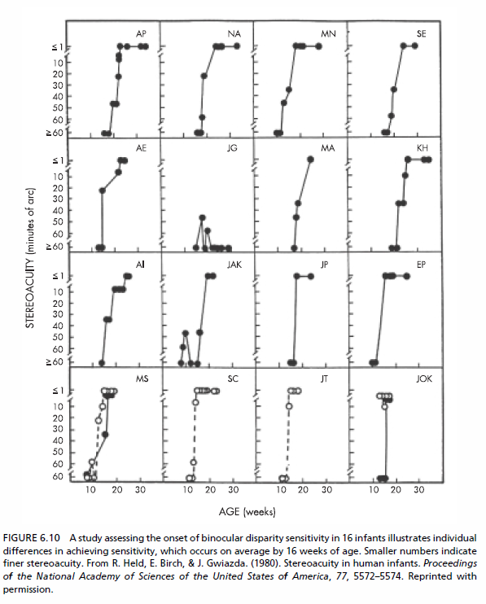
Stereoacuity Development
Requires binocular vision
Development appears variable?
Baby sees parent clearly for first time 3-1:39 https://www.youtube.com/watch?v=EyM6pEm8sEo

Slide 8
Early visual deprivation → later development
Developmental changes in capabilities
Low spatial frequency sensitivity—eventual recovery
But some capabilities are permanently damaged
    Mid and high spatial frequency
    Holistic face processing
    Face recognition based on spacing of features
Differences between spared vs. permanently damaged domains in terms of their typical developmental course?

Slide 9
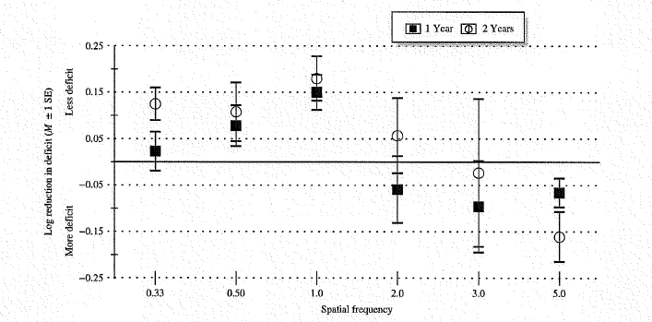
Sleeper Effect in Contrast Sensitivity
Increasing deficit for high spatial frequencies
  Compared to typically developing controls
Maurer, Ellemberg, & Lewis, 2006
Notes:
Figure 1 Reduction in patients’ deficit in contrast sensitivity when re-tested 1 or 2 years after the initial assessment. The first test
was between age 4 and 7 years. The graph shows how the patients’ deficit, compared to visually normal controls, changed when
they were re-tested 1 and 2 years later. For low spatial frequencies (wide stripes: up to 1.0 cycle per degree), patients’ sensitivity
improved more than that of controls, eliminating all or most of their deficit. For mid spatial frequencies (3–5 cycles per degree),
there was improvement in the control group but not in the patients, so that patients’ deficit increased. For high spatial frequencies
(10–20 cycles per degree), patients were unable to see the stripes at any test point. Reprinted from Maurer, Ellemberg & Lewis
(2006, Figure 4).

Slide 10
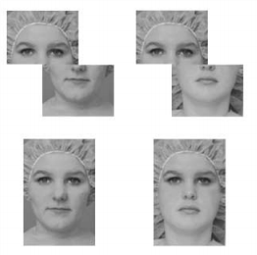
Holistic Face Processing: Misaligned and composite stimuli
Is top half the same?
LeGrand, Mondloch, Maurer, & Brent, 2004
Same?
Notes:
Figure 2 Test stimuli for the composite face effect. On ‘same’
trials, the top halves of the two sequential faces are the same
but they are combined with different bottom halves. The
subjects’ task is to indicate that the tops are the same. When
the halves are aligned in upright faces, visually normal adults
find the task difficult on same trials because holistic processing
creates the impression of two different faces. When the halves
are misaligned to break holistic processing, the task is much
easier. Reprinted from Le Grand, Mondloch, Maurer & Brent
(2004, Figure 1, left panel).

Slide 11
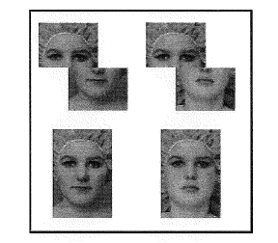
The Role of Experience in Visual and Auditory Development
Holistic Face Processing
LeGrand, Mondloch, Maurer, & Brent, 2004

Slide 12
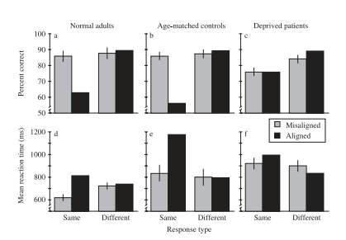
Holistic Face Processing
LeGrand, Mondloch, Maurer, & Brent, 2004
Notes:
Figure 3 Results for the composite face task for patients treated for bilateral congenital cataract and age-matched controls.
On
the critical probe trials (same/aligned), the control group is less accurate and has longer reaction times compared to both the patient group and their own performance when the holistic interference from the irrelevant bottom half is reduced by misalignment (same/misaligned).
Patients’ superior performance on same/aligned trials and their identical performance on same trials for the aligned
and misaligned blocks both provide evidence that the patients do not process faces holistically. Reprinted from Le Grand, Mondloch,
Maurer & Brent (2004, Figure 2).

Slide 13
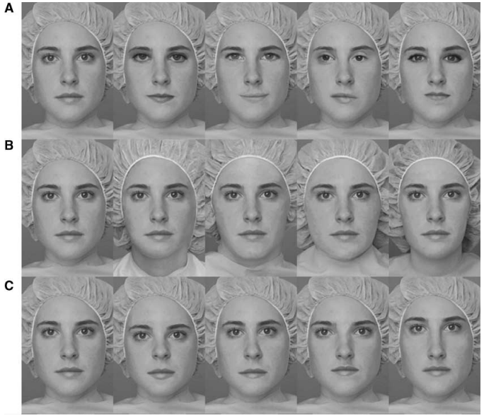
Face Recognition
Eye/mouth shape
Shape of external contour
Spacing of internal features
Notes:
Figure 4 The stimulus sets used to test sensitivity to differences among faces in the shape of the eyes and mouth (set A), the shape
of the external contour (set B), and the spacing of the internal features (set C). ‘Jane’ is shown as the left-most face in each panel,
along with her sisters differing along one of the three dimensions. For the tests, stimuli were presented almost life size. Patients
treated for bilateral congenital cataract have a deficit only when asked to discriminate faces in the spacing set (C). Reprinted from
Le Grand, Mondloch, Maurer & Brent (2003, Figure 1).

Slide 14
The Role of Experience in Perceptual Development (cont)
Interpretations of developmental mechanisms underlying sleeper effects
  Loss of optimal neural architecture
    Lack of visual input → loss of essential neural connections or reallocation of resources for different forms of processing
  Effects of altered timing and/or sequence of input
    Mismatch between input and prior experience
      No visual input → rapid increase in acuity
      Side effect of rapid increase =
        doesn’t give time to process ‘globally’
          as in typical development

Slide 15
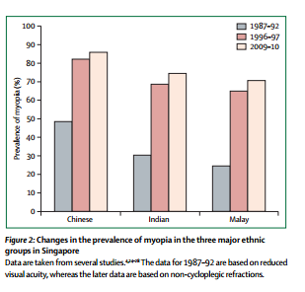
Historical & regional differences myopia rates (nearsightedness)
How would you interpret these data?
Notes:
‘Highest prevalences of myopia for young adults of Chinese ancestry.
Evidence that the prevalence of myopia are based primarily on genetic diﬀerences.
E.g., generally lower prevalences in rural areas than in urban areas.’

Slide 16

What do you see in this picture?
Phenomenon: www.youtube.com/watch?v=YIKm3Pq9U8M (54s)
Gislén, A., Warrant, E. J., Dacke, M., & Kröger, R. H. H. (2006). Visual training improves underwater vision in children. Vision Research, 46(20), 3443-3450. doi: http://dx.doi.org/10.1016/j.visres.2006.05.004
Notes:
Training:
http://www.deepdyve.com/lp/elsevier/visual-training-improves-underwater-vision-in-children-NyLb24uM7W

Slide 17
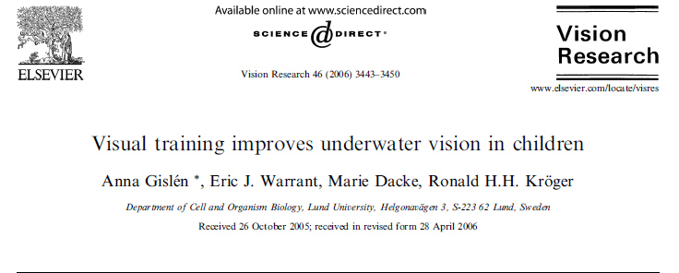
Children in a tribe of sea-gypsies from South-East Asia have been found to have superior underwater vision compared to European children. In this study, we show that the improved underwater vision of these Moken children is not due to better contrast sensitivity in general. We also show that European children can achieve the same underwater acuity as the Moken children. After 1 month of under- water training (11 sessions) followed by 4 months with no underwater activities, European children showed improved underwater vision and distinct bursts of pupil constriction. When tested 8 months after the last training session in an outdoor pool in bright sunlight—com- parable to light environments in South-East Asia—the children had attained the same underwater acuity as the sea-gypsy children. The achieved performance can be explained by the combined eﬀect of pupil constriction and strong accommodation.

Slide 18
Adaptiveness in Patterns of
Growth?
Adaptiveness of initial perceptual sensitivities?
  Touch/smell well developed at birth
    Approach/withdrawal responses
  Optimal hearing in mid-frequencies
    Sensitivity to lower/higher frequencies later
  Gradual development of acuity with clearest image at 12 inches in newborn
Notes:
p. 306 “the window of modifiability in perceptual adaptation appears to open early in life so that organisms can prepare quickly, efficiently, and optimally for the particular ecology in which they develop”

Slide 19
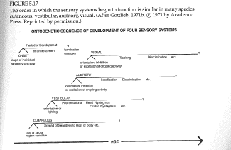
Sensory system development

Slide 20
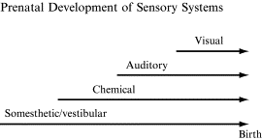
Sensory system development

Slide 21
Order of prenatal experience impacts sensory development
Hearing typically develops before sight
Rats, ducklings, and quail chicks exposed to visual stimulation prenatally
  before they normally would
Lose hearing ability at birth
Normal sensory development is contingent on extra-fetal environment
  E.g., being enclosed
                Lickleiter et al.

Slide 22
The Role of Experience in Perceptual
Development
Audition and Aging
  Nature/Nurture and
  loss of hearing
Hearing test by age: http://www.youtube.com/watch?v=AXhRmv1mrs4
Baltes, Reese, Nesselroade, 1977

Slide 23
How can perfect pitch develop?
Perfect pitch
  Experience- based changes in the ability to identify and reproduce a pitch: http://perfectpitchtest.com/
  Distorted tunes test (long)
    http://www.nidcd.nih.gov/tunetest/pages/dtt.aspx
Notes:
http://www.youtube.com/watch?v=fSfc21RDkbw-
http://www.youtube.com/watch?v=AXhRmv1mrs4
-true>
Lewkowiz
voicing
Changes in hearing acuity over the lifespan:
http://www.youtube.com/watch?v=AXhRmv1mrs4

Slide 24
Vehavioral Methods for Studying Perceptual Development
Measures
  Naturally occurring behaviors
  Preference paradigms
  Conditioning paradigms
  Habituation/Dishabituation

Slide 25
“Critical” Initial Formulation
Similarity in timing

Slide 26


Slide 27
Real-world visual statistics and infants’ first-learned object names
Clerkin et al., 2017

Slide 28
How are 1-year-olds mapping heard names to their referent objects?
Referential ambiguity
Statistical learning – keeping track!
Frequency distribution of objects in infants’ visual worlds
  Visual familiarity with objects
  Pervasiveness Hypothesis

Slide 29
How do one-year-olds link words that they hear to the scenes around them?
Theoretical problem for research: Referential Ambiguity
Learners acquire language by linking heard words to perceived scenes
BUT scenes are highly cluttered with a variety of objects / potential referents
Hylton
Notes:
Referential ambiguity: lack of clarity about what is being referred to.
For example, I’m an infant and I hear my siblings mention the TV. In my line of sight, I see a physical TV, a dog resting in front of it, a rug under the dog, a table that the TV is sitting on, and a story happening on the tv that also contains countless additional objects. How do I know which object is the TV?

Slide 30
Statistical word-referent learning
Potential explanation:
  Infants keep track of a set of objects across different situations and statistically determine word meaning
  BUT perceptual, attentional and memory systems may be insufficient for this
Hylton
Notes:
So over time, I have hundreds of scenes that involve the word “TV,” and perhaps a dog is in them 30% of the time, a ball in them 10% of the time, but the television is them 90% of the time, so I determine over time, with all of these aggregate scenes, that the word “TV” refers to the giant screen that plays stories.
-Wouldn’t this be amazing?
-But… we have evidence from a number of studies suggesting that perceptual, attentional and memory systems may be insufficient to handle all of the clutter that is in everyday scenes.

Slide 31
Proposed solution: visual statistics
Use a frequency distribution of objects in infants’ visual worlds.
Test the Pervasiveness Hypothesis:
  Some objects are far more common than others, and familiarity helps infants match them with words more quickly.
Use egocentric vision (head cameras)
Hylton
Notes:
Use egocentric vision (head cameras) to track the frequency distribution of visual objects in infant egocentric scenes.

Slide 32
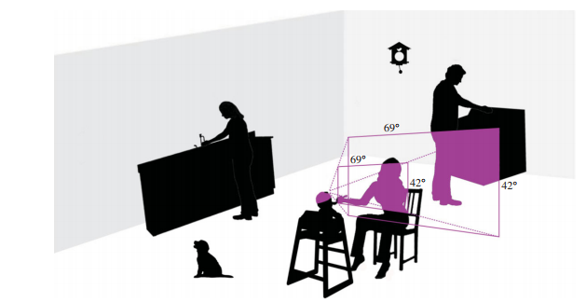
Aunty
Clock
Dad
Sink
Oven
Shoes
Mom
Dog
Hylton
Notes:
For example, in this scene NEAR the infant we have a sink, aunty washing dishes, a clock, dad, and a dog. The baby could see these objects if she was positioned differently or if she turned her head. But at the moment, her view is much narrower and only includes her mom, a pair of shoes (connected to dad), and the oven.
This selectivity is momentary, but could be governed by systematic constraints, like the height of the baby, where she is usually placed by her caregivers, etc. which could end up “privileging” certain object categories over others. So we could test the Pervasiveness Hypothesis, big figuring out if these high-frequency objects coincide with the object names that babies normally learn first.

Slide 33
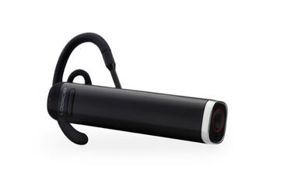
Participants and choosing scenes for coding
Eight infant participants (8.5 – 10.5 months)
Videos collected with infant head cameras
Mealtime videos chosen
  8.5 hours of 147 events
  917,207 frames, sampled for 5775 scenes
Hylton
Notes:
Age chosen because it comes just before first birthday, when first words traditionally happen.
This is an example of a wearable camera that goes over the ear, but the authors used one that was attached to a hat and centered above the nose.

Slide 34
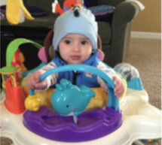
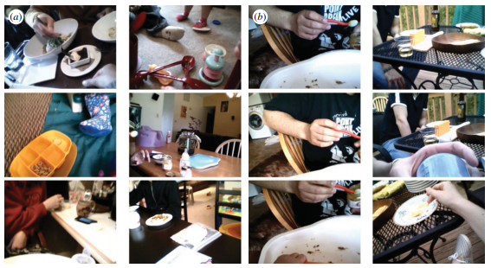
Methods
8 infants (8.5 – 10.5 months)
Videos of mealtime activity collected with infant head cameras (5775 coded scenes)
Each image coded by 4 adults (label up to 5 in-view objects, Types) → max. 20 unique Types per image.
Notes:
do less).

Slide 35
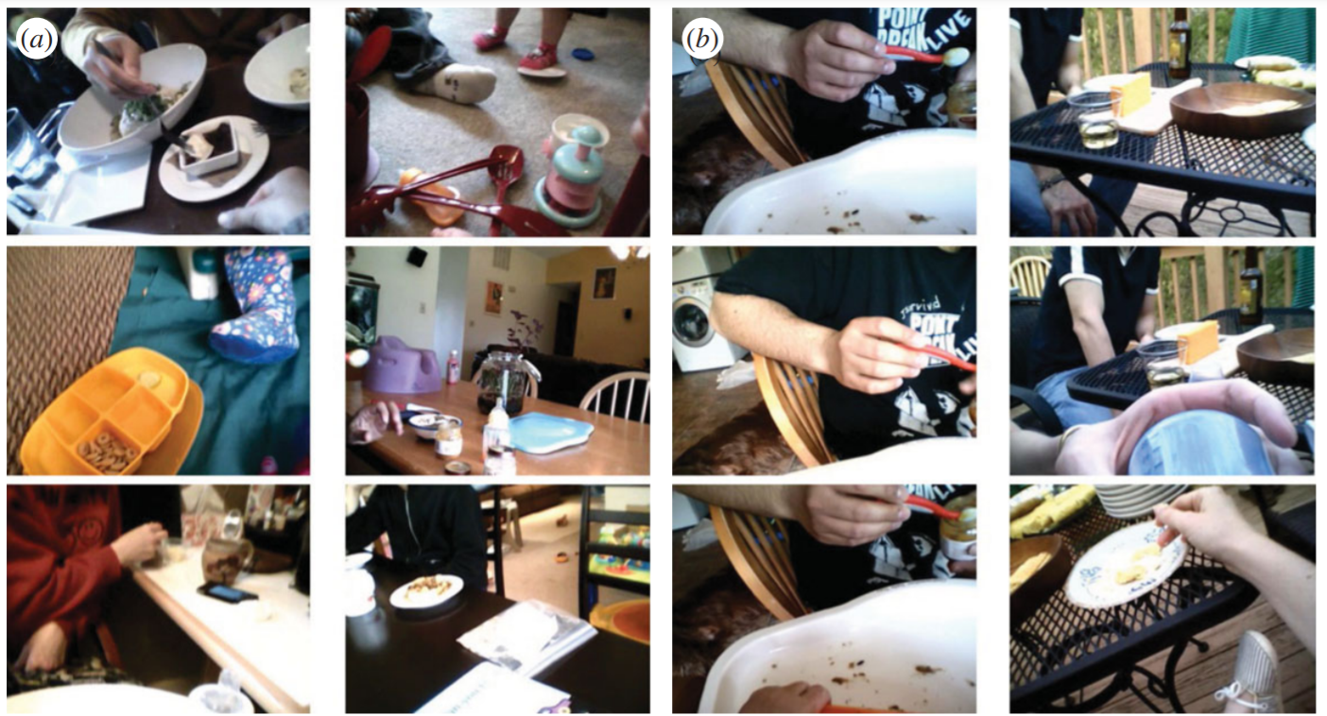
Hylton
Notes:
The six images on the left show a variety of ‘mealtime’ contexts examined in this study. Can anyone pick out some examples of contexts?
The six images on the right show two sequences (one per column) of images sampled (high chair, being fed with red spoon; at table in parent’s lap)

Slide 36
Coding scenes
Scene-to-text coding:
  Each coding set had 20 sequentially ordered images
  Each image was coded by four adults
  Each adult labelled up to five in-view objects
  Maximum unique objects per image: 20
Hylton
Notes:
Adults were sourced through Amazon Turk, paid to code images

Slide 37
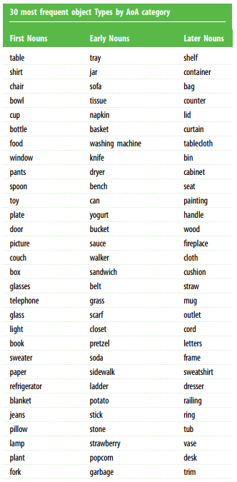
Age of acquisition (AoA) categories
745 unique object Types were categorized as...
First Nouns (133) – receptive vocabulary norms
  Bates-MacArthur Infant Communicative Developmental Inventory (CDI)
Early Nouns (59) – productive vocabulary norms
  Toddler CDI
Later Nouns (553) – all other object labels
  Mean AoA = 6.15 years (SD=1.56)

Slide 38

Age of Acquisition (AoA) Categories for 745 Objects
First Nouns (133)
  Bates-MacArthur Infant Communicative Developmental Inventory (CDI)
Early Nouns (59)
  Toddler CDI
Later Nouns (553)
  All other objects
Ahn
Notes:
They came up with a total of 745 unique objects and categorized these into three different Age of Acquisition Categories:
First Nouns (133) – come from an inventory designed for 8-16 month olds
Early Nouns (59) – come from an inventory designed for toddlers (50% for 30 month olds)
Later Nouns – everything else
Key prediction: early nouns will be less frequent in the views of 8.5-10.5 month olds compared to first nouns.

Slide 39
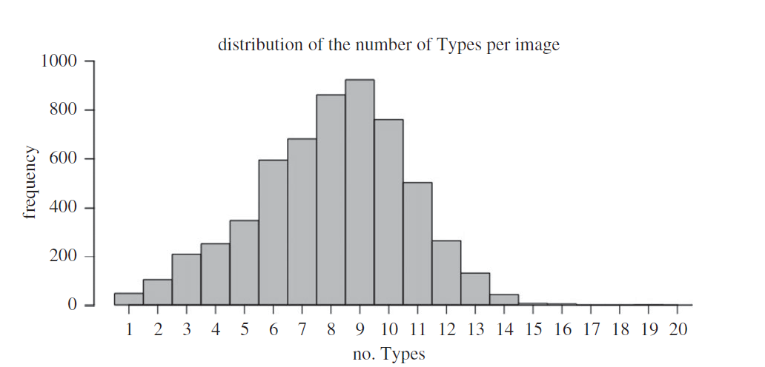
Objects per image: Median = 8; Mean = 7.94; SD = 2.73
Hylton
Notes:
This histogram shows the distribution of the number of objects coded per image. Remember that we can have no more than 20 unique objects per image (4 adults coding, 5 unique images each). Here you can see that we have the greatest frequencies for 8, 9, or 10 images: so the takeaway here is that infants are presented with a fair amount of clutter within their views.
So here, we see that there is both CLUTTER and REFERENTIAL AMBIGUITY.

Slide 40
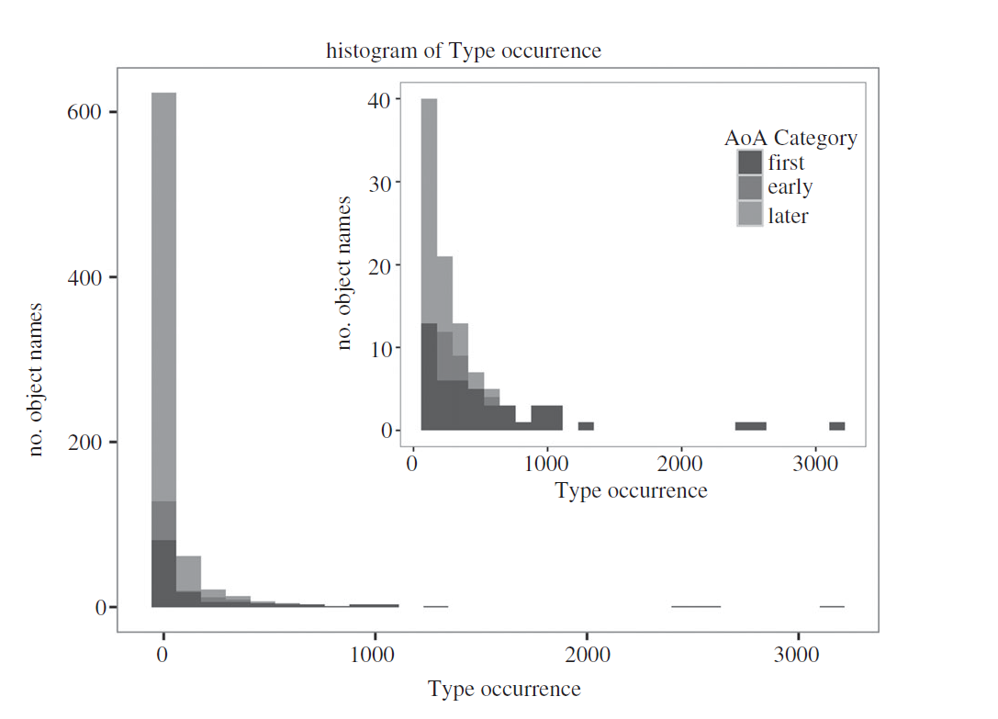
Frequency distribution
Niño

Slide 41
Very high-frequency objects (tail) are in First Words category (dark grey)
Nino
Notes:
This histogram shows us that the frequency distribution of unique objects is extremely right skewed.
Most of the objects are very infrequent.
However, some of the types are VERY present. Seven items occur in more than 1000 of the 5775 images (they make up 33% of all reported object instances).
The smaller histogram shows the distribution of the 100 most frequently reported objects.
Because the three different shades of grey show the Age of Acquisition categories, we can see that all of the very high-frequency objects—those in the tail—are in the First Words category (darkest grey).

Slide 42
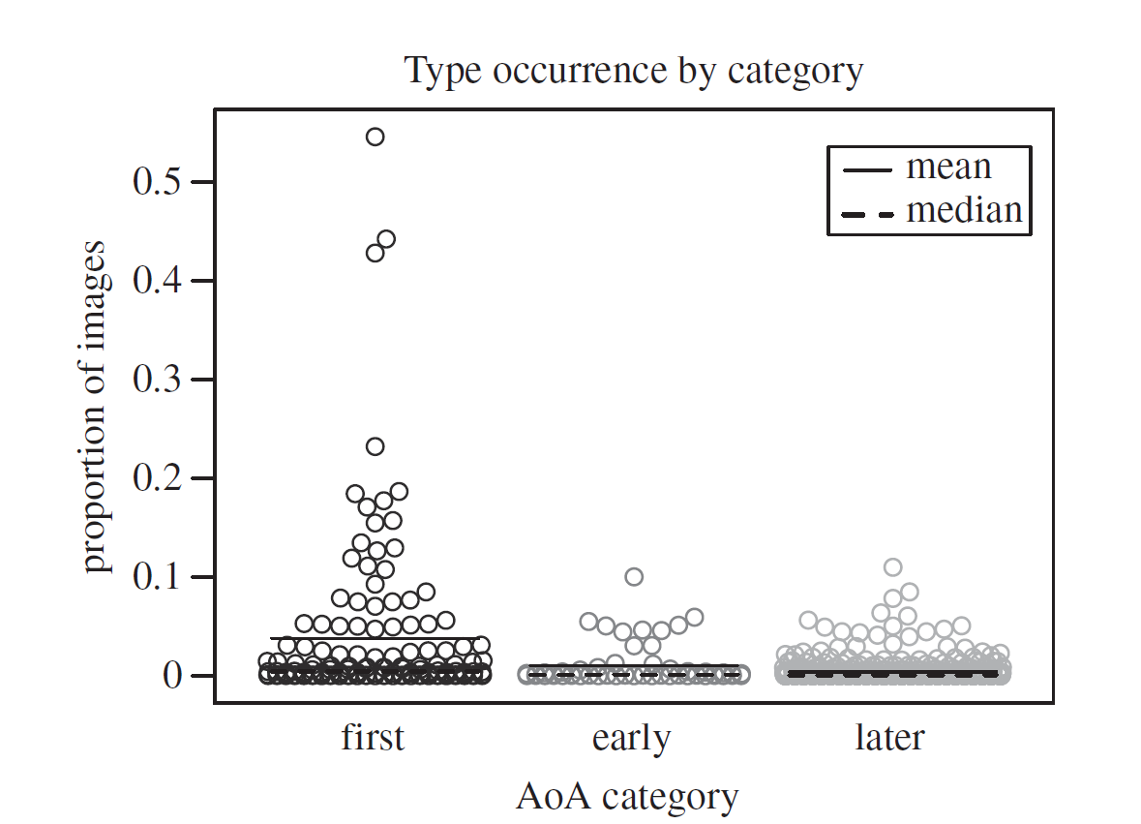
Object frequency and AoA

Slide 43
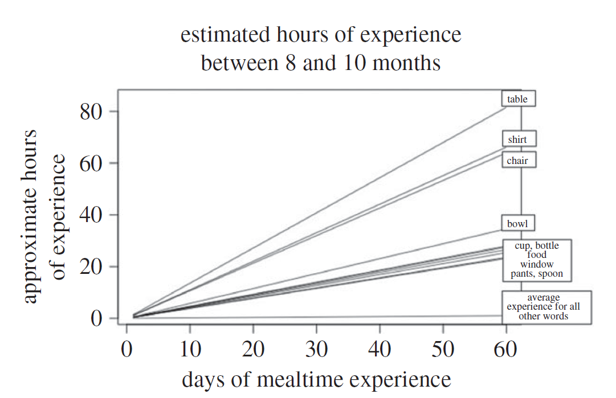
Nino
Notes:
-The researchers also estimated the number of mealtime experiences that babies have between 8 and 10 months by:
-looking at the frequency and duration of eating events in each video, and
-consulting a time-sampling study on daily activities of infants in this age range.
-They estimated that infants participate in five eating events per day, with each lasting about 3.5 minutes.
-Then they estimated the total number of hours that an infant would be visual exposed to different items over the two month period.
-You can see from the graph here that infants would be expected to be exposed to a table for approximately 80 hours, to a shirt and chair for approximately 60 hours, to a bowl for approximate 30 hours, etc. And these far outweigh the average amount of time for other object. So we can see that infants spend much more time with these select objects than they do with the hundreds of other objects that might make up the visual clutter in scenes.

Slide 44
Evidence for the Pervasiveness Hypothesis
Prevalence of a few object categories biases the candidate referents linked to heard words.
Greater visual familiarity → reduced referential ambiguity → facilitate statistical word-referent learning
Right-skewed distribution may be relevant to visual learning about the high-frequency objects
Ahn
Notes:
-We have generally cluttered scenes from an infant perspective.
-But across all scenes, we have a relatively small number of objects that are commonly present.
-The pervasiveness hypothesis poses that the fact that there are only a few objects commonly present means that infants are biased towards linking those objects with the words that they hear.
-In the study the fact that there is a strong correspondence between these common objects and normal first-learned words for infants provides evidence for the pervasiveness hypothesis.

Slide 45
Discussion Questions
There were only eight infants included in this study. Do we feel there were enough? Why or why not? What else might you like to know about these infants and/or their families in order to better interpret the results?
The researchers chose to use video footage of mealtimes in the study despite instructing caretakers to take footage of any parts of their day that they saw fit. What are some of the advantages and disadvantages of a) using mealtime and/or b) asking for any footage but using mealtime only?
Are there alternatives to the pervasiveness hypothesis that come to mind when reading this article? What are some reasons other than mere pervasiveness that might bias infant learning of words?
If you could add one element to this study to improve it (or add nuance), what would you add?
Hylton
Notes:
-What was the race/ethnicity/culture of these infants and their families? Did they speak more than one language at home? Mealtime can be very much influenced by culture—where one is sitting, how long it lasts, what utensils and how many people are around, etc. What was the SES of the families? What was the vision like for the infants (and do we even know much about infants’ vision or any disabilities related to vision at that age?
-May introduce bias—some families may have been more likely than others to use footage. Disadvantages of mealtime—some infants may still be breastfeeding, parents likely did not film this. Families that are and are not breastfeeding (and at what proportion) may be different.
-Strong emotions like fear or joy might bias learning. Many pointed out that “mama” and “papa” are often first words of babies, but proper nouns were not included in the study.
-i.e. also tracking audio for the clips and coding what words are simultaneously being heard by the infant?

Slide 46
Infant-perspective visual field
To test the Pervasiveness Hypothesis…
  Aimed to determine the frequency distribution of visual objects in infant egocentric scenes.
High-frequency objects are expected to coincide with the object names normatively learned first by infants.

Slide 47
Visual statistics and name-object learning
Prevalence of a few object categories biases the candidate referents linked to heard words.
Greater visual familiarity → reduced referential ambiguity → facilitate statistical word-referent learning
Right-skewed distribution may be relevant to visual learning about the high-frequency objects

Slide 48
Discussion
Auditory input by the parent is assumed during the meal time activities – how could auditory input be incorporated into the study and would it affect results?
Can we make assumptions about the process of word learning without measuring individual children’s vocabulary (through the CDI?) and looking at relationship between the object type in their meal time and results?
How would this process differ for children with language delays or other disabilities? What about visual disabilities?
Was mealtime the appropriate activity to select? Would results be different if another activity was selected?
Other thoughts?

Slide 49
What are the building blocks of parent-infant coordinated attention in free-flowing interaction?
Abney, 2020
Grassie

Slide 50
STUDY GOALS
  1. Determine the relative frequencies of different types of coordinated attention (gaze patterns from infant and parent)
  2. Determine the association between those types of coordinated attention and later infant vocabulary size at 12- and 15-months
Grassie

Slide 51
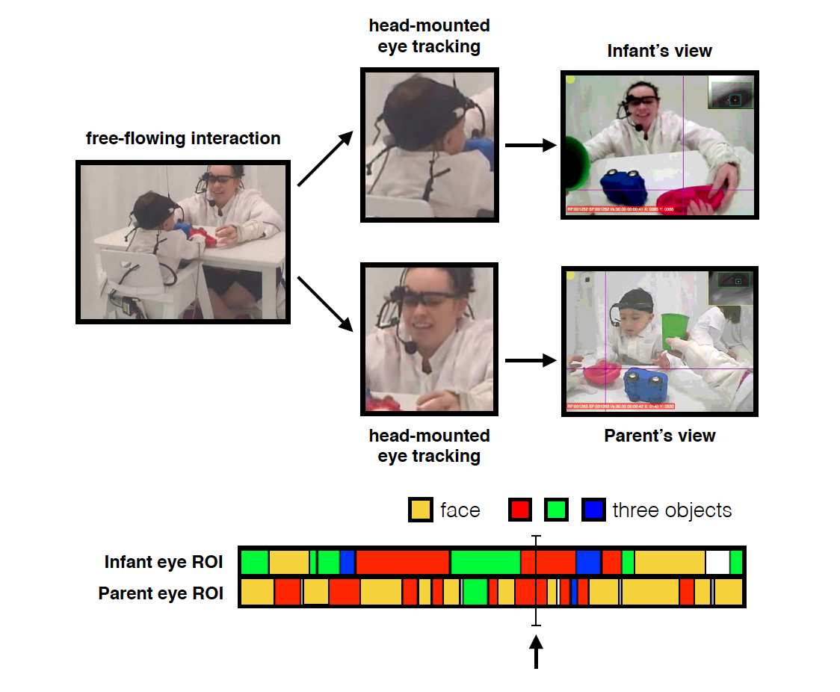
TASK OVERVIEW
Infant and parent both wear head-mounted eye tracking devices that capture regions of interest
Infant and parent play with toys
Examine where the infant and parent look (e.g., at each other, the toys, or both)
Investigate association of gaze behavior with later vocabulary
Grassie

Slide 52
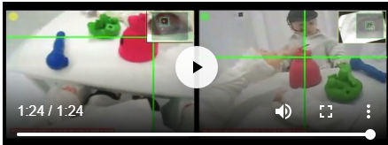
Video
https://ars.els-cdn.com/content/image/1-s2.0-S0960982216302020-mmc2.mp4

Slide 53
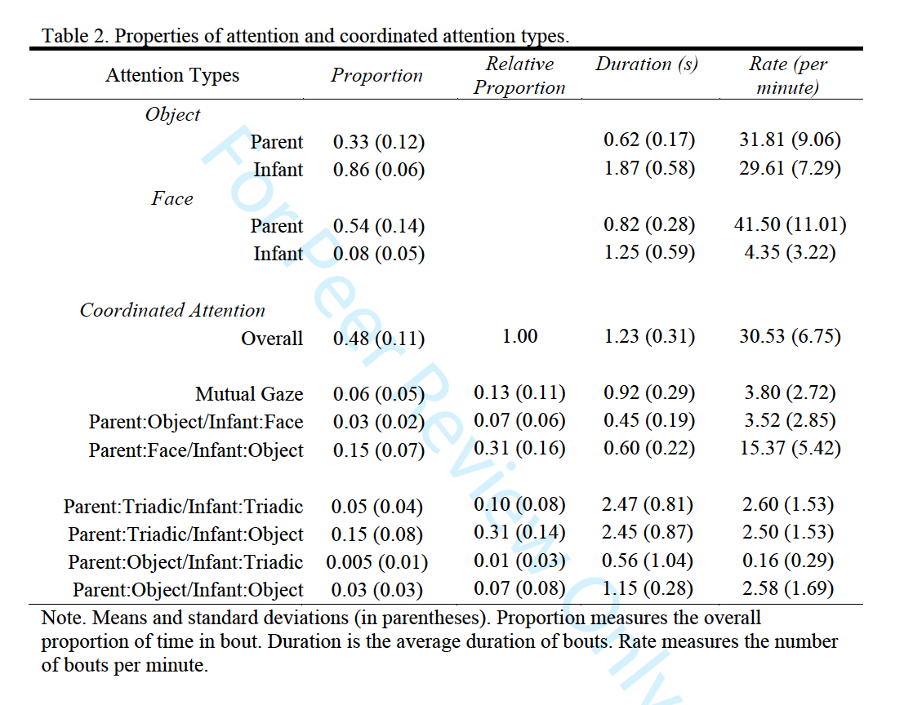
FREQUENCY OF
COORDINATED ATTENTION TYPES
2 types of visual attention made up the majority (60%) of time infants & parents spend in coordinated attention
Parent looking at infant’s face
Infant looking at object
Parent looking at infant’s face & object
Infant looking at object
Grassie

Slide 54


Slide 55
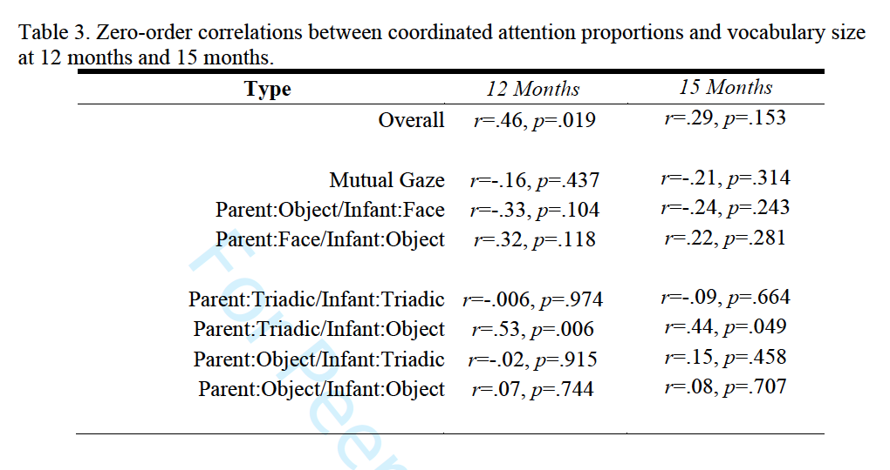
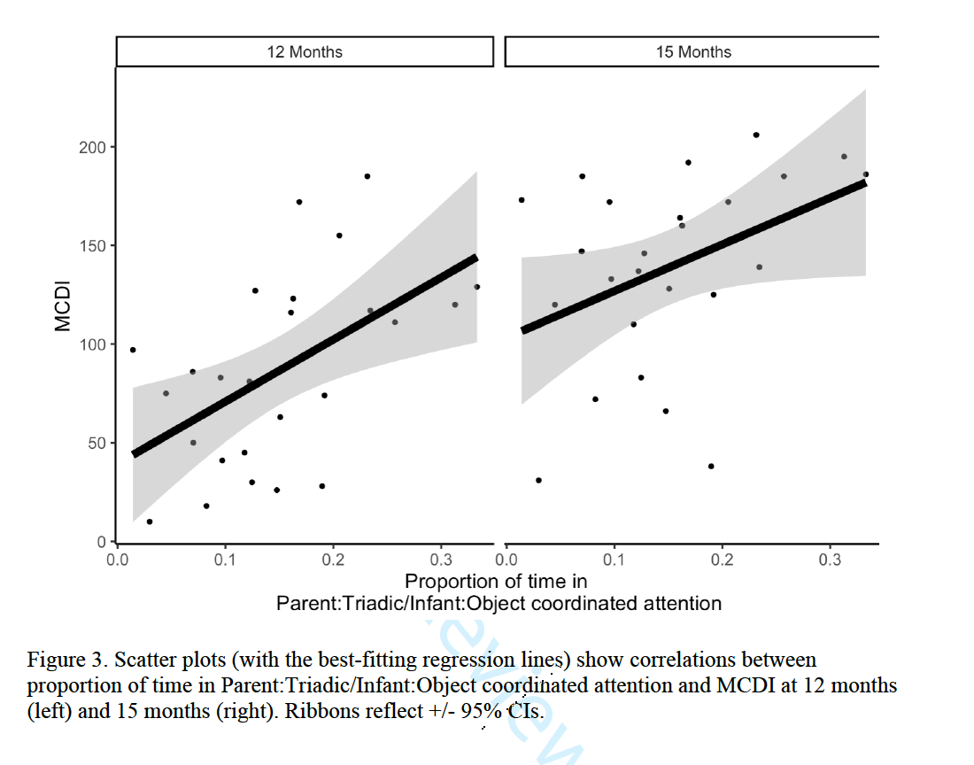
COORDINATED ATTENTION AND
LATER VOCABULARY
Positive association between vocabulary use and
parent looking at infant’s face & object while infant looks at object
Grassie

Slide 56
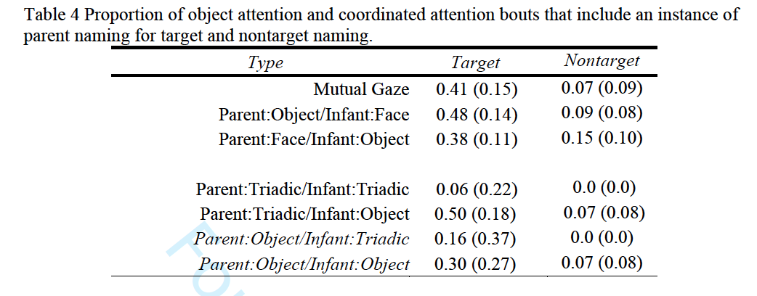
COORDINATED ATTENTION TYPE
AND LABELING OBJECTS
Parents label the object/target the Positive association between vocabulary use and
parent looking at infant’s face & object while infant looks at object
Grassie

Slide 57
TAKEN TOGETHER
Parents label the object infants are looking at
Parent looking at infant’s face & object
Infant looking at object
at 9 months
Larger vocabulary size
at 12 & 15 months
Grassie
Notes:
Previous research suggested that a key factor of infant word learning is that when an infant sustains attention on an object, a parent names the object

Slide 58
DISCUSSION QUESTIONS
How would you expect these results to differ for less attentive parents?
Were you surprised to see that infants look more at the objects compared to their parent’s face?
  What individual differences could contribute to the proportion with which an infant looks at their parent vs. object?
Given the role of parents labeling the object that their child is looking at on later vocabulary style, do you think that children of blind parents would have smaller vocabularies compared to those of seeing parents?
Given the increased frequency of children using tablets (assuming that parents aren’t actively observing their gaze), do you think vocabulary size has/will decrease?
Grassie

Slide 59


Slide 60

What is Sustained Attention (SA)?
Ability to voluntarily control one’s attention
Before the emergence of SA, young infants’ attention is often characterized by fleeting interest in novelty and distractions

Slide 61
Why do we care about sa?
Emerges around 10 – 12 months
      Growing steadily through early childhood
Attributed internal, individual factors
      i.e. temperament, self-regulation,
      EF, cognitive control
Relates to language, exploration,
problem solving, and school readiness
      Predicts development outcomes and
      diagnosis for attentional disorders

Slide 62

Social Origins of SA?
Infants develop in social contexts
      Thus development depends on
      social interactions
Everyday interactions (particularly play time) with caregivers scaffolds infant’s development of SA
      Parents’ attention
      Parent Responsiveness
      Joint attention (JA)

Slide 63
Current Study
Aim:
To examine the influence of social context on
infants’ sustained attention
Hypothesis:
      JA timing does not relate to infants’ SA duration
      Duration of JA relates to overall SA of infant
      Parent attention (JA) extends infants visual attention to an object (even after JA ends)

Slide 64
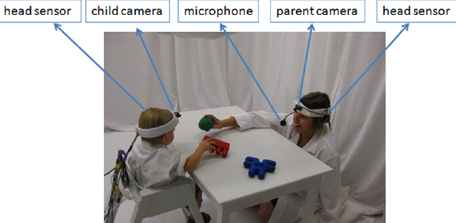
Methods
36 parent-infant dyads (11-13 m)
Head-mounted cameras/eye-trackers worn during free-play with 6 novel toys 2 different sets of 3 toys (played 1.5 min each set, twice)

Slide 65
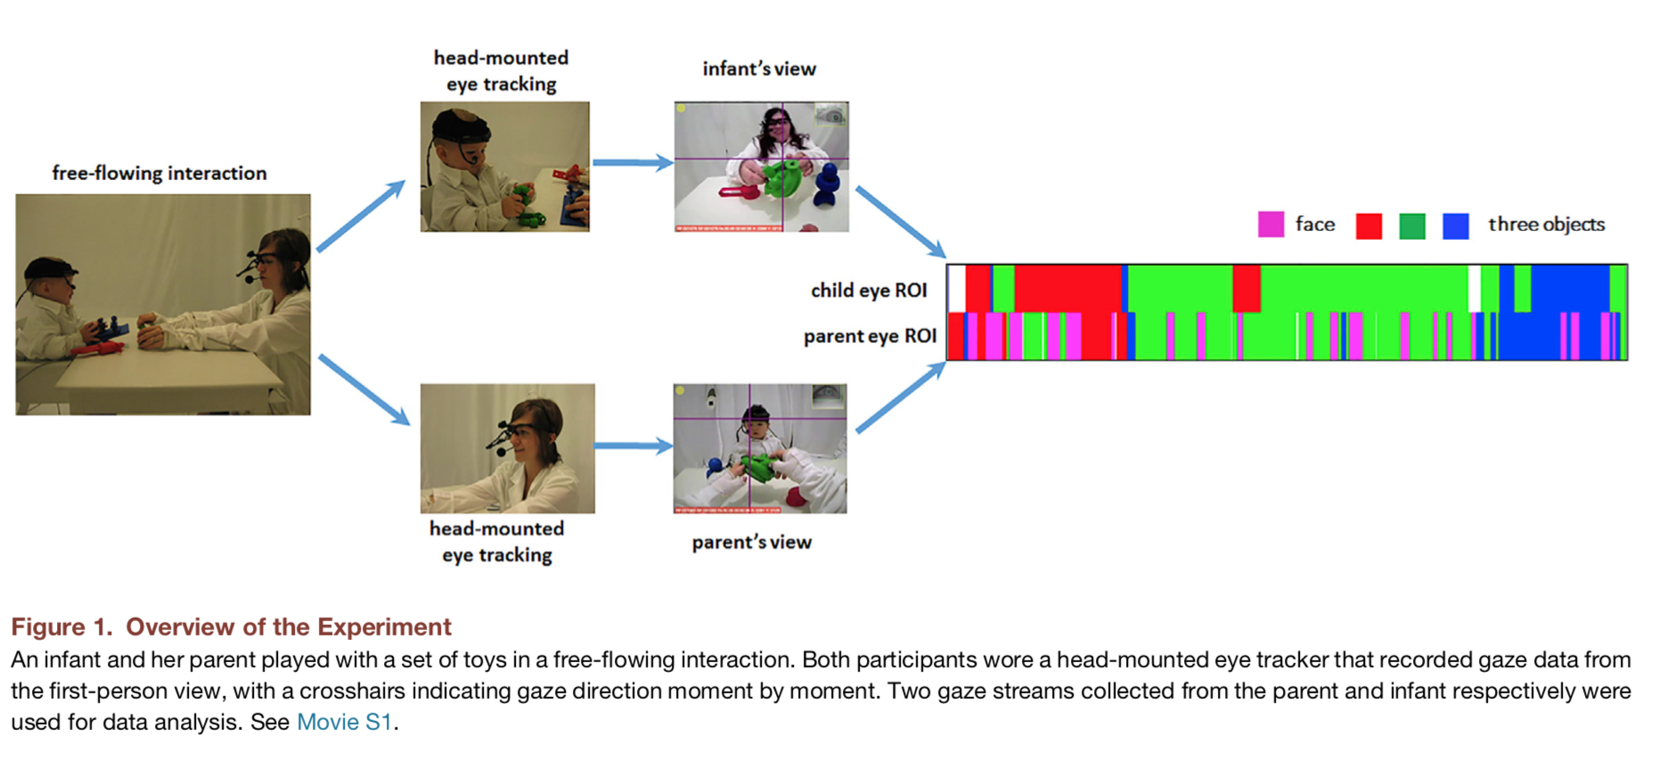
Coding
Human coders identified instances when eye gaze fell within one of 4 ROIs (3 toys & partner’s face)
Identified moments and duration of JA & SA
JA: parents & infants were jointly fixated on same object at same time for at least 500ms (can have looks away <300ms)
SA: 3+ seconds of infant
consistent looking at a single
object (without any looks away)
Notes:
a joint attention bout was defined as a continuous alignment of parent and infant fixation that lasted longer than 500 ms but that could include looksbriefer than 300 ms elsewhere.
This threshold ensures that the defined sustained attention bouts are on the tail of the distribution (exceeding the mean of the overall distribution) and thus are at the upper end of what children this age can do when visually focusing attention on a single object
More specifically, we operationally defined 3 s of consisten tlooking within the ROI for a single object without any looks else whereas the threshold for sustained attention by the infant.

Slide 66
Video
https://ars.els-cdn.com/content/image/1-s2.0-S0960982216302020-mmc2.mp4

Slide 67
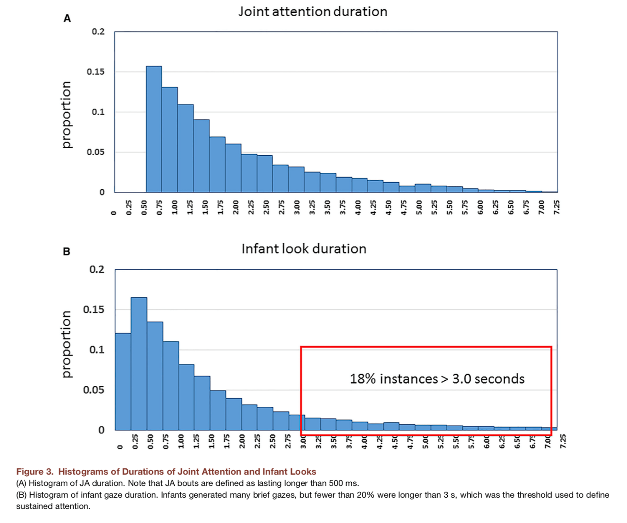
JA & sa durations
Notes:
Histogram of JA duration. Note that JA bouts are defined as lasting longer than 500 ms.
Parents and infants, on average, jointly attended to the same object34.24% (SD = 6.04%) of the total toy-play time, which wa scomposed of 9.37 (SD = 1.65) distinct JA bouts with an average duration per bout of 2.39 (SD = 0.61) seconds.
(B) Histogram of infant gaze duration. Infants generated many brief gazes, but fewer than 20% were longer than 3 s, which was the threshold used to define sustained attention.
The majority of infant looks to an object were brief.
Given this definition, infants generated 4.72 sustained attentionbouts per minute with a mean duration of 5.05 s, which ismuch longer than the observed average duration of looks to asingle object when one considers all such looks (t(35) = 12.54,p<0.001, d = 4.24)

Slide 68
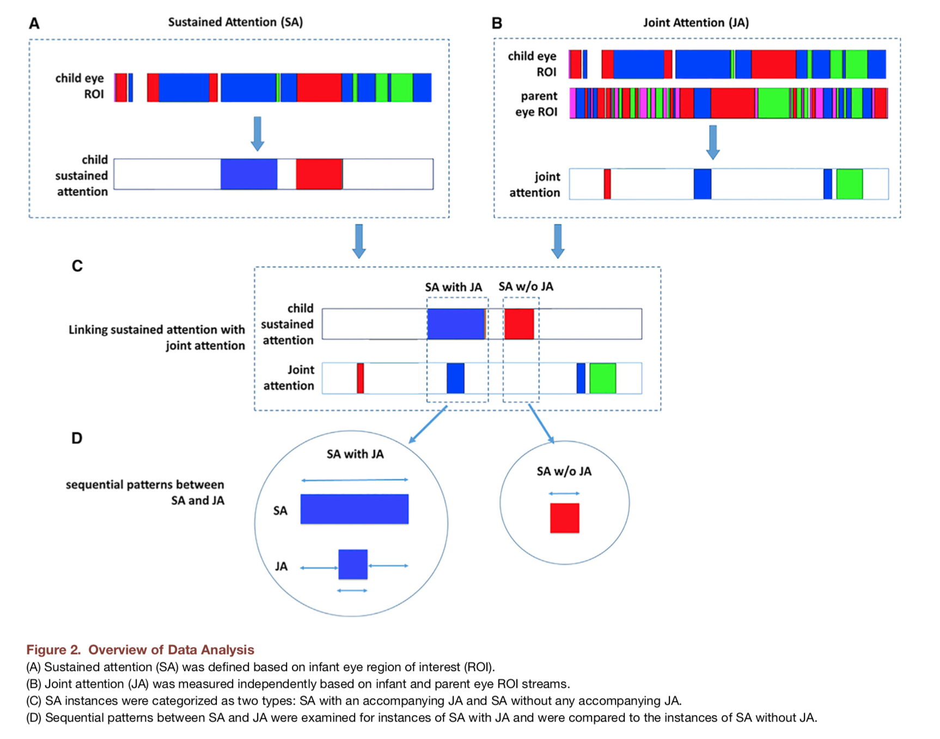
Instances of JA + child SA
Notes:
Sustained attention (SA) was defined based on infant eye region of interest (ROI).
(B) Joint attention (JA) was measured independently based on infant and parent eye ROI streams.
(C) SA instances were categorized as two types: SA with an accompanying JA and SA without any accompanying JA.
(D) Sequential patterns between SA and JA were examined for instances of SA with JA and were compared to the instances of SA without JA.
Divided infants SA bouts into SA + JA and SA alone
65% of instances of child SA occurred in accompany with JA
and the average duration of SA was significantly longer than without (increasing on average by 1 second

Slide 69
Instances of JA + child SA
Notes:
Sustained attention (SA) was defined based on infant eye region of interest (ROI).
(B) Joint attention (JA) was measured independently based on infant and parent eye ROI streams.
(C) SA instances were categorized as two types: SA with an accompanying JA and SA without any accompanying JA.
(D) Sequential patterns between SA and JA were examined for instances of SA with JA and were compared to the instances of SA without JA.
Divided infants SA bouts into SA + JA and SA alone
65% of instances of child SA occurred in accompany with JA
and the average duration of SA was significantly longer than without (increasing on average by 1 second

Slide 70
Instances of JA + child SA
Notes:
Sustained attention (SA) was defined based on infant eye region of interest (ROI).
(B) Joint attention (JA) was measured independently based on infant and parent eye ROI streams.
(C) SA instances were categorized as two types: SA with an accompanying JA and SA without any accompanying JA.
(D) Sequential patterns between SA and JA were examined for instances of SA with JA and were compared to the instances of SA without JA.
Divided infants SA bouts into SA + JA and SA alone
65% of instances of child SA occurred in accompany with JA
and the average duration of SA was significantly longer than without (increasing on average by 1 second

Slide 71
Instances of SA with and w/out ja
\\website.psy.miami.edu
Notes:
Sustained attention (SA) was defined based on infant eye region of interest (ROI).
(B) Joint attention (JA) was measured independently based on infant and parent eye ROI streams.
(C) SA instances were categorized as two types: SA with an accompanying JA and SA without any accompanying JA.
(D) Sequential patterns between SA and JA were examined for instances of SA with JA and were compared to the instances of SA without JA.
Divided infants SA bouts into SA + JA and SA alone
65% of instances of child SA occurred in accompany with JA
and the average duration of SA was significantly longer than without (increasing on average by 1 second

Slide 72
Results
H1: Mean SA-with-JA was longer than SA-without-JA
(M_{SA-with-JA} = 5.33 s, M_{SA-without-JA} = 4.38 s, β = 1.27, SE = 0.11, p < 0.001)
H2: No difference in total durations of the SA-with-JA bouts for long and short lags
  M_{long-lag} = 5,231 ms; M_{short-lag} = 4,876 ms; β = 0.07, SE = 0.17, N.S.)
H3: SA instances with long JA were longer overall
M_{long-JA} = 6,540 ms; M_{short-JA} = 4,293 ms; β = 0.87, SE = 0.17, p < 0.001)
H4: Infant attention to the target after JA ended was longer for longer JA periods than for shorter ones
    M_{long-JA} = 2,146 ms; M_{short-JA} =959 ms; β = 0.82, SE = 0.09, p < 0.001)
Nicolais, C.J..

Slide 73
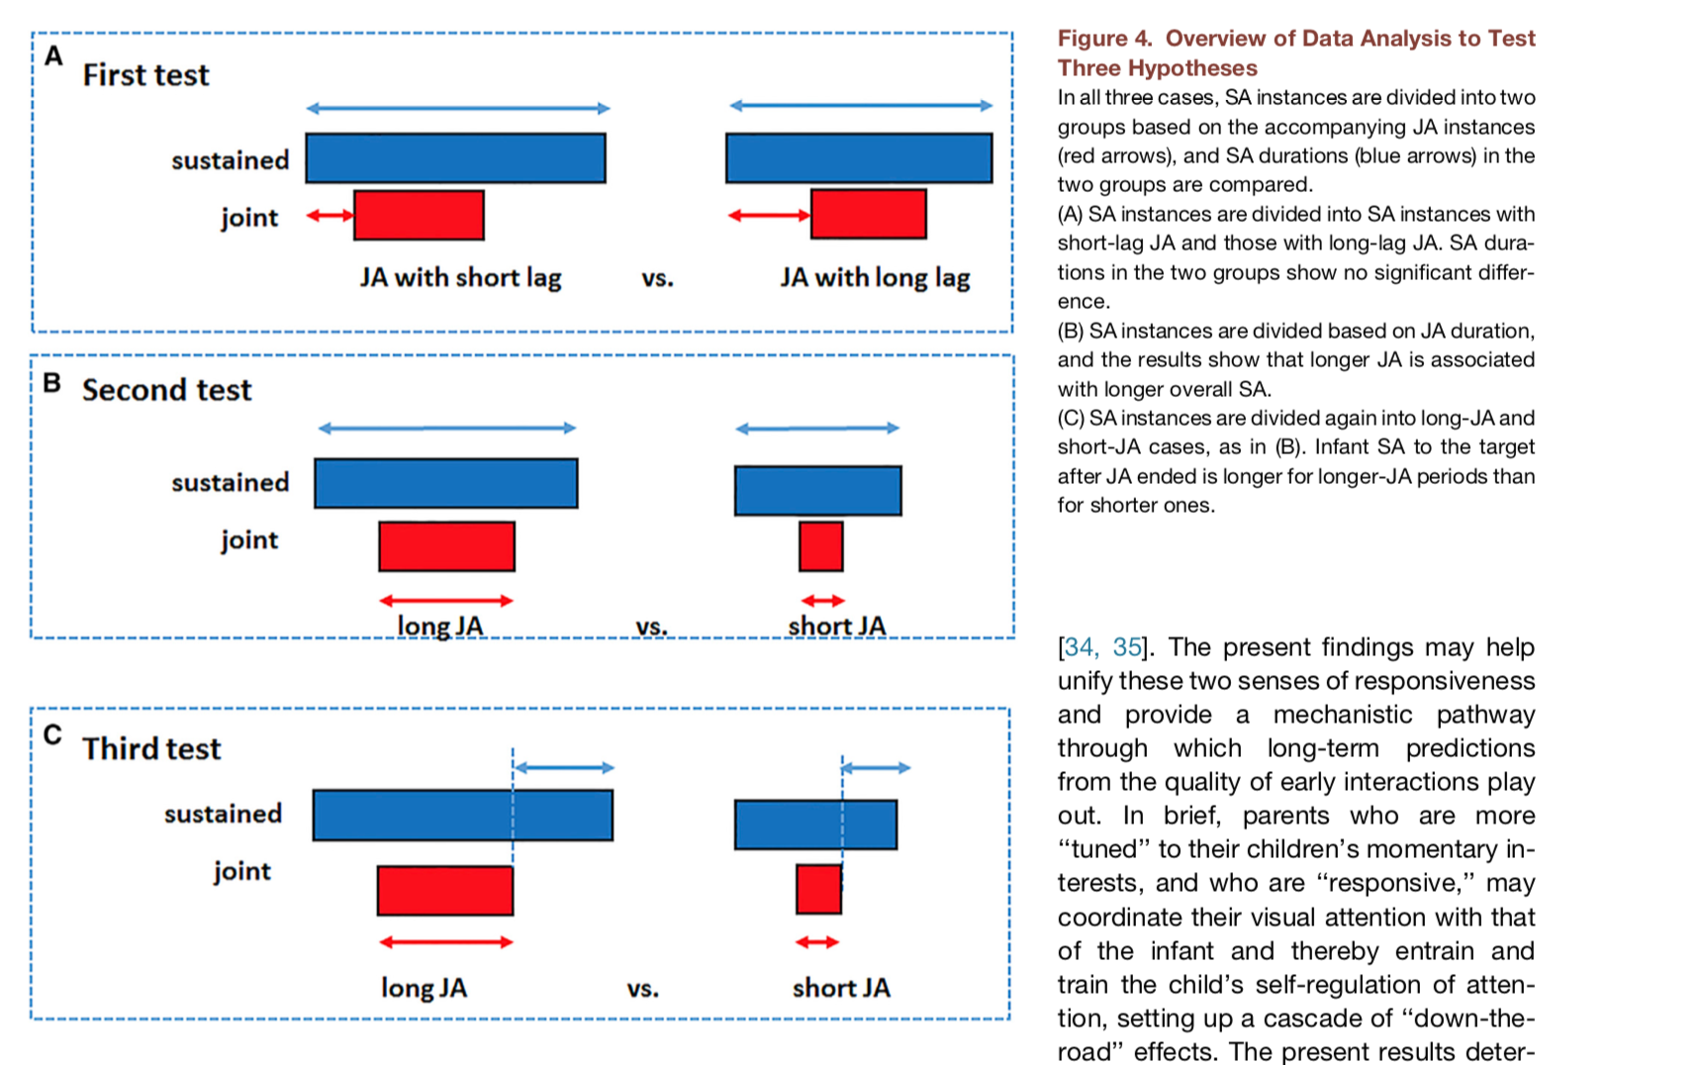
“Extension” Hypothesis
Notes:
In all three cases, SA instances are divided into twogroups based on the accompanying JA instances(red arrows), and SA durations (blue arrows) in thetwo groups are compared.
(A) SA instances are divided into SA instances withshort-lag JA and those with long-lag JA. SA dura-tions in the two groups show no significant differ-ence.
(B) SA instances are divided based on JA duration,and the results show that longer JA is associatedwith longer overall SA.
(C) SA instances are divided again into long-JA andshort-JA cases, as in (B). Infant SA to the targetafter JA ended is longer for longer-JA periods thanfor shorter ones.

Slide 74
Results
Speed/timing of JA did not relate to
infant SA duration
Duration of JA determined overall
duration of child SA
Parent looks to child’s interest:
      sustained infant’s interest in
      the object
      extended SA duration after parent looked away
“Extension” Hypothesis

Slide 75
Take-homes
Social interactions influence infant SA
    Duration of infant’s attention on an object is
    extended by the visual attention of parent.
    JA extends SA during & after it ends
Implies that differences in SA abilities/
development may be associated with
differences in early social experiences
Relates to parent responsiveness
    Key role in multiple domains of early development

Slide 76
Discussion
Do these results in fact suggest that there is a social component influencing sustained attention?
      Could there be a different component at play?
Could the parent being the “adult play partner” have a different effect than, for example, a sibling or a daycare provider?
What implications, if any, does this have for children of parents who's attention wanders?
If true, could this finding be helpful to children developing atypically?
      Is it generalizable in that sense?
If true, how can we expand on this study to further promote sustained attention?
How can the findings in this study be better supported?

Slide 77

Infant attention to objects they are holding
—and that their
parents are holding—
fosters infant-parent joint attention to
objects.

Slide 78


What we know…
The coordination of visual attention among social partners is central to:
  Language learning
  Joint action
  One’s ability to read social cues and understand other’s intentions
  Individual differences in ability to coordinate visual attention predict individual differences in language, social, and cognitive development
Limitations of gaze following as a measure of Joint Attention (JA) in laboratory tasks
Notes:
Everyday parent-infant interactions, such as toy play, take place in visual environments which are much more cluttered than the visual environments of traditional laboratory studies.
The increased complexity of the real-world visual environments that infants are immersed in within their everyday life make head and eye direction of their social partners insufficient cues for them to be able to differentiate between objects that are close to one another in space

Slide 79
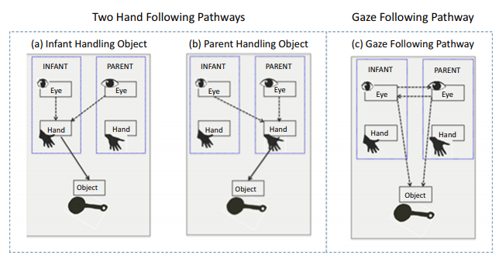
Pathways to Joint Attention
Traditional route to Joint Attention to an object is through Gaze Following

Slide 80
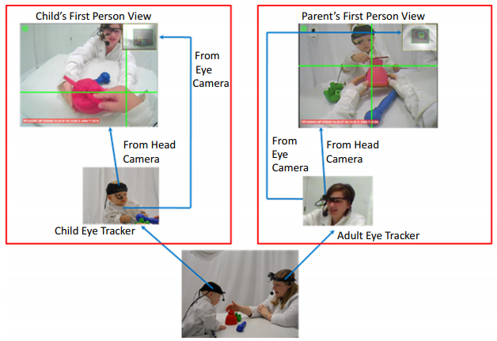
Method
Participants:
  51 infant-parent dyads
  11-24 months of age
Procedure:
  Videos of infant-parent dyads were collected using head-mounted eye-trackers and head cameras worn by both participants as they played with 6 novel toys
  Human coders identified instances where eye gaze (as visible in headcamera view) fell within one of four ROIs (3 toy objects and partner’s face)

Slide 81
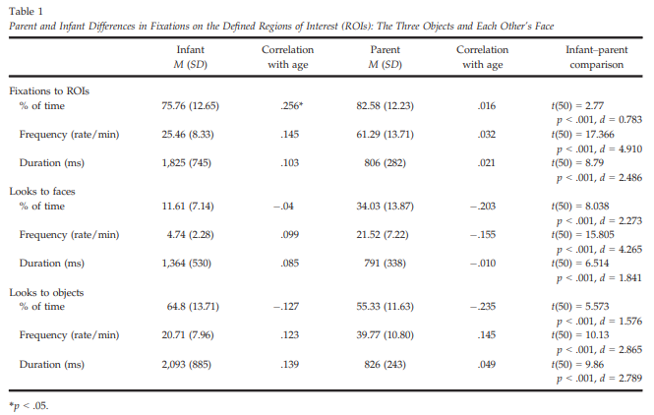
Parents more ROI total time & more switches between objects and faces than infants.
Infants had longer unbroken looks within ROI than parents.
Infants fixated objects more than parents; parents fixated infant faces more than infants.
Notes:
Infants and parents spent a high proportion of time fixating the ROIs, but parents spent more total time overall than infants and exhibited more attentional switches between objects and faces than infants.
Infants had longer unbroken looks within the same ROIs than did the parents.
Infants fixated the objects more than their parents whereas the parents fixated the faces of their infants much more than infants looked to their parents’ face.

Slide 82
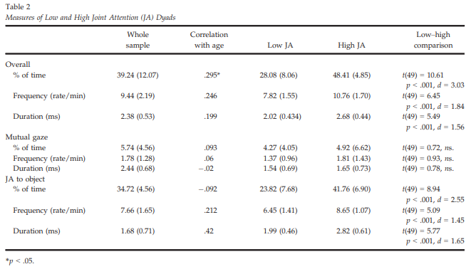
High JA and Low JA Dyads Differ on JA to Objects but Not Mutual Gaze

Slide 83
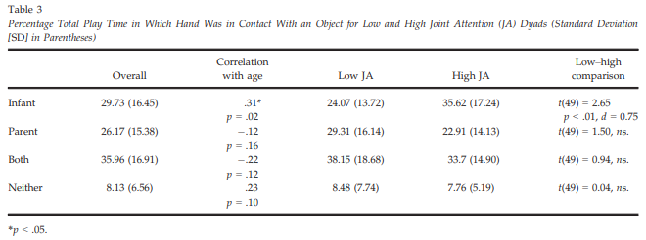
High JA Infants Exhibit Increased Object Manipulation Relative to Low JA Infants

Slide 84
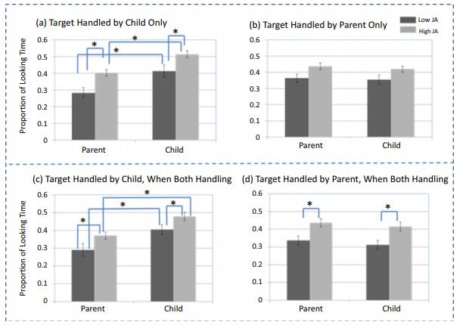
Increased Infant Object Manipulation → and Looking to Objects → Increased JA Bouts with Parents

Slide 85
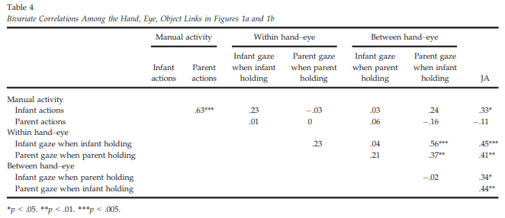
Infant Object Manipulation and Within and Between Hand-Eye Coordination are Reliably Correlated with JA to Objects

Slide 86
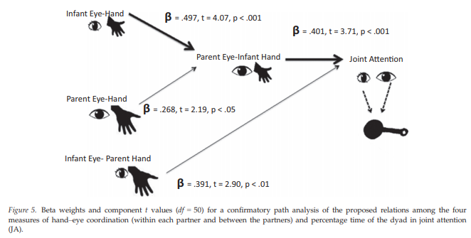
Parent Visual Attention to Infant Object Handling Mediates Relationship Between Infant Hand-Eye Coordination and JA

Slide 87
Conclusions
These findings suggest an alternate route to JA to an object (i.e., hand-following pathway) that provides more precise cues for infants to read in complex visual contexts.
  The hand-following pathway may scaffold more precise gaze following.
Infants who exhibit increased hand-eye coordination are likely to experience more bouts of JA with their parents, which in turn lead to better developmental outcomes.

Slide 88
Discussion Questions
What do these findings mean for atypical development?
Practical significance? Strategies for increasing coordination of attention during object play in the low JA dyads?
Future directions?
Other thoughts?

Slide 89
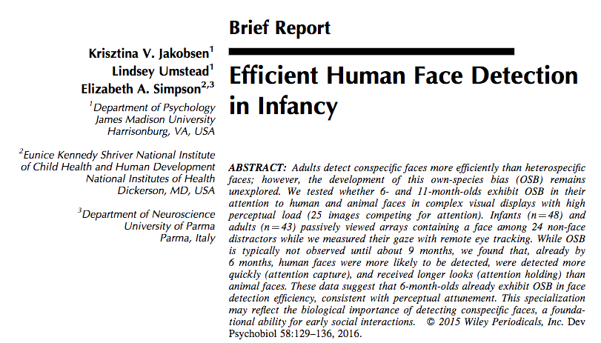
Jakobsen, K., Umstead, L., & Simpson, E. (2015). Efficient human face detection in infancy. Developmental Psychobiology, 58(1), 129-136.
Early Own Species Bias
detection, attention capture, attention holding
C. Morris

Slide 90
Background
“Faces are biologically important for the formation and maintenance of social relationships.”
Own-species bias (OSB)
Visual attention mechanisms:
  1. Detection
  2. Attention Capture
  3. Attention Holding
Martinez de Andino, 2017

Slide 91
Hypotheses
OSB in face detection, attention capture, and attention holding will be observed in adults and 11-month-olds, and may already be present in 6-month-olds.
Presented 25-item arrays of images
Martinez de Andino, 2017

Slide 92
Current Study
Infants recruited through emails at JMU
  23 6-month-olds (M = 6.1 months, SD = 0.31; 11 females; 78% Caucasian)
  25 11-month-olds (M = 11.1 months, SD = 0.31; 11 females; 84% Caucasian)
Adults recruited through an undergraduate research participant pool
  43 adults (M = 19.6 years, SD = 1.48; 27 females; 81% Caucasian)
Parents indicated highest level of education
Martinez de Andino, 2017

Slide 93
Methods: Eye Tracking
Participants viewed 12 25-item arrays (5 x 5 matrices)
  Photos in color
  Each array contained a unique neutral face of a human, primate, or mammal
  Faces were upright, with visible/open eyes, visible noses/mouths, and neutral expressions
  Remaining images were man-made and natural items
Adults: arrays displayed for 5 seconds each
Infants: arrays displayed for 8 seconds each

Slide 94
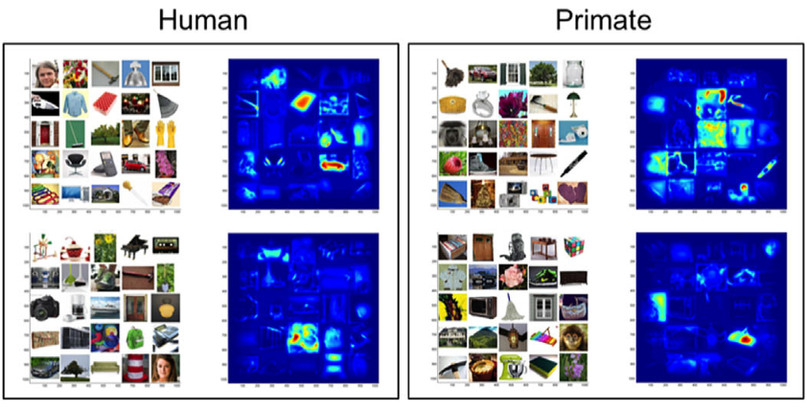
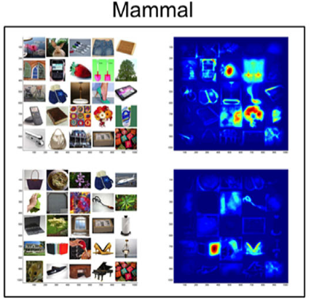
Arrays and salience maps
C. Morris
Notes:
There were 12 25-item arrays (5x5 matrices) each containing a unique neutral face of a human, non-human primate, or non-primate mammal surrounded by man-made and natural items. Salience groups - most salient regions are red, least are blue

Slide 95
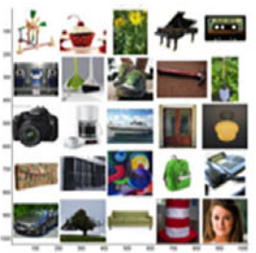

Human and primate arrays

Slide 96


Slide 97


Slide 98
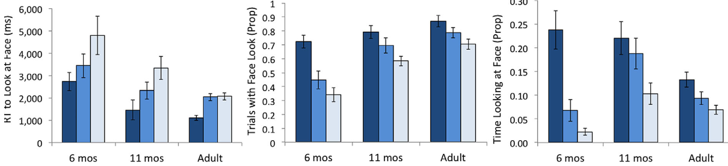
Results
attention
capture
attention
holding
detection
*Interaction
*Interaction
C. Morris

Slide 99
Discussion
Conclusions
  Pattern was similar across development for all three attentional measures
  By 6-months, human faces are more likely to be detected, and detected quicker, and hold attention longer
  By 6-months, infants already have adult-like OSB
Limitations
  Whether the face template is present at birth or requires experience
Martinez de Andino, 2017

Slide 100
Discussion
  Pattern was similar across development for all three attentional measures
  By 6-months, human faces are more likely to be detected, and detected quicker, and hold attention longer
  By 6-months, infants already have adult-like OSB
Limitations
  Whether the face template is present at birth or requires experience

Slide 101
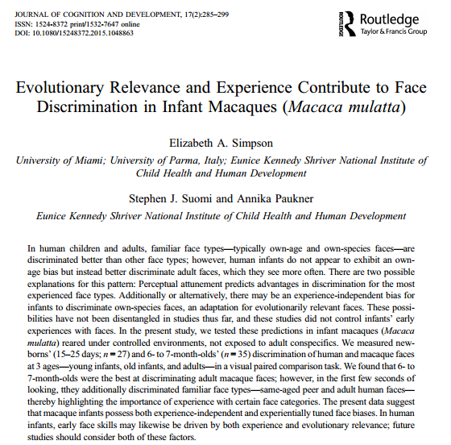
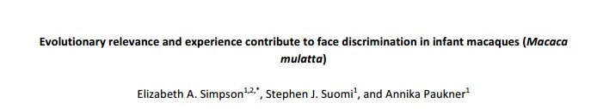

Slide 102

Experience vs. functionalism
Experience: Perceptual attunement
    Experience driven biases improve with exposure and decline without
      vs.
Functionalist approach
  Face-processing skills reflect age-appropriate developmental goals
  Biggest threat = absence of caregivers or presence of strangers → adult bias
Are developmental changes in face discrimination consistent with perceptual attunement or functionalist approach
Experience driven biases
  Perceptual attunement; improves with exposure, declines without
  Exposure must be accompanied by individuation (individual names)
Functionalist approach
  Face-processing skills reflect age-appropriate developmental goals
  Biggest threat = absence of caregivers or presence of strangers
Purpose:
  Test face discrimination biases in infant rhesus macaques with controlled, atypical exposure to faces
  Are developmental changes in face discrimination consistent with perceptual attunement or functionalist approach
  Are differences in discrimination the consequence of face viewing patterns during familiarization?
Background
Familiar face discrimination
  Race, peers, gender, species

Slide 103
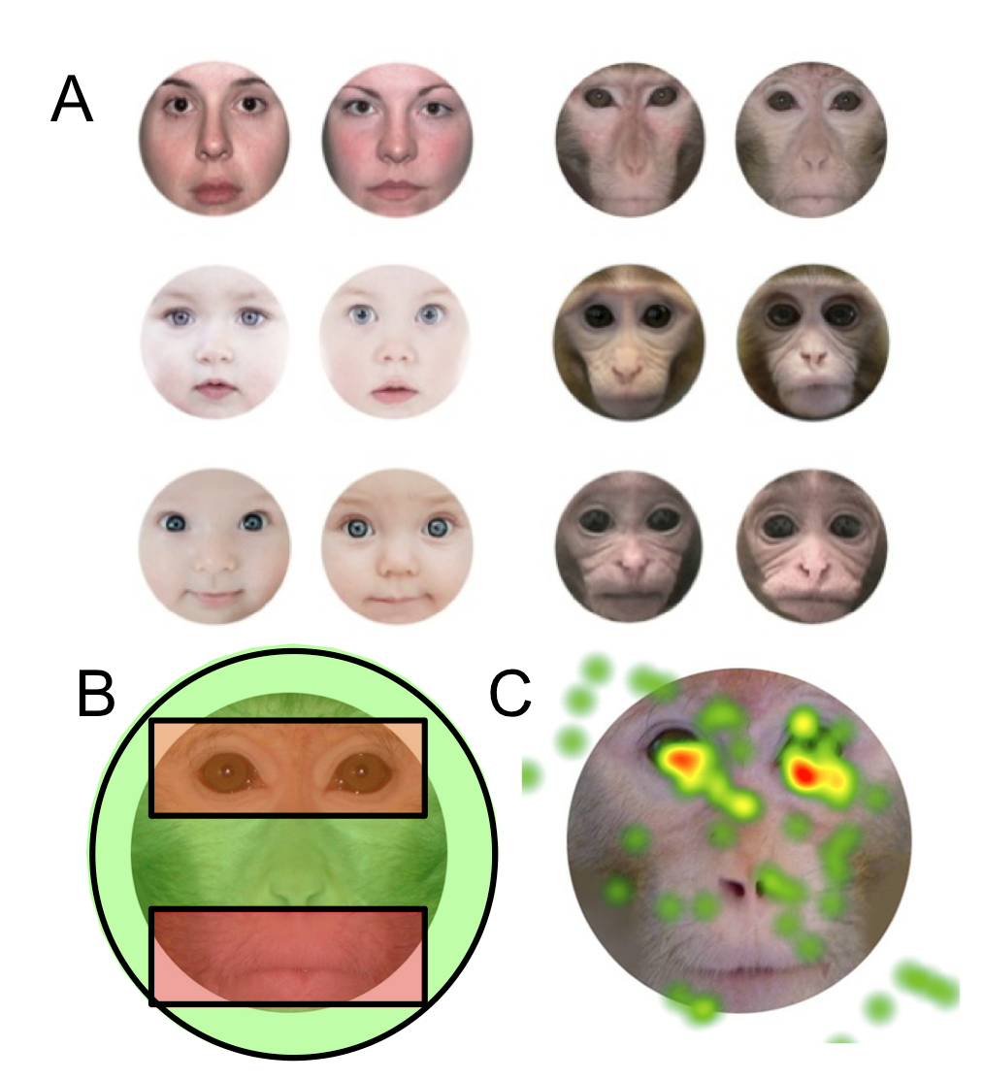

Slide 104
Methods
Rhesus macaques (2-groups)
  15-25-day-old (n = 27, 16 males)
  6-7 month-olds (n = 35, 21 males)
    More face experiences, especially for older infant macaques
Eye tracking
  60 distinct faces, 10 per face type
    Adult, older infant, younger infant
  Familiarized with a face for 10 s cumulative looking; then viewed familiar face next to novel face for 5 s
  Viewed 1 of 6 face types per day
    5 face pairings per day (30 trials across six days)
Analysis
  Identified areas of interest (AOIs) around each face
  Measured look duration at novel and familiar faces
  Measured proportion of time looking to the novel face during the first three seconds of looking
  Eye-mouth viewing index (eye / eye + mouth) [EMI]

Slide 105
6-7 mos look more at novel adult macaque faces
  No Bonferroni-corrected differences among newborns
  6-7 mo early stimulus viewing (first 1 - 2 seconds) looked at
      novel human adult faces
      novel monkey adult faces & same-aged peer monkey faces
        No significant differences among newborns
  Eye–mouth-index (EMI)
    Newborns: EMI’s greater than chance for adult faces only
    6-7 mo: EMI’s were greater than chance for all age groups
  and face discrimination

Slide 106
EMI encoding effects on discrimination of faces with high/low ecological validity/ familiarity
    EMI ecological relevance
      EMI adult monkey minus adult human
      EMI infant monkey minus EMI infant human
    Discrimination = total looking at novel stimuli / total looking at both stimuli
      Calculated discrimination relevance and familiarity measures
    EMI predicting Discrimination
      6-7 mo/olds: EMI infants sig. predicted discrimination for Infants stimuli
        Non-significant for adults
      Newborns: Neither model significant

Slide 107
Evidence for both perceptual attunement & functional approaches
  Infants may have developed predisposed attention to familiar adults due to necessity of a caregiver and threat of strangers
  Sensitivity to eye region of face increases with age
    Attending to the eye region of own-species faces predicts greater discrimination of own species faces
Notes:
Testing macaques at a later age may reveal stronger effects

Slide 108
Development by Sense
Differential development rates by sense
  Adaptiveness
Touch
  Sensitive at birth
    Questions regarding pain sensitivity prenatally and neonatally
Notes:
Adaptive to stagger developmental paths/timetables by sense to reduce mutual competition among systems for ambient stimulation; allowing heightened sensory organization and integration\
Overall patterns suggests that there is substantial but incomplete perceptual competency at birth

Slide 109
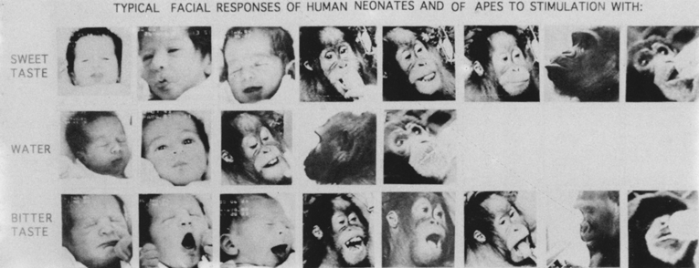
Development by Sense
Taste/Smell
  Differential behavioral responses to sweet, sour, bitter at birth (saltiness at 4mos)
    Reactions organized around approach/withdrawal
From Steiner & Glaser, 1995
Notes:
Overall patterns suggests that there is substantial but incomplete perceptual competency at birth

Slide 110
Taste/Smell
Taste
  Discriminate bitter, neutral, and sweet (Oster)
    Prefer sweet
Smell
  Turn down the corners of their mouths to bad smells, such as rotten eggs
  Facial relaxation to sweet smells like chocolate
  Porter et al.: preferential orienting to mom’s odors at 2 weeks
Controlled by subcortical regions of brain

Slide 111
Development by Sense
Hearing
  Both adults and children have preferential hearing for mid-frequencies (1000 Hz)
    Infants close to adult levels for mid-frequencies but low/high frequency hearing develops over 20 years
  Speech perception
    Phonemic discriminations at 6 mos
    Sensitive to timing & pauses in naturally occurring speech
    Across childhood sharpening of boundaries between
      Speech categories

Slide 112
Sensory capacity: Vision
Vision is functional from birth
But acuity is 1/25 that of adults
  20:500,
  blurry but in color
Improves to 20:20 by six months

Slide 113

Vision
  Orienting from birth esp. to faces
  Clear preferences
    Curved > straight
    Moderate density > high density
    Contours > inner elements
  Gradual development of acuity
    At birth 20/400 vision, maximum acuity at 12 inches
      Rapid development through 3-4 years
  Depth perception
    Binocular vision 4/5 mos

Slide 114
Adaptiveness in Patterns of
Growth?
Adaptiveness of initial perceptual sensitivities?
  Touch/smell well developed at birth
    Approach/withdrawal responses
  Optimal hearing in mid-frequencies
    Sensitivity to lower/higher frequencies later
  Gradual development of acuity with clearest image at 12 inches in newborn
Notes:
p. 306 “the window of modifiability in perceptual adaptation appears to open early in life so that organisms can prepare quickly, efficiently, and optimally for the particular ecology in which they develop”

Slide 115
Developmental Changes across Childhood
Increasing overlap with cognitive and language development – methodological challenge
  E.g., Table line drawing errors
Refinement of perceptual skills over childhood due to:
  Maturation of perceptual systems
  Maturation of complementary (e.g., motor) systems
  Experience
Increased application of perceptual skill to other domains
  Visually-guided reaching
  Cross-modal transfer
  Visual cues and postural stability
Notes:
Methodological challenge of overlap with cognition/language = increasingly difficult to separate how children perceive the world from how they act on it and what they know about it

Slide 116

Developmental Changes across Childhood
Visual cues and
postural stability
Schmuckler, 1997

Slide 117
What’s going on?
English-learning infants hear Hindi contrast better than English-speaking adults
Almost as well as adult Hindi-speakers

