Slide 1
Infant Development
Messinger, PhD
PSY 430

Slide 2
Neural development
(and behavioral associations)
Ontogeny and phylogeny
Longer gestation and cognitive development
Intelligence & cortical maturation dynamics
  cortical thickness
    Shaw, Burgaleta
              Developmental changes in variability (Nomi, et al.)
Autism
                Uddin on connectivity
  Hazlett et al – early brain overgrowth (surface area)
  Neural responses to affective speech, including motherese, map onto clinical and social eye tracking profiles in toddlers with ASD
Mom behavior → infant EEG power development
  Bell
Cortisol and SES
How to study the infant brain
Infant brain development
Brain development / risk-taking (Casey)

Slide 3
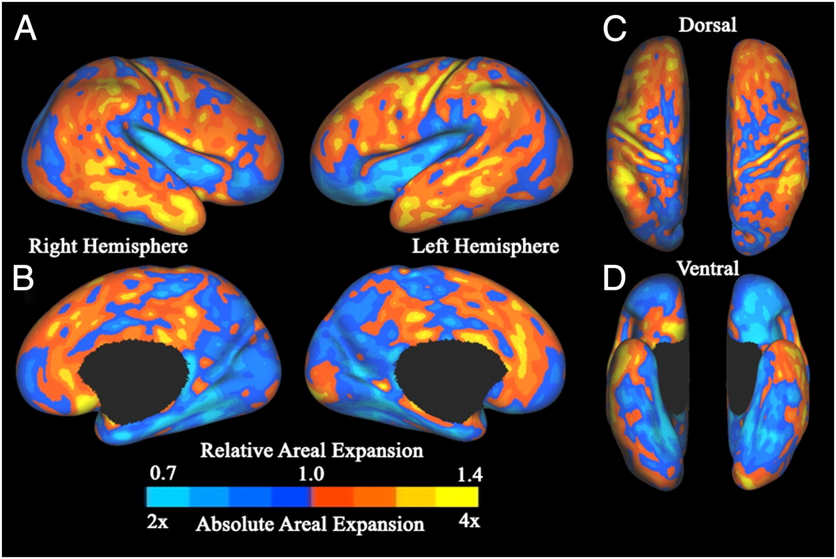

Postnatal cortical surface expansion.
Fig. 1. Postnatal cortical surface expansion. Maps of postnatal cortical surface expansion
on the standard mesh average inflated term infant surfaces for both hemispheres, shown in lateral (A), medial (B), dorsal (C), and ventral (D) views. The absolute expansion scale indicates how many times larger the surface area of a given region is in adulthood relative to that region’s area at term. The relative expansion scale indicates the difference in proportion of total surface area at term birth and adulthood.
Hill J et al. PNAS 2010;107:13135-13140
©2010 by National Academy of Sciences
Notes:
Postnatal cortical surface expansion. Maps of postnatal cortical surface expansion on the standard mesh average inflated term infant surfaces for both hemispheres, shown in lateral (A), medial (B), dorsal (C), and ventral (D) views. The absolute expansion scale indicates how many times larger the surface area of a given region is in adulthood relative to that region’s area at term. The relative expansion scale indicates the difference in proportion of total surface area at term birth and adulthood.

Slide 4
Cortical Expansion
Similar patterns of cortical expansion between infants and adults as between macaque monkeys and adults
“The pattern of human evolutionary expansion is remarkably similar to the pattern of human postnatal expansion”
  (Hill et al., 2010)

Slide 5
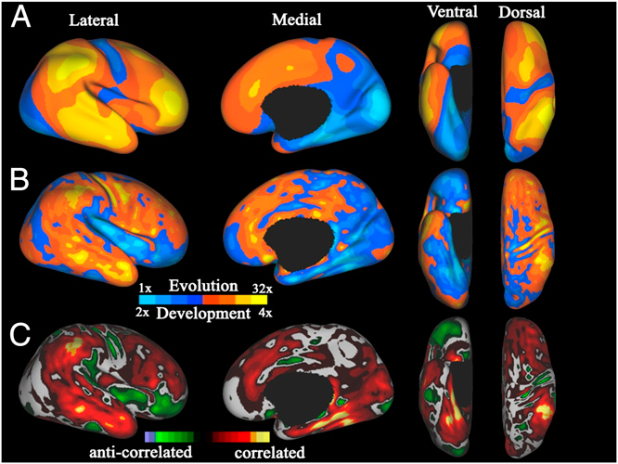
Comparing evolutionary and postnatal cortical surface expansion
(A) Map of regional evolutionary cortical expansion between an adult macaque
and the average human adult PALS-B12 atlas (right hemisphere only).
Evolution expansion scale indicates how many times larger the surface area is
in humans relative to the corresponding area in the macaque.
(B) Map of human postnatal cortical expansion (combined left and right hemispheres)
for comparison.
(C) Correlation map comparing postnatal to evolutionary cortical surface expansion.
Hill J et al. PNAS 2010;107:13135-13140

Slide 6
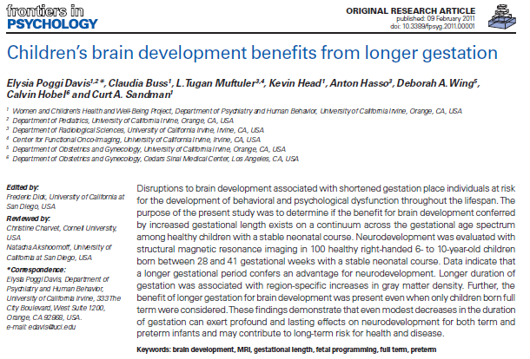
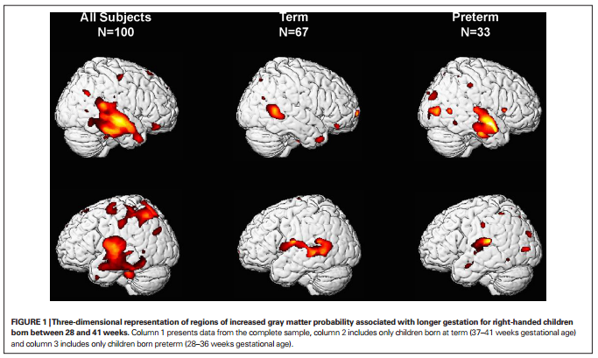
Increased gray matter probability associated with longer gestation

Slide 7
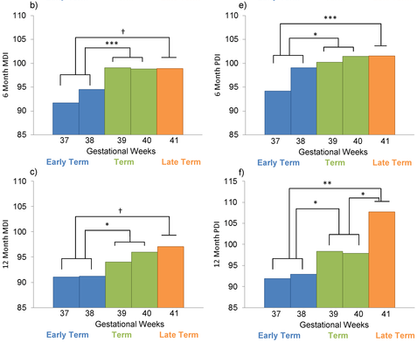

Longer Gestation among Full Terms → Higher Cognitive/Motor functioning
Espel EV, Glynn LM, Sandman CA, Davis EP (2014). PLoS ONE 9(11): e113758. doi:10.1371/journal.pone.0113758
http://127.0.0.1:8081/plosone/article?id=info:doi/10.1371/journal.pone.0113758

Slide 8
Intellectual Ability and Cortical Development (Shaw et al., 2006)
Cortical Thickness
  Index of
    neuronal density
    synaptic connections
    myelination
Regional differences in rates of
thickening and thinning over
development

Slide 9
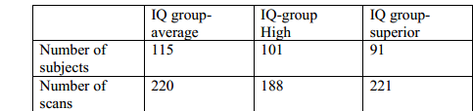
Longitudinal design..
178 participants (58%) had at least two scans; 92 (30%) had three or more scans;
Mean interscan interval was ~2 yr
  Superior (121–149), high (109–120), & average intelligence (IQ range 83–108).
    http://:
www.nature.com/nature/journal/v440/n7084/extref/nature04513-s1.pdf
  Age-appropriate versions of Weschler scales.
Notes:
For longitudinal analyses, subjects were divided into three groups on the basis of full-scale IQ with the primary constraint of attaining a roughly equal number of total scans in each group:

Slide 10
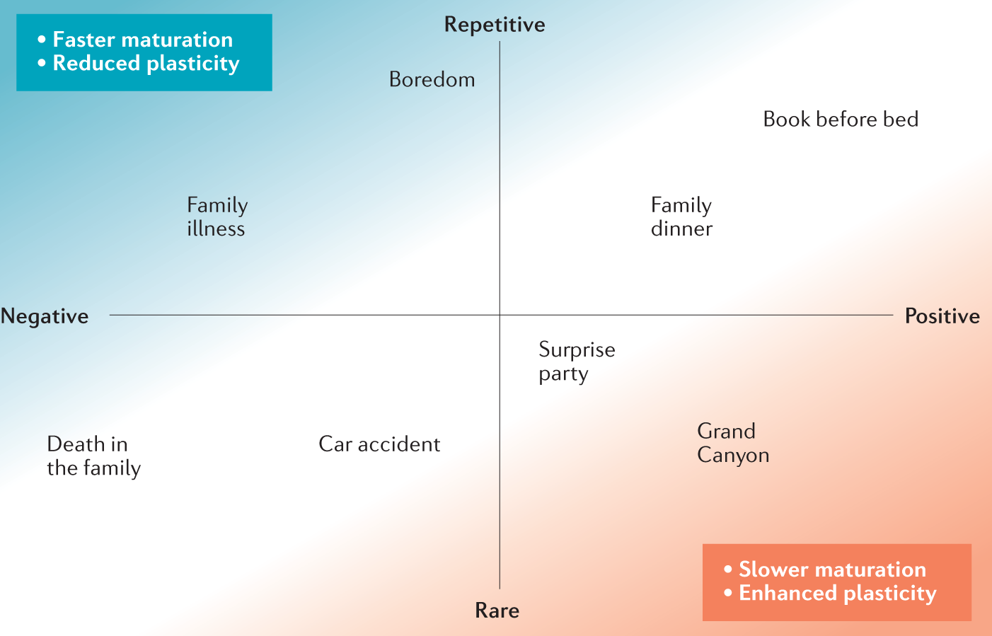
Childhood Experiences Affect the Pace 0f Brain Development: Integrative Theory
  Chronic, repetitive, & negative experiences encourage faster maturation, restricting plasticity
  Rare, positive experience are associated with strong neurochemicals signals -> delay maturational processes and enhance plasticity
Environmental Influences on the Pace of Brain Development
Tooley, Bassett, & Mackey; 2021
Notes:
Experiences in other quadrants (rare/negative, repetitive/positive) likely have a smaller impact on the global pace of maturation

Slide 11
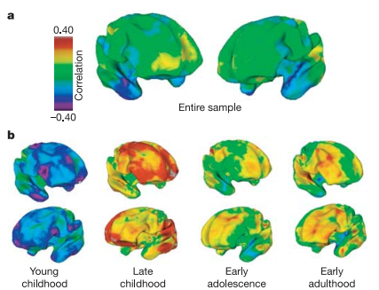
Associations of cortical thickness and IQ structure→function changes with age
(Shaw et al., 2006)
  Across entire sample?
  By age group?

Slide 12
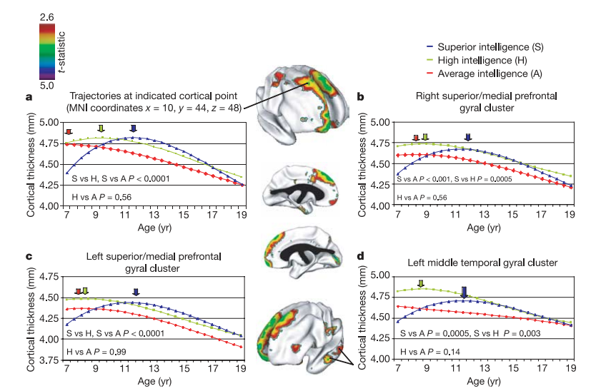
Interaction of IQ and age predict prefrontal cortical thickness growth trajectories
(Shaw et al., 2006)
Notes:
Figure 2 | Trajectories of cortical change. The brain maps (centre panel)
show prominent clusters where the superior and average intelligence groups
differ signiﬁcantly in the trajectories of cortical development (t-statistic
maps show areas of signiﬁcant interaction between these IQ groups and the
cubic age term). a, Graph showing the trajectories at the cortical point of
maximum trajectory difference in the right superior frontal gyrus (point
indicated in upper brain map). b–d, Graphs showing the trajectories of the
mean thickness of all cortical points in the other clusters. The graph in d
relates to the area indicated in the lower brain map. The age of peak cortical
thickness is arrowed and signiﬁcance values of differences in shapes of
trajectories are given on the graphs. MNI, Montreal Neurolog

Slide 13
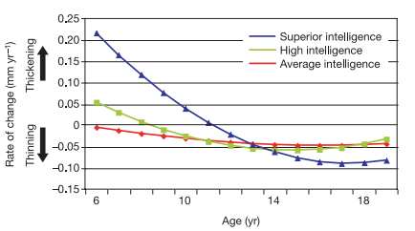
IQ group and rate of change in cortical thickness with age
(Shaw et al., 2006)

Slide 14
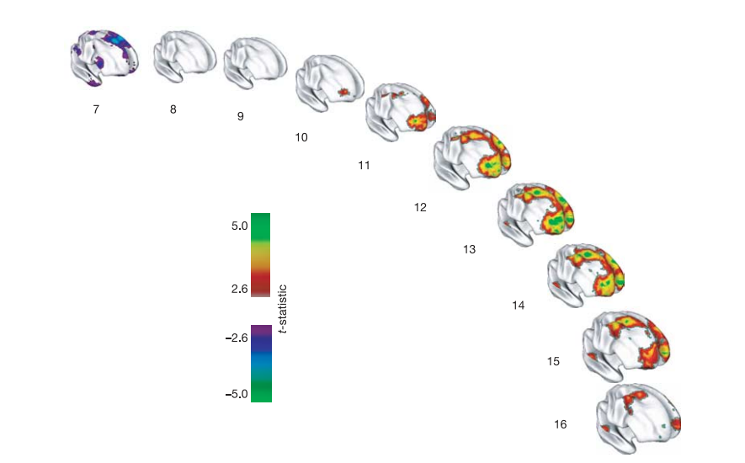
“[I]ntelligence is related to dynamic properties of cortical maturation”
“the superior intelligence group has a thinner superior prefrontal cortex at the earliest age (purple regions). There is then a rapid increase in cortical thickness (red, green and yellow regions) in the superior intelligence group, peaking at age 13 and waning in late adolescence.”
Notes:
Figure 4 | Developing differences in cortical thickness between the
superior and average intelligence groups. Group differences are
represented by t-statistics (t . 2.6), and show that the superior intelligence
group has a thinner superior prefrontal cortex at the earliest age (purple
regions). There is then a rapid increase in cortical thickness (red, green and
yellow regions) in the superior intelligence group, peaking at age 13 and
waning in late adolescence.

Slide 15
Adaptiveness/function of prolonged phase of prefrontal gain for IQ?
Benefit of longitudinal design?
  “Most previous studies infer developmental processes from purely cross-sectional data, an endeavor fraught with methodological complications” (p. 676)
(Shaw et al., 2006)

Slide 16
Cognitive ability changes and dynamics of cortical thickness (Burgaleta et al., 2014)
Background:
  IQ associated with changes in cortical thickness (Ramsden et al., 2011)
    Higher IQ associated with greater fluctuations in cortical thickness ;
    declines in cortical thickness during late adolescence (Shaw et al., 2006)
Goal:
  Better understand structural correlates of changes in IQ for healthy youth over time
    Are these changes in cognitive ability or measurement error?
Hypotheses:
  Structural change in the brain (e.g., cortical thickness/surface area) positively associated with Verbal IQ, Performance IQ, and Full Scale IQ for children/adolescents over time
    Associations in sensorimotor areas
Why do you think these are important questions to study?

Slide 17
Methods
(Burgaleta et al., 2014)
Sample
  Multi-site (6 sites), longitudinal study
  N= 188, Ages 6-20, Mean age at Time 1: 11.59 + 3.46; assessed at 2 year follow-up
Measures
  Cognitive Measures:
    WASI (VIQ, PIQ, and FSIQ)
  MRI and MRI processing system
    Used corticometric methods to represent gray matter change: cortical thickness (CTh) and cortical surface area (CSA)

Slide 18
Analysis
(Burgaleta et al., 2014)
  As part of pre-post design, computed difference scores for CTh, CSA, and IQ
      Change scores represent relative change compared to same-aged peers (not absolute change)
  Analyzed change by IQ change group (using 90% CI):
    Reliable IQ increases
    Reliable IQ decreases
    No reliable IQ changes

Slide 19
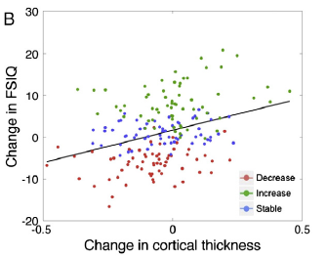
ΔFSIQ associated with Δ CTh
(not Δ CSA)
  ΔPIQ associated with changes in CTh; trend for ΔVIQ
(Burgaleta et al., 2014)

Slide 20
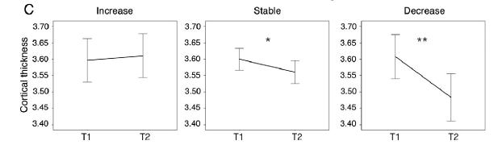
ΔCorticalThickness over time
  Increase IQ group: non-significant increase in CTh
  Stable IQ group: smaller decreases in CTh
  Decrease IQ group: steepest rates of reduction in CTh
Burgaleta et al., 2014

Slide 21
Conclusions
(Burgaleta et al., 2014)
Consistent with previous literature, individual differences in rate of change in cortical thickness appears to be related to changes in 3 parts of IQ
  Results of this study support that relationship over time
CSA does not seem to be associated with changes in IQ
How can we explain these changes in FSIQ/brain structure? Ideas for future directions?

Slide 22
Discussion
Frontoparietal regions previously related to general cognitive ability (Barbey et al., 2012)
Why CTh and not CSA?
  CTh = number of neurons, amount of glial and capillary support and level of dendritic arborization
    Sensitive to post natal development
    Not likely due to changes in number of cortical neurons
    Gliogenesis occurs as a consequence of learning and experience (Dong & Greenough, 2004)
  CSA = number and spacing of mini-columnar units of cells
    Dependent on neurogenesis and neuronal migration (complete by term gestation; Hill et al., 2010)
Synaptic pruning:
  Excessive loss of neuronal connections might be behind steeper cortical thinning
J. Rooks

Slide 23
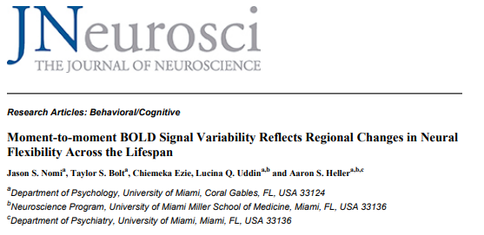

Slide 24
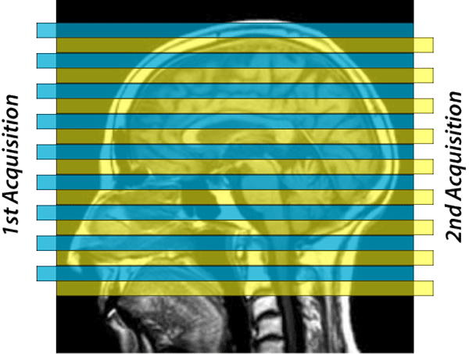
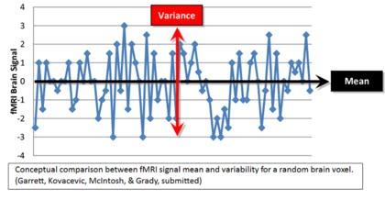
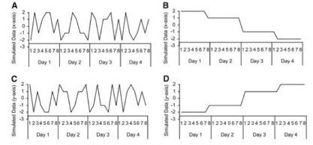
Variability -- mean square successive difference (MSSD)
Aims:
Test changes in MSSD across the lifespan
Test differences in MSSD between TR groups (repetition time between successive pulses)
Conduct analyses with resting-state versus task-based fmri
Jaso

Slide 25
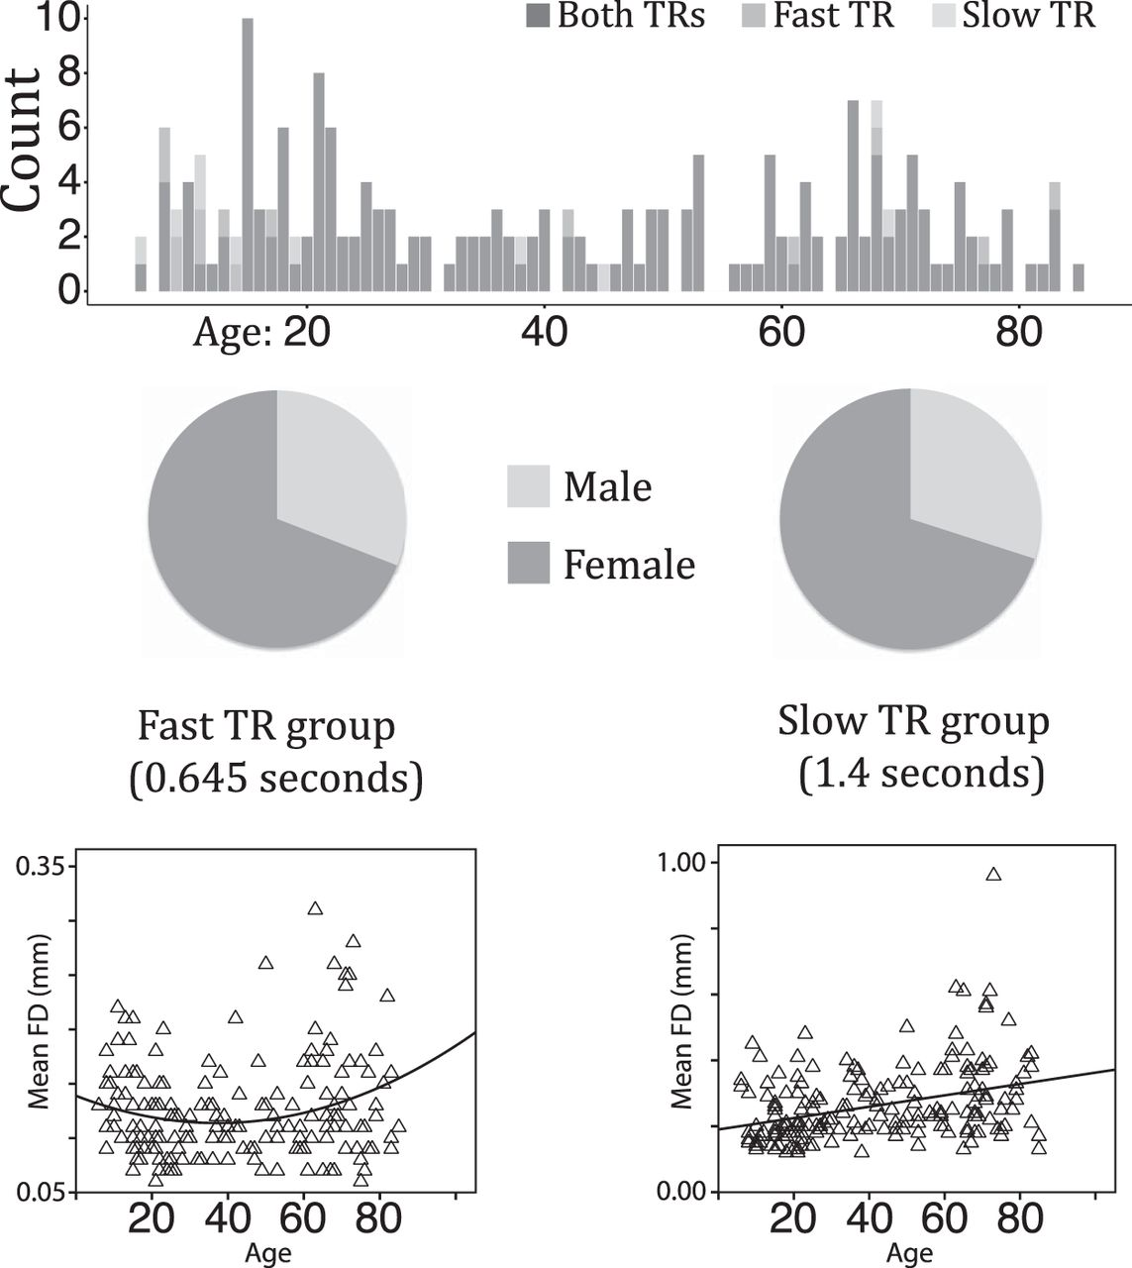
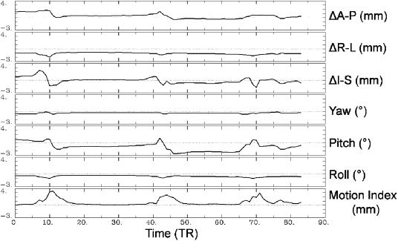
Participants
Why do you think it is important to control for framewise displacement?
Jaso

Slide 26

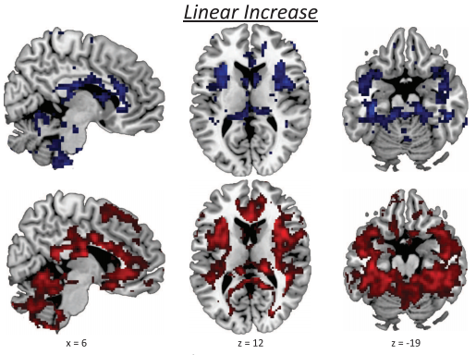
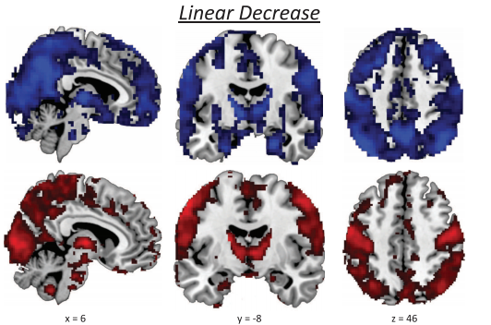
Difference in MSSD between TR groups
Jaso

Slide 27
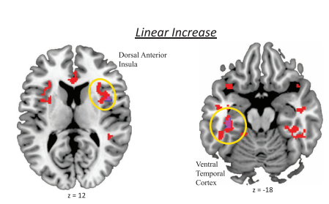
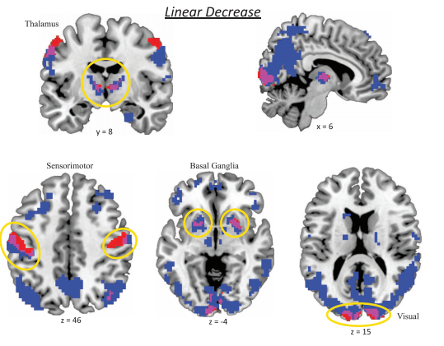
Different lifetime trajectories
Salience Network
Jaso
Do you find any of these results surprising? What implications does this have for the way we conceptualize development or how we think about the manifestation of certain illnesses?

Slide 28
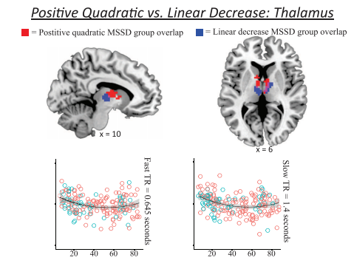
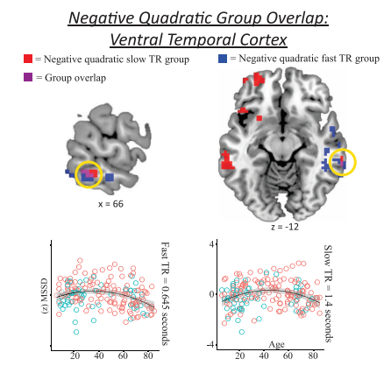
Results
What does a quadratic slope mean in terms of brain development across the lifespan?
How can we interpret these findings?
Jaso

Slide 29
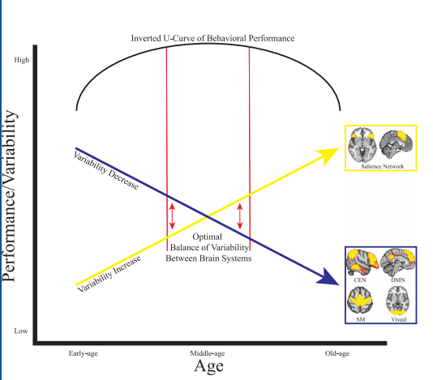
Intersecting variability trajectories
Do you think this developmental trajectory of bold signal variability is congruent with the manifestation of certain neural, developmental, or psychopathological illnesses?
Can you think of any “interventions” that could change this trajectory?
Jaso
Notes:
Do you think this developmental trajectory of bold signal variability is congruent with the manifestation of certain neural, developmental, or psychopathological illnesses?

Slide 30
Discussion Questions
What do you think we’re actually measuring when we assess for Bold signal variability during resting state? Do you think this information is valuable?
Do you think the results from this study would change if they had a more even gender split?
Jaso

Slide 31
Reconceptualizing functional brain connectivity in autism from a developmental perspective
Uddin, Supekar & Menon, 2013

Slide 32
Functional Connectivity =
“temporal correlations between remote neurophysiological events”
Analysis:
  1) seed region of interest
  2) correlating multiple regions
  3) mapping areas with shared profiles
Resting State fMRI – reflects history of task-dependent activation
Development and functional connectivity:
  Adults have more high level connections
  Networks are more diffuse in adult brain

Slide 33
Autism and Connectivity
ASD: social and communication deficits, repetitive and restricted behaviors
Hypo VS. Hyper connectivity theories
  Methodology? Conceptual questions? Development?!?!?!
Hypo-Connectivity
Language
Working Memory
Executive Functioning
Visuomotor coordination
Cognitive Control
Hyper-Connectivity
Language
Memory
Emotion Processing
Visual search
Visuomotor coordination

Slide 34
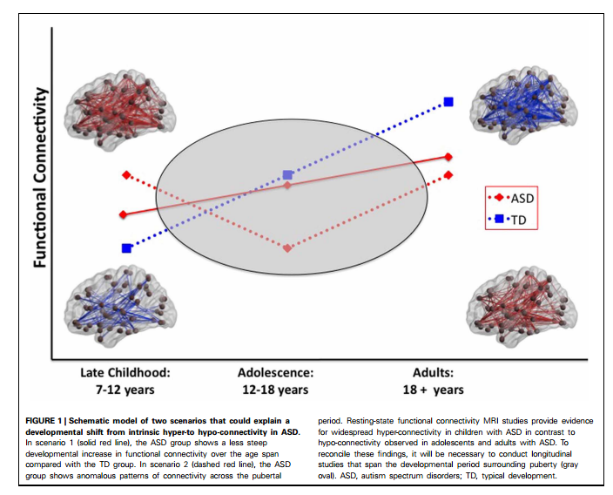
Functional Connectivity and ASD
Pattern of hypo-activity in adults
Hyper-activity in children
  Found in children aged 7-12
Possible hormonal role?
Reconceptualizing functional brain connectivity in autism from a developmental perspective.
Uddin, Supekar & Menon, 2013
Notes:
Direct your attention to Table 1

Slide 35
Core properties of structural brain connectivity stable during maturation
Structural connectivity based on diffusion tensor imaging (DTI) in 121 participants between 4 and 40 years of age.
The number of fiber tracts, small-world topology, and modular organization remained largely stable despite a substantial overall decrease in the number of streamlines with age.
Decrease mainly affected fiber tracts that had a large number of streamlines, were short, within modules and within hemispheres;
  such connections affected more than expected given # of occurrences in network.
    Streamline loss occurred earlier in females than in males.
Decrease in short-range connectivity?
    Preferential Detachment During Human Brain Development: Age- and Sex-Specific Structural Connectivity in Diffusion Tensor Imaging (DTI) Data. 2013. Sol Lim1,2, Cheol E. Han1,3⇑, Peter J. Uhlhaas4,5,6 Marcus Kaiser1,2http://cercor.oxfordjournals.org/content/early/2013/12/13/cercor.bht333.full.pdf+html

Slide 36
Milrad

Slide 37
Brain enlargement in infants, children, adolescents, and adults with ASD
Timing and significance in relation to ASD-relevant behavioral problems are unknown
  Most apparent in early childhood (eg 12-24 mos)
Prospective neuroimaging study for familial high risk for ASD (HR N=106, LR N=42)
  Comparable in race/ethnicity (85%white), family income, maternal age, gestational age, birth weight
  HR had more males
  LR mothers had higher education level
  Subset of longitudinal study of 318 HR infants (70 were clinically HR, 248 not clinical HR, and 117 LR)
Milrad

Slide 38
METHODS: Sample
Subset from longitudinal study of 318 HR infants (70 were clinically HR, 248 not clinical HR, and 117 LR)
Comparable in race/ethnicity (85%white), family income, maternal age, gestational age, birth weight
HR had more males
LR mothers had higher education level
Milrad

Slide 39
PARTICIPANTS
Milrad

Slide 40
Milrad

Slide 41
Brain change biomarkers of ASD? (before behavioral differences)
Infants evaluated 6, 12, 24 months
  Behavioral assessments (ADOS, CSBS)
  High resolution MRI of brain
H1: brain overgrowth begins before 24 mo.
  Overgrowth associated with expansion of cortical surface area
  Early brain changes linked in time to emergence of ASD-defining behaviors
Milrad
Notes:
Subset: 106 HR (15 HR-ASD, 91 HR-neg.), 42 LR

Slide 42
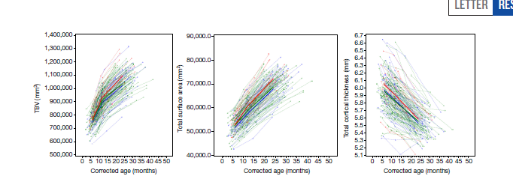
HR-ASD:
Increased surface area growth 6-12 mo
Milrad

Slide 43
HR-ASD:
Increased surface area growth 6-12 mo
Milrad

Slide 44
Pairwise Comparisons at 24 mo.
Milrad

Slide 45
Significant Differences at 24 mo.
Milrad

Slide 46
Surface Area Differences 6-12 mo.
Milrad

Slide 47
Milrad

Slide 48
Milrad

Slide 49
RESULTS SUMMARY
HR-ASD group showed significantly increased TBV GR compared to both groups
HR-ASD group showed increased surface area GR from 6-12 mo. compared to both groups (in areas related to sensory processing)
No group differences in cortical thickness
Sig. correlation between S.A. GR (6-12) and TBV (12-24) in all subjects, and in combined HR group (?)
No correlation between 24 ADOS score and 6-12 mo. TBV change rate at either time pt.
Sig. correlation between 24 ADOS and 12-24 mo. change rate
  Correlation with ADOS social affect score but not ADOS restrictive/repetitive score
CSBS composite score related to rapid TBV change rate at 12-24 months in HR subjects (but not 6-12 mo)
Group (HR+ vs HR-)x time (12-24) interaction for CSBS
Deep learning network/ classification algorithm predicted ASD at 24 mo. using sex, regional SA and cortical thickness at 6-12 mo., and intracranial volume (6-12) with 94% accuracy, 88% sensitivity, 95% specificity, 81% positive predictive value, and 97% negative predictive value
  *mostly predictive: surface area (not cortical thickness, TBV, or sex)
Milrad

Slide 50
DISCUSSION
Biomarker potential?
Reflective or causative?
Does expansion of surface area cause autism?
Brain overgrowth
Surface Area expansion 6-12 mo.
ASD 24 mo.
Notes:
Practical/clinical significance?
Why does this make sense? (or not…)
Methodological issues?

Slide 51
Milrad

Slide 52
Milrad

Slide 53
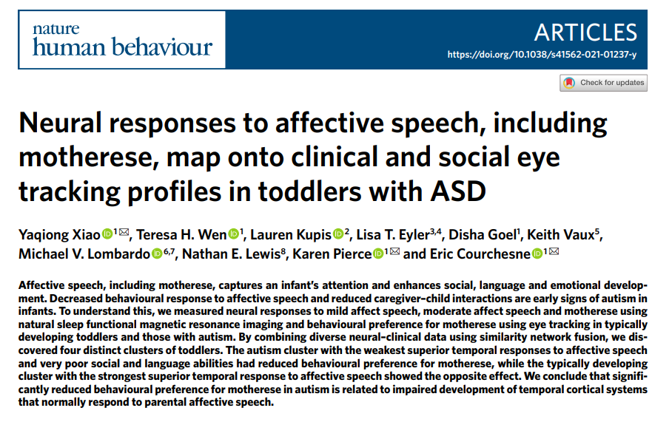

Slide 54
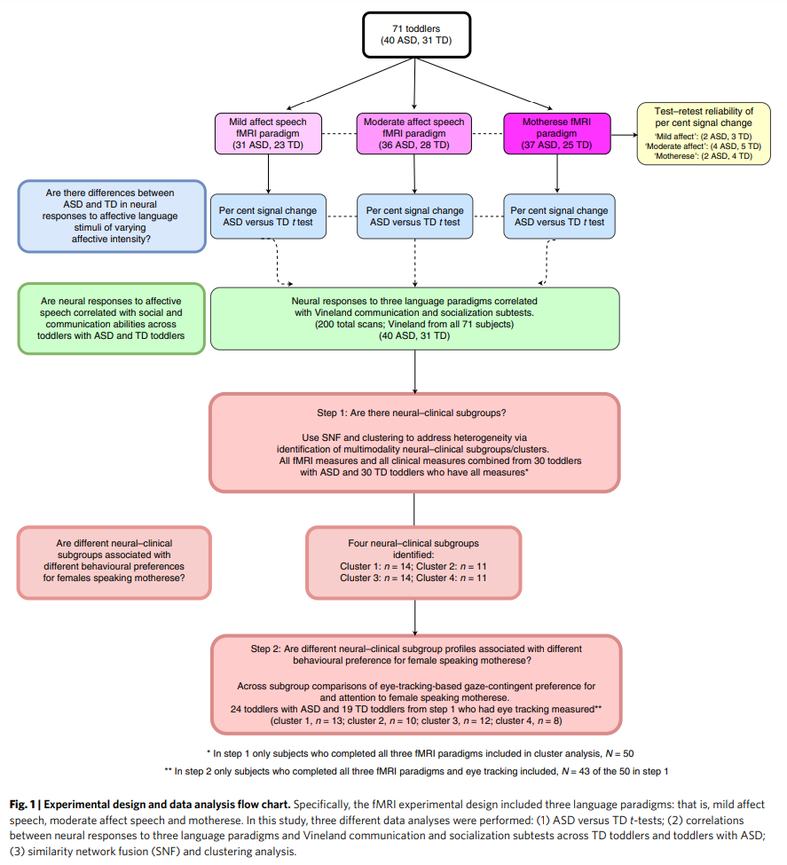

Slide 55
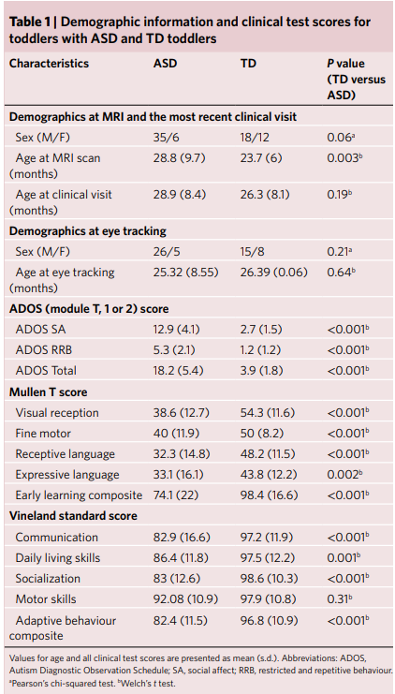

Slide 56
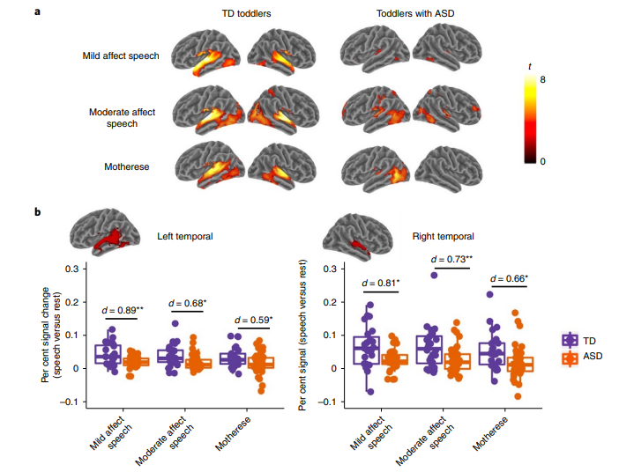
Reduced language-related brain activation in ASD vs TD toddlers
Notes:
Fig. 2 | Reduced language-related brain activation in toddlers with ASD as compared to TD toddlers. a, Whole-brain activation to speech paradigms with varying levels of prosody in TD toddlers and toddlers with ASD. b, Per cent signal change extracted from two ROIs (left and right temporal regions) within the Neurosynth ‘language’ meta-analysis map (https://neurosynth.org/) across three language paradigms. Barplots show average per cent signal change, and error bars show s.e.m. Asterisks indicate significant results of two-sample two-tailed t tests between groups (TD versus ASD). d, Cohen’s d. *P< 0.

Slide 57
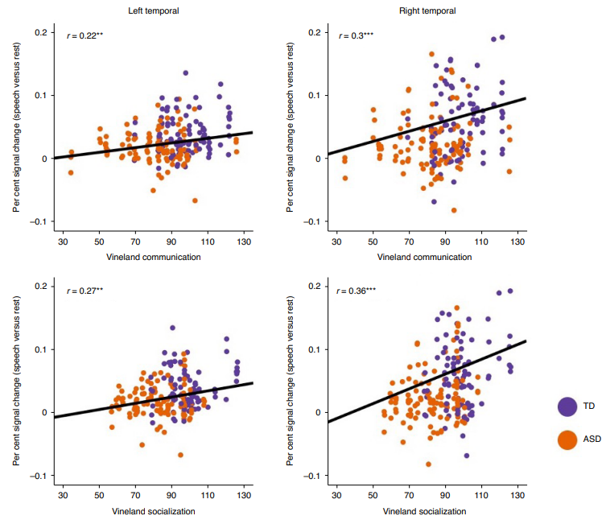
Correlations of brain activation to language and social communication
Notes:
Scatterplots showing correlations between brain activation to language and social communication abilities in toddlers. Black lines in each scatterplot represent regression model fit across all individuals (toddlers with ASD and TD toddlers) and language paradigms (mild affect speech, moderate affect speech and motherese). The r values indicate Pearson’s correlation coefficients (for estimated coefficients from mixed-effects models, see Supplementary Table 2). **P< 0.001.

Slide 58
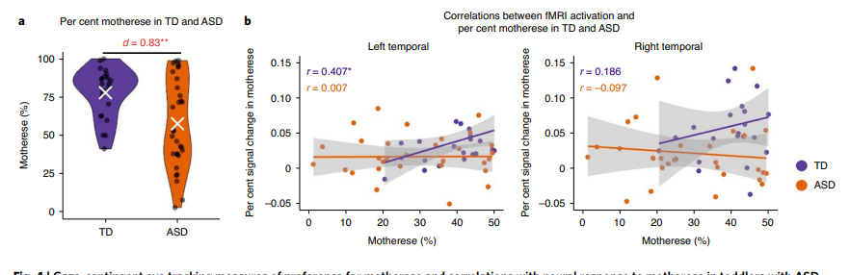
Gaze-contingent eye tracking preference for motherese.
One TD correlation of preference and neural response to motherese
Notes:
4 | Gaze-contingent eye tracking measures of preference for motherese and correlations with neural response to motherese in toddlers with ASD and TD toddlers. a, TD toddlers showed significantly stronger preference for motherese over non-social, computer ‘techno’ images and sounds compared to toddlers with ASD (t(52) = 3.25, P = 0.001, Cohen’s d = 0.83, 95% CI 0.25–1.4; two-sample one-tailed t test). d, Cohen’s d; white cross, group mean. b, Correlations between visual attention preference for motherese and neural response to motherese in toddlers with ASD and TD toddlers. In the TD group, there was a significant positive correlation in the left temporal ROI (r(21) = 0.407, P = 0.03), but no statistically significant correlations were observed for the right temporal ROI (r(21) = 0.186, P = 0.2). In the ASD group, there was no statistically significant correlation in either left (r(29) = 0.007, P = 0.49) or right temporal ROI (r(29) = −0.097, P = 0.7). *P< 0.01.

Slide 59
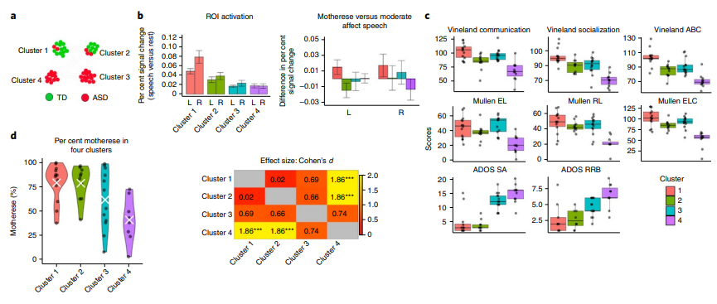
TD/ASD subgroups with distinct fMRI–clinical patterns
Notes:
Fig. 5 | TD and ASD subgroups with distinct fMRI–clinical patterns and correlations with behavioural preference for motherese. a, SNF and Louvain algorithm revealed four fMRI–clinical distinct subgroups (green, TD; red, ASD), including two clusters predominantly containing TD individuals (cluster 1: 12 TD, 2 ASD; cluster 2: 8 TD, 3 ASD) and two clusters entirely containing individuals with ASD (cluster 3: 0 TD, 14 ASD; cluster 4: 0 TD, 11 ASD). b, The left barplot displays average per cent signal change across language paradigms for each cluster. The right barplot shows differences in per cent signal change between motherese versus moderate affect speech in four clusters. The error bars represent the standard error of the mean. c, Social and language ability across clusters. Boxplots show interquartile range (IQR; first quartile, Q1; third quartile, Q3); the horizontal line inside the box represents the median; whiskers indicate Q1 – (1.5 × IQR) or Q3 + (1.5 × IQR). d, Toddlers in clusters 1 and 2 had significantly higher percentage fixation towards motherese versus non-social computer ‘techno’ images and sounds than toddlers with ASD in cluster 4 (cluster 1 versus 4: 79.28% versus 41%; t(19) = 3.95, P = 0.0009, Cohen’s d = 1.86, 95% CI 0.75–2.98; cluster 2 versus 4: 78.83% versus 41%; t(16) = 3.82, P = 0.001, Cohen’s d = 1.86, 95% CI 0.66–3.07). The white cross indicates group mean. The heatmap matrix shows standardized effect sizes (Cohen’s d) for each pairwise group comparison between clusters. Cohen’s d value is shown in each cell, and the standard effect size is also indicated by the colour of the cell. Asterisks indicate significant results of two-sample one-tailed t tests between clusters. ***P

Slide 60
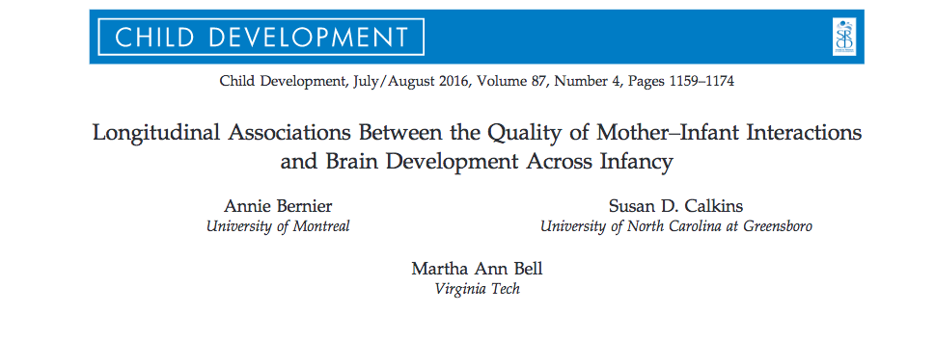
Lucette, 2017

Slide 61
Background
What is the impact on brain development?
Early caregiving relationships
Social, emotional, cognitive, biological outcomes
Lucette, 2017

Slide 62
Background
Adversity affects brain growth
  Providing a positive environment is associated with healthy brain development
No studies on the impact of normative parenting
Do normative variations in parenting affect brain development?
Lucette, 2017

Slide 63
Current study
Longitudinal study
Infant-mother dyads observed at 5 months, 10 months, 24 months
Is the quality of maternal parenting behavior related to infant brain development?
Outcomes: frontal EEG resting power and increase in frontal EEG resting power
Lucette, 2017

Slide 64
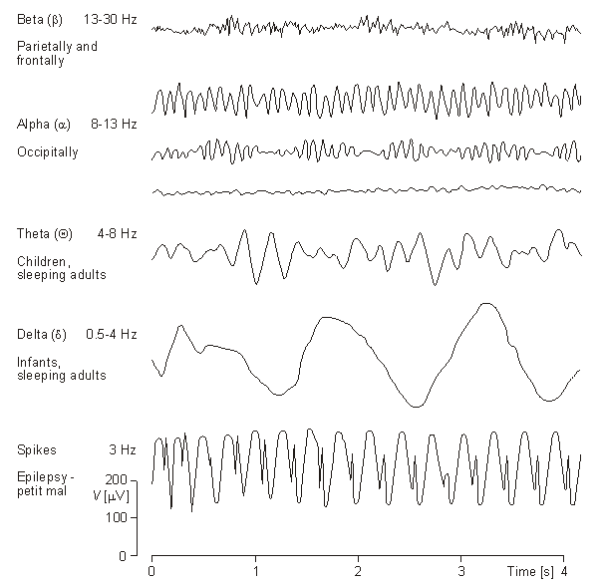
The EEG signal
Baseline/Resting EEG
  Ongoing EEG-- summation of all electrical activity occurring in the brain at a given moment
  Frequency distributions -- indicators of state (sleep/wake) and trait (arousal) marker

Slide 65
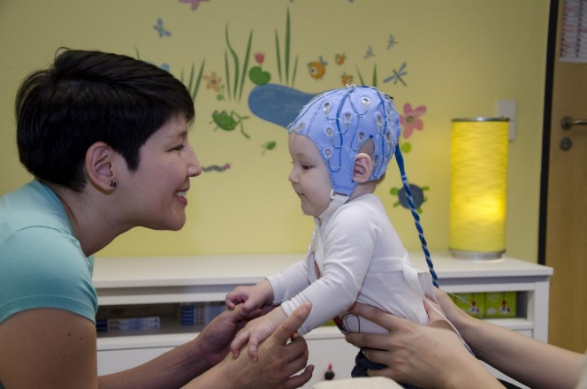
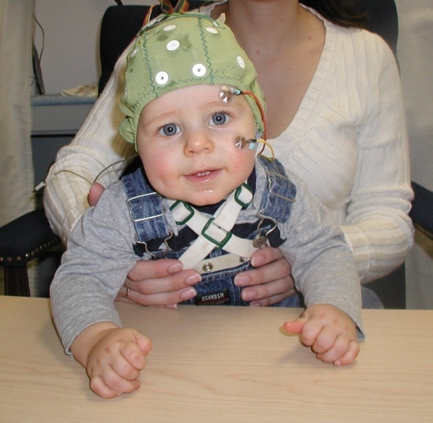

Methods
352 dyads
2 minutes mother-infant interaction
  as they would at home at 5 months
Maternal intrusiveness & positive affect
More neural activity = more EEG power
Frontal EEG resting power is indicative of brain development
Resting EEG recorded for one minute
  Colored balls at 5/10 mos, Nemo at 24
Lucette, 2017

Slide 66
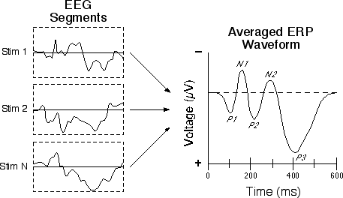
Event-Related Potentials (ERPs)
EEG data is time-locked to a specific stimulus or event and then averaged
  Averaging allows filtering of unrelated/background EEG

Slide 67
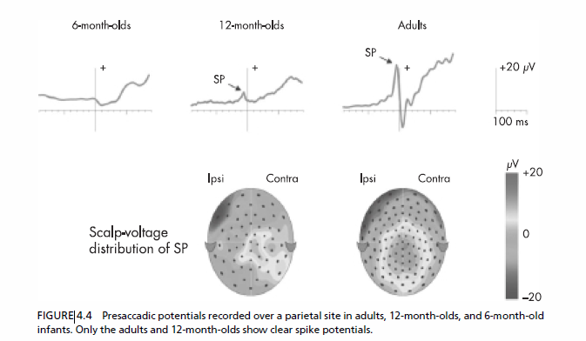
Development

Slide 68
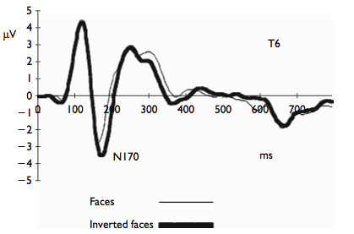
Brain Development
Activity-dependent specialization –
  Face Processing example
    N170 to faces becomes specialized for upright faces by 12 months; prior to that elicited to inverted and upright (de Haan et al., 2002; Halit et al., 2003)
Notes:
Does not imply innateness b/c most humans have very similar pre- and postnatal environments

Slide 69
Are maternal behaviors associated with EEG power?
Maternal intrusiveness not associated with EEG power
Maternal positive affect related to EEG frontal power at 10 and 24 months
Lucette, 2017

Slide 70
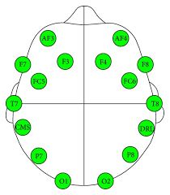
Maternal positive affect → age-related increases in frontal power
Maternal intrusiveness not associated with EEG power
Maternal positive affect related to EEG frontal power at 10 and 24 months
  Hierarchical regressions control for prior power
Lucette, 2017

Slide 71
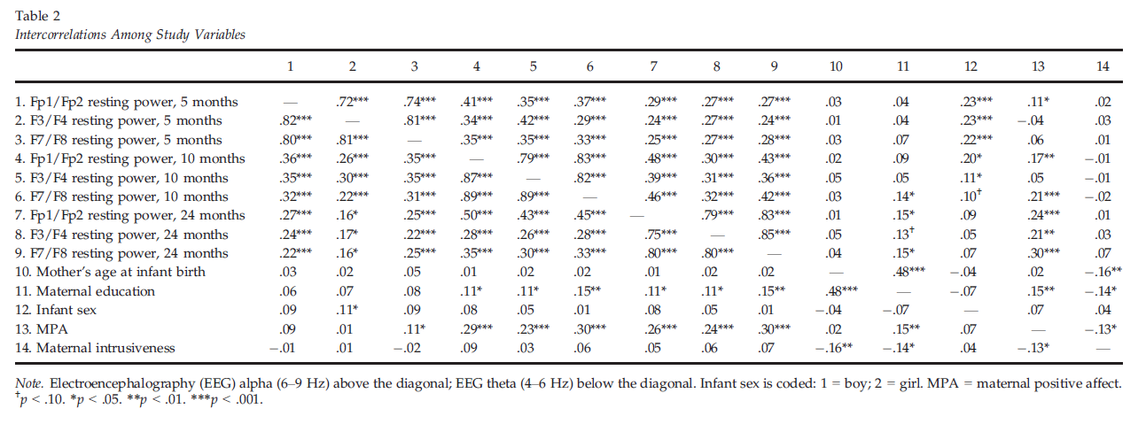
Maternal positive affect and infant EEG activity
Bernier, Calkins & Bell, 2016

Slide 72
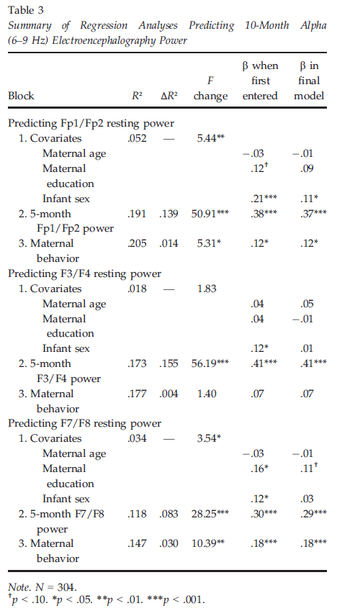
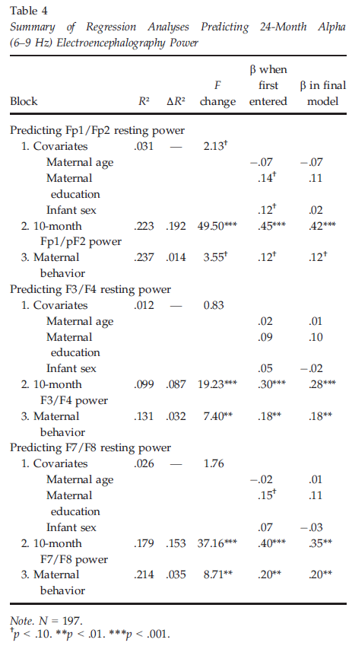
Mom positive affect → infant EEG power

Slide 73
Parenting→brain→behavioral functioning…
Normative variation in parenting quality may contribute to brain development….

Slide 74
Differential Regional Growth Rates – Adolescence (Casey et al. 2008)
Adolescence associated with increased incidence of:
  Unintentional injury
  Violence
  Alcohol and drug abuse
  Risky sexual behavior
Traditionally attributed to protracted development of PFC
  Is this explanation sufficient to explain changes in behavior?

Slide 75
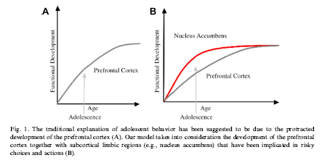
Differential Regional Growth Rates – Adolescence (Casey et al. 2008)
“Treating adolescence as a transitional developmental period rather than a single snapshot in time” (p. 63)

Slide 76
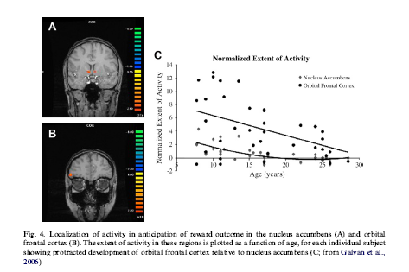
Using neuroimaging to examine developmental changes in
  Reward circuitry
  Cognitive control
  Their developmental interactions

Slide 77
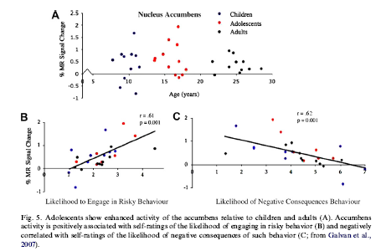
Individual differences and risk susceptibility

Slide 78

Kelly Shaffer

Slide 79

How low SES affects hormonal trajectories
Low SES predictive of disparate risk in multiple domains including
  Mental health
  Physical health
  Academic Achievement
Psychosocial factors alone do not account for the disparities
  Alternate pathways?
How does poverty get under our skin?

Slide 80
How does poverty get under our skin?
“Health disparities are a pressing reality of our society”
Low SES
Stress
HPA axis disturbance
Psychiatric & Physical ailments
Vigilance for Threat
Daily Home Chaos
Shaffer | Chen et al., 2009
Notes:
Lower SES more at risk for both mental and physical health problems
Depression, PTSD
Diabetes, obesity
Not random problems, but particularly those related to HPA axis disturbance
Psychological distress impacts body through “fight or flight” system
Chronic stress: chronically activated
First study to longitudinally assess how SES impacts change in physiology (HPA axis function), allowing for better understanding of how SES may produce HPA axis disturbance (and thus increase risk for later disease)
Also allows for study of mediators: HOW SES alters physiology
(1) Vigilance for threat: low SES negative events happen randomly, shown to appraise ambiguous events as more threatening
WHY WOULD THAT HAVE BEARING?
(2) Daily chaos in home environment: low SES more likely to have more crowding, noise, less predictable routines
WHY WOULD THAT HAVE BEARING? Authors didn’t discuss much (adds to stress burden)

Slide 81
Methods
54 healthy children → 50 included in analyses
IV: SES
  Family savings
  Home ownership
Mediators:
  Children’s perception of threat – Cognitive Appraisal and Understanding of Social Events videos
  Household chaos – Parent report on Confusion, Hubbub, and Order Scale
DV: Salivary cortisol – total cortisol output
Shaffer | Chen et al., 2009
Notes:
Separate models for 2 types of SES questions
Multiple measures per day – allows to measure both PATTERN (how the system is working) and MAGNITUTE (how MUCH system is working)
Analyses they report is on total system volume

Slide 82
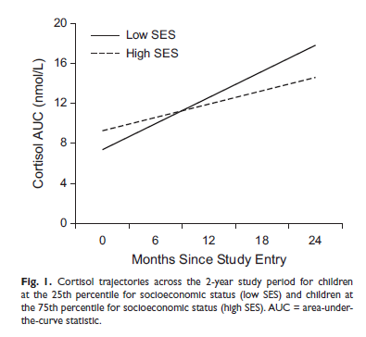
SES and Cortisol
Shaffer | Chen et al., 2009
Notes:
Does anyone want to take whack at interpreting this?
Lower SES households showed steeper increases over time
Predicted significantly by both family savings and home ownership
Intercepts: only home ownership differentiated intercepts
So, both family savings and home ownership are indicators of how much you’ll increase with time, but only home ownership is related to lower starting cortisol
Meaningful in any way?

Slide 83
SES and Cortisol Moderated by Threat Interpretation and Chaos
Low SES
Higher Home Chaos
Greater HPA output
Threat Interpretation
Shaffer | Chen et al., 2009
Notes:
When include both moderators, only home chaos remained as significant mediator

Slide 84


SES and Cortisol Moderated by Threat Interpretation
Both home ownership and family savings became nonsignificant predictors of total cortisol output when threat interpretation included in model
Reduced effect of SES by about 40%
Both home ownership and family savings became nonsignificant predictors of total cortisol output when threat interpretation included in model
Reduced effect of SES by about 40%
Both home ownership and family savings became nonsignificant predictors of total cortisol output when threat interpretation included in model
Reduced effect of SES by about 40%
Shaffer | Chen et al., 2009
Low SES
Higher Threat Interpretation
Greater HPA output
Notes:
Both home ownership and family savings became nonsignificant predictors of total cortisol output when threat interpretation included in model
Reduced effect of SES by about 40%

Slide 85
SES and Cortisol Moderated by Chaos
Low SES
Higher Home Chaos
Greater HPA output
Shaffer | Chen et al., 2009
Notes:
Same findings when Chaos only
Reduced effect of SES by about quarter to a third

Slide 86

Perceptions of threat as a mediator
‘Less family savings was associated with greater child threat interpretations, r(49) = –.47, p < .01.
Similarly, children living in rented homes made greater threat interpretations, t(47) = 2.88, p < .01 (see Fig. 2).
In turn, greater threat interpretations predicted larger increases in cortisol AUC over time (b = 0.3698, SE = 0.1853, p = .05).’

Slide 87
SES and Cortisol Interactions
Low SES
HPA axis disturbance
Girls > Boys
Post-Puberty > Pre-Puberty
Shaffer | Chen et al., 2009
Notes:
Stronger effect of SES on cortisol among certain subgroups of children
Girls – suggest hormonal system among women may be more impacted by social environment
Post-puberty – suggest SES may take more time to accumulate (those post-puberty had more impact)

Slide 88
Methods in Developmental
Neuroscience
Direct Assessments
  EEG/ERP
  Functional Magnetic Resonance Imaging (fMRI)
  Near Infrared Spectroscopy (NIRS)
Indirect Assessments
  Marker Tasks
Notes:
ERP = electrical activity of brain generated as groups of neurons fire synchronously; electrodes on head;
EEG = spontaneous natural rhythm of the brain; ERP = electrical activity induced by presentation of a stimulus;
With high density recording can infer position and orientation fo brain source of activity (=dipoles) ased o pattern of scalp surface electrical activity
Good temporal; less good spatial reso
The marker task is one in which the neural control of behavior in the task is well specified. For example, several aspects of the covert orienting of attention in the spatial cueing task are mediated by the superior colliculus and the parietal cortex. This has been shown in adults with diseases of the superior colliculus or with lesions to the parietal cortex brought about by strokes or illness (e.g., Rafal, 1998). Johnson (1997) proposes that such tasks may be used with infants and that developmental changes in the behavior may be used to infer developmental changes in the brain area upon which this behavior is based. The marker task approach is used widely to study the neurodevelopmental models of infant visual attention.lution

Slide 89




EEG/ERP Assessments

Slide 90
The EEG signal
Baseline/Resting EEG
  Ongoing EEG-- summation of all electrical activity occurring in the brain at a given moment
  Frequency distributions -- indicators of state (sleep/wake) and trait (arousal) marker

Slide 91
Event-Related Potentials (ERPs)
EEG data is time-locked to a specific stimulus or event and then averaged
  Averaging allows filtering of unrelated/background EEG

Slide 92
Development

Slide 93
Brain Development
Activity-dependent specialization –
  Face Processing example
    N170 to faces becomes specialized for upright faces by 12 months; prior to that elicited to inverted and upright (de Haan et al., 2002; Halit et al., 2003)
Notes:
Does not imply innateness b/c most humans have very similar pre- and postnatal environments

Slide 94

MRI
Uses magnet and radio waves to image bodily tissues
  Structural
  Functional

Slide 95



Near infrared spectroscopy
(NIRS)
Infrared light illuminates tissue and activity below skin
Wavelengths of light scatter in tissue and are absorbed differently depending on oxygen level (= activity)

Slide 96


NIRS habituation→recovery
Figure 4. A single near-infrared spectroscopy (NIRS) channel over prefrontal cortex from Nakano et al. (2009) showing decreasing activations in 3 blocks of 5 trials to a speech category, following by recovery to a novel speech category (orange) in the 4th block but not to a no-change control group (green). Hb haemoglobin. From “Prefrontal Cortical Involvement in Young Infants’ Analysis of Novelty”, by T. Nakano, H. Watanabe, F. Homae, and G. Taga, 2009, Cerebral Cortex, 19, pp. 455–463. Copyright 2009 by permission of Oxford University Press.

Slide 97

Four levels of brain development
From Nelson, 1999

Slide 98

Neural tube formation and differentiation
https://www.youtube.com/watch?v=lGLexQR9xGs (1:49)
Bloom, Nelson, & Lazerson, 2001
Notes:
Blastocyst = hollow sphere of cells with small mass of cells adhering to one point on its inner surface; blastocyst implants in uterine lining
blastocyst differentiates into three-layered structure; outer layer (ectoderm) gives rise to skin surface and nervous system; nervous system develops through process called nuerolation; portion of ectoderm begins to fold in on itself to form a hollow cylinder called the neural tube
Neural tube changes in length, circumference and radius
Neuronal development = proliferation, migration (prenatal); postnatal (synaptic pruning)
Volume of brain quadruples between birth and adulthood (due in large part to myelinization)
See large increase postnatally in size and complexity of the dendritic tree of many neurons (see figure4.3)

Slide 99

Overview
Increasing differentiation of areas of cortex
Infant is born during height of brain development
Tertiary sulci develop from 1 month before to 12 months after birth
http://www.youtube.com/watch?v=YXTA0lUBZW4 1:20-2:19
https://www.youtube.com/watch?v=86NDMfxU4ZU structural view

Slide 100
Neural migration
Many elements of initial neural migration specified genetically
By 20 weeks gestation, 100 billion neurons!
  50,000 – 500,000 neurons per minute
Neurons follow path of glial cells outward from ventricles
  To form 6 layers of cortex

Slide 101

Time lapse sequences
  Neuron migration
Radial migration (glial guidance) and somal translocation
  http://www.nature.com/neuro/journal/v4/n2/extref/nn0201-143-S1.mpg
Typical and Atypical http://www.youtube.com/watch?v=GBIa8G3gBH0&feature=related
neurite outgrowth
Notes:
http://www.youtube.com/watch?v=n_9YTeEHp1E&NR=1 removed

Slide 102
Proliferation & migration of neurons
General pattern of brain development genetically specified
  By 20 weeks, most neurons present
  3rd - 16th prenatal week most crucial
  At 8 weeks, head is half of fetus
But specific connections depend on generic growth processes and sensory-motor stimulation
  Trillions of connections still forming
  Trimming of these connections is developmental task

Slide 103
Neural development: Synaptogensis
Once in place, synapses are overproduced somewhat haphazardly
  1 year old has 150% more synapses than adult
These are pruned (diminish) during development
Repetition of sensory-motor patterns create more specific set of experience dependent synaptic linkages

Slide 104

Increase in complexity of neural connections
Does increasing
complexity asymptote?

Slide 105
How do the correct synapses form?
15,000 synapses for every cortical neuron
  1.8 million per second in first 2 years!
    Cerebral cortex triples in thickness in 1st year
Sensory and motor neurons must extend to correct brain area and form correct synapses
This quantity of information cannot be genetically micro-managed
  Edelman

Slide 106
Prolonged pre-specialization period supports plasticity
  Extent of plasticity depends on age at injury, site of damage, skill area
    Early injury ( < 6 mos) to either hemisphere affects language competence, rapid improvements by 5 yrs with compensatory activation (Stiles et al., 2001)
    Greater spatial impairments with effects differing on hemispheric damage
Notes:
Sleeper effects

Slide 107
Increasing specialization has functional implications
  - Examples of functional regressions
    Face perception (Pascalis, de Haan, & Nelson, 2002)
      By 9 months lose ability to discriminate monkey faces as well as human faces
    Phonemic discrimination (Werker & Polka, 1993)
      Young infants discriminate all phonetic contrasts (regardless of native language) but only up until 12 months of age
Notes:
Because of the way human brains develop, 6-month-old babies are better at recognizing certain faces than 9-month-old infants. Even more surprising, those 6-month-old babies are also better than adults at some face recognition.
apparently sometime between 6 and 9 months of age, babies' brains key in on the fact that human faces are the ones to which they need to pay attention.
Nelson says that as we get older, we get better at detecting the subtle differences in the faces we see a lot: human faces. But at the same time, we lose the ability to detect differences in things we don't see a lot. It's a phenomenon called "cognitive narrowing.“
Olivier Pascalis, who led the study at the University of Sheffield in England, says a baby's brain gets "hard-wired" during the first year of life, creating a template it can use to compare all those new human faces.

