Slide 1
Infant Development
PSY 430

Slide 2
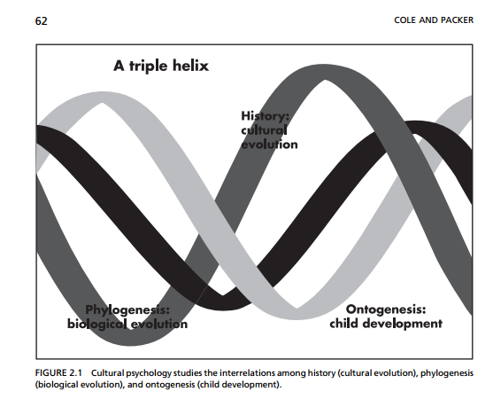
Individual development is how cultures continue

Slide 3
Culture: Corporal discipline and behavioral inhibition
Infant directed speech around the world
The cultural (mis) attribution bias in developmental psychology in the United States
Peer play interactions
Japanese toddlers and developmental discontinuity
Historical time and culture
Overview of corporal discipline → effects
    Reading figures
  Increased activation to fear vs. neutral faces in spanked 11-year-olds (Cuartas, et al.)
Culture around us in our work…
Notes:
About 3 million reports made annually to child protective services

Slide 4
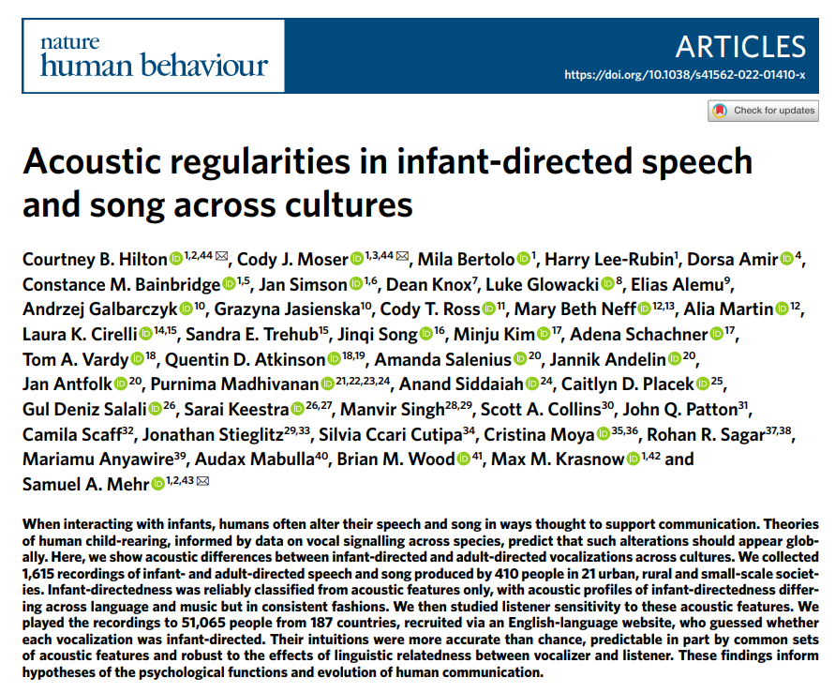

Slide 5
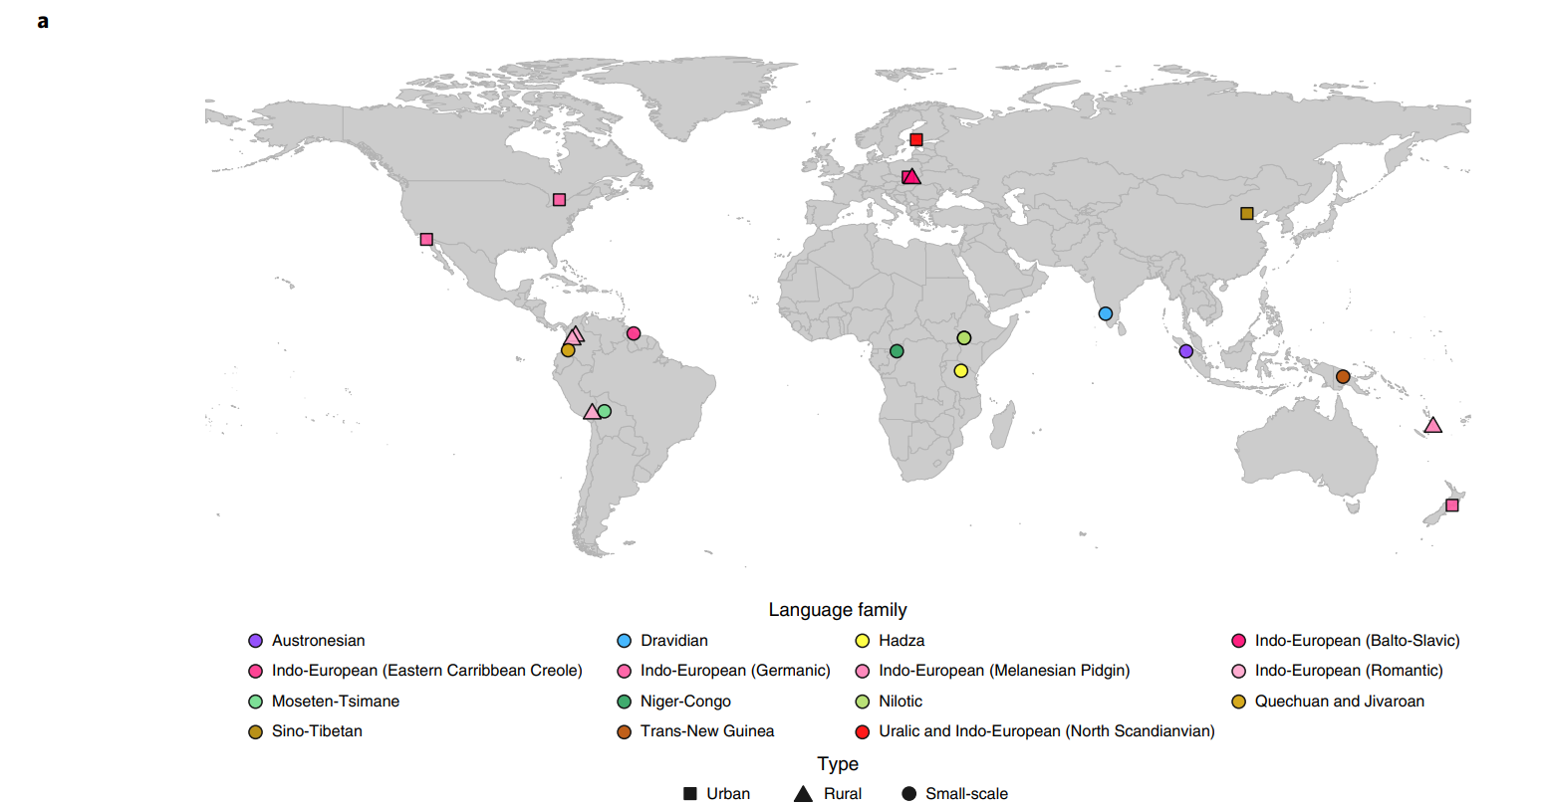
Speech and song in 21 urban/rural/small-scale societies--many languages

Slide 6
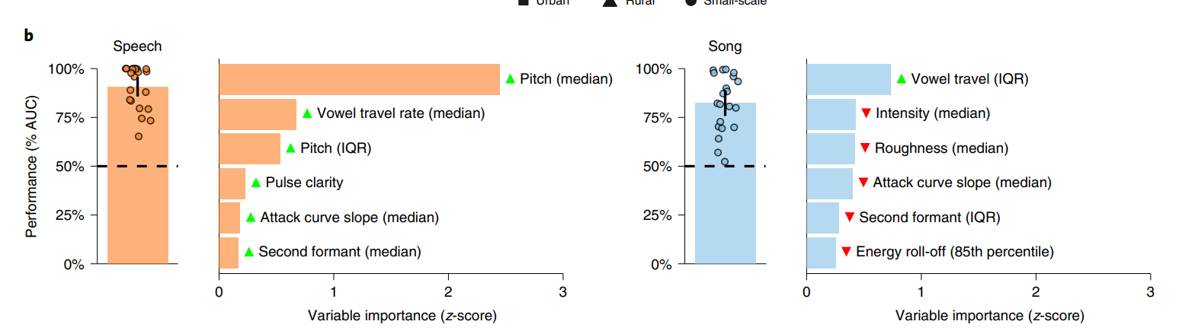
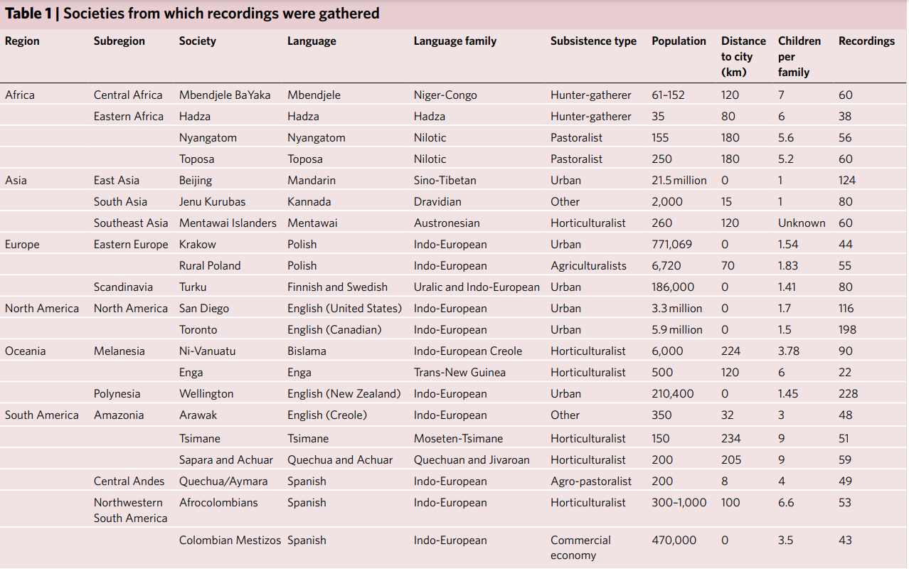
Machine-learning shows stereotyped acoustics of infant-directed speech/song

Slide 7
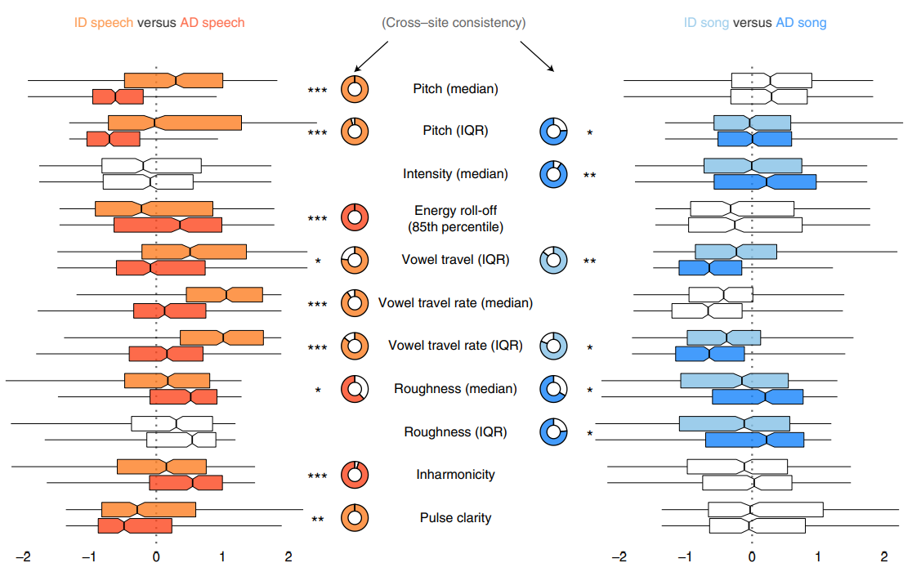
How people alter voices vocalizing to infants
Notes:
How people alter their voices when vocalizing to infants. Eleven acoustic features had a statistically significant difference between infantand adult-directed vocalizations, within-voices, in speech, song or both. Consistent with the LASSO results (Fig. 1b and Supplementary Table 2), the acoustic features operated differently across speech and song. For example, median pitch was far higher in infant-directed speech than in adult-directed speech, whereas median pitch was comparable across both forms of song. Some features were highly consistent across fieldsites (for example, lower inharmonicity in infant-directed speech than adult-directed speech), whereas others were more variable (for example, lower roughness in infant-directed speech than in adult-directed speech). The boxplots, which are ordered approximately from largest to smallest differences between effects across speech and song, represent each acoustic feature’s median (vertical black lines) and IQR (boxes); the whiskers indicate 1.5× IQR; the notches represent the 95% CI of the medians; and the doughnut plots represent the proportion of fieldsites where the main effect repeated, based on estimates of fieldsite-wise random effects. Only comparisons that survived an exploratory–confirmatory analysis procedure are plotted; the faded boxplots denote comparisons that did not reach statistical significance in confirmatory analyses. Significance values are computed via linear combinations with two-sided tests, following multilevel mixed-effects models (n= 1,570 recordings); *P

Slide 8
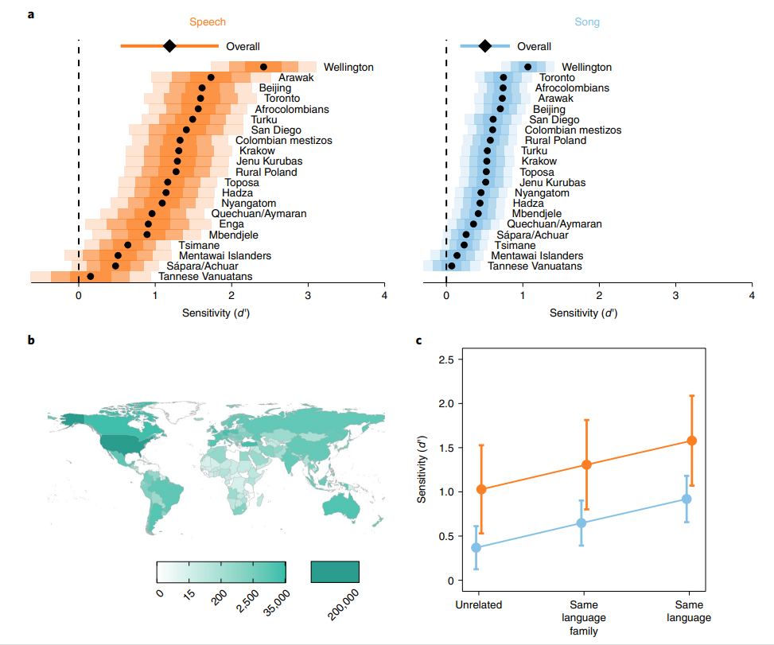
Naive listeners distinguish infant-directed from adult-directed vocalizations across cultures
Notes:
Naive listeners distinguish infant-directed vocalizations from adult-directed vocalizations across cultures. Participants listened to vocalizations drawn at random from the corpus, viewing the prompt ‘Someone is speaking or singing. Who do you think they are singing or speaking to?’ They could respond with either ‘adult’ or ‘baby’ (Extended Data Fig. 3). From these ratings (after exclusion n= 473 song recordings; n= 394 speech recordings), we computed listener sensitivity (d′ ). a, Listeners reliably detected infant-directedness in both speech and song, overall (indicated by the diamonds, with 95% CI indicated by the horizontal lines) and across many fieldsites (indicated by the black dots), although the strength of the fieldsite-wise effects varied substantially (see the distance between the vertical dashed line and the black dots; the shaded regions represent 50%, 80% and 95% CI, in increasing order of lightness). Note that one fieldsite-wise d′ could not be estimated for song; complete statistical reporting is in Supplementary Table 5. b, The participants in the citizen-science experiment hailed from many countries; the gradients indicate the total number of vocalization ratings gathered from each country. c, The main effects held across different combinations of the linguistic backgrounds of vocalizer and listener. We split all trials from the main experiment into three groups: those where a language the listener spoke fluently was the same as the language of the vocalization (n= 82,094), those where a language the listener spoke fluently was in the same major language family as the language of the vocalization (n= 110,664) and those with neither type of relation (n= 285,378). The plot shows the estimated marginal effects of a mixed-effects model predicting d′ values across language and music examples, after adjusting for fieldsite-level effects. The error bars represent 95% CI of the mean. In all three cases, the main effects replicated; increases in linguistic relatedness corresponded with increases in sensitivity

Slide 9
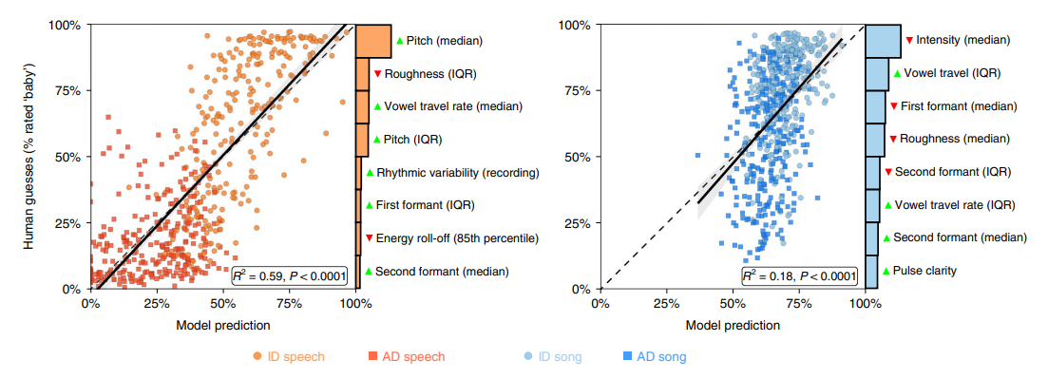
Human inferences about infant-directedness predictable from acoustic vocalization features
Notes:
Fig. 4 | Human inferences about infant-directedness are predictable from acoustic features of vocalizations. To examine the degree to which human inferences were linked to the acoustic forms of the vocalizations, we trained two LASSO models to predict the proportion of ‘baby’ responses for each non-confounded recording from the human listeners. While both models explained substantial variability in human responses, the model for speech was more accurate than the model for song, in part because the human listeners erroneously relied on acoustic features for their predictions in song that less reliably characterized infant-directed song across cultures (Figs. 1b and 2). Each point represents a recorded vocalization (after exclusions n= 528 speech recordings; n= 587 song recordings), plotted in terms of the model’s estimated infant-directedness of the model and the average ‘infant-directed’ rating from the naive listeners; the barplots depict the relative explanatory power of the top eight acoustical features in each LASSO model, showing which features were most strongly associated with human inferences (the green or red triangles indicate the directions of effects, with green higher in infant-directed vocalizations and red lower); the dashed diagonal lines represent a hypothetical perfect match between model predictions and human guesses; the solid black lines depict linear regressions (speech: F(1,526) = 773, R2= 0.59; song: F(1, 585) = 126, R2= 0.18; both P

Slide 10
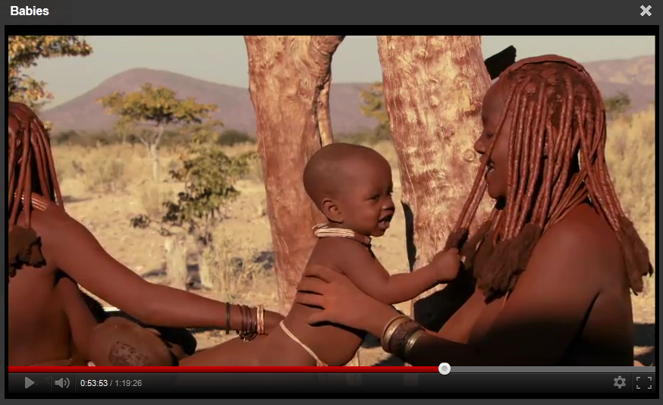
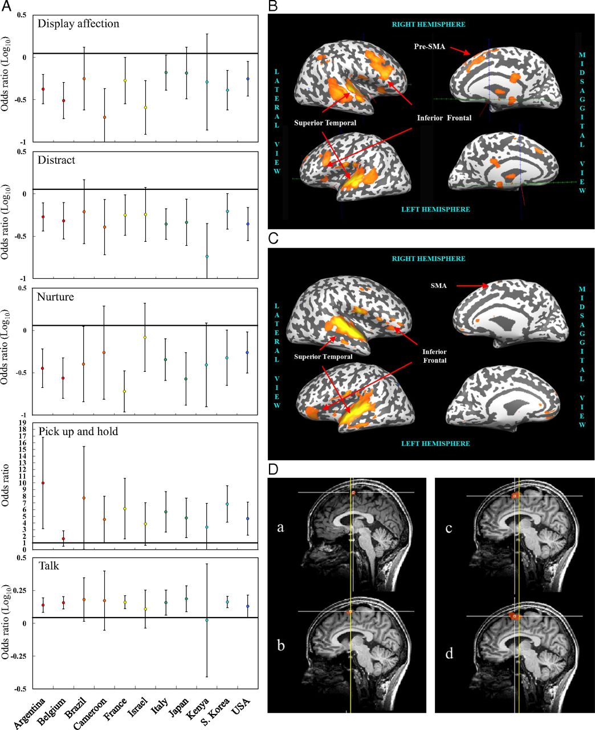
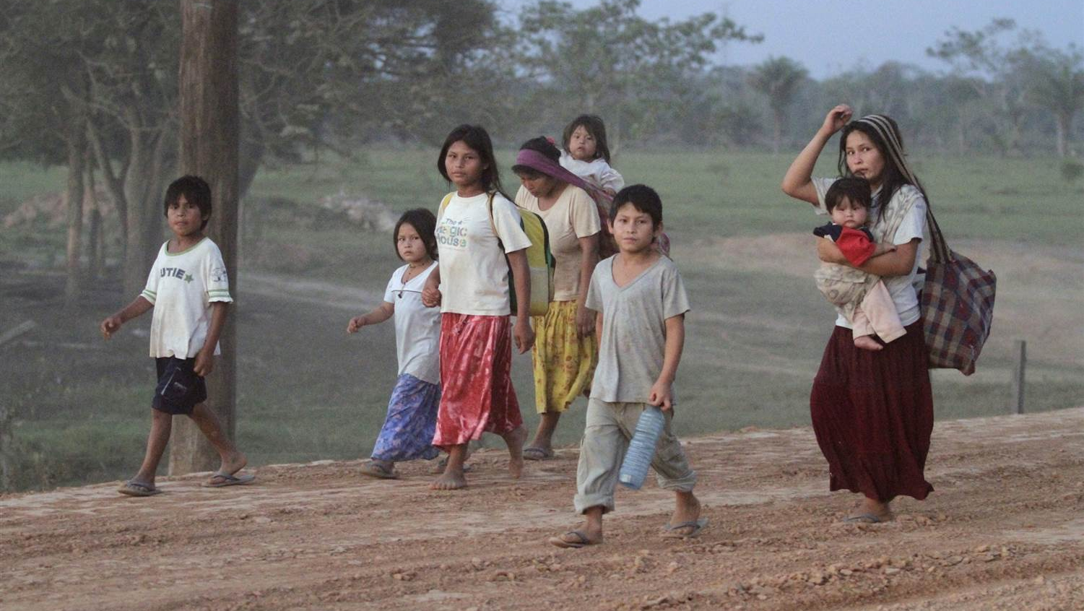
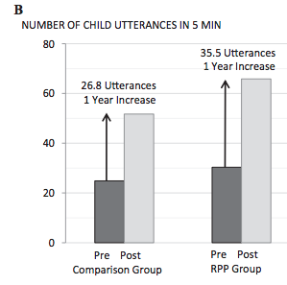
review
General responses to cry:
Pick up & hold, Talk

Slide 11
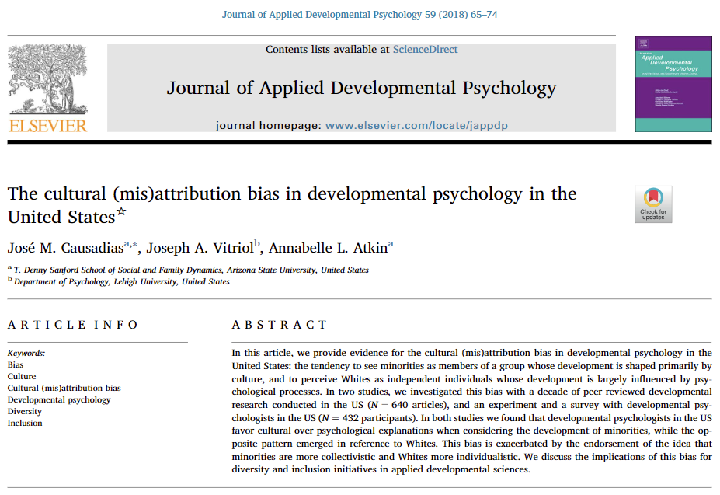

Slide 12
Cultural (mis)Attribution Bias
Diversity and Inclusion in Developmental Research
  Influence of culture, race, ethnicity, and other contexts
  Inclusion of scientists who represent this range
In the US, we emphasize culture et al. for (non-White) racial/ethnic minorities but not for Whites
Ahmad

Slide 13
Cultural (mis)Attribution Bias
Tendency to see of minorities as a group whose development shaped primarily by social-level cultural processes, and to perceive Whites as autonomous actors whose development is largely influenced by individual level psychological processes
  Deficit by difference approach: overemphasizing cultural differences -> reinforcing deficit perspectives
Ahmad

Slide 14
Cultural (mis)Attribution Bias
Bias consistent with individualism-collectivism paradigm
  Many within-group differences
  Stereotypical differences rebuked in meta-analyses
Found in mainstream US psychology
Assessing prevalence in developmental psychology via archival, experimental, and correlational methods
Ahmad

Slide 15
But culture central to the development of all human beings
Culture is dynamic, inherited, created, creates development through many processes at individual and collective levels
  Personality and culture are inseparable
Ahmad

Slide 16
Study 1: Journal Analysis
Developmental studies of culture, ethnicity, and race will have a higher percentage of minority participants than comparison studies.
In contrast with the ethnic distribution of the US, developmental studies of culture, ethnicity, and race will have a higher percentage of minorities in their samples, while comparison studies will have a lower percentage.
Ahmad

Slide 17
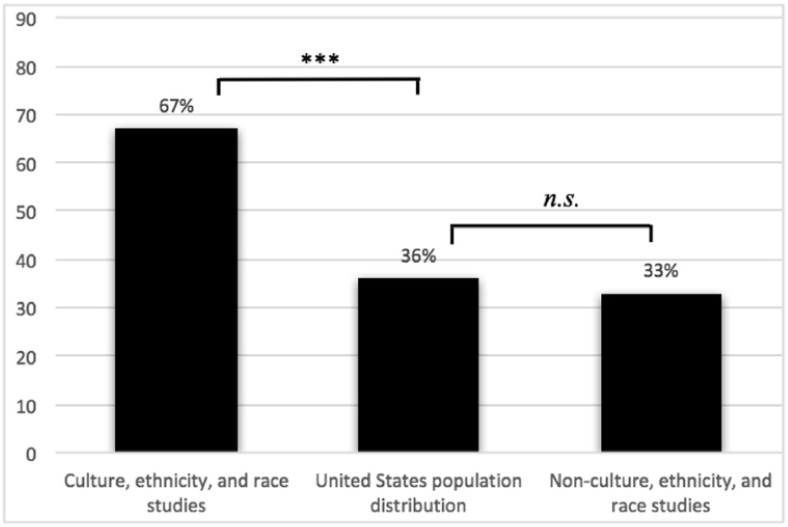
Minorities overrepresented in studies of culture
Fig. 1. Percentage of minority participants across studies and US population distribution.
Note. *** = p < .001, n.s. = non-significant (p > .05).
Ahmad

Slide 18
Study 2A: Experiment
More approval for a sample composed of minorities (vs. Whites) for a research study examining the role of culture on development, and this effect will not be moderated by ethnic self-identification of psychologists (White versus minority).
More approval for a sample composed of White (vs. minorities) for a research study examining research on the role of psychological processes on development, and this effect will not be moderated by psychologists' ethnicity.
Belief that Whites are more individualistic than minorities, and that minorities are more collectivistic than Whites, will consider minorities as more appropriate for research on the role of culture on development, and Whites as more appropriate for research on the role of psychological processes on development.
Ahmad

Slide 19
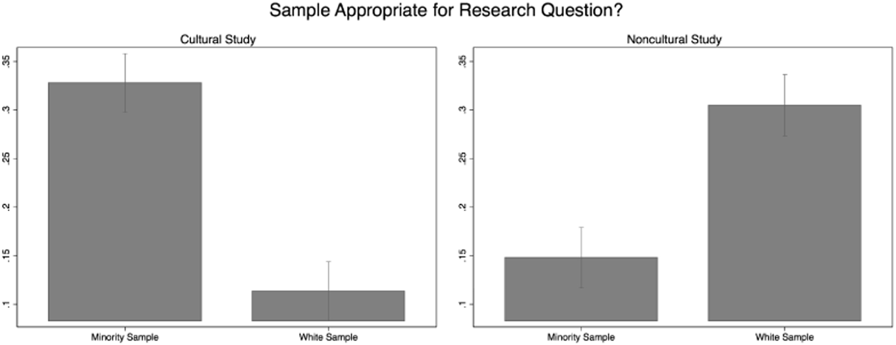
Irrespective of ethnic identification, professors rated studies of culture more approvingly if they had minority samples, and vice versa
Ahmad

Slide 20
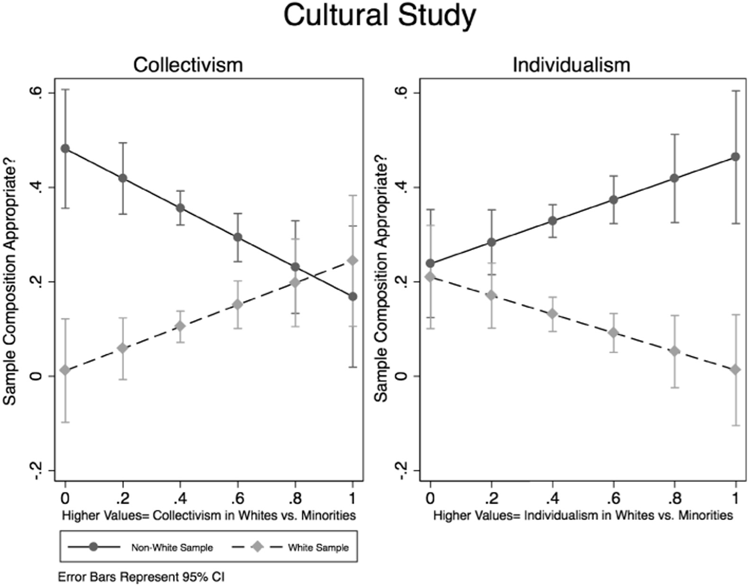
For a cultural study, belief in Whites as Individualistic and Minorities as Collectivistic drove approval ratings for the proposed studies
Ahmad

Slide 21
Study 2B: Survey
Professors will indicate that cultural processes are more influential than psychological processes in shaping the development of minorities than Whites, and this effect will not be moderated by developmental psychologists' ethnicity.
Professors will indicate that psychological processes are more influential in shaping the development of Whites than minorities, and this effect will not be moderated by developmental psychologists' ethnic self-identification (White versus minority).
Professors will indicate that other developmental psychologists believe cultural processes are more important for the development of minorities, while psychological processes are more important for the development of Whites, and this effect will not be moderated by developmental psychologists' ethnicity.
Ahmad

Slide 22
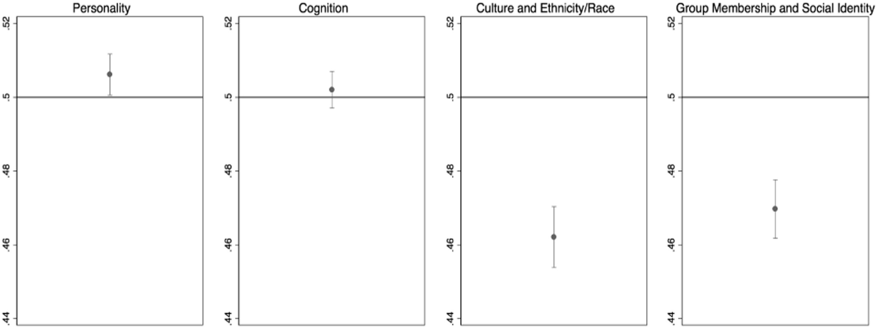
Professors endorsed cultural/social factors as more salient for minority development, and personality as more pertinent to development of Whites – minority professors more likely to endorse culture, ethnicity, and race
Ahmad

Slide 23
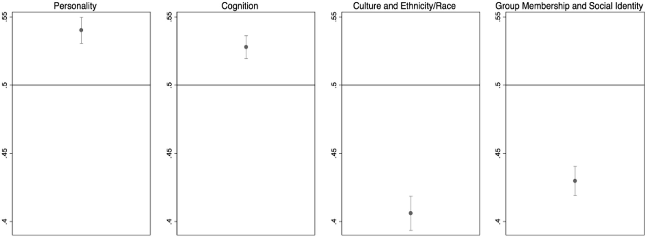
Developmental Psychologists did think that other Developmental Psychologists endorse the bias
Ahmad

Slide 24
Discussion
Cultural differences vs. cultural deficits
Individualism is a cultural orientation
Research examining cultural processes among Whites needed, especially those at-risk
  ”Other”-ness in celebrating culture is also preventing connectedness between groups
We should adopt a person-centered approach to statistical modeling as well as theory, policy, and interventions
Ahmad

Slide 25
Discussion
Strengths
Multi-method
Large sample
Assessed for potential moderators and other explanations
Weaknesses
Cultural (mis)attribution bias – lumping all “minorities”
“Researchers should recruit diverse samples (e.g., ethnic/racial minorities) for research questions examining the effects of culture, ethnicity, and race on development”
Where do we go from here? Incorporate intersectional identities?
Ahmad

Slide 26
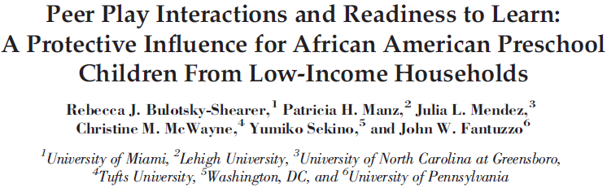
Positive influence of peer play on academic & social outcomes for African American preschoolers
  Previous research mostly white, middle-income children
Resilience-oriented framework
Developmental ecological theory
  Within-group variability
Transactional and bidirectional effects

Slide 27
Interactive peer play
Play dimensions in African American children:
  Play interaction
  Play disruption
  Play disconnection
Resilient Peer Treatment & Evident-based Program for Integrated Curricula
Interactive Peer Play
Academic/Social-Emotional Outcomes
Behavior Problems

Slide 28


Interactive Peer Play cont.
Social competency in other ethnic groups
  Latino subgroups
  Asian subgroups
Continued support of positive peer interactions beyond preschool
  How does this fit into our current education system?

Slide 29
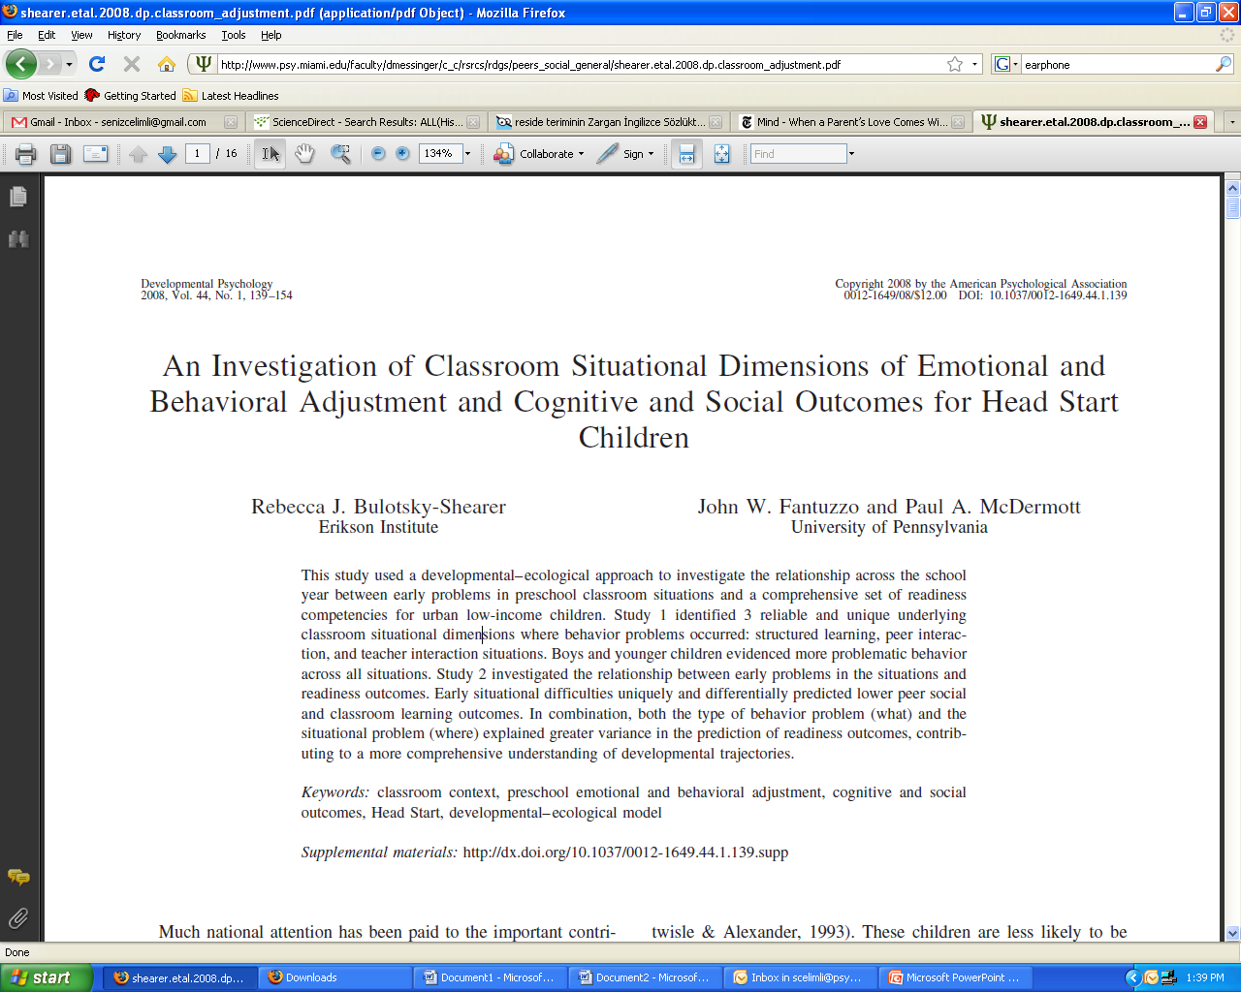

Slide 30
Adjustment Scales for Preschool Intervention (ASPI)--Context
  Existing scales consider behaviors to be “stable deficits” within children
    Do not consider whether behaviors vary over different settings
    Do not tell us when, where and how to intervene
  Development of the (ASPI)
    Specifically developed for low income preschool children
    “Language of preschool teachers, rather than psychiatric terms”
    22 developmentally appropriate preschool classroom situations & 2 non-situation specific unusual behavior problems
      22 maladaptive behaviors & 22 adaptive behaviors
      5 behavioral dimensions: “Phenos”
        Externalizing: aggressive, oppositional & hyperactive/inattentive
        Internalizing : withdrawn/low-energy & socially reticent
    Limitations:
      Didn’t measure impact of multiple contexts in classroom on outcomes
Notes:
Situations: Contextually relevant
Phenos: types problem behaviors
5 dimensions
Related to: peer social competencies, psychological adjustment, temperament & emotion regulation
Predict: classroom learning competency, receptive & expressive vocab, and peer social competency

Slide 31
    Theoretical Model:
      developmental-ecological approach → (bioecological systems theory)
  Goal: To examine the individual and interactional influence of the types of behavioral problems (what) and the situational context(s) in which they occur (where) on children’s developmental outcomes
  Identified 3 reliable and unique situational dimensions: “Situs”
    Structured learning
    Peer Interactions
    Teacher Interactions
    N=3,799 Head Start children
      4 > 5 year olds
      Boys > Girls
Notes:
Structured learning: differs from school-age academic expectations (teacher-directed); preschool involves more cooperative peer activities (play, child-directed and free-choice)
Age & Gender differences in line with literature

Slide 32
EMOTIONAL & BEHAVIORAL ADJUSTMENT
Within Routine Classroom Situations
(Situational Needs)
Problems in
Structured Learning
Problems in
Peer Interactions
Problems in
Teacher Interactions
Involvement in class activities
Taking part in games with
others
Maintaining companions/
friends
Paying attention in class
Sitting during teacher directed activities
Free play/individual choice
Working with hands (art)
Getting along with peers
Behaving in classroom
Respect for others’
belongings
Reaction to correction
Telling the truth
Standing in line
Talking to teacher
General manner with teacher
Answering teacher questions
Greeting teacher
Seeking teacher help
Helping teacher with jobs

Slide 33
  Unique relationship between situtypes and school readiness outcomes
    N=747
      Hypotheses:
        Situational dimensions would contribute unique variance to the prediction of social and learning outcomes
        The combined contribution of both situational and behavioral influences would be greater than either set alone
      Findings:
          Peer Social Competencies
            Play Disconnection, Disruption & Interaction
          Classroom Learning Competencies
        Most Importantly
          Contribution of structured learning to peer social competency & learning outcomes
          Phenos moderate the influence of Situs in the prediction of multiple social and learning competencies
Notes:
N: enrolled in the same program as participants of study 1, but in a different year
Unique: above and beyond the contributions of already established behavioral dimensions and child covariates (demo)
Problems in situtypes at the beginning of the preschool year will predict lower learning outcomes at the end of the preschool year
Outcome measures:
PIPPS T – Penn Interactive Peer Play Scale: measures common play behaviors that facilitate or interfere with prosocial peer interactions in the classroom
COR – Child Observation Record: emergent literacy, numeracy, social and motor competencies

Slide 34
  Implications for Policy & Practice
      ASPI guides intervention, rather than creating diagnostic labels
      children are assessed within a “naturalistic context”
    Developmental-ecological perspective
      Multiple levels of influence (dynamic transaction):
        child behavior (ontogenetic)
        & classroom situation (microsystem)
    Interventions:
      Goal shift:“fixing the child” → broader systemic approach
      Identification of “high-frequency” challenging situations and behavior problems (Classroom Management & Intervention Strategies)
      Professional Development
      Curriculum
Notes:
-ASPI translation
-Direct child assessment, Parent Report, 3 time points
-

Slide 35
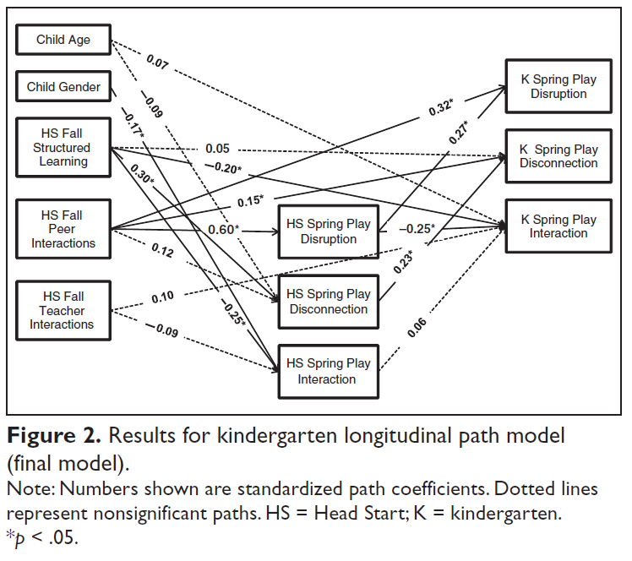
Fall Head Start Problems Predict
Spring Head Start and Spring Kindergarten Social Competence
Problems in peer interactions directly and indirectly affected play disconnection at the end of kindergarten through its effect on play disruption at the end of Head Start
Problems in structured learning situations indirectly predicted play disconnection at the end of kindergarten through its effect on play disconnection at the end of Head Start.
Bulotsky-Shearer, Dominguez, Bell, Rouse, & Fantuzzo, 2010

Slide 36
Culture and Development (cont)
Example: American vs. Japanese mothers’ responses to 5-month-old infants’ direction of orientation
  Mother vs. object in environment
    Differences in responsiveness based on orientation with overt attempts to change focus to fit own preference
    These preferences assumed to be based on cultural history and value orientation
Bornstein et al., 1990; 1991

Slide 37
Culture and Development (cont)
American vs. Japanese mothers’ responses to 5-month-old infants’ direction of orientation
    Differences in responsiveness assumed to be based on cultural history and value orientation
Bornstein et al., 1990; 1991, 1992

Slide 38
Turtle task
24- to 31-month-olds
Japanese mothers more frequently assisted their toddlers in fitting a shape before the toddlers had tried to fit the shape on their own (interdependence);
American toddlers did not attempt to fit more shapes on their own (autonomy);
More American toddlers left the task than did Japanese toddlers (autonomy).
Messinger & Freedman (1992)

Slide 39
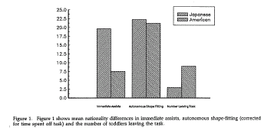
Figure

Slide 40
Video: Turtle task
American National (00)
Japanese American (11:10)
Japanese National (19:25)
Ds/users/video

Slide 41
Apparent developmental discontinuity
While the desires of Japanese infants are indulged, school-age children are expected to regulate their desires to conform to the demands of working in a group (Hendry, 1986).
A sharp contrast is thought to exist between the infant-centered relationship with the mother in the home and the expectation that 3-year-olds, upon entrance to nursery school, will learn to conform to shudan seikatsu, 'life in a group' (Peak, 1989)
  Not captioned. https://www.youtube.com/watch?v=qLo0phnh-kA
  Captions/ produced https://www.youtube.com/watch?v=jv4oNvxCY5k

Slide 42
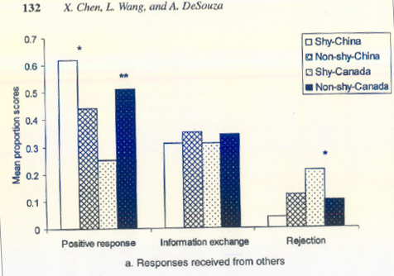
Culture and Peer Interactions
Chen, Wang, & DeSouza, 2006. Temperament, socioemotional functioning, and peer relationships in Chinese and North American children.
(Chen, 2012)
Notes:
Cultures have different socially accepted characteristics: obedience, independence, shyness, aggression. Values are basis for social evaluation and reaction in peer interactions.
Social initiative and self-control
Prosocial-cooperative behavior (optional v. required)
Aggression (acceptable exclusion or social support)
How does globalization/communcation affect this relationship

Slide 43
Japanese kids’ independence…
https://www.youtube.com/watch?v=ls_sLSo-QE0 from 1:36

Slide 44
Culture and Peer Interactions (Chen, 2012)
How is culture transmitted to a developing child?
  Emphasis on social mediation
Culture
Peer Interactions
Social Development
Notes:
What role does peer interaction play in socio-emotional development? Peer interactions shaped by culture.
Theoretical model: Peer interactions are the context in which cultural values and other aspects of culture shape social and emotional development.

Slide 45
Culture and Peer Interactions (Chen, 2012)
What are some unique aspects of culture transmitted via peer interactions vs. other types of socialization experiences?
Notes:
Expectations that are specific to that age group, general social rules
NOT: family traditions, parent values (honesty)

Slide 46
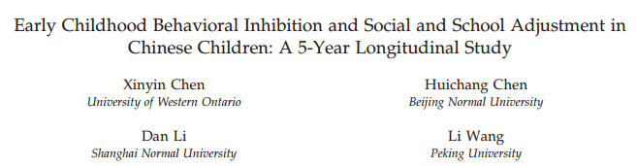
Chen, X., Chen, H., Li, D., & Wang, L. (2009). Early childhood behavioral inhibition and social and school adjustment in Chinese children: A 5-year longitudinal study. Child Development, 80, 1692-1704.

Slide 47
Behavioral Inhibition in
Chinese Children
Behavioral Inhibition (BI)
  tendency to exhibit vigilance, anxiety, and wariness in response to unfamiliar/challenging situations
  stable temperamental factor, affects up to 15% of typically developing children (Fox et al., 2005)
In West, associated with socioemotional and school difficulties, social anxiety, depression
But does BI have same significance in different cultural contexts?

Slide 48
Mechanisms leading to negative outcomes?
  Caregiver attitudes (e.g., rejection, disapproval)
  Responses of caregivers, teachers
  Lack of peer acceptance
  Negative self-perceptions
But does BI have same significance in different cultural contexts?

Slide 49
Behavioral Inhibition in
Chinese Children
Hypotheses
  Inhibition will be positively associated with:
    Cooperative behavior
    Peer integration and social status
    Positive school attitudes
    School competence
  Inhibition will be negatively associated with:
    Antagonistic behavior
    School problems
Notes:
Moderating roles of gender, parent education

Slide 50
Behavioral Inhibition in
Chinese Children
Measures
2 years
  Behavioral Inhibition
    Observational paradigm – single composite score
      Child plays with toys while mom fills out questionnaire in same room
      Clean up
      Unfamiliar woman enters, plays with novel toys, and encourages child to join play
      Similar situation repeated

Slide 51
Behavioral Inhibition in
Chinese Children
7 years
  Peer Interaction Paradigm (Quartets)
    Cooperative Behavior
    Antagonistic Behavior
  Social Adjustment
    Child-rated peer liking
    Child-perceived social integration
  School Adjustment
    School attitudes (child)
    School competence (teacher)
    Learning problems (teacher)
    Distinguished studentship

Slide 52
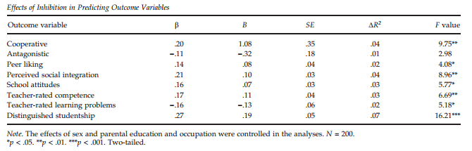
Age 2 inhibition predicts positive age 7 outcomes
Predictive Associations

Slide 53
Limitations?
BI has also been linked to higher morning cortisol, higher startle response, and elevated morning cortisol (Degnan, Alams, & Fox, 2010). Are these physiological differences a function of BI or of parental/environmental/cultural responses to BI?
How generalizable do you think the findings are…
  At other times (vs. 1994-1999)?
  To other regions?
Notes:
What other measures would you collect?

Slide 54
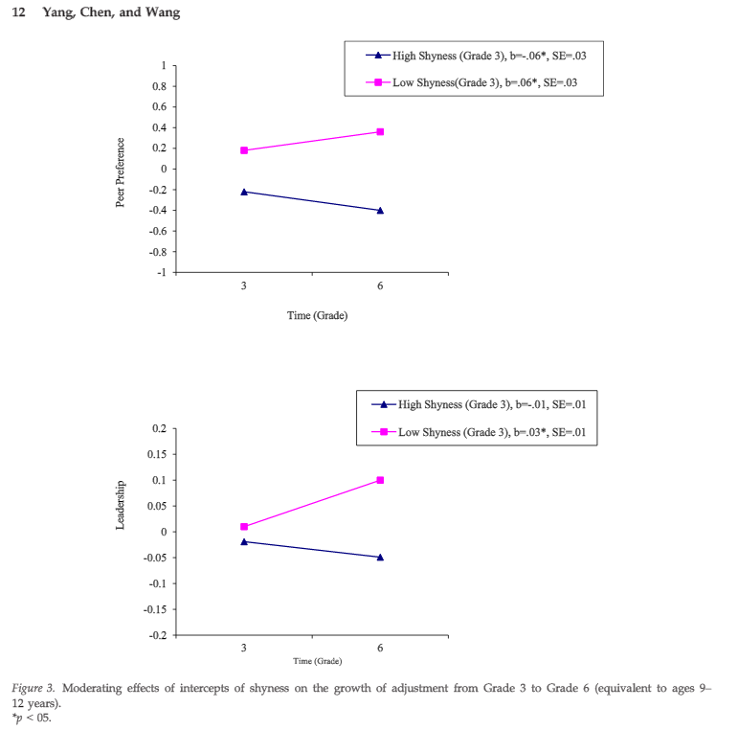
Cultural and developmental change
Is cultural change producing
developmental change?
Yang, F., Chen, X., & Wang, L. (2015). Shyness-Sensitivity and Social, School, and Psychological Adjustment in Urban Chinese Children: A Four-Wave Longitudinal Study. Child Development, n/a-n/a. doi: 10.1111/cdev.12414

Slide 55
Culture and Peer Interactions (Chen, 2012)
Peer Interactions
Culture
Socio-emotional development
Chen, X. (2012). Culture, peer interaction, and socioemotional development. Child Development Perspectives.

Slide 56
Examples from your own work?

Slide 57
Timeline of child maltreatment
Historically, harsh discipline viewed as parent’s right and responsibility
          https://en.wikipedia.org/wiki/Corporal_punishment
  Are our ancestors culturally different (other) than us?
  “Corporal punishment refers to spanking, paddling, or other forms of physical discipline in schools. While many states have banned corporal punishment in public schools, Florida allows the practice.”
            http://statelaws.findlaw.com/florida-law/florida-corporal-punishment-in-public-schools-laws.html
Idea of child maltreatment is gaining worldwide recognition

Slide 58
Abuse
Physical abuse
  Acts that result in actual or potential physical harm, resulting from an interaction that is within the control of a parent or person in a position of responsibility, power or trust. WHO
    UNICEF: persons under 18 years of age who suffer occasional or habitual acts of violence
Sexual abuse
  Involvement of a child in sexual activity that he/she does not fully comprehend, is not able to give consent to, and that violates the laws or taboos of society

Slide 59
Sexual abuse
Previous definition: Involvement of a child in sexual activity that he/she does not fully comprehend, is not able to give consent to, and that violates the laws or taboos of society

Slide 60
How to make a report
http://www.myflfamilies.com/service-programs/abuse-hotline
1 - 800 - 96ABUSE (1-800-962-2873)
Provide the following
  Victim name, address or location, approximate age, race and sex
  Signs or indications of harm or injury, including a physical description if possible
  Relationship of the alleged possible responsible person to the victim. Not required for report.

Slide 61
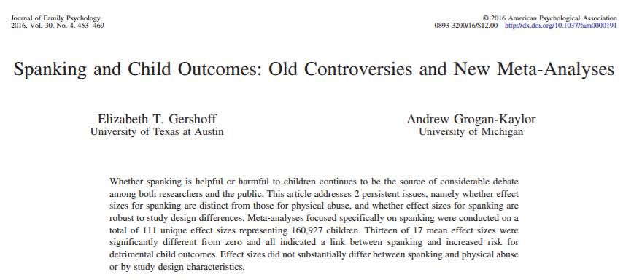
Thirteen of 17 mean effect sizes were significantly different from zero and all indicated a link between spanking and increased risk for detrimental child outcomes.
Effect sizes did not substantially differ between spanking and physical abuse or by study design characteristics.

Slide 62
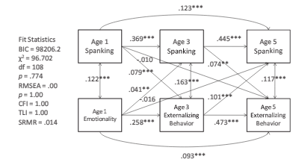
Spanking→Externalizing
N = 3,870
Maguire-Jack, K., A. N. Gromoske, et al. (2012).
"Spanking and Child Development During the First 5 Years of Life." Child Development 83(6): 1960-1977.
Emotionality= ”tendency to become aroused easily and intensely”
Notes:
Using data from the Fragile Families and Child Wellbeing Study (N = 3,870) and cross-lagged path analysis, the authors examined whether spanking at ages 1 and 3 is adversely associated with cognitive skills and behavior problems at ages 3 and 5. spanking at age 1 was associated with a higher level of spanking and externalizing behavior at age 3, and spanking at age 3 was associated with a higher level of internalizing and externalizing behavior at age 5. The associations between spanking at age 1 and behavioral problems at age 5 operated predominantly through ongoing spanking at age 3. The authors did not find an association between spanking at age 1 and cognitive skills at age 3 or 5.

Slide 63
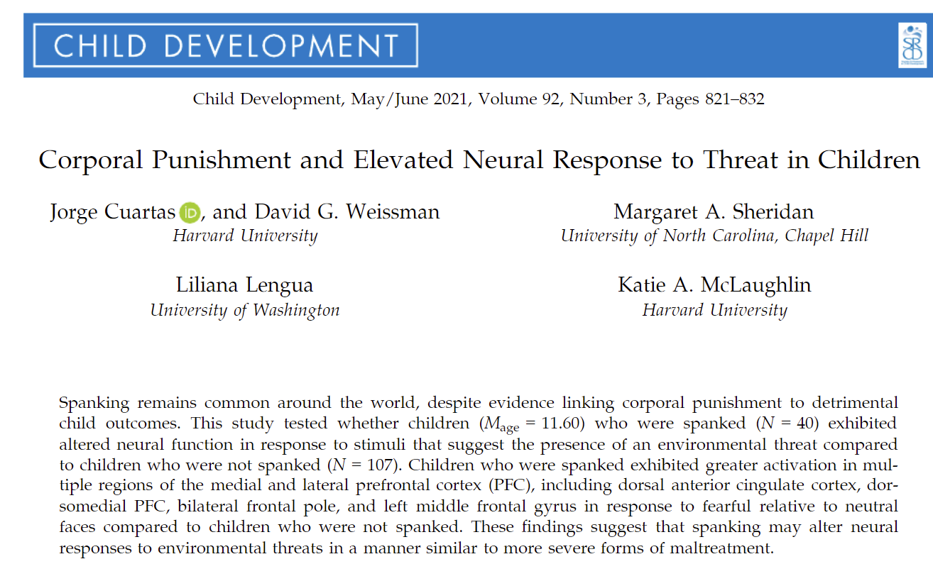
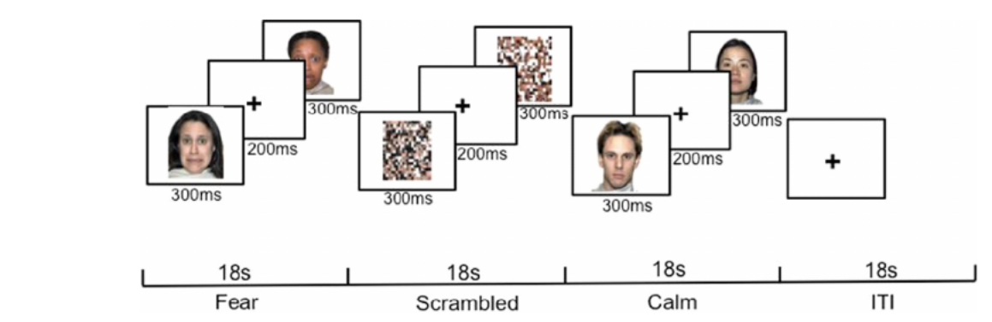

Slide 64
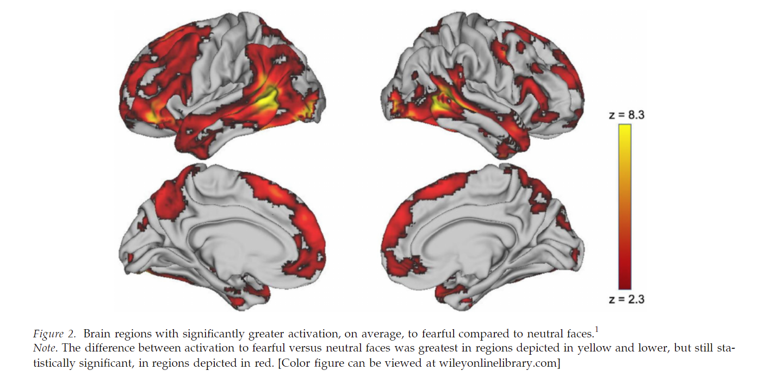
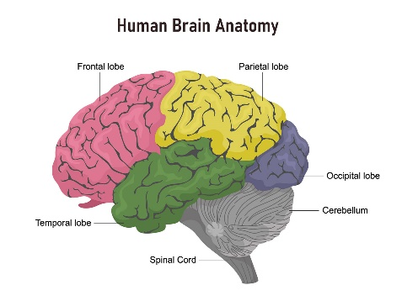
Overall: Fearful vs. neutral faces

Slide 65
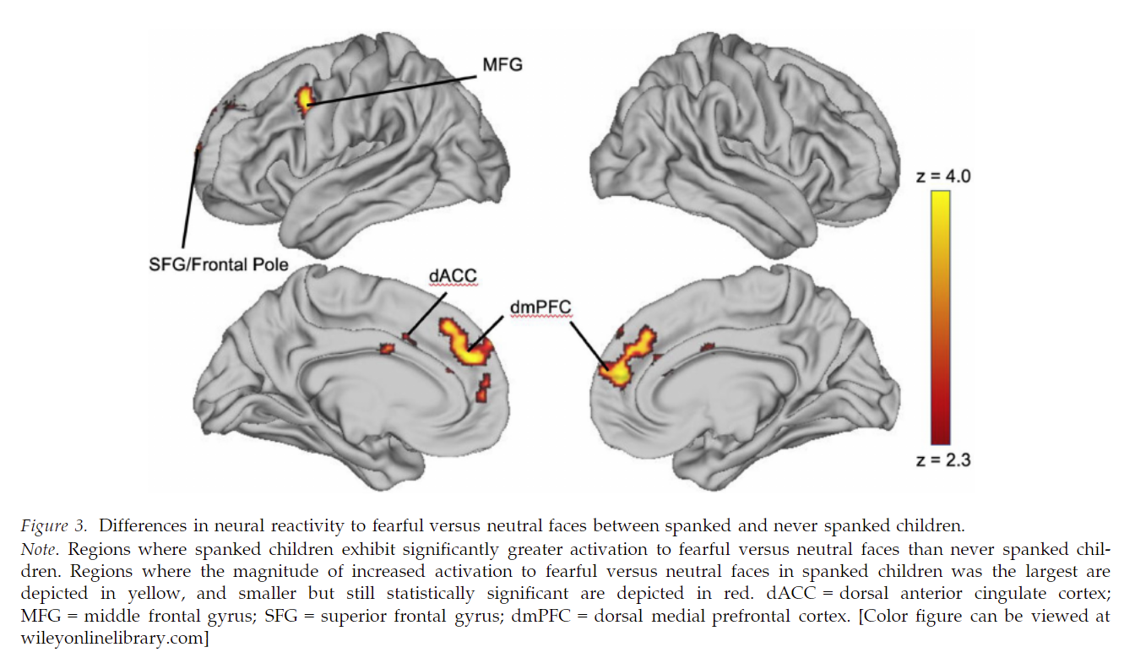
Spanked>never_spanked in fear vs. neutral

Slide 66
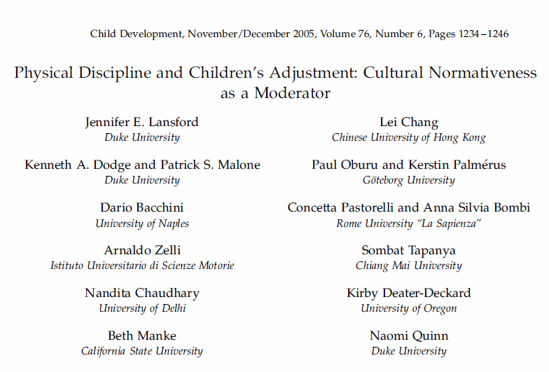

Slide 67
Cultural context
“In the anthropology literature, there are many examples of parental behaviors that appear to have no detrimental effects on children’s adjustment, despite the perception in other cultural contexts that these behaviors would be harmful to children.” (p. 1242)
Saez-Flores
But sometimes we do need to think about safety and development…

Slide 68
Why study this?
Prior research has looked at race and ethnicity as moderators of physical discipline and child adjustment—but less is known about the mechanism that drives the association
Much of previous research is in predominantly white samples
  There is a need for more culturally heterogeneous samples
Rothman

Slide 69
Previously proposed mechanisms
Social learning theory:
  Parents’ use of physical discipline teaches that aggression is appropriate in some situations
Rohner’s parental acceptance-rejection theory:
  Child’s interpretation of parental discipline as interpersonal rejection leads to negative effects on adjustment
Grusec & Goodnow’s Framework:
  Child’s perception of parental discipline as unfair or unreasonable reduces the likelihood that the disciplinary message is internalized
Carucci/Rothman
Notes:
After slide 11 (how does culture affect the way kids make these judgments?)

Slide 70
What is “normative”?
How much is the discipline perceived as normative?
Does the child think this happens in other households within their cultural group?
How normative is it actually?
Is this actually what other parents within this cultural group do to discipline their children?
Parents’ perceptions may also play a key role in interpretation of behavior
Physical discipline =
  Spanking
  Slapping
  Grabbing
  Shaking
  Beating up
Rothman

Slide 71
Research Question
How do cultural contexts moderate the effects of parents’ disciplinary strategies on child adjustment?
“Normativeness” of the disciplinary action
Parental discipline
Child adjustment
Rothman

Slide 72
Study Hypotheses
Mothers would significantly differ in frequency of use of physical discipline across cultures, and how normative they perceived the use of discipline to be
Actual normativeness
Perceived normativeness by both parent AND child
Parental discipline
Child adjustment
Rothman

Slide 73
Analyses / Results
H2: Both perceived normativeness AND actual normativeness would moderate the relationship between parental discipline and child adjustment
  Multilevel modeling (nested data: child-mother dyads within country)
Rothman

Slide 74
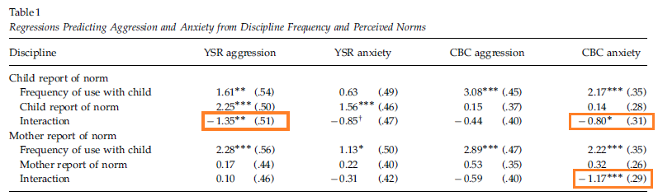
Significant interaction effects
Mothers’ use of physical discipline was related less strongly to child’s adjustment when the discipline was perceived as being culturally normative
Reid

Slide 75
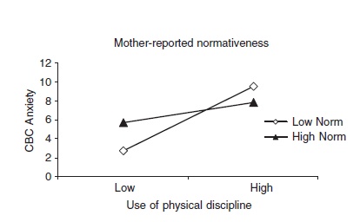
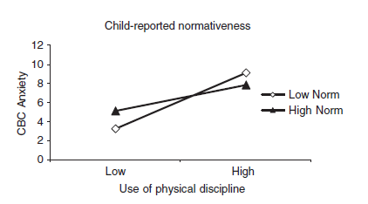
Physical Discipline and Normativeness
More frequent use of PD was associated with higher levels of anxiety (CBC ), regardless of normativeness (note attenuation of the slope) .
Reid

Slide 76
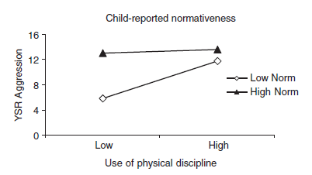
Testing the moderation hypothesis
Child-reported normativeness moderates the association between mother’s use of physical discipline and children’s anxiety (CBC)
Children who perceived discipline as highly normative had higher levels of aggression despite maternal reported frequency of physical discipline
Reid

Slide 77
In summary
Countries with lowest normativeness showed strongest associations (+) between maternal frequency of discipline and child behavioral problems
Regardless of normativeness, higher frequency of physical discipline was associated with higher anxiety and aggression
Frequent use of PD was associated with more aggression and anxiety across all countries
Rothman, Reid

Slide 78
Pros and cons of methods for addressing the topic
Methods
Surveys
Ease and convenience of administration (e.g. cost); Attention to language and fidelity of measures
Sample
Multi-national
Addresses important cross-cultural issues and contextual norms
Analysis
Multilevel modeling
Allowed for an assessment of differences between countries
Limited interpretation re: causation
Homogeneity of sample’s socioeconomic status
The chicken and egg scenario: physical discipline <-> child adjustment
Reid

