Slide 1
Preschool classroom effects, interventions, and outcomes
Psychology of Infancy
PSY430
Daniel Messinger, PhD

Slide 2
School Overview
Preschool as a developmental context
  Teacher→child phonemic interaction
Childcare effects
  @ 3, 4.5
    Classroom composition (context) effects
    Moderator: temperament?
    Experiments: EHS RCT, HS RCT (Bierman), Abecedarian
  @ 15, and end of high school
Cost-benefit analysis
Universal gifted screening (Card & Giuliano)
Context effects (Howes; Dmietreva

Slide 3
Preschool as a multilevel context
Classroom Practices
Curriculum Content
Instructional Design
School
Curriculum Policies
Demographics
Organization
Child
Classroom Engagement
Motivation
Self-Esteem
Achievement
Goals
Behavioral Interaction
External Relations
School, home,
community linkages
Teacher Characteristics
Beliefs
Instruction Techniques
Relationships with
students
Notes:
Hierarchical & interdependent levels of organization; further levels include district, state, nation; levels vary from proximal to distal
Effects on child are both direct and indirect; direct effect of cooperative learning practices/school policy on child’s self-esteem and achievement
Example of indirect: standardized testing (FCAT) changes instructional focus to drill and practice; which may be at odds with teacher’s own goals/beliefs; affects teacher’s motivation and then affects child’s performance and development
Dynamic interactions between levels
Processes change across children’s development—idea of goodness of fit with child’s stage (=developmentally appropriate practice)
Processes change at different school levels (e.g., declines in student well-being at transition to middle school)

Slide 4
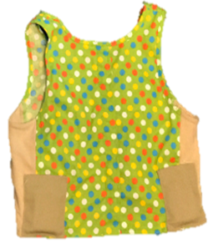
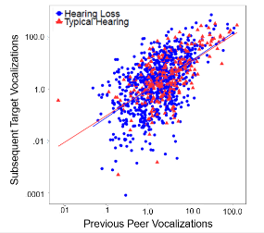
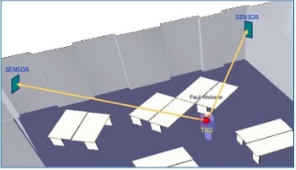



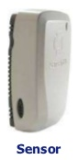

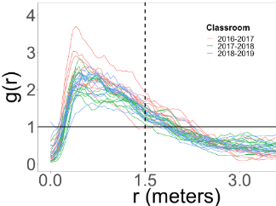

Interactive Behavior in Schools (IBIS)
What do we collect?
How do we collect this?
Hiring a data
scientist postdoc!

Slide 5
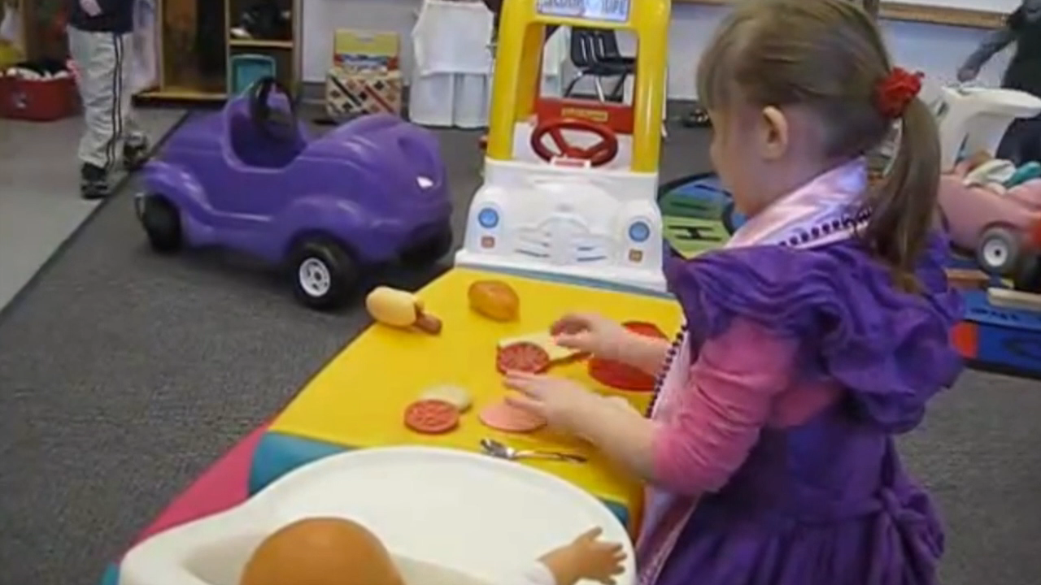
Real-time classroom interaction
5

Slide 6
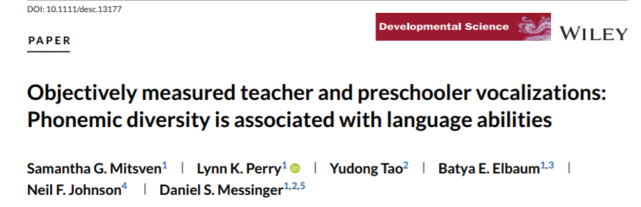


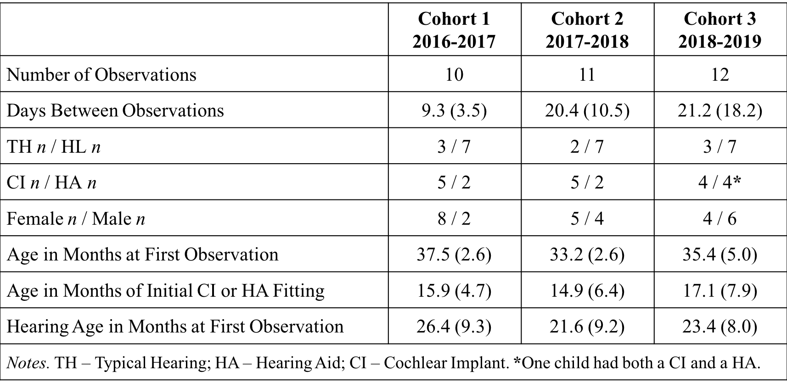
Three preschool classrooms that included children with hearing loss (HL) and typically hearing (TH) children between 2.5 and 3.5 years of age participated.
(N = 29, 16 girls, 14 Hispanic)
Vocalization data were collected over 34 total observations.
Note. HA – Hearing Aid; CI – Cochlear Implant. *One child had both a CI and HA.

Slide 7
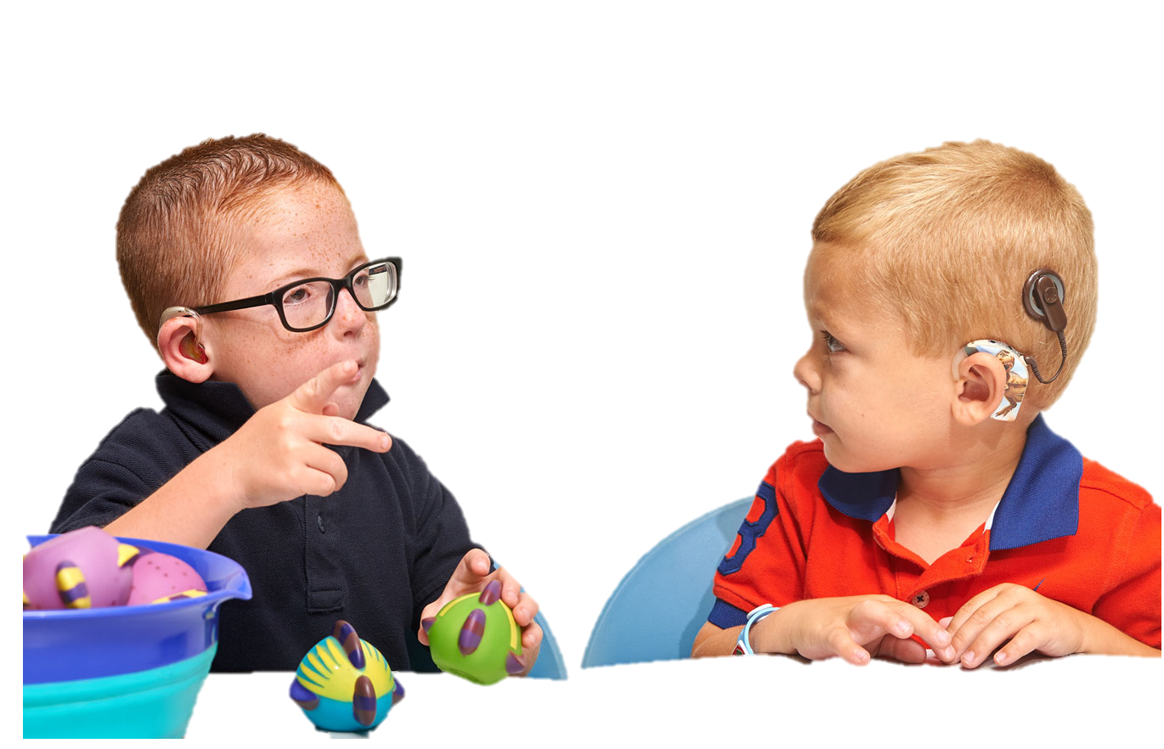
Reciprocal, longitudinal, peer speech patterns
Peer to target
Peer to target
Peer to target
…
…
Target to peer
Target to peer
Target to peer
Recording session t
Recording session t+1
Recording session t+n

Slide 8
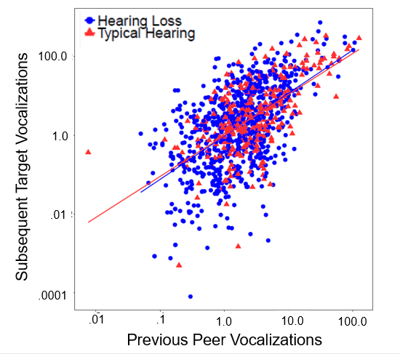
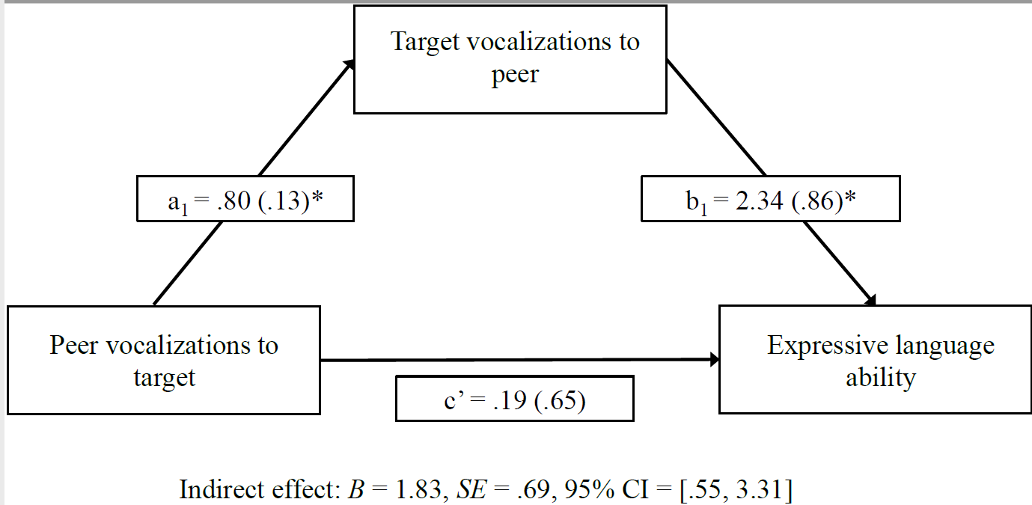

Peer vocalizations predict language ability
Regardless of hearing status
Peer vocalizations →
focal child vocalizations →
language abilities
Peer vocalizations to focal child →
Focal child vocalizations to peer
Perry, et al., 2022
B=.33, se=.08, t=4.02, X²(1)=15.71, p=.00007

Slide 9
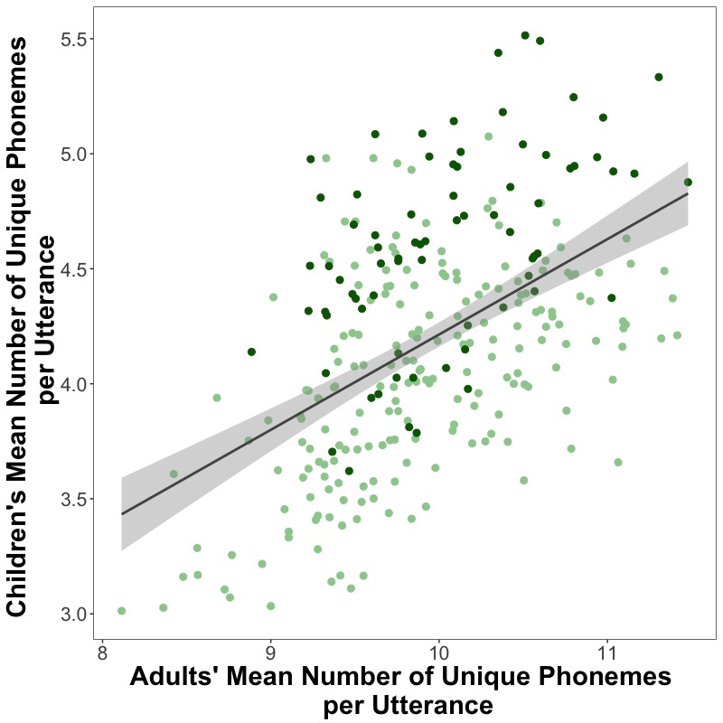



Teacher to child phonemic complexity
Teacher to child phonemes
“Thank you! I like grape juice.”
Phonemic diversity = 14
θ-æ-ŋ-k j-u.
aɪ l-aɪ-k g-r-eɪ-p ʤ-u-s.
Mitsven, et al., 2021

Slide 10
The rate and phonemic diversity of teachers’ utterances did not differ by children’s hearing status
b = -.04, X² = .01, p = .910
b = .16, X² = .52, p = .472

Slide 11
Children with hearing loss produced fewer & less phonemically diverse utterances than typically hearing peers
b = 1.22, X² = 4.26, p = .039
b = 1.49, X² = 13.95, p < .001

Slide 12
The quantity and quality of teacher speech predicted the quantity and quality of child speech, but...
b = .14, X² = 8.97, p = .003
b = .20, X² = 22.84, p < .001

Slide 13
But phonemic diversity of children’s speech more strongly predicted language abilities than the rate of their speech.
 | Model Outcome | Step and predictor | R² | ΔR² | df | p
Model 1A | Receptive language ability | 1. Child phonemic diversity | .353 | .353 | 1, 24 | .001
 |  | 2. Child rate | .395 | .042 | 1, 23 | .218
Model 1B | Receptive language ability | 1. Child rate | .263 | .263 | 1, 24 | .007
 |  | 2. Child phonemic diversity | .395 | .132 | 1, 23 | .035
Model 2A | Expressive language ability | 1. Child phonemic diversity | .352 | .252 | 1, 24 | .001
 |  | 2. Child rate | .383 | .031 | 1, 23 | .294
Model 2B | Expressive language ability | 1. Child rate | .239 | .239 | 1, 24 | .011
 |  | 2. Child phonemic diversity | .383 | .144 | 1, 23 | .030

Slide 14
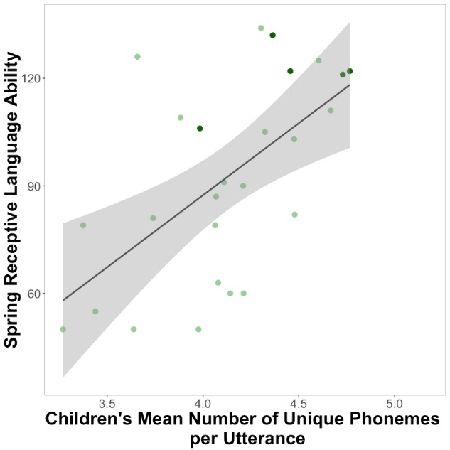
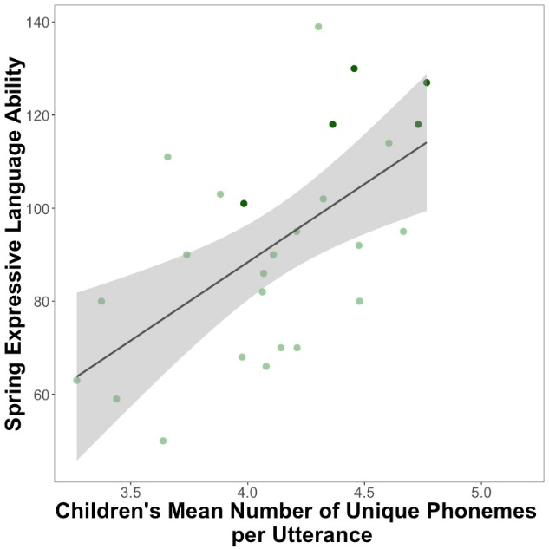
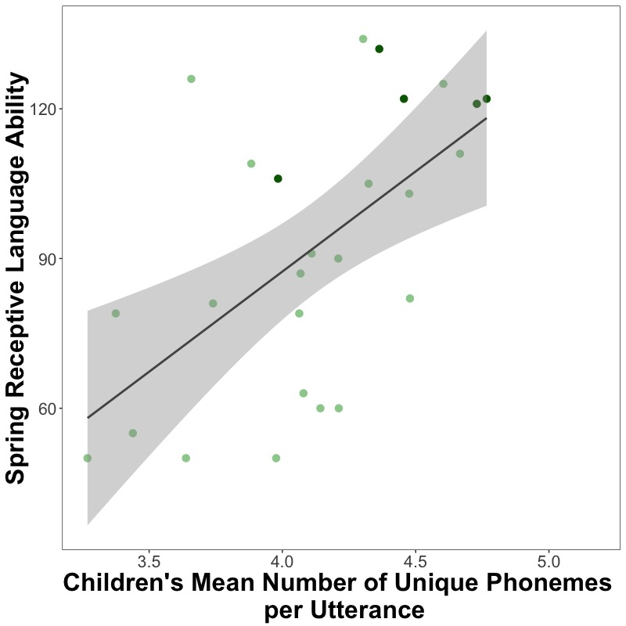
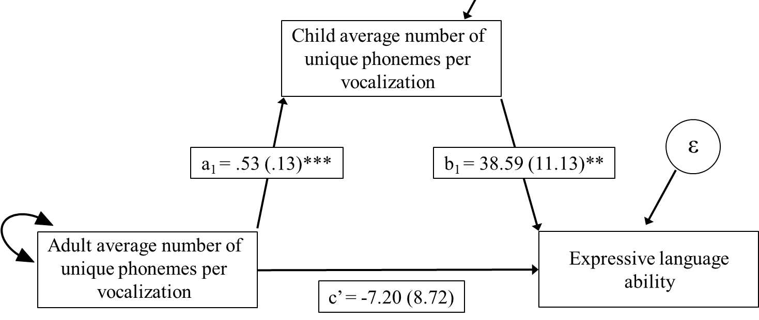
Adult phoneme → child phoneme → child language score

Slide 15
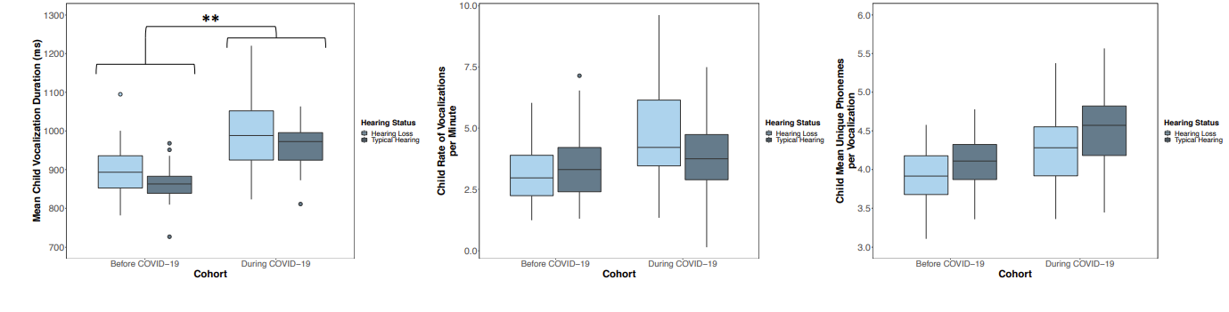
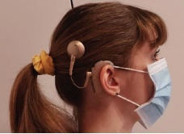


No apparent decremental effects of masks on child speech…..
Child Speech (Vocalization) Duration
Child Speech
Phonemic Diversity
Child Speech Rate
Christian Jerry
Sam Mitsven
Mitsven, et al. 2022

Slide 16
Children who produced more phonemically diverse utterances had higher end-of-year language abilities.
b = 33.26, SE = 12.56, t = 2.65, p = .015
b = 24.37, SE = 10.22, t = 2.38, p = .026

Slide 17
In fact, the phonemic diversity of children’s speech mediated the relationship between the phonemic diversity of their input and their language abilities.

Slide 18
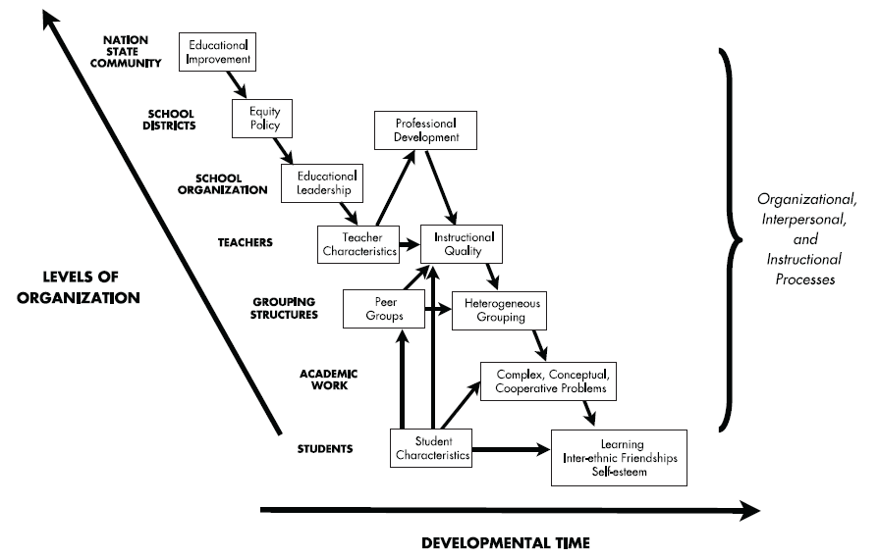
Levels of organization—1 (bottom) to 7 (top)
Hypothesized case: Heterogeneous grouping and complex instruction → increase educational equity
Broward gifted testing
2021 Bright Futures
direct and indirect effects
on child…

Slide 19
Individual level effects

Slide 20
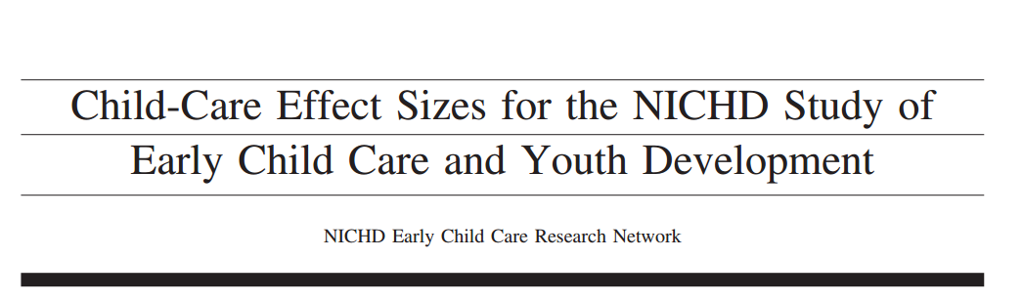
Individual level effects
ADD TITLE SLIDE HERE!
Participants (N=1364)
  (N=1,095 by 54 months)
24% ethnic minority
Assessed at 1, 6, 15, 24, 36, and 54 months

Slide 21
Background
Children attending child care has increased from under 25% to over 80%
This has generated questions about the effects of child care on children’s development
National Institute of Child Health and Human Development (NICHD) conducted a longitudinal study to observe these effects

Slide 22
Purpose of Study
To examine how variations in early child care experiences were related to children’s:
  Social-emotional adjustment
  Cognitive and linguistic performance
  Health
Compare effect sizes for quantity, quality, and type of care with effect sizes of parenting

Slide 23
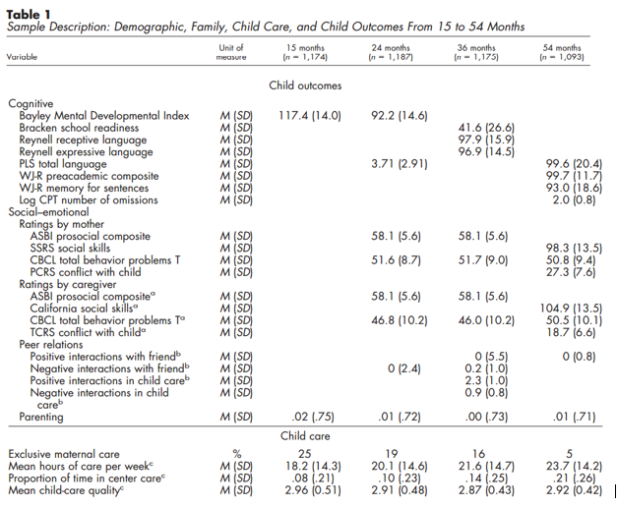
Measures

Slide 24
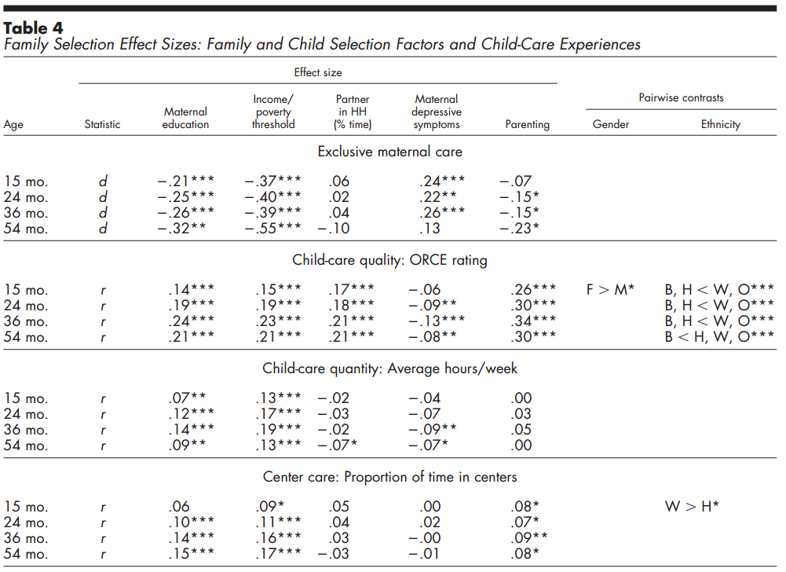
Family characteristics are associated with child-care quality, quantity, & type
INCLUDE TABLE 4 AND PUT BOXES AROUND FINDINGS WANT TO SHOW!

Slide 25
Child-care til 3 & peer competencies
More time in child-care →
  more negative with playmates (caregiver rated)
  more positive and skilled in peer play in child care (observed)
      Child-care not associated with peer competence as rated by mothers or as observed in dyadic play with a friend.
Positive responsive caregiver behavior most consistently associated with positive skilled peer interaction
Maternal sensitivity, children's cognitive and language competence predicted peer competence across all settings and informants
  family and child-care contexts may play complementary roles in development of early individual differences in peer interaction.
    NICHD_Early_Child_Care_Research_Network (2001). "Child care and children's peer interaction at 24 and 36 months: The NICHD study of early child care." Child Development 72(5): 1478-1500
  observed peer play not related to quantity of care.

Slide 26
Two and 3-year-olds in child-care
“more experience in child-care settings with other children present were … more positive and skilled in their peer play in child care
  But their caregivers rated them as more negative with playmates.
  Ss with more hours in child care rated by caregivers as more negative in peer play, but their observed peer play was not related to quantity of care.
  Child-care experiences were not associated with peer competence as rated by mothers or observed in dyadic play with a friend.
Maternal sensitivity and children's cognitive and language competence predicted peer competence across all settings and informants.”
                NICHD_Early_Child_Care_Research_Network (2001). "Child care and children's peer interaction at 24 and 36 months: The NICHD study of early child care." Child Development 72(5): 1478-1500.

Slide 27
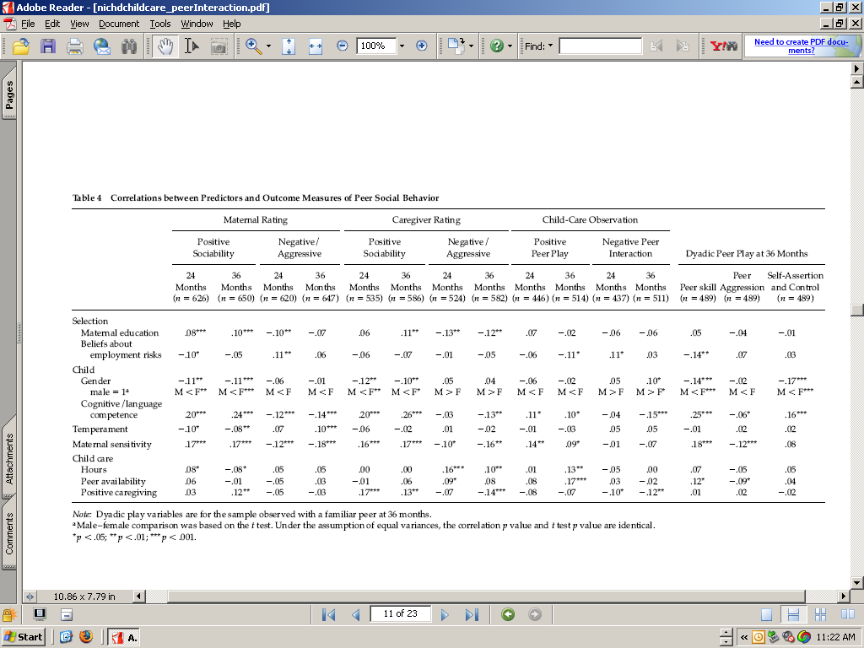

Slide 28
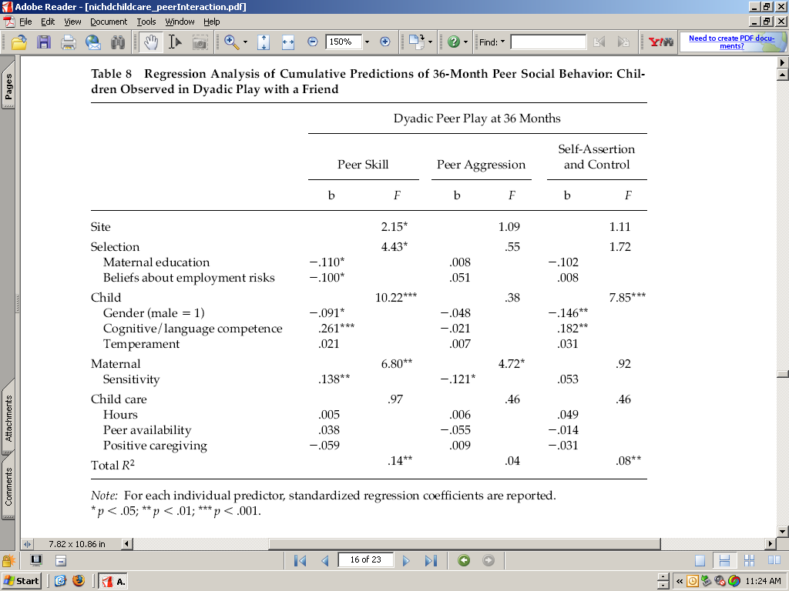
No child care effects on observed interaction
?

Slide 29
Exclusive maternal care did not predict outcomes
Higher quality child care related to higher cognitive, language, & pre-academic outcomes at every age
  better socioemotional and peer outcomes at some ages.
More childcare hours --> more behavior problems and conflict, according to care providers.
More center-care time → higher cognitive & language scores
  and more problem and fewer prosocial behaviors
    according to care providers.
        Children (n 1,261) were recruited at birth and assessed at 15, 24, 36, and 54 months.
Child-Care Effect Sizes through 4.5 years
Early Child Care and Youth Development
NICHD Early Child Care Research Network

Slide 30
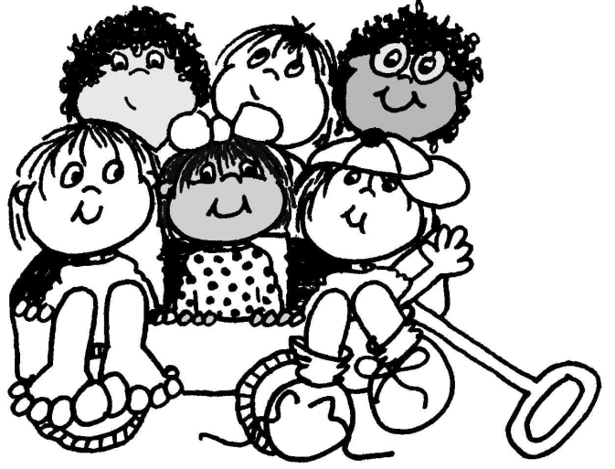

Classroom-composition effects
  A child’s externalizing behavior is explained by the child-care histories of children in their classrooms above and beyond their own
Child-care History, Classroom Composition, and Children’s Functioning in Kindergarten. Dmitrieva, Steinberg, Belsky. 2007.
http://pss.sagepub.com/content/18/12/1032.abstract
Notes:
Peer contagion
Non-parental child care associated with
Elevated levels of externalizing behavior
Enhanced linguistic, cognitive, and academic functioning

Slide 31
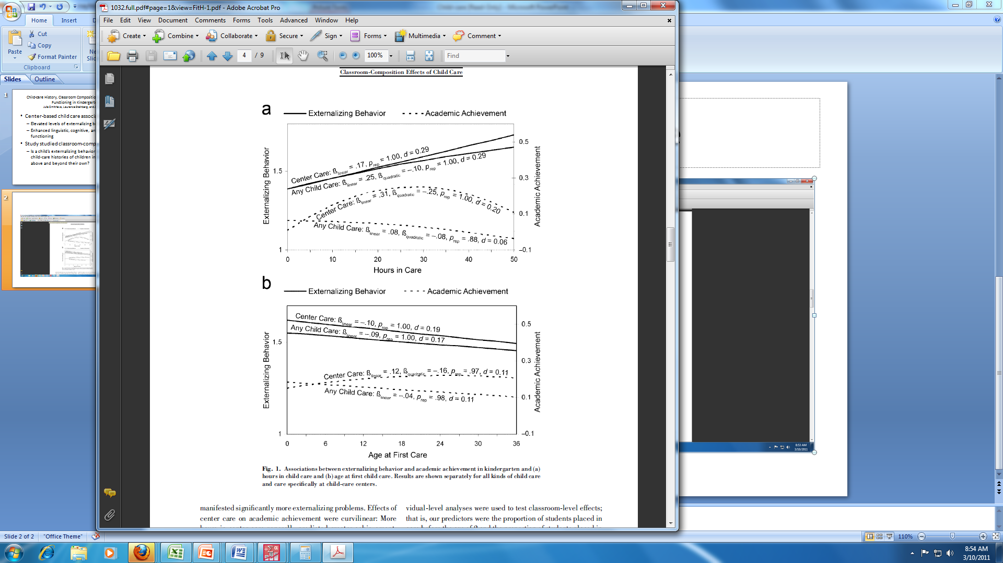
Individual effects of care
Predictors of poorer achievement
  >30 hrs/week
  initiation at center
  before 2 years of age
Used as classroom level predictors
  proportion of children in classroom
Center care versus any child care

Slide 32
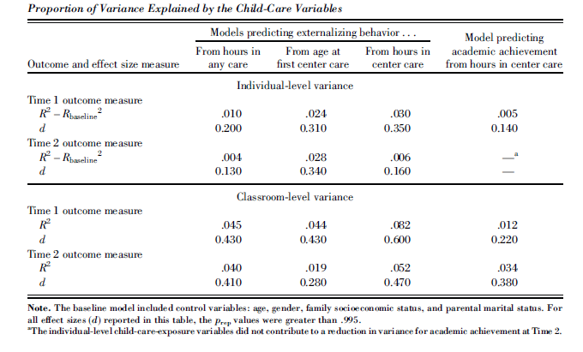
Classroom-level effects > individual effects
Variance in class-level characteristics
  externalizing behavior
    15% (T1) and 19% (T2) of variance
  achievement
    35% (T1) and 31%(T2) of variance
Significant classroom level effects

Slide 33
Conclusions and Discussion
Effects of early or extensive non-parental care affect not only the child, but their classmates as well
Being in a class with high proportion of students with child-care histories affects all children, independent of personal experience
Tuesday. “Interactions, relationships, and groups are mutually constitutive and have emergent properties.”
Notes:
Are effects amplified or attenuated over years of schooling?

Slide 34
Maternal Care and Parenting
Maternal care was not related to better or worse outcomes for children
Children with parents who were more responsive and stimulating had significantly higher cognitive, language, social-emotional, and peer outcomes

Slide 35
54 Month Outcomes

Slide 36
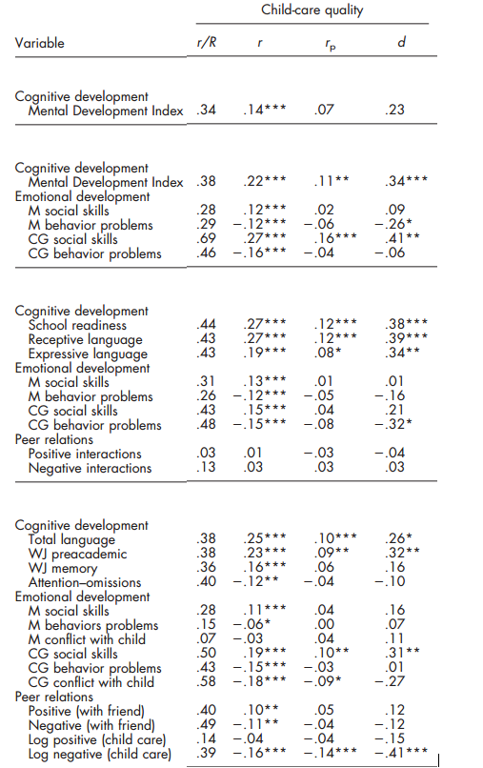
Child-Care Quality and Child Outcomes

Slide 37
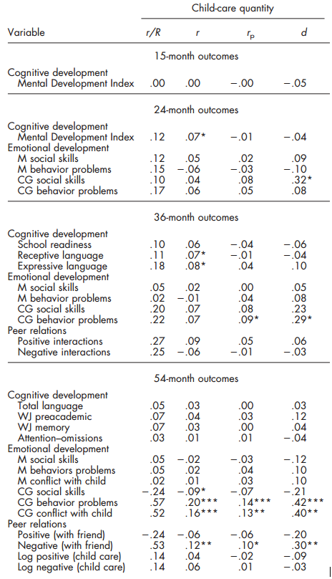
Child-Care Quantity and Child Outcomes

Slide 38
Conclusion
Parenting was a predictor of all child outcomes and matters more than child care
Quality, quantity, and type of care are related to children’s development
Exclusive maternal care not related to children’s outcomes

Slide 39
… Early head start evaluation findings … john m. Love, rachel chazan-cohen, helen raikes, and jeanne brooks-gunn (2013)
Miami
Randomized efficacy trial of 17 EHS programs
  Federal Early Head Start (EHS) began in 1995
3,001 low-income families
  35% African American, 24% Hispanic, and 37% White
  pregnant women or an infant under the age of 12 months
Randomly assigned to treatment or control
    91% of treatment group receiving some services
(1) impacts of EHS at ages 2 and 3 (when services were being offered) and at age 5, and (2) contributions of early education experiences across first 5 years
Experiment
DOI: 10.1111/j.1540-5834.2012.00699.x

Slide 40
Developmental effects
At 2 and 3 years, EHS benefited children and families: impacts were seen in all domains
  effect sizes .10 -.20
At 5, EHS children had better attention, approaches toward learning, fewer behavior problems
  But no effect on early school achievement
  A higher percentage of EHS than control children were enrolled center-based preschool.
At 5, children and families who experienced EHS followed by formal programs fared best overall.
Notes:
age 5 cognitive impacts for African American children
language impacts for Hispanic children who spoke Spanish.
Some significant family benefits.
Earlier treatment effects on child cognition and engagement with parent contributed to age 5 effects

Slide 41
Supplementary analyses
A higher percentage of EHS than control children were enrolled center-based preschool.
Nonexperimental analyses suggested that formal program participation enhanced children's readiness for school while also increasing parent-reported aggression.
At 5, children and families who experienced EHS followed by formal programs fared best overall.
Notes:
Although fewer than half the children enrolled in center-based preschool programs between ages 3 and 4, almost 90% participated in the year preceding kindergarten
Benefits in language, behavior, and parenting were associated primarily with EHS; benefits in early school achievement were associated primarily with preschool attendance.

Slide 42
Helping Head Start Parents Promote Their Children’s Kindergarten Adjustment:
The Research-Based Developmentally Informed Parent Program
Bierman et al. (2015)

Slide 43
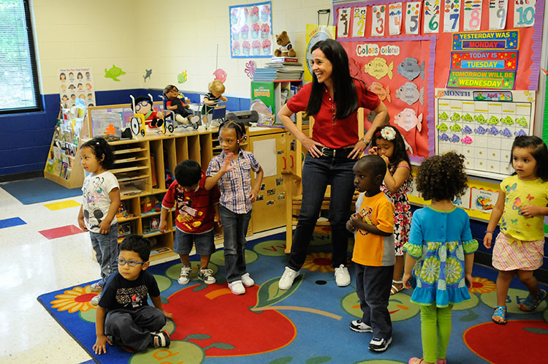
Background Information
Growing up in poverty = Delays in academic and social school readiness
The Head Start Program
  Offers enriching early learning opportunities
  Offers support for parents
Research Based Developmentally Informed (REDI ) Classroom Program
  Designed to promote school readiness in Social-Emotional Development and Literacy skills

Slide 44
The REDI CLASSROOM PROGRAM
Prosocial Skills
Emotional Understanding
Self Regulation
Problem Solving
Preschool Promoting Alternative Thinking Strategies (PATHS) Curriculum
Offers teachers ways to support the growth of…
Contains Dialogical Reading Program
Randomized Controlled Trial Results
Showed gains in Social Emotional skills, social problem solving, literacy skills, and classroom engagement, and decreased aggression.
Results faded by the end of kindergarten
Helping Head Start Parents Promote Their Children’s Kindergarten Adjustment:
The Research-Based Developmentally Informed Parent Program
Bierman et al. (2015)

Slide 45

The CURRENT STUDY
Explored the impact of an enhanced and expanded version of the REDI classroom Program

Slide 46
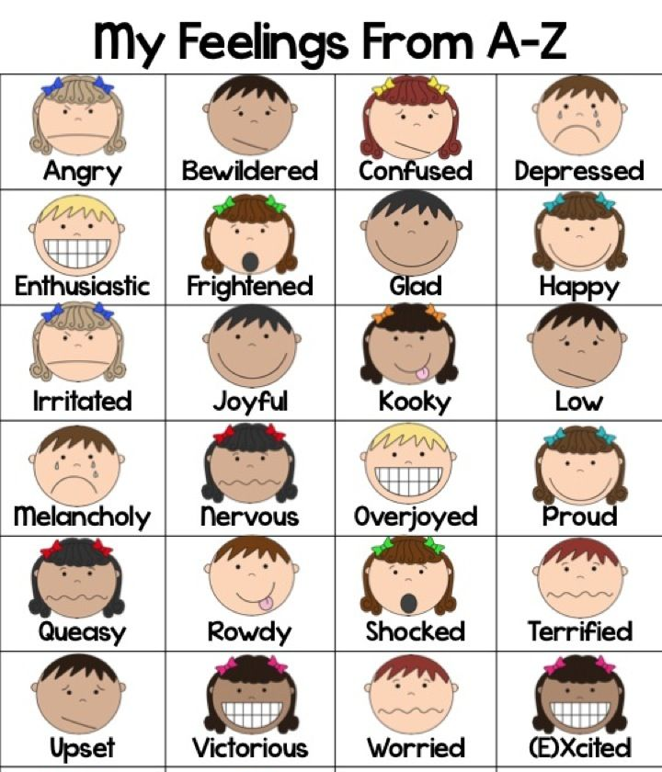
The Research Based Developmentally Informed Parent Program (REDI-P)
1) Increased Home Visits
  10 during Spring of preschool
  6 during Fall of kindergarten
2) Enriched Visits
  Evidence-based learning activities
  Support strategies
  All materials provided for parents
3) PATHS stories and Routines
  Compliment Lists
  Feelings Charts
  ”Turtle” to Calm Down

Slide 47
Participants
200 Children (55% European American, 26% African American, 19% Latino; 56% male), age 4.45 years old
Parents (39% single; 54% unemployed; median annual family income = $18,000)
REDI-P Intervention Group
  Received 16 home visits
Control Group
  Received 4 mail-home packets of parent-child math games
Pre-Intervention and Post-Intervention Assessments

Slide 48

Language and Literacy Skills
Expressive One-Word Picture Test
  Assessed Vocabulary
Emergent Literacy Skills- Composite
  Letter-Word Identification Scale
  Letter Naming Fluency Subscale
  Letter Sound Fluency Scale
Word Reading Efficiency Test
  Assessed reading fluency
Teacher-Rating
  12-item Academic Success subscale

Slide 49

Social-EMOTIONAL ADJUSTMENT
Self-Directed Learning
  5 items from the School Readiness Questionnaire
  5 items from the Learning Behaviors Scale
Prosocial Behavior and Emotional Regulation
  13 Items from Social Competence Scale
Aggression
  7 Items from the Teacher Observation of Child-Revised

Slide 50

Parent Support for learning
Parent Report
Video-taped Observation
In home observation

Slide 51
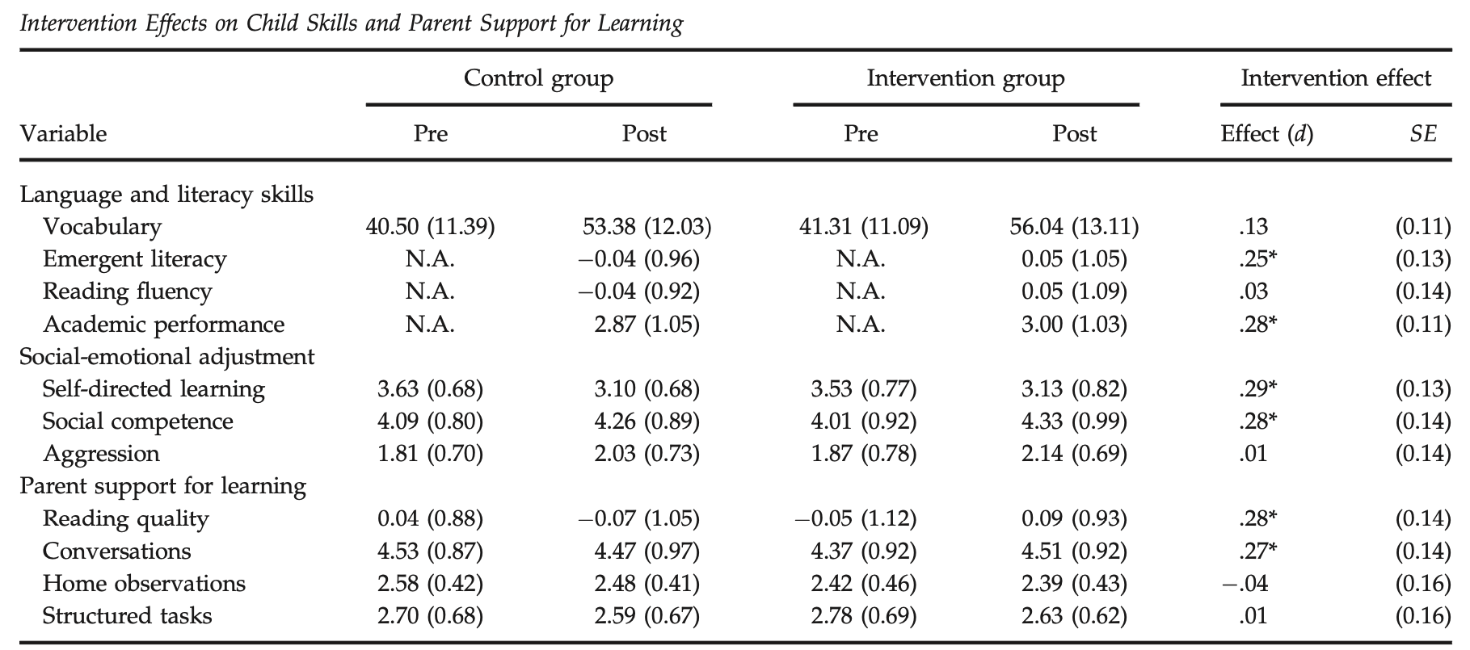
Randomized control

Slide 52
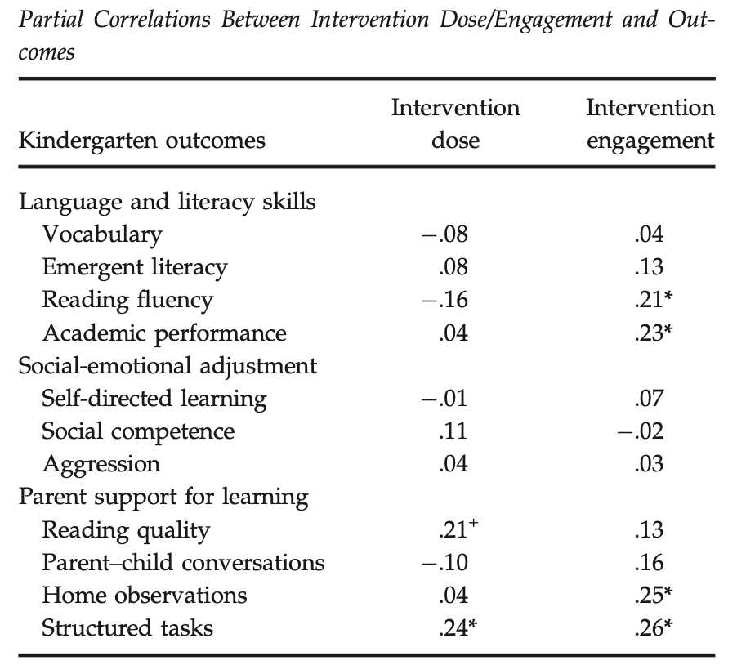
Results

Slide 53
Discussion
In this study, the REDI-P intervention was offered on an individual basis. Could this intervention be given in small groups instead? Would you expect to see the same or similar results? Would we have to modify the way the program is given in order to adapt it to small group settings?
Can we expect to see these results hold up over the course of 1st grade? 2nd? 3rd?
In the current study, 52% of eligible families participated, and the intervention called for 16 home visits. If the number of sessions was reduced, would you expect to see more families wish to participate? How would this impact the outcomes?
In this sample, over half of the participating parents were unemployed. Difference between working and nonworking parent? Stress, time, engagement, etc.

Slide 54
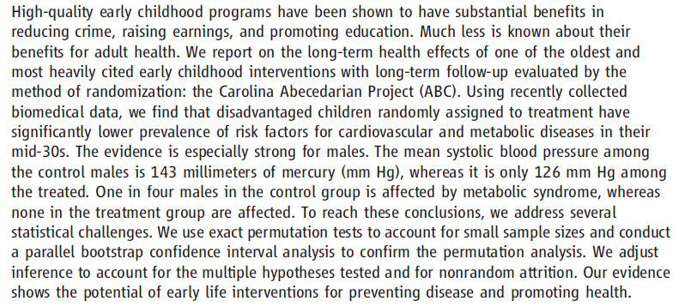
Early Childhood Investments Substantially Boost Adult Health (Campbell et al., 2014)
https://www.youtube.com/watch?v=8YyZ8FkFsK4
2:00-4:15
Maura, 2017

Slide 55

Background
Adult illnesses are more prevalent and problematic among those who have experienced adverse early life conditions
  Interventions that enrich the environments of disadvantaged children have impacts on cognitive, social and schooling outcomes
  But little is known about their benefits on health
Aim: Can high-quality, intensive interventions in the early years be effective in preventing or delaying the onset of adult disease?

Slide 56
ABC Intervention
Stage I: Early Childhood (birth – age 5)
  Cognitive & social stimulation
  Caregiving & supervised play
  Nutritional/health component
    2 meals/snack at childcare center
    Primary pediatric care, periodic check-ups , & daily screens
Stage II: School-Age Stage (ages 6-8)
  Focus on improving early math & reading skills via
  “home school resource teachers”

Slide 57
Method
122 children
Recruited in 1970s
  Handpicked as part of “social experiment”
Children randomly assigned to stage I and then again to stage II

Slide 58
Measures
(birth – end of stage II)
Baseline
  Child, parent, & teacher surveys
  Direct assessments
  Demographics (family structure, SES, birth circumstances)
Follow ups
  Cognition, personality, health, achievement, behavior
  Followed up again at 12, 15, 21, 30, mid-30s
Mid 30s: Assess cardiovascular & metabolic risk factors
  Physical : weight, height, waist, hips, systolic & diastolic BP
  Laboratory tests: blood collected during medical visit

Slide 59
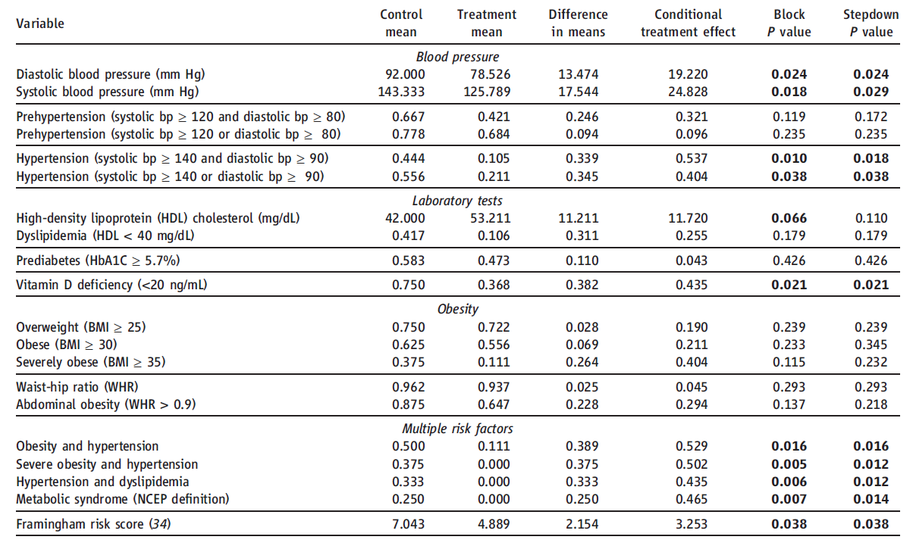
Results: Physical Health (Males)

Slide 60
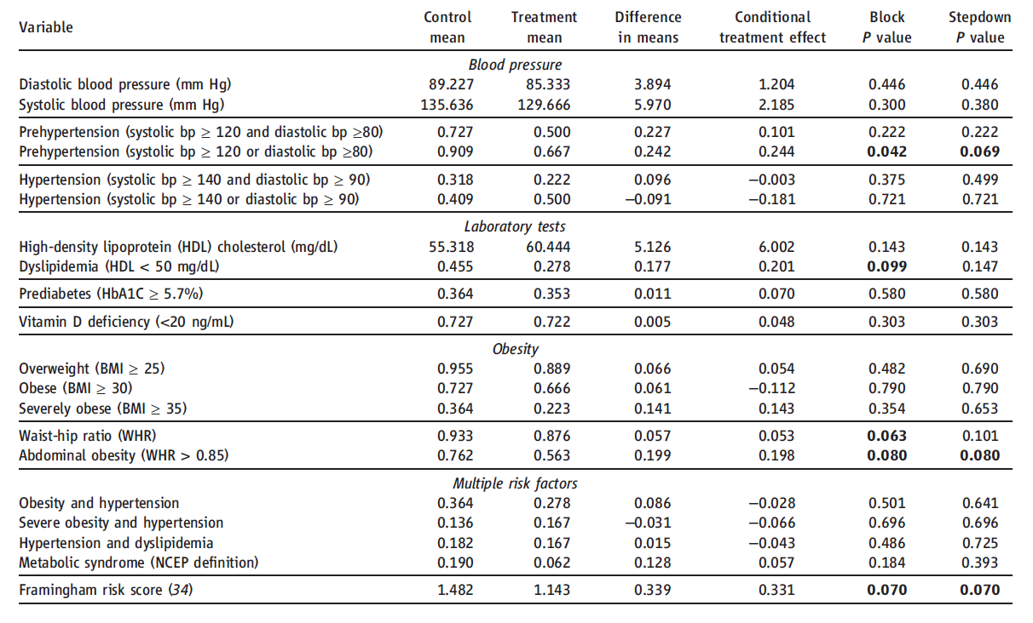
Results: Physical Health (Females)

Slide 61
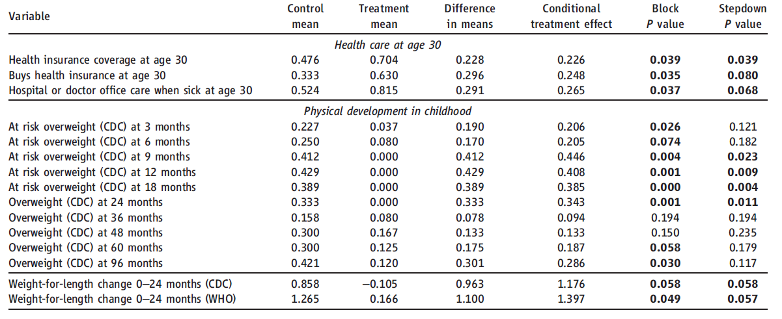
Positive Health Care & Health Indicators for Males

Slide 62
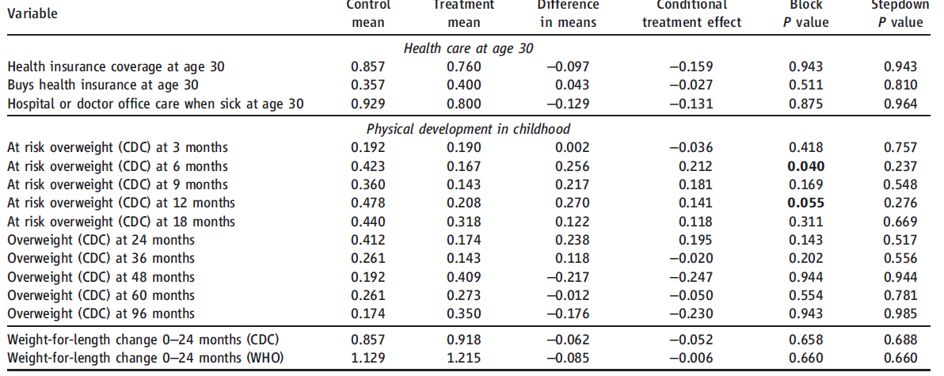
Results: Health Care & Physical Development (Females)

Slide 63
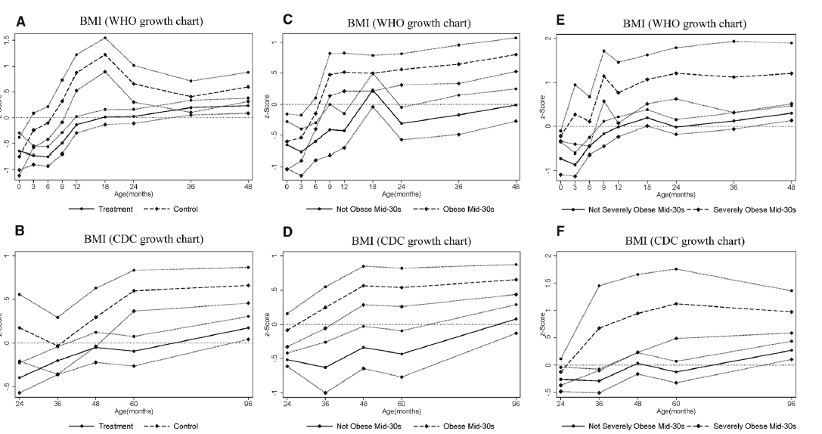
Results: BMI (Males)
BMI for males 0-4yrs
BMI for males 2-8yrs

Slide 64
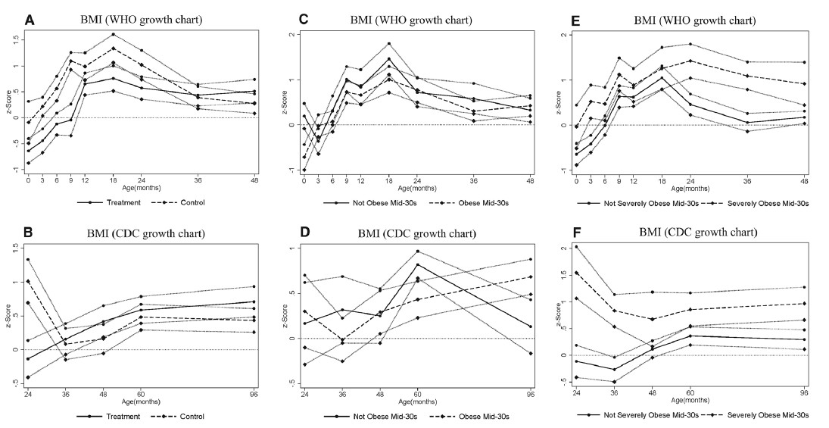
Results: BMI (Females)
BMI for females 0-4yrs
BMI for females 2-8yrs

Slide 65
Do you believe conclusions?
Children randomly assigned to the treatment group from ages 0 to 5 enjoyed better physical health in their mid 30s, with markers suggesting better future health
Highlights importance of intervening in the early years, suggests that early childhood programs can contribute to improving adult American health

Slide 67
Aim
Extend previous research by examining the links between routine early child-care experiences and adolescent functioning in a large and economically diverse sample
Early child-care is thought of two ways:
  Early child-care is associated with poorer social outcomes
  Early child-care promotes social and academic skills before entry to kindergarten
Notes:
Research supports both viewpoints:
Experimental studies of high-quality early intervention programs can enhance social, cognitive and academic development of economically disadvantaged children
Higher quality child care is associated with better cognitive and academic outcomes
Viewpoint: Early childcare causes attachment issues and disruptive behavior problems
More time in center-type settings has been related to negative social and behavioral outcomes but potitive academic outcomes
Main take-away: In general, higher quality of child care was related to higher cognitive-academic performance, whereas more hours of child care (especially by non-relatives) was related to more behavior problems.

Slide 68
Method
1,364 families were randomly selected from the National Institute of Child and Human Development Study of Early Child Care and Youth Development (NICHD SECCYD)
Demographics:
  26% of the mothers had no more than a high school education
  21% of families had incomes no greater than 200% of the poverty level
  22% were a minority
Notes:
Part of the National Institute of Child and Human Development Study of Early Child Care and Youth Development (NICHD SECCYD)
Families had to speak English
Were recruited from 10 locations in the U.S.

Slide 69
Measures
Construct | Measure | Time Points
Child-care type (type of child care arrangement: home-based care, father care, grandparent care) | Telephone and personal interviews with the mother | Every 3 months until the child reached 36 months and every 4 months until the child was 54 months
Child-care hours | Amount of hours per week child was in non-maternal care | 6, 15, 24 ,36, and 54 months
Child-care quality | Observational Record of Caregiving Environment (ORCE) | 6, 15, 24 ,36, and 54 months
Cognitive-academic achievement | Woodcock-Johnson Psycho-Educational Battery Revised | 54 months, 1st Grade, 3rd Grade, 5th Grade, Age 15
Risk Taking | Audio computer-assisted self-interview | Age 15
Impulsivity | Questionnaire | Age 15
Externalizing Problems | Teacher Report or Youth Self-Report | 54 months, 1st Grade, 3rd Grade, 5th Grade, & Age 15 (YSR)
Notes:
Child-care type- telephone and personal interviews (3 month intervals) to 4.5 years of age; moms reported types and hours of regularly used nonmaternal care; mom’s reported all of the care arrangements used since the previous interview; center, child-care home, in-home care, father care, or grandparent care. If child received at least 10 hours a week of that type of care it represented the type of care
WJ-
54 months and 1st grade: letter-word identification
3rd and 5th grade: broad reading (passage comprehension), applied problems (analyzing and problem solving in math), picture vocabulary (children’s ability to name objects)
age 15 Picture vocabulary and verbal analogies

Slide 70
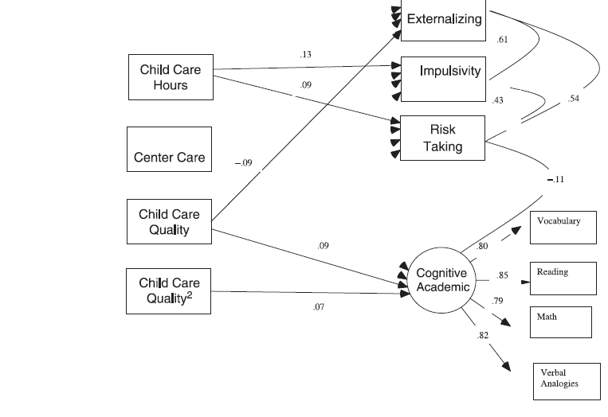
Child-care quality, quantity and type predict to 15 years
Notes:
Child care quality showed significant associations with children’s cognitive-academic achievement at age 15.
Children who experienced higher quality care had significantly higher levels of cognitive-academic achievement at age 15
Child care quality was linked to academic outcomes for adolescents whose care on average was moderate quality or better, with the magnitude of the quality effects being larger at higher levels of quality
Higher quality care is associated with higher academic outcomes but and lower externalizing scores at age 15
Adolescents who experienced more hours of nonrelative child care across their first 4.5 years reported more risk-taking and greater impulsivity at age 15
Exposure to center care was not related to academic achievement or problem behaviors at age 15
More hours in non relative care predicted poorer social adjustment

Slide 71
Results: Quality, Quantity and Type as Predictors
Child-care quality showed significant associations with children’s cognitive-academic achievement at age 15
Children who experienced higher quality care had significantly higher levels of cognitive-academic achievement at age 15
Higher quality care is associated with higher academic outcomes and lower externalizing scores at age 15
Adolescents who experienced more hours of nonrelative child care across their first 4.5 years reported more risk-taking and greater impulsivity at age 15
More hours in nonrelative care predicted poorer social adjustment
Notes:
Child care quality was linked to academic outcomes for adolescents whose care on average was moderate quality or better, with the magnitude of the quality effects being larger at higher levels of quality
Exposure to center care was not related to academic achievement or problem behaviors at age 15

Slide 72
Academic Achievement as Mediator through time
Association between child-care quality and age 15 cognitive-academic achievement explained partially by the association between child-care quality and academic skills at entry to school, which are maintained into high school
Notes:
The observed association between child-care quality and age 15 cognitive-academic achievement can be explained at least partially by the association between child-care quality and academic skills at entry to school, which are then maintained into high school

Slide 73
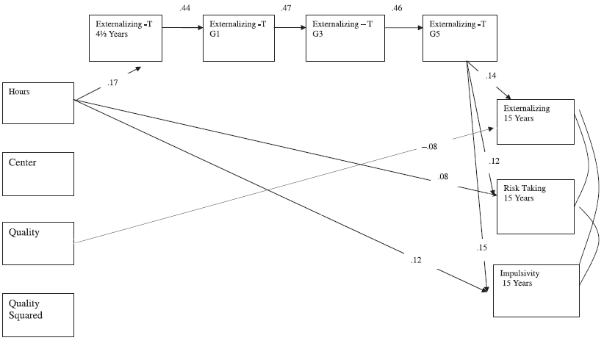
Problem behavior as mediator through time
Notes:
Higher hours spent in childcare significantly predicted higher risk taking behaviors and impulsivity at 15 years.
Modest levels of mediation when looking at the association between hours spent in childcare and externalizing behavior problems mediated by behavior problems beginning at 4.5 years old through 5th grade
This may be due to the changing informant of behavior problems. First the caregiver, then teacher (who switches) and then adolescent self report.
Higher quality non-relative childcare significantly predicted less externalizing behaviors at age 15.

Slide 74
Results: Problem Behavior as a Mediator
Higher hours spent in childcare significantly predicted higher risk taking behaviors and impulsivity at 15 years of age
There were modest levels of mediation when examining the association between hours spent in childcare and externalizing behavior problems at age 15
  May be due to the informant changing
Higher quality non-relative childcare significantly predicted less externalizing behaviors at age 15

Slide 75
Discussion Questions
If early child-care quality predicts greater cognitive-academic outcomes and hours spent in child-care predicts more externalizing problems at age 15, how do you find the right balance of child-care that produce the best outcomes?
Notes:
Why do you think time spent in child-care and quality of child-care were better predictors of adolescent outcomes than type of child-care?

Slide 76
Early child care quality predicts cognitive-academic achievement
Moderate to high quality child-care produces the greatest long term effects
Quality of early child care experiences have long lasting effects on all children despite SES
Higher quality nonrelative childcare is related to less externalizing behavior at age 15
More hours in child care and more center-type care → higher levels of behavior problems in children
The link between child care, cognitive-academic outcomes, and problem behaviors is consistent over 10 years

Slide 78
  Link between quality of care & problem behavior… Diathesis-stress or differential susceptibility?
Higher quality childcare is associated with better cognitive and academic outcomes
Diathesis-stress – highly negative children will suffer in low quality environment
Differential susceptibility - less negative children will thrive in higher quality environment
Poodle vs. Retrievers
Orchids vs. Dandelions
Notes:
Prior research has shown that higher quality childcare is associated with better cognitive and academic outcomes. High quality child care is seen as enviorments in which caregivers are attentive, responsive, stimulating and positive and not negative, neglectful or intrusive.

Slide 79
Study Aim
Does difficult temperament in infancy continue to moderate effects of childcare quality on problem behavior in adolescence (15 years)?
  842 total participants
    NICHD SECCYD
Notes:
So in this study they were looking to determine whether difficult temperatment in infancy continues to moderate effects of child care quality on problem beahvior in adolescence (so at age 15 here)
Methods wise, they are trying to understand whether these earlier detected differential suceptibility effects continue when measurement is changing from caregiver and teacher report to now adolescent report.
So for this study, they had a total of 842 participants and all of this was through the Study of Early Child Care and Youth Development from the National institiute of child health and human development.

Slide 80
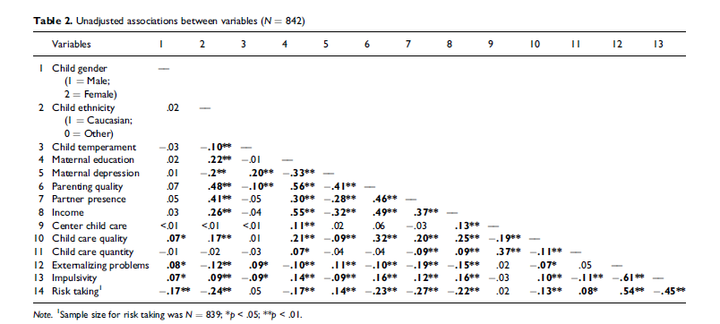
Measures
Notes:
Bivariate correlations between study variables
Child temperament associated with externalizing behavior problems
So this is one of the results table, but it shows all the measures that were completed in this study.
In terms of predictor variables, they measured child temperament and child care quality. Child temperament was measured by maternal report at 1 and 6 months using an adapted version of the infant temperament questionaire. Child care quality was measured through observational assessments in the primary child care arrangement at ages 6, 15, 24, 36 and 54 months
In terms of outcomes, they measured externalizing problems, risk taking and impulsivity. For externalizing behaviors, they had adolescents self-report externalzing behaviors using the Youth Self-Report. Risk taking was measured through adolescent report as well in which they reported risk taking behaviors using an audio computer assisted self interview. And they measured impulsivity through adolescent self report asl well in which they completed an 8 item survey to assess reactions to external constraints.
They also included a number of covariates including family background factors such as income, child gender, child ethnicity, maternal education, maternal depression and presence of a partner. They also measured parenting quality based on ratings of maternal sensitivity during 15 minute videotaped interactions at 6, 15, 24, 36 and 54 months and scoares of the Home Observation for Measurement of the Eniornment at the same ages. They also looked at the type of care in which tye classiefied it as a center, child care home, in home care or grandparent care or father care. And lastly they looked at child care quanitity in which they had parents provide info on the hours of routine nonmaternal care during phone and personal interviews

Slide 81
Results
Externalizing behavior problems were greater for females, single parent homes
Greater risk-taking :
  Males, non-Caucasian ethnicity, lower family income, higher proportion of partner absence
Greater Impulsivity:
  Lower family incomes, greater exposure to any non-maternal child care in early childhood years
Notes:
There were a bunch of results. So first, externalizing prolbmes were greater when children were female and when they lived in a single parent home. Greater risk taking was singificantly associated with male gender, non-caucasian ethnicity, lower family income and higher proportion of partner absence. And greater impulsivity was predicted by lower family income and greater exposure to any nonmaternal child care

Slide 82
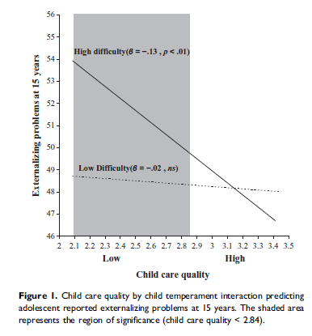
Difficult temperament→externalizing only in low child care quality
Diathesis stress model
Externalizing problems only significant when child care quality was less than 2.84
  Higher scores reflect children’s experience with caregivers who were more attentive, stimulating, positively affectionate, less intrusive and negative
Orchids vs. Dandelions?

Slide 83


Slide 84

Background
~50% of infants/toddlers and > than 75% preschoolers experience regular nonparental child care (Burchinal et al., 2015)
High-quality, early care and education improves early cognitive and social skills
Notes:
Based on studies involving children from low-income families enrolled in model programs

Slide 85
Purpose of Study
The purpose of the current study is to examine if participation in early child care settings predicts end of high school (EOHS)
  Academic outcomes
  Social outcomes
Extend previous research by examining the links between routine early child-care experiences and later outcomes in a large and economically diverse sample
Notes:
The purpose of the current study is to examine the extent to which participation in more typical early child care settings predicts academic and social outcomes at the end of high school (EOHS) in a large, economically diverse sample that includes children from middle-income families as well as highincome and low-income families.
Much less research has considered links between ECE experiences in typical early care settings and functioning in early adulthood for children from economically diverse families
The current study extends the examination of early child care experiences and adolescent functioning to the EOHS and considers standard measures of academic standing and behavioral indicators

Slide 86
Methods
Sample:
  NICHD Study of Early Child Care and Youth Development (SECCYD): (n= 1,364 families)
  Sample at 15 years (n =1,002)
  End of high school (EOHS) (n =779)
Notes:
The NICHD Study of Early Child Care and Youth Development (SECCYD) is one of the few longitudinal studies that can address this issue with a large sample that includes low-, middle-, and high-income children. Launched in the early 1990s to examine the effects of early child care, the SECCYD included 1,364 participants recruited at birth in 10 sites in the United States. In a series of reports, relations were considered between early child care and child functioning prior to school entry, in early elementary school, in later elementary school, and at age 15 years

Slide 87
Methods
EOHS measures of academic standing: typical grades, advanced coursework, class rank, and selectivity of the postsecondary institutions that young people plan to attend.
EOHS measures of social outcomes: social, emotional, and behavioral competencies
Covariates: as a potential moderator of relations between early child care and functioning
  Early childhood: Gender, race/ethnicity, maternal education (in years); maternal vocabulary Peabody Picture Vocabulary Test, mother NEO Personality,
  Early, Middle, and Adolescent Covariates: maternal depressive symptoms, observed maternal sensitivity, income-to-needs ratio, and presence of a husband or partner in the household.
  Unique to middle: quality of school experiences
Notes:
We also considered gender as a potential moderator of relations between early child care and functioning at the EOHS
Females receive higher academic marks in high school and college (Voyer & Voyer, 2014), and they graduate from high school and college at higher rates (Buchmann & DiPrete, 2006), whereas males engage in more risk-taking (Byrnes, Miller, & Schafer, 1999) and externalizing behaviors

Slide 88
Measures
HOME Home Observation of the Environment
WJR Woodcock-Johnson
PLS Preschool Language Scale
CBCL Child Behavior Checklist
Outcomes:
EOHS measures of academic standing:
  Grades
  Advanced Coursework
  Class Rank
  Plans after high school
    Selectivity of College
Behavioral adjustment
  Delinquent Behavior and Aggressive Behavior scales: Adolescents self-reported externalizing behaviors
  Report of risk-taking behaviors
  Weinberger Adjustment Inventory: reactions to external constraints
Notes:
Their responses were as follows: “I do not plan to get any further education beyond high school” (n 7); “I will eventually go to college, but first I will take some time off from school” (n 60); “I plan to join the military” (n 15); “I have joined the military” (n 11); “I plan to go to a trade school or technical school” (n 35); “I plan to go to a 2-year community college program” (n 123); and “I plan to go to a 4-year college program” (n 518). If

Slide 89
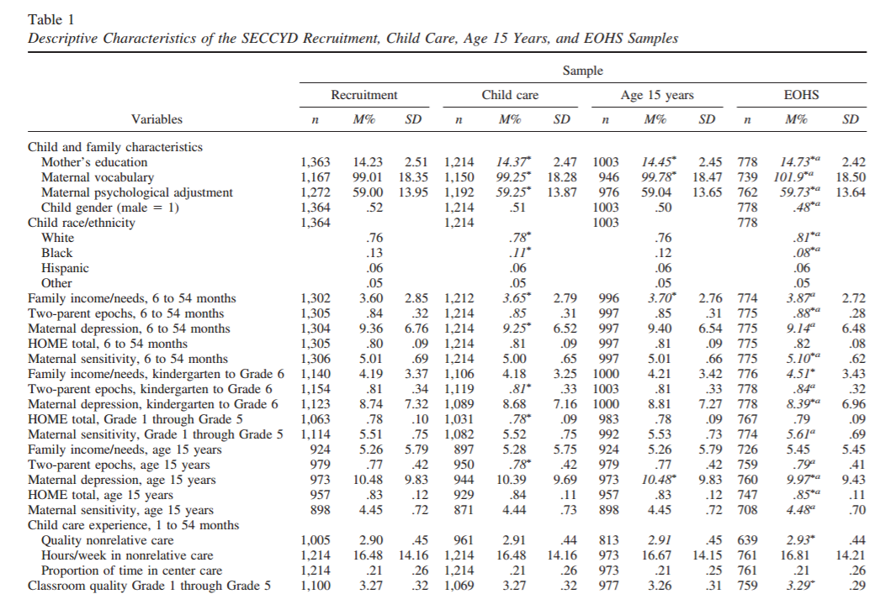
Measures
Moderators
Predictors

Slide 90
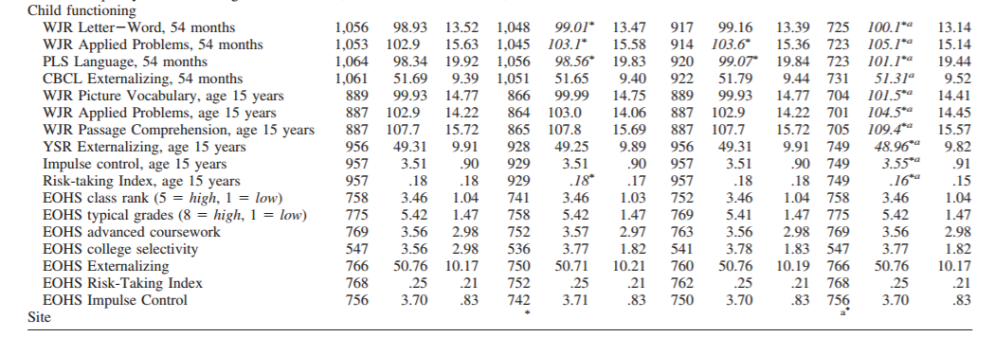
Measures: continued
Outcomes

Slide 91
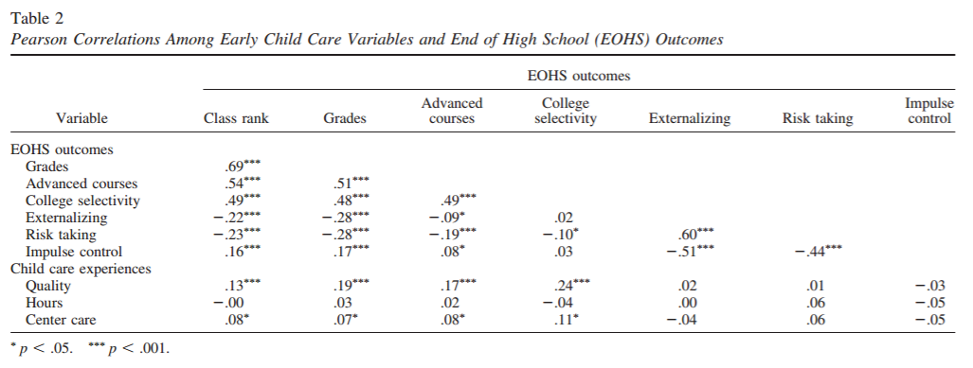

Child care quality correlated with EOHS outcomes
*Hours in child care NOT correlated with outcomes

Slide 92
Care quality…
Higher child care quality and more center-type care were correlated with higher class rank, higher grades, more advanced coursework, and plans to attend more selective colleges.
  Amount of time in early child care was not correlated with the measures of end of high school (EOHS) academic standing or behavioral adjustment.

Slide 93
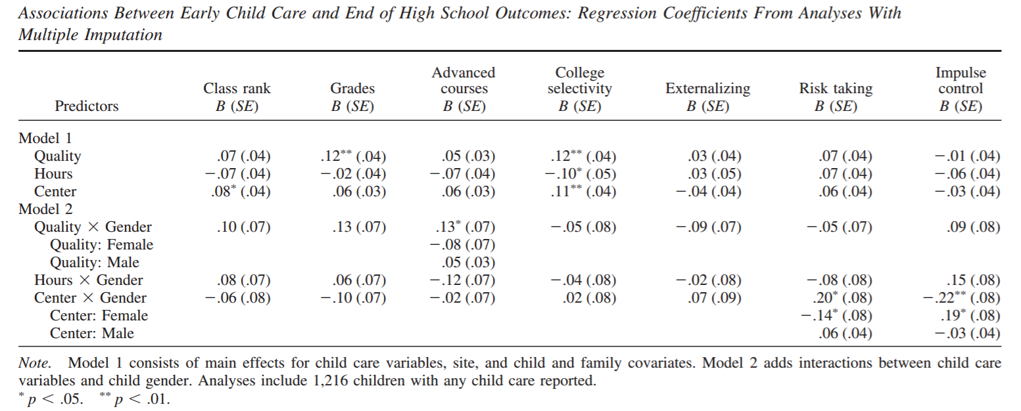
Are There Relations Between Early Child Care and Adolescent Outcomes at the EOHS?
*None of the early child care variables were related to the behavioral adjustment measures at the EOHS.
Notes:
Quality: higher academic grades and plans to attend more selective colleges
Adolescents with fewer hours in child care reported plans to attend more selective colleges
more center-type child care reported higher and College selectivity

Slide 94
Are There Relations Between Early Child Care and Adolescent Outcomes at the EOHS?
Quality: higher academic grades and plans to attend more selective colleges
Adolescents with fewer hours in child care reported plans to attend more selective colleges
More center-type child care reported higher and College selectivity
Notes:
Quality: higher academic grades and plans to attend more selective colleges
Adolescents with fewer hours in child care reported plans to attend more selective colleges
more center-type child care reported higher and College selectivity

Slide 95
Are relations between early child care and EOHS outcomes were moderated by gender?
*No significant interactions between early child care hours and gender were found for EOHS academic standing and behavioral functioning.
Notes:
Proportion of time in center care was differentially related to risk taking and impulse control
More epochs in center care was associated with less risk taking and greater impulse control for females but not for males
Higher quality care was positively, but nonsignificantly, related to reports of number of advanced courses for males and negatively, but nonsignificantly, related for females

Slide 96


Are relations between early child care and EOHS outcomes moderated by gender?
Girls who had more experience in center type care reported engaging in fewer risky behaviors and exhibiting better impulse control at the end of high school
Higher quality care was positively, but non-significantly, related to reports of number of advanced courses for males and negatively, but non-significantly, related for females
Notes:
Proportion of time in center care was differentially related to risk taking and impulse control
More epochs in center care was associated with less risk taking and greater impulse control for females but not for males
Higher quality care was positively, but nonsignificantly, related to reports of number of advanced courses for males and negatively, but nonsignificantly, related for females

Slide 97
Discussion
SECCYD reports more childcare hours predicted more behavior problems and conflict but not academic outcomes (not contradictory but opposite to this study)
NICHD ECCRN reports more center-care time was related to higher academic and cognitive performance
Limitations:
  EOHS was more privileged
  SECCYD sample is not nationally representative
Notes:
These findings are at odds from the SECCYD reports at earlier ages when higher hours of care were linked to more externalizing behaviors, but not to academic outcomes.
They are, however, with consistent with the longitudinal research by Masten and colleagues (2005) who observed developmental cascades in which higher externalizing behaviors in middle childhood predicted lower academic competence in adolescence.

Slide 98
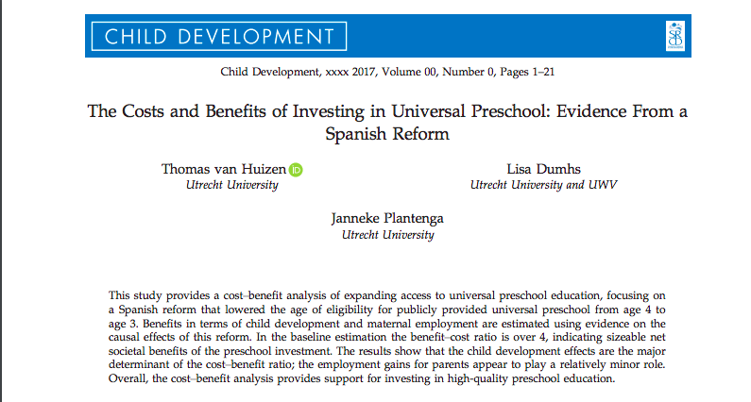
Cost-Benefit Analysis of Universal Preschool

Slide 99
Why publicly funded universal preschool?
  Most children in developed countries receive early childhood education care (ECEC)
Universal preschool offered for age > 3 in several European countries & increasingly in U.S. (OK, GA, NYC)
  Florida offers free prekindergarten to all 4-year-olds.
    Voluntary Prekindergarten
Main arguments to justify investing in ECEC
  (High quality) ECEC improves child development
    School readiness & performance, social & cognitive outcomes in adulthood
  Availability of ECEC may increase parental employment
    Affordable childcare allows parents to return to work--> high (female) employment

Slide 100
Cost-Benefit Analysis of Universal Preschool
Evidence on cost-effectiveness of ECEC programs comes from studies which evaluated targeted programs for disadvantaged children, show promise (e.g., 1 dollar invested yields 7-12 dollar return)
Targeted programs do not generalize to universal programs well, leading to biased estimates of monetized benefits
Natural experiments based on policy reform required to study causal impact of ECEC programs on child development & maternal employment
AIMS:
  To examine the extent to which benefits for children (developmental) + benefits for parents (employment) outweigh the costs (public investment) of universal preschool)

Slide 101
Universal Preschool from a Natural Experiment - LOGSE
  Spanish Ley Organica de Ordenacion General del Sistema Educativo (LOGSE) reform (implemented 1990s)
    Expanded coverage for universal preschool to age 3-yrs
    Fully subsidized
    Increased public preschool rates from 8.5% (1990) -> 67% (2002)
    Addressed quality of preschool service
      Curriculum
      Group size
      Staff educational requirements

Slide 102
Causal effects of universal preschool
  Identifying effects of universal preschool on maternal employment & child development:
  Difference in differences (DD) approach (compared high-intensity regions to low-intensity regions)
    Child development
      Math & Reading scores from 2000-2009 waves of PISA standardized assessment (age 15)
      Projected lifetime earnings= causal effect on scores X return to skills parameter (estimated increase in annual wage based on 1 SD increase in cognitive skills)
      Reduced grade retention used to predict earlier labor market entry effect
    Maternal Employment
      DDD approach used to compare employment rates among mothers whose youngest child is 3-years (treatment) compared to 2- years (control)

Slide 103
Methods: Cost-Benefit Analysis
  Benefits
    Treatment on Treatment (TOT) to estimate how causal effects→
      Lifetime earnings for parents: return to work/ stay employed
      Lifetime earnings for children: improved skill level/ enter workforce earlier
      Gains for tax-payers: Taxpayers gain as gross earnings of children and parents increase
    → Gains for society: Dollars society receives back for every dollar invested in ECEC
  Costs
    Cost per child estimated from annual public expenditure per child for preschool/ primary education + average additional costs per child (supplies, etc) = $4,027

Slide 104
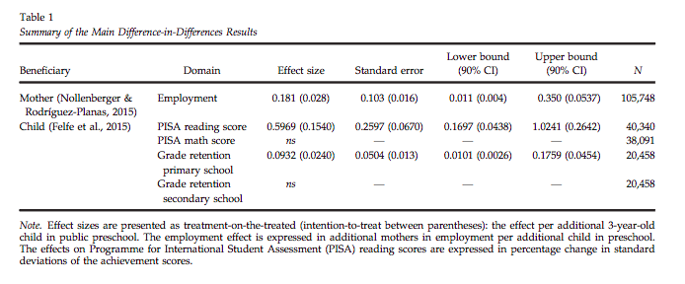
Mother employment and child score effects

Slide 105

Cost-Benefit Analysis
^65% of benefits
Every $ invested in ECEC→ Society gains $4

Slide 106

Its an investment: Cost-Benefit Analysis
Gains in gross lifetime earnings estimated at $12,751 by age 70 (discounted rate)

Slide 107
Summary
  CBA revealed universal preschool expansion from age 4 to age 3 has a cost-benefit ratio of >4.
  Child development effects (measured via academic achievement scores and projected return on skills) were the biggest driver of the cost-benefit ratio.
  Employment gains for parents play a small, but less substantial role.
  Low SES children benefit from high-quality ECEC more than high SES
  Findings reveal support for investing in high quality preschool education from age 3.

Slide 108
Discussion
  General thoughts on their methods for the CBA?
    Focuses on the long-term benefits of the reform instead of short-term effects, but what might be mechanisms for these long-term benefits?
    What other measures of child development could be used/ would you expect to translate to lifetime earnings or other future benefits?
    What other benefits (besides lifetime earnings) should potentially be examined in future cost-benefit analyses?
  Thinking about accessibility to ECEC vs. high-quality ECEC , how would universal preschool policies ensure high-quality programs & would there be additional costs associated with that?
  Thoughts on the authors’ policy implications of their findings to fully subsidize preschool for both low & high SES families vs. just low SES?
  Most studies in the U.S. examined targeted programs designed for specific (mainly low income) populations, how might universal programs be affected by heterogeneity in population e.g. SES disparities?

Slide 109
Discussion
Methodology (strengths/weaknesses)?
  Other variables to consider/control for?
What are the practical implications of this research?
  What components of the intervention do you think were driving effect?
    Any factors not assessed that may have contributed?
  What would a feasible implementation of this intervention look like – particularly considering current climate of US?

Slide 110
Classroom context effects

Slide 111
Relative influence of child & classroom characteristics
Preschoolers sensitive to contextual influences on social interaction skills
  Adaptive outcomes depend on goodness-of-fit between child characteristics and context
  Child characteristics
    Age
    Gender
    Ethnicity
    Ethnic match
    Language match
  Classroom characteristics
    Classroom diversity
    Entry policy
Howes, C., Sanders, K., & Lee, L. (2008). Entering a new peer group in ethnically and linguistically diverse childcare classrooms. Social Development, 17,
Notes:
Why?
b/c peer skills are still developing (still reliant on scaffolding/support from environment)
The classroom context (nesting of children within classroom, diversity, and entry policy) accounted for more of the variance in both complex play and peer anxiousness ratings than did child characteristics.

Slide 112
Peer Interaction Measures
  Revised Peer Play Scale
    Peer engagement (parallel, simple social, reciprocal, cooperative, complex social)
    Complex play (reciprocal, cooperative, complex social)
  Affective Quality of Play
    Anxious
    Aggressive
    Prosocial

Slide 113

Peer Interaction at Entry vs. 6 months
Proportion engaged increase with time
Prosocial increase with time
  Proportion engaged increase with time
Notes:
Prosocial increase with time
Ethnicity on behavior ratings; af amer higher aggression; asian amer higher anxiety

Slide 114


More diverse classes → Complex Play increase
particularly if ethnically matched peer present
Notes:
Older changed most in complex play
On average more diverse classes had greater increase, particularly if had an ethnically matched peer

Slide 115

Anxiousness decreases for children who had a peer with shared home language
Younger children decreased more (b/c very high to start with)
Children who had a peer with shared home language had larger decreases
Notes:
Younger children decreased more (b/c very high to start with)
Children who had a peer with shared home language had larger decreases

Slide 116


Aggression
African-Americans had greatest increase in aggression if no ethnically matched peer

Slide 117
Context
  Classroom variations accounted for up to 72 percent of the variance in complex play and at least 50 percent of the variance in peer ratings (anxiousness ratings).
  The classroom context (nesting of children within classroom, diversity, and entry policy) accounted for more of the variance in both complex play and peer anxiousness ratings than did child characteristics.

Slide 118

Mendez

Slide 119


See: http://www.fldoe.org/core/fileparse.php/7690/urlt/ESEGifted17English.pdf
https://forms.dadeschools.net/webpdf/7082.pdf
Brodar

Slide 120

“Gifted and talented” programs inequitably provide access to educational resources
•K-12 participation in gifted and talented programs (2012 data):
•7.6% of White students
•4.6% of Hispanic students
•3.6% of Black students
•1.8% of English language learners
•Disparities persist despite changing eligibility criteria
•Likely because youth from underrepresented backgrounds are less likely to be referred for evaluation
Brodar

Slide 121
Introduction of universal screening program in Broward County Schools provided natural experiment
•Starting in 2005, all 2nd graders completed the Naglieri Non-Verbal Ability Test
•Score ≥ 130 (or 116 for Plan B Eligible) referred for full evaluation with district psychologists
•Students could also still be nominated by parents or teachers
•Referred students placed in queue for testing OR parents could obtain testing outside of district to bypass the queue (e.g., at UM PSC, evals = $1,100)
•No other program changes
•Analysis of student records
•Pre/post differences
•Interrupted time series
•Compared “compliers” (newly-identified gifted students) versus “always takers” (those identified by traditional system)
•Compared the district to others in the state
Brodar

Slide 122

Black & Hispanic students over-represented in Plan B,
Plan B less likely to have IQ scores on record & be classified as gifted
Brodar, Mendez

Slide 123

Screening program led to large increases in the fraction of students classified as gifted
Brodar

Slide 124

Change in fraction of students identified as gifted can be attributed to screening given small year-to-year variability in comparable districts
Brodar

Slide 125

Screening had particularly large & positive impact for Black, Hispanic, and Plan B Eligible kids
Overall, universal screening led to 45% increase in odds of being identified as gifted
Brodar

Slide 126


Universal screening made a bigger difference for Plan B students and Hispanic and Black students
Mendez

Slide 127

Traditional referral system misses disadvantaged students, regardless of their cognitive abilities
Brodar

Slide 128

Distribution of IQ scores was similar under old and new procedures, especially for those who qualified under Plan B
Brodar

Slide 129

Screening program led to more equal distribution of students classified as gifted across schools
Brodar

Slide 130

Conclusions: The traditional parent/teacher referral system for gifted education systematically disadvantages kids from Black, Hispanic, ELL, and low-income backgrounds. Universal screening promotes equity and should be (consistently) funded.
Brodar

