Slide 1
Psychology of Infancy
PSY 430

Slide 2
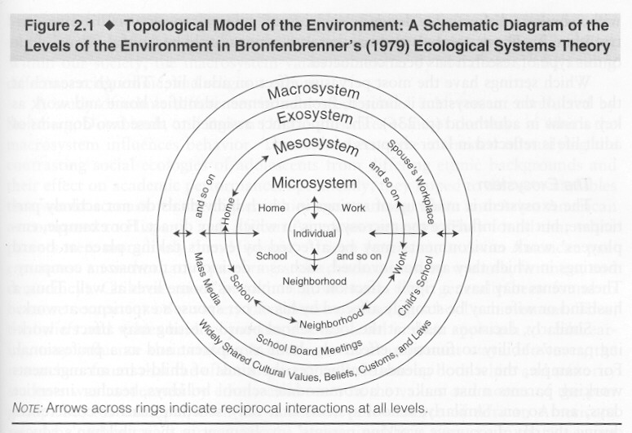
Socialization Processes
Parent-child relationships
  Face-to-face
  Still-face and prediction
  Attachment and its prediction
  Sensitivity and predicting
Peer relationships
School/community

Slide 3
Big picture
What produces secure attachment?
Infant – Temperament
Caregiver – Sensitivity
Social situation – divorce, daycare, social support
  May affect infant directly
    Situation - infant
  Or affect infant indirectly:
    Situation – caregiver sensitivity - infant

Slide 4
Attachment overview
Attachment as a motivational system
Measuring attachment security in the Strange Situation
Parental sensitivity predicts attachment security
  Experimental & observational (meta-analytic and large sample) evidence
Genetic moderation of stability in attachment?
Mother’s physiology and affect (reading)?
Temperament is weakly associated with attachment security (resistance)
Attachment stability, prediction, and the adult attachment interview (theory & practice)
But what’s sensitive?
  (More) evidence for the midrange model

Slide 5
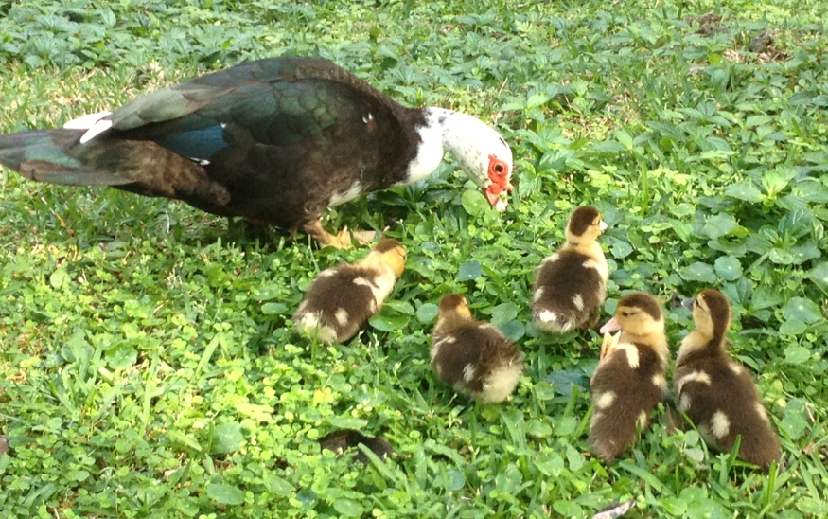
Introduction to Attachment
Christine Sinicrope

Slide 6
Attachment Theory
(Bowlby, 1969)
Based on ethological theories of emotional communication between infants and parents
  Infants have innate capacities to signal needs to others
    Examples of attachment behaviors?
  Adults are biologically predisposed to respond to these signals

Slide 7
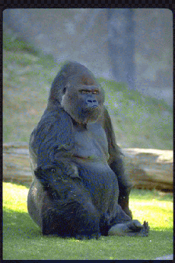
Environment of evolutionary adaptiveness
Protection from predators and . . . conspecifics (aka stranger danger)

Slide 8
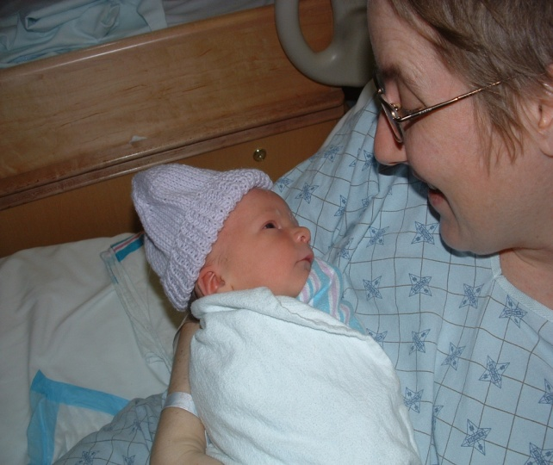
Recasting early interaction:
Signals that function to establish or maintain proximity of caregiver
  Indiscriminate Social
  Responsiveness (0 to 8 weeks)
Based on ethological theories of emotional communication between infants and parents

Slide 9
Attachment’s Function/Goal:
Keeping Caregivers Close

Slide 10
Attachment system
Inherent motivation
Organization of different behaviors
  Doesn’t matter how you get to caregiver
With single function
In a goal-corrected manner
Attachment as an organizational construct

Slide 11
Multiple attachments
Infants form attachments to many caregivers
A hierarchy is assumed
  In which infant turns first to primary caregiver
    But/and remember the Efe’s multiple caregivers
Role of fathers…

Slide 12
Intellectual History
Old dominant theory:
  Affection/attachment to mother originate because mother is the source of food
    Two versions
      Behaviorist: Contact becomes conditioned reinforcer because it is paired with food, an unconditioned reinforcer
      Learning theory: Primary drive toward food (oral) becomes secondary drive toward contact
Harlow says this is wrong
  Harlow movie: http://www.youtube.com/watch?v=KlfOecrr6kI

Slide 13
What forms the basis for attachment relationships?
How do we know that attachment represents an “emotional” bond?
Primary Drive Reduction Theory
  Preference based simply by having primary needs (i.e., hunger) met?

Slide 14
What forms the basis for attachment relationships? (cont)
Harlow’s studies and the rejection of “drive reduction” explanations
  Spitz (1946) noticed that infants in orphanages (who were adequately nourished but had no loving attention) did very poorly
  Harlow’s surrogate mother studies examined relative influence of feeding vs. contact/comfort on attachment

Slide 15
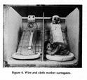
Harlow’s Surrogate Mother Studies
Bale-wire mesh
vs.
Terry cloth
Each could be
equipped with feeding
nipple
Test preference during
times of stress

Slide 16
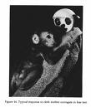
Harlow’s Surrogate Mother
Studies (cont)
https://www.youtube.com/watch?v=hsA5Sec6dAI
From Blum (2003)

Slide 17
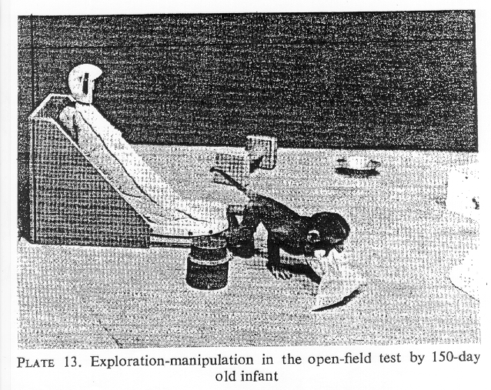
Key Attachment Concepts in Harlow
Contact with attachment figure
Retreat to attachment figure when afraid
Become less afraid
Use attachment figure as secure base from which to explore

Slide 18
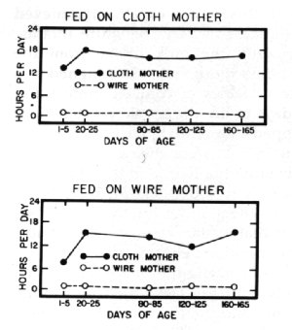
Time is spent on cloth mothers
Both wire and cloth fed spend most of their time on cloth surrogate mother
  Regardless of which “mother” fed you

Slide 19

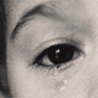
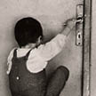
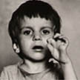

Attachment makes social contact a psychological reality
Carrying feelings of being with other inside you
Attachment disorders:
Romanian adoptees

Slide 20
Exposure to institutional rearing → disinhibited attachment disturbance
Romanian adoptees
Disturbance (from interview) means
  Lack of differentiation among adults;
  Clear indication that child would readily go off with a stranger;
  Lack of checking back w parent in anxiety-provoking situations.
        Rutter, M. and T. G. O'Connor (2004). "Are There Biological Programming Effects for Psychological Development? Findings From a Study of Romanian Adoptees." Developmental Psychology 40(1): 81-94
          In memoriam, Sir Michael Rutter

Slide 21
Internal Working Models
Mental representations of the availability of the attachment figure and what to do when the attachment system is activated
        Mental rules for organizing, accessing, and limiting access to information relevant to attachment.
Impact individual differences in strange situation behavior and, hence, infant attachment classification.

Slide 22
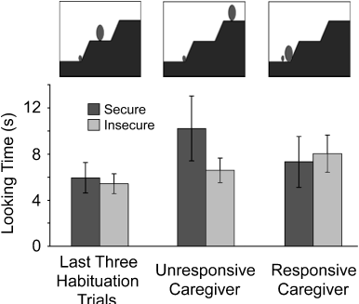
What infant expects
What do you expect?
Evidence for Infants’ Internal
Working Models of Attachment. 2007.
Susan C. Johnson, Carol S. Dweck, and Frances S. Chen

Slide 23
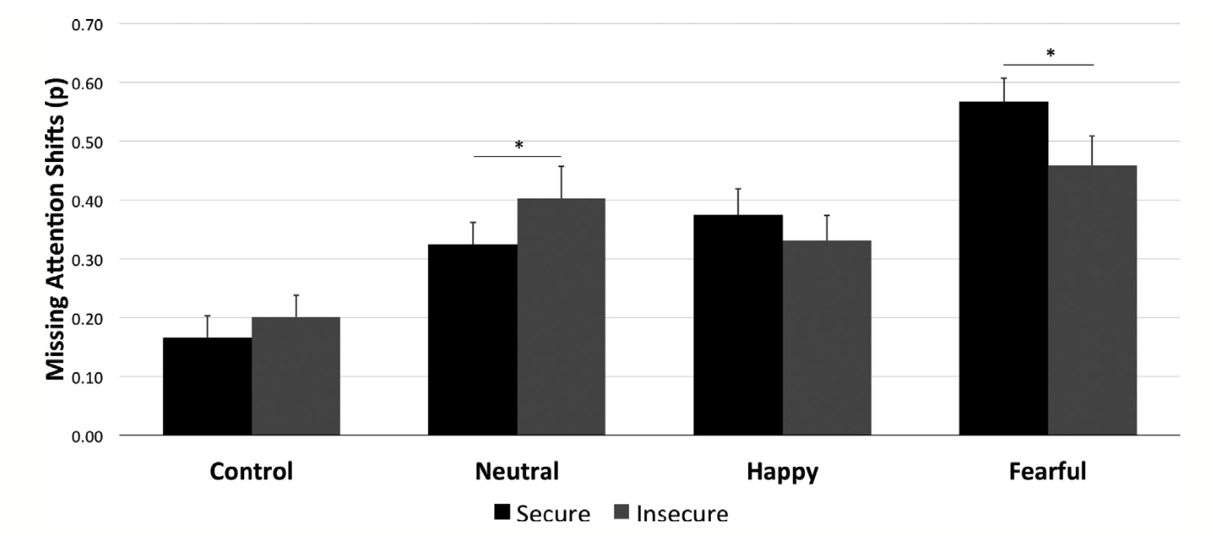
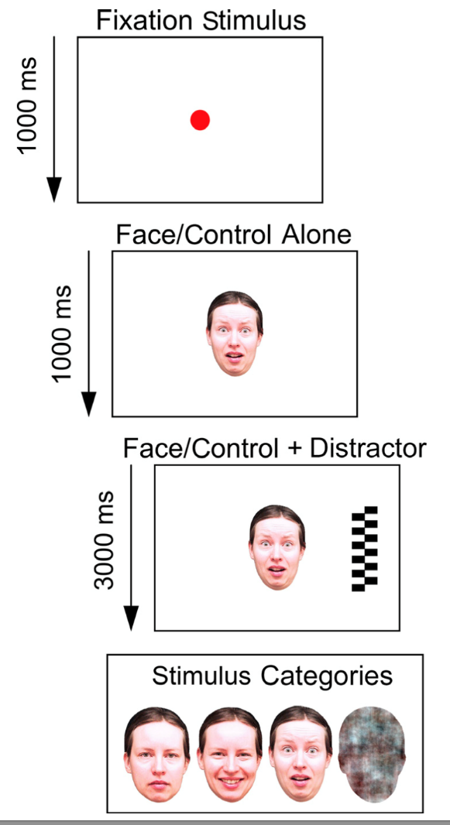
Attention to Fear Faces at 7 months Predicts 14 month Security
Peltola, Forssman, Puura, van IJzendoorn, & Leppänen (2015)

Slide 24
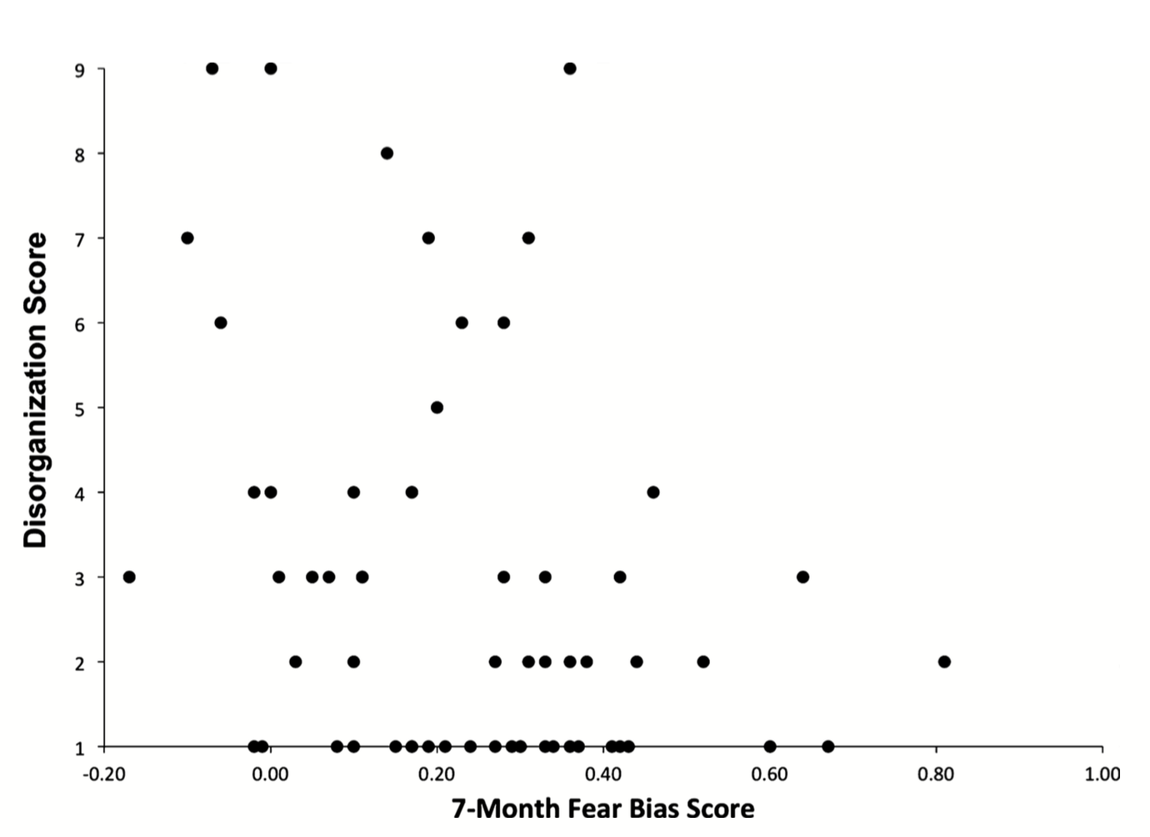
Attention to Faces Expressing Negative Emotion at 7 months Predicts Attachment Security at 14 months
Peltola, Forssman, Puura, van Ijzendoorn, & Leppänen (2015)

Slide 25
Measuring attachment security
A construct (secure attachment)
Is different than its measurement or operationalization
Attachment security can be measured with a Q-sort (an intricate rating system)
Prototypically measured with the Strange Situation (12 – 36 months at least)

Slide 26
Overall strategy
A – Avoidant
  Avoid caregiver
B – Secure
  Seek and be comforted by caregiver
C – Resistant
  Seek caregiving without surcease
D – Disorganized
  Lack a coherent strategy

Slide 27
Attachment types/categories
Low Avoidance
SECURE
RESISTANT
65%
15%
High Displayed Anxiety
Low Displayed Anxiety
AVOIDANT
DISORGANIZED
20%
No longer rare
High Avoidance
Notes:
Once children form an attachment to a caregiver, there are 4 specific types of attachment…
Secure Children: Use parents as a secure base. When separated, they may or may not cry but when the parent returns, they actively seek contact and their crying is reduced immediately. About 65% of North American infants in middle-SES families show this pattern
Avoidant children seem not to care whether parent is present or absent.
When the caregiver leaves, the infant is not distressed, and at reunion, do not move toward the parent or try to initiate contact, or slow to
-Parent does not provide adequate comfort when the child is emotionally upset, ill, or hurt (rejecting)
Resistant -Before separation, infants are reluctant to explore their environment, seem preoccupied with getting attention of caregiver.
-When their parent leaves, they are distressed, and when the caregiver returns, both seek and resist contact. They combine clinginess with angry, resistive behavior (hitting/pushing parents, continue to cry, can’t be comforted)
Parents tend to be inconsistent in response to their child’s signals of distress.
Disorganized/disoriented children lack an organized pattern to their behavior
-Disorganized children display unusual behaviors such as approaching the caregiver with their head averted (fear or confusion to the cg)
-Disorganization is considered an extreme form of insecurity
-At reunion, these infants show confused, contradictory behaviors (like looking away while the parent is holding them or approaching the parent with a flat, depressed emotion – some display odd, frozen postures)
Insecure Attachment averages 85% in maltreated children

Slide 28
Attachment Classifications
Secure Attachment (Type B; 65% in NA)
Ambivalent/Insecure-Resistant (Type C, 15% in NA)
Insecure/Avoidant (Type A, 20% in NA)
Disorganized (Type D, very rare)

Slide 29
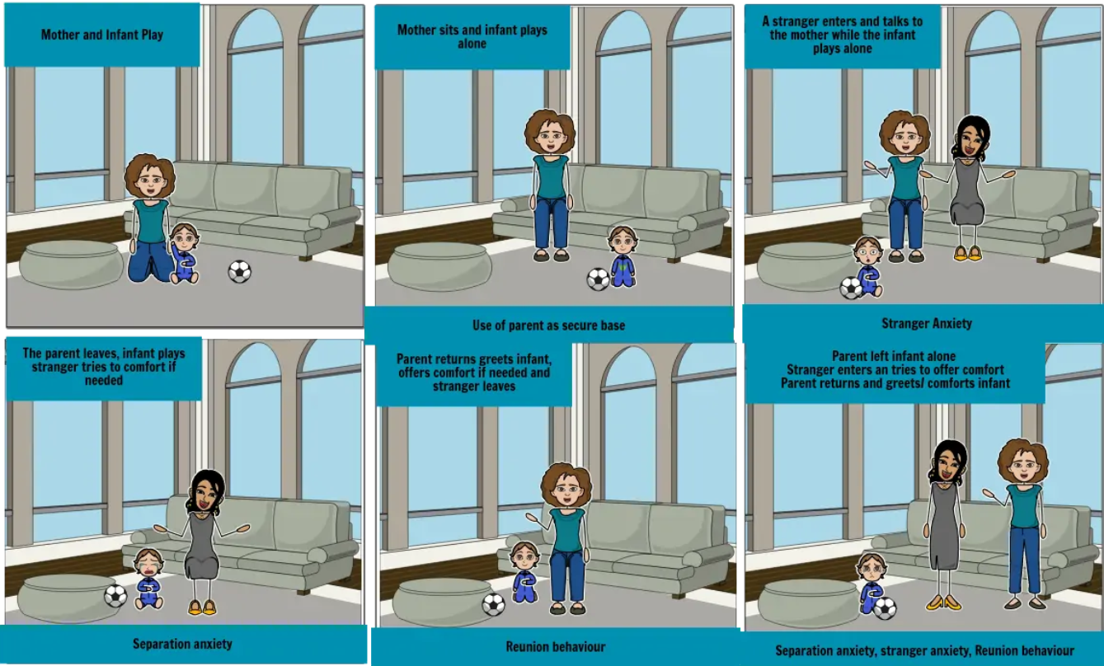
Ainsworth’s (1978) Strange Situation
  7 episodes increase stress (unfamiliar environment & adult, brief separations from parent)
  How are attachment behaviors are organized around parent
  Attachment classification based primarily on reunion behaviors
  See example at:
  http://www.youtube.com/watch?v=QTsewNrHUHU (van IJzendoorn)
  Attachment examples ppt
  https://nyu.databrary.org/volume/108/slot/10325/-?asset=28995
  8 minutes, 13 minutes
  Practice cases: 1, 2, 4, 7
https://www.youtube.com/watch?v=DRejV6f-Y3c (Waters)
Leung

Slide 30
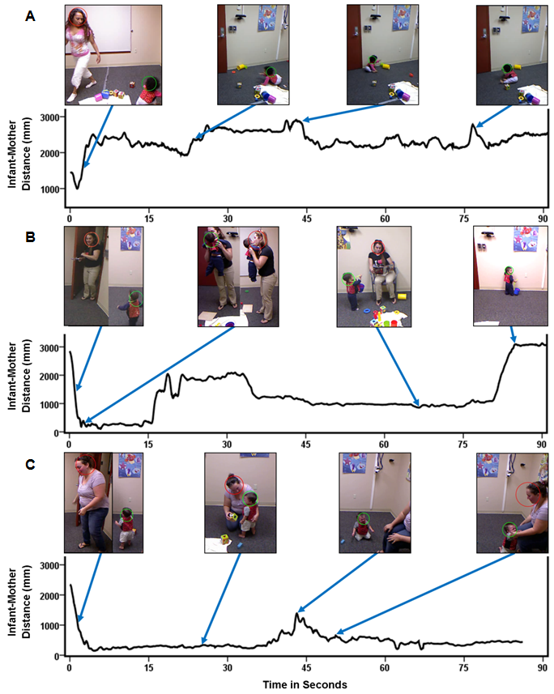
Strange Situation
Figure 2. Automated measurement of the distance between infant (green circle) and mother (red) in the first 90 seconds of the second Strange Situation reunion of infants reliably classified by an expert as A) avoidant, B) secure, and C) resistant. The avoidant infant shows the greatest overall distance from mother; the secure infant exhibits mid-range and variable distance; the resistant infant exhibits low distance levels, which show little variability.

Slide 31
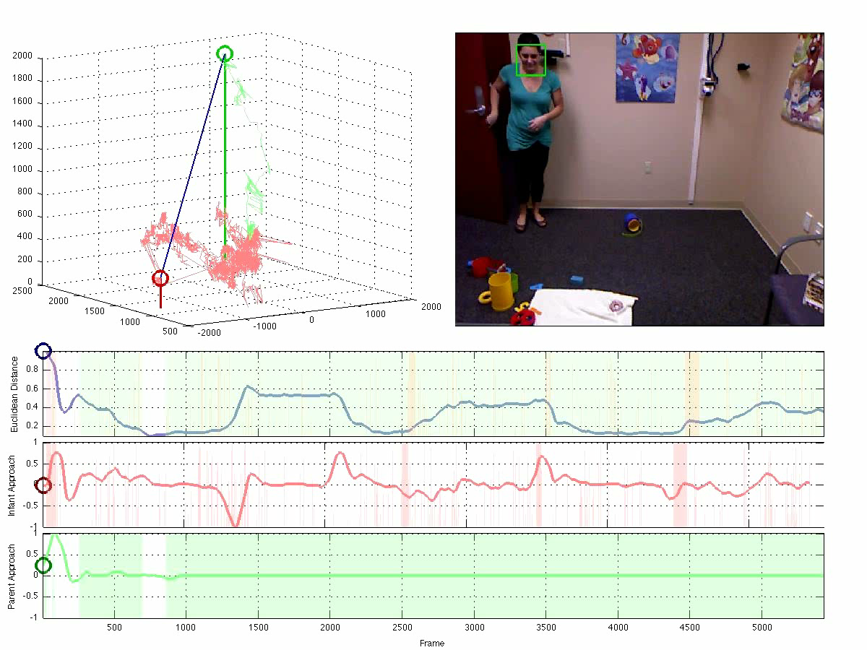
Attachment in Strange Situation
Fn1.r2. b6331

Slide 32
Attachment system
Stress activates the attachment system & reveals the child’s strategy
Security is an equilibrium
Avoidance is deactivation/shutting down
Resistance is over-activation/acting up
Notes:
So, the attachment behaviors are what we observe.
The attachment system is activated when the child is under stress.
We observe the behaviors that result and compare them to patterns and classify the child’s level of security.
Secure attachment is an balance btw proximity and exploration.
The child uses the mother as a secure base to explore their environment.
If frieghtened, he feels confident that he can go to mom for safety and comfort.
There are 2 types of insecure or anxious strageties: avoidance and resistance.
Avoidance is an insecure strategy where the child “shuts down” behaviorally.
These children do not see their mother as a secure base and they deal with that by shutting down their emotions.
Resistance is just the opposite. Here the child is overly emotional. Instead of shutting down they act up.
Resistant children get very distressed during the separations and are not able to be easily comforted.

Slide 33
Basis for Individual
Differences?
Sensitive/responsive caregiving
  Nurturant
  Attentive
  Nonrestrictive
  Synchronous
  Predictable

Slide 34
Ongoing debate
Individual differences in early attachment security are expected to have enduring implications for children's socioemotional development but are not expected to be shaped by child temperament
Individual differences in early attachment are the result of temperamental variation rather than characteristics of the specific parent-child relationship

Slide 35
The Current Study
What is the link between attachment and temperament?
  Conducted a meta-analytic review aimed at addressing the empirical overlap of infant attachment and temperament
  129 studies identified yielding 131 independent samples (13,018 children)

Slide 36
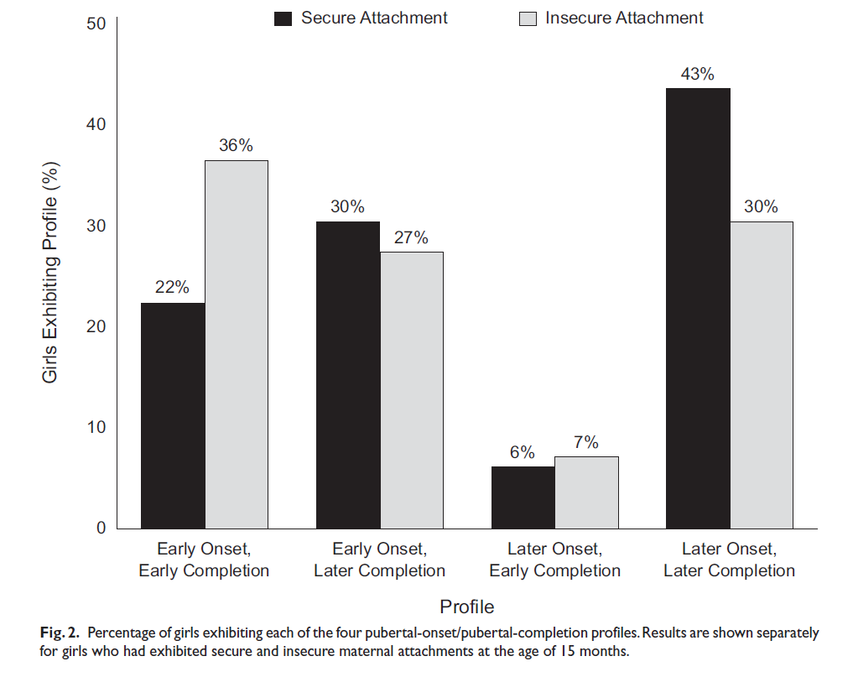
Attachment-Maturation Model
Early menarche: insecure over-represented?
Is insecurity a better fit to certain environments?
Belsky, Houts, & Fearon 2010

Slide 37
Predicting attachment security
Most infants are attached but only 2/3 of infants are typically securely attached.
There is strong but limited experimental evidence and extensive evidence from meta-analyses that caregiver sensitivity predicts secure attachment
Notes:
What does secure attachment predict?

Slide 38
Evidence for care-giving effects
Experimental
  Irritable infants
  Snugglies
Observational
  Meta-analysis of quasi-experiments

Slide 39
Experiment 2: Snuggly Effect!
49 low-socioeconomic status (SES) mothers of newborn infants
Given soft baby carriers (more physical contact) or infant seats (less contact).
More experimental (83%) than control infants (38%) were securely attached at 13 mo.
  3.5 mo, mothers in the experimental group were more contingently responsive than control mothers to their infants' vocalizations.
Low cost experimentally-validated intervention?
        Anisfeld, Casper, Nozyce, & Cunningham (1990). Does infant carrying promote attachment? An experimental study of the effects of increased physical contact on the development of attachment. Child Development, 61(5), 1617-1627.

Slide 40
Experiment 1: Sensitivity training
100 irritable, low-SES Dutch infants
50 mothers in experimental group
  receive 3 home visits to foster “contingent, consistent, and appropriate responses to + and - infant signals”
50 control mothers are observed only

Slide 41
Results
Experimental infants 36/50 (72%) secure
Control infants: 16/50 (32%) secure
Sensitivity training for mother decreases rates of insecurity among irritable infants
Meta-analysis of intervention studies showed a moderately large effect size, d = .48
  Van den Boom

Slide 42
Observational Meta-analysis:
Sensitivity Studies Only
Perceive signals accurately and respond promptly and appropriately
  22% (r = .22), 7,223 infants in 123 comparisons
Original Ainsworth subscale
  24% (r = .24), 837 infants in subset of 16 studies
  Socioeconomic class is a moderator
    Middle (r = .27); lower (r = .15)
De Wolff, M., & van Ijzendoorn, M. H. (1997). Sensitivity and attachment: A meta-analysis on parental antecedents of infant attachment. Child Development, 68(4), 571-591.

Slide 43
Conclusions
Sensitivity and quality of interaction are important and consistent (but not exclusive) predictors of attachment security.
Sensitivity important but not only factor
  Orthodox hypothesis supported weakly

Slide 44
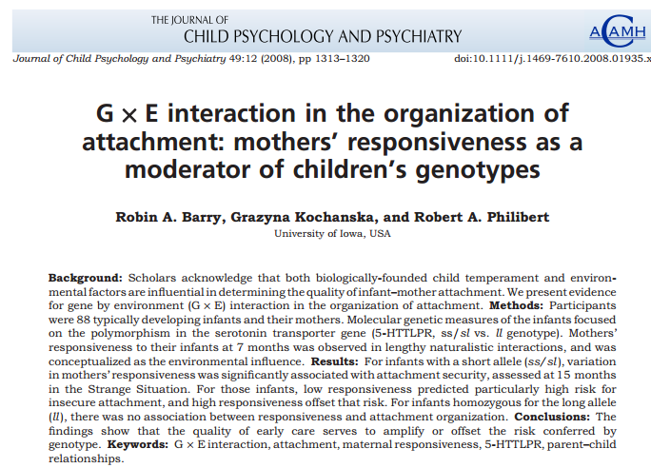

Slide 45
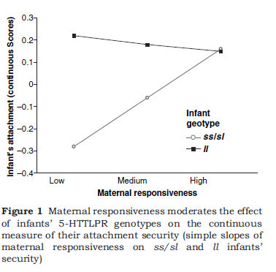
Gene*environment interaction?
Barry et al. 2008

Slide 46
Two Temperamental Pathways
Indirect effect
  Temperament → Caregiver-Infant interaction → Attachment security
Direct effect (Not empirically supported)
  Temperament → Strange Situation Behavior → “Attachment Security”
  Less prone to distress → “Avoidant”
  More prone to distress → “Resistant”

Slide 47
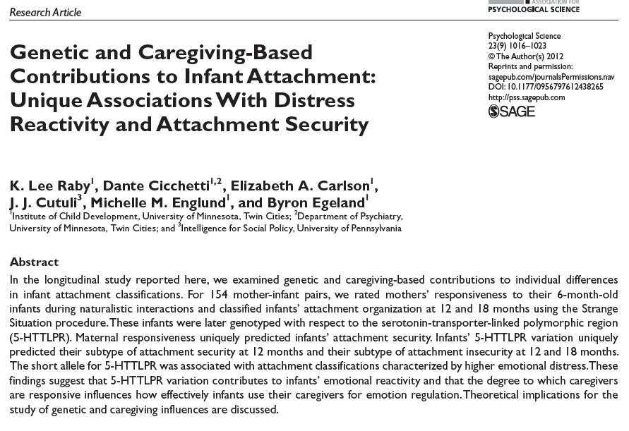

Slide 48
Empirical resolution?
What is infant attachment measuring?
  Caregiver responsiveness vs. child temperament
  Infant emotional reactivity vs. regulation
One possibility:
Insecure
Avoidant
Secure
B₁, B₂ vs B₃, B₄
Insecure
Resistant
Low
High
Distress Reactivity
Belsky; Sussman-Stillman; several replications

Slide 49
What about common genetic variant?
5HTTLPR
(Serotonin-transporter-linked polymorphic region)
  Short (S) allele – Negative affect, Emotional Disorders, Reduced Serotonin, Increased Amygdala Activity
    Long allele variant (L_{G})— same as S allele
  Long allele noncarriers (L_{A})

Slide 50
Goals
Determine unique contributions of caregiver quality and genetic variation (5HTTPLR) on infant attachment at 12 and 18 months
Caregiver quality will predict secure vs insecure
  More responsive mothers lead to secure babies
5HTTPLR variation will predict reactivity across security
  S and L_{G} alleles will be more reactive than L_{A}
155 infants and their mothers
  Maternal Responsiveness at 6m
    Home-interactions
  Attachment Classification at 12m and 18m
    Strange Situation
  Genetics at 32 years

Slide 51
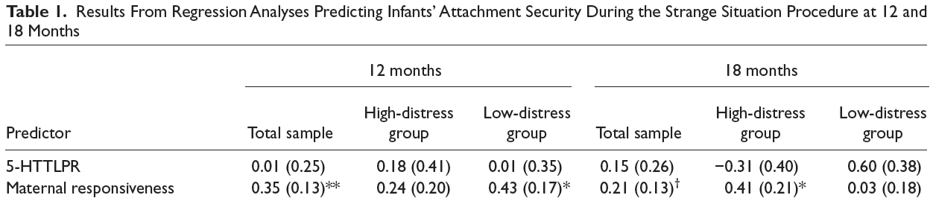
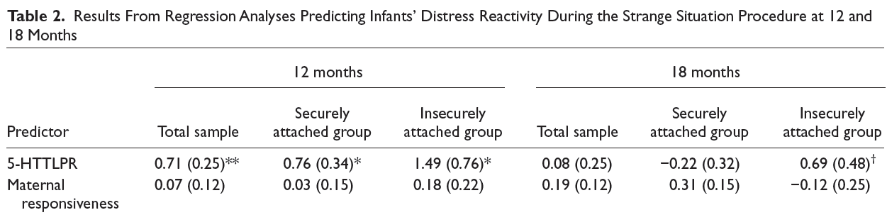
Predicting security & distress reactivity

Slide 52
Discussion
Should we keep investigating the effects of genes on attachment security?
  Multiple studies have found large environmental effects and “trivial genetic contributions” to infant’s attachment style
Maternal responsiveness expression did not predict distress reactivity
  Primate studies have shown that an unsupportive caregiving context may exacerbate the gene’s influence on negative affect
Are you convinced?
  Strengths/Limitations of this study
Future research?

Slide 53
Genetic and Caregiving-Based Contributions to Infant Attachment
Two contrasting explanations of differences in attachment:
  Quality of infant-caregiver relationship
  Reflection of infants’ temperament
Emotional reactivity vs. emotion regulation
Proposed reconciliation: distress reactivity during SSP shaped by predispositions for negative emotionality

Slide 54
Genetic and Caregiving-Based Contributions to Infant Attachment
155 infants and mothers
Measures of:
  Maternal responsiveness at 6 months
  Attachment at 12 and 18 months
  Emotional distress in SSP
  5-HTTLPR variation
  Raby et al., 2012

Slide 55
Genetic and Caregiving-Based Contributions to Infant Attachment
Maternal responsiveness predicted attachment
5-HTTLPR predicted distress during SSP, not attachment security
  Predicted subtypes
Genetic variation and caregiving context make unique contributions to differences in attachment behavior
  Caregiving → secure vs. insecure
  5-HTTLPR → how this is manifested

Slide 56
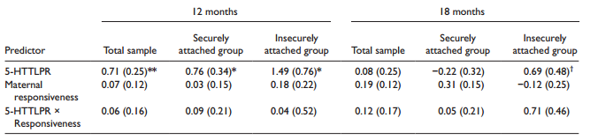
Maternal responsiveness uniquely predicted attachment security
Serotonin-transporter-linked polymorphic region (5-HTTLPR)--short allele associated with distress and B3/B4/C classifications at 12 months:

Slide 57
Disorganized attachment predicted by parent behavior
Strongly related to parental maltreatment, & moderately related to sensitivity
Unrelated to difficult infant temperament
2 studies have linked frightening parental behavior to disorganized attachment
    Though not significantly related to depression
      van IJzendoorn, M. H., Schuengel, C., & Bakermans Kranenburg, M. J. (1999). Disorganized attachment in early childhood: Meta-analysis of precursors, concomitants, and sequelae. Development and Psychopathology, 11(2), 225-249.

Slide 58
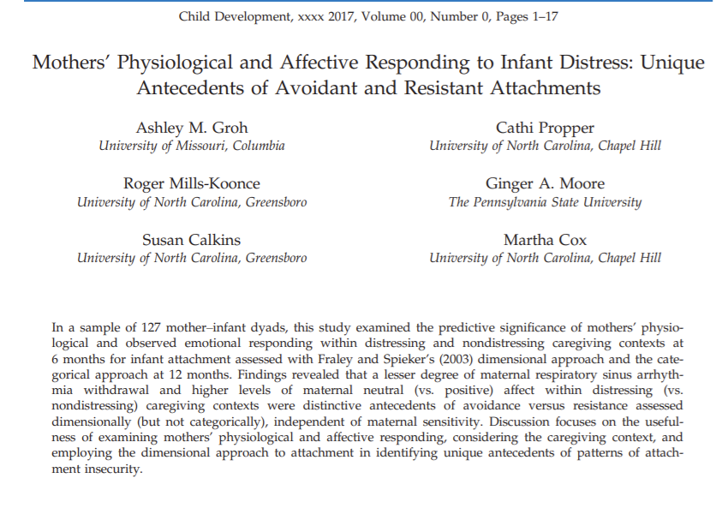

Slide 59
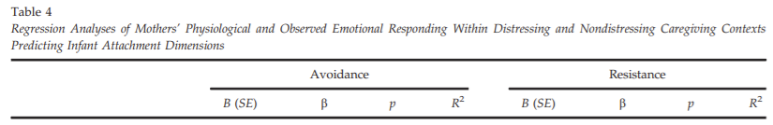
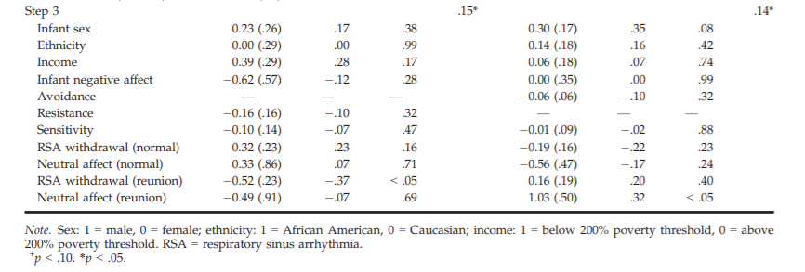
FFSF →? Dimensional avoidance
Positive values of RSA withdrawal indicated a larger decrease in RSA from baseline and, therefore, a greater degree of RSA withdrawal that putatively reflects attempts to regulate emotion and deploy attention.

Slide 60
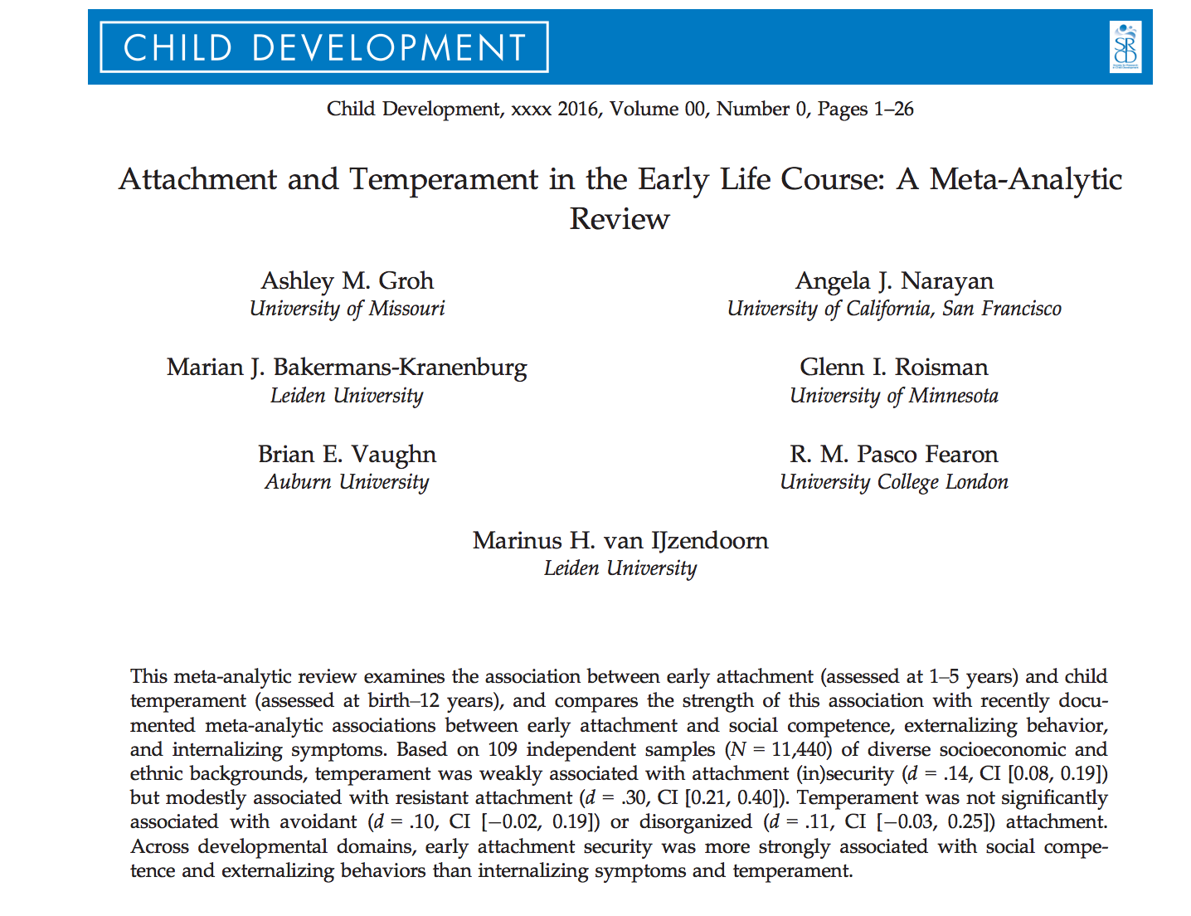
Attachment and Temperament
Are they overlapping constructs?

Slide 61
Quick Detour
What is temperament?
  “…individual differences in emotion, motor, and attentional reactivity and regulation that are constitutionally based but also shaped by experience”
What is attachment?
  “…relational construct with origins in history of parent-child relationship

Slide 62
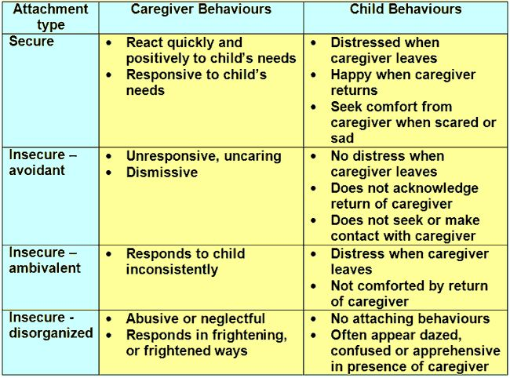
(Resistant)

Slide 63
Ongoing Debate
Attachment Theorists
  Early attachment security is shaped by caregiving environment not temperament
Temperament Theorists
  Variation in temperament yields individual differences in infant attachment
VS
Is there a link between early attachment security and temperament? And if so, what is its strength?
Does variation in method matter? And how temperament is operationalized?

Slide 64
Current Study
Meta-analytic review of 131 samples (N=13,018)
Estimated the association between early negative temperament (i.e., negative and positive emotion reactivity) and (in)secure attachment
  Why is this important?

Slide 65
Hypotheses
Early attachment insecurity will be weakly associated with negative temperament
Negative temperament will be weakly negatively associated with avoidant attachment and positively associated with resistant attachment
Negative temperament will be trivially associated with infant disorganization
Temperament will be associated with attachment sub-classifications (high/low emotional reactivity)
    Negative temperament will be associated with B3-C2 (high separation distress)
Early insecurity will be more strongly associated with lower levels of social competence and greater externalizing and internalizing symptomology than with negative temperament
Insecure father-child attachment would be weakly associated with negative temperament

Slide 66
Methods
Literature Search: 249 + 30 articles
Inclusion/Exclusion Criteria:
  Studies reporting on relationship between attachment and (all dimensions of) temperament
  Excluded studies that included peer competence, externalizing behavior, & internalizing symptoms
  Temperament measured by questionnaires; attachment observed (e.g. SSP)
131 final, independent samples

Slide 67
Methods
Coding System and Moderators
  Type of measure/identity of attachment rater
  Type of instrument to assess temperament
  Measurement of temperament in relation to attachment
  Temporal relation of attachment and temperament assessments
  Demographics (child sex/ethnicity, country of study, SES, contextual risk of cohort)

Slide 68
Methods
Meta-Analytic Procedures
  4 separate meta-analyses
  Moderator analyses
  Effect sizes (d) calculated as the standardized difference between secure and insecure attachment
  Random effects models
  95% CI around point estimates; computed homogeneity Q statistics and p-values

Slide 69
Results:
Mother-Child Attachment and Overall Negative Temperament
Comparison of associations between attachment classifications and negative temperament
  No significant contrasts in combined effect sizes for the following comparisons on temperament
    Secure vs. avoidant attachment
    Secure vs. disorganized attachment
    Avoidant vs. disorganized attachment
    Resistant vs. disorganized attachment
    High vs. minimal separation distress during SSP
  Significant contrasts found between
    Resistant vs. secure attachment: combined effect size of d = .26
    Resistant vs. avoidant attachment: combined effect size of d = .26
    Demonstrating that resistant attachment showed stronger associations with temperament than secure or avoidant attachment

Slide 70
Results:
Attachment and Specific Dimensions and Assessments of Temperament
Moderating effect of theoretical operationalization of temperament on association between attachment and temperament
  85% CIs for associations between each negative temperament dimension from the four main theoretical traditions and attachment security overlapped
  85% CIs for associations between negative temperament dimensions and resistant, avoidant, and disorganized attachment overlapped
Moderating effect of temperamental dimension on association between attachment and temperament
  85% CIs for association between attachment security and temperamental fearful distress, irritable distress, and positive emotionality overlapped
  85% CIs for meta-analytic associations between each temperament dimension and avoidant and disorganized attachment overlapped
  Resistant attachment found to be more strongly associated with greater levels of fearful distress than with lower levels of positive emotionality
Method of temperament assessment did not moderate association between attachment and temperament

Slide 71
Results:
Father-Child Attachment and Overall Negative Temperament
Negative temperament was not related to secure, avoidant, or resistant father-child attachment styles
  Secure: non-significant effect size of d = .15
  Avoidant: non-significant effect size of d = .08
  Resistant: non-significant effect size of d = .27
However, magnitude of associations were comparable to those found for mother-child attachment

Slide 72
Results:
Temperament, Social Competence, Externalizing Behavior, and Internalizing Symptoms
Comparison of combined effect sizes for association between attachment and temperament with prior meta-analyses on associations between attachment and socioemotional outcomes
  Secure attachment
    85% CIs for social competence and externalizing problems did not overlap with CIs for internalizing symptoms or temperament
    Secure attachment was significantly more strongly related to social competence and externalizing problems than to temperament and internalizing problems
  Resistant attachment
    85% CIs for social competence and temperament did not overlap with CI for internalizing symptoms, but did overlap with CI for externalizing problems
    Resistant attachment was significantly more strongly related to internalizing symptoms than to social competence or temperament

Slide 73
Results:
Temperament, Social Competence, Externalizing Behavior, and Internalizing Symptoms
Comparison of combined effect sizes for association between attachment and temperament with prior meta-analyses on associations between attachment and socioemotional outcomes
  Disorganized attachment
    85% CIs for internalizing symptoms and temperament did not overlap with CI for externalizing problems, but did overlap with CI for social competence
    Disorganized attachment was significantly more strongly related to externalizing problems than to temperament or internalizing symptoms
  Avoidant attachment
    Not significantly more strongly related to social competence, externalizing problems, or internalizing problems than to temperament

Slide 74
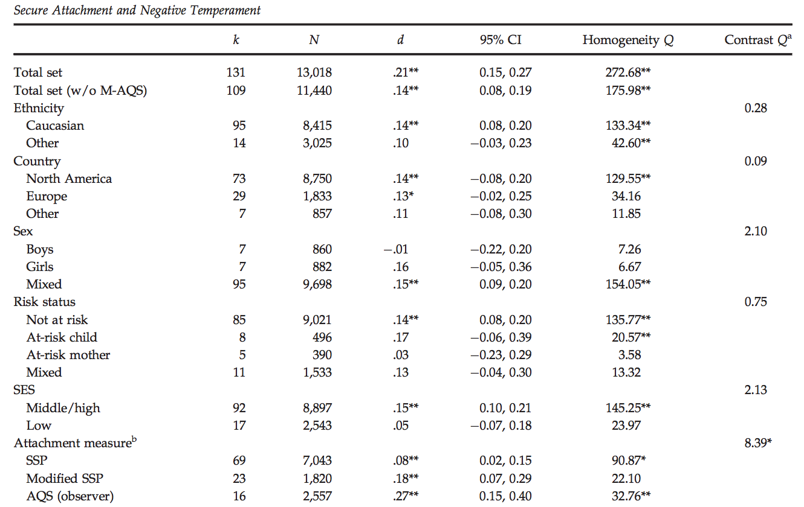
Results: Security and Negative Temperament
c

Slide 75
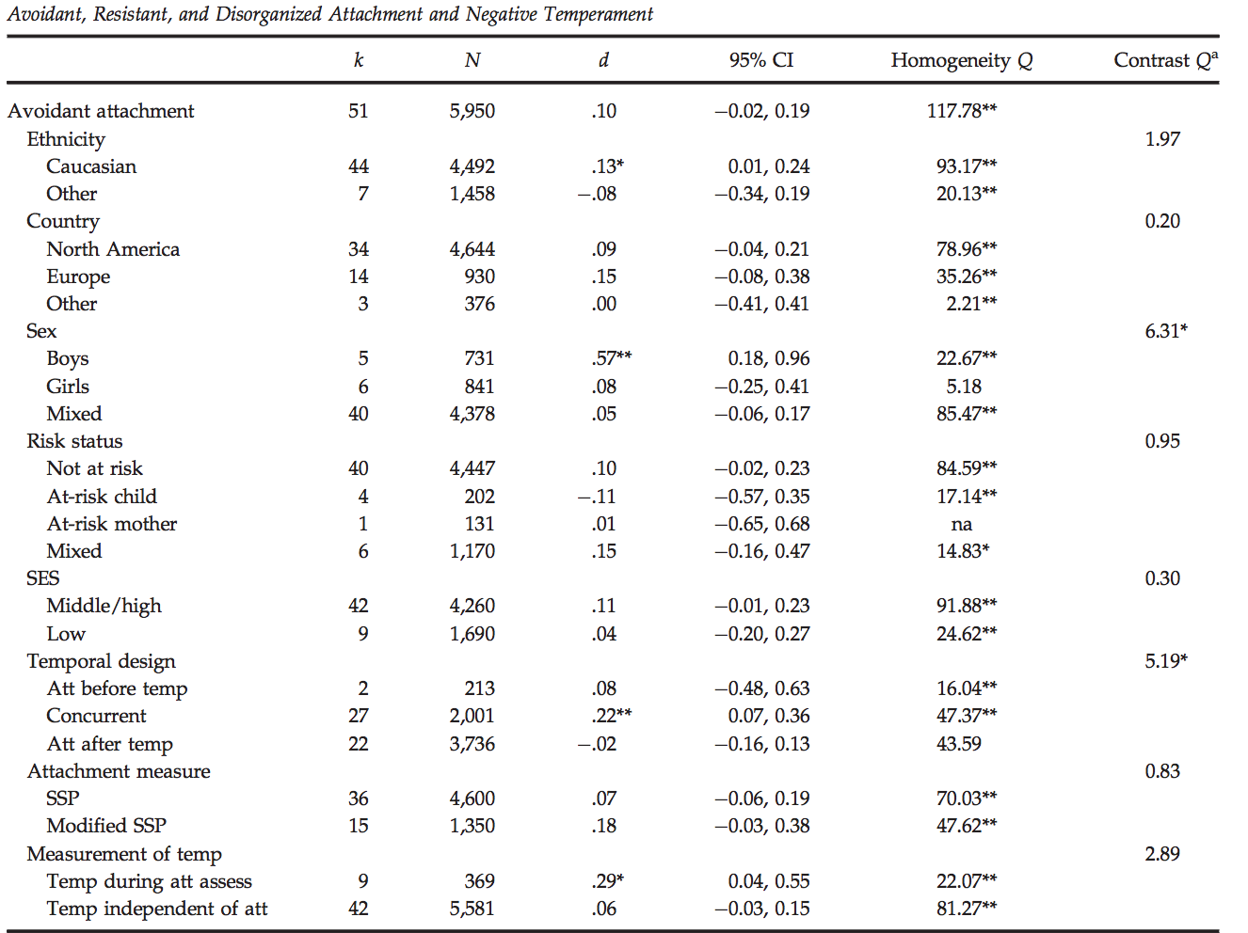
Results: Avoidant attachment and temperament

Slide 76
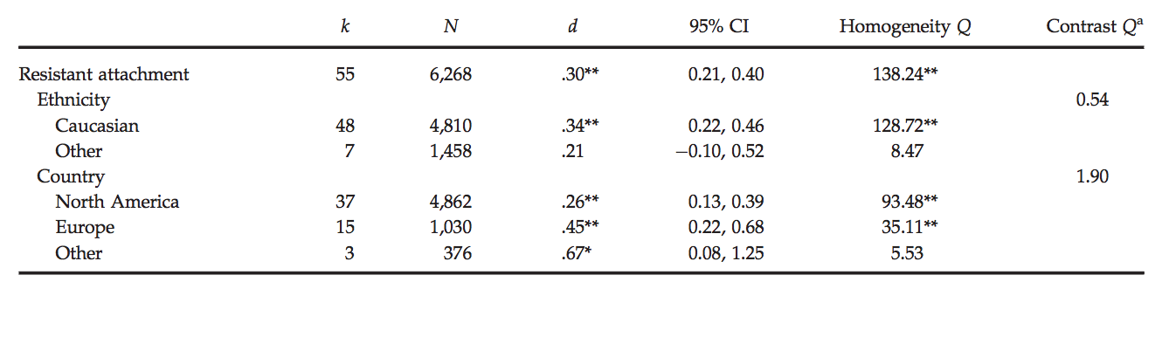
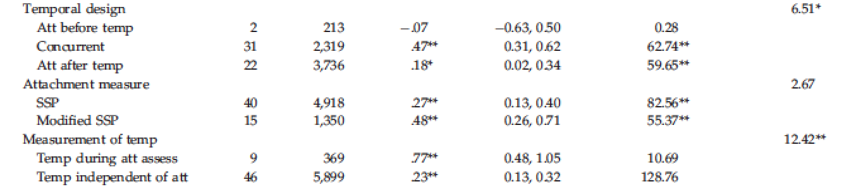
Results: Resistant attachment and temperament
Fisher

Slide 77
Results: Comparing Attachment Classifications
Contrasts between resistant vs. secure attachment, and resistant vs. avoidant attachment were significant
  Resistant attachment showed stronger associations with temperament than secure or avoidant temperament
Children classified as A1-B2 (low separation distress) versus B3-C2 (high separation distress) in SSP did not differ in negative temperament
Fisher

Slide 78
Results:
Dimensions and Assessment of Temperament & Father-Child Attachment
Association between negative temperament and attachment did not differ based on theoretical or dimensional classification
  Resistance more strongly associated with fearful distress vs. positive emotionality
Association also did not differ based on temperament assessment
Father-child attachment was not related to negative temperament
Fisher

Slide 79
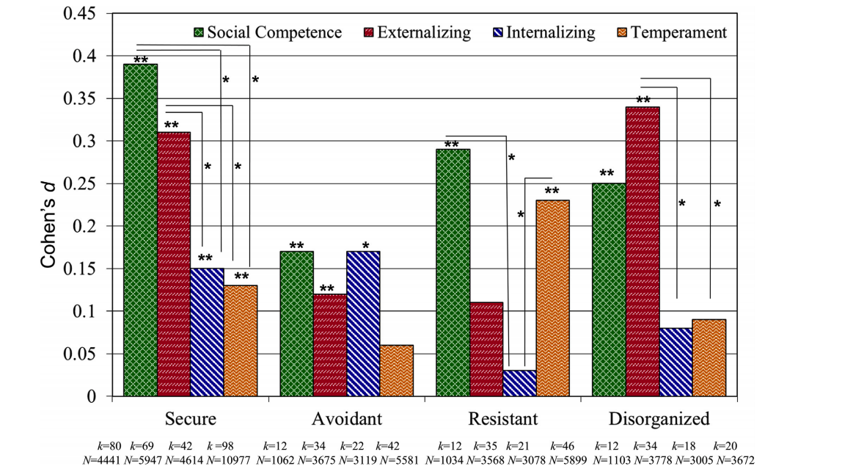
Overview
Temperament, Social Competence, Externalizing Behavior, and Internalizing Symptoms

Slide 80
Conclusions
Association between temperament and attachment security is weak
  Temperament is moderately associated with resistant attachment
Comparable to the weak association between attachment security and internalizing symptomatology
  Significantly weaker than association between attachment security and social competence and externalizing symptoms

Slide 81
The Big Question
How do early experiences of attachment relationships impact later relationships?
Through behavioral and then internal representations of what can be expected from relationships

Slide 82
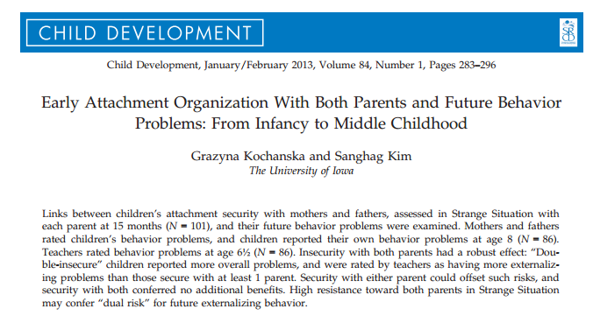
Predicting behavior problems

Slide 83
Participants
Typically developing infants from traditional two-parent families

Slide 84
Measures
15 month visit
  Strange Situation
6.5 year visit
  Teacher report of Problem Behavior using the Child Symptom Inventory-4
8 year visit
  Parent report of Problem Behavior using the Child Symptom Inventory-4
  Child report of Problem Behaviors using the Dominic-R

Slide 85
Results
Mother and Father report of problem behavior significantly correlate with each other but do not correlate with teacher report or child report

Slide 86
Can 1 secure relationship act as a buffer?
Teachers rated children who were insecurely attached to both parents as having more externalizing behavior problems
Being securely attached to at least one parent has a significant beneficial effect
Teachers perceived children who had insecure attachments with their father at 15- months as having more externalizing behavior problems at 6.5 years old.

Slide 87
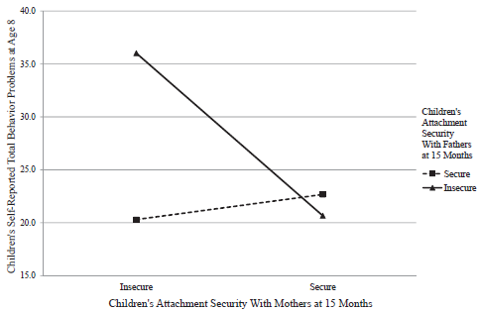

Double insecurity → behavior problems
(insecurity with dad is key)

Slide 88
Two insecure attachments…
..

Slide 89
Level of resistance
Disorganized attachment with dad at 15 months predicts children’s higher externalizing behavior problems
Child’s resistance with mother and father predicted higher teacher-rated externalizing behavior problems.
Even when children showed high resistance with their father, if the child demonstrated low resistance with mom it served as a protective factor
Low resistance with dad also predicted lower teacher reported behavior problems despite level of resistance with mom

Slide 90
Attachment and Children's Peer Relations
“Small-to-moderate” association between attachment security to mother and quality of children’s peer relations
  meta-analysis of 63 studies indicates
Effects “higher for studies that focused on children's close friendships rather than on relations with other peers.”
  Effects larger after early childhood
    “Gender & cultural differences … minimal”
      A Quantitative Review (Schneider et al ’2001)

Slide 91
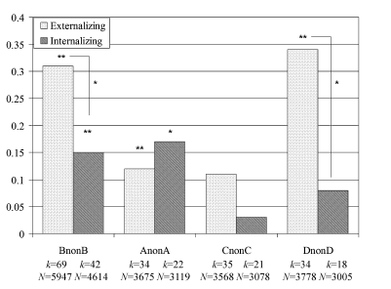
Disorganized/Nonsecure → Internalizing/Externalizing
Disorganized→ externalizing
(Groh, Roisman, van Ijzendoorn, Bakermans-Kranenburg, & Fearon, 2012)
Based on 42 independent samples (N = 4,614),

Slide 92


What about attachment in adulthood?

Slide 93
How Speakers are Categorized
As Autonomous (secure), Dismissing (avoidant), or Preoccupied (resistant)
  And, independently, as Unresolved/Disorganized
Not based on experiences themselves
But on speaker’s current relationship to the experiences
  how they’ve processed their past
Based on the coherence of their discourse

Slide 94
Validity of AAI
Classifications are stable
  2 months, 3 months, 1.5 years
Not related to IQ measures
  6 of 7 studies
Discourse style relates to attachment
  not interviews about job
Machine learning shows some ability to distinguish adult attachment in AAI

Slide 95
Parent-Infant
Attachment Correspondence
Meta-analysis of 13 studies using three major categories
75% secure vs. insecure agreement (K=.49)
70% three-way agreement (K=.46)
  Prebirth AAI show 69% three-way agreement (K=.44)
        Bakermans-kranenburg, M. J. & Vanijzendoorn, M. H. (1993). A Psychometric Study of the Adult Attachment Interview - Reliability and Discriminant Validity. Developmental Psychology, 29, 870-879.

Slide 96
Parent-Infant Correspondence

Slide 97
Breaking the Link
Parental attachment is not formed by past experiences but by current orientation to past.
Supportive experiences with a partner, friend or therapist can allow for earned autonomy in the face of experiences that would otherwise be associated with insecurity.

Slide 98
Interview
Interview a partner about one attachment figure focusing on questions 2 through 4
Each person analyzes their own responses
  no comments form partner
Only share what you want to share

Slide 99
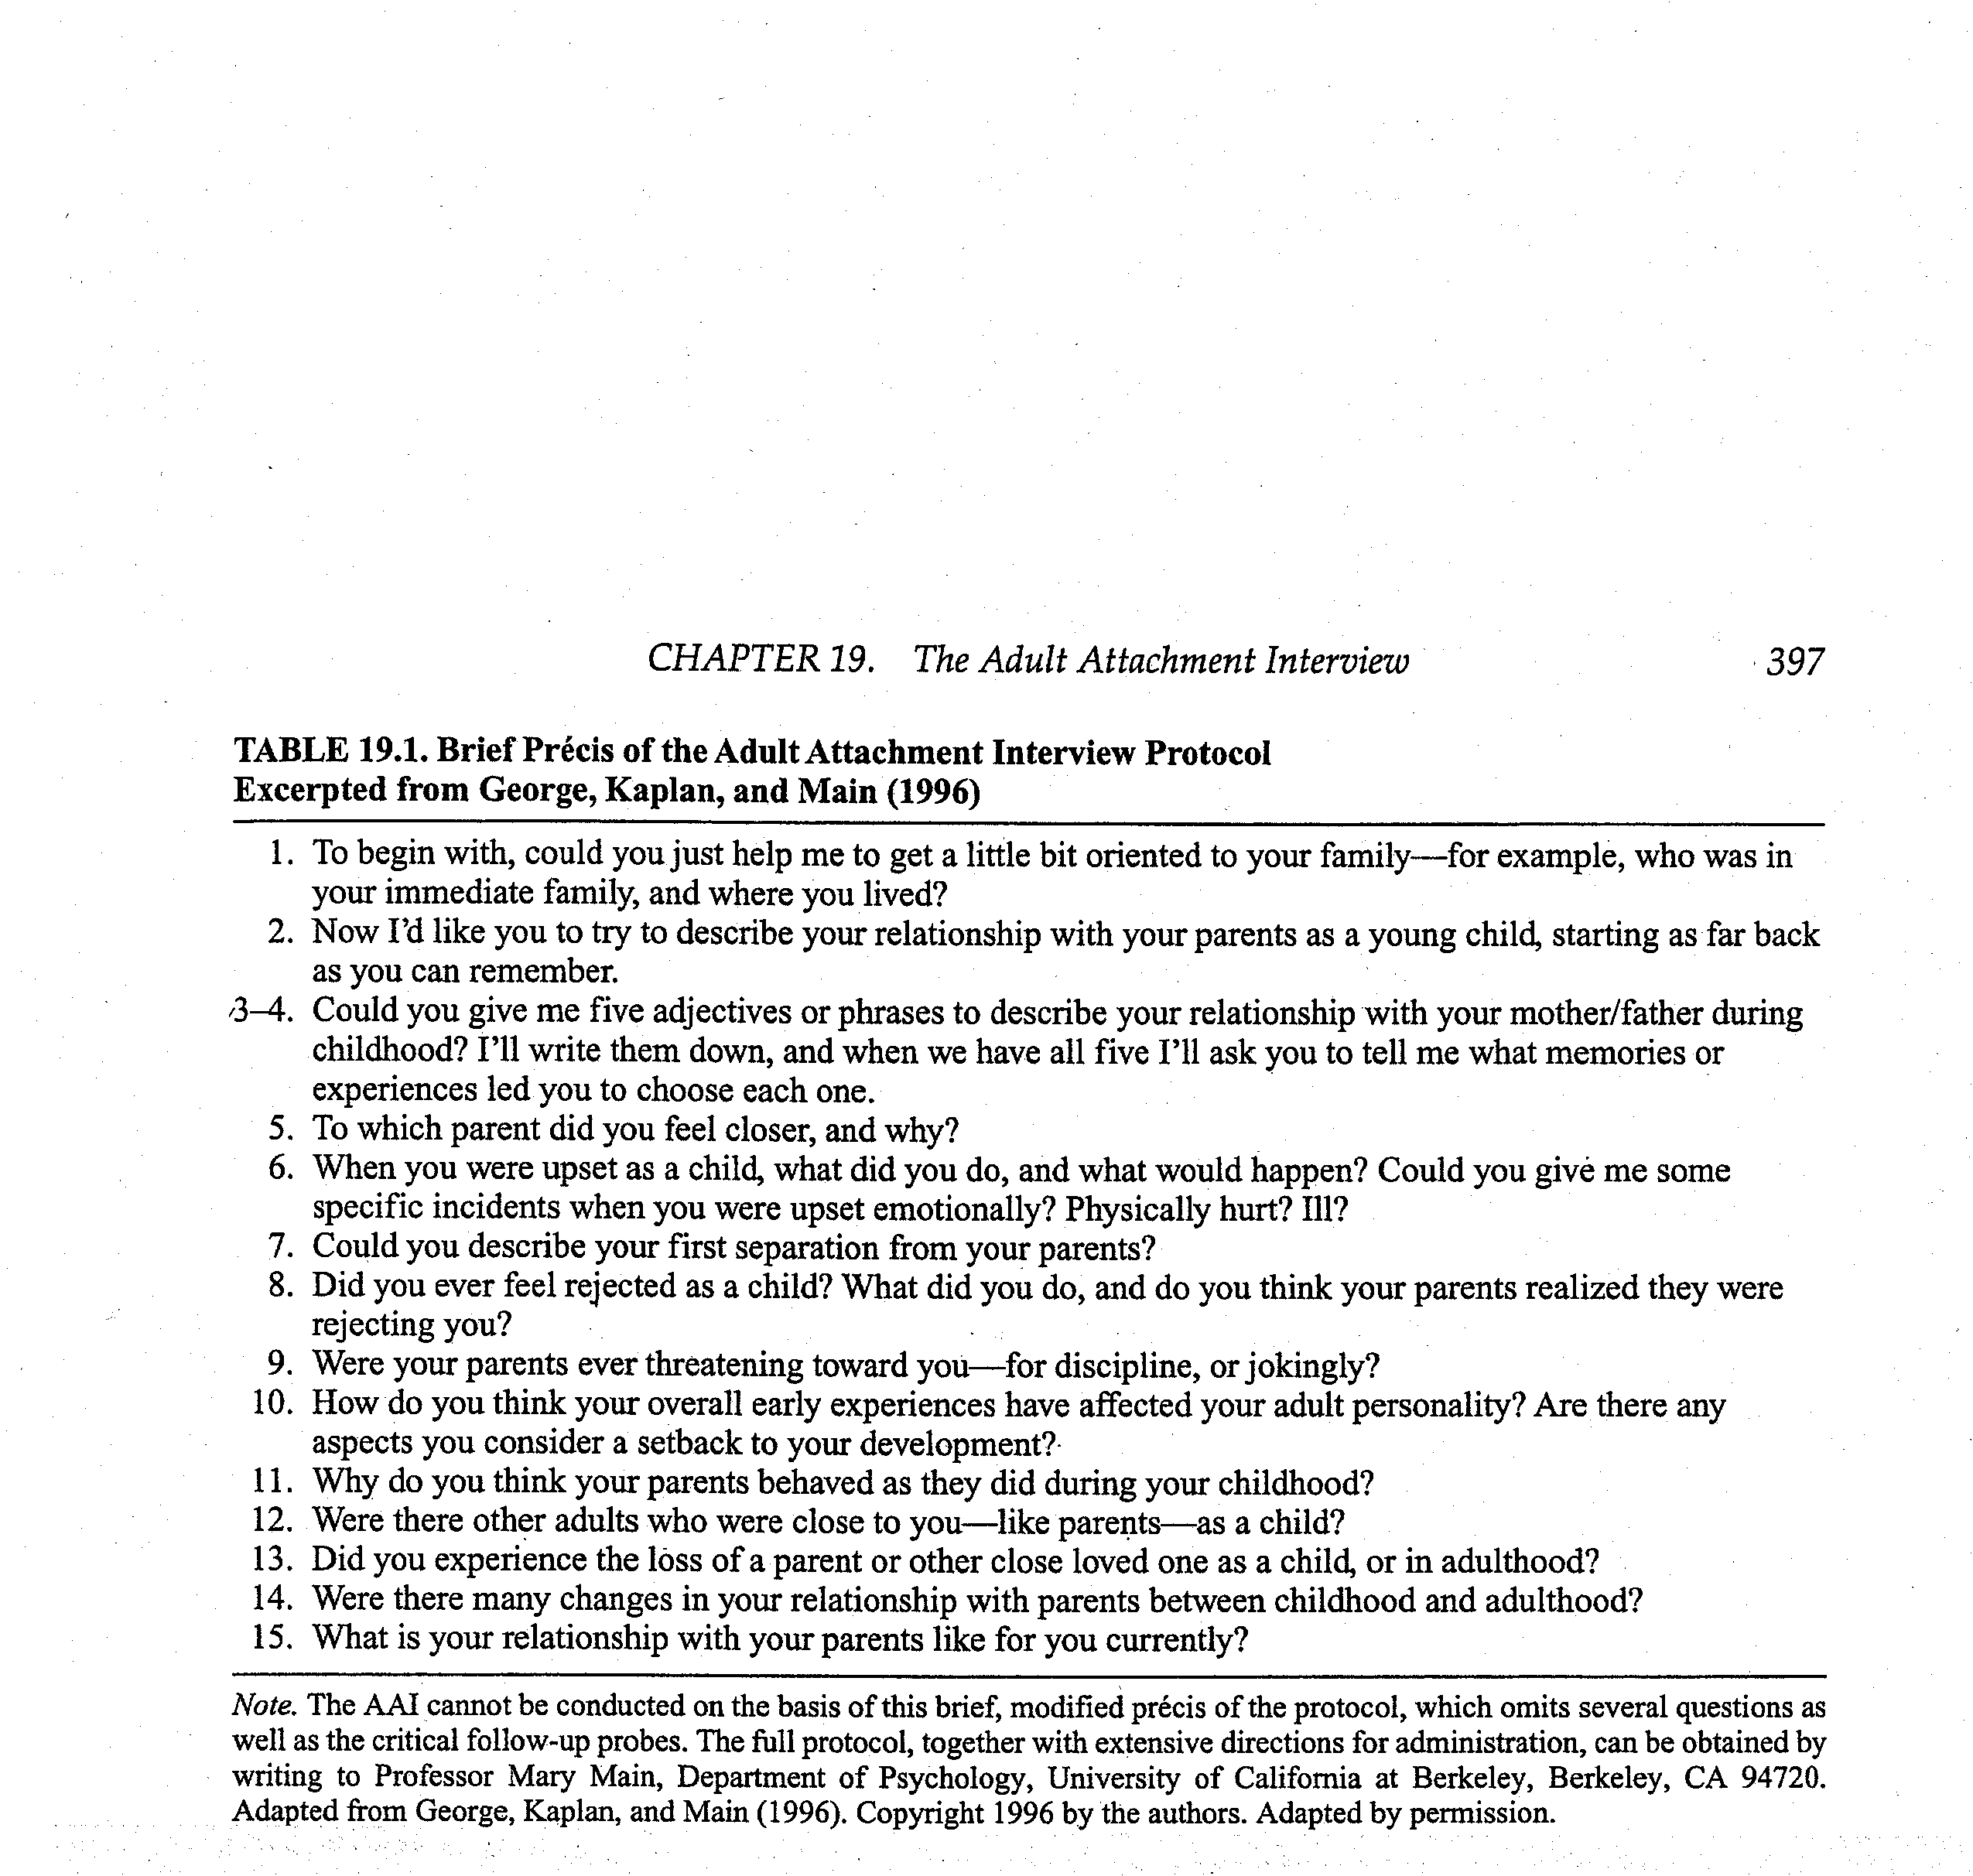
Adult Attachment Interview

Slide 100
How to Think About What You’ve Said
Scales associated with autonomous category
  coherence, metacognitive monitoring
Scales associated with dismissing category
  Idealization of attachment figures, insistence on lack of memory for childhood, dismissal of attachment-related experience/relationships
Scales associated with preoccupied category
  anger expressed toward attachment figure, passivity/vagueness in discourse

Slide 101
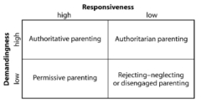
Parenting Styles in Middle
Childhood
Baumrind’s Model of Parenting Styles

Slide 102
Parent-Child Relationships in
Adolescence and Early Adulthood
Developmental progression in time spent with different people (parents, same-sex peers, opposite-sex peers)
  Does not mean that adolescents are disengaged from parents
Adult Attachment Interview (AAI; George et al., 1994)
  Autonomous
  Dismissive
  Preoccupied
Inter-generational transmission of attachment

Slide 103
Father-Child Relationships
(Tamis-LeMonda et al., 2004)
Results Summary:
  Mom/Dad behaviors correlated at each age
  Dad predicts mom behaviors over time but mom less predictive of dad
  Dad demographics (income/education) predict some aspects of parenting
  Dad and mom supportive parenting independently predict children’s outcomes
Notes:
Mom/dad correlated at each age
Dad predicts mom behavs over time but mom less predictive of dad

