Slide 1
Psychology of Infancy
PSY 430

Slide 2
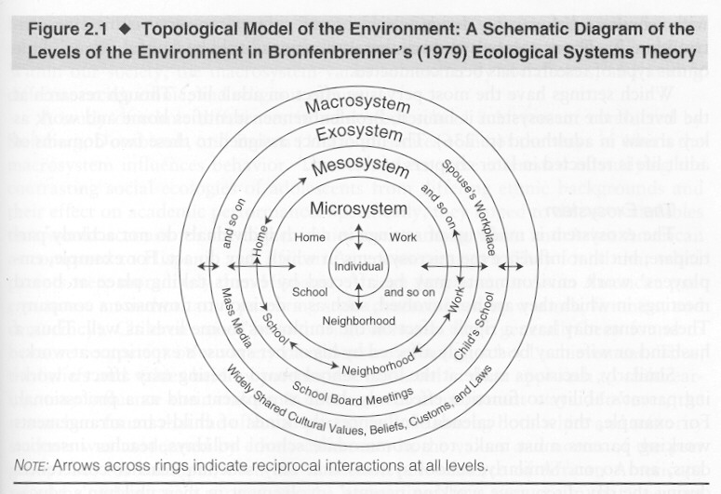
Domains of Development
Perception
Cognition
Language
Social/Emotional

Slide 3
Emotion and Social Development
Temperament
  Definition
  Models
  Mechanisms
Emotional Capacities
  Expression
  Understanding
  Awareness
Self-Awareness
  Components and developmental change

Slide 4
Emotion & temperament overview
Infant positive affect as a predictor (Coffey)
Definitions, background, example
  4—48 months, Fox et al., 2001
  Exuberance→5 years, Degnan et al.
Reactivity and self-regulation
  Approach/withdrawal
Goodness of fit
Differential sensitivity
Stability of temperament
  Marshmallow redux, Watts et al.
  Delay of gratification over 40 years, Casey et al., 2011
  2→20 years, Schwartz et al., 2003
Associations with wealth and political ideology
Adolescent dynamics (Heller & Casey)

Slide 5

Cascade of Infant Happiness: Infant Positive Affect Predicts Childhood IQ and Adult Educational Attainment (Coffey, 2019)
Thomas Tsai

Slide 6
Connection between happiness, intelligence, and success
Happiness in adults predicts success.
Intelligence and education are also linked to future success.
Is there a connection between happiness during infancy, childhood intelligence, and adult success?
Tsai
Notes:
Extant research, mostly in adult populations, suggests that happiness leads to success, contrary to lay beliefs that success brings happiness.
While there is substantial research supporting this claim, a gap exists in the literature understanding how happiness during infancy relates to later success.
[CLICK] A marker of childhood success is education, which has been linked to intellectual abilities, and both of which have also been associated with future success and well-being
These evidence then suggests that happiness, intellectual abilities, and success are all somehow connected.
[CLICK] So. this study is interested in understanding the cascade of positive affect. Specifically, the links between happiness in infancy to childhood cognitive abilities and adult success.

Slide 7
Theoretical framework linking happiness to success
Happiness: frequent positive affect (PA) and infrequency negative affect (NA)
PA expands creativity, cognitive abilities, prosocial behaviors, etc., while NA constricts and produces specific thought-action repertoire (e.g., fight-or-flight; Fredrickson, 2013).
Higher PA in infancy -> a cascade of resource and skill building -> greater success in adulthood
Tsai
Notes:
In this paper, the author operationalized happiness as the frequency of positive affect and infrequency of negative affect.
[CLICK] Based on the broaden-and-and build theory by Barbara Fredrickson, PA broadens one’s thought-action repertoire, expanding creativity, cognitive abilities, and resources in general that may lead to more success. In infants, broadened curiosity could be manifested in greater exploration of the environment or perhaps greater engagement with peers or caregivers. NA, on the other hand, according to this theory, stunts growth and learning. While NA can be adaptive in certain situations, such as times of survival needs or fight or flight response, in the long run, it prevents opportunities to enhance resources necessary for building on intelligence and success, at least that’s what the author proposes.
[CLICK] So Coffey posits that higher PA in infancy leads to a cascade of resource and skill building, which then leads to greater success in adulthood.
One of the strengths of this study is that it looked at the potential enduring benefits of PA and NA on later success.

Slide 8
Happiness in infants and later IQ
Indirect evidence suggests that environmental factors, which likely influences PA and NA, are associated w/ IQ
  Immigrating to better living conditions (likely resulting in greater frequency of PA) predicted higher IQ
  Low SES (likely resulting in greater frequency of NA) predicted lower IQ
Tsai
Notes:
In terms of the link between happiness in infants and later IQ, there aren’t actually many studies directly linking happiness and IQ. However, indirect evidence suggests that circumstantial improvements like immigrating to better living conditions, likely resulting in greater frequency of PA, predicts greater IQ. Similarly, lower SES, likely resulting in greater frequency of NA, predicted lower IQ.

Slide 9
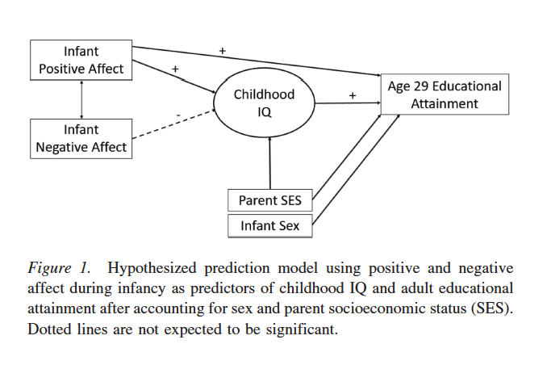
HYPOTHESIZED MODEL & RATIONALE
Broaden and Build Theory suggests positive affect broadens thought process (creativity & exploration) which in turn allows people to build resources (skills & connections) to use later.
Negative affect may result in limited exploration that could reduce opportunities for cognitive growth (reserve cognitive capacity for distress alleviation)
Positive childhood experiences linked to higher childhood IQ
Notes:
So, with these all this in mind, here is a model of the 3 hypotheses of the paper. Namely,
1. [CLICK] Higher PA but not [CLICK] lower NA would predict higher age 29 education attainment, controlling for [CLICK] sex and parent SES [CLICK]. The dotted pathways here indicate hypothesized non-significance.
2. [CLICK] Higher PA but not [CLICK] lower NA would predict higher childhood IQ, again controlling for [CLICK] sex and parent SES
3. [CLICK] PA and higher adult educational attainment would be mediated by childhood IQ

Slide 10
Hypothesized Predicted Model
Tsai
Notes:
So, with these all this in mind, here is a model of the 3 hypotheses of the paper. Namely,
1. [CLICK] Higher PA but not [CLICK] lower NA would predict higher age 29 education attainment, controlling for [CLICK] sex and parent SES [CLICK]. The dotted pathways here indicate hypothesized non-significance.
2. [CLICK] Higher PA but not [CLICK] lower NA would predict higher childhood IQ, again controlling for [CLICK] sex and parent SES
3. [CLICK] PA and higher adult educational attainment would be mediated by childhood IQ

Slide 11
Method
N = 130 (“low risk”)
At ages 1 and 1.5 yrs: parents’ demographics, parent-reported infant PA and NA, infant cognitive intelligence
Ages 6-8 yrs: childhood intelligence
Age 29: self-reported educational attainment
Tsai
Notes:
The study consisted of 130 individuals. This sample, as indicated by a prior report, was noted as “low risk”, meaning that they experience low levels of negative affect.
Data were collected from around ages 1 and 1.5, when parents reported their demographics, including SES, the infant’s affect, and infant’s cognitive intelligence was assessed
Then, at ages 6, 7, and 8, the child’s intelligence was assessed with the WISC
Finally at age 29. participants, now adults, reported their highest level of education attained
OPTIONAL:
The ways in which data is collected in this study has its strengths and weaknesses. We can get into the limitations later, but a couple strengths involves when happiness and success were measured. Specifically, happiness was measured prior to any formal education. This is important because schooling cultivate intellectual skills and curiosity, which may become a confounding factor in the study. Also, this study focused on post-education success rather than measuring success during school, which may not be as central to long-term success and well-being as overall educational attainment.

Slide 12
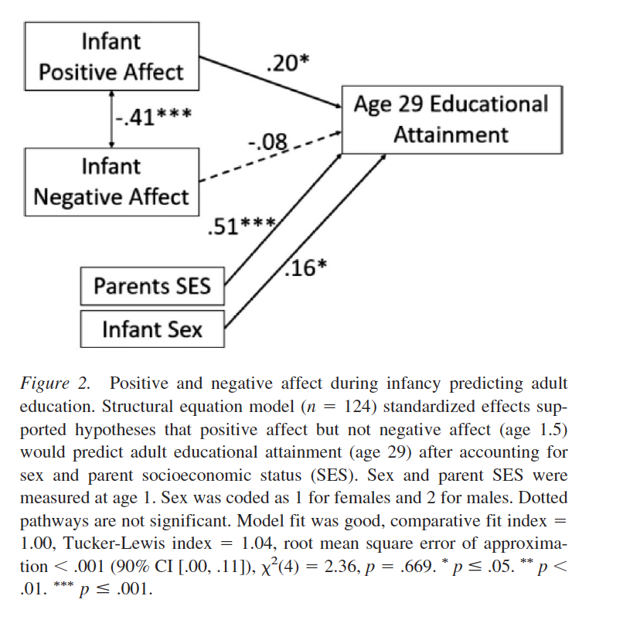
AFFECT & EDUCATION
Positive affect in infancy significantly predicts educational attainment in hypothesized direction controlling for demographic variables
Negative affect negatively but not significantly predicts educational attainment in
Notes:
So, with these all this in mind, here is a model of the 3 hypotheses of the paper. Namely,
1. [CLICK] Higher PA but not [CLICK] lower NA would predict higher age 29 education attainment, controlling for [CLICK] sex and parent SES [CLICK]. The dotted pathways here indicate hypothesized non-significance.
2. [CLICK] Higher PA but not [CLICK] lower NA would predict higher childhood IQ, again controlling for [CLICK] sex and parent SES
3. [CLICK] PA and higher adult educational attainment would be mediated by childhood IQ

Slide 13
H1: Infant Affect → Educational Attainment
Intelligence at age 1.5
Tsai
Notes:
So, looking at the results of the first hypothesis of the link between affect and educational attainment. Only positive affect predicted educational attainment at age 29, after controlling for sex and SES. This model suggests that higher positive affect but not lower negative affect predicted adult educational attainment even when account for sex and parent SES.
Alternate explanation: Throughout the analyses for each of the three hypotheses, the author also evaluated alternative explanations for each result by including a measure of [CLICK] intelligence at age 1.5 intelligence. The reason for that was because PA may be an indicator of intelligence and it really is intelligence that is linked to educational attainment, and not PA. The result of this modified model for the first hypothesis showed that, even when including intelligence at infancy, higher infant PA directly predicted higher educational attainment. [CLICK] Notably, intelligence during infancy did not predict adult educational attainment beyond other factors, which added support to the first hypothesis that PA predict later educational attainment.

Slide 14
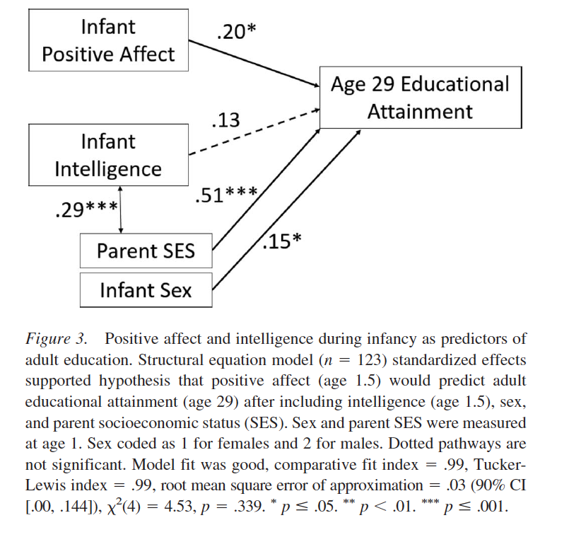
ROLE OF INFANT INTELLIGENCE
Tested alternate explanation that positive affect is an indicator of intelligence during infancy and would have no predictive value beyond intelligence.
Infant intelligence neither correlated with positive affect not predictive of educational attainment
Notes:
So, with these all this in mind, here is a model of the 3 hypotheses of the paper. Namely,
1. [CLICK] Higher PA but not [CLICK] lower NA would predict higher age 29 education attainment, controlling for [CLICK] sex and parent SES [CLICK]. The dotted pathways here indicate hypothesized non-significance.
2. [CLICK] Higher PA but not [CLICK] lower NA would predict higher childhood IQ, again controlling for [CLICK] sex and parent SES
3. [CLICK] PA and higher adult educational attainment would be mediated by childhood IQ

Slide 15
H2: Infant Affect → Childhood IQ
Intelligence at age 1.5
Tsai
Notes:
For the second hypothesis, testing whether higher frequency of positive affect and lower frequency of negative affect predicted higher childhood IQ, only positive affect predicted childhood IQ after controlling for sex and parent SES. As hypothesized, higher infant PA, but not lower NA, predicted higher childhood IQ even when accounting for sex and SES.
When intelligence at age 1.5 was included in this model, positive affect and intelligence during infancy predicted childhood IQ after accounting for SES.

Slide 16
H3: Does childhood IQ explain the affect-educational attainment link?
Intelligence at age 1.5
Tsai
Notes:
In a test of the last hypothesis, positive affect was a significant predictor of childhood IQ, and childhood IQ predicted adult educational attainment. There was also a significant path from PA to educational attainment. The indirect path from PA to educational attainment via childhood IQ was marginally significant. With positive affect in the model, the negative affect to IQ path was not significant.
When negative affect was removed from the model (thus faded out because it was not initially related to outcome variables), higher PA directly predicted higher childhood IQ and directly predicted educational attainment. The indirect path from infant PA to adult educational attachment via childhood IQ was also significant. This I think is interesting because this suggests that NA plays a role in the cascade of positive affect on later success, even in this low-risk sample.
OPTIONAL: In conclusion, PA marginally predicted adult educational attainment via childhood IQ but negative affect was not associated with either outcome variable.
When including age 1.5 intelligence, the indirect path from infant PA to adult educational attainment via childhood IQ was marginal. Infant intelligence also marginally predicted adult education via childhood IQ.

Slide 17
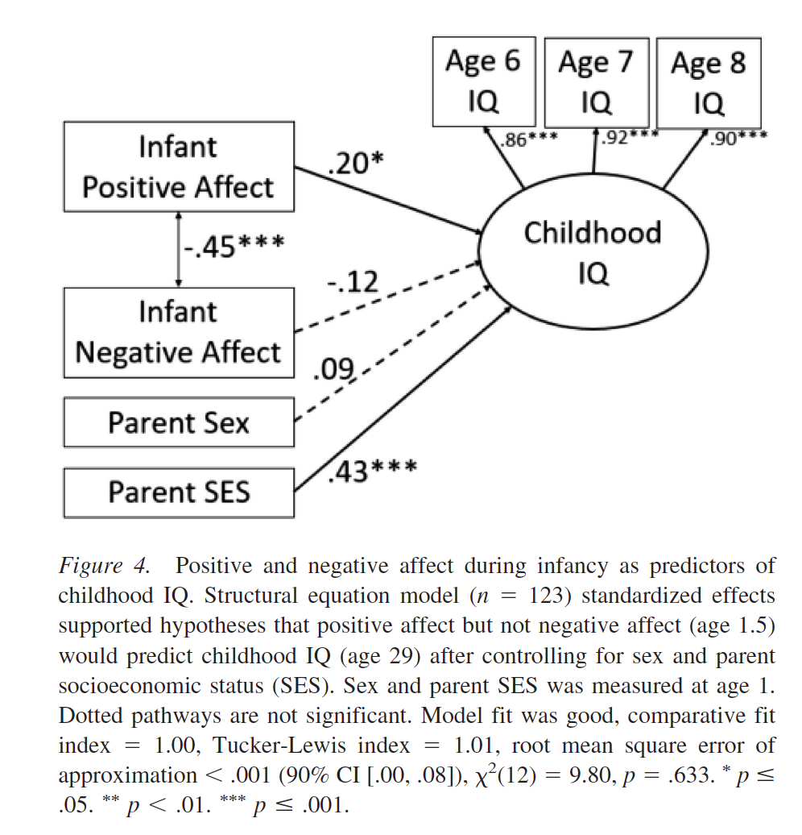
AFFECT & CHILD IQ
Positive but not negative affect in infancy is significantly associated with childhood IQ
Notes:
So, with these all this in mind, here is a model of the 3 hypotheses of the paper. Namely,
1. [CLICK] Higher PA but not [CLICK] lower NA would predict higher age 29 education attainment, controlling for [CLICK] sex and parent SES [CLICK]. The dotted pathways here indicate hypothesized non-significance.
2. [CLICK] Higher PA but not [CLICK] lower NA would predict higher childhood IQ, again controlling for [CLICK] sex and parent SES
3. [CLICK] PA and higher adult educational attainment would be mediated by childhood IQ

Slide 18
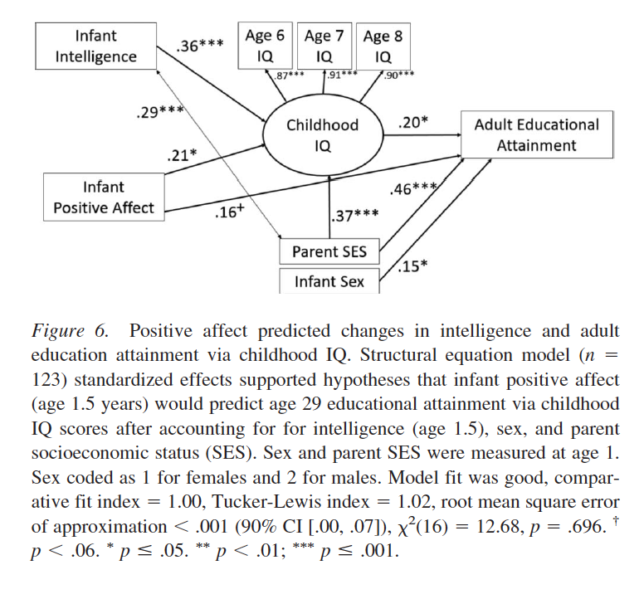
OVERALL MODEL
Positive affect positively predicts adult educational attainment via childhood IQ
Infant intelligence positively predicts adult educational attainment via childhood IQ
Model accounts for 40% variance in adult educational attainment
Notes:
So, with these all this in mind, here is a model of the 3 hypotheses of the paper. Namely,
1. [CLICK] Higher PA but not [CLICK] lower NA would predict higher age 29 education attainment, controlling for [CLICK] sex and parent SES [CLICK]. The dotted pathways here indicate hypothesized non-significance.
2. [CLICK] Higher PA but not [CLICK] lower NA would predict higher childhood IQ, again controlling for [CLICK] sex and parent SES
3. [CLICK] PA and higher adult educational attainment would be mediated by childhood IQ

Slide 19
Conclusion
PA prior to formal education appears to predict later cognitive abilities and educational success.
Given these outcomes are linked to better well-being (e.g., better health, longevity, higher income), parents, educators, etc. may want to place a higher value on early affective experiences.

Slide 20
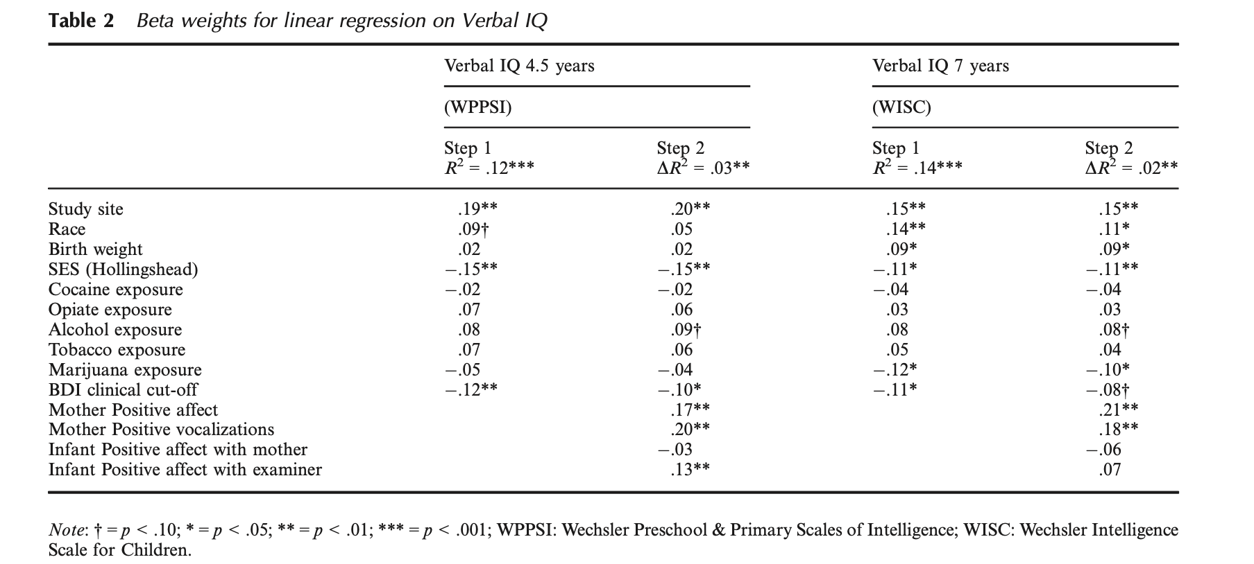
Maternal and Infant Affect at 4 months predicts performance and verbal IQ at 4 and 7 years in a diverse population
Sheinkopf et al., 2016
Vulovic

Slide 21
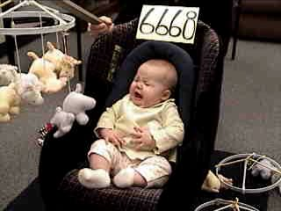
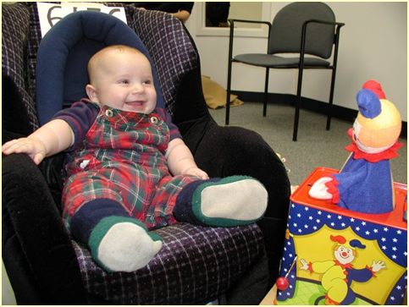
Temperament
  Biologically based individual differences in behavior tendencies that are present early in life and are relatively stable across various situations and over the course of time (Goldsmith et al., 1987; Rothbart & Bates, 2006; Wachs & Kohnstamm, 2001)
  personality in formation
https://www.youtube.com/watch?v=fAmyt5gRd3k
VIDEO_TS.IFO –
1:30-12:00

Slide 22
But does
Calling something temperament does not make it more ‘biological,’ inherited, or stable than any other construct
Temperament is a measured construct with particular characteristics
  Stable/Unstable
  More heritable/Less heritable

Slide 23
Stability of Temperament
Is a child’s temperament immutable?
Example from Fox et al. (2001)
    4-month-old infants selected based on reactions to unfamiliar sensory stimuli
    3 groups of infants
      High Negative
      High Positive
      Low Reactive

Slide 24
Shyness/Inhibition by
4-month temperament group
.
8
.6
.4
.
2
Standardized measure of inhibition (+/- 1 SE)
Low Reactive
0.0
High Negative
High Positive
-.2
-.4
-.6
-.8
14
24
48
Age (months)
Fox, Henderson, et al. (2001)
      Kagan classic: http://www.youtube.com/watch?v=CGjO1KwltOw

Slide 25
What influences stability?
Experience in out-of-home care

Slide 26
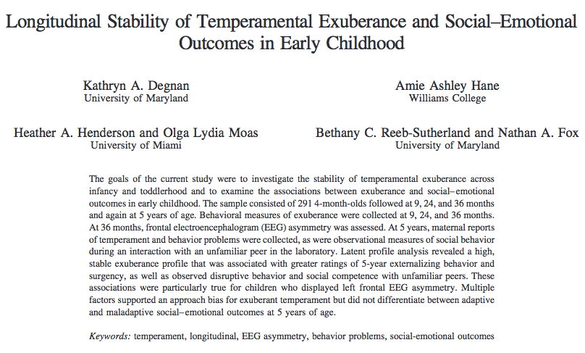

Slide 27
Background
Behavioral Inhibition | Temperamental Exuberance
Negative affect in response to novelty | Positive affect in response to novelty
Avoidance Behavior | Approach Behavior
Social reticence | Sociability
Introversion | Extraversion
Temperamental Exuberance has been associated with a number of positive outcomes:
Greater joy
Greater social competency
More appropriate and productive emotion regulation
Greater self-esteem in adolescence
But also negative outcomes:
Greater impulsivity
Greater aggression and oppositional behaviors

Slide 28
Method
291 infants selected from larger pool on basis of their classification as high negative/high motor reactive, high positive/high motor reactive, or control
Assessed at the following time points:
  4 months (initial temperament screening)
  9 months (behavioral and affective reacitvity)
  24 months (behavior & affect during BI tasks)
  36 months (behavior, affect, & EEG)
  5 years (peer dyad assessment, parent ?s)

Slide 29
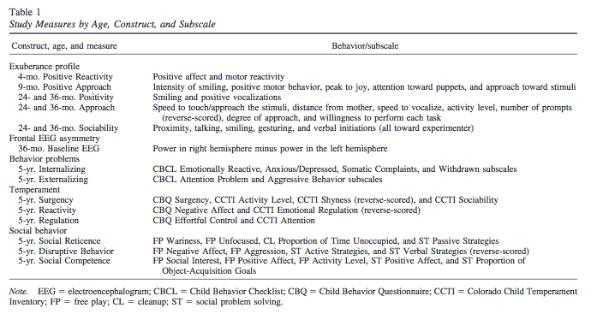
Measures

Slide 30
Results: Stability of Exuberance
ANOVAS
  Temperament group at 4 months related to 9-month Positive Approach (differences between + and – reactivity; control and – reactivity)
  Temperament group not significantly associated with any of 24-mo, 36-mo, or 5-year outcomes
Correlations
  9-mo + approach & 24-mo Exuberance (.22)
  24-mo Exuberance & 36-mo Exuberance (.31)
  36-mo Exuberance & 5-year Surgency (.29)
  36-mo Exuberance & 5-year social reticence (-.16)

Slide 31
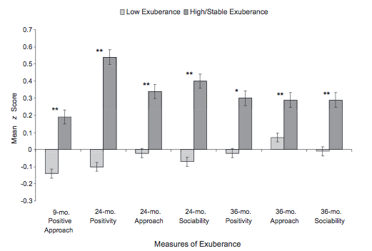
Stability of Exuberance
Longitudinal Latent Class Analysis (LCA)

Slide 32
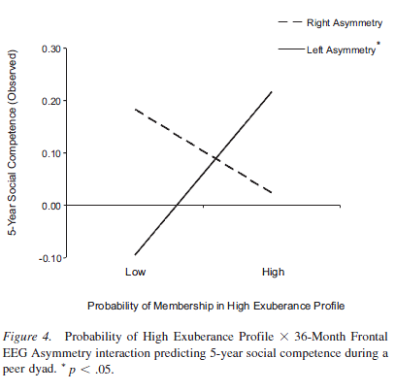
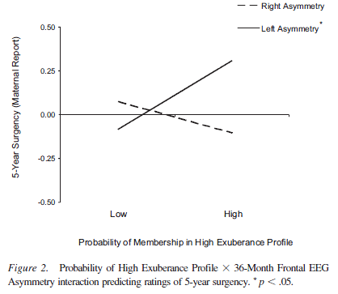
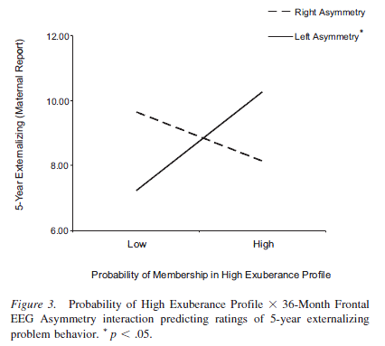
Exuberance*
EEG_ Asymmetry →surgency, competence, & externalizing

Slide 33
Results: Relationship of Exuberance to 5-year Outcomes
Maternal Report
Exuberance x Assymetry→Surgency (+) | Exuberance→ Social Reticence (-)
Exuberance x Asymmetry→Externalizing (+) | Left frontal Asymmetry→Disruptive Behavior (+)
---relationship was significant only for left frontal asymmetry profile | Exuberance x Asymmetry→ Social Competence (+)
 | ---relationship was significant only for left frontal asymmetry profile

Slide 34
Infant Temperament * Mom Negativity → 7-year Social Wariness

Slide 35
Preschool Social Reticence * Mom Solicitousness →7-year Social Wariness

Slide 36
Thomas & Chess: Early temperamental types
Difficult Child (10%)
  irritable, irregular biological rhythms
  intense response to new situations
Easy Child (40%)
  happy, regular biological rhythms
  accept new situations
Slow to warm up, inhibited, child (15%)
  Reluctant/hesitant in new situations
New York Longitudinal Study (Thomas & Chess, 1984)
Which one are you?

Slide 37
Evolution in our Conceptualization of the Neural Basis of Temperament
Hippocrates-Galen
  Personality types = balance of bodily humors
Pavlov & Students
  Relation of CNS to individual differences
  Interplay between cortex and subcortex
  Influence of contextual factors
Notes:
AFTER CURRENT 12

Slide 38
Models of Temperament:
Thomas & Chess
  Parents’ descriptions of 141 infants and children based on structured interviews
  Derive 9 dimensions of responding
    Activity Level, Rhythmicity, Distractibility, Approach/Withdrawal, Adaptability, Attention Span/Persistence, Intensity of Reaction, Threshold of Responsiveness, Quality of Mood
  Dimensions cluster to describe 3 basic types
    Easy Child (40%)
    Difficult Child (10%)
    Slow-to-Warm Up (15%)
Which one are you?

Slide 39
Models of Temperament:
Goldsmith & Campos
    Individual differences in the expression of primary emotions (anger, fear, joy, interest)

Slide 40
Rothbart temperament model:
Individual differences in reactivity & self-regulation
  Reactivity = excitability or arousability of behavioral, endocrine, autonomic, & CNS responses
    speed, strength & valence of response to stimulation
      behavioral approach/activation system and behavioral inhibition/anxiety system
  Self-Regulation = processes that modulate reactivity including attention and inhibition
  behaviors that control behavioral and emotional reactions to stimulation ( + or -)
    develops: reactive control, then active self regulation at end of 2nd year
    maps to development of brain areas involved in executive attention control

Slide 41
Neural bases of development of individual differences in temperament
Reactivity–
  speed, strength & valence of response to stimulation
Self Regulation –
  behaviors that control behavioral and emotional reactions to stimulation ( + or -)
    develops: reactive control, then active self regulation at end of 2nd year
    maps to development of brain areas involved in executive attention control
Corresponds to current brain-behavior models:
  behavioral approach/activation system and behavioral inhibition/anxiety system
  Henderson, H. A., & Wachs, T. D. (2007). Temperament theory and the study of cognition-emotion interactions across development. Developmental Review, 27(3), 396-427. doi: 10.1016/j.dr.2007.06.004

Slide 42
Reactivity: BAS and BIS: motivational tendencies
Behavior Approach System (BAS)
  - governs approach/appetitive motivations
  - responds to signals of reward/end of punishment
  - behavior towards goals, positive feelings
Behavior Inhibition System (BIS)
  - inhibition, interruption of behavior , increase in arousal/vigilance
  - responds to signals of punishment, nonreward, novelty
  - underlies states of fear and anxiety
- Temperament differences: relative balance of positive affect/approach versus negative affect/inhibition behaviors

Slide 43
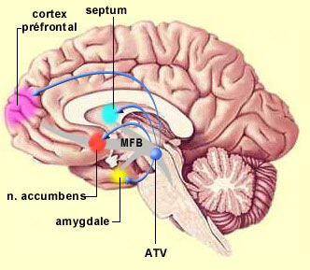
Neurolophysiology of approach/withdrawal
Amygdala
- connections with brainstem nuclei—universal fear reactions
- sensitive to ambiguity and uncertainty
- temperament related to differences in amygdala activity
Nucleus accumbens
- anticipatory reward-related responding
- activity related to size of anticipated reward
EEG asymmetry
- resting EEG asymmetry during stressful task related to differences in dealing with novel/stressful events
- right frontal EEG asymmetry discriminated among preschoolers’ levels of social play

Slide 44
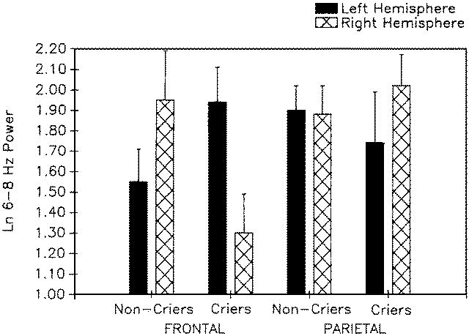
Greater right frontal power among 10-month-olds who cried in response to maternal separation

Slide 45
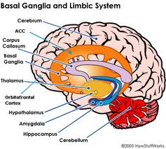
Self-regulation
Attentional and effortful processes that modulate reactivity
  through voluntary inhibition, response modulation, and self-monitoring (Ahadi et al, 1993)
  form basis for well-regulated behavior and emotion
  executive system monitors and regulates reactivity
Anterior cingulate cortex (ACC) and Effortful control
  ACC facilitates voluntary control of thoughts and emotions
  ACC as neural alarm

Slide 46
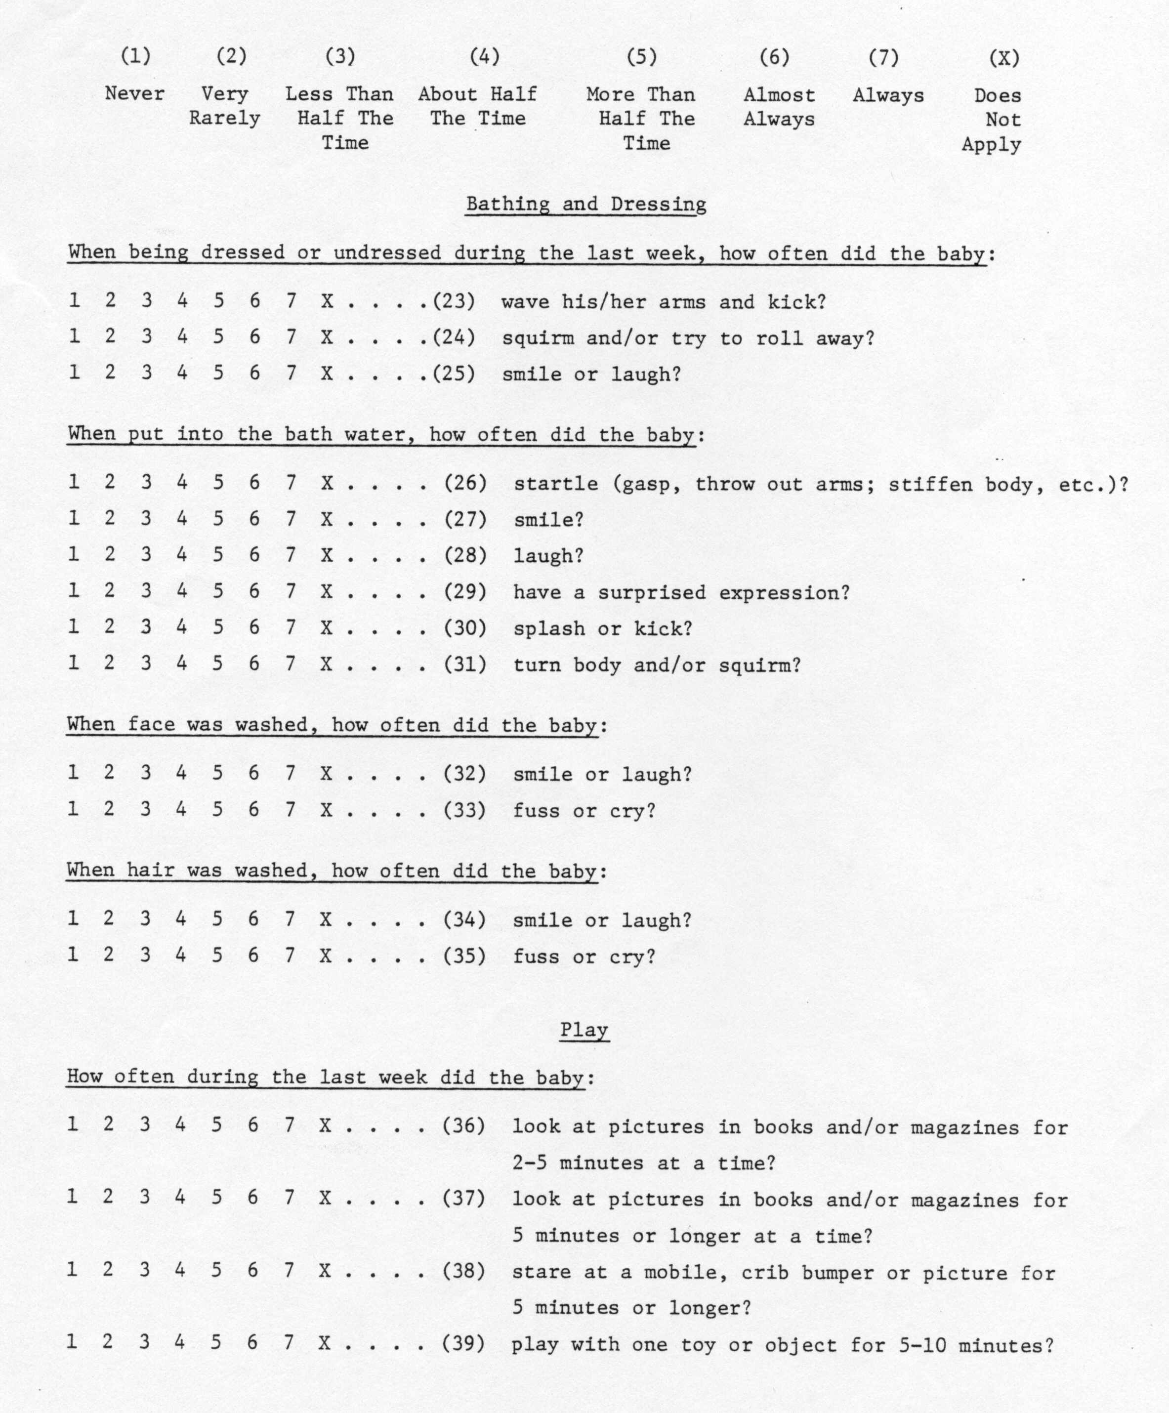
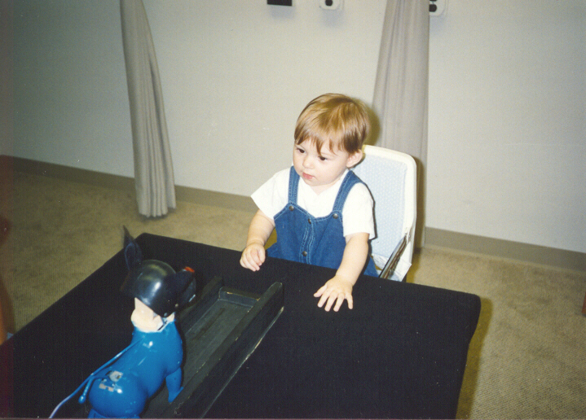
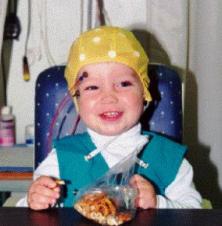
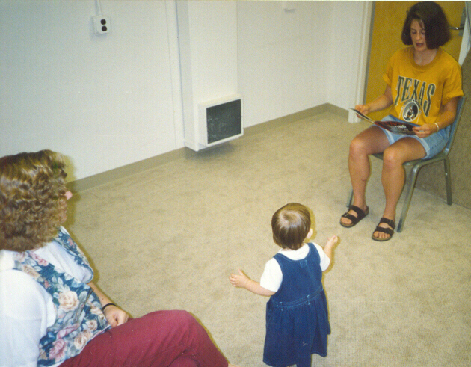
Assessment of Temperament
Parental Report
Laboratory Observations
Physiological Assessment

Slide 47
When do parents and raters agree?
When there’s non-optimal behavior
  “maternal and observer ratings of infant negativity converged when infants manifested high degrees of negative affect during routine home-based activities.
  …ratings of infant positivity converged when infants experienced low mutually positive affect during play….
      Hane et al., 2006

Slide 48
Temperament (cont)
Mechanisms through which temperament affects later development
  Direct effects
  Indirect effects
  Evocative effects (on social relationships; on perceptions of others)
  Niche picking
  Goodness-of-fit

Slide 49
Temperament mechanisms
Mechanisms through which temperament affects later development
  Direct effects
  Indirect effects
Temperament
Adjustment
Temperament
Environment
Adjustment

Slide 50
Indirect effect of shyness on academic skills
Shy (M)
1.00
Shyness
Lang (K)
-.11 (.06)
1.00 (1.20)
Shy (CG)
1.50
Math (K)
Academic Skills
.94
-.82 (.20)
.04 (.01)
SPS Competence
.96
Lang (G1)
IC (M)
1.08 (.26)
.85
1.00
Inhibitory Control
.76 (.12)
Math (G1)
IC (CG)
1.47
SPS = social problem solving skills
Walker & Henderson, 2012

Slide 51
Temperament (cont)
  Evocative Effects
Actor Partner Interdependence Model

Slide 52
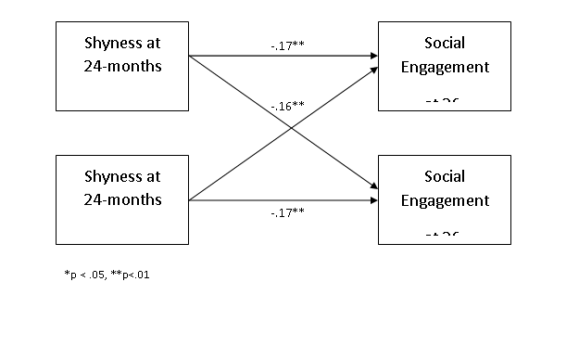

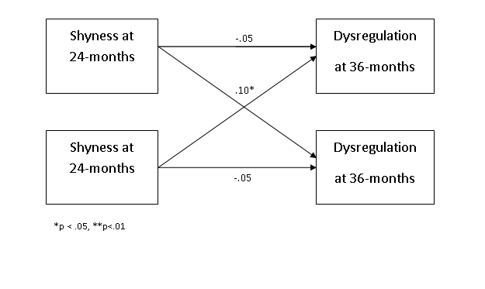
Example- Evocative Effects

Slide 53


Niche Picking

Slide 54
Temperament (cont)
  Temperament x Environment Interactions (Goodness-of-fit)
Environment
#1
Outcome a
Temperament
Environment
#2
Outcome b

Slide 55
Goodness-of-Fit
The “meshing” of temperament with environmental properties, expectations, and demands
  Implications for creating environments that recognize each child’s temperament while encouraging adaptive functioning
Niche picking

Slide 56
Applications of Goodness-of-Fit
A “difficult” temperament promotes survival during famine conditions in Africa (De Vries, 1984)
    Why?
Low activity level is a risk for mental retardation among children raised in a poor institution (Schaffer, 1966)
    Why?

Slide 57
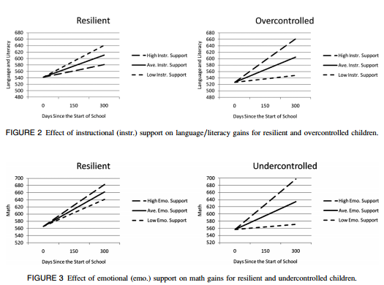
Goodness-of-fit applications:
Differential Sensitivity Model
Vitiello et al., 2012

Slide 58
Belsky & Pluess (2009)
Differential Sensitivity Model
  How different from traditional diathesis-stress model?
How do study designs differ based on these models?
  Range of environments?
  Range of psychological and behavioral outcomes?
Notes:
Individual differences characteristics make individual more sensitive to BOTH negative and positive aspects of environment; more plastic
Model is that person characteristics moderate the effects of environmental effects

Slide 59
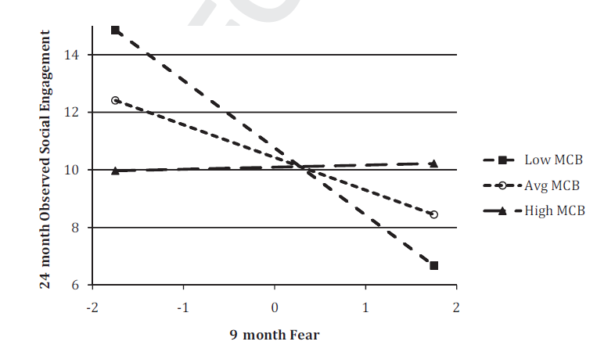
Differential susceptibility?
MCB – Maternal
Caregiving Behavior
(Quality)
Penela et al., 2012

Slide 60
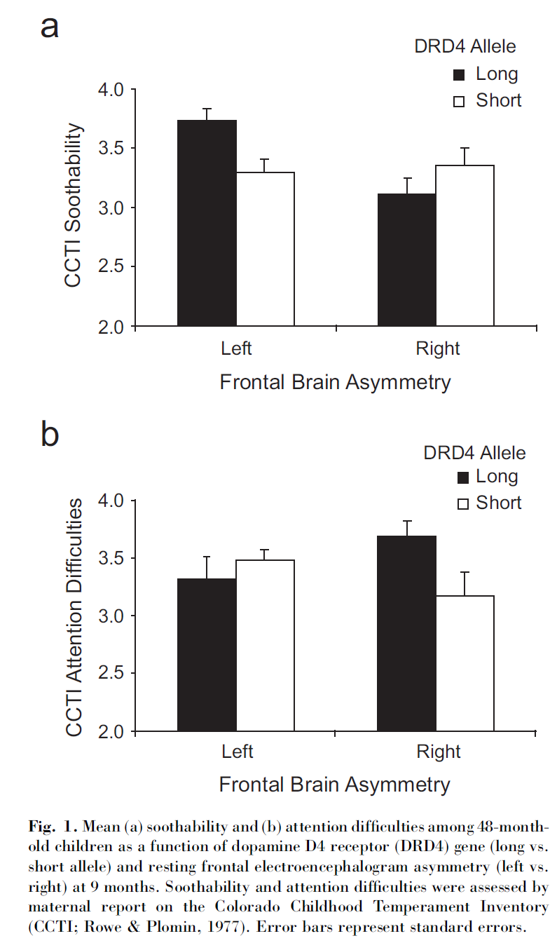
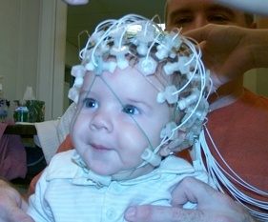
Gene-Endoenvironment Interaction
DRD4 - Long Allele
  Polymorphisms—alleles 6-10 repeats
  Novelty/Sensation Seeking
  Attention Problems/Aggression
  Susceptibility to Parenting
EEG Asymmetry
  Left Frontal – “Easy” Temperament
  Right Frontal – “Negative Reactive” Temperament
"Long" versions of polymorphisms are the alleles with 6 to 10 repeats. 7R appears to react less strongly to dopamine molecules.[8]
http://en.wikipedia.org/wiki/Dopamine_receptor_D4
      Schmidt, Fox, Perez-Edgar & Hamer (2009)

Slide 61
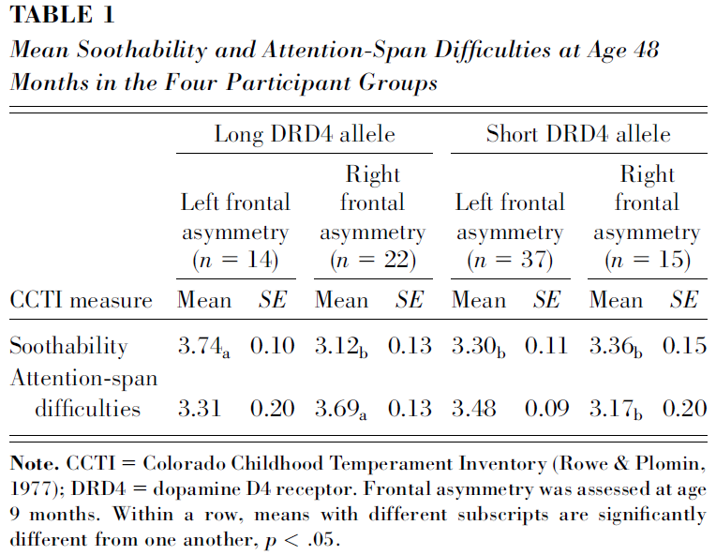
Frontal Asymmetry, DRD4, Temperament
Differential susceptibility
9 mo
  EEG, Genes
48 mo
  Temperament
CCTI – Maternal Report
  Soothability
  Attention Difficulties

Slide 62
DRD4 Susceptibility to Asymmetry
DRD4 by Asymmetry
    Soothability
    Attention Difficulties
      Asymmetry unrelated to DRD4
      Complex Gene-Gene Interaction?
  Schmidt, Fox, Perez-Edgar & Hamer (2009)

Slide 63
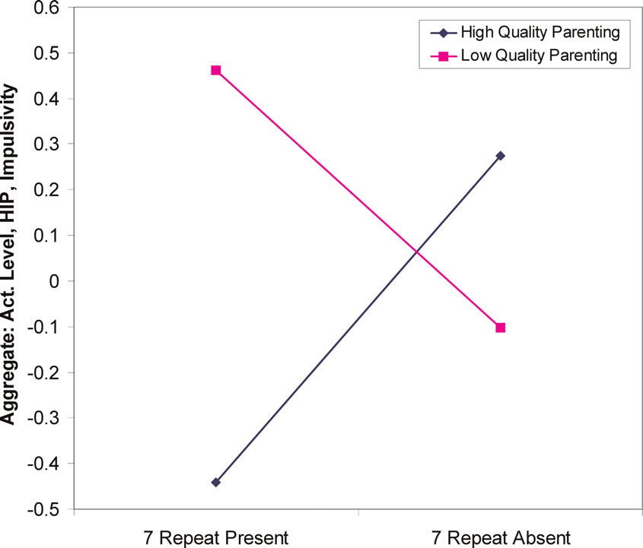
Genes influence relation between parenting and temperament
18-21 month olds
DRD4 48 (7-repeat allele) “long” allele increased sensitivity to environmental factors such as parenting.
  Lower quality parenting→ higher sensation seeking.
  Higher quality parenting→ lower sensation seeking
  Parenting quality interacts with genetic variation in dopamine receptor D4 to influence temperament in early childhood Sheese BE, et al. Dev Psychopathol 2007 19(4):1039-46

Slide 64
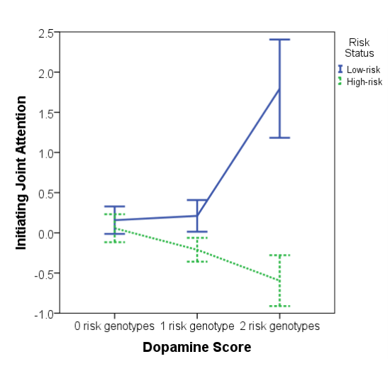
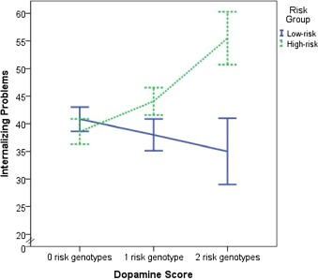
Dopamine and autism risk
Do candidate
gene approaches replicate?
Gangi et al., 2017
Gangi et al., 2016

Slide 65
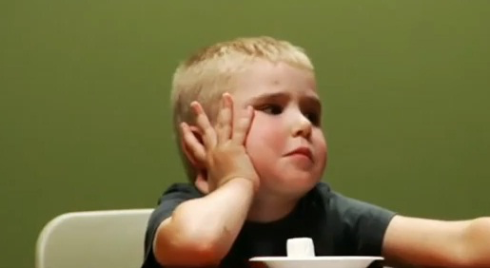
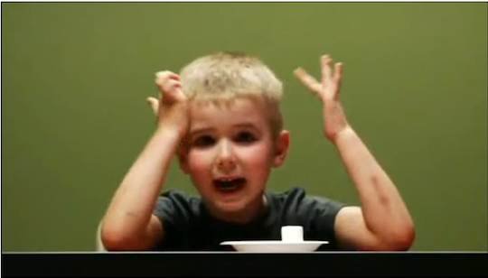

Behavioral and neural correlates of delay of gratification 40 years later
Casey, BJ, Somerville, LH, Gotlib, IH, et al. (2011)

Slide 66
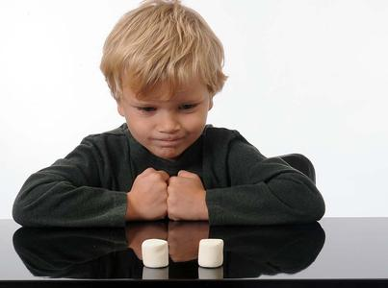
Background
Purpose of the study
  Examine behavioral and neural correlates of impulse control
    Do those who had difficulty delaying gratification during childhood show same pattern in their 40’s?
    Do they have stronger sensitivity to alluring social cues?
Notes:
Purpose of the study was to examine differences in people who were classified as high DoG’s versus Low DoGs in early childhood, and see if there were differences in the ability to control impulses and whether that varied based on social cues
Both behaviorally and neutrally looking at a go/nogo task
Important terms
DOG=marshmallow
Wont be as rewarding for 40 year olds
CC=inhibition of impulses

Slide 67
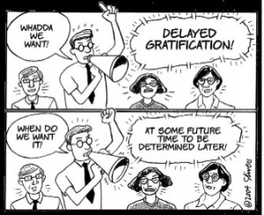

Slide 68
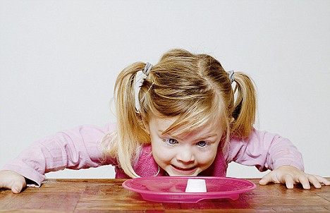
Delay of Gratification:
  “The ability to resist immediate reward for a later, larger reward”
      https://www.youtube.com/watch?v=0mWc1Y2dpmY
Cognitive Control:
  “The ability to suppress competing inappropriate thoughts or actions for more appropriate ones”
Notes:
Purpose of the study was to examine differences in people who were classified as high DoG’s versus Low DoGs in early childhood, and see if there were differences in the ability to control impulses and whether that varied based on social cues
Both behaviorally and neutrally looking at a go/nogo task
In this study Delay of Gratifcation is operationalized how the subjects performed as children
Cognitive Control is operationalized by performance on impulse inhibition on the GO /No GO task

Slide 69
Background
Delay of Gratification in early childhood has been shown to predict Cognitive Control in later years
  Cognitive Control ability varies by how potent the competing response is (e.g. alluring social context makes Cog Control harder)
  There are individual differences in how much each person uses cognitive control strategies
Inferior frontal gyrus (IFG) in prefrontal cortex involved in suppressing competing thoughts/action
Notes:
DoG predicts CC (which was more of what they measured here)
But CC depends on what it is you’re controlling
Behaviorally – Go/NoGo task
Neural correlates
Individual Differences in Cog Control - For example, “cooling” the hot, appealing, or appetitive features of tempting stimuli by reappraisal or reframing strategies to focus on their cool, cognitive features (e.g., to envision the marshmallow as a cloud or a little cotton ball, rather than as a sweet, delectable treat) has been shown to be highly effective in enhancing delay of gratification (e.g., 1, 15–17). The same preschool child who yielded immediately to the temptation by representing the hot, appetitive features of the reward (e.g., its yummy, sweet, chewy taste) could wait for long periods for the same tempting stimulus by focusing on its cool qualities (e.g., its shape). At the same time, there seem to be important, naturally existing individual differences in the spontaneous use of such strategies (e.g., 5, 18).

Slide 70
Background: Cool vs. Hot
Cool
  Top-down control; prefrontal regions
  Inferior frontal gyrus
    Involved in resolving interference among competing actions
Hot
  Bottom-up control; limbic and emotional regions
    Emotions and desires under the control of the stimulus (vs. other way around)
Notes:
When looking at the cognitive and neurological processes involved, there's a cool versus hot dichotomy
The cool part is the ability to control or delay
The hot part is the impulse
In DOG studies, using cooling strategies like reappraisal and reframing help with the delay
diminished activity in the right prefrontal cortex, implicated in response inhibition (13, 27–29), and by amplified activity in the ventral striatum

Slide 71
Hypotheses
Low delayers would show less impulse control in suppression of a response to “hot” relative to “cool” cues (in 40’s)
Consistently low delayers would exhibit
  Lower right prefrontal cortex activation (response inhibition)
  Higher ventral striatum activity (processing positive/rewarding cues)
Notes:
The hot system would be stronger in this group
The cool system would be weaker in this group

Slide 72
Methods
Participants
  Contacted 117 individuals from 500 original participants who were above or below average on (a) delay of gratification task at age 4 and (b) self-report measures of self-control in their 20’s and 30’s
  59 agreed to participate in experiment 1 (behavioral task); 24 in experiment 2 (fMRI)
Measure of impulse control
  Comparison of (a) reaction time and (b) accuracy during “cool” and “hot” versions of go/nogo tasks
    Cool= males/females with neutral expressions
    Hot= happy and fearful/neutral faces (all go and nogo)
    For experiment 2, same impulse control task with differences in timing and # trials

Slide 73




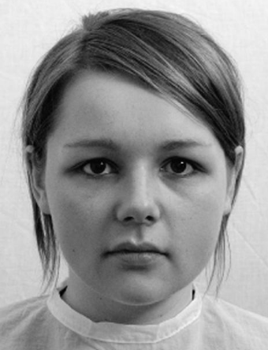
“Cool” Go/Nogo Task
Go
Go
Go
NoGo
Go
Notes:
. The “cool” version of the go/nogo task consisted of male and female stimuli with neutral expressions. Within a single run, both male and female stimuli were presented, one sex as a “go” (i.e., target) stimulus to which participants were instructed to press a button, and the other sex as a “nogo” (i.e., nontarget) stimulus to which participants were instructed to withhold a button press

Slide 74


“Hot” Go/Nogo Task
Go
Go
Go
NoGo
Go
NoGo
Notes:
The “hot” version of the go/nogo task was identical to the “cool” version, except that for this task fearful and happy facial expressions served as stimuli. Both expressions were used as targets (go) and nontargets (nogo) in a 2 (trial type: go, nogo) × 2 (emotion: fear, happy) factorial design

Slide 75
  Low delayers showed significant decrease in performance for “hot” relative to “cold” trials (hot=happy faces) (Exp. 1)
Go Trials: no differences in response time or accuracy by group
    High accuracy on “go” trials for both “cool” and “hot” tasks
NoGo Trials (inhibition): more variability
  Differences between low/high delayers in response to emotional or “hot” cues (happy faces)
  Low delayers showed significant decrease in performance for “hot” relative to “cold” trials (hot=happy faces)

Slide 76
EXPERIMENT 2: Results
Behavioral results
  More false alarms for low delayers, but not significant
Imaging results
  High delayers: More polarization of activity in inferior frontal gyrus (IFG)
  Low delayers: More activity in ventral striatum when happy “nogo” cues
Notes:
On “go” tasks, no differences in response time or accuracy by group
Results in grey
In the high delay group, cool and hot didn’t really differ for NoGo Accuracy
In the low delay group, accuracy was worse in the hot trials
On Hot trials, high delayers had better accuracy than low delayers (at trend level)
Specifically, the high and low groups differed in their accuracy for happy faces, such that high was > low
Therefore, only found differences between groups ability to suppress/inhibit response to emotional or “hot” cues (happy faces)
Difficulty suppressing responses to happy faces in low delay adults
Resisting “temptation”

Slide 77
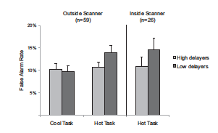
  Low delayers showed significant decrease in performance for “hot” relative to “cold” trials (hot=happy faces) (Exp. 1)
  Similar pattern in and out of the scanner
Experiment 1
Experiment 2

Slide 78
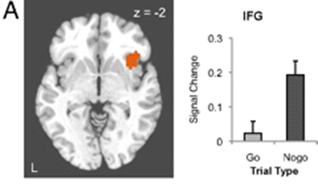
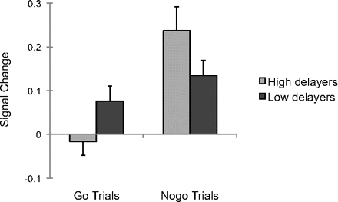
Task and person differences in inferior frontal gyrus (IFG) (exp. 2)
  More IFG polarization on NoGo trials than Go trials in the High Delay group
  IFG associated with accurately withholding a response
Fig. 2A Casey et al. (2011)
Fig. 3 Casey et al. (2011)
Notes:
Right IFG is a Cool zone
Fig. 2 The right inferior frontal cortex was associated with correct inhibition of a response (nogo) relative to making a correct response (go). Left: Activation map depicting right inferior frontal gyrus activation Right: Percentage change in MR signal for “go” and “nogo” trials in the inferior frontal gyrus
Fig. 3
Differential inferior frontal gyrus recruitment between nogo and go trials is more pronounced in high delayers than in low delayers. The right inferior gyrus (region shown in Fig. 2A) showed a significant interaction between group and trial type, with greater polarization of inferior frontal gyrus response to “nogo” relative to “go” trials for high delayers.

Slide 79
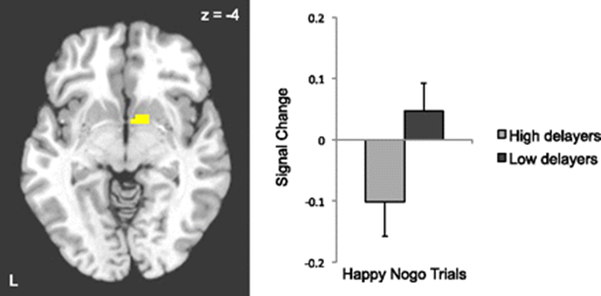
Ventral striatum anticipation
For Happy NoGo trials, the Low delayers had more VS activity than the high delayers.
  Anticipatory motivation
Fig. 4 Casey et al. (2011)
Notes:
VS is a Hot Region
When the NoGo trial was a happy face, the Low delayers had more VS activity than the high delayers.
This highlights the importance of the stimulus salience when people are required to resist.
Low delay ability in early childhood predicts greater recruitment of ventral striatum when inhibiting responses to positive social cues 40 y later. Left: Activation map for the three-way interaction of task, emotion, and delay group depicting ventral striatum activity Right: Ventral striatal response to happy “nogo” trials in high and low delayers.

Slide 80
Conclusions
Individual differences in impulse control are relatively stable over time
Behavioral associations of delay ability involve responses to “compelling” cues, not cognitive control in general
Resisting temptation is associated with less activation in inferior frontal gyrus and more in ventral striatum when low delayers are resisting “alluring cues”
Notes:
Low and high delayers continue to show differences in CC
How salient the stimulus is actually matters when thinking about controlling impulses
Neurological differences in impulse control on people with low and high DOG
“Consistent with delay experiments on the value of ‘cooling’ the hot features of temptations” (Casey et al., 2011)
“Behavioral correlates of delay ability are a function not only of impulse control but also of the salience of the stimulus one has to resist” (Casey et al., 2011)
Third, resisting temptation is supported by ventral frontostriatal circuitry, with the inferior frontal gyrus showing lesser recruitment in low delayers and the ventral striatum showing exaggerated recruitment in low delayers when resisting alluring cues

Slide 81
Experiment 1: Behavioral Results
2 (Group, High vs. Low Delayers) X 2 (Task, Hot vs. Cool) ANOVA
  Hot Task Emotion, Fear vs. Happy
No Go Accuracy (False Alarms)
 | Hot |  | Cool
High Delay | Fear | Happy |  | Hot = Cool
Low Delay | Fear | Happy |  | Hot < Cool
 | High > Low (trend) Fear: High=Low Happy: High> Low |  | High =Low
Notes:
On “go” tasks, no differences in response time or accuracy by group
Results in grey
In the high delay group, cool and hot didn’t really differ for NoGo Accuracy
In the low delay group, accuracy was worse in the hot trials
On Hot trials, high delayers had better accuracy than low delayers (at trend level)
Specifically, the high and low groups differed in their accuracy for happy faces, such that high was > low
Therefore, only found differences between groups ability to suppress/inhibit response to emotional or “hot” cues (happy faces)
Difficulty suppressing responses to happy faces in low delay adults
Resisting “temptation”

Slide 82
Experiment 2: Neurological Results
Right Inferior Frontal Gyrus Polarization (Correct Response)
 | Go |  | NoGo
High Delay | Fear | Happy | Fear | Happy | NoGo > Go
Low Delay | Fear | Happy | Fear | Happy | NoGo > Go (n.s.)
Fig. 2A Casey et al. (2011)
Fig. 3 Casey et al. (2011)
Notes:
Right IFG is a Cool zone
More IFG polarization no NoGo trials than Go trials; only significant for the High Delay group
IFG associated with accurately withholding a response
Fig. 2 The right inferior frontal cortex was associated with correct inhibition of a response (nogo) relative to making a correct response (go). Left: Activation map depicting right inferior frontal gyrus activation Right: Percentage change in MR signal for “go” and “nogo” trials in the inferior frontal gyrus
Fig. 3
Differential inferior frontal gyrus recruitment between nogo and go trials is more pronounced in high delayers than in low delayers. The right inferior gyrus (region shown in Fig. 2A) showed a significant interaction between group and trial type, with greater polarization of inferior frontal gyrus response to “nogo” relative to “go” trials for high delayers.

Slide 83
Experiment 2: Neurological Results
Ventral Striatum Activity (Correct Response)
 | Go |  | NoGo
High Delay | Fear | Happy | Fear | Happy
Low Delay | Fear | Happy | Fear | Happy
 |  |  |  | Low > High
Fig. 4 Casey et al. (2011)
Notes:
VS is a Hot Region
When the NoGo trial was a happy face, the Low delayers had more VS activity than the high delayers.
This highlights the importance of the stimulus salience when people are required to resist.
Low delay ability in early childhood predicts greater recruitment of ventral striatum when inhibiting responses to positive social cues 40 y later. Left: Activation map for the three-way interaction of task, emotion, and delay group depicting ventral striatum activity Right: Ventral striatal response to happy “nogo” trials in high and low delayers.

Slide 84
Watts et al., 2018

Slide 85
What is “gratification delay”?
Gratification delay: ability to “resist immediate reward for a later, larger reward”
Part of the self-control “umbrella”
  Gratification delay, conscientiousness, self-regulation, executive function
Thought to be a critical non-cognitive skill

Slide 86
The original Marshmallow test
Series of studies by Mischel & Shoda linked gratification delay to later achievement (SAT scores) and behavioral outcomes
Limitations
  Small, selective sample
  Variations in marshmallow test procedure
  Potential confounding factors not measured

Slide 87
Study questions
Do Mischel and Shoda’s findings extend to a larger, more diverse sample?
Are the longitudinal relationships between gratification delay and achievement present when controlling for confounding factors?
A “conceptual, rather than traditional, replication”

Slide 88
Study of Early Child Care and Youth Development (SECCYD)
Conducted by National Institute of Child Health and Human Development (NICHD)
10 US sites – urban and rural
Data from birth-15 years
Current study (n = 918):
54 months
Grade 1
Age 15

Slide 89
Gratification delay task (54 mos)
Children presented with an ”appealing edible treat”
Instructed to wait for interviewer- received two treats if successful
Given option to ring bell at any time
Maximum wait time: 7 minutes

Slide 90
Outcome measures
Academic Achievement
Subtests from Woodcock-Johnson Revised (WJR):
Behavioral problems
Child Behavior Checklist (CBC): Mother-reported externalizing & internalizing behavior
Grade 1: Letter-Word Identification
15 yrs: Passage Comprehension
Math achievement
Reading achievement
Grade 1: Applied Problems
15 yrs: Applied Problems
Grade 1
15 yrs

Slide 91
Covariate categories
2 different sets of covariates
(1) Child background and HOME controls
Demographics
(2) Concurrent 54-month controls
Cognitive skills at 54 mos (WJR subtests)
Externalizing & internalizing behavior at 54 mos (CBC)
Early cognitive functioning at 24 mos (Bayley Mental Development index)
Temperament at 6 mos (Early Infant Temperament Questionnaire)
Quality of home environment at 36 mos (HOME inventory)
Mother’s intelligence at 36 mos (Peabody Picture Vocabulary Test)
Letter-Word Identification
Applied Problems
Memory for Sentences
Incomplete Words

Slide 92
Demographic characteristics

Slide 93
Results: Gratification delay

Slide 94
Results: Gratification delay

Slide 95
Non-degreed: Achievement

Slide 96
Non-degreed: Achievement

Slide 97
Non-degreed:
No behavior problem associations

Slide 98
Degreed: Achievement

Slide 99
Degreed: Behavior

Slide 100
No SES x gratification interaction

Slide 101
Take-home points
Children of non-degreed mothers had shorter delay times, lower achievement scores, higher externalizing/internalizing behavioral scores
For children of degreed and non-degreed mothers:
Associations between gratification delay and later achievement attenuated when controlling for sociodemographic/early cognitive factors
No association between gratification delay and later behavior
No interaction effect of SES x gratification on achievement or behavioral outcomes

Slide 102
Food for thought
The replication crisis
What does it mean that some of our most "exciting" effects rarely reproduce?
Why might Watts et al. have not gotten the same results as Mischel and Shoda’s original research?
Interventions for gratification delay
How might early interventions in gratification delay (e.g., parent interventions) aid in self-control development?
Interventions focused on teenagers involving metacognitive strategies?
Reviewing the Marshmallow test
Is the Marshmallow test the most accurate measure of gratification delay? Potential confounds/drawbacks?
Is 7 minutes sufficient to account for variation in gratification delay?

Slide 104
The Child Is Father of the Man?
My heart leaps up when I behold
A rainbow in the sky:
So was it when my life began;
So is it now I am a man:
So be it when I shall grow old,
Or let me die!
The Child is father of the Man;
And I could wish my days to be
Bound each to each by natural piety.
      William Wordsworth, "My Heart Leaps Up When I Behold"

Slide 105
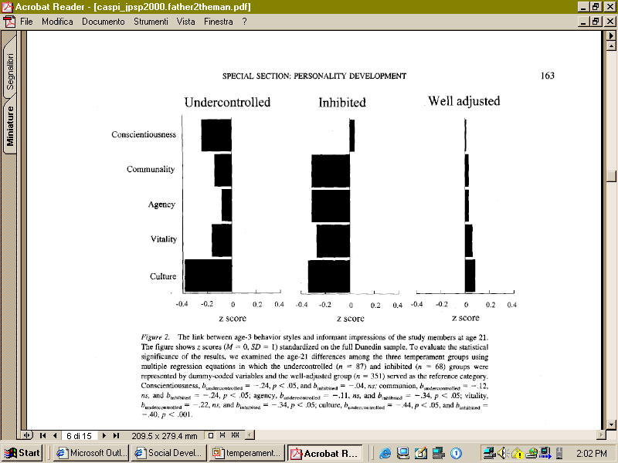
Age-3 behavior styles and informant impressions at age 21
Caspi

Slide 106
Inhibited and Uninhibited Infants
“Grown Up”
“[A]dults who had been categorized in the second year of life as inhibited, compared with those previously categorized as uninhibited, showed greater functional MRI signal response within the amygdala to novel versus familiar faces.”
  22 adults (M = 21.8 years)
  at two years were inhibited (n=13) or uninhibited (n = 9)
        20 JUNE 2003 VOL 300 SCIENCE Carl E. Schwartz,1,2,3* Christopher I. Wright,2,3,4 Lisa M. Shin,2,5 Jerome Kagan,6 Scott L. Rauch2,3

Slide 108
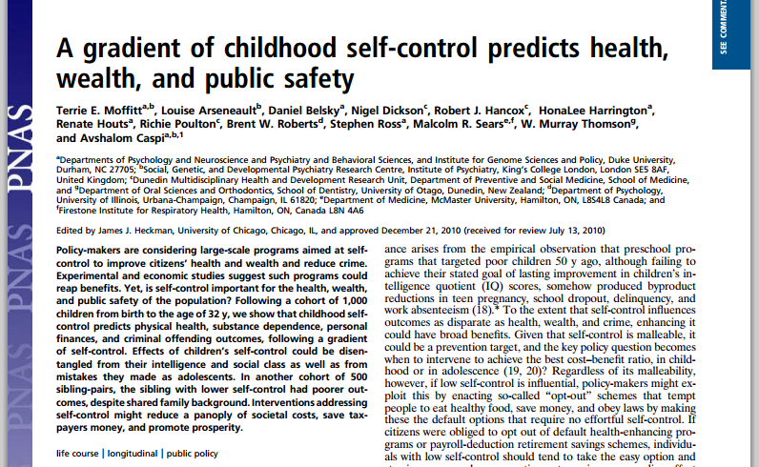

Slide 109


Temperament and Self-Control
(Moffitt et al., 2011)
Delay gratification
Control impulses
Perseverance

Slide 110
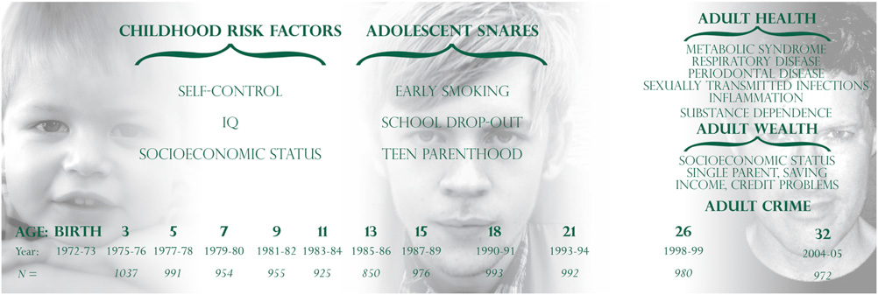
Temperament and Self-Control
(Moffitt et al., 2011)
Moffitt et al. (2011)

Slide 111
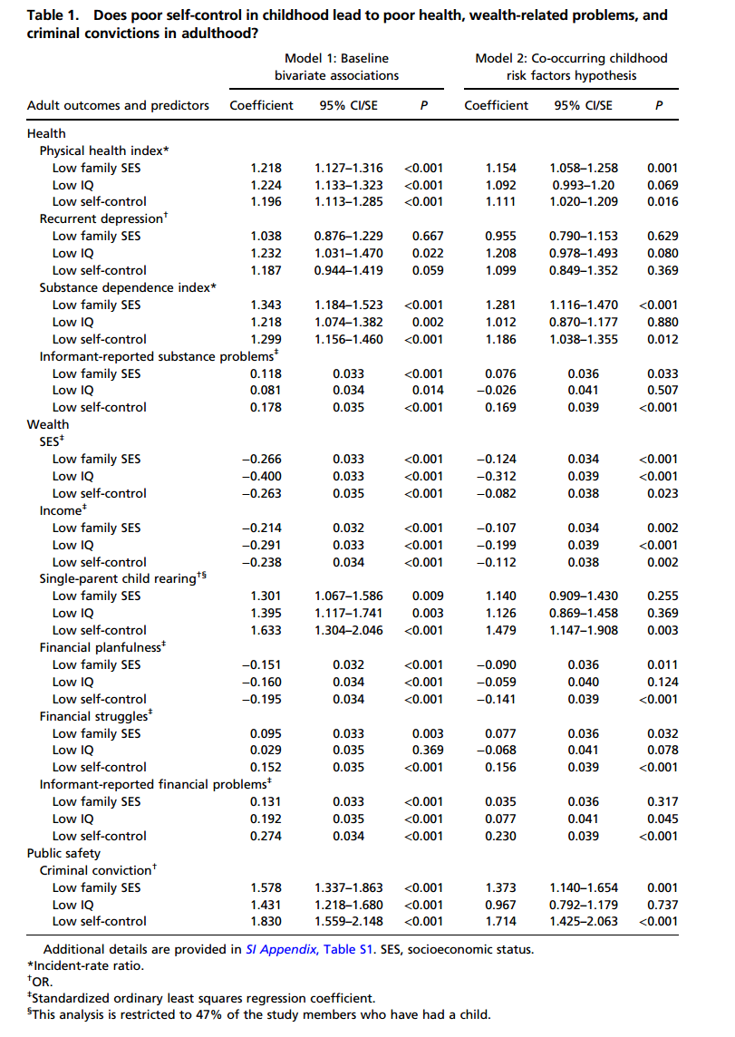

Slide 112
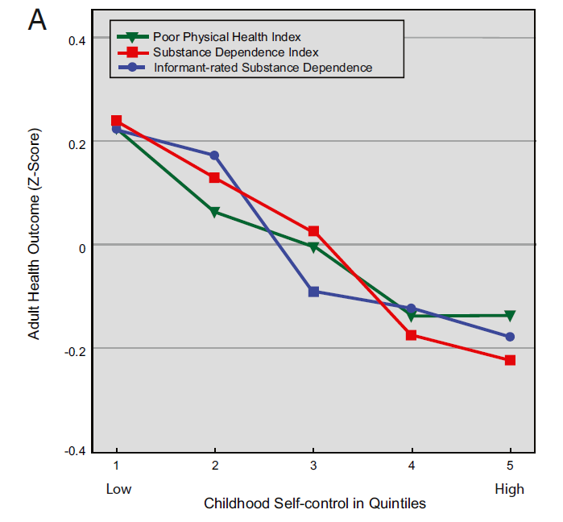
Child Self Control & Adult Health
Temperament and Self-Control
(Moffitt et al., 2011)

Slide 113
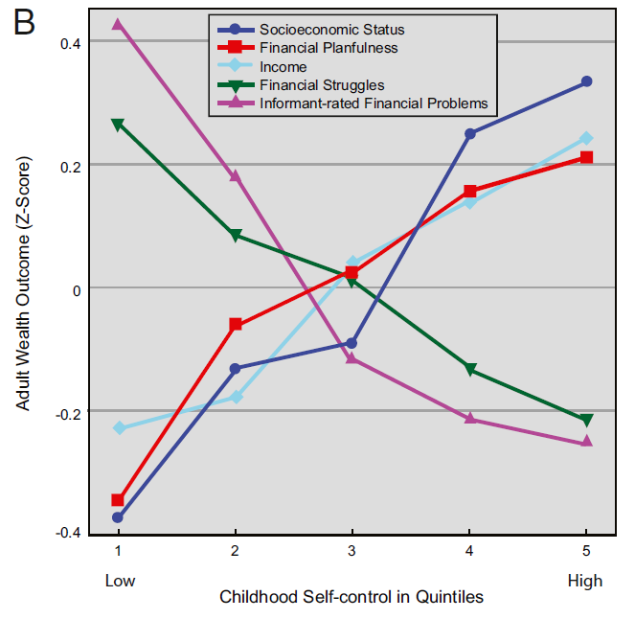
Child Self Control & Adult Wealth
Temperament and Self-Control
(Moffitt et al., 2011)

Slide 114
How Early Can Self-Control Predict Health, Wealth, and Crime?
We isolated staff ratings of the children’s self-control observed during 90-min data collection sessions at the research unit in the mid-1970s, when they were 3–5 y old (27).
This standardized observational measure of preschoolers’ self-control signiﬁcantly predicted health, wealth, and convictions at the age of 32 y, albeit with modest effect sizes (SI Appendix, Table S5).

Slide 115
Thus
Early childhood intervention that enhances selfcontrol is likely to bring a greater return on investment than harm reduction programs targeting adolescents alone (30)
Children who became more self-controlled from childhood to young adulthood had better outcomes by the age of 32 y, after controlling for their initial levels of childhood self-control (SI Appendix, Table S3).

Slide 116
Developmental Antecedents of Political Ideology (Fraley et al., 2012)
Prospective study examining antecedents of political ideology at 18 yrs of age
  Temperament (54 months)
    Restlessness/Activity; Shyness; Attentional Focusing; Fear
  Parenting attitudes (at 1 month)
    Authoritarian parenting attitudes
    Egalitarian parenting attitudes
  Maternal Sensitivity
    Observed over first 4.5 yrs of child’s life
  DV = Conservatism
    e.g., death penalty, abortion, censorship, racial segregation

Slide 117
Developmental Antecedents of Political Ideology (Fraley et al., 2012)
Prospective study examining antecedents of political ideology at 18 yrs of age
  Temperament (54 months)
    Restlessness/Activity; Shyness; Attentional Focusing; Fear
  Parenting attitudes (at 1 month)
    Authoritarian parenting attitudes
    Egalitarian parenting attitudes
  Maternal Sensitivity
    Observed over first 4.5 yrs of child’s life
  DV = Conservatism
    e.g., death penalty, abortion, censorship, racial segregation

Slide 118
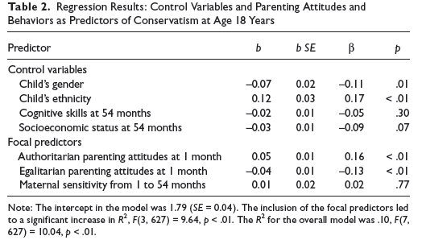
Parenting attitudes→conservatism
(Fraley et al., 2012)

Slide 119
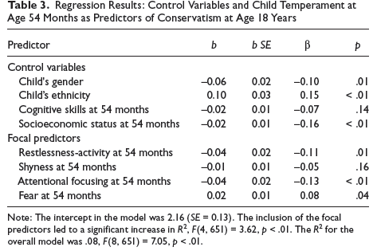
Temperament
Fraley et al. (2012)

Slide 120
Negative Emotion and Emotion Socialization (Nelson et al., 2012)
Examination of role of ethnicity in predicting parents’
  Beliefs about negative emotion
  Self-reported responses to negative emotion
  Observed emotion teaching practices
Group differences
Beliefs mediate group differences in responses?
  Differences by emotion type?
  Differences by child gender?
  EA (n=137) and AA (n=65) mother-child dyads when children were 5 yrs old

Slide 121

Negative Emotion and Emotion Socialization (Nelson et al., 2012)

Slide 122
Development of Self
Components of self:
  Subjective self-awareness (“I-self”)
    Develops via experiences of agency in first year
    Recognition of others’ subjective entities (e.g., IJA)
  Self-representation (“me-self”)
    Objective characteristics of self
    Verbal self-reference, assertion of competence, emergence of self-conscious emotions
    Concrete, observable characteristics, rudimentary psychological characteristics

Slide 123
Development of Self
Components of self (cont):
  Autobiographical personal narrative
    Personally-significant memories bound together because of relevance to self
  Self-evaluations
    Positive bias in preschool years. Why?
    With development, more differentiated and realistic
  Social self
    Enhanced self-monitoring leads to intentional management of self-presentation in presence of others

