Slide 1
Psychology of Infancy
PSY 430

Slide 2
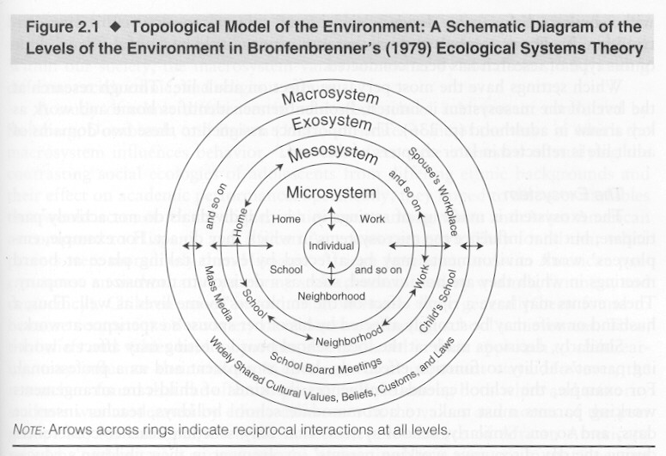
Domains of Development
Perception
Cognition
Language
Social/Emotional

Slide 3
Overview: Infant emotion
Innate structural versus functionalist vs dynamic view
  Unique brain regions
  Perceptually distinct
  Situational specificity
    Surprise, video examples
  Intensification—a structural or functionalist view?
Developmental overview
  Emotion socialization
  Emotion predicts

Slide 4
Emotion
Quick and long term behavioral motivation
  Hunger-Distress-Cry
  Interest-Attentive face
  Engaging playful other – joy - smile
Organize action, physiology, cognition, & perception
To meet environmental and internal demands
Patterns constitute core aspects of temperament/personality functioning
https://www.youtube.com/watch?v=Or0Zv57OvYI twins fight over toothbrush`

Slide 5
Infant emotional development
Distress is present at birth
Interest and joy emerge in the first 2 mos.
  Joy develops through at least 6 mos.
Anger, sadness, fear differentiate 4-12 mos...
Pride and shame develop between 1 & 2 years

Slide 6
Emotion and Self-Development
  Increases in self-awareness (2/3 yrs) leads to expression of new, more complex emotions
    Cognition→emotion
    Self-Conscious Emotions
      Pride
      Guilt
      Shame
      Embarrassment

Slide 7
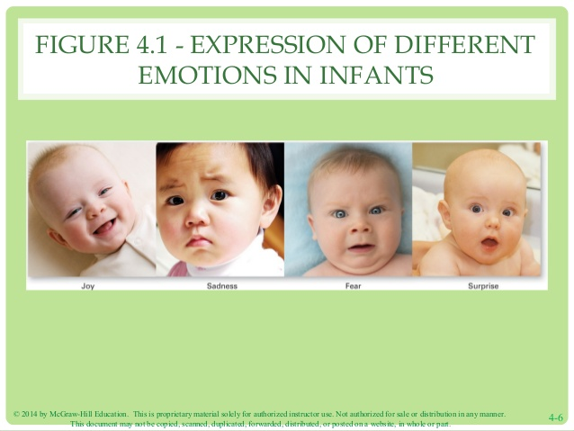
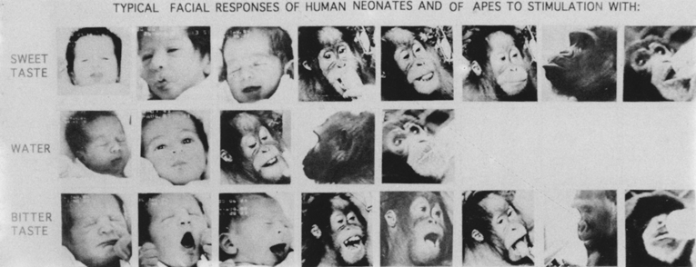
Structuralist vs. functional emotion theories
  Structuralist
    (discrete emotion theory, natural kinds)
      Emotions comprise unique patterns of subjective feeling, cognitive appraisal, physiological arousal, facial expressions
        Basic emotions promote survival and reproductive success
          These are pretty convincing, right?
Pretty convincing, right?

Slide 8
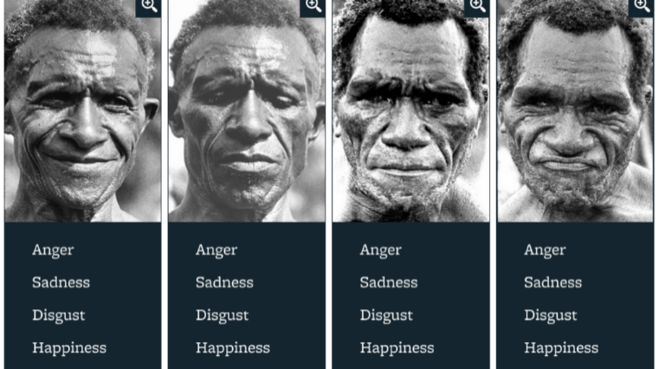
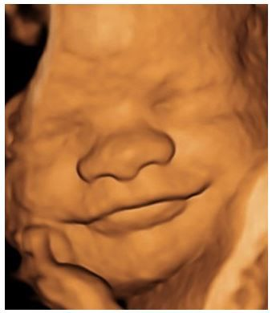
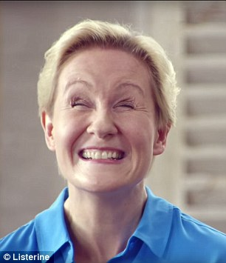
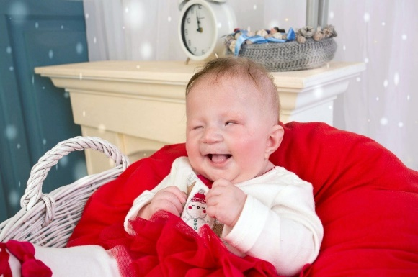
Evidence for DET
Cross-cultural evidence
Newborn facial musculature
  Fetal/non-human facial expressions
Congenitally blind people
Infant emotional responses to paradigms

Slide 9
Structural view: emotional feeling without knowledge of feeling
Infantile memory
  Strong emotional associations
  Without explicit knowledge of associations
  Makes associations inaccessible to reflection and difficult to change
  Memories of smells, movements, even abuse
But cognitive view: feeling plus cognition yields emotion

Slide 10
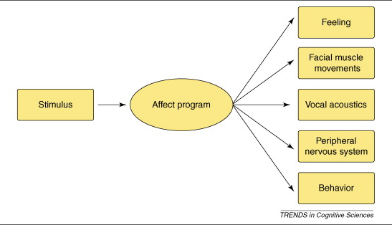
The Structuralist View
“each emotion kind is characterized by a distinctive syndrome of hormonal, muscular, and autonomic responses that are coordinated in time and correlated in intensity “
p. 30 Barrett, 2006

Slide 11
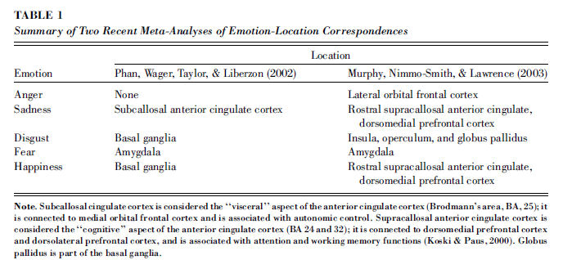
But where in the brain are specific emotions?

Slide 12
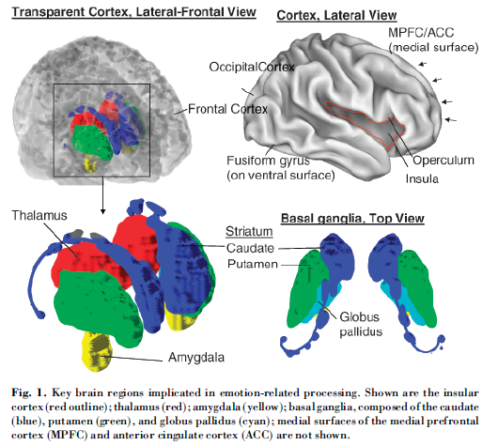
Brain regions related to emotion processing
Ventromedial prefrontal cortex (Lindquist et al., 2016), the anterior cingulate cortex (Murphy et al., 2003), and basal ganglia (Phan et al., 2004) are candidate structures.

Slide 13
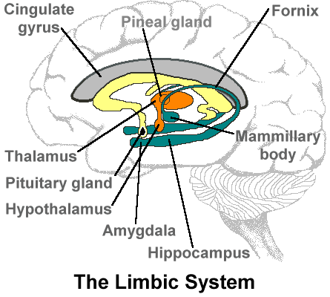
Emotional brain - Limbic system
Border of primitive brain stem and cortex
Lower portions - visceral (bodily) feelings
  Developed at birth
Limbic cortex – awareness of feeling
  Damasio: Emotion is a neurochemical process. Feeling is our sensation of that process

Slide 14
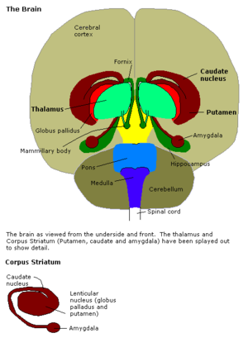
Amygdala
Transforms sensory stimuli to emotion elicitors
    Not mediated by neocortex
  Input: rapid, automatic appraisal of relevance
  Output: Expression and Experience
  Reactivity of amygdala determines temperament

Slide 15
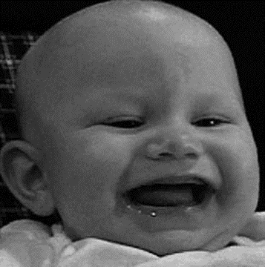
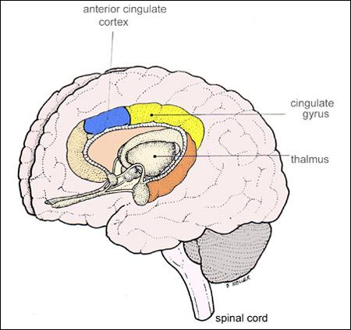
Where is joy located?
(Lindquist et al., 2016; Lindquist, Satpute, Wager, Weber, & Barrett, 2016), the anterior cingulate cortex (Murphy et al., 2003),
Basal ganglia involved in related action tendencies.
Anterior cingulate cortex, ventromedial prefrontal cortex
Greater left than right cerebral activation (Duchenne smiles, tail wagging, etc), Murphy et al., 2003
Notes:
The neurophysiology of happiness and joy. Unexpectedly, meta-analyses of neuro-imaging studies of adults have not unambiguously identified regions of interest activated by positive emotions (Barrett & Wager, 2006), although the the anterior cingulate cortex (Murphy, Nimmo-Smith, & Lawrence, 2003), and the basal ganglia (Phan, Wager, Taylor, & Liberzon, 2004) are candidate structures. More robust evidence suggests an association of joy and other approach related emotions with laterality differences in cerebral activation (Barrett & Wager, 2006). Emotions involving approach motivation, particularly joy, are associated with greater left than right frontal cerebral activation (Murphy et al., 2003). Laterality differences, combined with an absence of robust structural candidates, suggests a distributed cerebral basis for positive emotions, one which may involve distributed activation networks.

Slide 16
Facial affect programs?
Current evidence:
  Relevant linked brain systems
    networks
  But not distinct affect programs
  Fear may be exception
  Panskepp and current animal work

Slide 17
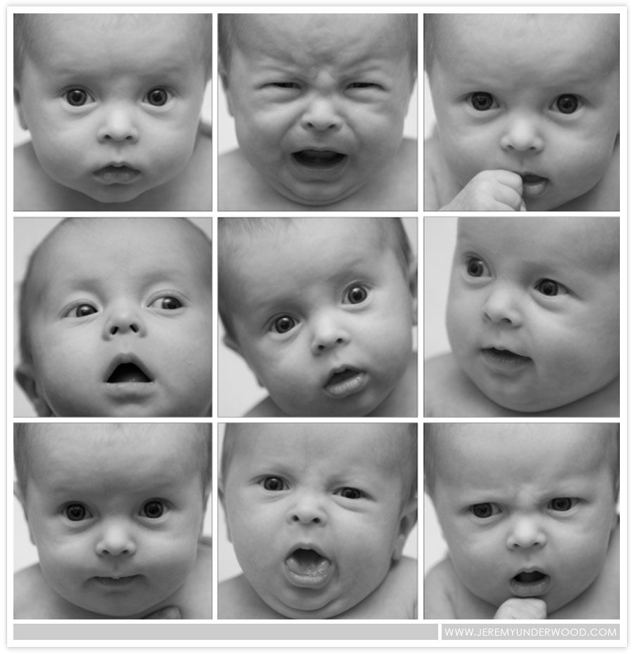
Criticism of DET/Structural
Infant facial expressions:
  Ambiguous
  Unrelated to context
  Rapidly changing
  Variations of prototypical expressions
  Negative emotion ambiguity
  Positive emotion variety
  Positive/negative commonalities…
    Theoretical implications….
Mitsven, S. G., Messinger, D. S., Moffitt, J., & Ahn, Y. A. (2020). Infant Emotional Developments, pp. 748-782. In Lockman, J. & Tamis-Lemonda, C. (Eds.), Handbook of Infant Development. Cambridge University Press.

Slide 18
Discrete infant emotions…?
Do you believe?
What are our criteria for belief?

Slide 19
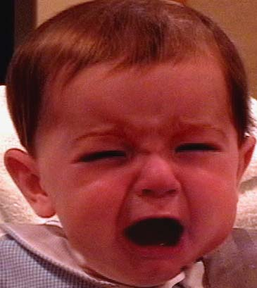
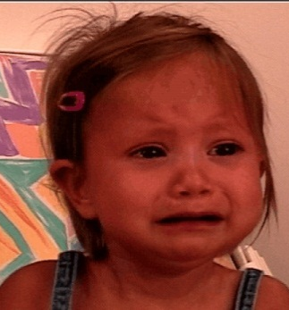

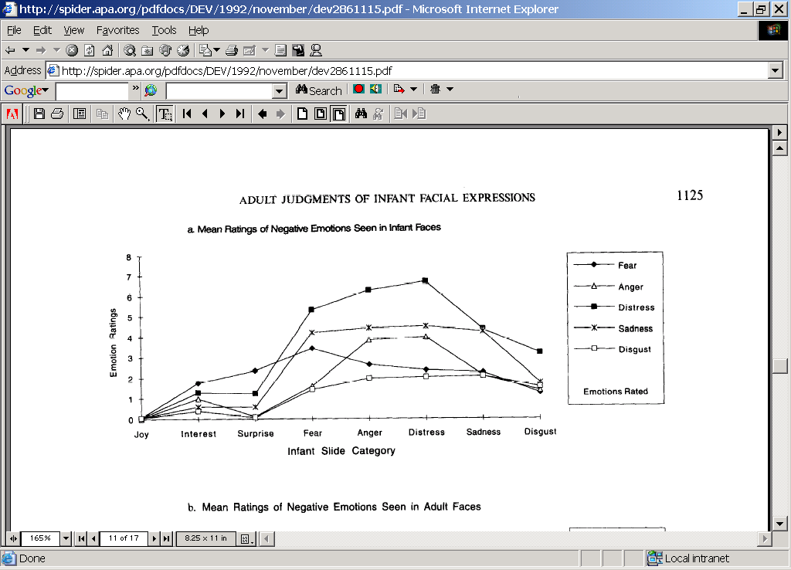
Infant negative expressions rated as distress
Example slides 3-10 are pictures: http://www.slideserve.com/marilu/emotions
(Oster et al., 1992)

Slide 20
How distinct are they?
Sad → distress → smile: http://www.youtube.com/watch?v=akPVtObBUOk&feature=related
Fear elicitor→distress: https://www.youtube.com/watch?v=ND14pBQmtgo
Neutral→sad—distress https://www.youtube.com/watch?v=Dx9Mh8_fpD8

Slide 21
Situational appropriateness: Production studies
Premise:
In response to an appropriate elicitor (situation), hypothesized emotional expression should occur significantly more than other expressions

Slide 22
Negative emotional expressions are not situationally specific
Through 2 months, Justine
  shows distress to bathing, being moved, & pacifier removal (inoculation and hunger)
After 2 months, anger and, to a much lesser degree, sadness are most common reaction to all negative elicitors
  infants cry, not a specific reaction
        Camras, 1992

Slide 23
Specifying Specificity: Facial Expressions at 4 Months
Evidence for a family of frustrating, goal-blocking events that elicited expressions and cortisol responses indicative of anger at 4 months.
Yet situations also elicited expressions and cortisol changes indicative of sadness.
Bennett, David S.; Bendersky, Margaret; Lewis, Michael
Infancy. Vol 6(3), 2004, 425-429

Slide 24
Specific elicitors → discrete expressions?
Expressions from specific elicitors?
Sad → distress → smile: http://www.youtube.com/watch?v=akPVtObBUOk&feature=related
Fear (surprise?) elicitor→distress: https://www.youtube.com/watch?v=ND14pBQmtgo
Neutral→sad—distress https://www.youtube.com/watch?v=Dx9Mh8_fpD8

Slide 25
Expressions of discrete emotions lawfully associated with their elicitors?
Sad → distress → smile: http://www.youtube.com/watch?v=akPVtObBUOk&feature=related
Fear elicitor→distress: https://www.youtube.com/watch?v=ND14pBQmtgo
Neutral→sad—distress https://www.youtube.com/watch?v=Dx9Mh8_fpD8
Distress:
Sad→disress (response to dad): https://www.youtube.com/watch?v=l7oD9WX-1CU
Smile→Fear/orient→distress: http://www.youtube.com/watch?NR=1&feature=fvwp&v=QiBrPkGoqFM
Fear→distress: http://www.youtube.com/watch?v=fASp42ZvjIM&feature=fvwrel,
http://www.youtube.com/watch?feature=fvwp&NR=1&v=H-1me_wsuyk (alligator bite)
Sad: http://www.youtube.com/watch?v=szLjXta0Szw, dad singing http://www.youtube.com/watch?v=dAzLsnYvdYo&feature=related (lower lip in response to rasberries)

Slide 26
Do elicitors need to be stronger?
Compendium [removed]: http://www.youtube.com/watch?v=cypeLuCIrU0 6:38
Maze game (fear in children)
  Boy: http://www.youtube.com/watch?v=ZGd5NqP6qd4
  Girl: http://www.youtube.com/watch?v=LC5qPvTQUdo
  girl 0:55-1:07, boy 1:45-2:30: Long: http://www.youtube.com/watch?v=q9kNCBGEyfk
  https://poki.com/en/g/scary-maze

Slide 27
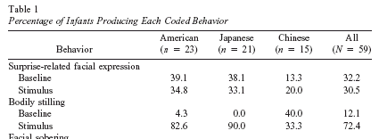
Surprise! Its not in the face
Reactions to covert toy switch

Slide 28
Surprise –basic expression or emotion socialization
Babies (removed): https://www.youtube.com/watch?v=akYXHDjk5JU
Posed adult: http://www.youtube.com/watch?v=f4AyfrM8Q2o
Babies
  Expression on demand: http://www.youtube.com/watch?v=8DaKcKqVheE&NR=1
  100 Surprised Baby Reactions https://www.youtube.com/watch?v=fz6rFxfkgfM
    First is classic, 2nd is terror
Girl and Dad homecoming 1:05—1:40. http://www.youtube.com/watch?v=q5HXl_zJ5po

Slide 29
Interest expressions as coordinative motor structures
Opening the mouth is accompanied by brow raising in infants, thus producing "surprise“ expressions in non-surprise situations.
  Raised-brow movements significantly co-occurred with head-up and/or eyes-up movements at 5 & 7 mos.
  Knit-brows co-occurred with eyes-down at 5 mo and head-down at 7 mo
    Michel, G. F., Camras, L. A., & Sullivan, J. (1992). Infant interest expressions as coordinative motor structures. Infant Behavior and Development, 15(3), 347-358.

Slide 30
Dynamic systems
Development, interaction, and (emotional) behavior are complex
involving multiple interfacing/interacting constituents
which produce patterns we see as pre-designed regularities
Coordinative structure? http://www.youtube.com/watch?v=cOvtNPljtv0&feature=related
A bottom-up approach
  Discrete emotions as preferred states formed from the interface of multiple constituents

Slide 31
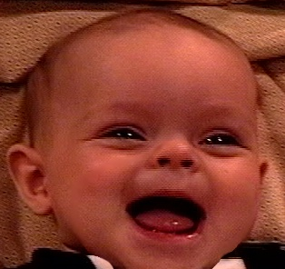
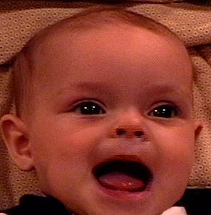
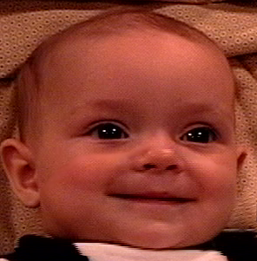
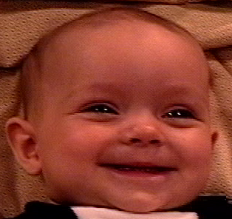
All smiles are positive, but some
are more positive than others
Closed mouth
Open mouth
No eye constriction
(Non-Duchenne)
Smiling alone (basic)
Open mouth
Eye constriction
(Duchenne)
Eye constriction
Open mouth +
eye constriction
Notes:
Different sample

Slide 32
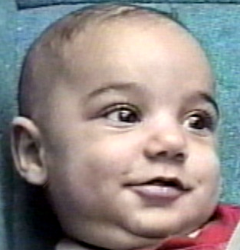
Any smile (even a non-Duchenne) is
more positive than no smile
Messinger et al., 1999; 2001
Notes:
Infants engage in relative more Smiling alone than non-smiling when gazing at mother and when mother is smiling

Slide 33
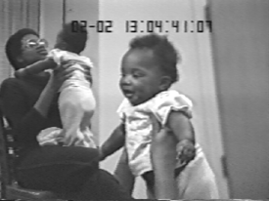
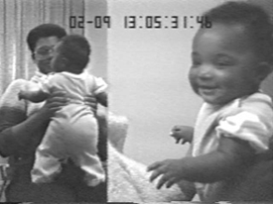
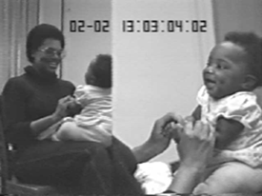
Some smiles are more positive
Cheek-raise smiling
when mother smiling
Open-mouth smiling
when gazing at mother
Open-mouth
cheek-raise smiling when gazing at smiling mother
Messinger et al., 2001

Slide 34
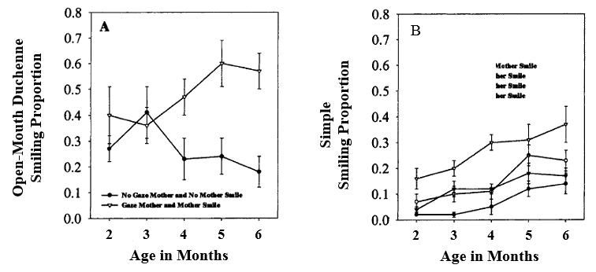
The development of joy
Messinger, et al., 2001
Notes:
Same proportions

Slide 35
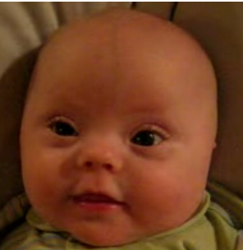
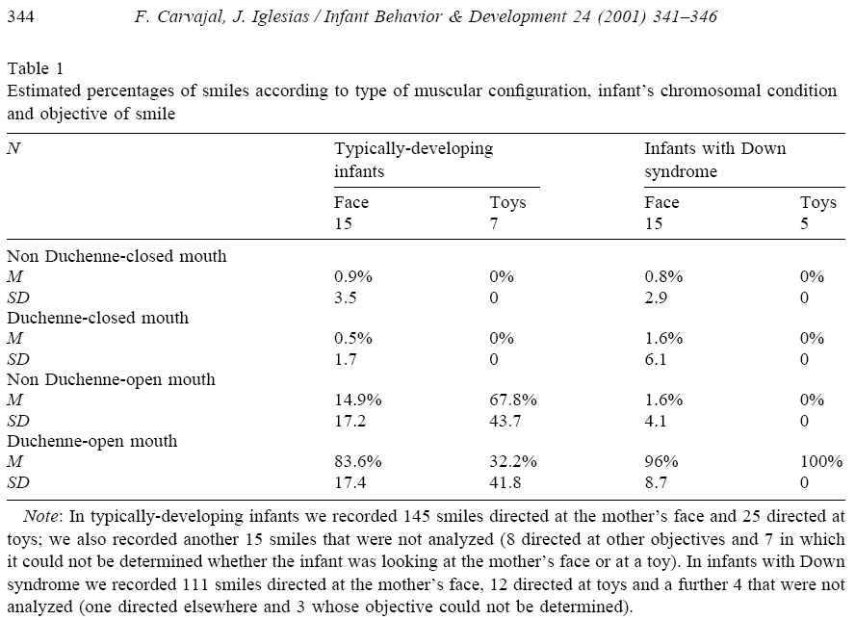
Indiscriminate smiling in trisomy
http://www.youtube.com/watch?v=KMbKlOL8q5s

Slide 36
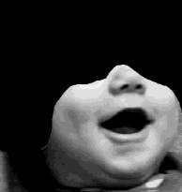
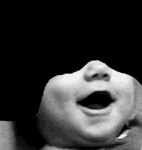
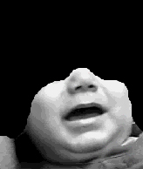
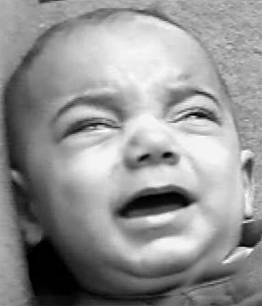
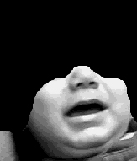
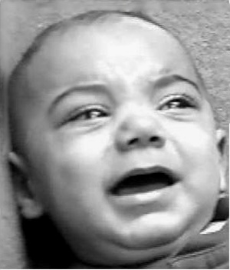
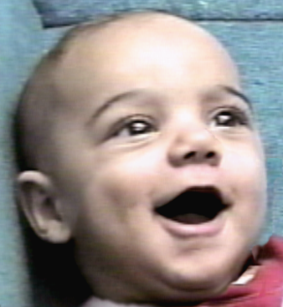
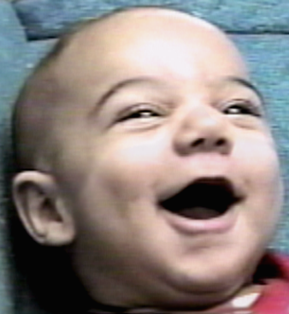
Facial expression communication
A systems view
+ Eye constriction
- Eye constriction
Positive Emotion
Positive Rating
Negative Rating
8
7
6
5
4
3
Messinger, 2002

Slide 37
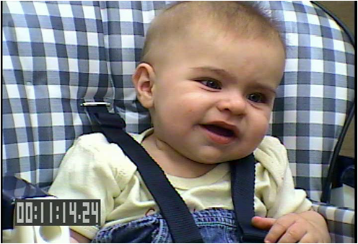


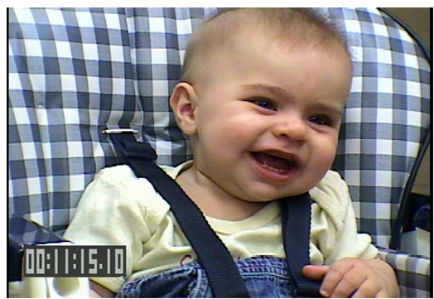
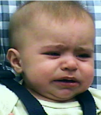
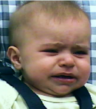
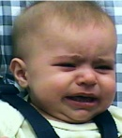
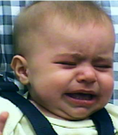
But what about dynamic expressions?
Messinger, Mattson, Mahoor, & Cohn, Emotion, 2012
Bolzani-Dinehart, et al., 2005

Slide 38
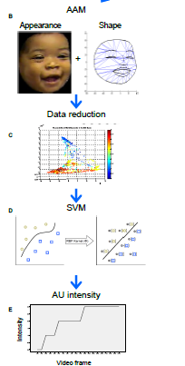
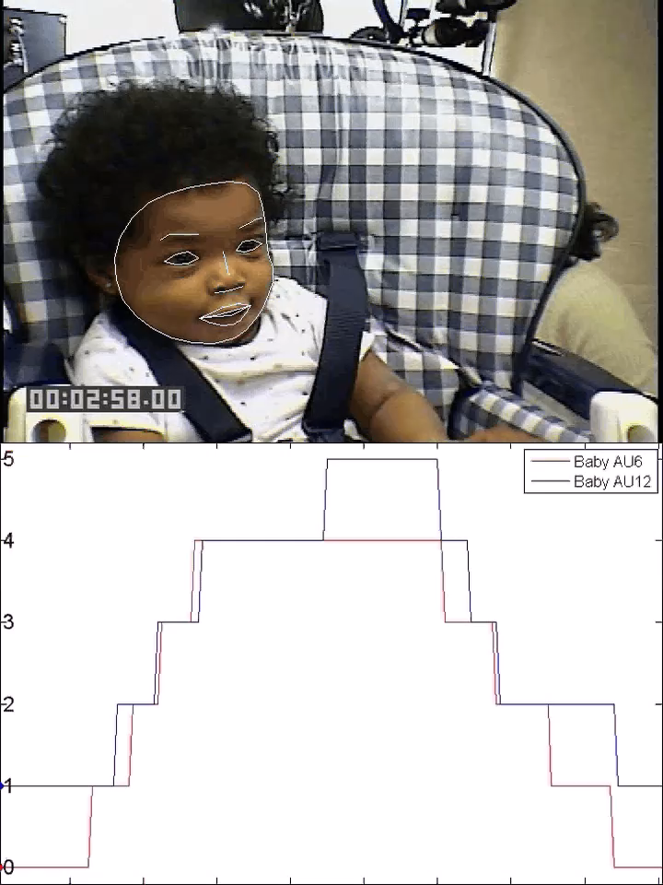
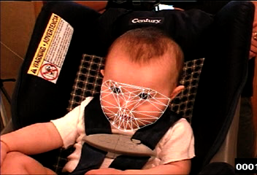
Automated Measurement
Computer
Vision
Pattern
Recognition
b86_FF_AU12+6_ma.halfspeed.cine

Slide 39
Intensifiers of positive and negative
Messinger , Mattson, Mahoor, & Cohn, 2012

Slide 40
Intensifiers of positive and negative
Messinger , Mattson, Mahoor, & Cohn, 2012

Slide 41
Darwin’s Duchenne: Eye Constriction During Infant Joy and Distress
Rachel M. Verhagen
March 9, 2021
PSY 620

Slide 42
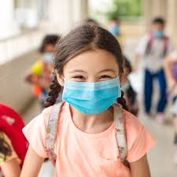
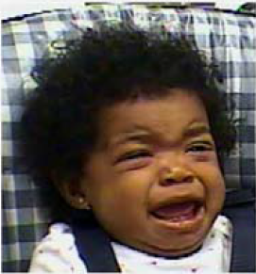
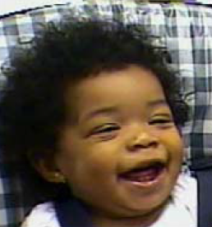
Introduction – Darwin’s Duchenne
Duchenne smiles (those with eye constriction) are perceived as more positive and strongly predict joy
  Fake smiles – lips stretch out and up but do not involve eye constriction
What about negative affect?
  Darwin proposed eye constriction also plays a role in negative emotion (e.g., weeping and crying)
  Gap in literature: no experimental investigation of BOTH smile and cry expressions as indicators of emotional intensity
Patel/Puccetti/Verhagen

Slide 43

Aims – Study 1 (Face to Face/Still-Face)
Research Aims
  Does eye constriction index intensity of both positive and negative infant facial reactions?
Face to Face/Still-Face (FF/SF)
  Manipulation of parental responsivity - Parent first plays with infant, then become unresponsive
Play
  H1: Higher proportion of smiles
  H2: Higher proportion eye constriction in smiles during play vs. still face
Still Face
  H1: Higher proportion of cry-faces
  H2: Higher proportion eye constriction in cries during still face versus play
https://www.youtube.com/watch?v=apzXGEbZht0
Verhagen
Notes:
Start video at :30, end at 2:00

Slide 44

Study 1 Methods
Participants
  12 six-month-olds and their parents (11 mothers/1 father)
    Children were ethnically diverse and 2/3 male
Coding – Action Units of Facial Action Coding System
  Smiles indexed by oblique action of zygomaticus major (AU12)
  Cry-faces indexed by lateral action of risorius (AU20)
  Eye constriction indexed by orbicularis oculi, pars orbitalis (AU6)
    Draws the cheeks and skin around the temple towards eyes
  Coding was automated through model which tracked rigidity of facial features
Borenstein/Verhagen
Notes:
Start video at :30

Slide 45

Study 1 Results: H1 Confirmed
H1 confirmed: Main effect of condition = greater proportion of smiles during play compared to cries during still-face & greater proportion of cry-faces during still-faces compared to play.
Patel/Puccetti/Verhagen
Notes:
The mean proportion of time involving smiling declined from Play (M = .13, SD= .08) to the Still-Face (M = .02, SD = .03), F (1, 11) = 17.10, p,.01, gp 2= .61. The mean proportion of time involving cry-faces increased from Play (M = .11, SD = .25) to the Still-Face (M = .32, SD = .29), F (1, 11) = 4.97, p,.05, gp 2= .31.
A higher proportion of smiles involved eye constriction during Play (M = .64, SD= .30) than did smiles during the Still-Face (M = .34, SD= .38), F (1, 11) = 6.70, p= .03, gp 2= .38. A higher proportion of cry-faces involved eye constriction during the Still-Face (M = .70, SD= .38) than during Play (M = .36, SD = .39), F (1, 11) = 11.43, p,.01, gp 2= .51. These results provide evidence in support of the hypothesis. In a positive-emotion eliciting context, smiling was more likely to be accompanied by eye constriction. In a negativeemotion eliciting context, cry-faces were more likely to be accompanied by eye constriction.
What does it mean that play involved a similar proportion of smiles and cry-faces?
The presence of eye constriction predicted stronger smile and cry-face expressions. How does this add to the above finding?
Does this response to emotional elicitors generalize?

Slide 46

Study 1 Results: H2 Confirmed
H2 confirmed: Higher proportion of eye constriction in smiles during play versus still face. Higher proportion of eye constriction in cry-faces during still face versus play
Patel/Puccetti/Verhagen

Slide 47


Study 2 Aims & Method
Research Question: Is eye constriction involved in infants’ cry-face expressions using a naturalistic elicitor of pain?
Participants
  24 infants, 6 or 12 months
  Data from YouTube videos of vaccination
Method
  Cry faces indexed using AU20 and eye constriction by AU6
  Both were coded manually on a frame-by-frame basis
Patel/Puccetti/Verhagen

Slide 48

Study 2 Results
Results
  Most cry faces involved eye constriction at both 6 and 12 months of age
  Extends results to a naturalistic elicitor of negative emotion: “Duchenne distress expression” is a response to not only parent ceasing play but also painful stimulus
Patel/Puccetti/Verhagen

Slide 49
Conclusions - Duchenne indicates strong positive and negative emotions
A given facial action, such as eye constriction, may have a consistent function in a range of facial expressions
Eye constriction markers emotional intensity in both experimental and naturalistic settings
Possible functions of the Duchenne marker include:
  Regulate exposure to intense emotional stimuli
  Partially, but does not completely block vision → May increase attention to internal emotional state
  Signals include intense positive engagement (play) and need for comfort (pain)
  In adults: smiling, pain, orgasm
Patel/Puccetti/Verhagen

Slide 50

Discussion Questions
Any methodological concerns?
Would adults’ appraisal of distressing or disgusting stimuli vary if they keep a still face vs a distressed face?
How would infants respond to an incongruent face (i.e., Duchenne distress with smiling facial expression)?
How does infant eye expression affect parents’ interpretations of infant affect and subsequent responses to the infant?
What factors might alter parental responsivity to/accurate identification of infant affect, and what impact might this have on an infant’s emotion regulation skill development?
What would these findings look like in infants who are later diagnosed with ASD?
Does the response from the caregiver affect the child’s subsequent eye restriction?
What about individual differences in facial expression?
Do individuals connect better with others who show greater frequencies of Duchenne smile (or more eye constriction, along with activation of AU12) and connect worse with others who show greater frequencies of Duchenne distress (or less eye constriction, along with activation of AU20)?
Verhagen

Slide 51




Slide 52



Darwin’s Duchenne:
Eye Constriction during Infant
Joy and Distress
(Mattson et al., 2013)

Slide 53

Introduction
Darwin hypothesized that attributes of certain emotions translate across species
Duchenne smiles are perceived as more positive and strongly predict joy
What about negative affect?
  Darwin proposed eye constriction also plays a role in negative emotion (e.g., weeping and crying)
  Gap in literature: no experimental investigation of BOTH smile and cry expressions as indicators of emotional intensity
Patel/Puccetti

Slide 54


Overview (Heller & Casey, 2016)
Adolescence: intersecting physical, psychological, & environmental change

Slide 55

Research Aims
Research Aim
  Does eye constriction index emotional intensity for positive & negative infant facial expressions?
Study 1: Face to Face vs. Still Face (FFSF)
PLAY
3 minutes H1: Higher proportion of smiles H2: Higher proportion eye constriction in smiles during play versus still face
STILL FACE
2 minutes H1: Higher proportion of cry-faces H2: Higher proportion eye constriction in cries during still face versus play
Patel/Puccetti

Slide 56

Methods
Participants: 12 six-month olds and their parents (11 mothers/1 father)
  Children were ethnically diverse and 2/3 male
Facial Coding: Action units (AU) of the anatomically-based Facial Action Coding System (FACS)
  Smiles indexed by oblique action of zygomaticus major (AU12)
  Cry-faces indexed by lateral action of risorius (AU20)
  Eye constriction indexed by orbicularis oculi, pars orbitalis (AU6)
    Draws the cheeks and skin around the temple towards eyes
  Coding was automated through model which tracked rigidity of facial features
  Support vector machines classified the intensity of each AU (trace -> maximal)
Borenstein

Slide 57

Eye constriction has a common meaning—intensification—across positive and negative expressions
Signals a focus on internal state to self and other
Notes:
Isre icon

Slide 58




Experimental evidence for role of eye constriction
Mattson, et al.,PLOS One, in press
Mattson, et al., 2013, under review

Slide 59





Slide 61


Negative facial expressions with eye constriction inversely associated with parent‐rated temperamental emotion regulation and concurrent LPFC activation
LPFC activation
Positive expressions with eye constriction during frustration may be associated with stronger LPFC activation.

Slide 62

Smiling photos and life
…and life

Slide 63

Smile intensity & self-reported personality

Slide 64

Smile intensity & other-reported personality

Slide 65
Smile intensity and Life Outcomes
Life Outcome | Positive expression | Controlling for Attract./Social Desirability
Married by age 27 | .19 | .18/.16
Single into adulthood | -.20 | -.18/.20
Ever divorced | .15 | ~.15/~.15
Personal Well-being
Age 21 (n=112) | .20 | .20/.11
Age 27 (n=86) | .25 | .26./.23
Age 43 (n=105) | .18 | .19/12
Age 52 (n=101) | .27 | .28/.24

Slide 66
Smile intensity and Observer Expected Interactions (n=114)
Observer Expectations | Positive emotional expression
Expected positive emotions | .70
Expected negative emotions | -.57
Approach-acceptance | .52

Slide 67



Other outcomes
Smiles predict lifespan in 1952 baseball players
Not replicated with larger version of
Same database

Slide 68
Other outcomes
Divorce
Lifespan (baseball players)
Emotional Flynn effect
  A Century of Portraits: A Visual Historical Record of American High School Yearbooks
  https://arxiv.org/abs/1511.02575

Slide 69





Kindergarteners’ Family & School Photos
Cross-modality emotional communication
✗ Smile intensity in classroom & home
  ✓ Warm family touch & smile intensity
    in classroom & home
  ✗ Total family touch & smile intensity, parent’s affect
Child-parent expressive similarity
  ✓ Father and child smile intensity
Facial emotion display as “thin slice” of temperament?
  ✓ Smile intensity in classroom (not home) & extraversion
  ~ Girls’ warm family touch & extraversion
 | Mother | Father
Child | ✓ | ✓
Girl | ✓ | ✓
Boy | ✗ | ✓
  - No significant r’s for effortful control or negative affect
Notes:
Smiling
Boys = girls
Mothers > fathers

Slide 70
Boys expressions by behavior ratings
Why?
Keltner et al., 1999
Notes:
80th%ile. Higher % of their own expressions

Slide 71
Structuralist vs. functional perspectives on emotion
Functionalist
    Emotions serve to establish, maintain, or change relation between person and environment on matters of significance to person
      Emotion associated with goal-attainment, relationships, situational appraisals, action tendencies, self regulation,

Slide 72

Chimpanzee “Laugh Faces”
Male chimp with juvenile: https://www.youtube.com/watch?v=KcCOs-zDt-o

Slide 73
Chimpanzee “Laugh Faces” Davila-Ross, Jesus, Osborne, & Bard (2015)
Humans combine facial and vocal expressions, allowing for more versatile meanings and explicit communication.
Are primates able to produce the same types of facial expressions with and without accompanying vocalizations
Examine evolutionary relation of chimp open mouth faces to human laugh faces.

Slide 74
Methods
46 Chimps (24 Female) in a Wildlife Orphanage in Zambia
Video recorded spontaneous play between two playmates with observer 10 m away.
Videos were coded for open-mouth faces, based on the wide parting of lips
ChimpFACS
  I.E. raising cheeks or lips, pulling up lip corners, protrusion of tongue, dropping jaw, etc.
Measured the contextual use of open mouth faces.

Slide 75

6 common chimpFACSunits in open mouth faces
Notes:
They found 6 common units in chimpFACS coded open mouth faces
None of these AUs were produced in isolation
See Table 1
Shows the 17 different action combinations
14 occurred in both silent and laughing open-mouth faces

Slide 76


Chimp open mouth faces with & without laughter dominate in physical contact
Notes:
number of open mouth faces chimps produced during rough and gentle play.
Open-mouth faces with laughter were more often produced in play with physical contact than play without physical contact, for both rough and gentle play. Silent open-mouth faces were significantly more often found in play with physical contact than play without contact, but only during rough play

Slide 77
Functionalist theory
Emotion is the person’s attempt or readiness to establish, maintain, or change the relation between the person and the environment on matters of significance to that person (Saarni et al., 1998).
  Emotion is associated with goal-attainment, social relationships, situational appraisals, action tendencies, self-understanding, self regulation, etc.

Slide 78
Developmental Changes in Emotion
Psychobiological foundations
  Subcortical mediation of basic emotions
  Developing subcortical-frontal connections permit more effective emotion regulation
Emotion Perception
  Discrimination/categorization of expression by 5 months of age
  Rely on others’ reactions to interpret unfamiliar situations = social referencing (12+ months)
  Understanding of subjective state of emotion (24+ months), allows for prosocial displays of comforting etc.

Slide 79
Unknowns
The development of childhood crying
The development of childhood versions of the adult anger expression

Slide 80
Developmental patterns
Socialization
  Emotion displays become more restricted
  Full-face to partial face - miniaturization
Cognitive input
  shame, guilt, pride, embarrassment emerge
    involve rudimentary appraisal of self vis-à-vis other
      dynamic systems

Slide 81
Understanding effects of emotions on others
The use of display rules
  Increased ability to understand and apply social rules for display of emotion in social situations
    Emotion masking
      Primitive forms in preschool; more flexible, reasoned use in middle childhood

Slide 82
Emotion Regulation
Display rules
  Increased ability to understand and apply social rules for display of emotion in social situations
    Emotion masking
      Primitive forms in preschool; more flexible, reasoned use in middle childhood
Emotion Regulation
  Adaptive management of emotional experiences
  Developmental transition from other-regulation to self-regulation
    Internalization of socialization experiences

Slide 83
Volitional regulation of smiling increases from 4 to 6 to 8 years
Modified disappointing gift paradigm
  98 children aged 4, 6, and 8 were motivated to volitionally deceive an observer by false smiling, regardless of receiving an attractive, unattractive, or no gift. 10 naïve observers judged the quality of emotion and type of gift.
Children's competence to volitionally regulate their expressions increased with age.
  This ability was positively associated with children's understanding of how to differentiate between emotion and expression.
    Girls did not display superior regulation than boys.
      Child Dev. 2015 Mar-Apr;86(2):579-97. doi: 10.1111/cdev.12315. Epub 2014 Nov 9. Kromm H¹, Färber M, Holodynski M.

Slide 84
Expressions become more outward directed (Holodynski, 2004)
Expressions of strong positive emotion—receiving candy from a previously recalcitrant vending machine—between 6 and 8 years of age
Younger children exhibited similar levels of joyful expressions with and without an experimenter present.
Older children exhibited weaker joyful expressions when alone than when in the social condition
  although reported levels of joy did not decline.

Slide 85
Specificity—intersituational & intrasituational
‘Children produced more joy facial expressions in joy episodes (intersituational specificity) and more joy and surprise than other expressions in joy and surprise episodes (intrasituational specificity).
But children produced anger, fear, and sadness expressions more in noncorresponding episodes and produced these expressions less than other expressions in corresponding episodes.’
120 7-9 year-olds; discussions with mother
  Castro, et al. (2018).

Slide 86
Halloween Candy
50 secs http://www.youtube.com/watch?v=WOlpdd7y8MI

Slide 87
Emotions
Organize action, physiology, cognition, and perception to meet ever-changing environmental and internal demands
In patterns constituting core aspects of temperament/personality functioning
Motivate action and thought, creating value in life—and impacting wellness and sickness

