Slide 1
Psychology of Infancy
PSY 430

Slide 2
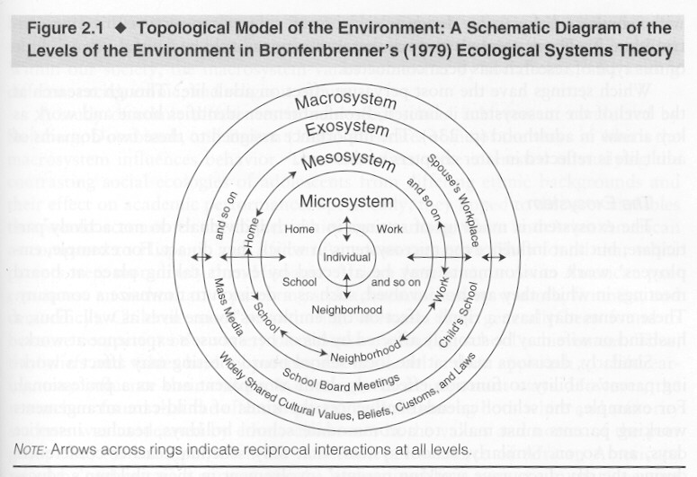
Domains of Development
Perception
Cognition
Language
Social/Emotional

Slide 3
Cognition
From ppt11 (last time)
  Habituation (slides 47-62)
  Piaget (slides 63-82)
Measurement
  Assessments versus/and standardized tests
  Predicting mathematics ability
  MAAP: Perception and cognition
Infant intelligence
  ACE
Genes & environment
  (Tucker-Drob) in the USA
  Genes (Tucker-Drob) in the world
Intervention (planned environmental change)
  Deprivation as the control
  Early intervention counts most
Education (as intervention) and IQ
      Infant versus chimp intelligence structure

Slide 4
Cognition
From ppt11 (last time)
  Habituation (slides 47-62)
  Piaget (slides 63-82)
Measurement
  Assessments versus/and standardized tests
  Predicting mathematics ability
  MAAP: Perception and cognition
Infant intelligence
  ACE
Genes & environment
  (Tucker-Drob) in the USA
  Genes (Tucker-Drob) in the world
Intervention (planned environmental change)
  Deprivation as the control
  Early intervention counts most
Education (as intervention) and IQ
Final projects
Back to object constancy and sticky mittens
      Infant versus chimp intelligence structure

Slide 5
Infant habituation →child intelligence
‘Habituation and recognition memory in first year of life predict IQ between 1 and 8 years
  Weighted (for N) mean correlation of .36
  Raw median correlation of .45.
  Similar for habituation & recognition memory.
  Predictions higher than for standardized infant tests of general development for nonrisk but not for risk samples.
    For nonrisk samples, predictions not consistently higher than predicting from parental education and socioeconomic status!
                A Meta-Analysis of Infant Habituation and Recognition Memory Performance as Predictors of Later IQ Robert B. McCall, Michael S. Carriger Child Development, Vol. 64, No. 1 (Feb., 1993), pp. 57-79

Slide 6
Lab-based assessments of intelligence
Fagan Test of Infant Intelligence
Assesses cognitive development in infancy.
Composed of habituation-dishabituation items.
  “a “novelty score” -- amount of fixation during the test phase devoted to the novel picture
      divided by the total fixation time to both the novel and familiar picture.”
    Fagan manual: http://infantest.com/ftii.pdf
Used for research studies—index of the relative level of functioning in group being studied
  Does not determine an individual child’s performance relative to children in the norming sample
    like in the Bayley

Slide 7
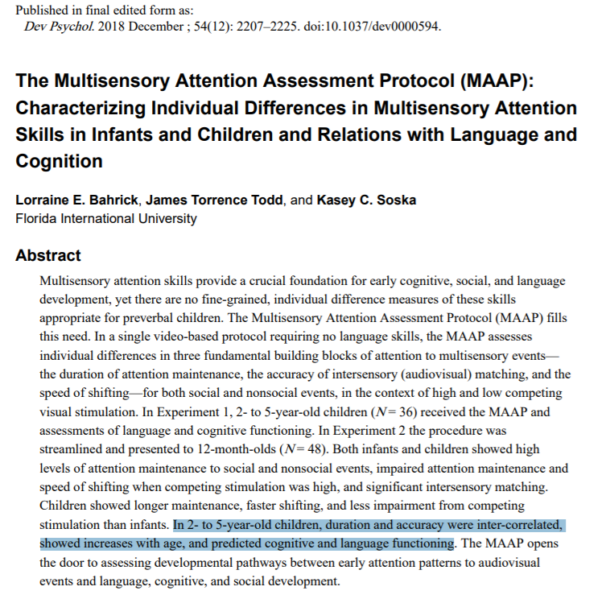

Standardizing lab protocols--MAAP
https://nyu.databrary.org/volume/326

Slide 8
Normed assessments of cognitive development in infancy
Eg Bayley, Mullen, Battel
Extensive research use
  Exposure, prematurity, autism risk, ZIKA…
Identification of infants at risk for developmental delay in order to provide early intervention services.
Scaled scores used at every age

Slide 9

Bailey

Slide 10
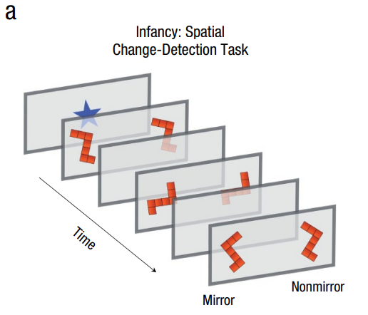
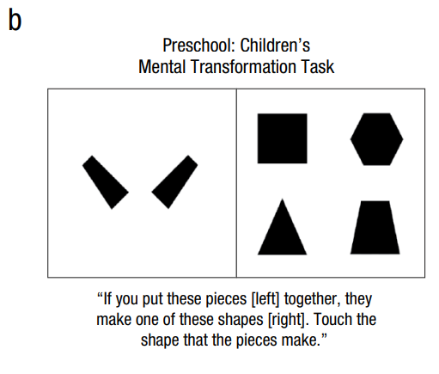
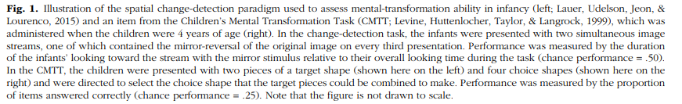
Method
53 children (25 female)
Participated as:
  Infants (6-13 months)
  Preschoolers (4 years)
Infants were presented with a spatial change-detection task
Preschoolers completed multiple cognitive tasks
  Spatial tasks: the Children’s Metal Transformation Task (CMTT)
  Quantitative measures
  Nonspatial and nonquantitative tasks (e.g., vocabulary working memory)
Bailey

Slide 11
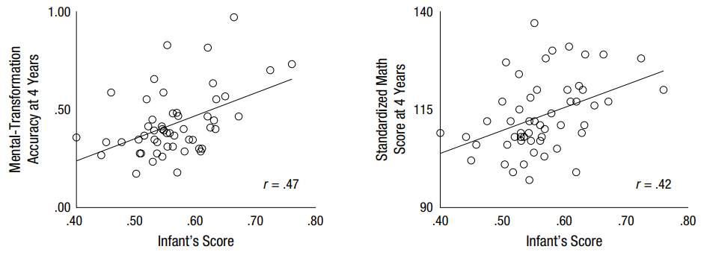
Infants’ scores on the spatial change-detection task significantly predicted their performance on the CMTT and the symbolic-math test (WJ III or WJ: Applied Problems)
Bailey

Slide 12
Fundamental question:
How do children know?
Infants have innate knowledge of essential properties of world
  Nativist account: the mind produces ideas that are not derived from external sources
    Infants have an inborn conception of what objects are
Infants must construct knowledge of essential properties of world
  Constructivist account or empiricist account: experience, especially of the senses, is the only source of knowledge.
Individual
Differences

Slide 13




Intelligence: New Findings and Theoretical Developments
Nisbett et al (2012)

Slide 14
Genes and the Environment
Heritability is between .4 - .8
6 genetic markers associated w cog ability
  but they only explain 1% of variance in cog ability
Fourth Law of Behavioral Genetics
G/E contribution to SES varies based on SES
  More genetic variation in families with high SES
  More environmental variability in low SES
  Mixed results for European studies…
  Children in impoverished environments showed higher heritability
Nisbett et al (2012)
Intelligence: New Findings and Theoretical Developments

Slide 15
Gene * Environment
Biological
  Breast feeding increased IQ by 8 points
    Due to fatty acids in breast milk?
Social:
  SES, Adoption, hearing more words (30 million word gap)
Shared environment effects higher in childhood/adolescence than adulthood
  Birth order (3 points)
    More attention to older child?

Slide 16

Kelly Shaffer

Slide 17
Behavior genetics logic

Slide 18
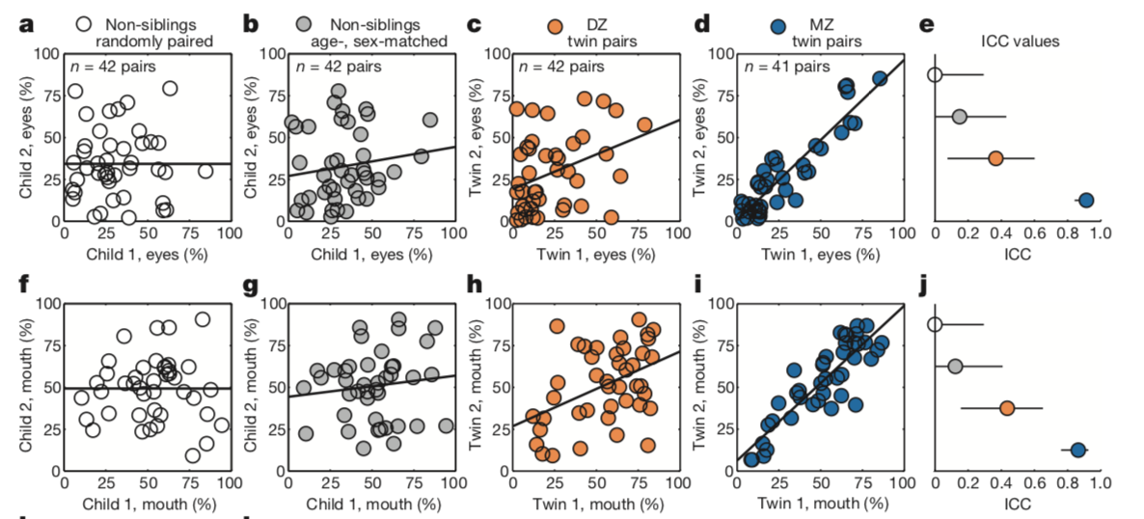
Gaze time associated with genetic relatedness
Aim: measure macro-level social visual engagement, calculating percentages of time spent looking at eye and mouth regions
Concordance in eye (0.91) and mouth (0.86) looking were incredibly high for MZ twins
DZ twins showed much lower correlations for eye (0.35) and mouth (0.44) looking.
Non-siblings showed no significant correlations for either matching
Notes:
e, j: interclass correlation coefficient and 95% confidence interval
When seen for follow-up 15 months after initial testing, at 36.8 ± 1.7) months (mean ± s.d.), monozygotic twins again demonstrated pairwise concordance in eye-looking of 0.93 (0.75–0.98), while dizygotic concordance was 0.25 (0.00–0.60) (Extended Data Fig. 4a–l and Extended Data Table 2b, see Methods), indicating strong preservation of genetic influence on social visual engagement over development (Extended Data Fig. 4m, n). Moreover, longitudinal within-subject stability—from 21 until 36 months—was high in both groups: equal approximately to 0.70 (Extended Data Fig. 5a–e).

Slide 19
A (additive genetics) C (common environment) and E (unique environment)—ACE Model
Correlation between MZ twins provides an estimate of A + C : r_{mz} = A + C
Dizygous (DZ) twins share common environment & mean 50% of genes:
  correlation between DZ twins is an estimate of ½A + C: r_{dz} = ½A + C
2x difference between MZ and DZ twins gives us genetic effect (A)
  2(r_{mz} - r_{dz} )
  difference between the MZ and DZ correlations is half the genetic similarity…
C is simply the MZ correlation minus our estimate of A.
  C = r_{mz} – A = 2 r_{dz} – r_{mz}
The random (unique) factor E is estimated by how much the MZ twin correlation deviates from 1. E = 1 – r_{mz}
  A = 2 (r_{mz} – r_{dz})
http://en.wikipedia.org/wiki/Twin_study

Slide 20
Gene x SES → Mental Ability (MA)
SES-related disparities in MA increase from 10 mos to 2yrs
General contribution of genes & environment
  Heritability higher at age 2
SES moderates genetic contribution to MA change
  Increasing heritability of MA in infancy most evident for high SES
    Tucker-Drob, E. M., Rhemtulla, M., Harden, K. P., Turkheimer, E., & Fask, D. (2011). Emergence of a Gene Ã— Socioeconomic Status Interaction on Infant Mental Ability Between 10 Months and 2 Years. Psychological Science, 22(1), 125-133.
Fernandez

Slide 21
SES vs. Environment
SES-related disparities widen over childhood
→ Cumulative environmental damage
72% high SES families
Greater influence of genes
Heritability of Cognitive Ability = 50% in General Population
10% low SES families
Greater influence of environment
Turkheimer, Haley, Waldron, D’Onofrio, and Gottesman (2003)
Shaffer | Tucker-Drob et al., 2011
Notes:
Cumulative environmental damage:
Kids in advantaged homes can select experiences that allow them to maximize their genetic potential/in line with their genetic propensities
E.g., kids with genes coding for extraordinary intelligence can do all these stimulating activities that encourages their development vs. kids not blessed in that area may not select those opportunities
Kids in disadvantaged homes don’t have access to stimulating activities
E.g., regardless of whether you have genes coding for extraordinary intelligence or not, you can’t access stimulating activities
Idea supported by genetics work:
Overall heritability (genetic influence) of cognitive ability = 50%
Among upper SES, see much higher influence of genes on cognitive ability
Among lower SES, see much higher influence of environment on cognitive ability

Slide 22
SES vs. Environment in Child Development: Timing?
When do childhood Gene x SES effects emerge
Youngest documented SES differences = 7 yo
Parenting differences related to SES:
  Time spent with children: high SES > low SES
  Sensitivity to children's signals: high SES > low SES
Shaffer | Tucker-Drob et al., 2011
Notes:
Unknown when these SES splits in cognitive ability begin
Youngest documented split in cognitive ability due to SES measured in 7 year olds
Evidence to suggest split may occur earlier than formal education

Slide 23
Methods
Mental Ability: Bayley Short (Mental only)
SES composite of
  Paternal education
  Maternal education
  Paternal occupation
  Maternal occupation
  Family income
750 twin pairs from Early Childhood Longitudinal Study, Birth Cohort (ECLS-B)
Assessed at 10 months and 2 years old
‘Observed’ zygosity
Shaffer | Tucker-Drob et al., 2011

Slide 24
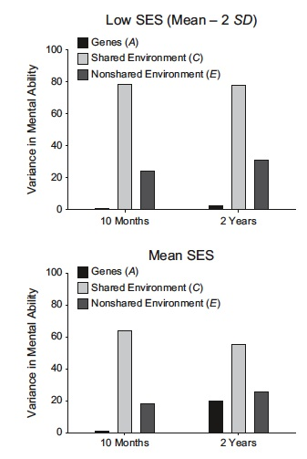
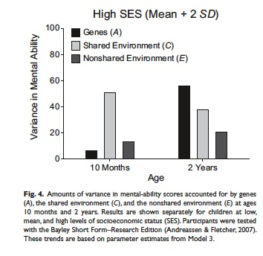
  By 2, genetic influence on mental ability larger for high SES
    Effect of genes on mental ability increases over infant development in high SES case (Tucker-Drob, et al.. (2011)
Fernandez

Slide 25
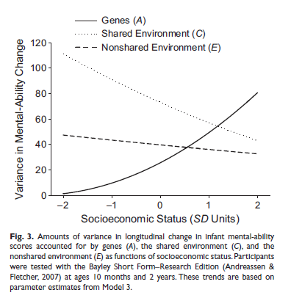
Development drivers differ by SES
Shaffer | Tucker-Drob et al., 2011
Notes:
Shown nicely here (same concept displayed differently, whichever one you can wrap your head around best):
Look just at high SES section: most of the variability in children’s gains in mental ability is accounted for by their genes
Now just look as low SES section: none of the individual difference in children’s gains in mental ability is accounted for by their genes, but rather by the kids’ shared environment
So, if I’m a child in low SES, I’m going to experience gains if my mom and dad happen to show more attention, there’s less chaos around, more books in our house, etc.
Whereas if I’m a child in high SES, I’m going to see most gains if my genes code for it

Slide 26
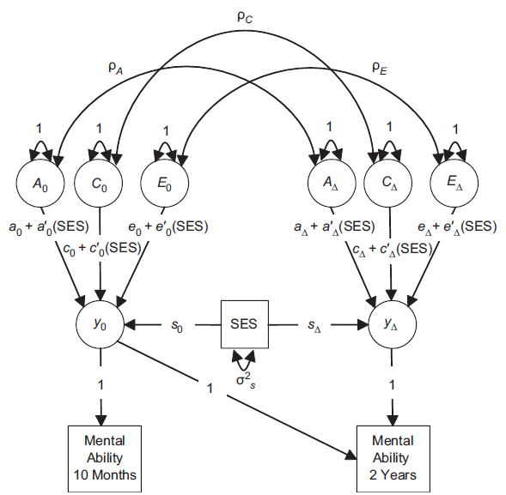
A (additive genetics), C (common environment) & E (unique environment)
  750 pairs of twins
  Zygosity score
    Monozygotic (MZ)
    Dizygotic (DZ)
  Analytic Method
    2 latents: Bayley initial (10mos) & change (10 mos to 2 yrs)
    Predicting mental abiity
Fernandez
Notes:
Fig. 1. Path diagram of the behavioral genetic model (Model 3) fit to mental-ability scores at age
10 months and age 2 years. Participants were tested with the Bayley Short Form–Research Edition
(Andreassen & Fletcher, 2007). This diagram represents one half of the model (i.e., one twin in
each pair). Single-headed arrows represent regression relations, and curved double-headed arrows
represent variances and covariances. The factors y0 and yD represent baseline mental ability and change
in mental ability, respectively. The factors A, C, and E represent additive genetic influences, sharedenvironmental
influences, and nonshared-environmental influences, respectively. Each biometric path
was modeled as a combination of a main effect (a, c, and e) and an interaction with socioeconomic
status (SES; a′, c′, and e′ ). The regression of the factor on SES is denoted by s.
Early Childhood Longitudinal Study, Birth Cohort (ECLS-B)

Slide 27
Development drivers differ by SES
Shaffer | Tucker-Drob et al., 2011
Notes:
Shown nicely here (same concept displayed differently, whichever one you can wrap your head around best):
Look just at high SES section: most of the variability in children’s gains in mental ability is accounted for by their genes
Now just look as low SES section: none of the individual difference in children’s gains in mental ability is accounted for by their genes, but rather by the kids’ shared environment
So, if I’m a child in low SES, I’m going to experience gains if my mom and dad happen to show more attention, there’s less chaos around, more books in our house, etc.
Whereas if I’m a child in high SES, I’m going to see most gains if my genes code for it

Slide 28
Discussion
“Although SES is often conceived of as a purely environmental variable, socioeconomic groups may differ in the frequencies of specific genetic polymorphisms”
→ Are SES and genes confounding variables?
“We overinvest in most schooling and post-schooling programs and underinvest in preschool programs for disadvantaged persons”
→ Do you agree?
Shaffer | Tucker-Drob et al., 2011
Notes:
President Obama just called for free community college programs … should we all lobby for him to abandon that over to preschool funding?

Slide 29
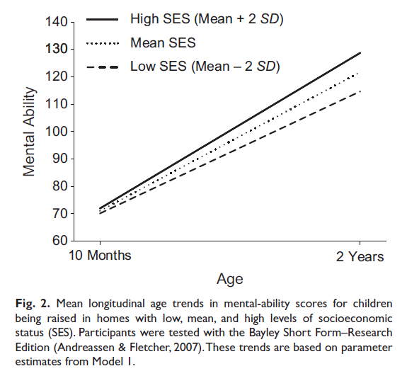
SES differences in change

Slide 31
Theories of Intelligence:
Genes vs Environment
Hereditarian
  Primarily genetic
    Differences are inherited
  Evidence
    Large correlations of IQ in twin studies, increase with age
Sociological
  Primarily environmental
    Differences result from experience
  Evidence
    IQ deficits observed in neglected children
Goodman
Notes:
Heritability of intelligence will be lower among individuals raised under conditions of greater childhood socioeconomic disadvantage.

Slide 32
Theories of Intelligence:
Genes & Environment
Combined Perspective
  Scarr-Rowe Hypothesis (Genes x SES)
    IQ is more heritable in high SES
    IQ is more environmental in low SES
  Evidence
    Heritability of Verbal IQ was stronger in well-educated families
      This effect may (or may not) replicate
Goodman
Notes:
Heritability of intelligence will be lower among individuals raised under conditions of greater childhood socioeconomic disadvantage.

Slide 33
Theories of Intelligence:
Genes x Environment (?)
Inconsistencies
  Gene x SES interactions may be false positives
  Gene x SES interaction studies may be underpowered
  Gene x SES interactions may differ by population
    Three-way interaction (Gene x SES x Country)
    Theory: Results from social inequality in education & healthcare
Goodman
Notes:
Heritability of intelligence will be lower among individuals raised under conditions of greater childhood socioeconomic disadvantage.

Slide 34
Present Study
Does the Gene x SES effect exist in the U.S.?
If yes, is this effect similar in other countries?
Is there a Gene x SES x Country effect?
Goodman

Slide 35
Meta-Analytic Plan
Identify studies to test Gene x SES interaction
Five Inclusion criteria:
  Intelligence continuously measured with objective assessment
  Genetic influence was measured with siblings/twins
  Zygosity was established with objective assessment
  Ordered or continuous measure of SES
  No study sampling decisions due to IQ, diagnosis, etc.
14 independent studies
  43 effect sizes from ~25,000 pairs of twins or siblings
Evans
Notes:
Because of their analysis plan, they either reanalyzed data, or got reanalysis of data from the original authors.

Slide 36
ACE Model Components
ACE model used to parse genetic contribution (Main effects)
  A = additive genetic (a)
  C = shared environment (c)
  E = non-shared environment (e)
  (+ SES (s))
Examine each ACE factor x SES (Interaction effects)
  A x SES (a’ )
  C x SES (c’ )
  E x SES (e’ )
Country coded as US or Non-US (i.e., Western Europe & Australia)
Notes:
A = additive genetic (represent the sum of the effects of the individual alleles at all loci that influence the trait.)
C = shared environment (environmental variation shared by family members)
C = non-shared environment (unique environmental influences, that differ between people in the same family)
Using Z scores made it so that effect sizes could be directly compared.

Slide 37
Conceptual Model
MZ=1.0/DZ=0.5
1.0
1.0
1.0
1.0
1.0
1.0
1.0
A₁
C₁
E₁
A₂
C₂
E₂
c+c'×SES
c+c'×SES
a+a'×SES
e+e'×SES
a+a'×SES
e+e'×SES
IQ₁
s₁
SES
s₂
IQ₂
Notes:
A1-A2 constrained to 1/.5 bc this is the additive genetic effect
C1-C2 constrained to 1 bc this is the shared environmental effect
E1/E2 are independent bc this is the unique environmental contribution
Here, we have unobserved latent genetic and environmental variables in the circles
And the observed, measured IQ and SES variables in the squares
Causal paths = arrows
Curved double headed arrows = correlations/variances of the latent variables.

Slide 38
Results
Across all studies:
  No Gene x SES interaction
Between study contexts:
  U.S. = Gene x SES
  Non-U.S. = no Gene x SES
Evans

Slide 39
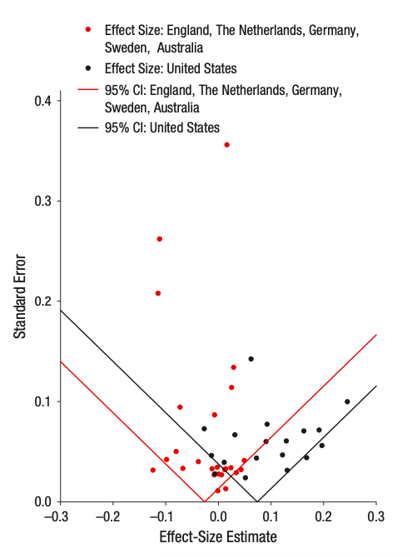
Results
Funnel plot of effect sizes indicates there is no evidence for publication bias
No evidence of p-hacking or selective reporting
Robustness checks did not meaningfully change results
Woodard
Notes:
*funnel plot of effect sizes: triangle indicates where 95% of data points should be if there is no heterogeneity in population effect sizes. No evidence for publication bias
*also p-curve analysis: used the p-checker app to see if there was p-hacking or selective reporting. No evidence for this was found.
*also robustness checks: included and excluded various patterns of the data to see if results changed. They didn’t. basically saying that findings aren’t attributed to a few selected studies being significant. so findings are pretty robust

Slide 40
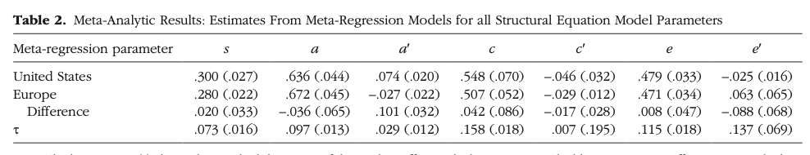
Results
Across all studies: no gene x SES interaction
Between study contexts:
  US: gene x SES interaction
  Non-US: no gene by SES
Woodard

Slide 41
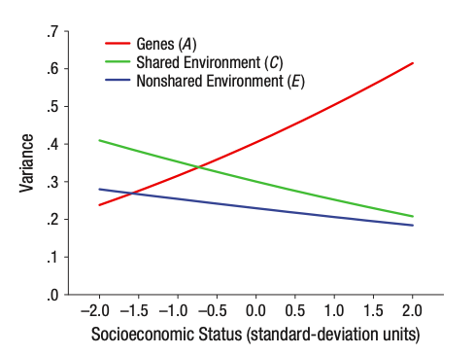
Results
Variance in cognitive test performance for the US sample accounted for by genetic and environmental factors graphed as a function of SES
Woodard

Slide 42
Results
Replicated well-established phenomenon that genetic influences on intelligence increase AND shared environmental influences on intelligence decrease with childhood age
Woodard

Slide 43
Gene x SES (US Only)
Evans

Slide 44
But overall no gene x SES interaction as its not present in Europe
Across all studies: no gene x SES interaction
Between study contexts:
  US: gene x SES interaction
  Non-US: no gene by SES
Woodard

Slide 45
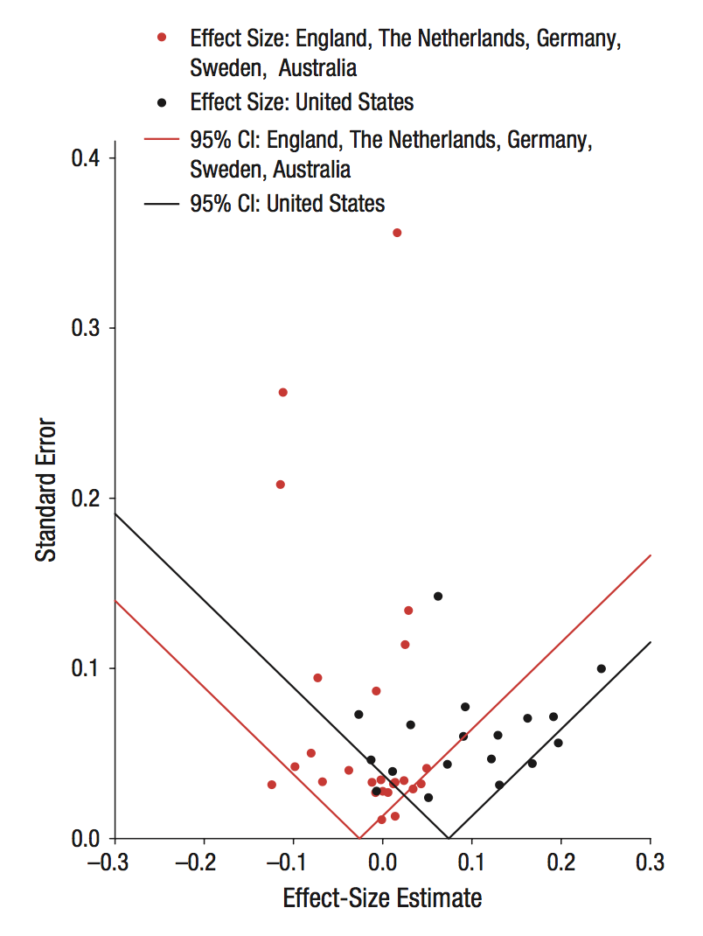
Validity Checks
Notes:
*funnel plot of effect sizes: triangle indicates where 95% of data points should be if there is no heterogeneity in population effect sizes. No evidence for publication bias
*also p-curve analysis: used the p-checker app to see if there was p-hacking or selective reporting. No evidence for this was found.
*also robustness checks: included and excluded various patterns of the data to see if results changed. They didn’t. basically saying that findings aren’t attributed to a few selected studies being significant. so findings are pretty robust.

Slide 46
Probing Additional Moderation
Moderation by other factors (age of sample, achievement vs IQ)
  No Evidence
Evans

Slide 47
Age Trends
Notes:
Figure S2. Age trends in genetic, shared environmental, and nonshared environmental variance in cognitive test performance.
Replicated well-established phenomenon that genetic influences on intelligence increase and shared environmental influences on intelligence decrease with childhood age.

Slide 48
Summary
Moderately sized Gene x SES interaction on IQ and achievement (a′ = .074), only in the U.S.
  Genetic influences are stronger at higher SES
  Environmental influences are stronger at low SES
Effects are robust
  Not driven by 1 or 2 studies
  No evidence for bias in either US or Non-US studies
No additional moderators supported.
  The difference in moderation does not appear to result from cross-national difference in other outcomes assessed.
Goodman

Slide 49
Discussion Questions
To what extent would neighborhood-level SES, as opposed to individual-level SES, change the interpretation of the study?
Are you convinced that racial and ethnic diversity did not drive the differences between U.S. and non-U.S. samples?
How might considering racial, ethnic, and cultural diversity change the findings and/or implications this study?
  Diversity within the United States & diversity in represented countries
Why was the Gene x SES so consistently unsupported outside the U.S.?
In mid to high SES, genetics contribute 40-60% of IQ variability. What implications does this have for interventions that target intellectual development? What are the study’s implications for policy, education, and development more broadly?
Goodman
Notes:
*what did you think about their assessment of studies of cross-national differences in racial diversity?
One possibility that we were unable to fully test in our meta-analytic data set is the extent to which the Gene × SES interactions detected in the United States were driven by the greater racial and ethnic diversity of the U.S. sample compared with the non-U.S. samples.
Tucker-Drob et al. (2011) reported that Gene × SES effects persisted in a nationally representative sample of American children even when race, and its inter- action with the biometric components, was controlled.

Slide 50
Intervention
“It is in contrast to severe deprivation that enrichment shows its statistically significant effects.”
Timing
    Gottlieb & Blair, 2004

Slide 51
Intervention only benefits deprived… Does this fit?
Rodent research: early experiences avert the deterioration of learning ability seen when rodents are reared in impoverished conditions
It is only in comparison to impoverished conditions that enrichment shows an influence
Exposure to enriched conditions after exposure to impoverished conditions does not matter
Gottlieb & Blair 2004

Slide 52
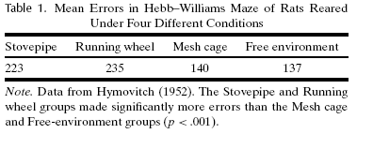
Early visual experience & exploration!
From about 27 days of age to 100 days of age:
a stovepipe cage (little motor or visual experience),
an enclosed running wheel (motor activity but little variation in visual experience),
a mesh cage restricted motor activity but variation in visual experience as cage moved daily in lab.
(4) large free environment box – socially and physically stimulating

Slide 53
Early vs. late experience
Its early experience that’s important
Table 2. Mean Errors in Hebb-Williams Maze of Rats With Different Early and Late Environmental Experiences
Free environment/ Stovepipe | Stovepipe/ Free environment | Free environment/ Free environment | Normal Cage/ Normal Cage
161 | 248 | 152 | 221
Note. Data from Hymovitch (1952). The Stovepipe/Free Environment and Normal Cage groups made significant more errors than the other two groups (p <.001).

Slide 54
Cognitive Development - Applications
Gottlieb & Blair (2004)
  Summary of impact of environmental variation in later learning in rodents
    Role of experience type
    Role of timing

Slide 55
The Abecedarian Project: Early Intervention in High Risk Families
  Multiple risks
    Low parental education
    Low income
    Father absence
    Unstable work history
    Family members with low IQ
    History of social service contacts
    Family history of school failure and psychopathology
  Random assignment to each = 4 conditions
    Daycare Intervention (birth – 5 years) vs. no treatment
    School age home-visiting intervention vs. no treatment
Gottlieb & Blair (2004)
(Ramey & Campbell, 1984)

Slide 56
Abecedarian project:
2 intervention components
Birth – 5 years: “comprehensive educational daycare intervention”
  “utilized developmentally appropriate curricula designed to facilitate children’s language, motor, social, and cognitive growth.
    Full-day care, 50-weeks a year
    93% enrolled by 3 months
5 – 8: “school age intervention delivered through home visitors, liaisons between home and school.
  designed to increase parent involvement in the educational process

Slide 57
Abecedarian intervention conditions
Early daycare intervention (birth – 5) with follow through services to 8 years
Only the educational daycare intervention
Only the school age follow through
An untreated control group.

Slide 59
Early intervention counts!
Gottlieb & Blair (2004) (cont)
Short-term Effects of Early Intervention on IQ Longer-term Effects of Early vs. Later Intervention
Notes:
Main effect of intervention

Slide 60
Early intervention counts!

Slide 61
Real life: % retained in grade

Slide 62
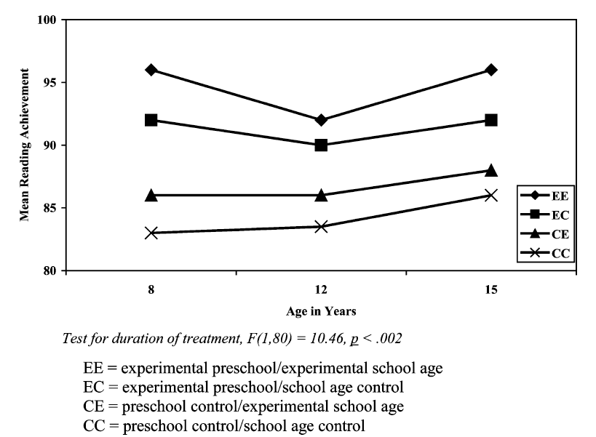
Later school: Reading level

Slide 63
Cognitive Development - Applications
Experiment 2
  Participants
  Conditions
  Interpretation
Notes:
Broader age range (2-13 years)
Addition of no-demonstration + demonstration (baseline) condition
Added familiar vs. unfamiliar demonstrator conditions---made no difference in performance
Importantly---no age related differences – in fact older children MORE likely to imitate; and even the 10 children who figured out simple solution in no-demonstration phase; all imitated after demonstration phase.

Slide 64

Education → Intelligence?

Slide 65
Education & Intelligence
Question:
“Do increases in normal-range educational duration after early childhood have a positive effects on student’s later intelligence?”
Why do we care?
  Cognitive skills asses by IQ tests have been linked to…
    Superior work performance
    Better physical & mental health
    Greater longevity
Notes:
Other than out of just pure intellectual curiosity…why would we care about whether increased education has positive effects on intelligence later in life?
Well, some things that are generally considered positive have been associated with the cognitive skills assessed by IQ tests including…

Slide 66
Education & Intelligence
Positive correlation between IQ test scores and years of education completed
Possible explanations:
  More education leads to greater intelligence
  Selection processes are at work such that more intelligent children end up spending more years in school
How do we know if one is true, the other, or both?
Notes:
We know that there is a positive relationship between scores on intelligence tests and the years of education an individual completes
However, this is just a correlation and there are different possible explanations for this relationship; two ways of looking at it include…
Even if the latter is true, that selection processes are in play, that does not necessarily mean that our first possible explanation cannot also be true
Because of this, it is difficult to test the causal hypothesis that more education leads to higher intelligence
This MA incorporates studies that use “sophisticated” designs that get around this probelm

Slide 67
3 Types of Studies
Control prior intelligence:
  Longitudinal study
  Cognitive testing data from before and after variation education duration
Policy change:
  Studies in which education duration changes because of some broader factor not specific to the individual
School-age cut-off
  Regression-discontinuity analyses used to study impact of school district date-of-birth cutoffs
Notes:
Past reviews have explored this relationship and this problem, but none have done so quantitatively.
This is why our present authors embarked on a meta-analysis. Hooray!
So how did they pick studies that would help them address this issue? Well they limited it to 3 types:
The first is what it sounds like: they looked at longitudinal studies that included measures of cognitive testing from before and after the variation in education duration,
allowing the association between education & intelligence to be explored while controlling for prior intelligence statistically
The second category included studies where some broader change not specific to the individual resulted in changes in education duration.
For this one they give the example education reforms in Norway in the 1960s; the number of years of required education was increased by 2 years and implemented in a staggered fashion
such that different places in the country implemented the change at different times. This allowed them to see how additional years of schooling received by some but not others impacted scores
on intelligence tests when men entered the universal military draft
The third category included studies in which school systems impose date-of-birth cutoffs such that children who are very similar in age starts school at different times allowing us to parse apart the influence of schooling
versus improvement with age

Slide 68
Primary Questions
Do increases in normal-range educational duration after early childhood have positive effects on student’s later intelligence?
What factors might moderate the effect of education on intelligence?
To what extent might the obtained meta-analytic effects be impacted by publication bias?
Notes:
#2: age! Do educational effects fade or decline with increasing age? I.e., if someone gets more education later on, does it have the same effect?
#3: could there be publication bias yielding a disproportionate number of positive results?

Slide 69
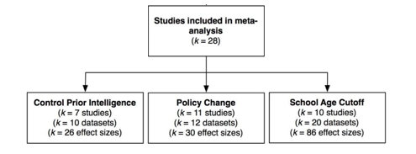
Method
Study Inclusion Criteria
  Objective, continuous cognitive outcome measures
  Variation in education after age 6
  Population studied generally healthy & neurotypical
  Fit one of the 3 study type categories
28 studies → 42 datasets → 142 effect sizes → 615,812 individuals
Notes:
-Included data from a number of published and unpublished sources.
-Needed objective cognitive measures (not simply subjective teacher ratings) that were continuous (so not necessarily IQ tests, could be tests of cognitive abilities presumably
tapped by IQ tests like memory and executive function)
-Were interested in effects of later educational process not preschool, etc., so focused on after age 6
-Did not include studies that focused on samples of patients with dementia or neurodevelopmental disorders
-Diagram from supplemental material shows the studies they initially selected for inclusion

Slide 70
Primary Questions
Do increases in normal-range educational duration after early childhood have a positive effects on student’s later intelligence?
What factors might moderate the effect of education on intelligence?
To what extent might the obtained meta-analytic effects be impacted by publication bias?
Notes:
#2: age! Do educational effects fade or decline with increasing age? I.e., if someone gets more education later on, does it have the same effect?
#3: could there be publication bias yielding a disproportionate number of positive results?

Slide 71
Increases in educational duration after early childhood positively affect later intelligence
Effect sizes rescaled into the # of IQ point units, on the standard IQ scale (M = 100, SD = 15), associated with 1 additional year of education
Effect size estimate for school-age cutoff group was significantly larger than that for the other two categories
However, there was considerable heterogeneity both within each group and in the overall model
Looked at moderators to potentially explain the heterogeneity
 | Control Prior Intelligence | Policy Change | School-Age Cutoff | TOTAL
Effect Size (SE) | 1.197 (0.203)*** | 2.506 (0.583)*** | 5.229 (0.530)*** | 3.394 (0.503)***
Notes:
Quick note: they rescaled the effect sizes into # of IQ point units on the standard IQ scale (M = 100, SD = 15) associated with 1 additional year of education

Slide 72
Primary Questions
Do increases in normal-range educational duration after early childhood have a positive effects on student’s later intelligence?
What factors might moderate the effect of education on intelligence?
To what extent might the obtained meta-analytic effects be impacted by publication bias?
Notes:
#2: age! Do educational effects fade or decline with increasing age? I.e., if someone gets more education later on, does it have the same effect?
#3: could there be publication bias yielding a disproportionate number of positive results?

Slide 73
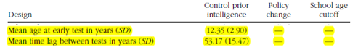

Results: Moderator Analyses
Control Prior Intelligence Studies
Age at early test: not significant
Time lag between tests: significant
  Smallest age gap (5 years): ~2.4 IQ points gained per additional year of education
  Largest age gap (~72 years): ~0.3 IQ points gained per additional year of education
Policy Change Design Studies
Age at which policy change occurred (to change required # years of education): not significant
Notes:
-Age at early test did not vary a whole lot and did not significantly relate to effect size in control prior intelligence studies
--------------------------------------------------------------------------------------------------------------------------------------
-Age at intervention ranged from occurring at 7.5 years of age to 19 years of age
-No significant difference in effect size based on the age at which the change in # of years of compulsory schooling occured

Slide 74

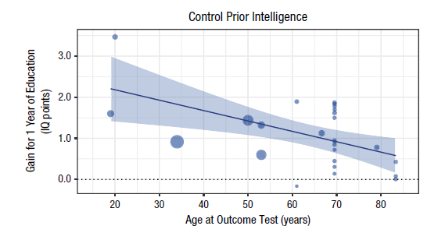
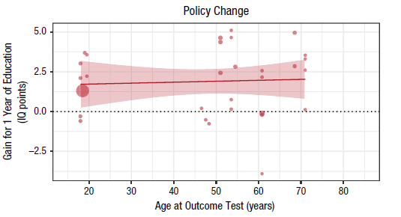
Results: Moderator Analyses
Age 18
~2.15 IQ pnts gained
per yr of education
Age 83
~0.49 IQ pnts gained
per yr of education
Age 18
~1.69 IQ pnts gained
per yr of education
Age 71
~2.41 IQ pnts gained
per yr of education
Notes:
-For the control prior intelligence studies, outcome age was a significant moderator with effect size of education declining by -0.026 IQ pts per year of age
-Basically, when people are tested at a later age, additional years of education seem to have less of an effect on IQ, whereas at earlier ages, education seems to have a greater effect
-For the control policy change studies, outcome age was not a significant moderator unless largest effect sizes (>3) were excluded
-For school-age cutoff designs, not shown in a figure but not significant; also comparatively little variation in age at time of outcome test
NOTE: larger bubbles for more precise studies

Slide 75
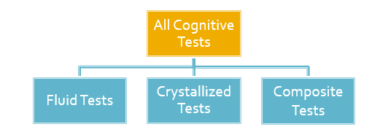
Results: Moderator Analyses
Outcome Test Category:
For control-prior-intelligence studies:
  Stronger education impacts on composite tests (~1.88 IQ pnts gained per yr of edu) than on fluid tests (~0.84 IQ pnts gained)
For policy-change studies:
  Education significantly impacted performance on composite (~2.31 IQ pnts gained per yr of edu) and fluid tests (~0.2.27 IQ pnts gained) but NOT crystallized tests
For school-age cutoff studies:
  Education significantly impacted performance on composite (~6.53 IQ pnts gained per yr of edu), fluid (~5.10 IQ pnts gained) and crystallized tests (~5.43 IQ pnts gained)
Notes:
Achievement-involved content likely directly taught at school (reading, math, science tests)
Other-remaining tests, IQ-type measures (processing speed, reasoning, vocab)

Slide 76
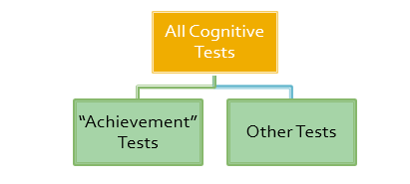
Results: Moderator Analyses
Outcome Test Category:
For policy-change studies:
  Education did not have a significantly different impact on “achievement” (~2.76 IQ pnts gained per yr of edu) versus other tests (~1.78 IQ pnts gained)
For school-age cutoff studies:
  Education had a significantly greater impact on “achievement” (~6.23 IQ pnts gained per yr of edu) versus other tests (~3.84 IQ pnts gained)
Notes:
Achievement-involved content likely directly taught at school (reading, math, science tests)
Other-remaining tests, IQ-type measures (processing speed, reasoning, vocab)
*Also looked at male-only versus coed studies. No differential education effect.
*Also looked at results when entering multiple moderators into the models for each study type group; all that were significant previously remained significant

Slide 77
Primary Questions
Do increases in normal-range educational duration after early childhood have a positive effects on student’s later intelligence?
What factors might moderate the effect of education on intelligence?
To what extent might the obtained meta-analytic effects be impacted by publication bias?
Notes:
#2: age! Do educational effects fade or decline with increasing age? I.e., if someone gets more education later on, does it have the same effect?
#3: could there be publication bias yielding a disproportionate number of positive results?

Slide 78
Results: Testing for Publication Bias
Compared published and unpublished studies in each group (control-prior intelligence, policy-change, school-age cutoff) to see if effect sizes differ
  Effect sizes either didn’t differ or were actually larger in the unpublished work
Also conducted 3 other types of tests (funnel plots, p-curve, and PET-PEESE analyses)
Overall, these publication bias tests suggested that there was “minimal systematic bias” in the results

Slide 79
Summary
Consistently found that having more years of education associated with greater intelligence test scores
The studies included in the meta-analysis were intentionally chosen for their designs to limit potential confounds of selection processes (i.e. intelligent people end up with more years of education because they are more intelligent)
Because of this approach, results support the idea that education may have a causal effect on intelligence
Overall, found that there were approximately 1-5 IQ points gained per additional year of school

Slide 80
Discussion Questions
What do you think of the different types of studies they selected to include in this meta-analysis? Do you find the results for one type of study to be more convincing than for others? What are the relative strengths and weaknesses in trying to parse apart the intelligence-education association in this way?
They tested several moderators, but are there other potentially moderating factors you would like to see in a meta-analysis like this one (or in the studies that it encompasses)?
What do you think of how they collapsed a diverse set of outcome tests across studies? How does this impact the interpretation of their findings? Were you satisfied with how they addressed this issue their moderation analyses?
Overall results suggest that each year of additional education improves IQ by 1 to 5 points. Even if this association is statistically significant, is the size of the effect large enough for us to care? Should we intervene based on these results? If so, to what extent? Do you think there are limits to this effect?
When we demonstrate that education improves intelligence scores, what sort of relationship do you think we are really getting at? What does it mean to improve intelligence? Which cognitive factors do you think are affected? Should we be surprised that education has an impact?
Notes:
#4: I think what I am getting at is that are we just measuring the same thing we are teaching?
-Not just “cognitive abilities” but things like aptitude for and familiarity with test-taking…how could we separate out this piece?
-Do we need to?

Slide 81
The Structure of Individual
Differences in the Cognitive Abilities of Children and Chimpanzees
Hermann et al. 2010
Ni Sun-Suslow

Slide 82
Two approaches to studying cognition
  Compare experimentally constituted groups on some cognitive task.
    Individual differences = “error variance”
  Analysis of individual difference and their intercorrelations (Sternberg, 1999, 2004).
    Look for underlying factors that might be responsible for individual variation in cognitive performance on multiple cognitive tasks.
Ni Sun-Suslow

Slide 83
Is structure of cognitive abilities similar in humans and chimpanzees?
Comparing cognitive performance of chimpanzees, orangutans, and 2-year-old humans on a wide-ranging battery of cognitive tasks:
  All species has same basic cognitive skills in physical domain
  Human children showed more skills in social domain
Ni Sun-Suslow
Notes:
Physical domain = tasks involving space, quantities, and causality
Social domain = communication, social learning, theory of mind

Slide 84
Interspecies analysis of individual difference and intercorrelations
Hypothesis:
Children would show a distinct factor for social intelligence, whereas chimpanzees would not.
Population:
 | Chimpanzees | Humans
N | 106 | 105
Ages | 3-21 years | 2.5 years
Females | 50% | 50%
(ethnicity?) | Uganda, Republic of Congo | Mostly German
Ni Sun-Suslow
Notes:
Humans were recruited by telephone from existing database from Hermann et al., 2007 study.

Slide 85
Test Battery
Primate Cognition Test Battery (PCTB)
3-5 hour battery
Chimpanzees tested in familiar room, humans tested in laboratory accompanied by parent
Ni Sun-Suslow

Slide 86
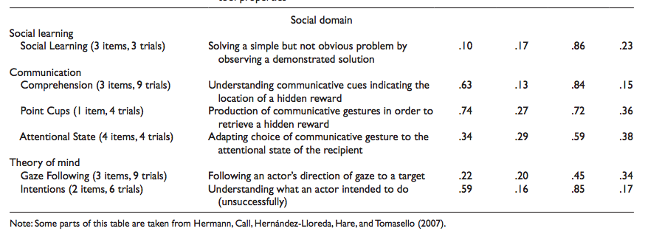
Social Cognition
Ni Sun-Suslow

Slide 87
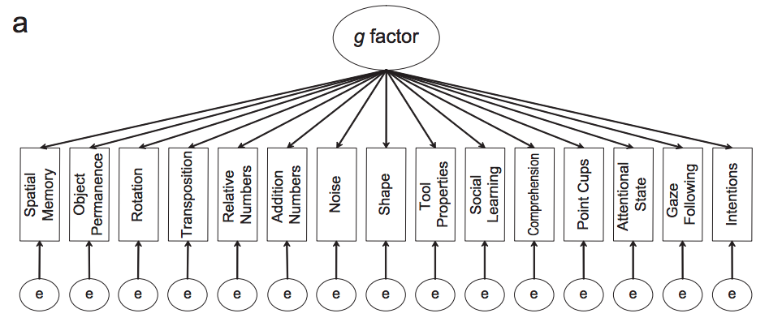
general intelligence
CFA model based on Tomasello & Call (1997)’s theoretical analysis of primate cognition.
Ni Sun-Suslow
Notes:
Theoretical models used in data analysis

Slide 88
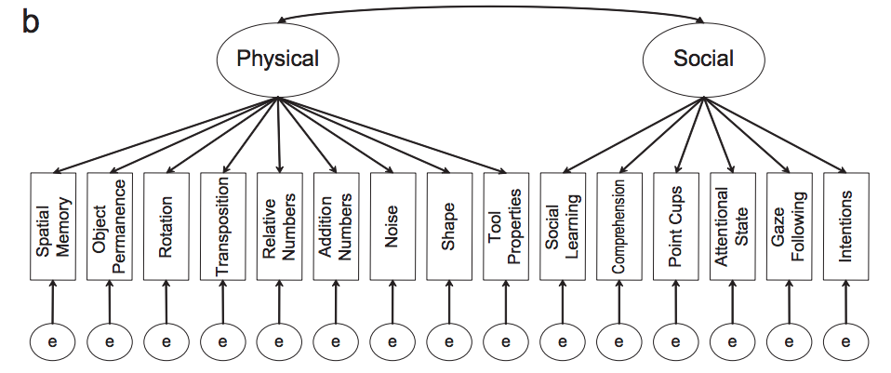
Two-factor model
Ni Sun-Suslow
Notes:
Physical and social factors

Slide 89
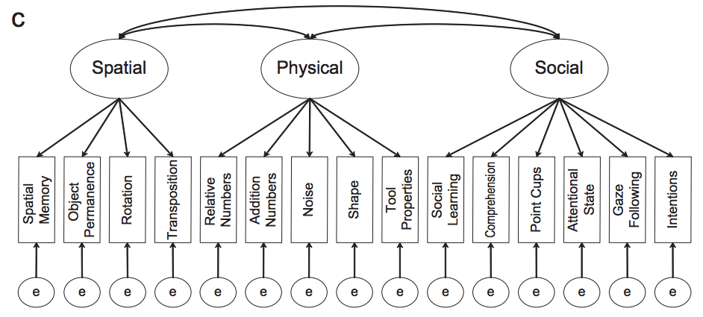
Three-factor model
Ni Sun-Suslow
Notes:
Theory posits that physical cognition evolved mainly in response to demands of foraging and comprises of skills involving space (for finding food), quantity (for comparing yields of different foraging locations), and causality (for extracting food from different places).
Social cognition evolved in response to demands of social interaction and comprises skills of social learning (for learning important things vicariously), communication (for manipulating other individuals), and theory of mind (for predicting the behaviors of others)

Slide 90
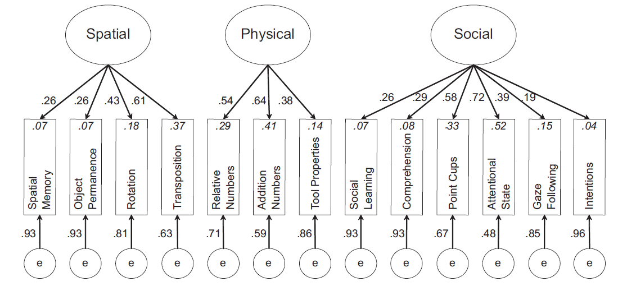
  Best fitting model for children
  (social separate)
    Hermann et al. (2009)
Notes:
Study of individual .
Fig. 2. The best-fitting model from the confirmatory factor analysis of the human children’s performance on the Primate Cognition Test Battery. In
this model, performance on 13 tasks loaded onto three factors (e = error). The numbers alongside the arrows are standardized parameter estimates.
The numbers in italics are the squared multiple correlation values, which represent the lower bounds of the proportion of variance accounted for by
the factors.
Battery of 15 cognitive tasks spanning 3 domains
Spatial
Physical
Social
Tested fit of 1, 2, and 3-factor models separately by species (see Figure 1)
differences and intercorrelations gives info about underlying structure of cognition

Slide 91
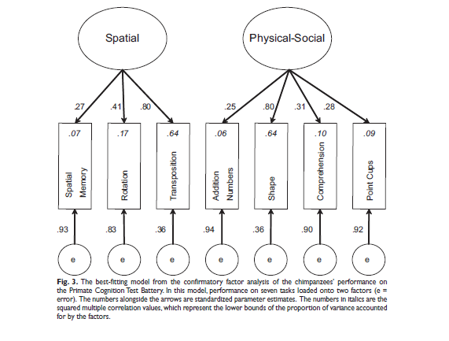
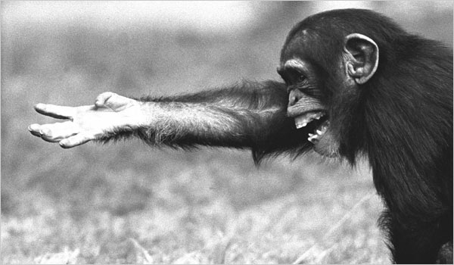
Best fitting model for chimpanzees
(no social)
Notes:
No factor that identified social cognition skills apart from physical cognition ones

Slide 92
Cognitive Development - Applications
Hermann et al. (2009)
  Good example of application of psychometric approach to studying intelligence
  Interpretations of
    group differences vs individual differences and inter-correlations
Notes:
Study of individual differences and intercorrelations gives info about underlying structure of cognition

Slide 93
Cognitive Development - Applications
Hermann et al. (2009)
  No support for “g” in either species
  Is social cognition uniquely human?
    Humans have higher mean scores
    Unique & separable structure
Notes:
May not find support for “g” because used an especially wide range of cognitive tasks (compared to most standardized assessments)
Mean differences and unique integrated social processing for humans may suggest that humans have evolved a coherent and specialized set of social-cognitive skills
Limitations?
Interpretation of underlying structure is entirely dependent on tests used
Low variability in performance on some test items
Different age ranges for human and chimp groups (chimps ranged from juvenile to adult) vs. children (2 yrs old)
**different species evolve different cognitive skills for dealing with ecological and social problems they face; therefore humans = social cognition

