Slide 1
Psychology of Infancy
PSY 430

Slide 2
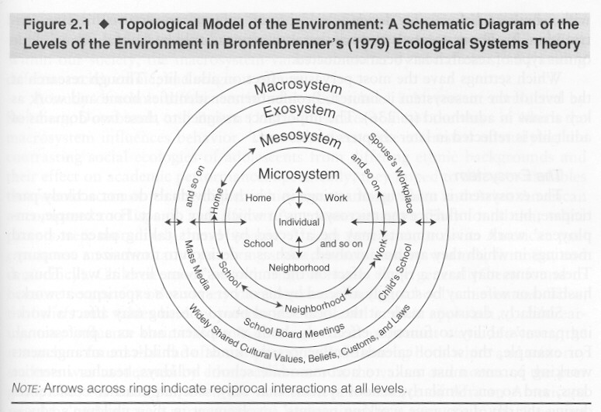
Domains of Development
Perception
  Joint attention
Cognition
Language
Social/Emotional

Slide 3
Perception in the world
Infants perceive with hands and gaze
Perceptual narrowing
  Visual and auditory
Face processing
  Other-race effect (ORE)
  Individualized training – short & long term effects
  Wait, is there an ORE (for dynamic stimuli)?
ASD implications of where you gaze…
Longer infant gazes →
  Lower intelligence
  Higher effortful control
  4-10 months→41 months

Slide 4
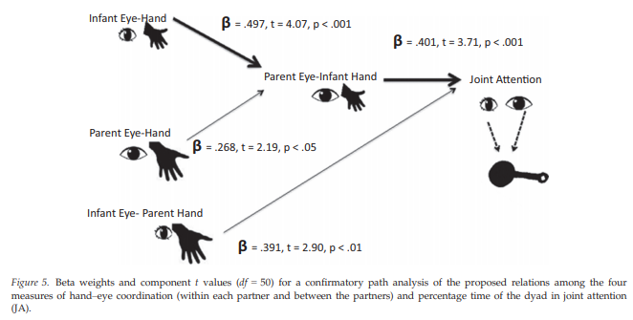
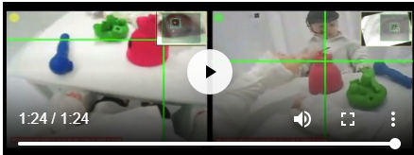
Paths to word acquisition
Parents label the object infants are looking at
Parent looking at infant’s face & object
Infant looking at object
at 9 months
Larger vocabulary size
at 12 & 15 months
Grassie
Notes:
Previous research suggested that a key factor of infant word learning is that when an infant sustains attention on an object, a parent names the object

Slide 5
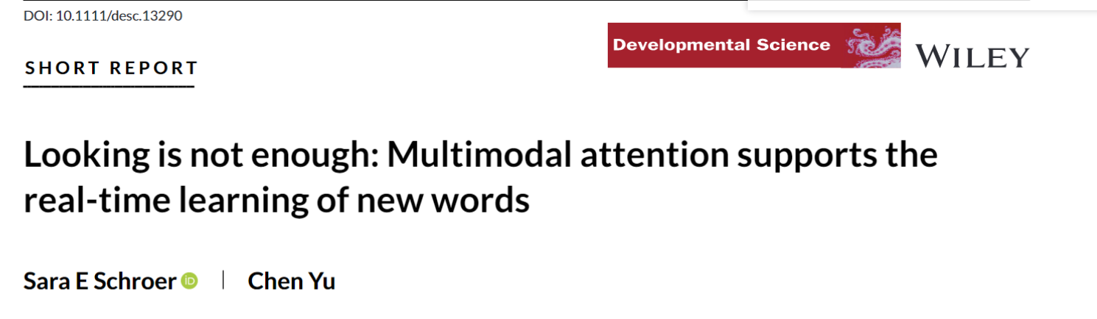
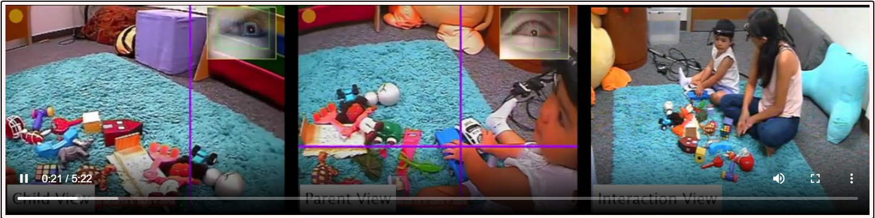
Hand and eyes

Slide 6
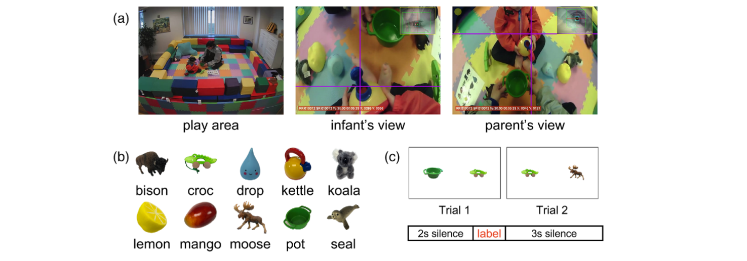
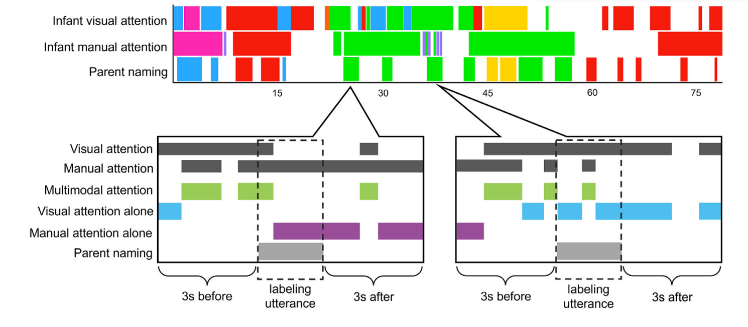

Slide 7
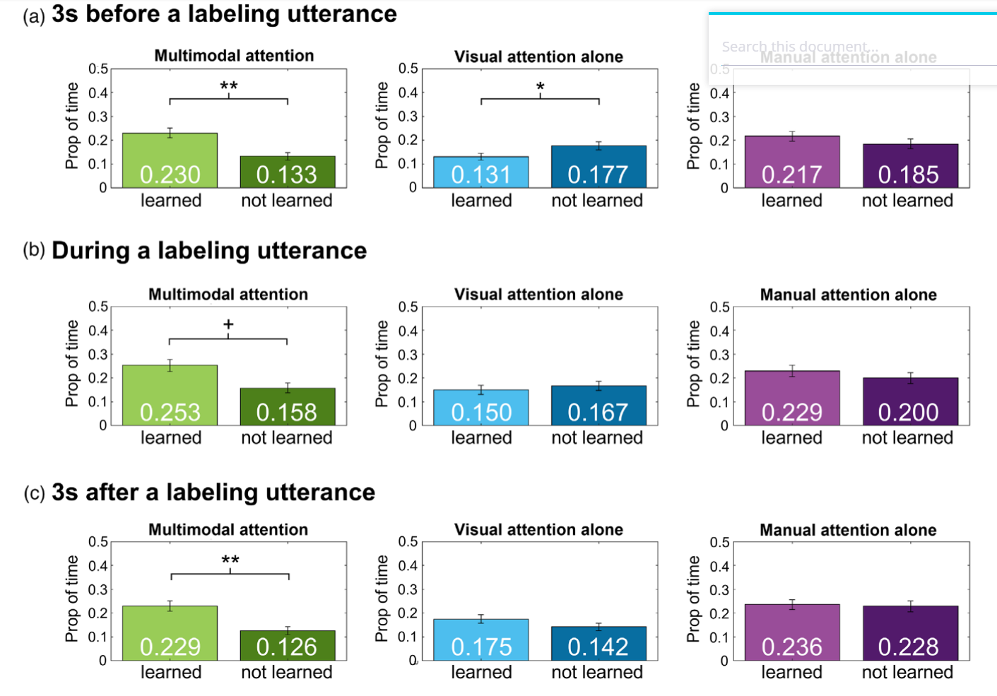
Label objects infants are looking at and touching

Slide 8
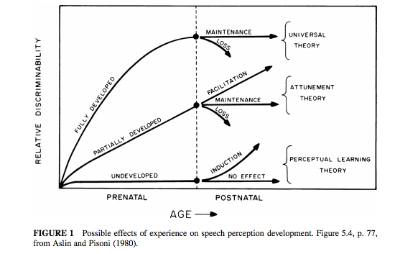
“Critical” Initial Formulation
Similarity in timing

Slide 9
What’s going on?
English-learning infants hear Hindi contrast better than English-speaking adults
Almost as well as adult Hindi-speakers

Slide 10
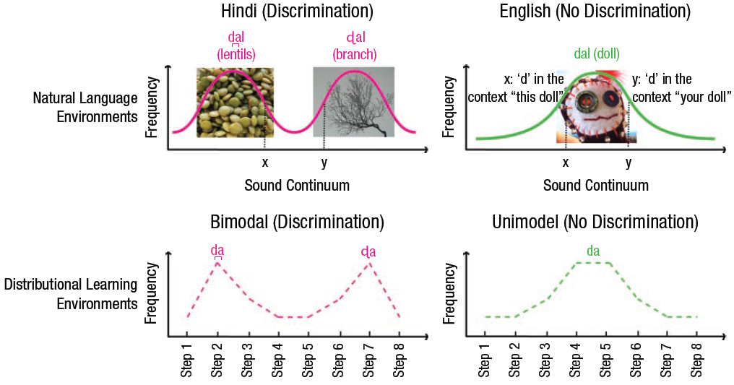
Perceptual Narrowing During Infancy: A Comparison of Language and Faces
Maurer and Werker (2013)

Slide 11
Voice versus face perception
Distinctions can be reestablished
  By increasing exposure time or training
Induction of new skills and reorganization of existing skills
  At 9 months items from native face categories are processed differently than at 3 months
In later childhood and adulthood
  Other-race face distinctions can be reacquired
  Phonetic distinctions are not as successful
Differences in timing of perceptual narrowing
  Present earlier for other-race faces and vowels and for other-species faces and consonants

Slide 12
Evidence As Usual
Newborn prefers listening to speech and looking at faces
  But not specific
At 3 months
  Preference specific to human faces and voices
At 3-6 months
  Discriminate within native & non-native speech contrasts
  Discriminate within own- & other-species faces and voices
  As well as other non-native distinctions (lexical tone, sign categories, other-race faces)
Older infants fail these distinctions
Notes:
Prenatal listening history may explain voice bias, but not fully
Infants can discriminate both native and non-native consonant and vowel contrasts at birth

Slide 13
Somewhat Contrary Evidence
Distinctions can be reestablished
  By increasing exposure time or training
Induction of new skills and reorganization of existing skills
  At 9 months items from native face categories are processed differently than at 3 months
In later childhood and adulthood
  Other-race face distinctions can be reacquired
  Phonetic distinctions are not as successful
Differences in timing of perceptual narrowing
  Present earlier for other-race faces and vowels and for other-species faces and consonants

Slide 14
Qualifying the Construct
Not only a decline in perception of non-experience stimuli
Improvement in perception of experienced stimuli
Experience dependent cascading windows
  Infants attune to rhythmical properties of the native language before the segmental properties
Critical period
  Biologically based timetable in language processing
  Learning based timetable in face processing

Slide 15
Perceptual Narrowing
Young infants show greater preparedness to respond to any potential social signal
Set of experience-expectant sensitivities that have adaptive significance
Minimal input needed to maintain sensitivities
Mechanistic explanation is implied

Slide 16
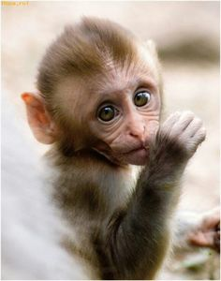
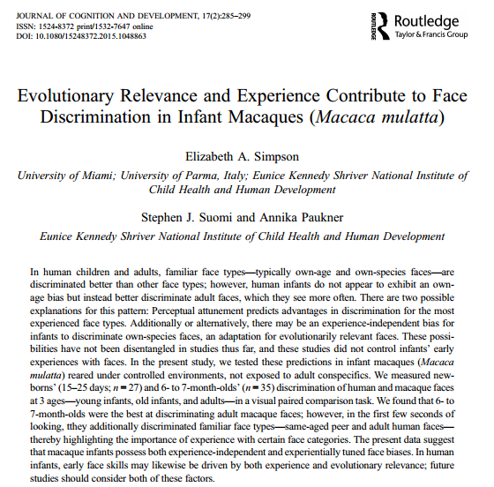
Experience vs. functionalism
Experience: Perceptual attunement
    Experience driven biases improve with exposure and decline without
      vs.
Functionalist approach
  Face-processing skills reflect age-appropriate developmental goals
  Biggest threat = absence of caregivers or presence of strangers → adult bias
Are developmental changes in face discrimination consistent with perceptual attunement or functionalist approach
Experience driven biases
  Perceptual attunement; improves with exposure, declines without
  Exposure must be accompanied by individuation (individual names)
Functionalist approach
  Face-processing skills reflect age-appropriate developmental goals
  Biggest threat = absence of caregivers or presence of strangers
Purpose:
  Test face discrimination biases in infant rhesus macaques with controlled, atypical exposure to faces
  Are developmental changes in face discrimination consistent with perceptual attunement or functionalist approach
  Are differences in discrimination the consequence of face viewing patterns during familiarization?
Background
Familiar face discrimination
  Race, peers, gender, species

Slide 17
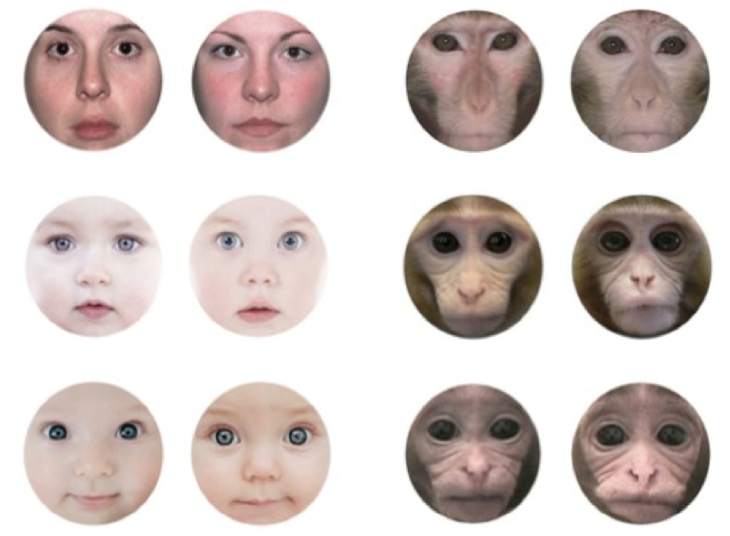
Simpson et al. example

Slide 18
Results mixed
  No Bonferroni-corrected differences among newborns
  6-7 mo early stimulus viewing (first 1 - 2 seconds) looked at
      novel human adult faces
      novel monkey adult faces & same-aged peer monkey faces
        No significant differences among newborns
  Eye–mouth-index (EMI)
    Newborns: EMI’s greater than chance for adult faces only
    6-7 mo: EMI’s were greater than chance for all age groups
  and face discrimination

Slide 19
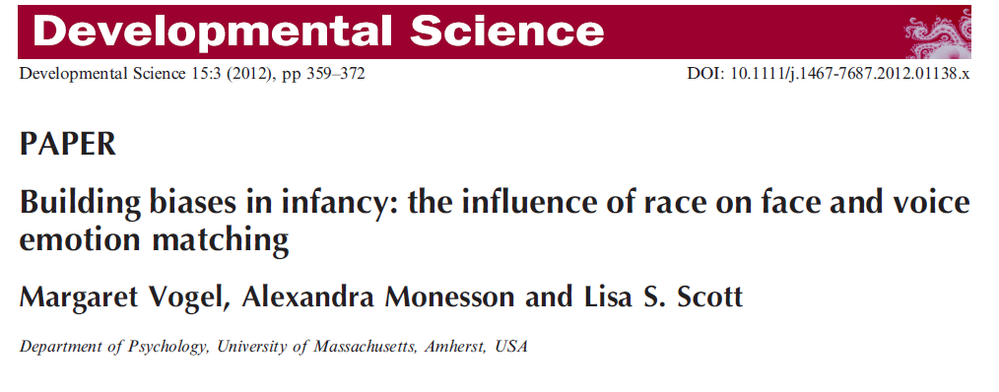

Slide 20
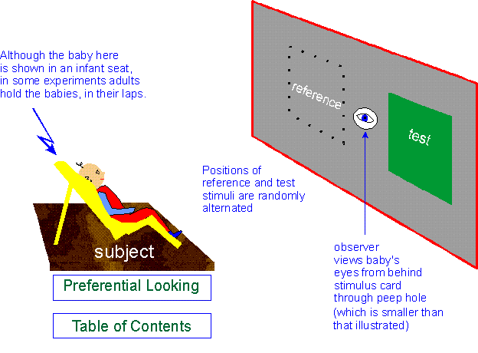
Preference paradigms for Studying Perceptual Development
    (see Bar-Haim et al., 2006)
Notes:
Preference is clear; but lack of preference doesn’t necessarily mean difference not detected; therefore often rely on conditioning paradigms that involve less inference of null result

Slide 21


Slide 22
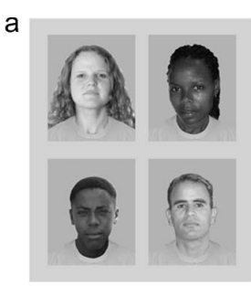
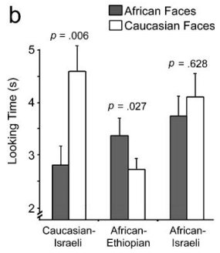
Preface: Face Processing preference
  Bar-Haim et al., 2006

Slide 23
Origin of other-race effect (ORE)
Perceptual narrowing- infants become attuned to faces that they are exposed to more in the environment (own-race faces) relative to less frequently encountered faces (other-race faces)
Perception of emotion
Experience and emotion processing

Slide 24
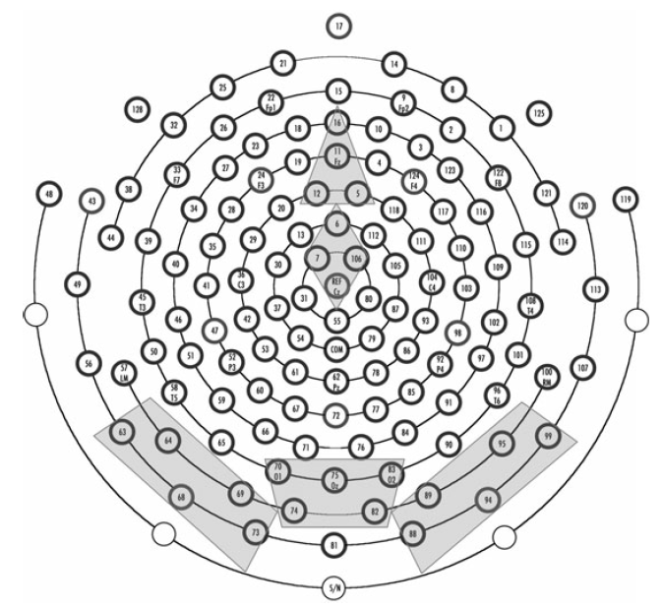
3 ERP components associated with both face and emotion processing in infants
Posterior ERP components related to perception:
  N290
  P400
Anterior ERP component related to attention:
  Negative control component (Nc)

Slide 25
Purpose of Study
Examine whether decline in ability to recognize other-race faces influences the ability to match emotion sounds with faces expressing congruent or incongruent emotional expressions

Slide 26
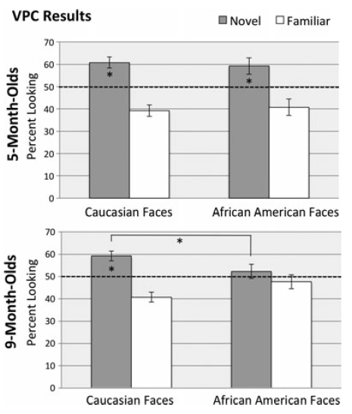
Face Processing (Vogel et al., 2012)--Behavioral Findings
Viewed familiarized happy face paired, side-by-side, with a novel happy face of same race for accumulated looking time of 10 s.
  Side of stimulus presentation switched after 5 seconds.
  Then completed task using faces from the race not previously viewed.
Notes:
Figure 3 Behavioral visual-paired comparison (VPC) results.
All infants completed one VPC task for Caucasian faces and a
second VPC for African American faces. Pictured is mean
percent looking (±SE) toward the novel and familiar stimuli
after 30 seconds of familiarization to the familiar face.
Whereas 5-month-old infants looked longer to the novel
Caucasian and African American faces, showing evidence of
discrimination for both races, 9-month-old infants only looked
longer to novel Caucasian faces.
Familiarized to two, side-by-side, images of same smiling face for 30 s accumulated looking time

Slide 27
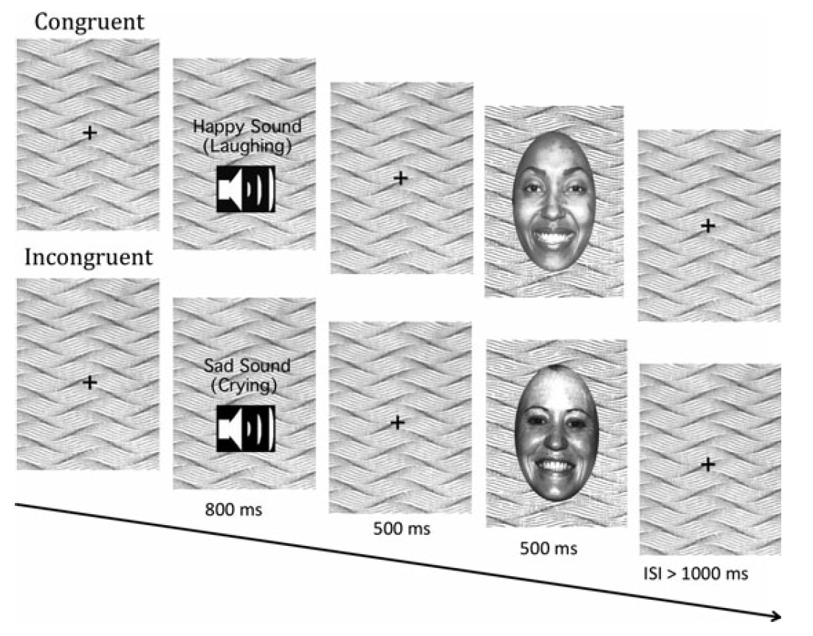
Method
Sample
  Caucasian infants (5 mo and 9 mo) who have little or no previous experience with African Americans
Behavioral procedure
  Visual paired comparison (VPC)
Electrophysiological procedure
  ERP recorded

Slide 28
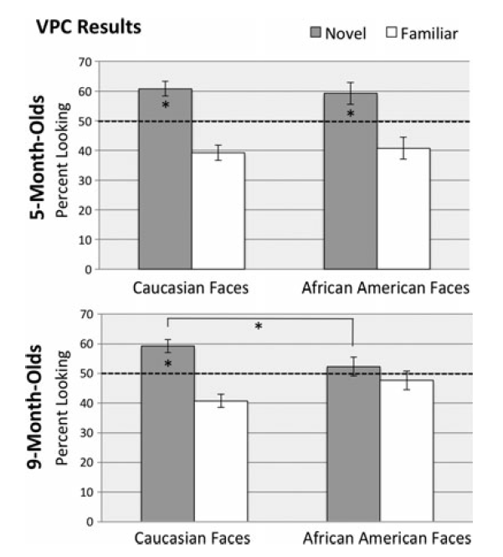
Behavioral visual-paired comparison (VPC) results
Notes:
after 30 seconds of familiarization to the familiar face. Whereas 5-month-old infants looked longer to the novel Caucasian and African American faces, showing evidence of discrimination for both races, 9-month-old infants only looked longer to novel Caucasian faces.

Slide 29
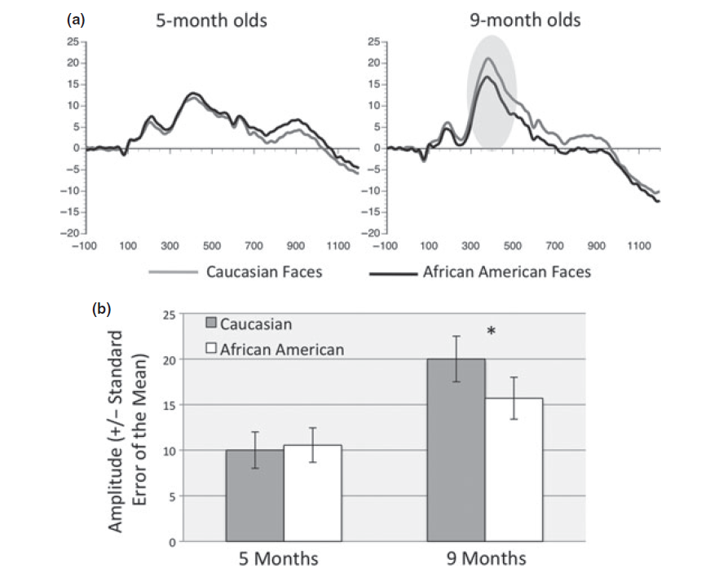
ERP (P400 amplitude) incongruency
Perceptual processing of congruency. (a) Illustrates the P400 component in response to African American and
Caucasian congruent and incongruent sound ⁄ face pairs in 5-month-old and 9-month-old infants
Notes:
P400 is a component of face-processing response
Figure 6 Perceptual processing of congruency. (a) Illustrates the P400 component in response to African American and
Caucasian congruent and incongruent sound ⁄ face pairs in 5-month-old and 9-month-old infants (arrow denotes significant latency differences).
(b) Mean Latency (±SEM) for the P400, across conditions, for both ages. In 9-month-old infants the latency in response to the Caucasian incongruent condition peaked faster than the Caucasian congruent condition. No differences were found for 5-month-old infants.

Slide 30
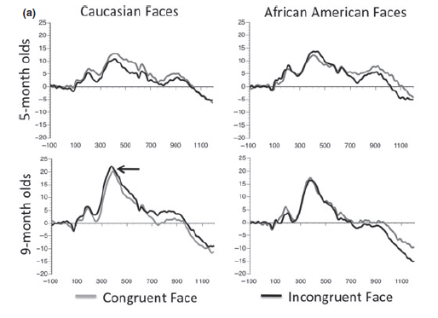
Effect of congruency on latency is specific to Caucasian faces at 9 months
Face Processing (Vogel et al., 2012)
Notes:
Figure 6 Perceptual processing of congruency. (a) Illustrates the P400 component in response to African American and
Caucasian congruent and incongruent sound ⁄ face pairs in 5-month-old and 9-month-old infants (arrow denotes significant latency differences).
(b) Mean Latency (±SEM) for the P400, across conditions, for both ages. In 9-month-old infants the latency in response to the Caucasian incongruent condition peaked faster than the Caucasian congruent condition. No differences were found for
5-month-old infants.

Slide 31
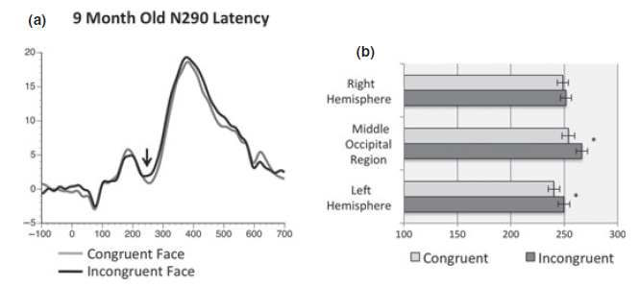
N290 component in 9-month-old infants
Notes:
Figure 4 N290 component in 9-month-old infants: (a) ERP response to congruent versus incongruent faces. The response to
congruent faces peaked earlier than the response to incongruent faces. (b) This earlier peaking N290 was primarily driven by latency
differences recorded over in the left hemisphere and middle occipital regions.

Slide 32

Conclusions
Perceptual narrowing and the ORE influence emotion processing
Notes:
Neural networks used to process emotion change during development

Slide 33
Follow up study assessing the long-term effects (at ages 4-6) of conceptual learning between 6 and 9 months of age
Early training with names (Boris the monkey) makes you a faster human face processor

Slide 34
Perceptual narrowing and training
  As a result, environmentally relevant categories are privileged in both perception and recognition
Scott & Monesson, 2009
  By 9 mos, infants better distinguish faces in familiar groups
  With 6 hours of individual level (“Boris”) training (6 to 9 mos), 9-month-olds differentiate unfamiliar monkey faces
  9-month-olds with individual-level, but not category-level experience, show better stroller discrimination
  Learning to individuate objects or faces during infancy leads to neural specialization
    N170 ERP is part of an index of expert holistic processing in adults
      Modulated by inversion of faces
Perceptual narrowing/tuning
  Labeling Early individual-level learning results in differential processing of learned categories
that can be measured in event-related potential (ERP) waveforms
Notes:
Perceptual narrowing- Developmental process during which the brain uses environmental experiences to shape perceptual abilities. This process improves the perception of things that people experience often and causes them to experience a decline in the ability to perceive some things to which they are not often exposed
given approximately 6 hours of training from 6 to 9 months of age, 9-month-olds continued to differentiate unfamiliar monkey faces, while 9-month-olds with no experience exhibited a decline in discrimination ability (Pascalis et al., 2005). Furthermore, when labeling was experimentally manipulated (individual names: ‘Boris’, ‘Fiona’; a category label: ‘Monkey’, ‘Monkey’; or no label at all), only 9-month-olds trained with individual names (from 6 to 9 months of age) continued to differentiate monkey faces (Scott & Monesson, 2009).

Slide 35
Individual-level experience
9-month-olds with individual-level experience, but not category-level experience, demonstrate increased visual discrimination of strollers
Learning to individuate objects or faces during infancy leads to neural specialization that can be measured in event-related potential (ERP) waveforms
  The N170 ERP is part of an index of expert holistic processing in adults
    Modulated by inversion of faces
    and lab-trained objects of expertise

Slide 36
Purpose of Study
Examine whether early conceptual learning between 6 and 9 months leads to sustained advantages and neural changes in the same children at 4-6 years of age
  Stimulus or process-specific?

Slide 37
Hypotheses
Compared to children who experienced category-level training or were not trained at all
  Children who experienced individual learning at 6 months will:
    Respond faster and have larger N170 inversion effects for the category (monkey-monkeys for monkeys and strollers-strollers) they were trained in (stimulus-specific) OR
    Respond faster and have differential N170 inversion effects to stimuli they continued to learn at the individual level (e.g., human faces) (process-specific)
Notes:
A process-specific effect
would be consistent with findings in adults that report
that the FFA (Fusiform Face Area) responds to both
faces and non-face objects of expertise (e.g. Bilalic,
Langner, Ulrich & Grodd, 2011; Gauthier, Skudlarski,
Gore & Anderson, 2000; Harley, Pope, Villablanca,
Mumford, Suh, Mazziotta, Enzmann & Engel, 2009) as
well as reports of N170 suppression effects in response to
faces when concurrently processing faces and objects of
expertise (Greebles: Rossion, Kung & Tarr, 2004; cars:
Rossion, Collins, Goffaux & Curran, 2007).
In
the present investigation, it is possible that in the absence
of continued stimulus-specific learning about monkey
faces or strollers, the behavioral and neural changes seen
at 9 months of age following training will diminish and
those neural resources will instead be recruited for
individuating human faces.

Slide 38
6 months to 6 years
  78 children (4-6 years-old)
  Randomly assigned to label (“Boris”) versus category (“monkey”) learning groups in previous study (Scott & Monesson, 2009, 2010; Scott, 2011)
Parents read/looked at a book with either 6 monkey faces or strollers for 3 months (6 hours total)
    Labeled at the individual or category level
Children completed a behavioral discrimination and ERP inversion task that included
  untrained exemplars from within the trained category
    monkey faces or strollers
  untrained categories (strollers for children trained with monkey faces and monkey faces for children trained with strollers)
  Also test with human faces
“Boris” vs. “monkey”

Slide 39
Method & Analyses
Behavioral procedure
  Match-to-sample paradigm
  Response time and accuracy
  Independent t-tests
Electrophysiological procedure
  Upright and inverted images of
  monkey faces, strollers, and
  human faces
  3x3x3 mixed model MANOVA
    Factors: training group, condition,
    and region
Notes:
After three correct practice trials
with colored shapes (M = 3.2 trials), children completed
three random match-to-sample trials from each of the
following four conditions: (1) novel exemplars from
within trained category, (2) familiar trained exemplars
from within the trained category, (3) exemplars from the untrained category (e.g. strollers for children trained with
monkey faces), and (4) human faces. For each trial,
children viewed one image for 5 seconds. After a 5-
second delay, the familiar image and a novel image from
within the same category were presented side-by-side.
Children indicated via button press which of the two
images was familiar. The number of trials per condition
was consistent with what was used for the visual-paired
comparison task when the participants were infants
(Scott, 2011; Scott & Monesson, 2009).

Slide 40
Behavioral Results
Children in the individual-level training group exhibited faster overall response times compared to children with category-level training (t(36) = 2.62, p = .01) and with no training (t(48) = 2.07, p = .04)
Children with individual level training exhibited significantly faster response times to human faces compared to children with category-level training (t(36) = 2.80, p = .01) and children with no training (t(48) = 2.71, p = .01) (Figure 2)
No significant response time differences between training groups in response to the trained or untrained stimuli

Slide 41
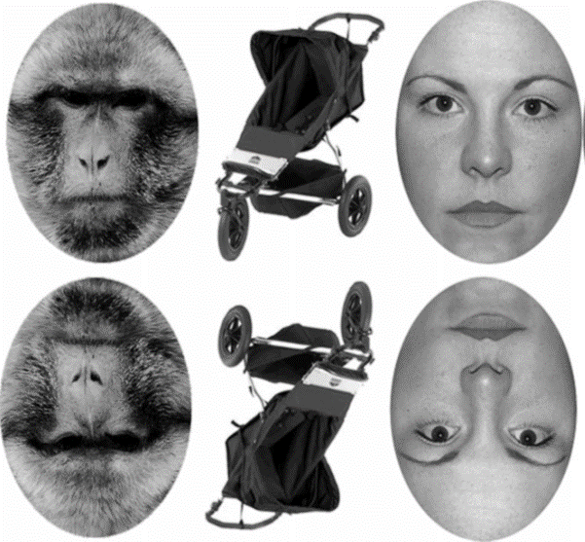
Individual-trained are faster to human faces
(& overall)

Slide 42
Electrophysiological Results
Children trained at individual level → inverted human faces elicited a larger negative amplitude than upright human faces
Children trained at category level + no-training control group → upright human faces elicited a larger negative amplitude than inverted human faces
Children trained at the individual level show significantly faster response times to human faces relative to other training groups

Slide 43
Results

Slide 44
Results
Only individual-level training on monkey faces

Slide 45
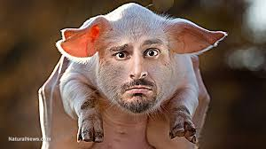
Individual-level training!
Children with early individual-level training exhibited faster response times and adult-like neural responses to human faces
Early individual-level learning results in long-lasting process-specific benefits
What is it about individual labels?
How could this address the other race effect?
Brief, early learning experiences prior to formal education can be important for later developmental abilities

Slide 46
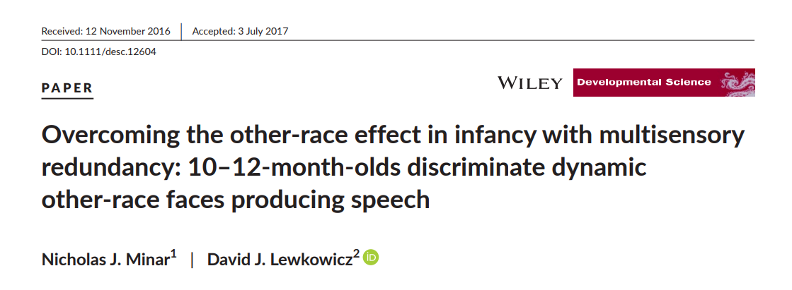

Slide 47
Phenomenon of Other-Race Effect (ORE) Among Adults
Adults better at recognizing, distinguishing, and remembering face of people of their own race than of other races
Question posed by the ORE literature: when and how does this begin?

Slide 48
ORE begins within 1st year of life
ORE function of perceptual narrowing
  Infants move from lower ability ability to discriminate faces of all races to increased discrimination ability for same-race faces and decreased discrimination ability for other-race faces
  Process begins as early as 3 mos. and complete by 9 mos.
ORE explained by disproportionate exposure to same-face faces
Increased exposure to other-race faces delays or reverses perceptual narrowing

Slide 49
Limitation of Prior Literature
ORE studies in infants relied upon static images (i.e., b/w photos) or dynamic silent faces (i.e., videos w/ no sound)
Stimuli not ecologically valid
  Infants perceive dynamic faces with vocalizations in daily life
  Attend more to dynamic vocalizing faces than either static or dynamic silent faces

Slide 50
Importance of multisensory input
Multisensory redundancy in perception of dynamic vocalizing faces increases perceptual salience
  Improved perception
  Improved learning
  Improved memory
Question of whether older infants still retain ability to distinguish other-race faces if they are dynamic and vocalizing

Slide 51
Study Aims
Primary: determine whether infants at two sets of ages (4-6 mos. and 10-12 mos.) can discriminate own- and other-race faces
  If so, determine whether this depends on dynamic images with vocalization
Secondary: determine if infants use selective attention to different face parts

Slide 52

Habituation/Test Procedure
1s look-away criterion for habituation/trials
  Stimulus presentation continued until 60s elapsed or infant looked away for more than 1s
Pre-test (up to 60s)

Slide 53
Pre-test (up to 60s)
Notes:
Winnie the Pooh video: 60s; assess initial level of attention; continue to maxium of 60s or when 1s lookaway criterion was met

Slide 54
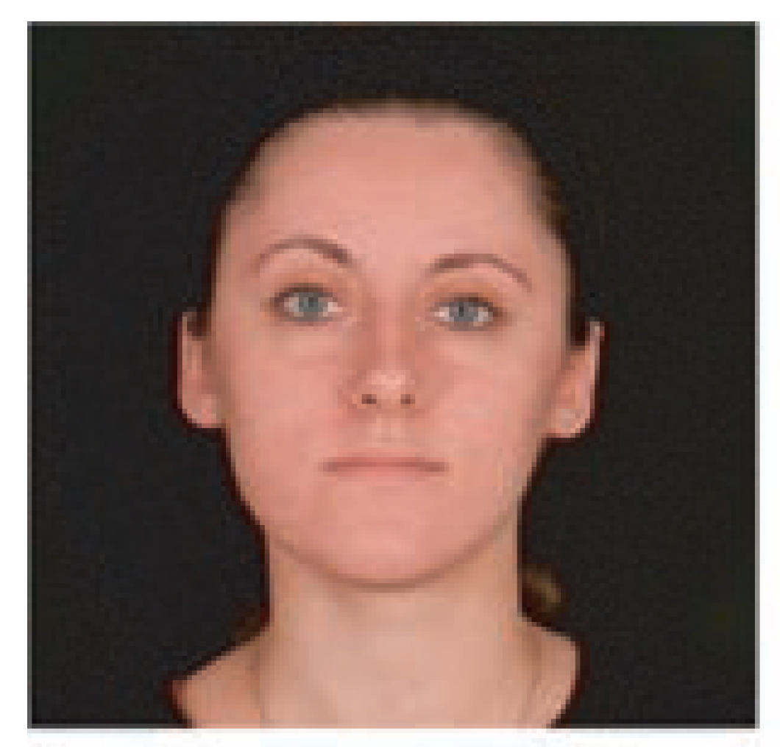
Habituation
Notes:
Habituation trials – 1s look-away criterion
Attention-getter presented after each trial presentation of the stimulus
Habituation was deemed to occur when the total amount of looking during the three most recent trials were less than 50% of the looking time during the first three trials.

Slide 55
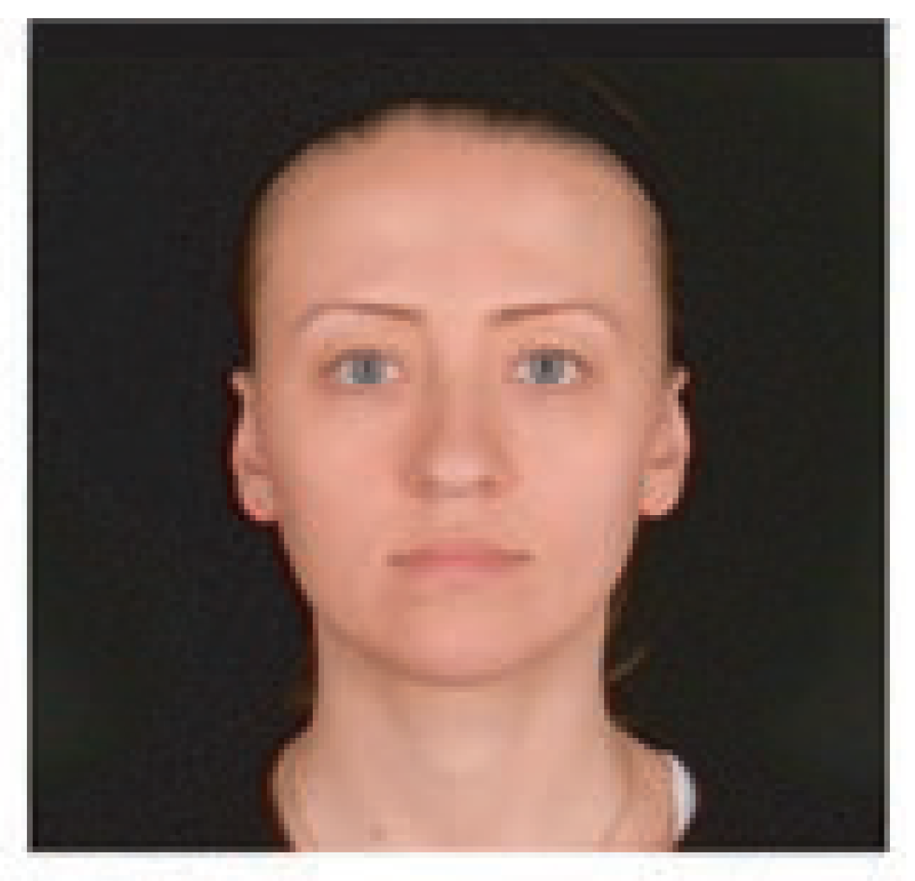
Test Phase
Notes:
Start with the Familiar test trial (face presented during habituation phase)
Novel test trial (different face)

Slide 56
Post-test (up to 60s)
Notes:
Responsiveness used to measure terminal level of attention

Slide 57
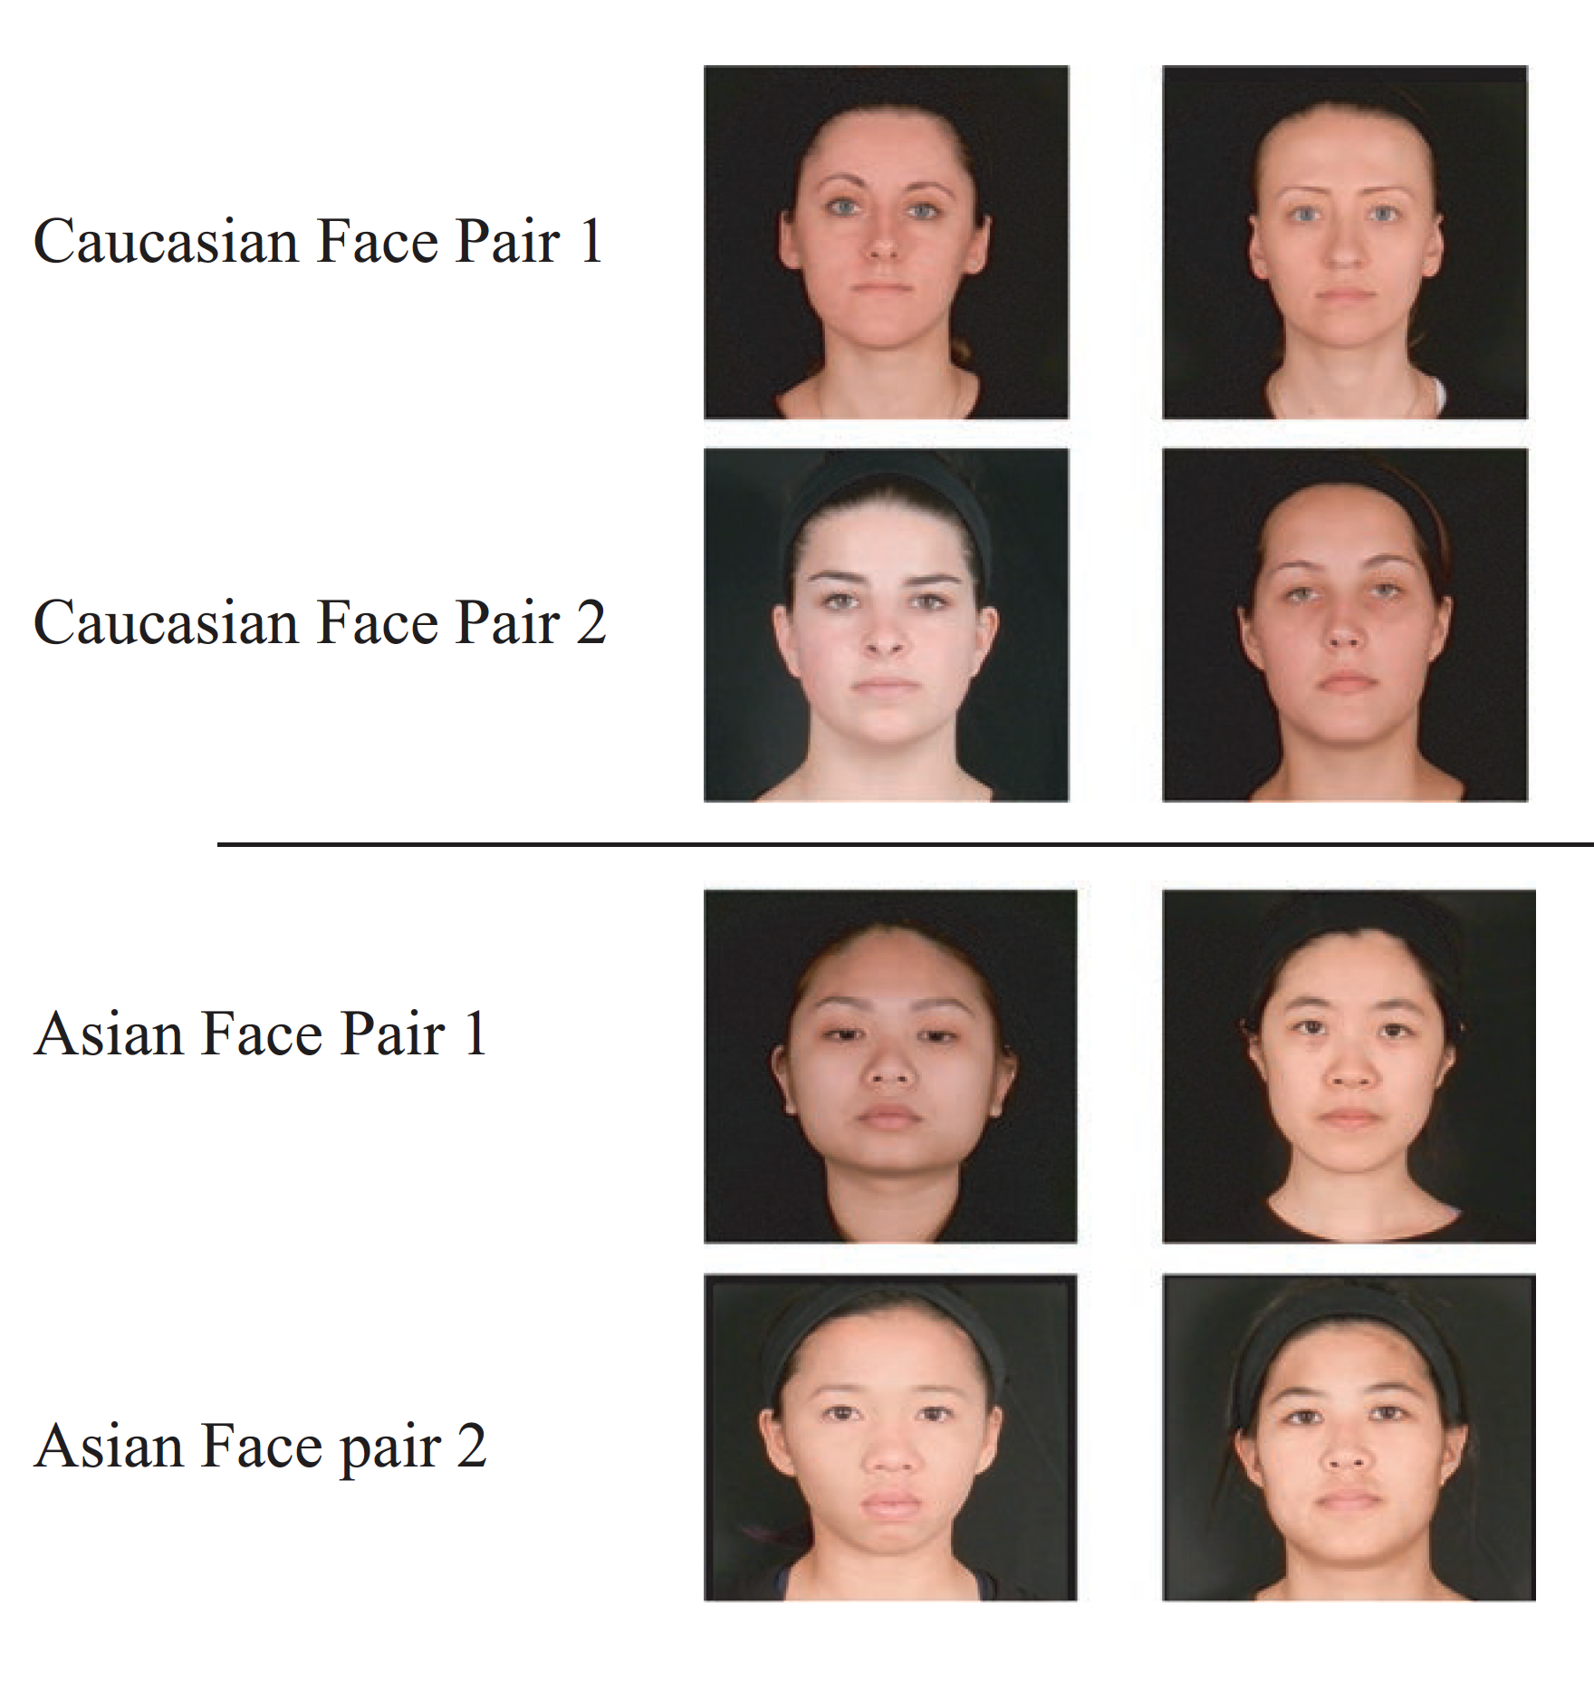
Test Stimuli
Notes:
Each infant presented with one set of faces - either same-race faces or other-race faces – but not both
Stimulus actors self-identified as being either Caucasian or Asian (Chinese, Japanese, or Vietnamese)
All 8 faces rated as similar in attractiveness/distinctiveness by 30 adult raters

Slide 58
Experiment 1
Test stimuli: Dynamic image with audible speech utterances
Participants:
  Group 1: 28 4-6 month old Caucasian infants
  Group 2: 27 20-12 month old Caucasian infants
  Exclusions
    Fussy (4); inattentive/parental interference (3); mixed racial background (6)
Notes:
Audible speech utterances were the same across all presentations

Slide 59
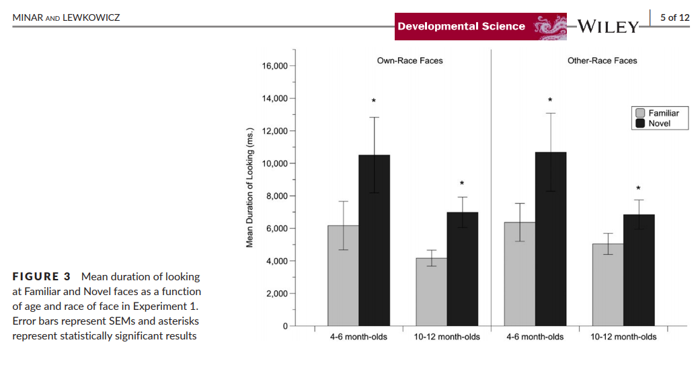
Test stimuli: Dynamic image with audible speech utterances
Notes:
they combined the duration of looking scores for the two Familiar and the two Novel test trials to yield a single mean duration of looking score for each respective type of test trial.
Figure 3 shows the mean duration of looking at the Familiar and Novel faces as a function of age, separately for own-race and other-race faces.
To test the hypothesis that infants would exhibit response recovery when presented with novel faces of either race, they used planned, paired-samples, t tests (one-tailed) to compare responsiveness across the Familiar and Novel test trials at each age, respectively.
These tests indicated that both groups (the 4–6-month-old infants and the 10-12 month old infants) exhibited significant response recovery when presented with novel Caucasian faces as well as novel Asian faces.
In sum, the results from this experiment indicate that infants of both ages successfully discriminated own- and other-race dynamic faces which were accompanied by a redundant audible speech utterance.
Critically, the findings demonstrate that 10–12-month-old infants can discriminate other-race faces when they can be seen and heard uttering a speech sound, which contrasts with results from previous studies.
The researchers interpreted that the infants’ successful facial discrimination was based on the dynamic multisensory characteristics of the faces. Specifically, the multisensory redundancy probably increased the perceptual salience of the face which in turn probably increased the infants’ attentional focus, to the point that it made it possible for them to engage in deeper processing of facial feature information.

Slide 60
Experiment #2
Test stimuli: Dynamic image with no audio
Participants:
  Group 1: 24 4-6 month old Caucasian infants
  Group 2: 24 20-12 month old Caucasian infants
  Exclusions
    Fussy (2); mixed racial background (1); recent eye infection (1)

Slide 61
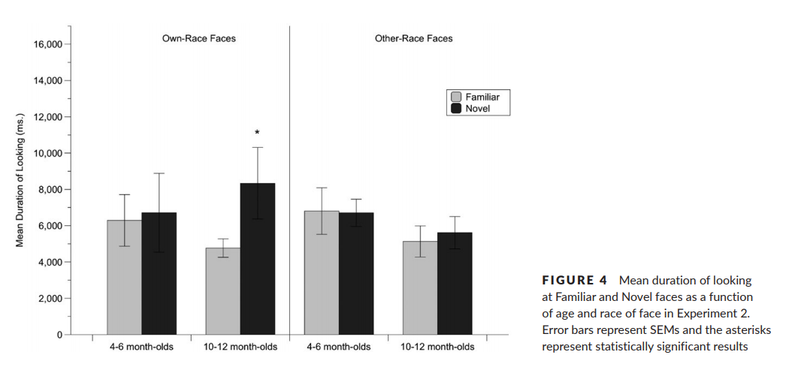
Test stimuli: Dynamic image with no audio
Narrowing effect?
Notes:
The next experiment tested this possibility.
If the successful face discrimination obtained in Experiment 1 depends on the accompanying and redundant speech utterances, then infants should not be able to discriminate silent faces even if they can see articulating speech.
If, however, dynamic facial cues are sufficient for discrimination, then the infants should be able to discriminate the faces.
So the researchers repeated Experiment 1, except that this time they presented the faces in silence.
They hypothesized that the younger infants would be able to discriminate both types of faces because of their broad perceptual tuning for all face categories, but that the older infants would not be able to discriminate other-race faces because of the effects of perceptual narrowing.
Once again, 2 age groups were tested: 4-6 month olds and 10-12 month olds.
Also once again, data informing the mean duration of looking scores for the two familiar and two novel test trials were collapsed to get a single mean for each respective type of test trial.
Results indicated that the 4–6-month-old infants did not exhibit response recovery to either the novel Caucasian face or to the novel Asian face.
In contrast, results indicated that the 10–12-month-old infants exhibited response recovery to the novel Caucasian face, but not to the novel Asian face.
Findings indicated that dynamic visual cues alone are not enough to elicit discrimination in the younger infants nor are they sufficient to elicit discrimination of other-race faces in the older infants.
Only the own-race faces were able to be discriminated for the 10–12-month-old infants.

Slide 62
Experiment #3
Test stimuli: Dynamic image with non-human sound (“boing”)
Participants:
  Group 1: 25 4-6 month old Caucasian infants
  Group 2: 24 20-12 month old Caucasian infants
  Exclusions
    Fussy (3); mixed racial background (6); recent health concern (1)

Slide 63
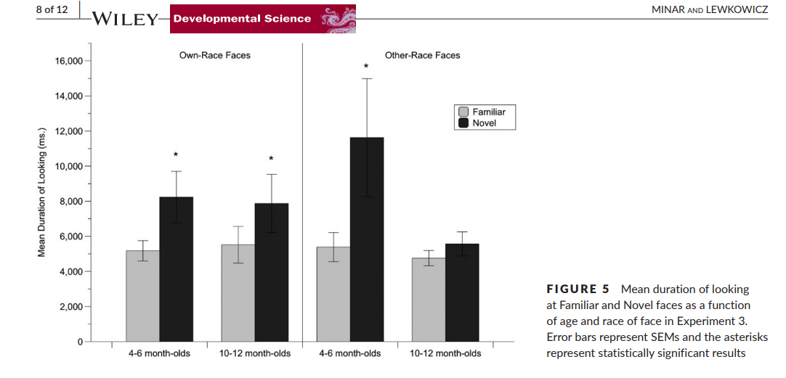
Dynamic image with non-human sound (“boing”) (classic effect)
Notes:
The previous experiments showed that both age groups of infants can discriminate dynamic other-race faces as long as they are accompanied by a redundant speech utterance.
If that’s the case, what specific form must the redundancy take for the older infants to overcome the ORE?
Must the redundancy be represented by equivalent speech information across the modalities or can it be a more general form of redundancy that is specified by facial speech cues together with temporally synchronized sounds?
To answer this question, we repeated Experiment 1 except that this time we presented the faces together with a temporally synchronized nonspeech sound.
The same videos were used, this time though the faces saying /a/ were accompanied by a “boing” sound.
These tests indicated that the 4–6-month-old infants discriminated the Caucasian faces and the Asian faces.
In contrast, the paired-samples t tests indicated that the 10–12-month-old infants discriminated the Caucasian faces, but that they did not discriminate the Asian faces.
In other words, the data from the older infants suggest that they require that other-race faces be accompanied by redundant speech attributes, rather than just sounds, to be able to successfully discriminate other-race faces, while the younger infants do not.

Slide 64
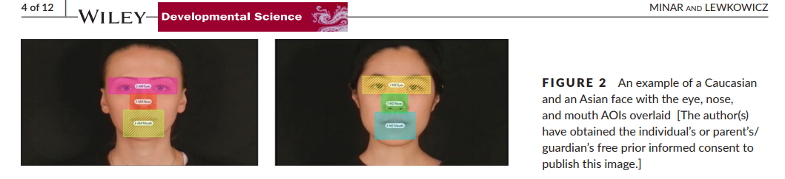
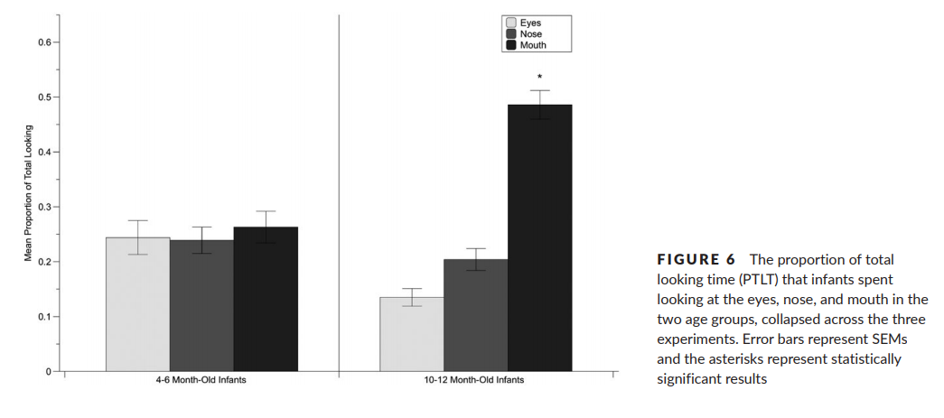
Selective Attention
Eye tracking AOIs
regardless of race and a speech syllable or a non-speech sound, the 4–6-month-old infants distributed their attention equally to the three regions of the face during the habituation phase but that the 10–12-month-old infants allocated most of their attention to the mouth.
Notes:
To collect the point-of-gaze data with the eye tracker, the researchers defined four areas-of-interest (AOI): the whole face, eyes, nose, and mouth. To determine where infants focused their attention during learning, they examined point-of-gaze during the first three habituation trials. They calculated each infant’s proportion-of-total-looking time (PTLT) scores for the eyes, nose, and mouth AOI by dividing the amount of total looking to each of these AOIs by the total amount of looking to the whole face AOI.
Then they entered the PTLT scores into a mixed, repeated-measures ANOVA, with AOI (eyes, nose, and mouth) as the within-subjects factor and Age (4–6 and 10–12 months of age), FaceRace (Caucasian or Asian), and Experiment (1, 2, or 3) as between subjects factors.
These results indicate that, regardless of the actor’s race and whether it was accompanied by a speech syllable or a non-speech sound, the 4–6-month-old infants distributed their attention equally to the three regions of the face during the habituation phase but that the 10–12-month-old infants allocated most of their attention to the mouth.

Slide 65
Discussion Questions
On what basis did the authors limit the infants by race (Caucasian) and exclude mixed race infants?
What would we expect to see if the study were done with infants growing up in multiracial contexts? In monoracial but non-Caucasian contexts?
Why rely upon adult assessments of similarities between stimuli (i.e., racial categorization, attractiveness, distinctiveness)? Are there viable bias-free alternatives?
Are there potential implications of this study for infant caregiving?
How might hearing impairment affect an infant’s perceptual narrowing with respect to facial discrimination?

Slide 66
Methods for Studying Perceptual Development
HR, HR variability, RSA
Absolute thresholds and/or Difference thresholds
Psychophysiology
  CNS Measures
    Neurological anatomy
    Single cell recordings
    Functional recordings
      EEG/ERP, PET, fMRI
    ANS Measures (HR, HR variability, RSA)
Behavioral Measures
  Naturally occurring behaviors
  Preference paradigms
    Conditioning paradigms
    Habituation/Dishabituation
    Eye-tracking
Notes:
Ans measures include HR, HR variability, RSA; sensitive to changes in attention state; reflect orienting, sustained attention, state changes
Problems with inferring perceptual experiences from physio measures; extraneous variables and interpretation takes a lot of inference

Slide 67
Eye-tracking as a window into cognition & experience
HR, HR variability, RSA
Habituation and IQ
Gaze duration and temperament
Gazing patterns and autism

Slide 68
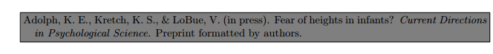
Visual cliff and fear of heights?
Do crawling infants avoid crossing the brink of a dangerous drop-off because they are afraid of heights?
No, avoidance and fear are conflated.
Instead, infants avoid crawling or walking over an impossibly high drop-off because they perceive affordances for locomotion—the relations between their own bodies and skills and the relevant properties of the environment—that make descent impossible.
    Visual cliff
    https://www.youtube.com/watch?v=p6cqNhHrMJA
    Databrary https://nyu.databrary.org/volume/5
Notes:
http://www.youtube.com/watch?v=4OelrPzpQ6Q (not working)

Slide 69
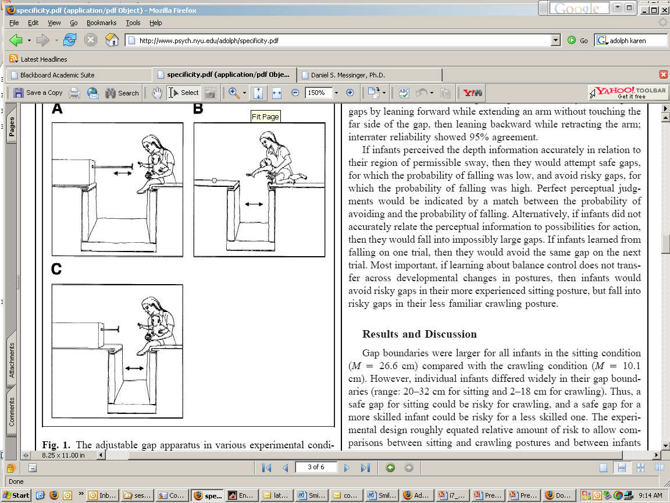

“Babies avoided reaching over risky gaps in the sitting posture but fell into risky gaps while attempting to reach in the crawling posture…
        Karen E. Adolph (2000) . Specificity of Learning: Why Infants Fall Over a Veritable Cliff . Psychological Science 11 (4), 290–295.

Slide 70
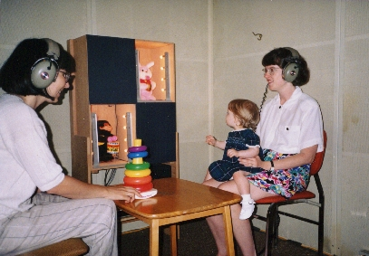
Conditioning paradigms
Reinforcement of a voluntarily controlled motor activity leads to it being repeated

Slide 71
Do babies at risk for ASD like faces?
Infants prefer familiar voices, faces, bio motion
Are these preferences disrupted in autism?
  Later ASD: lack of eye contact, joint attention, inability to recognize emotions
Baby sibling longitudinal design
  Tested at 2,3,4,5,6,9,12,15,18,24 months
  110 infants (59 High Risk for Autism)
  12 with ASD at 3 year outcome
  Current study only looks at males (11 ASD, 25 LR-TD)

Slide 72
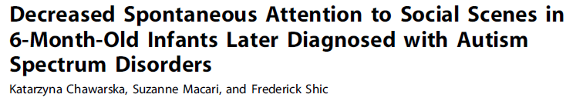
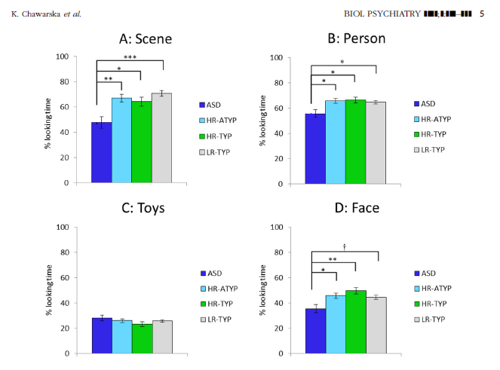

Slide 73
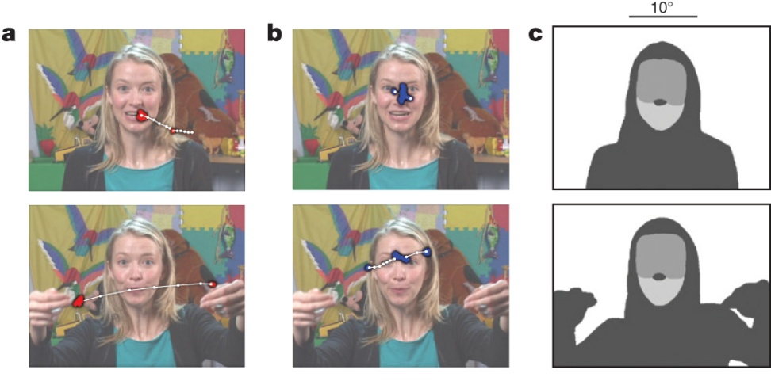

Attention to eyes is present but in decline in 2–6-month-old infants later diagnosed with autism. W Jones & A Klin Nature 000, 1-5 (2013) doi:10.1038/nature12715
Example stimuli, visual scanpaths, regions-of-interest, and
longitudinal eye-tracking data from 2 until 24 months of age.

Slide 74
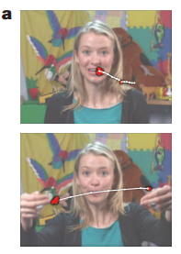
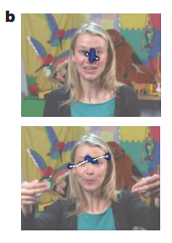
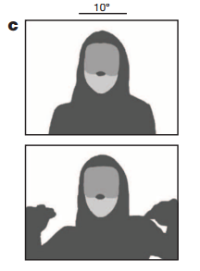
Methods
Tracked eye gaze during naturalistic “caregiver interaction” videos
Measured percentage of visual fixation to eyes, mouth, body and objects in a naturalistic video
Tracked over time

Slide 75
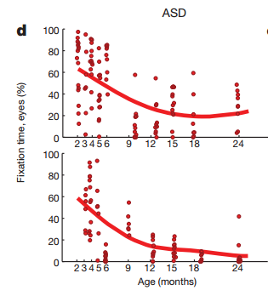
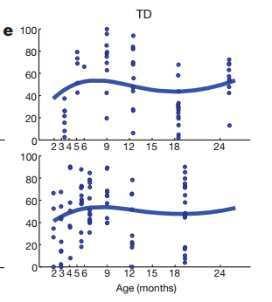
TD vs ASD
TD
Look more at eyes than anywhere else from 2 to 6 months
Mouth fixation increases during 1st year, peaks at 18 months
Body and object fixation drops through first year
ASD
Eye fixation declines from 2-24 months
Mouth fixation increases until 18m
Object and body fixation declines slowly in 1st year
Object fixation rises in 2nd year
Notes:
Two individual kids

Slide 76
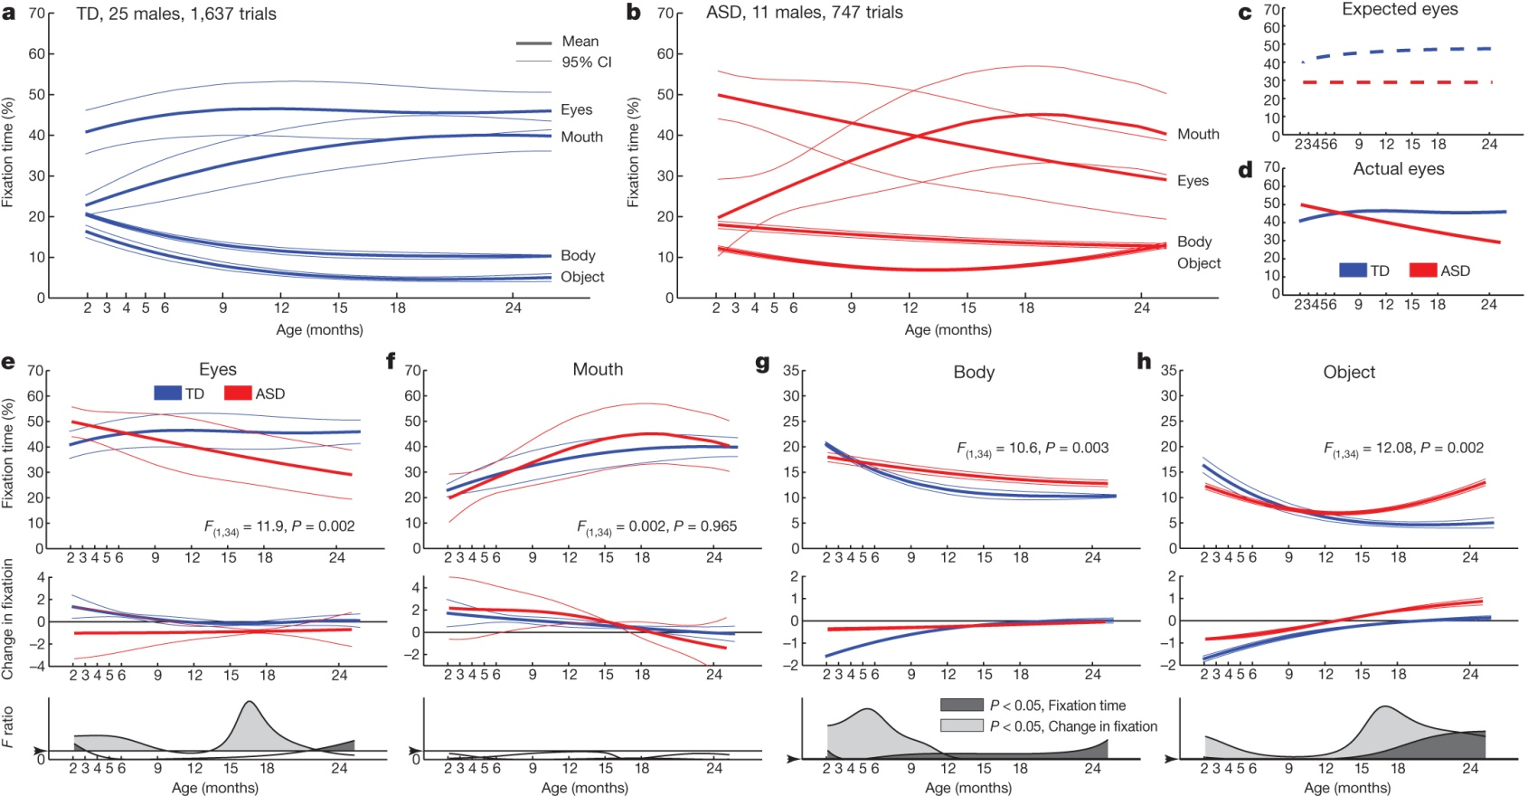
Growth charts of social visual engagement for typically
developing children and children diagnosed with ASD.
Early decrease in gazing at eyes
W Jones & A Klin Nature 000, 1-5 (2013) doi:10.1038/nature12715

Slide 77
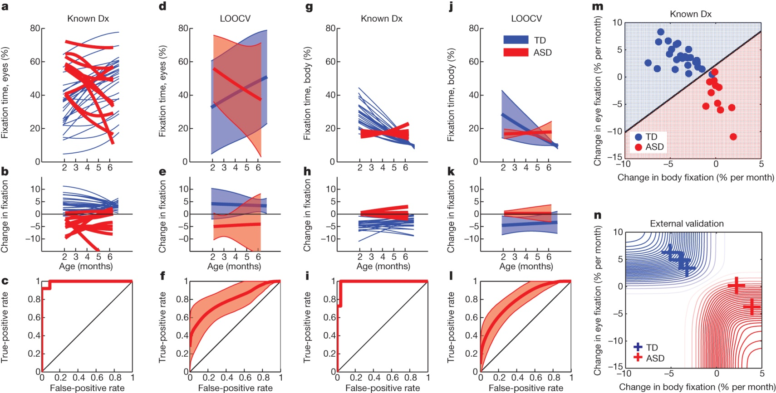
Male ASD marker
Visual fixation between 2 and 6 months of age relative to diagnosis at year 3
W Jones & A Klin Nature 000, 1-5 (2013) doi:10.1038/nature12715

Slide 78
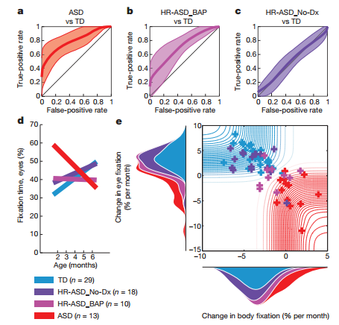
More prediction

Slide 79
Infant viewing of social scenes is under genetic control and is atypical in autism
Constantino, J.N., et. al.., 2017

Slide 80
background
Autism is broadly defined by behavioral irregularities in social development, that result social and communicative impairments
  Within the first 6 months, children who are later diagnosed with ASD show atypical social visual engagement
Authors aimed to explore the genetic structure of factors affecting normative social development – specifically visual social engagement
  Hypothesizing that typical genetic variation in the population influence individual social development, and are disrupted in autism

Slide 81
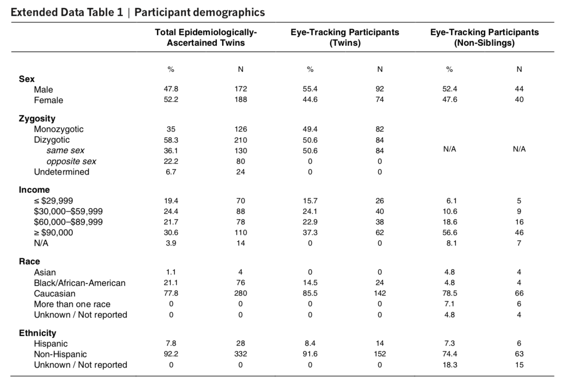

Participants
338 toddlers, 18-24 months
  82 monozygotic twins (MZ)
  84 dizygotic twins (DZ),
  84 non-sibling (42 randomized pairs age & sex matched)
  88 non-twins diagnosed with ASD
coinciding with large shifts in language, cognition, and adaptive behavior , and affording wide variation in our trait of interest
Eye-tracking (using ISCAN) on 27 video based stimuli for ~20 minutes
  Adult female speaking directly into camera (didactic interaction with caregiver)
  Children playing in a child care setting
Notes:
Non-siblings had no familial biological relationship to one another, lived apart, and were compared with twins in two ways: individually matched in sex and age and randomly matched in 10,000 re-samplings without replacement
We restricted analyses to same-sex twin pairs (inclusion of opposite-sex dizygotic pairs yielded either no change or accentuation of monozygotic–dizygotic differences).

Slide 82
Similar methods
Tracked eye gaze during naturalistic “caregiver interaction” videos
Measured percentage of visual fixation to eyes, mouth, body and objects in a naturalistic video
Tracked over time

Slide 83
Methods
Each twin or non-sibling tested individually
Eye-tracking (using ISCAN) on 27 video based stimuli for ~20 minutes
  Adult female speaking directly into camera (didactic interaction with caregiver)
  Children playing in a child care setting

Slide 84

Gaze time associated with genetic relatedness
Aim: measure macro-level social visual engagement, calculating percentages of time spent looking at eye and mouth regions
Concordance in eye (0.91) and mouth (0.86) looking were incredibly high for MZ twins
DZ twins showed much lower correlations for eye (0.35) and mouth (0.44) looking.
Non-siblings showed no significant correlations for either matching
Notes:
e, j: interclass correlation coefficient and 95% confidence interval
When seen for follow-up 15 months after initial testing, at 36.8 ± 1.7) months (mean ± s.d.), monozygotic twins again demonstrated pairwise concordance in eye-looking of 0.93 (0.75–0.98), while dizygotic concordance was 0.25 (0.00–0.60) (Extended Data Fig. 4a–l and Extended Data Table 2b, see Methods), indicating strong preservation of genetic influence on social visual engagement over development (Extended Data Fig. 4m, n). Moreover, longitudinal within-subject stability—from 21 until 36 months—was high in both groups: equal approximately to 0.70 (Extended Data Fig. 5a–e).

Slide 85

To test specificity of social engagement measurements, they compared eye-looking with 1) time spent looking at non-social content and 2) time spent attending to task
MZ twins, eye-looking (0.91) was significantly more concordant than non-social object-looking (0.66) and more concordant than time spent attending to task (0.46)
DZ twins, eye-looking (0.35) was not more concordant than either object-looking (0.09) or attention to task (0.34), and Non-siblings, showed no significant correlations
While heritable effects of domain general visual attention are likely to be observable in other contexts, these analyses indicate effects that are differentially social.
Notes:
To test the specificity of these measurements to social engagement, they compared eye-looking concordance with 1)time spent looking at non-social content (inanimate objects and/or background) and time spent attending to task (maintaining stable onscreen fixation).

Slide 86

Experiment 2
Aim: to measure moment-by-moment micro-level instances of social visual engagement, testing (in tens of milliseconds) concordance in timing and direction of eye movements, and location of visual fixation
Example of MZ (top, blue) and DZ (bottom red/orange) eye position data
Notes:
testing for concordance—on timescales of tens of milliseconds—in timing of eye movements, in direction of eye movements, and in the collocation of contemporaneous visual fixations.
We also tested whether observed concordance could be partitioned into variation reflecting either stimulus response17 (responding to specific features of the exact stimulus presented) or goal-directed action18 (individual differences in seeking social information).
In the next experiment, we measured moment-by-moment, micro- level concordance (Fig. 2a, b). Macro-level concordance observed in the first experiment does not guarantee micro-level concordance; similarly, micro-level concordance could be present but present too weakly to yield global similarities. Comparison of the two creates an opportunity to test how genetic variation might influence social visual engagement across varying phenomenological timescales.

Slide 87

To analyze the concordance in timing of eye movement, they used schematic peristimulus time histograms to show probability of co-occurring eye movements
DZ show a slight increase in the probability for time-locked instances of eye-movement concordance
MZ twins show a larger increase
Notes:
Higher the peak, the more co-occurnace
We first analyzed concordance in timing of eye movements (Fig. 2c). moment-to-moment monozygotic concordance—weakened substantially in dizygotic twins—when viewing social scenes. Number and rate of eye movements did not differ significantly by group
However, monozygotic twins demonstrated greater probability of moving their eyes at the same times: for each saccadic eye movement by twin 1 (rapid eye movement between fixations), within 350 ms, there was an 18.6% increase in twin 2’s probability of also making an eye movement (Fig. 2d, e).

Slide 88

Then analyzed time-locked initiation of eye-movement
  DZ twins showed no significant changes
  MZ twins showed a 21.1% increase in the probability of time-locked movements within +/_ 16.7 ms
Notes:
More surprisingly, when analyses were restricted to moments of motor initiation of a saccade (Fig. 2f), we observed a 21.1% increase in probability of time-locked eye movements: within ±16.7 ms, monozygotic twins, but not dizygotic twins, initiated saccades at the same moments (Fig. 2g, h). These results suggest that monozygotic toddlers, freely viewing naturalistic social stimuli, may synchronize not only the timing of overt eye movements, but also the activity of neuronal ensembles commonly associated with those movements: activity connecting areas of cortex to brainstem and cranial nerves, ultimately resulting in time-locked shifts of gaze.
21.1%

Slide 89

Next they tested for concordance in the direction of eye movements
First finding when twins were looking at the same location at the same time then testing probability of twins subsequent eye movements in same or different directions
MZ twins were more likely than DZ to shift eye movements in more similar subsequent directions
Notes:
i, Schematics showing the probability of saccades shifting in the same or different directions (angular difference, twin 1 − twin 2).
j, k, Polar histograms measuring the distribution of differences in saccade directions for dizygotic and monozygotic twins, in relation to the upper bound (95% confidence interval) of results expected by chance, measured by permutation testing. l, Across all comparisons, monozygotic twins shift saccades in more similar subsequent directions than dizygotic twins.
We mined the eye movement data to identify contemporaneous collocated fixations: instances when both twins fixated on the same approximate locations at the same moments. In such cases, twins not only share an approximate fixation location, but also share an approximate pattern of retinal irradiance (stimulation of retinal photoreceptors). By identifying these instances, we could then test the probability—given initially shared retinal stimulation—of twins subsequently moving their eyes in the same or different directions.
Across all comparisons (Fig. 2l), monozygotic twins were more likely than dizygotic twins to shift saccades in more similar subsequent directions (see Methods).

Slide 90

MZ > DZ co-occurring col-located visual engagement
Twins’ probability of fixating on the same social content at the same moment
If twin 1 and twin 2 both looked at the eyes (or mouth) at the same time, this counted as a ‘hit’ for shared fixation; if twin 1 looked at the eyes when twin 2 looked at the mouth (or vice versa), this counted as a ‘miss’.
Both DZ AND MZ groups showed significant co-occurring collocated visual engagement
  MZ twins exhibited greater concordance
Notes:
m, Schematics showing probability of fixating on the same semantic content at the same moment. Left, collocated, co-occurring eye and mouth fixations. Right, non-collocated, non- co-occurring fixations. n, o, Collocated, co-occurring fixations for dizygotic and monozygotic twins, plotted as z scores relative to results expected by chance, measured by permutation testing. p, Collocated, co-occurring fixations (diagonals from n and o); data are shown as mean ± s.e.m. from individual variation.
Next, we compared twins’ probability of fixating on the same social content at the same moments (Fig. 2m). If twin 1 and twin 2 both looked at the eyes (or mouth) at the same time, this counted as a ‘hit’ for shared fixation; if twin 1 looked at the eyes when twin 2 looked at the mouth (or vice versa), this counted as a ‘miss’. While both groups show more co-occurring, collocated fixations than chance (Fig. 2n, o), monozygotic twins exhibited greater concordance than dizygotic twins

Slide 91

Over different videos….
Finally (for typically developing twins), they found that MZ twins exhibited high eye-looking concordance when twins were watching the same or different video stimuli
DZ ad MZ showed significant when twins watched different videos of same content (children playing)
MZ showed significance when watching videos of different content.
Suggesting biological mechanisms may relate to systems behind goal-seeking and social information valuation
Notes:
Monozygotic twins exhibit high twin–twin concordance in eye-looking, whether watching the same or different video stimuli, evidence of active niche-picking in the goal-directed seeking of social information. a–d, Paired measurements of eye-looking in monozygotic twins for all video stimuli presenting dyadic interaction (a), measurements collected when both twins watched the same dyadic interaction videos (b), measurements collected when each twin watched different dyadic interaction videos (c), or measurements collected when each twin watched different content categories, showing either dyadic caregiver interaction (twin 1) or triadic peer interaction (twin 2) (d). See Extended Data Fig. 6 for stimuli examples. e, Intraclass correlation coefficients (ICCs) and 95% confidence intervals for a–d. f–j, Measurements in dizygotic twins for the same comparisons in a–e. k–o, Measurements in age- and sex-matched non-siblings for the same comparisons in a–e.

Slide 92

ASD -- low mouth & low eye
Compared previous results to two independent cohorts of toddlers diagnosed with ASD
  N=42 and N=45
Children with ASD showed significant reductions in the same measurements of social visual engagement
→Low eyes, low face
Potentially providing a robust diagnostic index for ASD membership
  Figures d, e, f
Notes:
Comparison of social visual engagement in epidemiologically ascertained toddlers from the general population relative to two cohorts of toddlers diagnosed with autism spectrum disorder.
a, Raw data marking individual levels of eye- and mouth-looking in
250 epidemiologically ascertained toddlers watching video scenes of
peer interaction. b, Population density contours for the data in a.
c, Comparison with data from 43 toddlers diagnosed with autism spectrum disorder (ASD). The black line marks classification boundary from linear discriminant analysis. d, Classification based on individual levels of social visual engagement. Threshold for the receiver-operating characteristic (ROC) curve varied by extent of eye- and mouth-looking. CI, confidence interval. e, Data from the replication cohort of 45 toddlers with ASD. Classification boundary as in c. f, Classification based on individual levels of social visual engagement. As in d, threshold for the ROC curve varied by extent of eye- and mouth-looking. Black diamond on red empirical ROC marks true-positive and false-positive rates observed in replication cohort using the optimal threshold identified in C and d

Slide 93
Conclusion
MZ twins exhibit strikingly high concordance in levels of eye-looking; greater probability of shifting their eyes at the same moments in time; greater probability of shifting their eyes in the same subsequent directions; and greater probability of fixating on the same semantic content
These same behaviors were decreased in children diagnosed with ASD
Indicating a strong biological basis for variation in social visual engagement, and providing a new link between ASD behavioral presentation and underlying genetic influences

Slide 94


Habituation/Dishabituation
Habituation reflects building of mental representation of the stimulus; comparison of presented stimulus to internal representation

Slide 95
Perception, cognition, and communication
ASD implications
  Looking where?
Longer infant looking →
  Lower intelligence
  Higher effortful control
  Coordinating looking
    Joint_Attention_Gesture.pptx
Cognition: Nurture v. nature
  Neonatal imitation
  Early learning
  4-10 months→41 months

Slide 96
Stimulus

Slide 97
This pattern
Was presented to 93 premature infants for 60 sec.
Fixation duration in infancy and score on the intelligence test, r(91) = -.36, p < .0002.
Infants who gazed at the pattern for more time had lower intelligence at 18 years if age.
  Less gaze time→higher intelligence
Why?
  Sigman, M., Cohen, S. E., & Beckwith, L. (1997). Why does infant attention predict adolescent intelligence? Infant Behavior & Development, 20(2), 133-140.

Slide 98

Individual Differences in Infant Fixation Duration Relate to Attention and Behavioral Control in Childhood
(Papageorgiou et al., 2014)

Slide 99
Individual Differences in Infant Fixation Duration (Papageorgiou et al., 2014)
What We Know…
Fixation duration = reliable measure of attentional control in adults
Evidence of continuity of attention from infancy → preadolescence
Children with ADHD exhibit a trend toward shorter fixations
Individual Differences in Infant Fixation Duration
Temperament & Behavior in Childhood
What We Don’t Know…
?
Notes:
Fixation Duration: Time between saccadic eye movements when eyes are relatively stable
Infant attention correlates with attention in toddlerhood/preadolescence
Infant attention correlates with IQ at age 11

Slide 100
Individual Differences in Infant Fixation Duration (Papageorgiou et al., 2014)
Fixation
Executive Attention
Effortful Control
Surgency
?
Emotion regulation
Temperament
Extraversion, Motor activity, Impulsivity
Notes:
Executive attention & Temperament
Fixation relates to Executive attention because it involves a conflict between keeping eyes stationary & disengaging
Time spent resolving conflict (Stroop) correlates with parent reports of Effortful Control – temperament trait of ability to regulate emotions & inhibit dominant response to activate a subdominant response
E.C. is negatively correlated with Surgency (trait aspect temperament in which person exhibits high levels of extraversion, motor activity, and impulsivity), impulsivity, and hyperactivity
E.C. differentiates reliably between typically developing children & those with ADHD (children w/ADHD score lower on E.C.)

Slide 101
Individual Differences in Infant Fixation Duration (Papageorgiou et al., 2014)
Fixation
Executive Attention
Hyperactivity & Impulsivity
?
Among children with ADHD
Behavior
Notes:
Executive attention & Temperament
Fixation relates to Executive attention because it involves a conflict between keeping eyes stationary & disengaging
Time spent resolving conflict (Stroop) correlates with parent reports of Effortful Control – temperament trait of ability to regulate emotions & inhibit dominant response to activate a subdominant response
E.C. is negatively correlated with Surgency (trait aspect temperament in which person exhibits high levels of extraversion, motor activity, and impulsivity), impulsivity, and hyperactivity
E.C. differentiates reliably between typically developing children & those with ADHD (children w/ADHD score lower on E.C.)

Slide 102
What We Know…
Fixation duration = reliable measure of attentional control in adults
Evidence of continuity of attention from infancy → preadolescence
Children with ADHD exhibit a trend toward shorter fixations
Individual Differences in Infant Fixation Duration
Temperament & Behavior in Childhood
What We Don’t Know…
?
Notes:
Fixation Duration: Time between saccadic eye movements when eyes are relatively stable
Infant attention correlates with attention in toddlerhood/preadolescence
Infant attention correlates with IQ at age 11
Individual Differences in Infant Fixation Duration (Papageorgiou et al., 2014)

Slide 103
1st Study to combine eye tracking with a longitudinal design
Sample
  Infant Eye Tracking (4-10 mo.) → Parent Qnr (mean age = 41.59 mo.)
  N = 271 – 51 (did not return Qnr) = 172
  Caucasian, middle SES, London residents
Measures
  2-stage analysis for eye tracking data: algorithm + hand-moderated
  Temperament: Early Childhood Behavior Questionnaire (ECBQ) and Children’s Behavior Questionnaire (EBQ)
  Behavior: Revised Rutter Parent Scale for Preschool Children (RPSPC) and Strengths and Difficulties Qnr (SDQ)

Slide 104
Individual Differences in Infant Fixation Duration (Papageorgiou et al., 2014)
Method
Parent-reported Childhood Temperament
Preschool: Early Childhood Behavior Qnr (ECBQ) School-age: Children’s Behavior Qnr (CBQ)
Effortful Control | Attentional focusing
 | Inhibitory control
 | Low-intensity pleasure
 | Perceptual sensitivity
Surgency | Activity level
 | High-intensity pleasure
 | Impulsivity
 | Shyness (reverse-scored

Slide 105
Individual Differences in Infant Fixation Duration (Papageorgiou et al., 2014)
Results
Parent-reported Childhood Temperament
Preschool: Early Childhood Behavior Qnr (ECBQ) School-age: Children’s Behavior Qnr (CBQ)
Effortful Control | Attentional focusing
 | Inhibitory control
 | Low-intensity pleasure
 | Perceptual sensitivity
Surgency | Activity level
 | High-intensity pleasure
 | Impulsivity
 | Shyness (reverse-scored
Infant Fixation Duration
Covariates: Child’s age, Qnr version, Child’s sex, Total # of eye tracking trials completed and fixations detected

Slide 106
Individual Differences in Infant Fixation Duration (Papageorgiou et al., 2014)
Results
Parent-reported Childhood Behavior
Hyperactivity-Inattention Scale
Preschool: Revised Ruttner Parent Scale (RRPSPC) -- Rate frequency of 4 different behaviors School-age: Children’s Behavior Qnr (CBQ) -- Rate frequency of 5 different behaviors
Infant Fixation Duration
Covariates: Child’s age, Qnr version, Child’s sex, Total # of eye tracking trials completed and fixations detected

Slide 107
Individual Differences in Infant Fixation Duration (Papageorgiou et al., 2014)
Method
Parent-reported Childhood Behavior
Hyperactivity-Inattention Scale
Preschool: Revised Ruttner Parent Scale (RRPSPC) -- Rate frequency of 4 different behaviors School-age: Children’s Behavior Qnr (CBQ) -- Rate frequency of 5 different behaviors

Slide 108
Age as a moderator
    The variance of childhood surgency accounted for by variation in infant fixation duration increases as the age of the infant increases
Infant Age
Individual Differences in Infant Fixation Duration
SURGENCY in Childhood
Notes:
To shed light on the developmental mechanisms that link attention in infancy to temperament and behavior in childhood, we explored whether the interactive effect of infant fixation duration and age of the infant explained variation in effortful control, surgency, and hyperactivity- inattention. Table S4 in the Supplemental Material pres- ents the results of the regression model. The Mean Fixation Duration × Infant Age interaction was signifi- cantly associated with surgency in childhood (β = −0.20, R2 = .03, p = .05). This result suggests that the direction of the association between mean fixation duration and sur- gency remains the same (negative) irrespective of the age of the infant; the fact that the association is significant suggests that the variance of childhood surgency accounted for by variation in infant fixation duration increases as the age of the infant increases.

Slide 109
Individual Differences in Infant Fixation Duration (Papageorgiou et al., 2014)
Conclusions
Results supported hypotheses
Associations were moderate in magnitude – “to be expected”
  Effortful control (2% variance), Surgency (7%), Behavior (6%)
Potential implications:
  Studying fixation duration can help us understand mechanisms through which executive control develops
  Investigating the causes of individual differences in infant fixation duration could inform interventions for executive attention
  Future: Fixation duration might be used to identify individuals at risk for developing ADHD

