Slide 1
Language (individual differences)
Daniel Messinger, PhD

Slide 2
Distinguishing between non-native speech sounds in 1st year
At birth, infants are capable of discriminating all phonetically relevant differences in the world’s languages
They perceptually partition the acoustic space underlying phonetic distinctions in a universal way.
By 6 months of age, infants raised in different linguistic environments show an effect of language experience.
Their representations are becoming language specific

Slide 3
What’s going on?
English-learning infants hear Hindi contrast better than English-speaking adults
Almost as well as adult Hindi-speakers

Slide 4
How does this develop?
Infants lose this ability in the first year of life, especially toward one year of age

Slide 5
Consider the spoken tokens of “doll.”
To a Hindi speaker, the difference between the “d” sounds in “this doll” versus “your doll”—a phonetic contrast between a dental [d̪al] versus a retroflex [ɖal], respectively—would signal two possible word forms (either lentils or branch).
In English, both of those “d” sounds signal just one possible word form—phonetically labeled as an alveolar [dal].

Slide 6
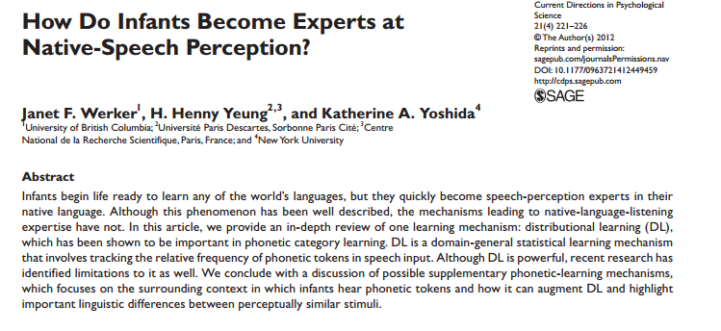

Slide 7
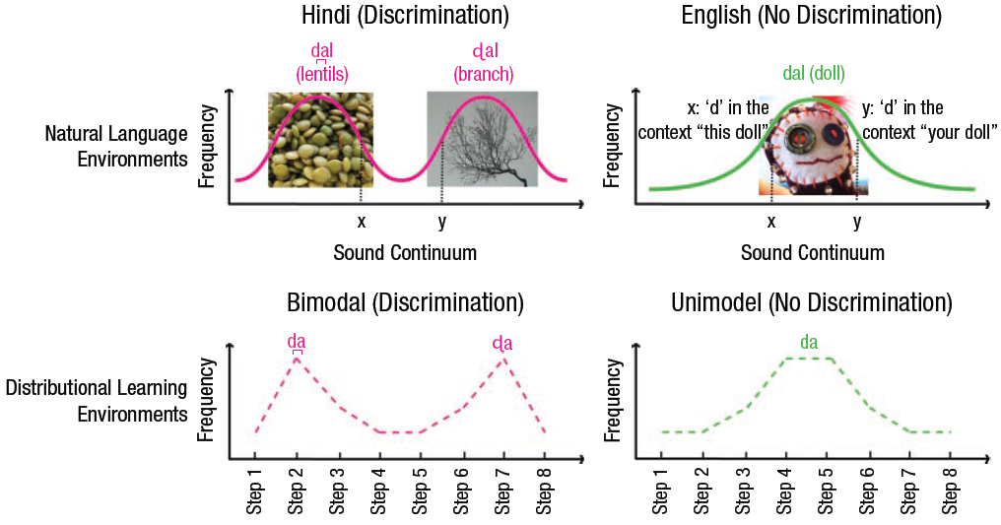
Different languages provide different phonetic experiences
Notes:
Fig. 1. An illustration of distributional learning and acquired distinctiveness. The top panel illustrates the variability around the pronunciation
of “d” an infant might hear in a natural-language environment, depending on whether the infant is growing up learning Hindi (left) or English
(right). The middle panel illustrates how this variability is modeled using relative frequencies of sounds that are created along an 8-step
continuum from dental [d̪a] to retroflex [ɖa], as used in studies of distributional learning. The bottom panel illustrates how this variability is
modeled in studies of acquired distinctiveness: Two consistent sound-object pairings are presented to highlight the distinction between [d̪a]
and [ɖa] in comparison to inconsistent pairings. Image of lentils: FoodStories (2009). Retrieved from Flickr: http://www.flickr.com/photos/
foodstories/4016993694/. Image of branch: Andy Magee (2011). Retrieved from Flickr: http://www.flickr.com/photos/amagee3/5394212150/.
Image of doll: elasticcamel (2004). Retrieved from Flickr: http://www.flickr.com/photos/91524358@N00/2419004722/. All images used with
permission.

Slide 8
What this mean for development
Development involves relatively permanent change, but not always improvement in all things.

Slide 9
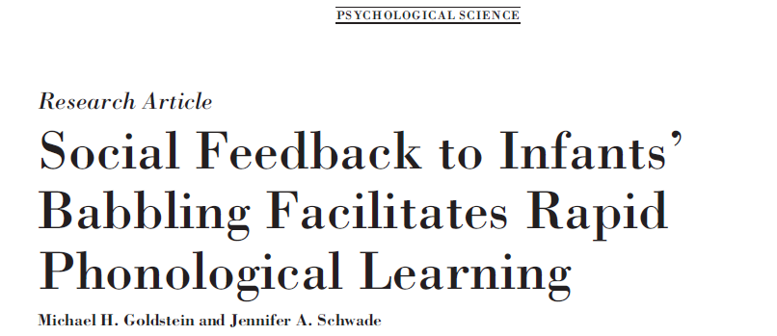
2008

Slide 10
Production: Infant vocal development
Infants typically speak first words by 12 months
Learn to produce speech-like syllables (phonemes) first
Language structured according to environment
How does this occur?
Most research emphasizes anatomical changes of vocal tract
Social environment plays important role
Has previously been ascribed to imitation

Slide 11
Infant vocal development background
By 8 months, infants categorize speech into phonemes congruent with native language
Recent studies of mother-infant interactions found little mimicry by prelinguistic infants
MOST matching is from parents imitating infants…
Alternate mechanism of language development: caregivers consistently respond to babbling and cause changes in patterns of vocalizations (contingent reinforcement)

Slide 12
Goals of current study
Determine role of contingent adult speech in guiding vocal learning
Social contingency can create opportunity for trial-and-error learning
Do infants use social feedback this way in shaping language development?
Previous studies have shown that young infants (3mo olds) were able to produce more speech-like sounds when took turns vocalizing with adults who responded contingently
Current study: first to measure vocal learning in real time by manipulating:
phonological structure (vowels or consonant-vowel sounds)
level of contingency (in response or not in response to infant vocalizations) of parents’ speech

Slide 13
Method
General:
60 infants, 9.5-month-olds and caregivers, playroom
Instructions to parents through headphones
Second session with three parts (baseline 1, social response, baseline 2) each ten minutes long
Conditions (4): looking at types of vocal learning AND contingent reinforcement
Contingent response with fully resonant vowels (contingent-resonant)
Contingent response with words to introduce consonant-vowel combinations (contingent-CV group)
Yoked control conditions for each- matched with a contingent dyad
Coding:
Types of vocalizations, frequency of vocalizations,

Slide 14
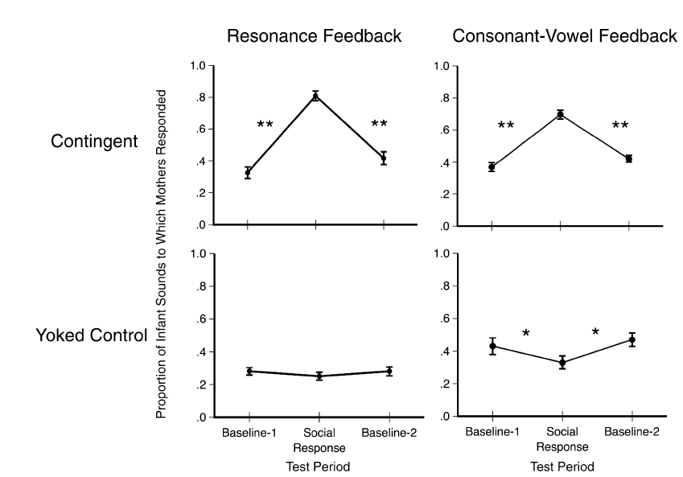
Manipulation check
Notes:
Fig. 1. Mean proportion (1 SE) of infants’ sounds to which mothers responded in each 10-min test period. Data are reported for the contingent and
yoked control conditions in both feedback groups. Asterisks indicate a significant change from one test period to the next np < .05, nnp < .01.

Slide 15
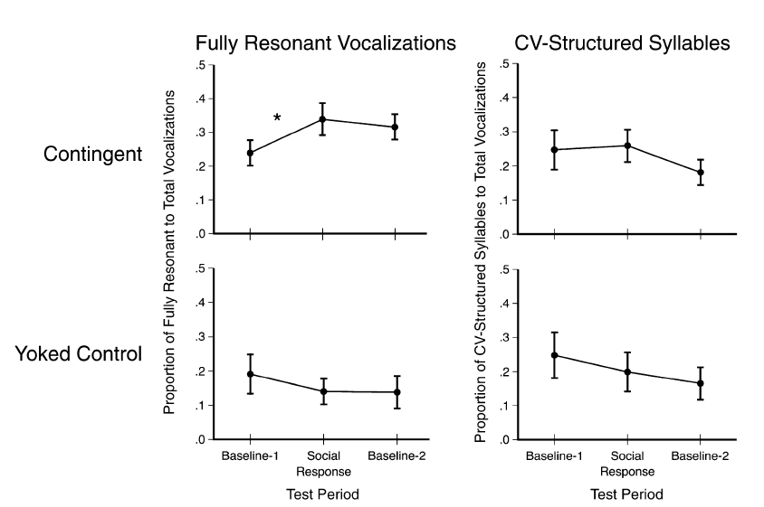
Resonance feedback group
Notes:
Fig. 2. Changes in vocalization quality for infants in the contingent and yoked control conditions who received feedback structured as fully resonant
vowels (resonance feedback group). Graphs in the left column indicate the ratio (mean 1 SE) of fully resonant to total vocalizations across the three
10-min test periods. Graphs in the right column indicate the ratio (mean 1 SE) of syllables with consonant-vowel (CV) structure to total vocalizations
across the three 10-min periods. The asterisk indicates a significant change between test periods, p < .05.

Slide 16
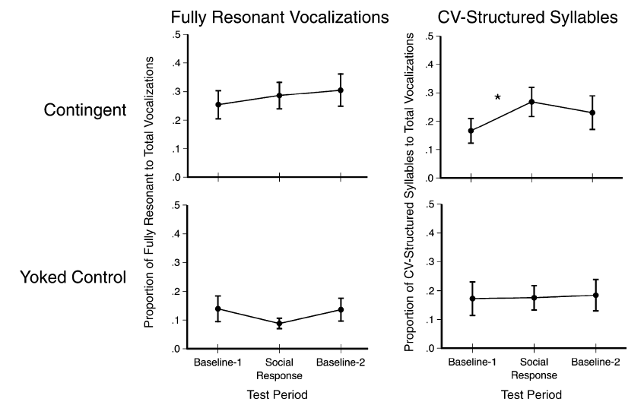
CV feedback group
Notes:
Fig. 3. Changes in vocalization quality for infants in the contingent and yoked control conditions who received feedback structured as consonantvowel
(CV) syllables (CV feedback group). Graphs in the left column indicate the ratio (mean 1 SE) of fully resonant to total vocalizations across the
three 10-min test periods. Graphs in the right column indicate the ratio (mean 1 SE) of CV-structured syllables to total vocalizations across the three
10-min periods. The asterisk indicates a significant change between test periods, p < .05.

Slide 17
Feedback changes structure of infant vocalizations in the moment
Even though these vocalizations occur in a specific developmental order

Slide 18
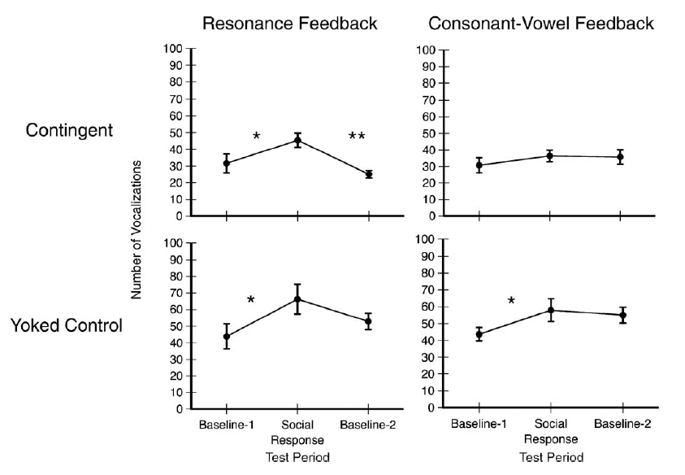
Overall infant vocalizations
?
Notes:
Fig. 4. Mean number (1 SE) of infant vocalizations produced in each 10-min test period. Data are reported for the contingent
and yoked control conditions in both feedback groups. Asterisks indicate a significant change from one test period to the next, np < .05, nnp < .01.
Volume 19—

Slide 19
Tardif et al., 2008

Slide 20
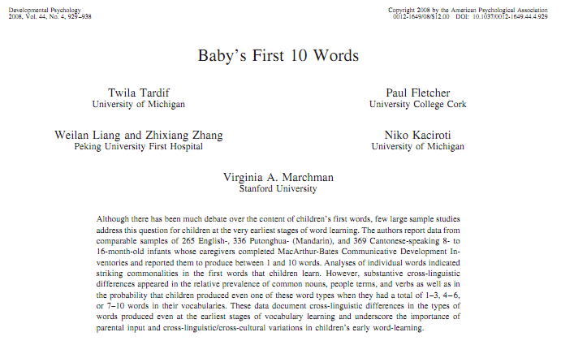

Slide 21
Overview
Examine variations in vocabulary composition as a function of vocabulary size specifically in early vocabulary development (first 10 words)
What categories of words do children first produce?
Is there a noun bias (people, objects, etc.)?

Slide 22
Research Questions
1. Do children exhibit word class bias in their first 10 words?
2. How variable are these words across languages?

Slide 23
Sample
970 children learning:
American English
Mandarin Chinese
Cantonese Chinese
Children were sampled from the US, Hong Kong, and Beijing
Children were screened for a number of medical exclusion criteria
Parents of the children were native speakers of their particular language

Slide 24
Similarities of Words Across Languages
6 of the top 20 words appeared in all three languages
Almost all categories had strong similarities in words that appeared
Children first learned nouns that were manipulable objects that they frequently encountered

Slide 25
Word Class Bias
Children across cultures consistently produced people terms
Prevalence of object and animal words varied across cultures
Most words children produced fell into people and sounds/ sound effect categories
Fewest words in adjectives and closed class categories

Slide 26
Word Class Bias
Children across cultures consistently produced people terms
Prevalence of object and animal words varied across cultures
Most words were people and sounds/ sound effects
Fewest words in adjectives and closed class categories

Slide 27
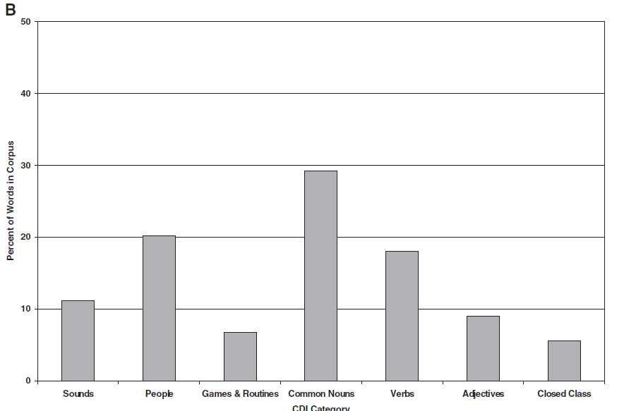
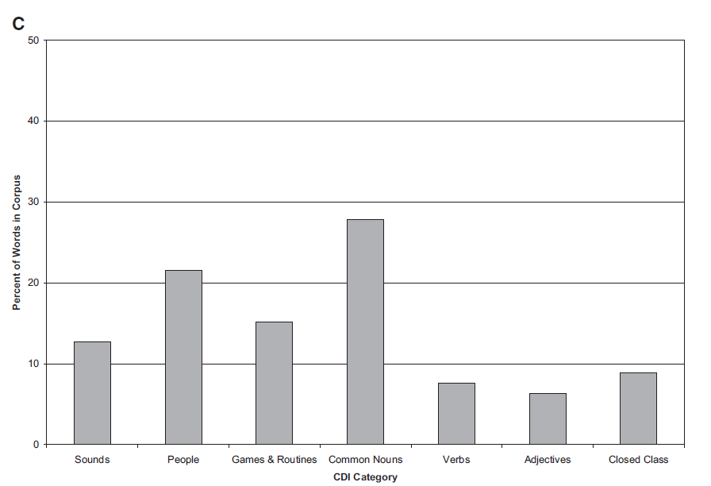
Proportions of Word Categories
Children from the US
Children from Beijing
Children from Hong Kong

Slide 28
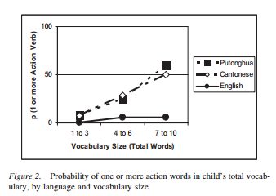
Cross-cultural differences in first words

Slide 29
Variability within Word Categories
Nouns: aside from people terms, manipulable objects and animals were the most common
Verbs: action verbs were most common
Descriptive Terms: state adjectives and adverbs (hot, slow, etc.) were most common
Other terms: “Hi” and “Bye” were the most common

Slide 30
Highchair philosophers: the impact of seating context-dependent exploration on children’s naming biases Lynn K. Perry, Larissa K. Samuelson, and Johanna B. Burdinie
There are perceptual differences between solid objects and nonsolid substances that lead to an early appreciation of their distinction
explored whether naming of nonsolids would improve if they were tested in typical/familiar context of highchair during mealtime
Children tested in the highchair demonstrated better understanding of how nonsolids are named, demonstrating a developmental cascade between
context, exploration, and word learning

Slide 31
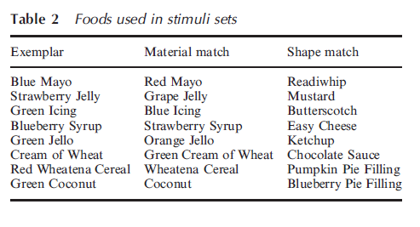
child was given the exemplar object and the two test items to explore
experimenter asked children to find “their own” exemplar, either by name (warm up), with novel names (test), or with no name
children classified via parental reports on messiness and whether they used a highchair or booster at home
coded the final choice (shape versus material)
Figure 1 Example stimuli sets used in experiment. Left panel shows a whole exemplar set; right panel shows a pieces exemplar set.

Slide 32
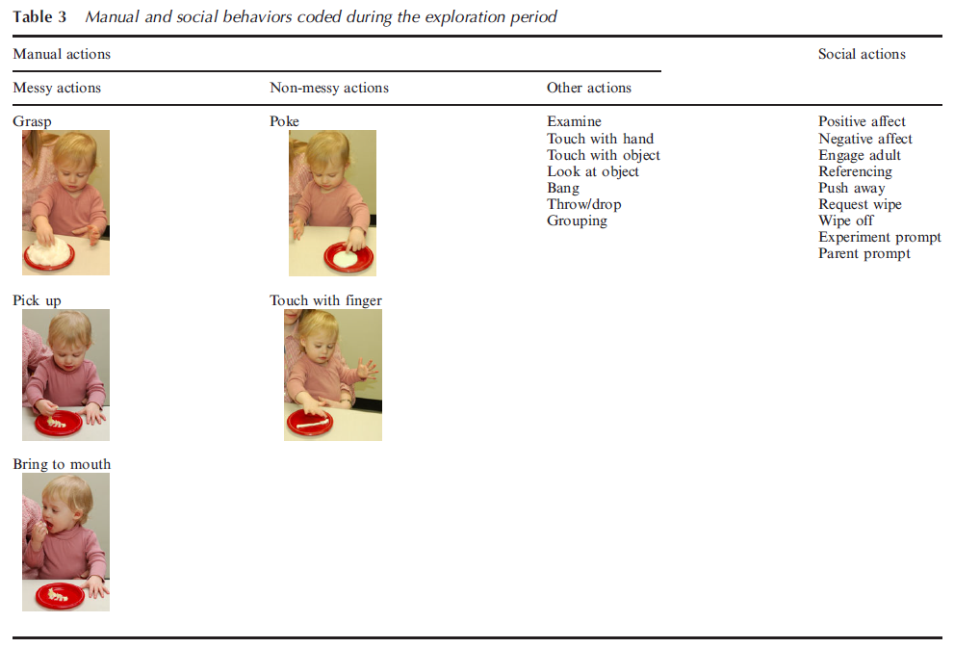

Slide 33
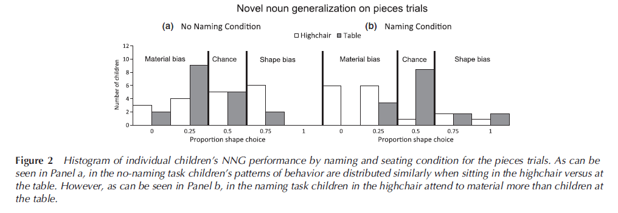

Slide 34
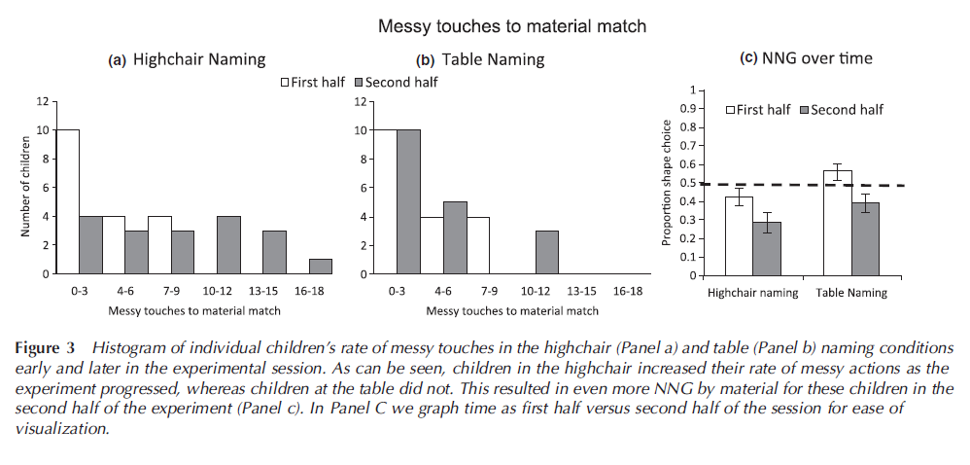

Slide 36
Background
There are differences in language development across SES
Environment plays a role in language development
Mothers are primary source of language experience
Is the effect of environment global or is there evidence for environmental specificity?
Notes:
Effect of environment global – supportive environment benefits all aspects of development and unsupportive impede them. The fact that the effects of SES are pervasive is consistent with the global effect model
Principle of Environmental specificity – different aspects of the environment affect different aspects of development. E.g. aspects of maternal behavior that predict language development arent the same as those that predict play development

Slide 37
Study Aims & Hypotheses
Explain the relationship between SES and language development through environmental specificity
Identify underlying mechanism of this relationship
Hypotheses
Differences in children’s SES-related language-learning experiences can explain SES differences in vocabulary development
Maternal speech mediates the relationship between SES and vocabulary development

Slide 38
Sample
Participants (N=63)
Children ages 16-31 months
33 High-SES families
College educated
Employed in professional or managerial positions
30 Mid-SES families
High School education
Employed in unskilled, semiskilled, or service position
Moms not employed outside the home more than 15 hr/week
Notes:
Kids’ ages ranged from 16 to 31 months and were just beginning to combine words; mean length of utterances (MLU) were between 1.26 and 1.28 words
Recorded conversations between mom and kids as they got them dressed, fed them breakfast, and played with experimenter provided toys
2 recordings 10 weeks apart

Slide 39
Methods
Measures
Maternal Speech - linguistic and social properties
Child Vocabulary - # of word types in 90-utterance speech sample
Mediation Model
SES→ Child Vocabulary
SES→ Maternal Speech
Maternal Speech → Child Vocabulary
Strength of relationship between SES and Child Vocabulary reduced
Correlations and Multiple Regression
Alert
Notes:
Maternal speech - the total number of utterances produced was counted from the full transcripts, Measures of the linguistic properties of input included the number of word tokens and the number of word types (# of different word roots) mothers produced
As indexes of social properties of interaction, two subcategories of maternal utterances were also coded and counted: the number of utterances in episodes of joint attention (mom & kid focused on same object or activity) and the number of topic-continuing replies to the child.
Child speech - The measure of productive vocabulary was then the number of word types in the 90-utterance speech sample.

Slide 40
Methods
Participants (N=63)
33 High-SES families
College educated
Employed in professional or managerial positions
30 Mid-SES families
High School education
Employed in unskilled, semiskilled, or service positions
Measures
Maternal Speech
Child Vocabulary
Mediation Model
SES→ Child Vocabulary
SES→ Maternal Speech
Maternal Speech → Child Vocabulary
Strength of relationship between SES and Child Vocabulary reduced
Correlations and Multiple Regression

Slide 41
Maternal speech mediates relationship between SES & vocabulary
SES -> 5% of variance in child vocabulary
SES significantly associated with maternal MLU
MLU -> 22% of variance in child vocabulary
When removed, only 1% of variance explained by SES
So…there are 2 processes going on
1. SES affects maternal speech
Childrearing beliefs
Time availability
2.Maternal speech affects language growth
Provides data for child’s word-learning mechanisms
Longer utterance -> more variance in word types (richer vocabulary)
Longer utterance -> more info about meaning
Longer utterance -> richer syntax

Slide 42
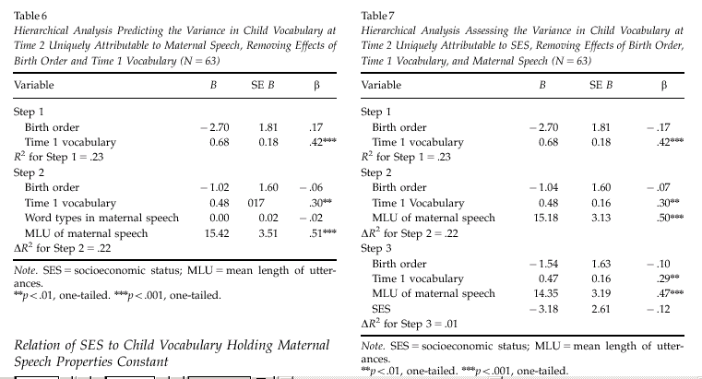
SES → Parenting → Child language
Hoff (2003)

Slide 43
Results
Notes:
Table 3: SES at time 1 assoc with child vocab; accounted for an additional 5% of the variance
Table 4: The high-SES mothers produced more utterances, more word tokens, and more word types; had higher MLUs; and produced more topic continuing replies to their children than did the mid-SES mothers.

Slide 44
Results cont.
Notes:
Mean length of utterance of maternal speech assoc with child vocab – accounted for 22% of variance (Word tokens dropped from analysis)
Table 7- supported full mediation – SES no longer significant after accounting for maternal speech

Slide 45
Maternal speech mediates relationship between SES & vocabulary
SES → maternal speech
Childrearing beliefs
Time availability
Maternal speech → language growth
Provides data for child’s word-learning mechanisms
Longer utterance -> more variance in word types (richer vocabulary)
Longer utterance -> more info about meaning
Longer utterance -> richer syntax
Notes:
SES related differences in language use - differences in the quantity, lexical richness, and sentence complexity of mothers’ speech to their children
SES may also be associated with differences in the time available for leisurely parent–child interaction
Children who heard longer utterances built productive vocabularies at faster rates than children who heard shorter utterances

Slide 46
Conclusion
Relationship between SES and language development influenced by language experiences
Evidence for environmental specificity
Enriching language experience can increase vocabulary development for lower SES children
Notes:
one reason children from different social strata use different-sized vocabularies is that they have different language experiences
Argument for specificity: not that any experiential correlate of SES predicts any developmental correlate of SES. Rather, the picture of environmental influence and of SES effects that the present findings suggest is one in which vocabulary development depends on particular properties of language experience.
Implication: Specific remediation should be effective – change language experience of low SES kids, should see and effect on vocab

Slide 47
Discussion Questions
How would the relationship change if the researchers included low SES mothers and children?
Should SES be used as a continuous variable?
What other mother-child interactions could have been examined?
Researchers looked at 2 time points, 10 weeks apart, is that enough time?
How might the study’s findings help explain SES-related differences in IQ?
Alert

Slide 48
Socioeconomic status differences in language experience are associated with later child language competence and IQ
Meaningful differences in the everyday experiences of young American children. Hart & Risley (1995). Baltimore, MD: Brookes Publishing Co

Slide 49
Quantity of language: Nouns, adjectives, and adverbs to child

Slide 50
How language experience is associated with later child IQ
“Parenting” = Language diversity + feedback tone + symbolic emphasis + guidance style + responsiveness
Predicts between and within SES groups

Slide 51
Language experience—not SES—makes the difference

Slide 52
Implications for intervention Hart & Risley
‘To intervene with vocabulary growth rate … increase the experiences available to the children
Limited success … ultimately the growth rates increased only temporarily.
Could easily increase the size of the children’s vocabularies, could not accelerate the developmental trajectory.’
“Removing barriers and offering opportunities and incentives is not enough to overcome the past, the transmission across generations of a culture of poverty.”

Slide 53
Support environmental specificity model
Vocabulary development depends on specific properties of language experience
Implies that enriching language experience can increase vocabulary development for low-SES kids

Slide 54
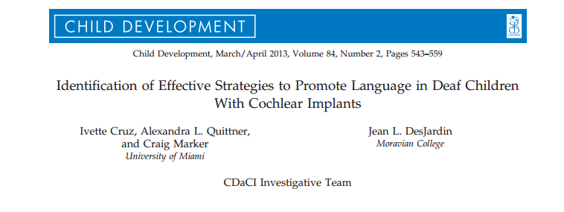

Slide 55
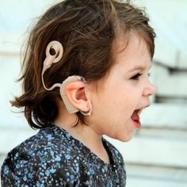
Background
90% of children with sensory neural hearing losses born to hearing parents
Important Factors:
Maternal sensitivity
SES
Age of cochlear implantation
Duration of auditory deprivation
Parental linguistic input
Quantitative (Word types, Mean length of utterance)
Qualitative (Facilitative language techniques [FLTs])
Notes:
Social Interactionist Theory of language development – young children learn language in the context of their daily experiences and interactions
Maternal sensitivity has been shown to significantly predict growth in oral language for deaf children
Children implanted earlier have better language outcomes
Better baseline hearing thresholds and a shorter history of hearing deprivation were associated with steeper increases in receptive and expressive language over 3 years
Higher SES and Maternal education predicted better receptive and expressive language skills in deaf children receiving cochlear implants
Quality of parental involvement have a major impact on growth of language development in children who are deaf
Both quantitative and qualitative linguistic input is associated with better receptive and expressive language outcomes in young, hearing children (kids learn words more rapidly when they frequently hear different types of words)
Higher level FLTs – recast, open ended question, parallel talk
Lower level FLTs – close ended questions, comment, directives

Slide 56
Hypotheses
The total number of word types would increase over time and be positively associated with improvements in language
Higher level FLTs would be more effective in fostering growth of language than lower level FLTs
Lower level FLTs would be used more frequently prior to cochlear implantation
Secondary aim: describe and compare the quantitative and qualitative strategies used by parents in structured and unstructured tasks

Slide 57
Methods
93 children 2 years of age and younger at pre-implantation
Baseline: 2-4 weeks prior to cochlear implantation surgery, with return visit 4-6 weeks later for implantation activation
Assessments at 6 months (not included in data), 12 months, 24 months, and 36 months 6 month
demographics, Reynell Developmental Language scales, videotaped interactions (one structured, one unstructured)
Notes:
Play in both structured and unstructured task was for 10 minutes, the first 5 minutes was coded
Unstructured: age-appropriate toys were provided and each parent-child dyad was told to play as they did at home
Structured: art gallery task – parents were asked to show child a series of art pictures mounted on the wall at different heights, were told to talk about the pictures for 5 minutes, and to determine which picture the child liked best

Slide 58
Analyses
Latent Growth Curve Modeling
Dynamic Bivariate Latent Difference Score Modeling

Slide 59
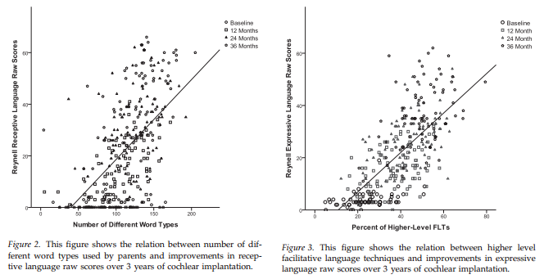
Parent language practices→ child language
Cruz, et al., 2013

Slide 60
Results
Structured tasks were better facilitators of oral communication
SES significantly predicted initial levels of expressive and receptive language, but not parental use of FLTs
SES was significantly related to number of word types at baseline and number of word types predicting expressive language, but not receptive
Use of lower level FLTs had no effect on expressive or receptive language
Total number of different word types predicted greater improvements in receptive language, but not expressive
Notes:
Structured tasks produced a higher amount of oral communication, but not higher quality
Lower level FLTs enhance language learning in young hearing children at the prelinguistic stage of development, but they did not appear to affect language learning in this sample

Slide 61
Clinical Implications
High quality parent-child interactions, using higher level FLTs and a variety of word choice are optimal for children’s oral language development in the first 3 years postimplantation
Parents with more limited education and income appear to be equally capable of using higher level FLTs compared to parents of a higher SES group (training should not be dependent on SES group)

Slide 62
Vernon-Feagans et al. (2012)
Early language development predicted by distal risk factors like poverty and maternal education
Proximal processes that link these to child outcomes
Focus on household chaos

Slide 63
Vernon-Feagans et al. (2012)
Large representative sample of children living in low wealth rural communities
Longitudinal design over first 3 years of life
Goals
Structure of household chaos using multiple measurements
Relations of chaos to child language outcomes
Mediating role of positive and negative parenting

Slide 64
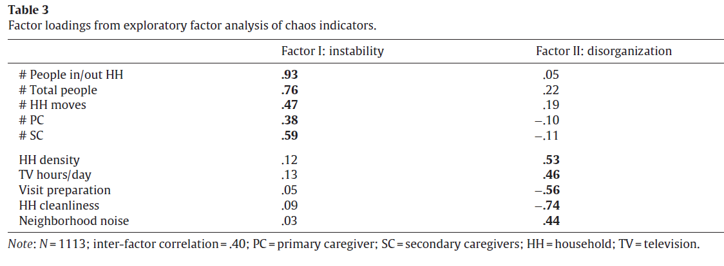
Vernon-Feagans et al. (2012)
Chaos structure

Slide 65
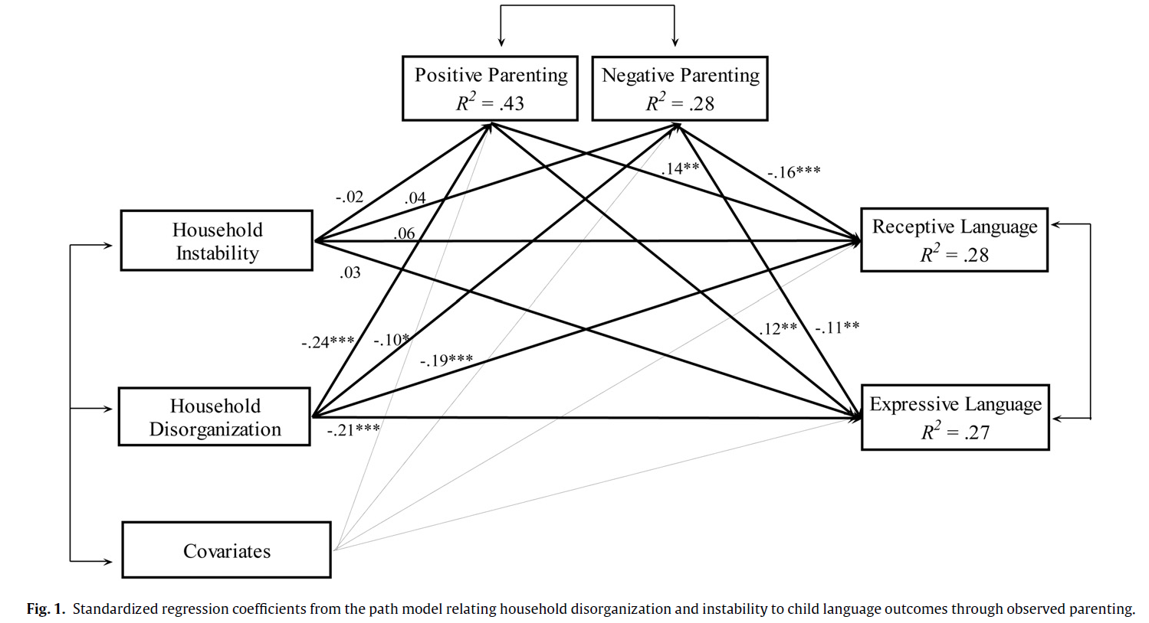
Large representative sample of children living in low wealth rural communities
Vernon-Feagans et al. (2012)

Slide 66
Houston et al. (2012)
Effects of early auditory experience on word learning skills
How does timing of exposure influence word learning?
Use of young children with cochlear implant to explore effects of deprivation
(like the cataract example for visual development)

Slide 67
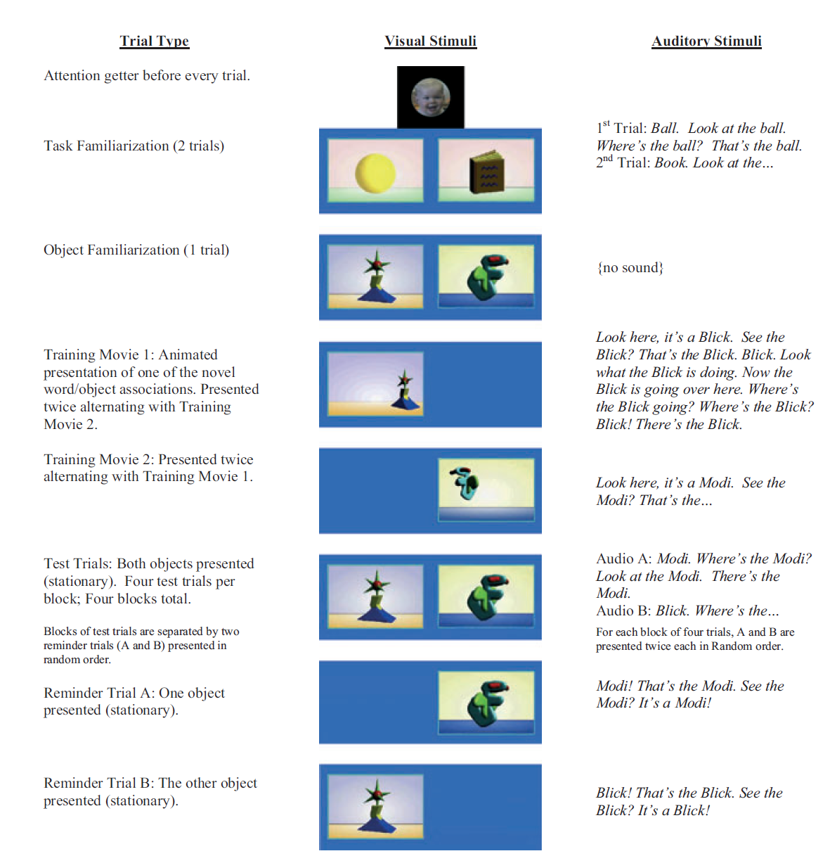
Houston et al. (2012)

Slide 68
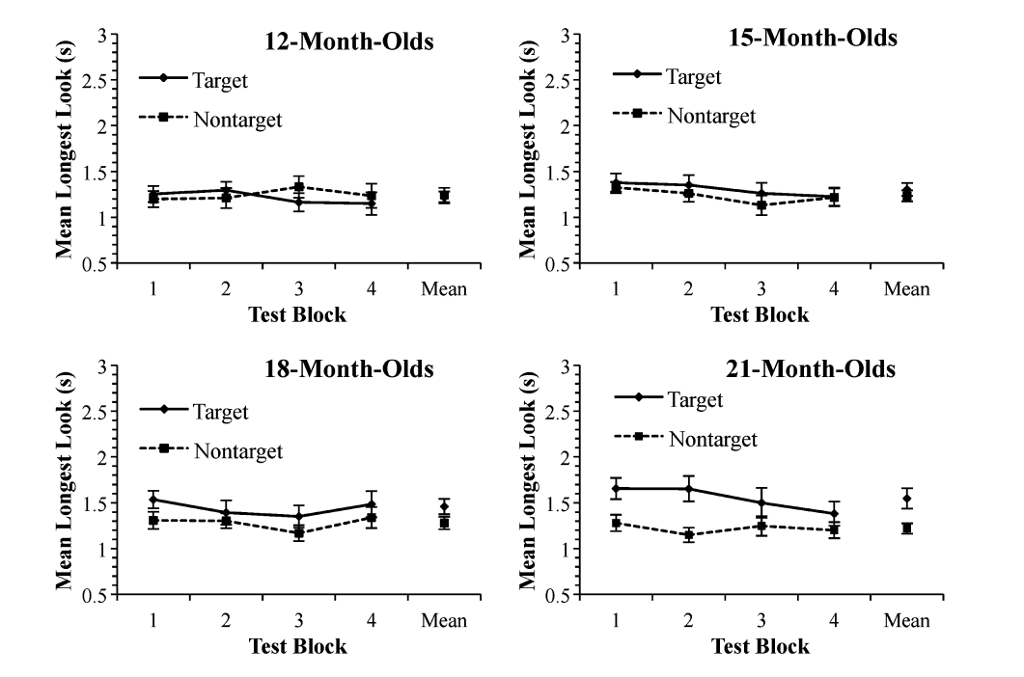
Houston et al. (2012)

Slide 69
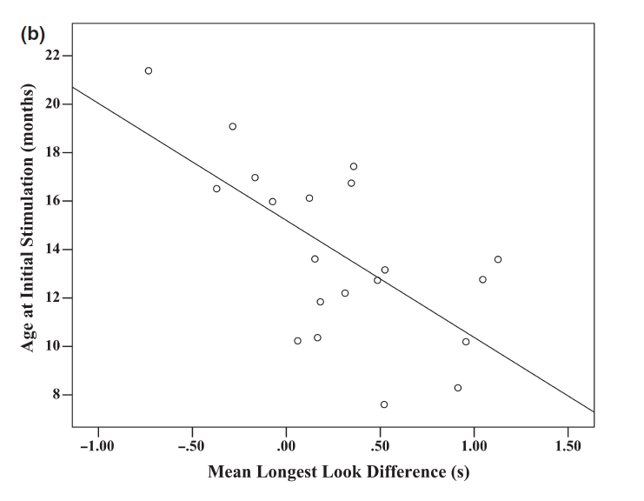
Houston et al. (2012)
Age at implantation as predictor of performance

Slide 70
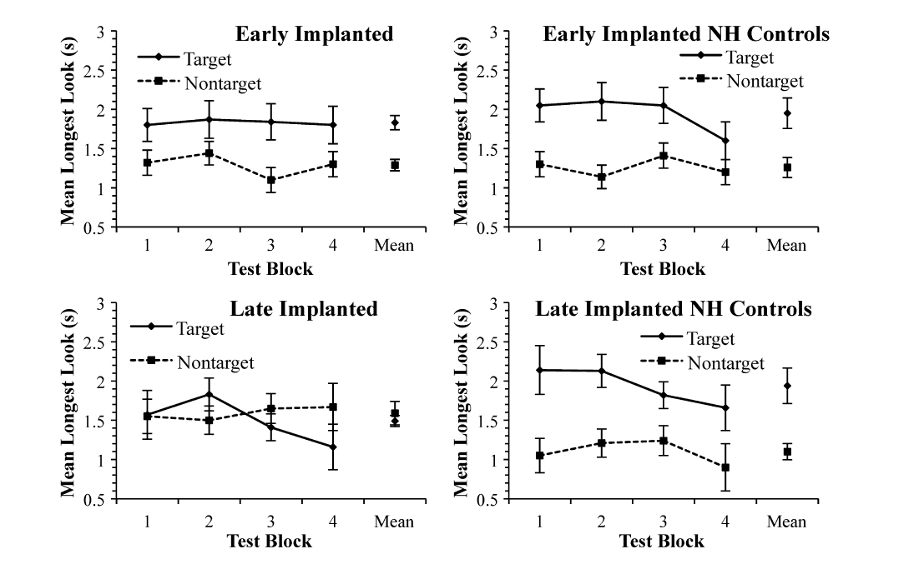
Houston et al. (2012)
Age at implantation vs. chronological age matched controls

