Slide 1
Physical Growth and Motor Development
Psychology of Infancy
PSY430
Daniel Messinger, PhD

Slide 2

Overview
What is neoteny?
What is the basic patterns of physical growth in infancy?
How do genes and environment influence growth?
What are the differences between individual and group growth curves?
List some major milestones and range of age of acquisition
What are some differences in the ordering of these milestones
Why do babies fall into gaps? What is the sway model?
  Does mastering one milestone influence postural control in another?
How do infants and mothers move around together?
  Who leads?
How do infants learn how to cruise?
  Is development the loss of variability?

Slide 3
Body and Brain Growth
Cell division
  Mostly prenatal
After birth
  Enlargement of existing cells
  Though new cells are also formed

Slide 4
Infancy is a period of rapid, decelerating physical growth.
Rapid, decelerating growth characterizes
  Head circumference
  Body length
  Weight

Slide 5
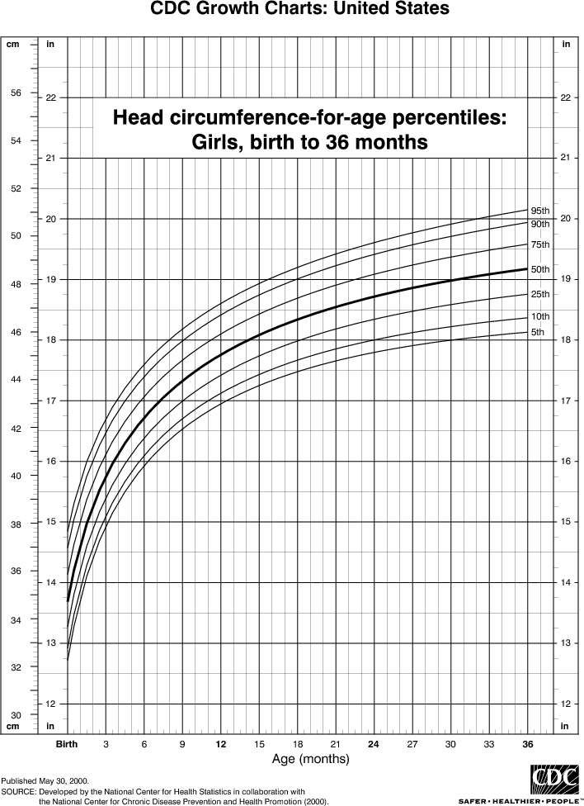
Rapid, decelerating growth:
Head circumference
6 mos.. 17”
24 mos. 19”
Birth 13.75”
12 mos. 18”

Slide 6
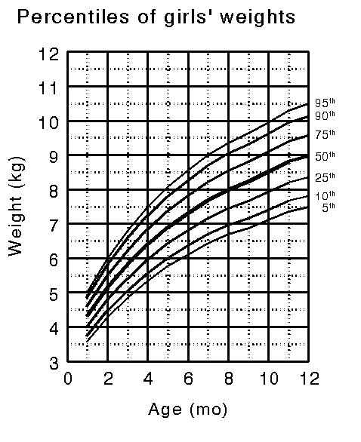
Head circumference
An index of brain size
  but not necessarily meaningful for individuals
  concern below 3rd percentile or above 97th
Can be used as a predictor of early outcome in premature infants
  at birth and at one month or later corrected age
It’s staying the course that its important
  allowing for catch-up growth
  reach growth channel by 12 - 14 months
  handout

Slide 7
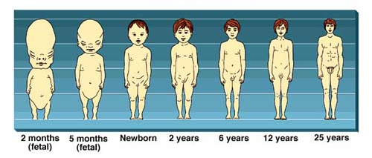
Babies have big heads
  Newborn head is 25% of own body length
  Head length is 40% of mature length at birth
  Adult head is only ~15% of body length

Slide 8
Why?
Why such large heads?
Why such rapid, early growth in head size?
Birth video?

Slide 9

Neonteny:Mickey has a baby face
Flat with small nose and cheekbones
Small lower jaw
Big cranium and forehead

Slide 10
Neoteny: Holding on to infant-like characteristics
Neoteny characterizes human body form
  Big heads and faces
    Large eyes
    Smaller muzzle
    Spine attached at base of skull
  Brain continues growth after birth
    Essential constraint in human evolution

Slide 11
Neoteny characterizes human behavior
  Late sexual reproduction
  Play and curiosity throughout life span
  Cultural flexibility

Slide 12
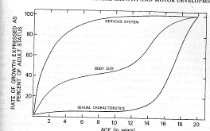
Nervous system>Size>Sexuality

Slide 13
Head growth allows brain growth
Rapid, decelerating growth
At birth,
  1 lb.
  15% of total body birthweight
  25% of final (adult’s) brain weight
At 6 months
  50% of final (adult’s) brain weight
Big investment

Slide 14
At the same time - Myelinization
Fatty sheaths develop and insulate neurons
Dramatically speeding up neural conduction
Allowing neural control of body
  General increase in first 3 years is likely related to speedier motor and cognitive functioning
    allowing activities like standing and walking
Endangered by prenatal lead exposure

Slide 15
Infancy is a period of rapid, decelerating physical growth.
Rapid, decelerating growth characterizes
  Head circumference
  Body length
  Weight

Slide 16
Genes and environment
Body size influenced by multiple genes
  each has a small effect
  some do not function until after birth
  when individual differences emerge
Body size influenced by environment
  nutrition
  uterus can also constrain or promote growth

Slide 17
Genes and environment example
Japanese-American infants
  Smaller than European-American infants
    genetics
  But larger than Japanese national infants
    dietary differences
    STILL TRUE?
  Higher socioeconomic status
    Taller, heavier kids who grow faster
      Professional 3 year olds: 1/2” taller
        In England

Slide 18

Pregnancy coffee & child height…
At 4 to 8 years, children of women with low caffeine & paraxanthine during pregnancy were shorter than children of women who consumed no caffeine, with increasing gaps in height in a historical cohort through 8 years.

Slide 19
Historical increase in body size
“Secular trend”
24,070 5- to 17-year-old children between 1973 and 1992 (Bogalusa, La)
Height of schoolchildren increased .7 cm per decade
  independent of race, sex, and age.
  decrease in short children (<10th %ile)
  Most among preadolescents, blacks, boys,
  not seen among the 15- to 17-year-old children
  may reflect an acceleration of maturation.
    David S. Freedman; Laura Kettel Khan; Mary K. Serdula; Sathanur R. Srinivasan; Gerald S. Berenson
    Secular Trends in Height Among Children During 2 Decades: The Bogalusa Heart Study
    Arch Pediatr Adolesc Med 2000 154: 155-161

Slide 20
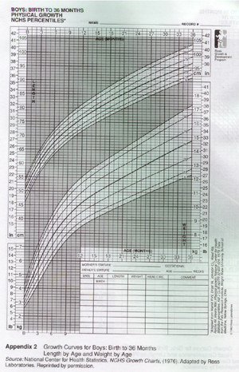
Rapid, decelerating growth: Length
Birth length 20”
  add 10” by one year
  add 5” more by 2 years
  Two year height approximately 1/2 adult height
Boys

Slide 21
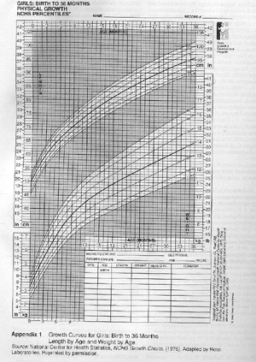
Rapid, decelerating growth:
Weight
Newborn girl (7.25 lbs.)
  Gain 1.3 pounds per month for the first 6 months
    100% bigger
      Double birth weight
  Then 1 pound per month through 12 months
    50% bigger
      Triple birth weight
  Then less than a half a pound per month through 36 months
Girls

Slide 22
Group curves
Large samples
  Many children at a given age (e.g., 3 months)
  Find median (50th %ile), %s
    e.g. at 17 months, only 5% < 75 cm.
  Longitudinal data may have been collected
    but at monthly intervals
What does individual growth in length look like?

Slide 23
Common view
Individual follows continuous growth curves
  Portrait of group is portrait of individual
But parents report of
  growing by leaps and bounds
  growth spurts
  growing overnight
        were dismissed

Slide 24
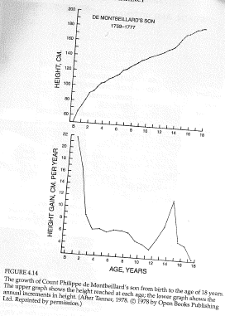
One child’s growth

Slide 25
Saltatory growth
Lampl measures length/height
  3 samples of babies
  every two weeks, weekly, daily
  same pattern in all groups
  re-measures for reliability

Slide 26
Growth jumps or spurts
Growth occurs in spurts,
  jumps of almost a cm. (.9)
separated by periods of no growth [stasis]
  of 2 to 15 days
Total growth is sum of spurts
Longer stasis continues, more likelihood of a spurt
  but spurts aperiodic

Slide 27
Saltatory growth is the rule
prenatal
infant
child
adolescent

Slide 28
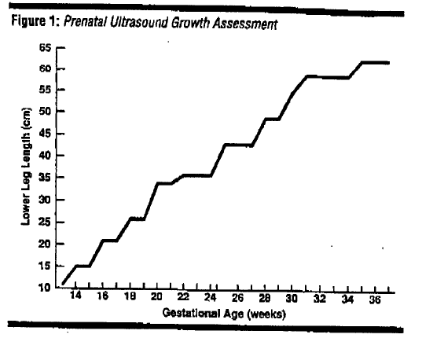
Prenatal growth

Slide 29
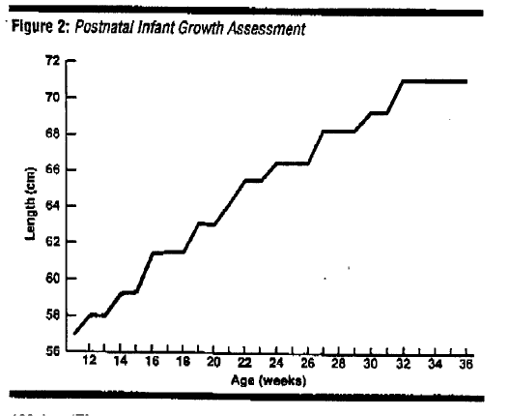
Postnatal growth

Slide 30
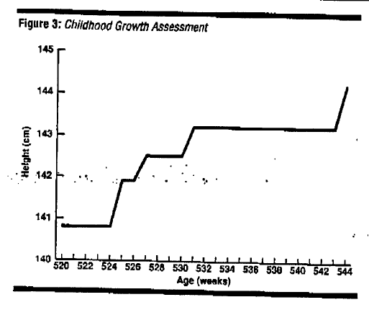
Childhood growth

Slide 31
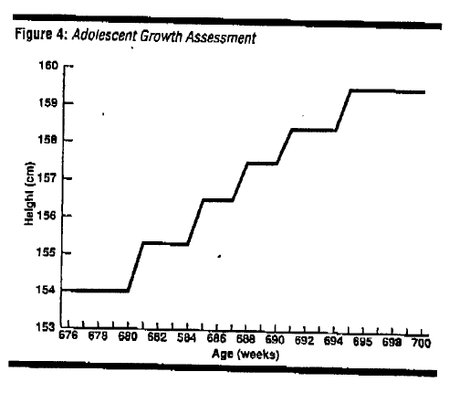
Adolescent growth

Slide 32
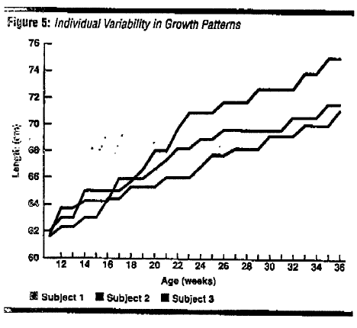
Individual differences

Slide 33
Growth occurs at the epiphyses
growth centers in the bones where new cartilage cells are produced & gradually harden
as growth continues, the epiphyses thin & disappear & no more growth of the bone is possible

Slide 34
Practical consequences
Fussiness and hunger during growth periods
Sleep patterns
  less before, more during?

Slide 35
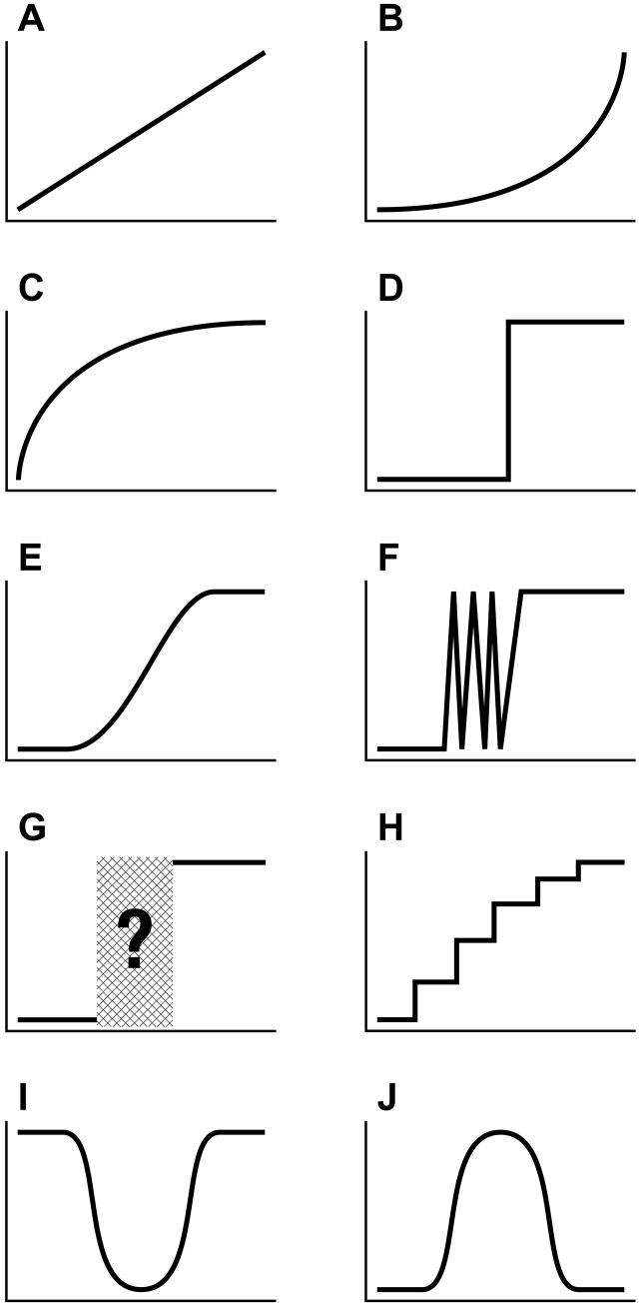
Developmental moral
If you’re interested in individual growth, look at the growth of individuals!
If change occurs between two time points, observe frequently during this period to describe the form development takes.
Long-term = smooth; short-term = choppy

Slide 36
Growth hormone treatment for short stature children?

Slide 37
Growth principles
Cephalocaudal trend:
  pattern of physical growth & motor control
  proceeds from head to tail;
    growth of head & chest before trunk & legs
Proximodistal trend:
  pattern of physical growth & motor control proceeds from
    the center of the body outward;
      growth of the arms & legs before hands & feet

Slide 38
What is the Shape of Developmental Change?
Adolph et al, 2008
Developmental trajectories take many forms
Accurate depiction of trajectory depends on sampling rate of observations
“Microgenetic method” – small time intervals to observe developmental process
Overly large sampling intervals can distort shape of change
  produce errors in estimating onset ages
  inaccurate picture of developmental trajectory
Notes:
Microgenetic method – doesn’t quantify consequences of different sampling rates for depicting different patterns of development
Distort shape – skills with variable trajectories and reversals can appear as step functions, with a single abrupt transition
Onset ages – infrequent sampling may miss variability and give later onset age, or can occasionally catch a day skill is present but not stable and give earlier onset age

Slide 39
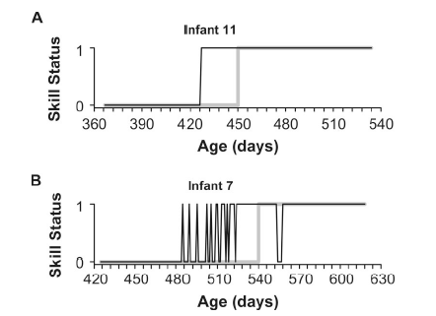
Sampling rate can misrepresent both form & age of development

Slide 40
Present study:
Measured impact of varying sampling rates on sensitivity for detecting developmental trajectories
Parent-completed daily checklist for gross motor skills
  Software simulated sampling at longer intervals by selecting points at 2 to 31 day intervals for each skill
Most skills showed variable acquisition period before stable performance
Small increases in sampling interval → less sensitivity to variability
    (drops off quickly at intervals longer than 2-3 days)
  Skills with variable trajectories appeared as single, step-like transitions
  Increased interval length also increased errors in age of onset, mostly delays
Notes:
Variable acquisition period – variability – transitions between occurrence and absence
***Accurately characterizing variable and step-like developmental trajectories can be affected by (inadequate) sampling***

Slide 41
Guidelines for determining sample rates:
Determine the base rate
  Estimating the typical rate a skill is expressed
Find the acquisition period
  Preliminary investigation using larger sample intervals can help identify approximate time span to examine more closely
Sample as small as you can
  Sample at the minimum practicable interval, especially around acquisition period
Look before the onset
  Estimates of onset ages may produce delay errors, so dense sampling should include the time before the estimated onset
Look for changes in variability
  Variable trajectories will show fluctuations before stable performance level

Slide 42
Motor development
Overall patterns
Individual differences
Individual development

Slide 43
Motor milestones

Slide 44
Overall Motor Milestones

Slide 45
Individual differences
(in crawling onset)
WHO Motor Development Study: Windows of achievement for six gross motor development milestones. WHO MULTICENTRE GROWTH REFERENCE STUDY GROUP.Acta Pædiatrica, 2006; Suppl 450: 86/95

Slide 46
Individual variability in locomotion
Different ways to crawl
    Standard: http://www.youtube.com/watch?v=Q6lfP6fpjDI nonstandard: http://www.youtube.com/watch?v=bh_ABVxpBsQ
    _{Elephant Walk:}
Early Walks
  http://www.youtube.com/watch?v=zjKVcpCSTk0&feature=related
  http://www.youtube.com/watch?v=6tGXp8km9AY
  http://www.youtube.com/watch?v=La2Vg9pr13g--NYU Infant Action Lab - Infant walking around our playroom with an eye tracker

Slide 47
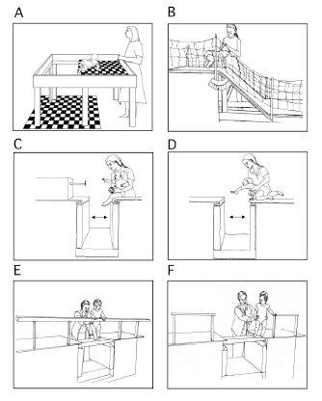
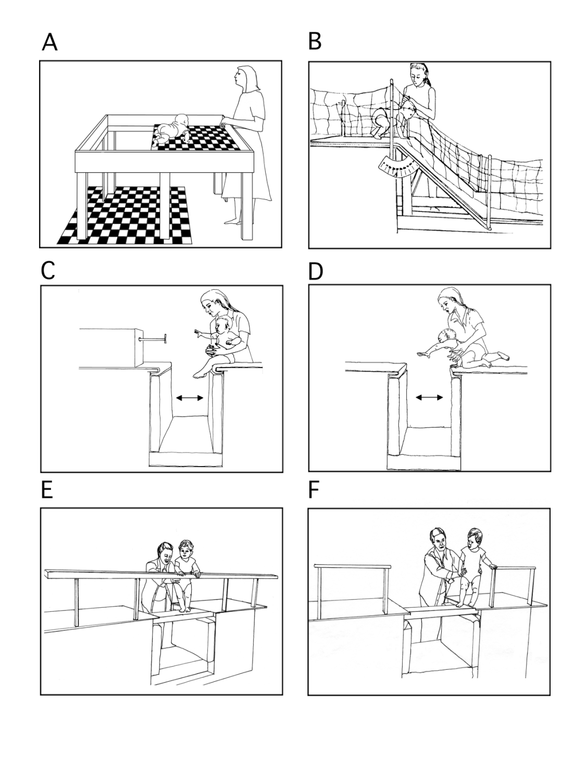
Learning in motor development
The gap video:
https://www.youtube.com/watch?v=1MIyjUo-zF0
Notes:
https://www.youtube.com/watch?v=1MIyjUo-zF0

Slide 48
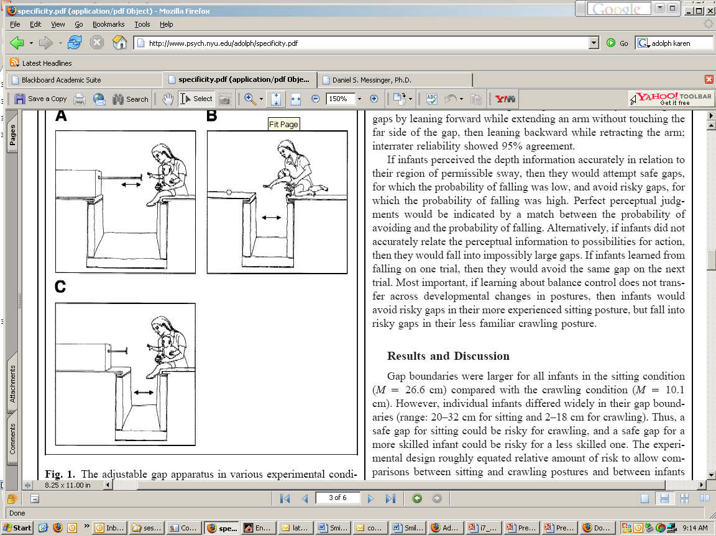
Does sitting help crawling?
“Babies avoided reaching over risky gaps in the sitting posture but fell into risky gaps while attempting to reach in the crawling posture…
        K. Adolph (2000) . Specificity of Learning: Why Infants Fall Over a Veritable Cliff . Psychological Science 11 (4), 290–295.

Slide 49
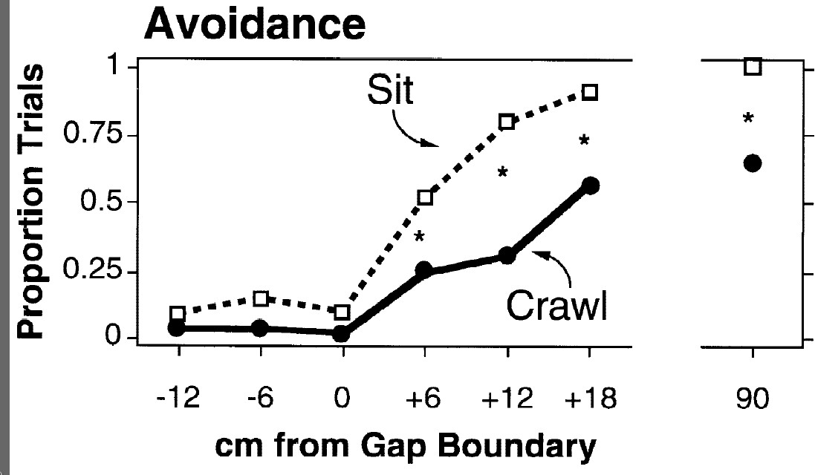
Fewer errors sitting than crawling
6 infants crawled into a .9 m gap

Slide 50
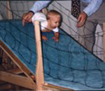
Does one motor milestone help another?
The gap video:
https://www.youtube.com/watch?v=1MIyjUo-zF0
        Karen E. Adolph (2000) . Specificity of Learning: Why Infants Fall Over a Veritable Cliff . Psychological Science 11 (4), 290–295.

Slide 51
Each postural milestone is a different, modularly organized control system
…infants' adaptive avoidance responses are based on information about their postural stability relative to the gap size.
the results belie previous accounts suggesting that avoidance of a disparity in depth of the ground surface depends on general knowledge such as fear of heights…’

Slide 52
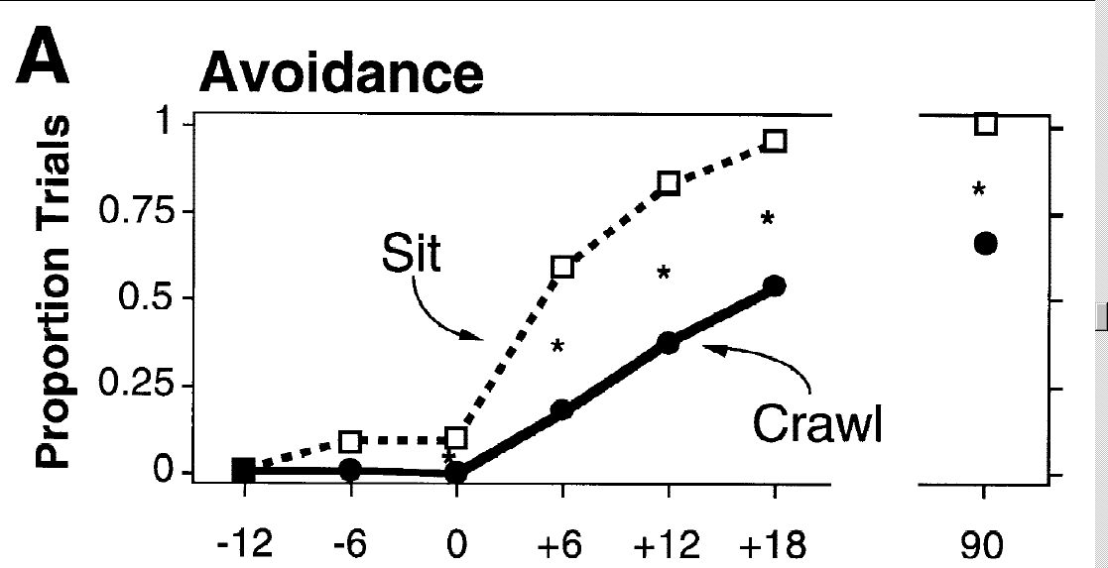
6 infants crawled into a .9 m gap

Slide 53
When infants first acquired a new posture, they appeared oblivious to their limits …
In their first weeks of crawling and walking, infants plunged straight down impossibly steep slopes.
Over weeks of locomotor experience, they became more discerning and responses became more adaptive.
The gap video:
https://www.youtube.com/watch?v=1MIyjUo-zF0
Adolph, 2008

Slide 54
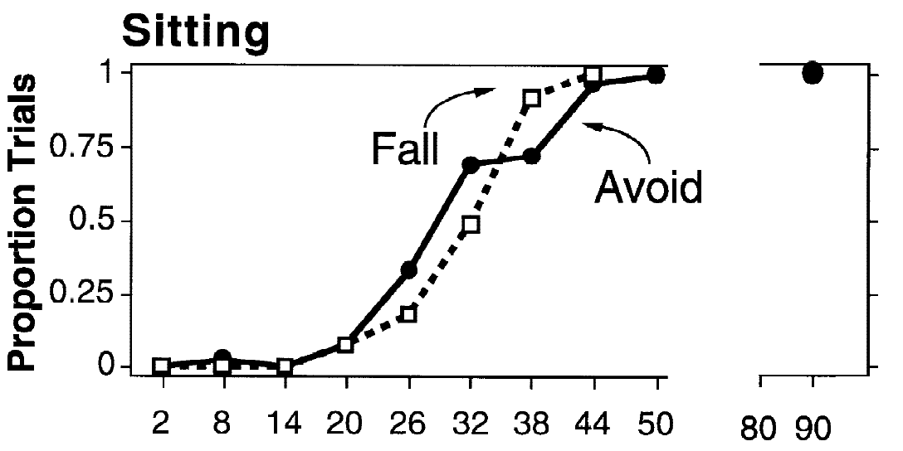
13 infants show calibrated sitting

Slide 55
Sway model: Bottom up learning
Experience with an earlier-developing skill does not transfer automatically to a later-developing skill
Sitting, crawling, and walking postures, … involve different regions of permissible sway for different key pivots …
  the hips for sitting, the wrists for crawling, and the ankles for walk­ing.

Slide 56
Extensive experience with each postural milestone in development
may be required to define the relevant control variables for the new perception-action system and to facilitate their on-line calibration.
  different muscle groups for executing movements and for generating compensatory sway; different vantage points for viewing the ground; different pat­terns of optic flow as the body sways back and forth; different cor­relations between visual, kinesthetic, and vestibular information; and so on.

Slide 57
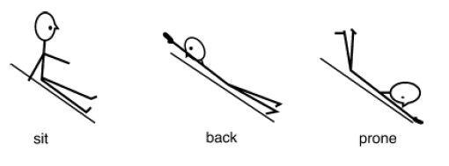
Learning to learn?
‘Rather than learning cue–consequence associations (slopes are paired with falling), … infants learn to generate solutions to novel locomotor problems
  perceive whether balance will be compromised and figure out an alternative position for descent). (Adolph, 2008)

Slide 58
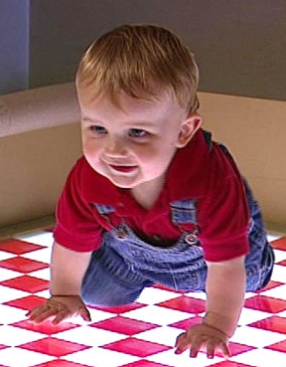
Specificity of Learning: Why Infants Fall Over a Veritable Cliff (Adolph, 2000)
Human infants require locomotor experience
  Duration of experience predicts avoidance of cliff
What do infants learn via crawling?
  Fear of heights?
  Association of depth-perception with disequilibrium?
  Novel perceptual input at cliff?
If true, learning should generalize to other postures

Slide 59
The Sway Model
  Learning is posture-specific
    Different regions of permissible sway, muscles, optic flow, etc
  Postural milestones: sitting, crawling, cruising, walking
  To judge possibility for action, must judge muscle torque to counter destabilizing torque
Sitting and Crawling
  Infants encouraged to reach across gap
    Sitting v. crawling conditions
    Successful (reach toy), failed (fall), avoidance (do not reach)
  If learning is posture-specific, infants will avoid risky gaps when sitting, but not when in crawling posture

Slide 60
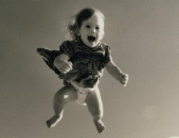
Results
Avoidance of risky gaps did not generalize across changes in posture
  Overestimated ability to span gaps in crawling posture, but not in sitting
Infants showed no evidence of learning from falling
  In immediately repeated trials after falling, 88% attempted to span gap again
Coordination between perception and action is specific to postural control system
Learning transfers from everyday experience with balancing to risky situations
Learning is more specific and more flexible
that previously recognized

Slide 61


Slide 62
Organizing locomotor planning
Infants primarily use touch and vision to guide their movement
  (perception-action cycle)
Exploring the environment incurs costs (time, energy, risk)
Touch is more costly than vision
Infants “ramp-up” to more costly strategies when the environment is trickier
Infants also gain experience over time and need to plan less

Slide 63
Used a headmounted eyetracker
to determine how infants used vision and touch to plan their movement across a bridge
Questions:
  Does amount of visual and haptic planning differ by bridge width?
  Does haptic exploration follow visual?
  Does exploration predict motor choices?
  What do infants do while crossing the bridge?
  Does being a better walker impact this?
Prince presenting Kretch & Adolph 2016

Slide 64
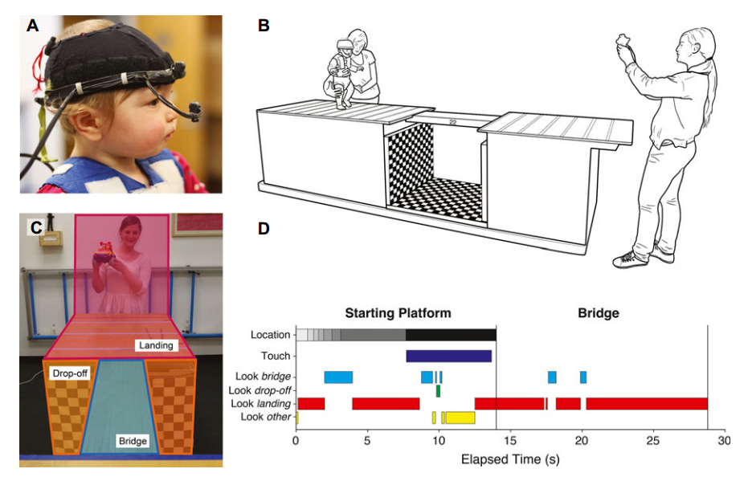
Infants looked at bridge most trials, but briefly; exploratory touching only for risky bridges, but touches were lengthy
https://nyu.databrary.org/volume/193 not authorized...
Prince presenting Kretch & Adolph 2016

Slide 65
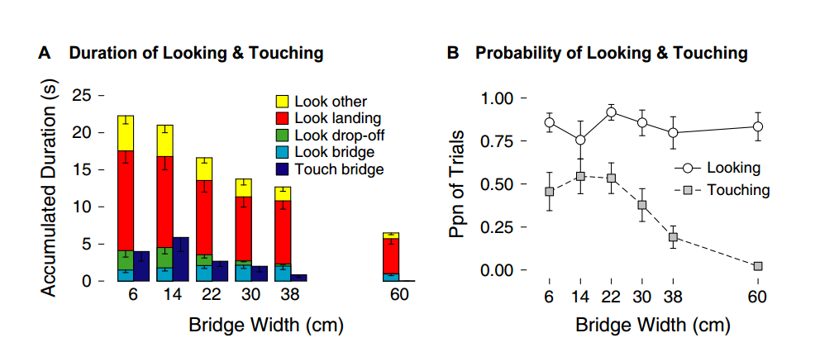
Infants looked at bridge most trials, but briefly; exploratory touching only for risky bridges, but touches were lengthy
Prince presenting Kretch & Adolph 2016

Slide 66
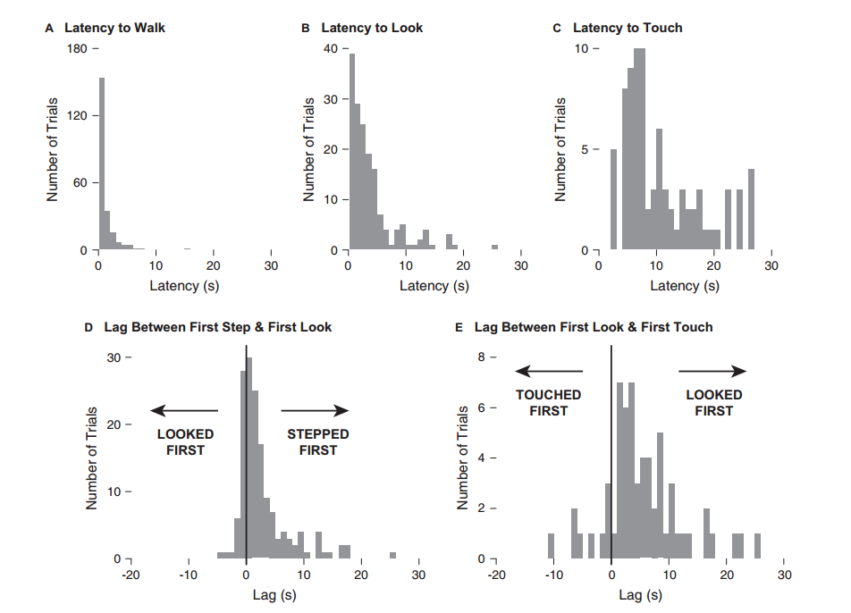
Organizing motor planning (cont.)
Prince presenting Kretch & Adolph 2016

Slide 67
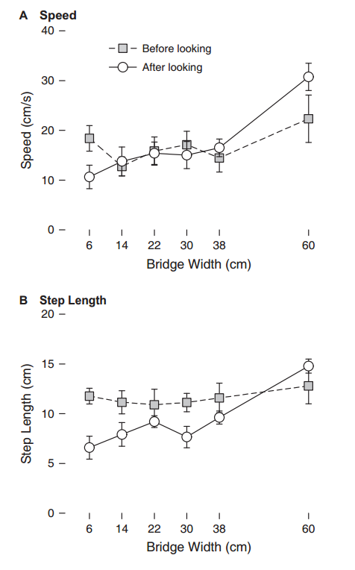
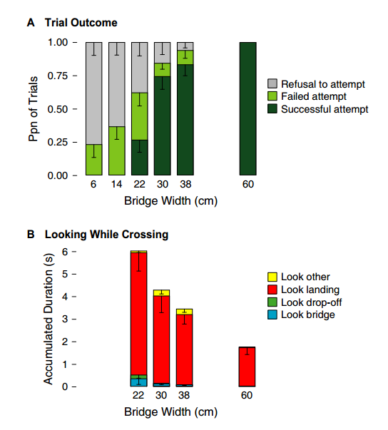
Organizing motor planning (cont.)
Prince presenting Kretch & Adolph 2016

Slide 68
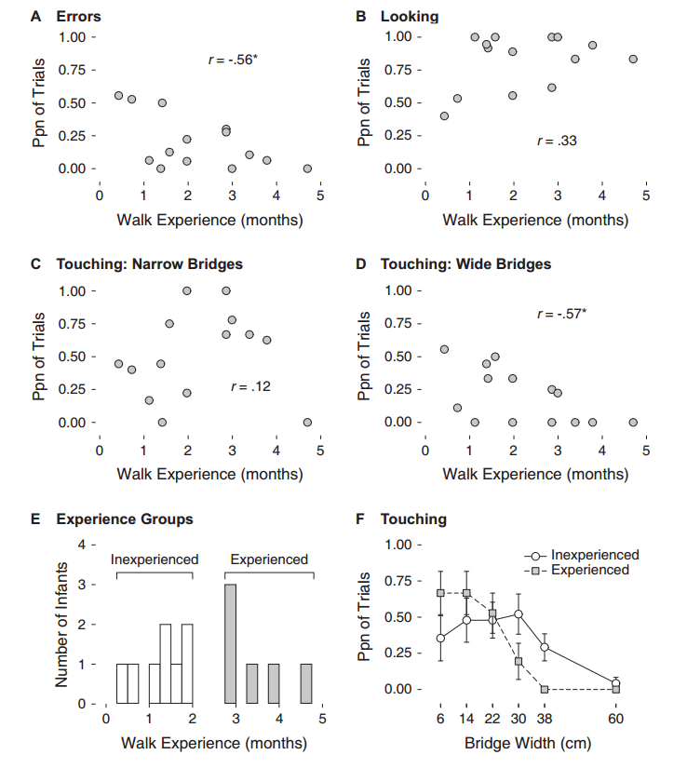
Exploration followed a sequential ‘ramping-up’ process
Looking at the bridge occurred early and from a
distance, providing an initial assessment that
prompted subsequent gait modifications and haptic
exploration on risky bridges.
Prince presenting Kretch & Adolph 2016

Slide 69
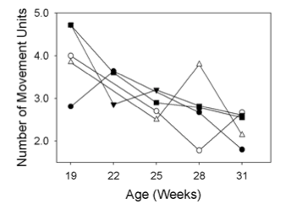
Reaching (robotics video)

Slide 70
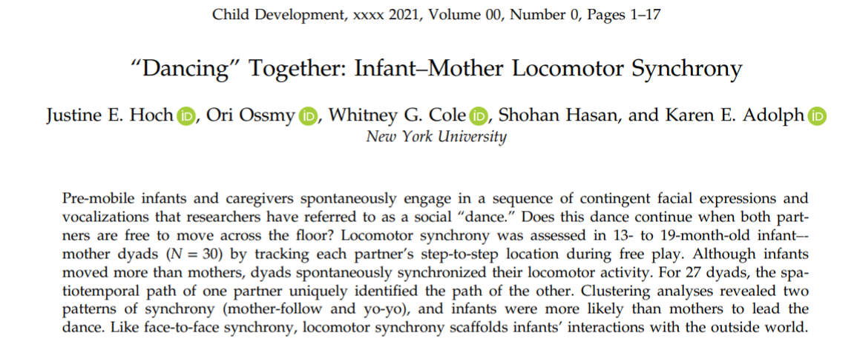
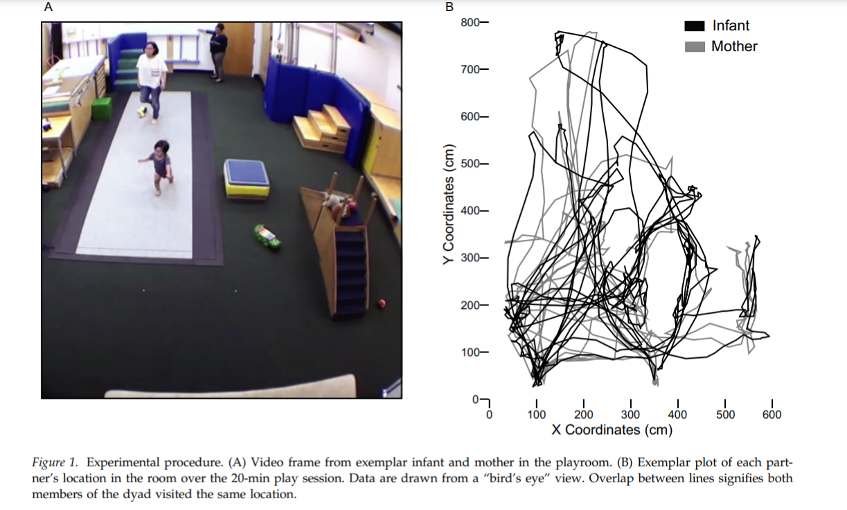
https://nyu.databrary.org/volume/943

Slide 71
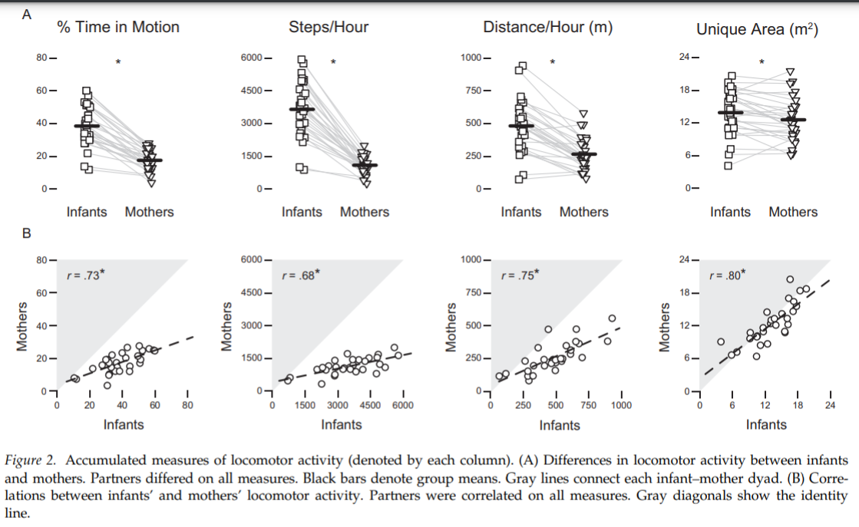
Associated differences:
Continuity vs. stability…

Slide 72
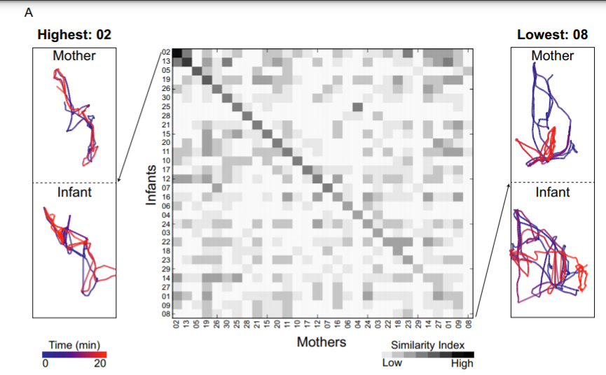
Similarity—difference trajectories

Slide 73
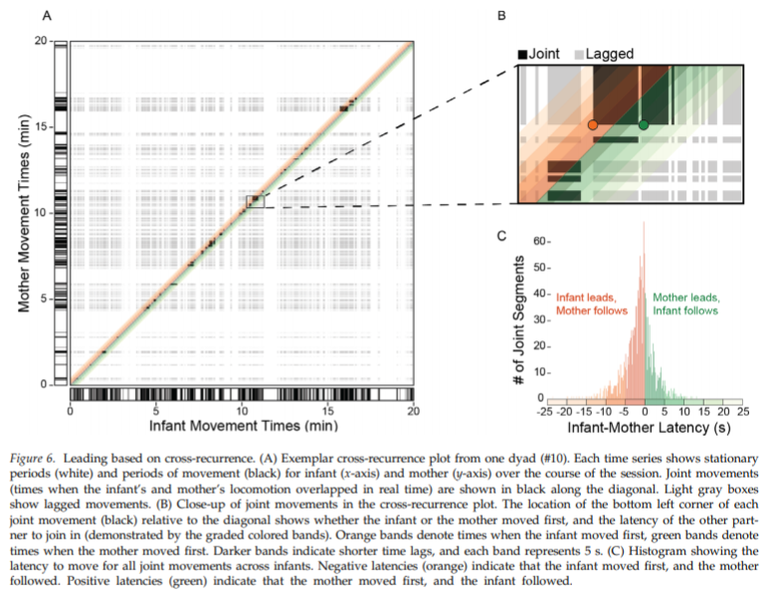
Movement dynamics for one dyad

Slide 74
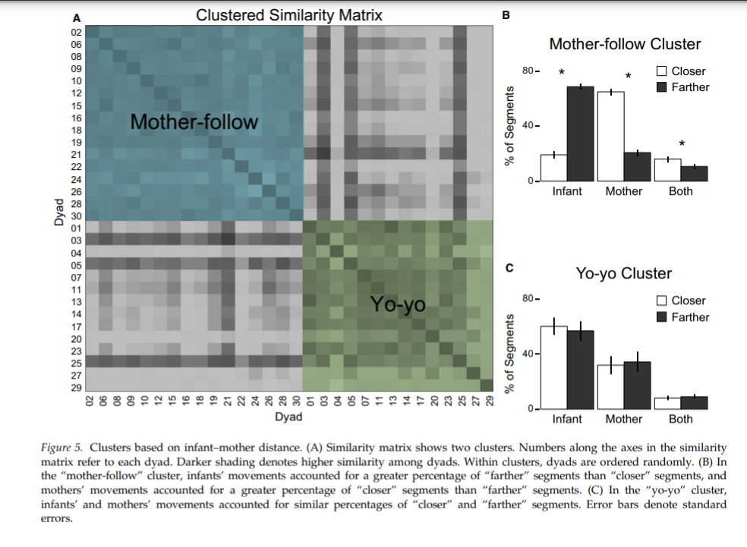
Mother-follow vs. yo-yo cluster
Attachment…?

Slide 75
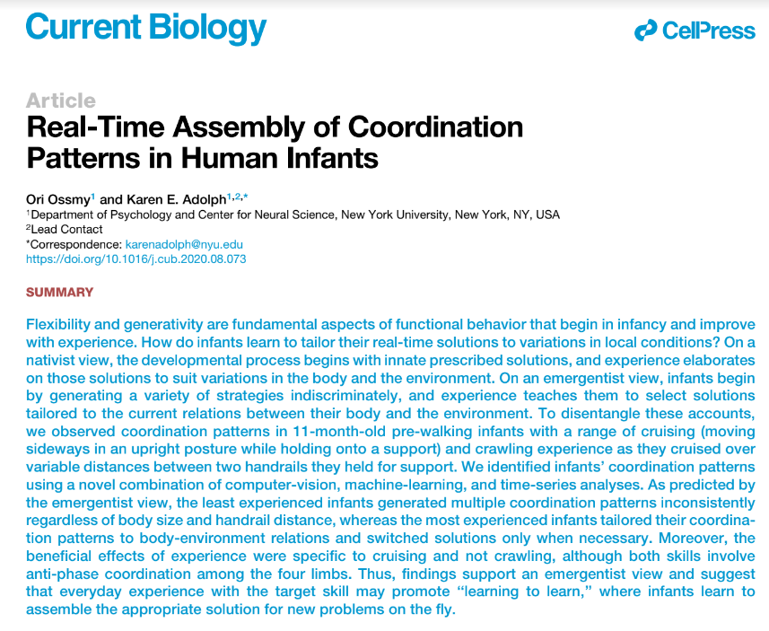
https://nyu.databrary.org/volume/1116/slot/44828/-?asset=233512

Slide 76
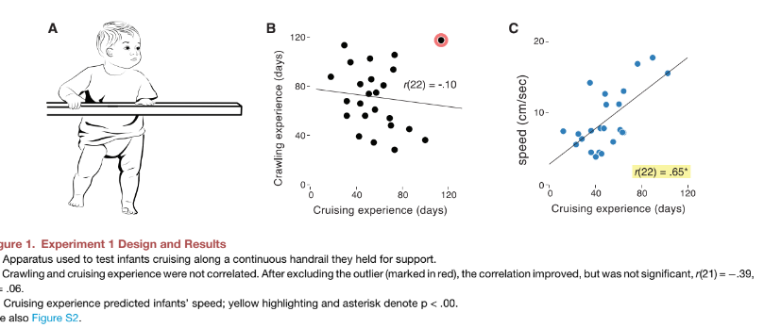

Slide 77
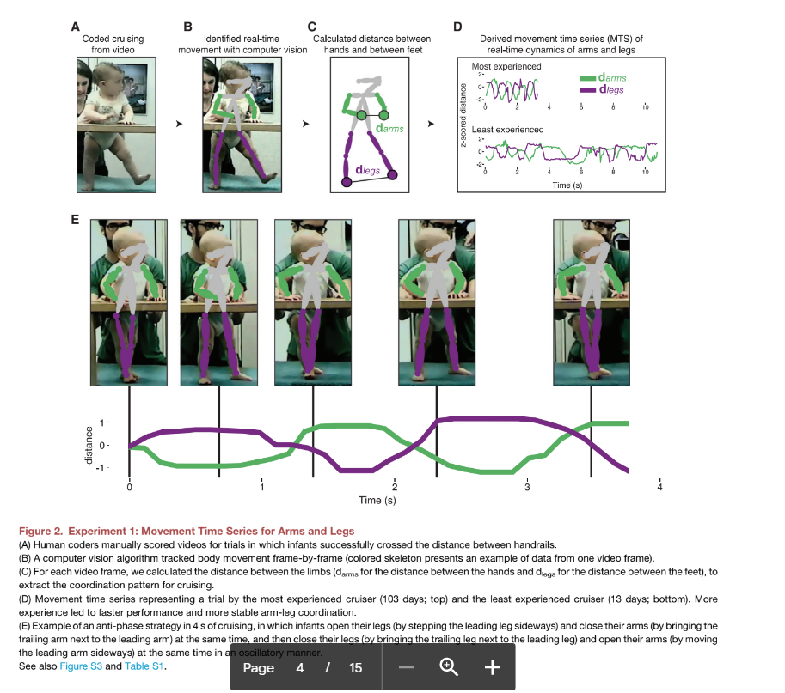

Slide 78
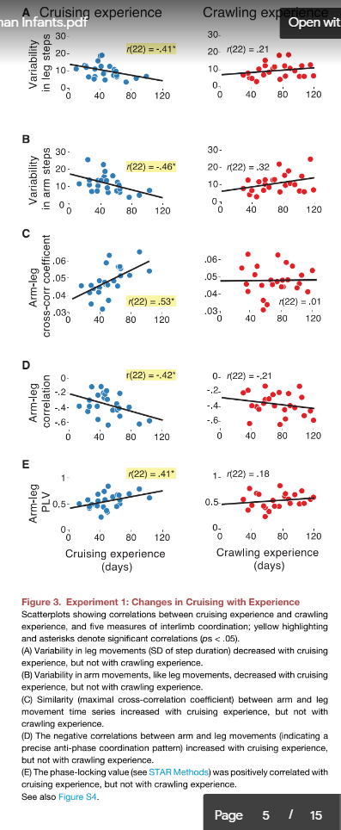
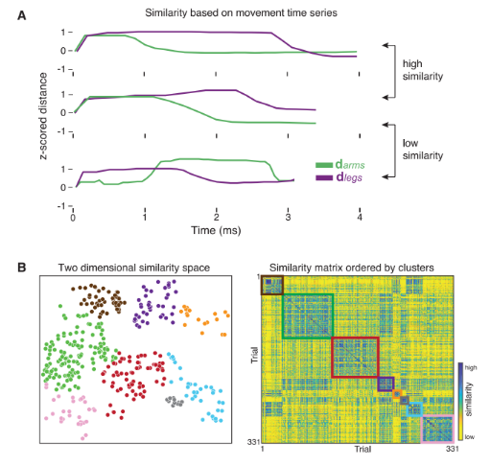

Slide 79
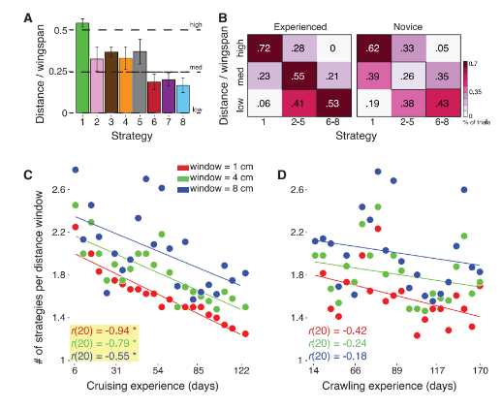
Strategies
Notes:
Figure 7. Experiment 2: Changes in Coordi-nation Strategies with Experience
(A) Average ratio between infant wingspan andhandrail distance for each strategy across trials
(error bars denote standard errors).(B) Differences between experienced and novicecruisers in when they used each strategy for eachwingspan-distance ratio.(C and D) Switching index (see STAR Methods)
decreased with cruising experience using windowsizes of 2, 4, and 8 cm (C), whereas the switching
index did not significantly decrease with crawlingexperience for any window size (D); yellow high-
lighting and asterisks denote significant correla-tions (ps < .05).

