Slide 1
Cognition
Messinger

Slide 2
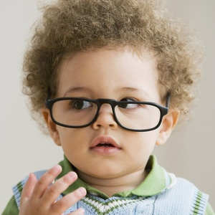



Intelligence: New Findings and Theoretical Developments
Nisbett et al (2012)

Slide 3
Factors that affect IQ
Biological: Breast feeding increased IQ by 8 points
  Fatty acids in breast milk?
Social: SES, Adoption, hearing more words (10-30 million word gap)
Shared environment effects higher in childhood/adolescence than adulthood
  Birth order (3 points) – More attention to older child?

Slide 4
Genes and the Environment
Heritability between .4 - .8
6 genetic markers related to cognitive ability
  but they only explain 1% of variance in cog ability
Heritability varies based on SES for children
  Heritability higher in families with high SES
  For low SES, more variability in IQ can be traced to the shared environment
  Mixed results for European studies.
    Low SES children showed higher heritability?

Slide 5
Interventions
SES again – High SES children increase in IQ over the summer, lose SES children decrease
Good preschool programs’ effects fade out by late elementary school
Still…. adults in these programs more likely to graduate, own homes, etc…

Slide 6

Interventions
School
  Quality of teaching, longer school day, smaller classes, interactive computer programs
Increases in working memory (e.g. n-back test training)
Drugs and exercise (physical & cognitive) have modest effects

Slide 7
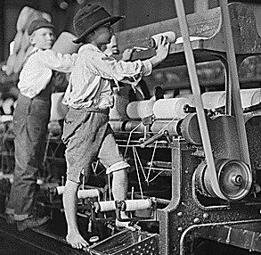
Flynn effect fun!
The impact of industrialized nations

Slide 8
Neurological Underpinnings
Links between the PFC and performance on fluid reasoning tasks
  PFC needed for solution of visuospatial reasoning
PFC less involved in tasks that require crystallized intelligence
No consistent neural pattern of activation in the brain for reasoning
How do we interpret this?

Slide 9
Group differences
Battle of the sexes – Overall, similar levels of IQ
Women – better at verbal fluency and memory
Men – visuospatial abilities (as young as 3 months of age)
SATs – Boys score 1/3 SD higher than girls (unequal n problem)
Males more variable on both ends of the spectrum
Causes – biopsychosocial model? evolutionary explanations?

Slide 10
Group differences
Racial differences due to environment…genetics and adoption studies support this
Stereotype Threat – robust findings
Asian vs Non-Asian differences may be due to culture and motivation
Jewish vs. Non-Jewish differences may be due to sphingolipids?

Slide 11
Issues
Working memory = fluid intelligence?
The Flynn effect
The concept of g
  Is Cattell’s claim true? (1971): more fluid g = more crystallized g
Self-regulation and self control
Stress on the CNS and attention
SO…where should we focus?
Applications to your own research?

Slide 12

Kelly Shaffer

Slide 13
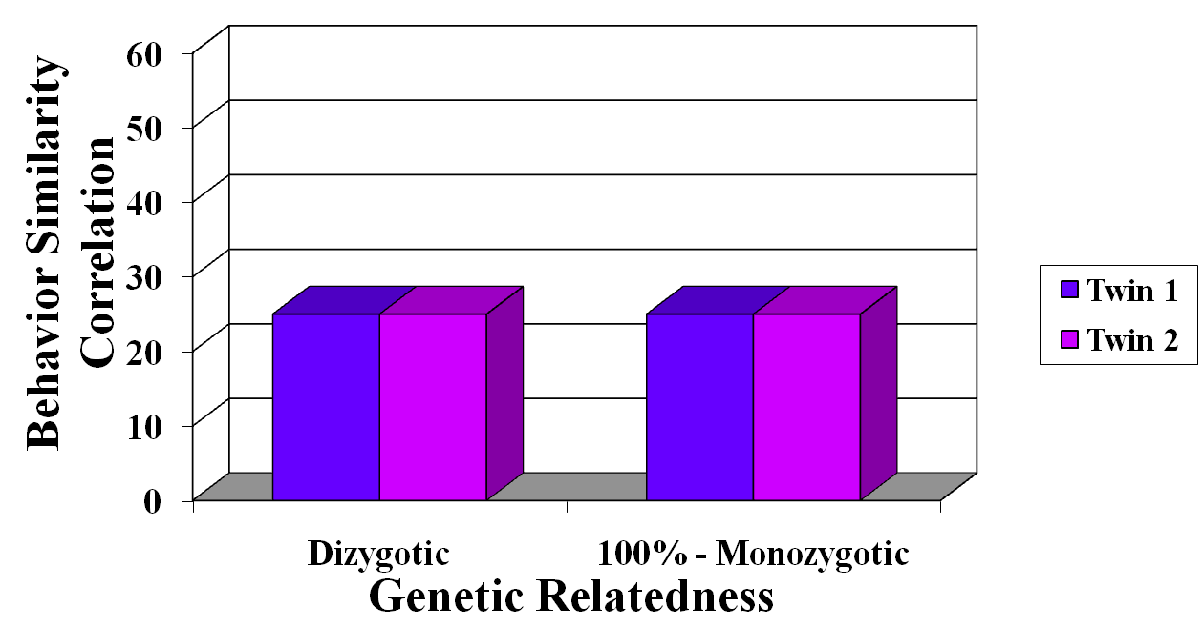
No genetic influence

Slide 14
Genetic influence

Slide 15
Gene x SES → Mental Ability (MA)
SES-related disparities in MA increase from 10 mos to 2yrs
General contribution of genes & environment
  Heritability higher at age 2
SES moderates genetic contribution to MA change
  Increasing heritability of MA in infancy most evident for high SES
    Tucker-Drob, E. M., Rhemtulla, M., Harden, K. P., Turkheimer, E., & Fask, D. (2011). Emergence of a Gene Ã— Socioeconomic Status Interaction on Infant Mental Ability Between 10 Months and 2 Years. Psychological Science, 22(1), 125-133.
Fernandez

Slide 16
SES vs. Environment in Child Development
SES-related disparities widen over course of childhood
→ Cumulative environmental damage
72% high SES families
Greater influence of genes
Heritability of Cognitive Ability = 50% in General Population
10% low SES families
Greater influence of environment
Shaffer | Tucker-Drob et al., 2011
Notes:
Cumulative environmental damage:
Kids in advantaged homes can select experiences that allow them to maximize their genetic potential/in line with their genetic propensities
E.g., kids with genes coding for extraordinary intelligence can do all these stimulating activities that encourages their development vs. kids not blessed in that area may not select those opportunities
Kids in disadvantaged homes don’t have access to stimulating activities
E.g., regardless of whether you have genes coding for extraordinary intelligence or not, you can’t access stimulating activities
Idea supported by genetics work:
Overall heritability (genetic influence) of cognitive ability = 50%
Among upper SES, see much higher influence of genes on cognitive ability
Among lower SES, see much higher influence of environment on cognitive ability

Slide 17
SES vs. Environment in Child Development: Timing?
When do childhood Gene x SES effects emerge
Youngest documented SES differences = 7 yo
Parenting differences related to SES:
  Time spent with children: high SES > low SES
  Sensitivity to children's signals: high SES > low SES
Shaffer | Tucker-Drob et al., 2011
Notes:
Unknown when these SES splits in cognitive ability begin
Youngest documented split in cognitive ability due to SES measured in 7 year olds
Evidence to suggest split may occur earlier than formal education

Slide 18
Hypotheses
SES will be positively related to change in mental ability (SES x Age)
Mental Ability
Time
Shaffer | Tucker-Drob et al., 2011
Notes:
Ask you to think in interactions:
We know for all kids, mental ability will increase with age (MAIN EFFECT of age)
This hypothesis suggests a MODERATION of the effect of age on mental ability such that
Higher SES = greater gains
Lower SES = less gains
For purposes of grasping concept, I’m dichotomizing, but the analyses allowed them to run with continuous variables
High SES: steeper positive slope – show greater/faster gains
Low SES: flatter positive slope – show lesser/slower gains

Slide 19
Hypotheses
Genes will influence change in mental ability (Genes x Age)
Mental Ability
Time
Shaffer | Tucker-Drob et al., 2011
Notes:
“high mental ability genes”: steeper positive slope
“low mental ability genes”: flatter positive slope
Genes won’t account for differences early in infancy, but will start to account for more of the individual variability in scores as children develop

Slide 20
Hypotheses
There will be an interaction between SES and genes related to change in mental ability (SES x Genes x Age)
LOW SES
HIGH SES
Mental Ability
Mental Ability
Time
Time
Shaffer | Tucker-Drob et al., 2011
Notes:
Now, think three way interaction: the effect of genes on development over time is DIFFERENT across SES levels
High SES:
No difference between “high ability” and “low ability” genes at 10 months
Big difference between “high ability” and “low ability” genes at 2 years
Low SES:
No significant difference between “high ability” and “low ability” genes at 10 months NOR 2 years

Slide 21
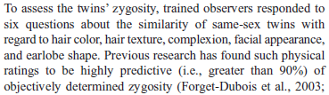
Sample
750 twin pairs from Early Childhood Longitudinal Study, Birth Cohort (ECLS-B)
Assessed at 10 months and 2 years old
Zygosity:
Shaffer | Tucker-Drob et al., 2011
Notes:
Cool thing abt this study: representative of children born in 2001, so “Range of ethnicities, incomes, and locations” so high external validity among this cohort in the US
Included this clip about how zygosity was measured: just thought wild!
Twins coded with scores 6-8 “monozygotic”, above = “dizygotic”
Correlated with parents’ report at r=.8
Assume b/c can’t rely on parent report, getting doctors’ report not feasible for all, blood test not feasible for all
Your thoughts?

Slide 22
Measures
Mental Ability: Bayley Short Form-Research Edition (Mental Scale only)
SES: composite of
  Paternal education
  Maternal education
  Paternal occupation
  Maternal occupation
  Family income
Shaffer | Tucker-Drob et al., 2011

Slide 23
Results: Hypothesis 1
“SES-related disparities in mental ability emerge over the course of infant development”
  SES was unrelated to mental ability at 10 mn
  SES was related to change in mental ability from 10 mn to 2 yr
Mental Ability
Time
Shaffer | Tucker-Drob et al., 2011
Notes:
So, shocker, all hypotheses were supported
1 SD Increase SES = extra 1/3rd SD increase in mental ability from baseline
High SES: steeper positive slope – show greater/faster gains
Low SES: flatter positive slope – show lesser/slower gains

Slide 24
Results: Hypothesis 2
“Genes begin to play a role in the development of mental ability between 10 mn and 2 years”
Mental Ability
Time
Shaffer | Tucker-Drob et al., 2011
Notes:
Genes were unrelated to individual differences in mental ability at 10 months, but were significantly related to a child’s gains in mental ability over time
“high mental ability genes”: steeper positive slope
“low mental ability genes”: flatter positive slope

Slide 25
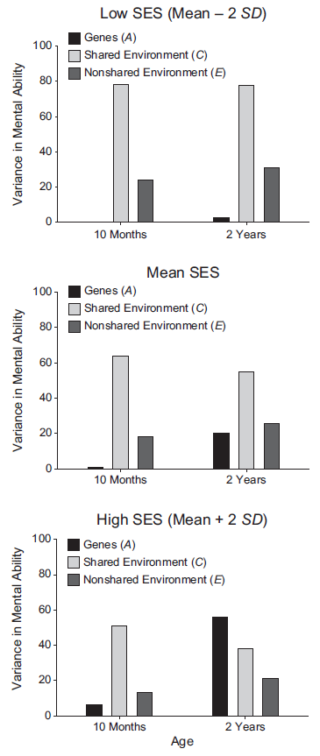
Results: Hypothesis 3
“The extent to which genes influence mental development differs according to SES”
  By 2 years: genetic influences on mental ability are larger among children from high SES vs. low SES
LOW SES
HIGH SES
Mental Ability
Mental Ability
Time
Time
Shaffer | Tucker-Drob et al., 2011
Notes:
This is where we’re thinking about the three-way interaction
High SES:
No difference between “high ability” and “low ability” genes at 10 months
Big difference between “high ability” and “low ability” genes at 2 years
Low SES:
No significant difference between “high ability” and “low ability” genes at 10 months NOR 2 years

Slide 26
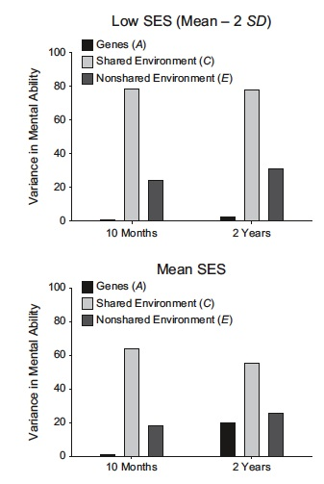
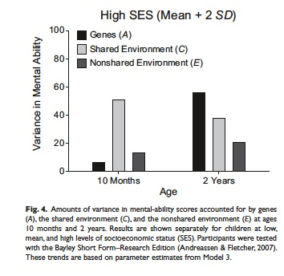
    Effect of genes on mental ability increases over infant development in high SES case (Tucker-Drob, et al.. (2011)
Fernandez

Slide 27
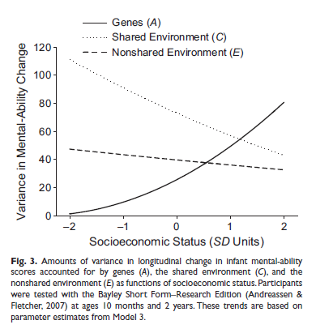
Results: Hypothesis 3
Shaffer | Tucker-Drob et al., 2011
Notes:
Shown nicely here (same concept displayed differently, whichever one you can wrap your head around best):
Look just at high SES section: most of the variability in children’s gains in mental ability is accounted for by their genes
Now just look as low SES section: none of the individual difference in children’s gains in mental ability is accounted for by their genes, but rather by the kids’ shared environment
So, if I’m a child in low SES, I’m going to experience gains if my mom and dad happen to show more attention, there’s less chaos around, more books in our house, etc.
Whereas if I’m a child in high SES, I’m going to see most gains if my genes code for it

Slide 28
Discussion
“We overinvest in most schooling and post-schooling programs and underinvest in preschool programs for disadvantaged persons”
→ Do you agree?
Shaffer | Tucker-Drob et al., 2011
“Although SES is often conceived of as a purely environmental variable, socioeconomic groups may differ in the frequencies of specific genetic polymorphisms”
→ Are SES and genes confounding variables?
Notes:
President Obama just called for free community college programs … should we all lobby for him to abandon that over to preschool funding?

Slide 29
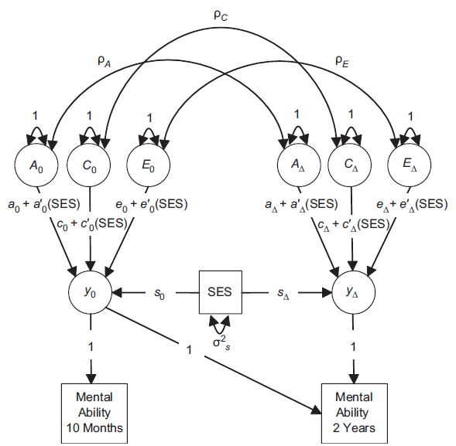
Method
  750 pairs of twins (from ECLS-B)
  Zygosity score
    Monozygotic (MZ)
    Dizygotic (DZ)
  Analytic Method
    2 latents: BSF-R initial (10mos) & change (10 mos to 2 yrs)
    Regressed on MA
Fernandez
Notes:
Fig. 1. Path diagram of the behavioral genetic model (Model 3) fit to mental-ability scores at age
10 months and age 2 years. Participants were tested with the Bayley Short Form–Research Edition
(Andreassen & Fletcher, 2007). This diagram represents one half of the model (i.e., one twin in
each pair). Single-headed arrows represent regression relations, and curved double-headed arrows
represent variances and covariances. The factors y0 and yD represent baseline mental ability and change
in mental ability, respectively. The factors A, C, and E represent additive genetic influences, sharedenvironmental
influences, and nonshared-environmental influences, respectively. Each biometric path
was modeled as a combination of a main effect (a, c, and e) and an interaction with socioeconomic
status (SES; a′, c′, and e′ ). The regression of the factor on SES is denoted by s.

Slide 30
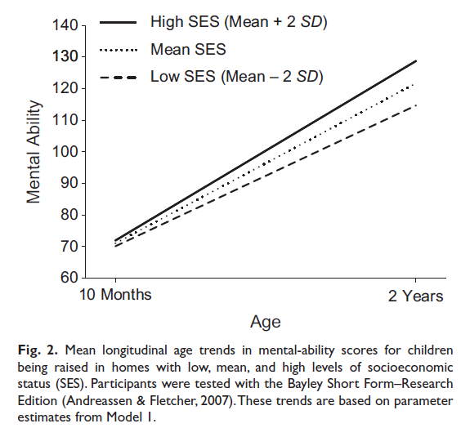
SES differences in change

Slide 31
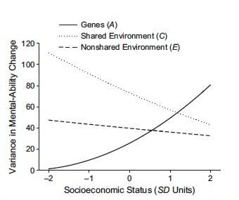
Results
  Model 1
    10 mos, SES not related to MA
    MA increased dramatically between 10mos & 2yrs
    Significant relation between SES & magnitude of change
  Model 2
    Effect of genes on mental ability increases over infant development
  Model 3…
Fernandez
Notes:
Fig. 3. Amounts of variance in longitudinal change in infant mental-ability
scores accounted for by genes (A), the shared environment (C), and the
nonshared environment (E) as functions of socioeconomic status. Participants
were tested with the Bayley Short Form–Research Edition (Andreassen &
Fletcher, 2007) at ages 10 months and 2 years. These trends are based on
parameter estimates from Model 3.

Slide 32
Devika Jutagir

Slide 33
Theories of genetic and environmental influence on Intelligence
Individual differences in intelligence:
  Hereditarian perspective: Individual differences in intelligence are primarily genetic.
  Sociological perspective: Differences primarily rooted in environmental experience.
Scarr-Rowe hypothesis: “IQ scores within advantaged groups will show larger proportions of genetic variance and smaller proportions of environmental variance than IQ scores for disadvantaged groups. Environmental disadvantage is predicated [sic] to reduce the genotype-phenotype correlation in lower-class groups.”
Results of studies on the Scarr-Rowe hypothesis are mixed.
Jutagir | Tucker-Drob & Bates, 2015
Notes:
Heritability of intelligence will be lower among individuals raised under conditions of greater childhood socioeconomic disadvantage.

Slide 34
Questions
Does the range of studies from the United States support a positive estimate of Gene × SES interaction on achieved IQ?
Do studies on participants outside the United States show a similar greater-than-zero Gene × SES effect?
Can a single estimate adequately account for all of the observed effect sizes, or are separate estimates necessary to represent effect sizes from the United States and from Western Europe and Australia?
Jutagir | Tucker-Drob & Bates, 2015
Notes:
“high mental ability genes”: steeper positive slope
“low mental ability genes”: flatter positive slope
Genes won’t account for differences early in infancy, but will start to account for more of the individual variability in scores as children develop

Slide 35
Methods: Meta-Analysis
Search terms: twin, gene, socioeconomic status, education, income.
Inclusion criteria:
  Intelligence/achievement continuously measured with objective performance-based test.
  Inference of genetic influence had to be made using siblings (preferably twins) with varying degrees of genetic relatedness.
  Degree of genetic relatedness known to a high degree of certainty.
  Ordered categorical/continuous measure of childhood family SES examined as moderator of genetic variance in intelligence/achievement.
  Participants not selected on the basis of psychiatric or medical diagnoses, patient status, or intelligence/achievement test scores.
14 independent studies
  43 effect sizes.
  24,926 pairs of twins and siblings.
Jutagir | Tucker-Drob & Bates, 2015
Notes:
“Inconsistencies among findings. First, reports of Gene × SES interaction on IQ might be false positives resulting from poorly powered studies conducted against a backdrop of bias toward publishing and citing positive findings. Alternatively, Gene × SES interactions might be true effects, but researchers could fail to replicate them because of low power or poor methodology. Finally, multiple authors have suggested that Gene × SES interactions may differ in strength across different populations or societies (Bates, Hansell, Martin, & Wright, 2015; Bates et al., 2013; Hanscombe et al., 2012; Tucker-Drob, Briley, & Harden, 2013; Turkheimer & Horn, 2014). Those supporting this type of explanation have pointed to higher social stratification in access to education (Hauser, 1970) and relatively modest social health (Adler & Newman, 2002) and social-welfare support (DeNavas-Walt & Proctor, 2014) in the United States compared with Australia and Western Europe.”
Data were relatively evenly split across U.S. (18 effect sizes, 8 studies, 10,831 twin or sibling pairs) and non-U.S. (Western Europe and Australia; 25 effect sizes, 6 studies, 14,095 twin or sibling pairs) samples.

Slide 36
Results
Jutagir | Tucker-Drob & Bates, 2015
Notes:
In an unconditional meta-analytic model, meta-analytic mean for the Gene × SES interaction was non- significant (a􏰀 = .029, SE = .019, p = .136), but there was substantial heterogeneity in the effect (the standard deviation of the random effect was .048; SE = .019, p = .011).
When a dummy-coded nation variable (0 = non–United States, 1 = United States) was added to the meta-regression model, there was a significant difference between Gene × SES effect sizes from the United States compared with those from Western Europe and Australia (b = 0.101, SE = 0.032, p = .001).
There was a significant Gene × SES effect for U.S. studies (a􏰀 = .074, SE = .020, p < .0005), but a trivial and nonsignificant Gene × SES effect for non- U.S. studies (a􏰀 = −.027, SE = .022, p = .223).

Slide 37
Results: United States Sample
Jutagir | Tucker-Drob & Bates, 2015

Slide 38
Results
Jutagir | Tucker-Drob & Bates, 2015
Notes:
We examined each of the following study characteristics as moderators of the a􏰀 effect size in turn, each time controlling for whether or not effect sizes came from U.S. samples: childhood age, single versus composite measure of SES, achievement or knowledge test score versus intelligence test score, and single measure of cognitive ability versus composite cognitive measure. None of these moderators was statistically significant.
“Beyond nation, we did not identify any other significant moderators of Gene × SES effects. We examined whether test performance was measured in childhood or adulthood, childhood age of testing, whether the tests measured either achievement and knowledge or intelligence, whether a single or composite indicator of SES was used, and whether the tests were of single ability or a composite cognitive measure.”

Slide 39
Discussion
Does the range of studies from the United States support a positive estimate of Gene × SES interaction on achieved IQ? Yes
Do studies on participants outside the United States show a similar greater-than-zero Gene × SES effect? No
Can a single estimate adequately account for all of the observed effect sizes, or are separate estimates necessary to represent effect sizes from the United States and from Western Europe and Australia?
Jutagir | Tucker-Drob & Bates, 2015

Slide 40
Discussion
“Gene × SES effects are not uniform but can rather take positive, zero, and even negative values depending on factors that differ at the national level.”
“Further research on between-nations variability in the effects of family SES on cognitive development is particularly important.”
Possible mechanisms underlying variability:
  National differences in how concepts of letter and number that underpin literacy and numeracy are imparted (Ramani & Siegler, 2008).
  Educational quality (Taylor, Roehrig, Soden Hensler, Connor, & Schatschneider, 2010).
  Medical and educational access (Bates et al., 2013; Tucker-Drob et al., 2013).
  Macrosocietal characteristics (e.g., upward social mobility; Ritchie, Bates, & Plomin, 2014).
  Income support (Duncan, Morris, & Rodrigues, 2011).
Jutagir | Tucker-Drob & Bates, 2015
Notes:
One possibility that we were unable to fully test in our meta-analytic data set is the extent to which the Gene × SES interactions detected in the United States were driven by the greater racial and ethnic diversity of the U.S. sample compared with the non-U.S. samples.
Tucker-Drob et al. (2011) reported that Gene × SES effects persisted in a nationally representative sample of American children even when race, and its inter- action with the biometric components, was controlled.

Slide 41
Functional significance of imitation?
Nielsen & Tomaselli (2010)
  Why expect cultural differences in children’s tendency to overimitate?
Notes:
Functional significance = learning how to use NEW objects (accommodation)
Western—learning via demonstration which characterizes much of parent-child interaction; therefore children can assume these actions are attempts to transmit relevant knowledge; so over-imitation might simply be reaction to this teaching approach– children shown things and taught how to use via ordered, guided instruction
Non-Western – children expected to learn largely through observation and caregivers rarely explore object use with children (therefore, overimitation might be less likely)

Slide 42
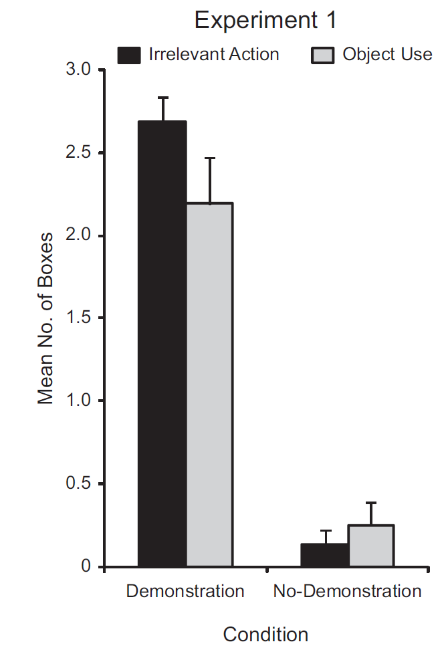
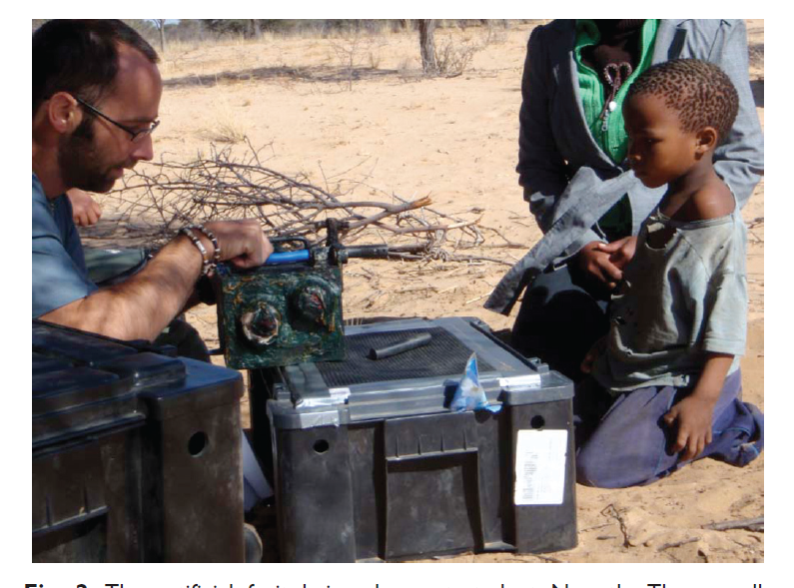
Cognitive Development - Applications
Notes:
2-6 yrs old; between subjects design with 2 conditions demonstration (irrelevant action vs. causally related by unnecessary action vs. no demonstration
Blue box (open door with knob), switch box (slide switch to open mallet provides distraction), artificial fruit
DVs = perform irrelevant action; use object to open box

Slide 43
Cognitive Development - Applications
Experiment 1
Notes:
2-6 yrs old; between subjects design with 2 conditions demonstration vs. no demonstration
Blue box, switch box, artificial fruit

Slide 44
Cognitive Development - Applications
Experiment 2
  Participants
  Conditions
  Interpretation
Notes:
Broader age range (2-13 years)
Addition of no-demonstration + demonstration (baseline) condition
Added familiar vs. unfamiliar demonstrator conditions---made no difference in performance
Importantly---no age related differences – in fact older children MORE likely to imitate; and even the 10 children who figured out simple solution in no-demonstration phase; all imitated after demonstration phase.

Slide 45
Cognitive Development - Applications
Hermann et al. (2009)
  Good example of application of psychometric approach to studying intelligence
  Interpretations of
    group differences vs individual differences and inter-correlations
Notes:
Study of individual differences and intercorrelations gives info about underlying structure of cognition

Slide 46
Cognitive Development - Applications
Hermann et al. (2009)
  No support for “g” in either species
  Is social cognition uniquely human?
    Humans have higher mean scores
    Unique & separable structure
Notes:
May not find support for “g” because used an especially wide range of cognitive tasks (compared to most standardized assessments)
Mean differences and unique integrated social processing for humans may suggest that humans have evolved a coherent and specialized set of social-cognitive skills
Limitations?
Interpretation of underlying structure is entirely dependent on tests used
Low variability in performance on some test items
Different age ranges for human and chimp groups (chimps ranged from juvenile to adult) vs. children (2 yrs old)
**different species evolve different cognitive skills for dealing with ecological and social problems they face; therefore humans = social cognition

Slide 47
Agree?
“It is in contrast to severe deprivation that enrichment shows its statistically significant effects.”
    Gottlieb & Blair, 2004

Slide 48
Gottlieb & Blair 2004
Rodent research: early experiences avert the deterioration of learning ability seen when rodents are reared in impoverished conditions
It is only in comparison to impoverished conditions that enrichment shows an influence
Exposure to enriched conditions after exposure to impoverished conditions does not matter

Slide 49
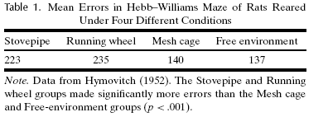
Early visual experience & exploration!
From about 27 days of age to 100 days of age:
a stovepipe cage (little motor or visual experience),
an enclosed running wheel (motor activity but little variation in visual experience),
a mesh cage restricted motor activity but variation in visual experience as cage moved daily in lab.
(4) large free environment box – socially and physically stimulating

Slide 50
Early vs. late experience
Its early experience that’s important
Table 2. Mean Errors in Hebb-Williams Maze of Rats With Different Early and Late Environmental Experiences
Free environment/ Stovepipe | Stovepipe/ Free environment | Free environment/ Free environment | Normal Cage/ Normal Cage
161 | 248 | 152 | 221
Note. Data from Hymovitch (1952). The Stovepipe/Free Environment and Normal Cage groups made significant more errors than the other two groups (p <.001).

Slide 51
Cognitive Development - Applications
Gottlieb & Blair (2004)
  Summary of impact of environmental variation in later learning in rodents
    Role of experience type
    Role of timing

Slide 52
Abecedarian project:
2 timed intervention components
Birth – 5 years: “comprehensive educational daycare intervention”
  “utilized developmentally appropriate curricula designed to facilitate children’s language, motor, social, and cognitive growth.
    Full-day care, 50-weeks per year, 93% enrolled by 3 months
5 – 8: “school age intervention delivered through home visitors, liaisons between home and school.
  designed to increase parent involvement in the educational process

Slide 53
Cognitive Development - Applications
Gottlieb & Blair (2004) (cont)
  Applications to Early Intervention
    The Abecedarian Project
    Multiple risks
      Low parental education
      Low income
      Father absence
      Unstable work history
      Family members with low IQ
      History of social service contacts
      Family history of school failure and psychopathology
(Ramey & Campbell, 1984)

Slide 54
Cognitive Development - Applications
Gottlieb & Blair (2004) (cont)
    The Abecedarian Project
      Daycare Intervention (birth – 5 years) vs. no treatment
      School age home-visiting intervention vs. no treatment
    Random assignment to each = 4 conditions
Ramey & Campbell, 1984

Slide 55
Abecedarian intervention conditions
Early daycare intervention (birth – 5) with follow through services to 8 years
Only the educational daycare intervention
Only the school age follow through
An untreated control group.

Slide 57
Early intervention counts!

Slide 58
Early intervention counts!
Short-term Effects of Early Intervention on IQ
Longer-term Effects of Early vs. Later Intervention
Gottlieb & Blair (2004)
Notes:
Main effect of intervention

Slide 59
Real life: % retained in grade

Slide 60
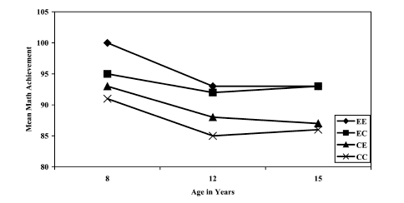
Cognitive Development - Applications
Gottlieb & Blair (2004) (cont)
    Longer term effects of Early & Later Intervention on Academic Achievement
Notes:
More importance for later intervention;
Suggests environmental enrichment FOLLOWING deprivation not likely to have effect; but later enrichment may prevent FURTHER declines

Slide 61
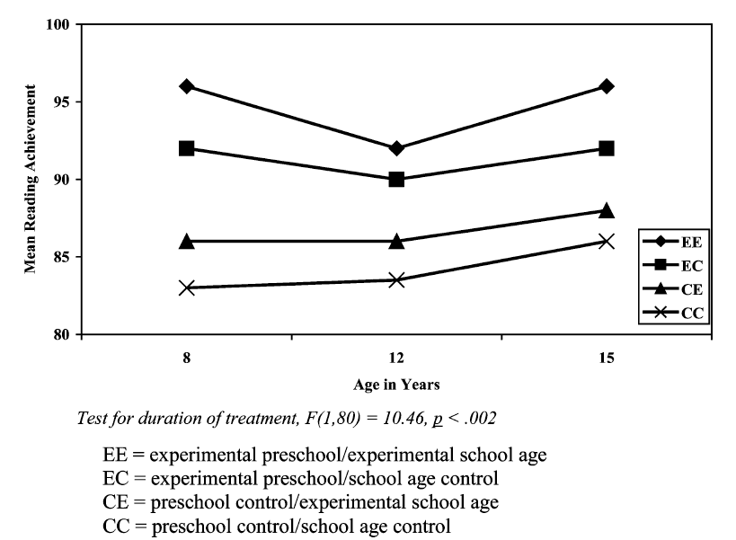
Later school: Reading level

Slide 62
Cognitive Development - Applications
Gottlieb & Blair (2004) (cont)
  Interpretations?
    Species-typical development vs. enriched development

Slide 63
Definitions
Structural networks: anatomical connections linking cortical and subcortical brain regions
Functional networks: Set of connections among brain regions derived by observing neural activity during tasks and rest

Slide 64
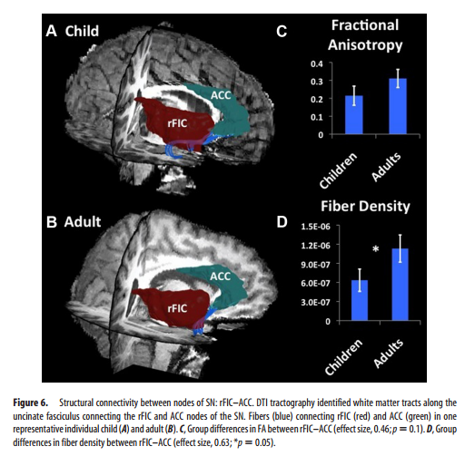
  Dynamic Reconfiguration of Structural and Functional Connectivity Across Core Neurocognitive Brain Networks with Development. Uddin, et al., 2011
’Right fronto-insular cortex (rFIC) is a component of a salience network (SN) mediating interactions between large-scale brain networks involved in externally oriented attention [central executive network (CEN)] and internally oriented cognition [default mode network (DMN)].
The causal influence of the rFIC on nodes of the SN and CEN was greater in adults than children.

Slide 65
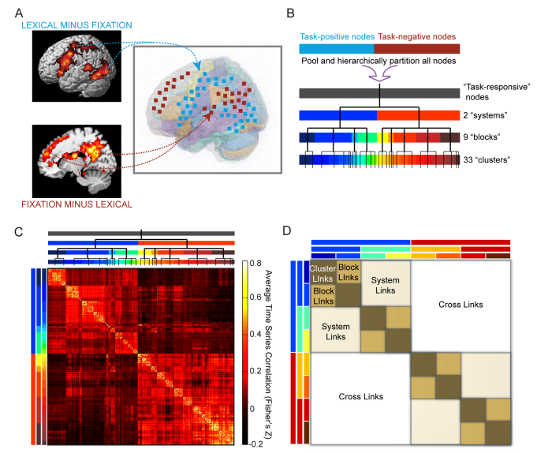
Changes in Task-Related Functional Connectivity across Multiple Spatial Scales Are Related to Reading Performance. Wang, et al., 2013. PlosOne
Figure 2. Determination of task-responsive network and hierarchical partitioning to form three levels of functional hierarchy. (A) We determine group-level GLM random effects contrasts of lexical minus fixation trials (task-positive) and fixation minus lexical trials (task-negative) to define two functional systems encompassing task-responsive brain regions. Voxels within these regions are coarse-grained to 66666 mm3 ROIs to form the highest-resolution units of our network, called nodes. Time series of hemodynamic response are extracted from these nodes and are pairwise cross-correlated to define a weighted connectivity matrix for all subjects. (B) Schematic illustration and dendrogram of hierarchical partitioning. All nodes are pooled together and iteratively partitioned using modularity-based clustering algorithms to form a hierarchical network of relations. Each group on a higher level is partitioned to yield subgroups on the next lower level. Three levels of partitioning are defined, with various numbers of groups on each level: 2 ‘‘systems,’’ 9 ‘‘blocks,’’ and 33 ‘‘clusters.’’ (C) Matrix of Fisher’s Z-transformed correlation coefficients averaged over all subjects. Nodes are ordered to keep clusters, blocks, and systems contiguous. Colored bars and dendrogram along the sides indicate group membership of nodes at all three levels and correspond to those from (B). (D) Categorization of link type depends on the lowest level at which the two associated nodes are classified in the same group; i.e. same cluster (‘‘cluster links,’’ brown), same block but different clusters (‘‘block links,’’ tan), same system but different blocks (‘‘system links,’’ beige), or between systems (‘‘cross links,’’ white). Colored bars illustrate the partition of nodes into different groups at the three levels, similar to (B) and (C), but the specific groupings in (D) are conceptual only and do not represent real data doi:10.1371/journal.pone.0059204.g002

Slide 66
Difficulties in assessing cognitive development in infancy
Infants may become distracted, tired, or bored.
It’s hard to motivate infants to perform at their best.
Interpretation of measurable dependent variables (e.g., looking time) is key

Slide 67
Fagan Test of Infant Intelligence
Assesses cognitive development in infancy.
Composed of habituation-dishabituation items.
  “a “novelty score” -- amount of fixation during the test phase devoted to the novel picture
      divided by the total fixation time to both the novel and familiar picture.”
    http://infantest.com/ftii.pdf
Used for research studies—index of the relative level of functioning in group being studied
  Does not determine an individual child’s performance relative to children in the norming sample – like in the Bayley

Slide 68
Normed assessments of cognitive development in infancy
Research
  Exposure, prematurity, autism risk, ZIKA…
Identification of infants at risk for developmental delay in order to provide early intervention services.
Scaled scores used at every age

Slide 69

Bayley Scales of Infant Development II (1993)
Permits observation of concepts noted by Piaget:
  A not B search error
  intentional, goal-directed behavior.
    performance is compared with large group of infants on whom the test was normed.
        Applied developmental research
        1 through 3 ½ years
        Extensively normed
        Basis for early referral
        Test-retest reliability
Mullen Scales are alternate assessment
Links unavailable 9/2016
http://www.youtube.com/watch?v=76SRamqYn0A&feature=related blue puzzlehttp://www.youtube.com/watch?v=kpx4AgO-Oxw&feature=relmfu yellow pegs
http://www.youtube.com/watch?v=y1-ANMq1Cwo&feature=relmfu doll
Notes:
15
BAYLEY PERHAPS MOST COMMoNLY USED index of cognitive and motor development in applied developmental research
for the age group for which it is designed - kids under 3
Extensively normed WITH A REPRESENTATIVE census SAMPLE
MEASURE IN APPLIED DEVELOPMENTAL RESEARCH ON YOUNG CHILDRE
CLINICALLY, Basis for early referral
Test-Retest reliability .5 - .7
SCALED SCORES
OF MEAN=100, SD 15, INDEX OF MMR IS 2 SD

Slide 70
What’s on the test?
A series of difficulty-graded items
One Year
  Mental
    Making speech sounds and words
    Fitting a piece in puzzle
    Basic motor tasks
  Motor
    Standing, walking, & throwing
Two & three year
  Mental
    Uses multiple words in phrases
    Completing puzzle
    Counting & concepts
  Motor
    Runs, jumps, copies shapes
Cognitive performance becomes more verbal.
Children have to make verbal responses and understand more complex verbal instructions
Notes:
16

Slide 71
The Structure of Individual
Differences in the Cognitive Abilities of Children and Chimpanzees
Hermann et al. 2010
Ni Sun-Suslow

Slide 72
Two approaches to studying cognition
  Compare experimentally constituted groups on some cognitive task.
    Individual differences = “error variance”
  Analysis of individual difference and their intercorrelations (Sternberg, 1999, 2004).
    Look for underlying factors that might be responsible for individual variation in cognitive performance on multiple cognitive tasks.
Ni Sun-Suslow

Slide 73
Initial evidence
Comparing cognitive performance of chimpanzees, orangutans, and 2-year-old humans on a wide-ranging battery of cognitive tasks:
  All species has same basic cognitive skills in physical domain
  Human children showed more skills in social domain
Ni Sun-Suslow
Notes:
Physical domain = tasks involving space, quantities, and causality
Social domain = communication, social learning, theory of mind

Slide 74
Interspecies analysis of individual difference and intercorrelations
Hypothesis:
Children would show a distinct factor for social intelligence, whereas chimpanzees would not.
Population:
 | Chimpanzees | Humans
N | 106 | 105
Ages | 3-21 years | 2.5 years
Females | 50% | 50%
(ethnicity?) | Uganda, Republic of Congo | Mostly German
Ni Sun-Suslow
Notes:
Humans were recruited by telephone from existing database from Hermann et al., 2007 study.

Slide 75
Test Battery
Primate Cognition Test Battery (PCTB)
3-5 hour battery
Chimpanzees tested in familiar room, humans tested in laboratory accompanied by parent
Ni Sun-Suslow

Slide 76
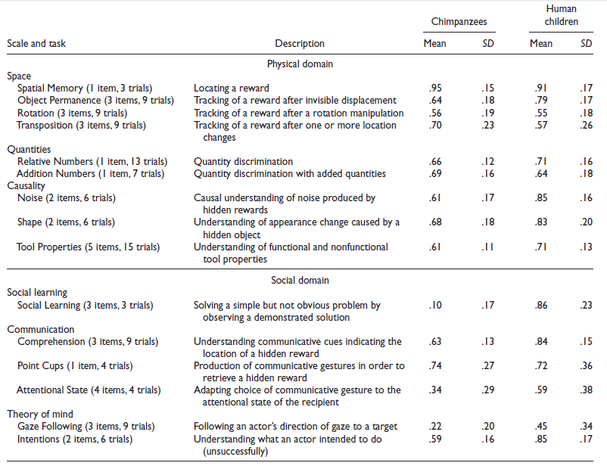
Primate Cognition Test Battery (Mean Proportion of Correct Responses)

Slide 77
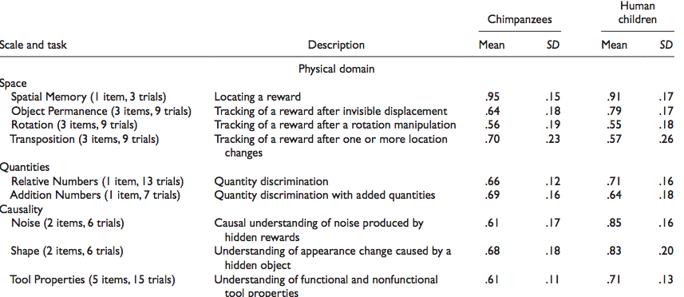
Physical Cognition
Mean Proportion (SD) of correct responses by Chimpanzees and Human Children
Ni Sun-Suslow

Slide 78
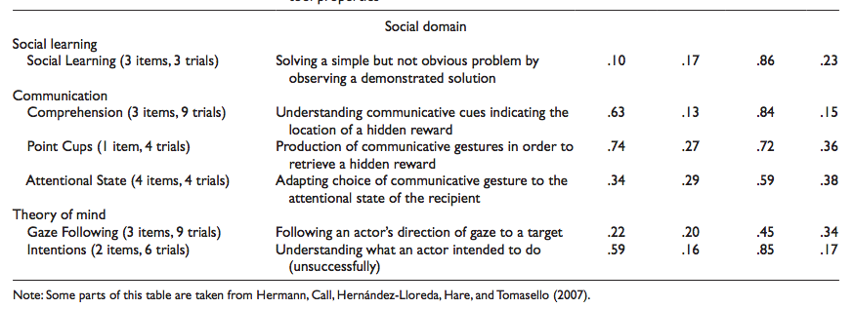
Social Cognition
Ni Sun-Suslow

Slide 79
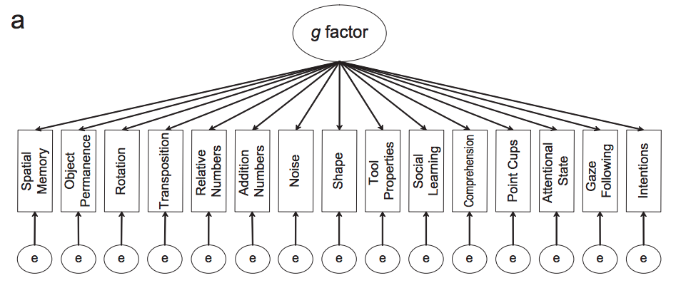
general intelligence
CFA model based on Tomasello & Call (1997)’s theoretical analysis of primate cognition.
Ni Sun-Suslow
Notes:
Theoretical models used in data analysis

Slide 80
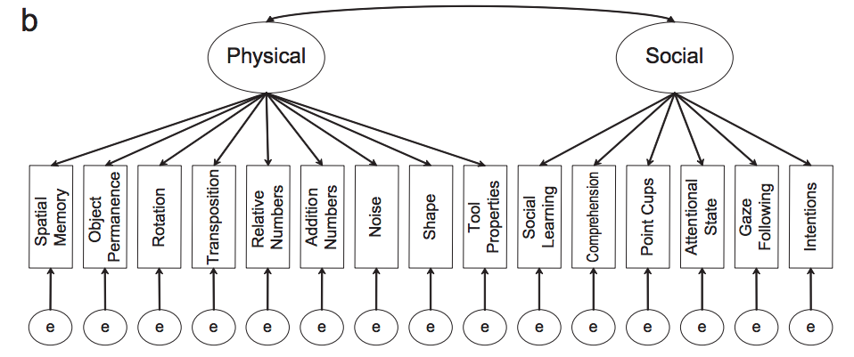
Two-factor model
Ni Sun-Suslow
Notes:
Physical and social factors

Slide 81
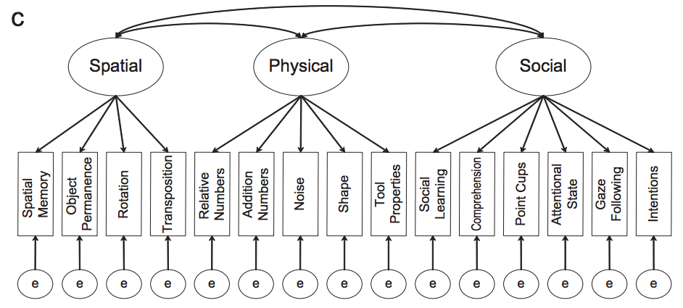
Three-factor model
Ni Sun-Suslow
Notes:
Theory posits that physical cognition evolved mainly in response to demands of foraging and comprises of skills involving space (for finding food), quantity (for comparing yields of different foraging locations), and causality (for extracting food from different places).
Social cognition evolved in response to demands of social interaction and comprises skills of social learning (for learning important things vicariously), communication (for manipulating other individuals), and theory of mind (for predicting the behaviors of others)

Slide 82
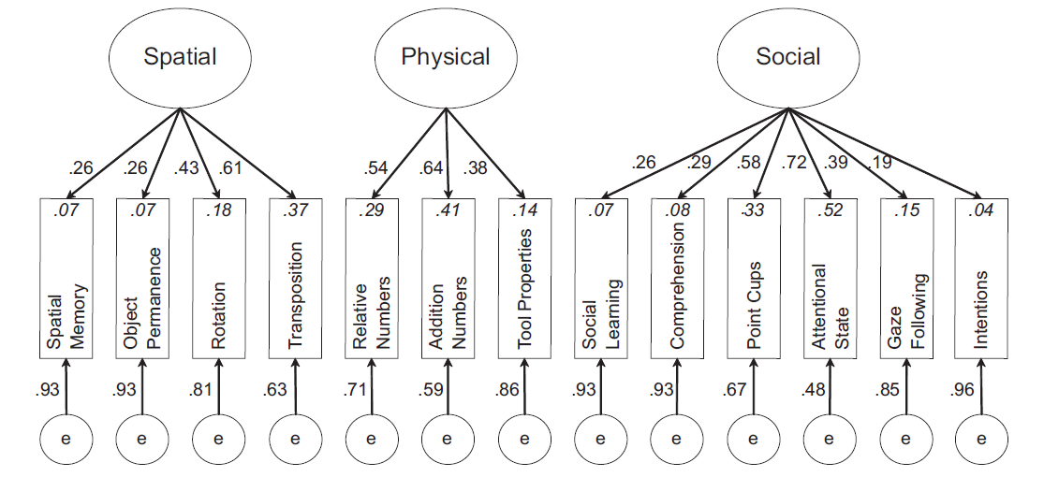
  Is the underlying structure of cognitive abilities comparable in humans and chimpanzees?
Best fitting model for children
    Hermann et al. (2009)
Notes:
Study of individual .
Fig. 2. The best-fitting model from the confirmatory factor analysis of the human children’s performance on the Primate Cognition Test Battery. In
this model, performance on 13 tasks loaded onto three factors (e = error). The numbers alongside the arrows are standardized parameter estimates.
The numbers in italics are the squared multiple correlation values, which represent the lower bounds of the proportion of variance accounted for by
the factors.
Battery of 15 cognitive tasks spanning 3 domains
Spatial
Physical
Social
Tested fit of 1, 2, and 3-factor models separately by species (see Figure 1)
differences and intercorrelations gives info about underlying structure of cognition

Slide 83
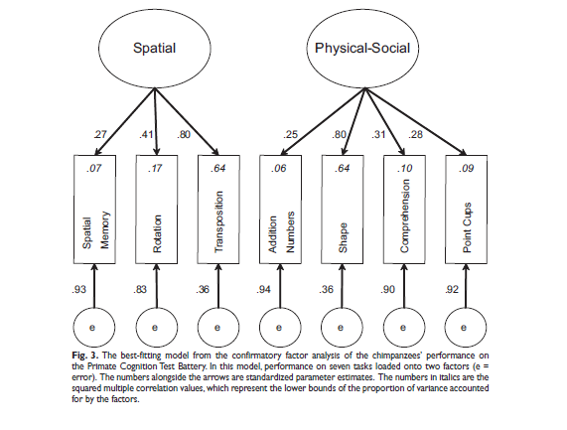
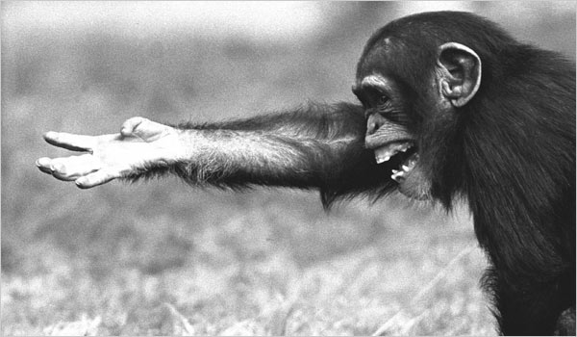
Cognitive Development - Applications
  Best fitting model for chimpanzees
Notes:
No factor that identified social cognition skills apart from physical cognition ones

Slide 84
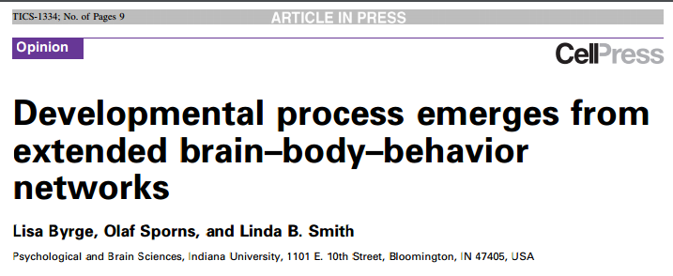
Cognition and behavior results from interconnected structural and functional brain networks
Changing brain connectivity causes AND results from developmental changes in behavior

Slide 85
Brain-Body-Behavior Networks
Brain-Body-Behavior networks
  Explain interaction between neural connectivity, behavior, sensorimotor experiences
  “Actively select and create information that in turn modifies the brain’s internal structure”

Slide 86
Structural and Functional Links
Functional networks:
  Remain connected even when not specifically engaged
  Are constrained by structural connectivity
Notes:
There are specialized regions BUT we now know that there’s a high level of cooperation.
Found during resting state task-free brain studies

Slide 87
Brain←→Behavior
  Pick up an object, hold, rotate, use object.
  Visual information is generated that supports visual object recognition
Brain Networks
Behavior
TIME
Notes:
Behavior in turn evokes neural activity that changes connectivity
Longer tasks produce longer perturbations, reverberations. Juggling (practice)

Slide 88
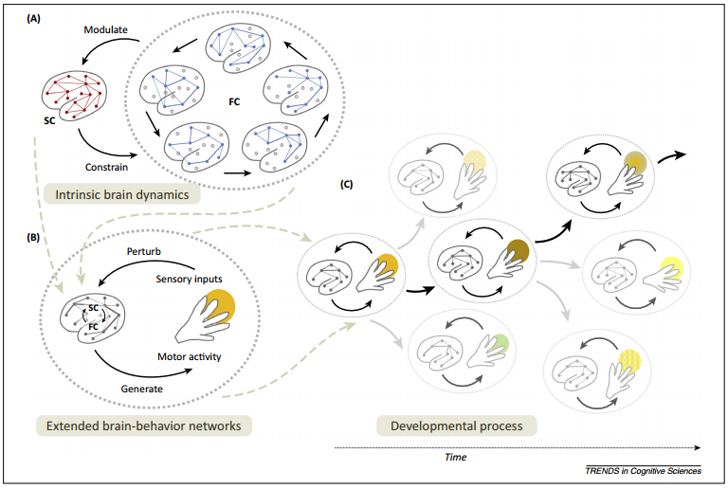
(Brain←→Behavior)→(Brain←→Behavior)

Slide 89
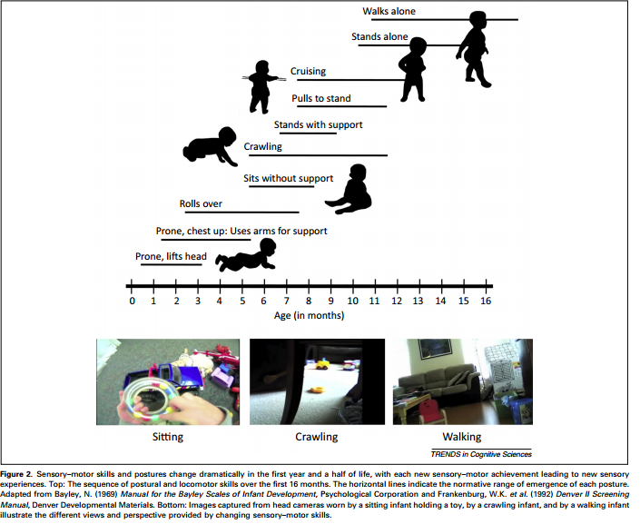
All aspects of the circular process change with time
Notes:
Other examples: literacy

Slide 90
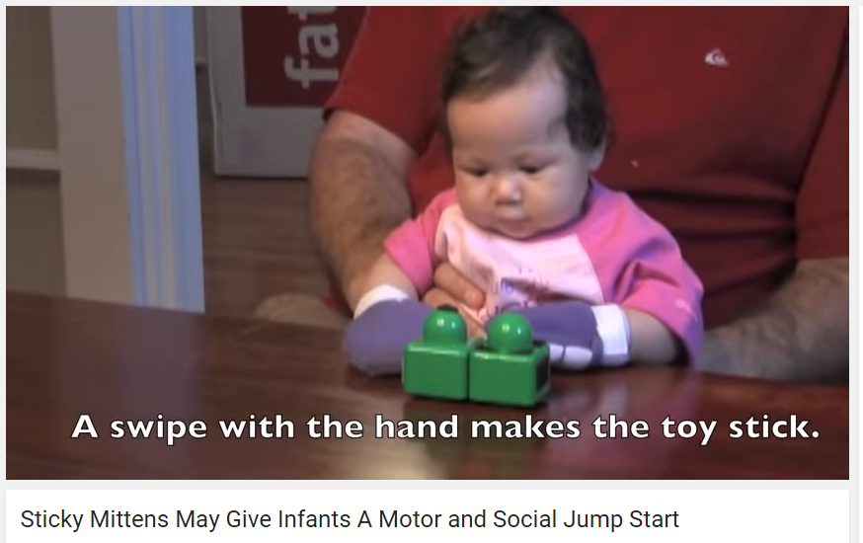
Experimental example
Infants and precocious reaching experience:
  Infants wore Velcro mittens
  Early experience leads to increases in later visual attention to objects and oral exploration of objects
https://www.youtube.com/watch?v=hJGRM4LFJjU
                https://nyu.databrary.org/search?q=mittens
Notes:
Hypo: increased reaching increases functional coupling btwn neural networks for vision, spatial orienting of attn, and manual action. Strengthens structural connectivity

Slide 91
9 month floor-based exploration
https://www.youtube.com/watch?v=P3mNHcPVOnI

