Slide 1
Cognition
Daniel Messinger, Ph.D.

Slide 2
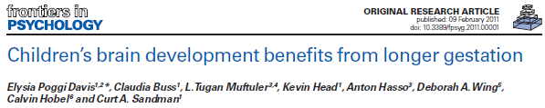
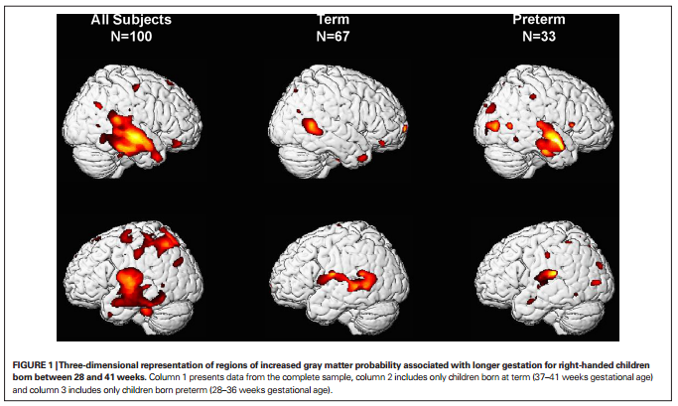

Slide 3
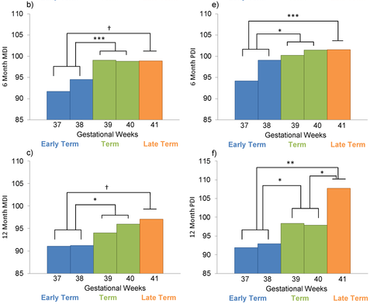

Longer Gestation among Full Terms → Higher Cognitive/Motor functioning
Espel EV, Glynn LM, Sandman CA, Davis EP (2014). PLoS ONE 9(11): e113758. doi:10.1371/journal.pone.0113758
http://127.0.0.1:8081/plosone/article?id=info:doi/10.1371/journal.pone.0113758

Slide 4
Fundamental question:
How do children know?
Infants have innate knowledge of essential properties of world
  Nativist account: the mind produces ideas that are not derived from external sources
    Infants have an inborn conception of what objects are
Infants must construct knowledge of essential properties of world
  Constructivist account or empiricist account: experience, especially of the senses, is the only source of knowledge.

Slide 5
Cognitive Development
Theories of Cognitive Development
  Conditioning and habituation
  Piaget
  Neo-Piagetian Theory
  Vygotsky
Psychometric Approaches
  Structure of Intelligence?
Systems Theories
  Sternberg Triarchic Theory
  Gardner’s Multiple Intelligences

Slide 6
Basic learning mechanisms
Classical Conditioning
  infant responds to a stimulus
Operant Conditioning
  Infant action changes the likelihood that an action will occur.
Habituation and Dishabituation
    http://www.cogs.susx.ac.uk/users/alisonp/dev1/lecture2.html

Slide 7
Classical Conditioning
With repeated pairings of neutral stimulus (conditioned stimulus) and unconditioned stimulus, the infant begins to respond to the neutral stimulus, a conditioned response.
Classical conditioning motivates infants to understand which events “go together,” to anticipate what happens next.
Classical conditioning of reflexes

Slide 8
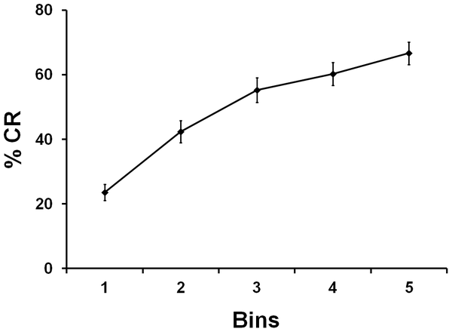
Classical conditioning curve for 1-month-olds (learning over time)
Reeb-Sutherland BC, Levitt P, Fox NA (2012) The Predictive Nature of Individual Differences in Early Associative Learning and Emerging Social Behavior. PLoS ONE 7(1): e30511. doi:10.1371/journal.pone.0030511
http://127.0.0.1:8081/plosone/article?id=info:doi/10.1371/journal.pone.0030511

Slide 9
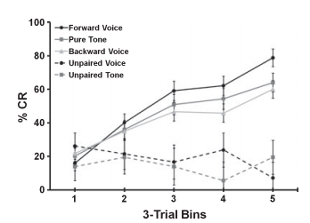
Classical conditioning at one month
Sleeping infants increased learning across trials, regardless of stimulus type.
But infants conditioned to the 'social' stimulus showed increased learning compared to infants conditioned the non-social stimuli.
Sleeping infants presented with 'social' (voice) or non-social stimulus (tone or backward voice) followed by an air puff to the eyelid.

Slide 10
Operant conditioning
(ABA certificate)
A behavior followed by a stimulus that changes the likelihood of the behavior occurring again.
  A stimulus that makes a behavior more likely to occur again is a reinforcer.
    Two kinds of reinforcers:
      presentation of a desired stimulus
      removal of an unpleasant stimulus.
  A stimulus that makes a behavior less likely to occur again is called punishment.
    Two kinds of punishment:
      removal of a desired stimulus
      presentation of an unpleasant stimulus.

Slide 11
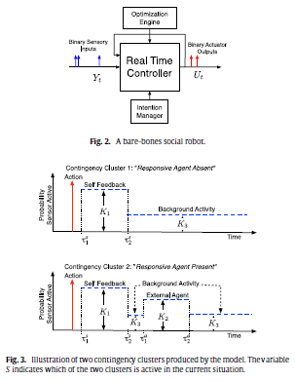
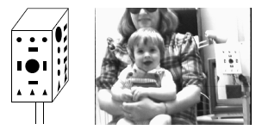

Designing rewards for young robots
http://www.sciencedirect.com/science?_ob=ArticleURL&_
“use the reduction of uncertainty (information gain) as a reward signal. The result is an interesting form of learning … the learner rewards itself for conducting actions that help reduce its own … uncertainty”
{Butko, 2010 #Butko, N. J., & Movellan, J. R. (2010). Detecting contingencies: An infomax approach. Neural Networks, 23(8–9), 973-984. doi: http://dx.doi.org/10.1016/j.neunet.2010.09.001

Slide 12
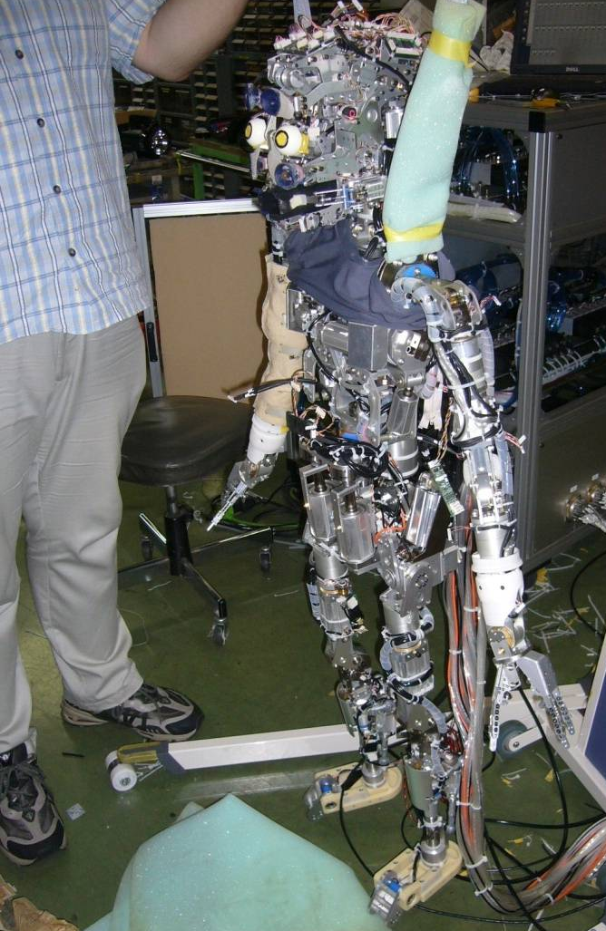
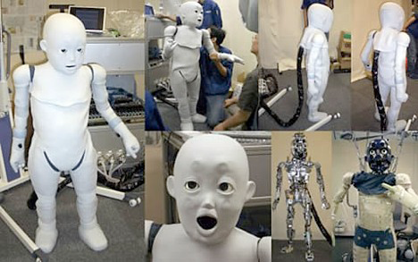
Operant conditioning in robotics?
“A new approach to reinforcement learning for control problems which combines value-function approximation with linear architectures and approximate policy iteration.” Lagoudakis & Parr, 2003

Slide 13
Stimulus
Infants who gaze longer
  Lower IQ at 18 years
Infants who gaze shorter
  Higher IQ at 18 years
Fixation duration and IQ
  r(91) = -.36, p < .0002

Slide 14
Infant habituation →child intelligence
‘Habituation and recognition memory in first year of life predict IQ between 1 and 8 years
  Weighted (for N) mean correlation of .36
  Raw median correlation of .45.
  Similar for habituation & recognition memory.
  Predictions consistently higher than for standardized infant tests of general development for nonrisk but not for risk samples.’
        A Meta-Analysis of Infant Habituation and Recognition Memory Performance as Predictors of Later IQ Robert B. McCall, Michael S. Carriger Child Development, Vol. 64, No. 1 (Feb., 1993), pp. 57-79
    For nonrisk samples, predictions not consistently higher than predicting from parental education and socioeconomic status!

Slide 15
Habituation as a measure of cognitive function?
A measure of learning and memory:
  habituation implies that the infant has encoded some of its properties & retained them.
Habituation rate is linked to later achievement.
  Individual differences in speed of habituation relates to later IQ scores (Fagan & Singer, 1983).
        www.cogs.susx.ac.uk/users/alisonp/dev1/lecture2.html
Bored faster → Brighter??

Slide 16
Why does Infant Attention Predict Intelligence?
Three Theories
  Speed or efficiency of information processing
    Inhibition of responses to uninformative/familiar
      Sigman et al., 1991
  Fixation taps processing
    Sigman, Cohen, Beckwith, 1997

Slide 17
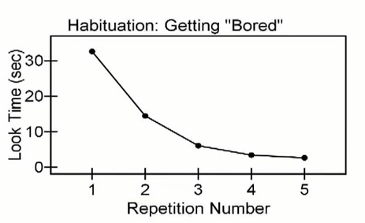
Bored faster → Brighter??
        http://www.youtube.com/watch?v=dlilZh60qdA from 1:30

Slide 18
Can infants count?
“Humans innately possess the capacity to perform simple arithmetical calculations......... Infants possess true numerical concepts: they have access to the ordering of numerical relationships between small numbers. They can calculate the results of simple arithmetical operations of small numbers of items” Wynn (1992).
        from Tony J. Simon “Explaining Apparent Infant Numerical Competence in Terms of Object Representation”
Notes:
2
3
Claim resulted from data gathered from following expt
carried out with 5 Mo old babies.

Slide 19
The Task
Notes:
3
4
Describe ACTIVELY (as ìEventsî)
Desribe Screen drop in lines 2 & 3

Slide 20
More looking to impossible results
13
12
1+1=1
11
2-1=2
"Addition"
10
Looking time
"Subtraction"
9
8
1+1=2
2-1=1
7
6
1 object
2 objects
Simon et al. (1995)
Replication of Wynn (1992)
Number of Objects Remaining
Notes:
4
6
1st process in devíing theory to explain this is see if beh reliable
so carried out our own replicaitons
SHOW GRAPH
However my hypoth was incíd LT NOT based on Num abilities
Instead could be explained by Phys Impossibility
in all imposs outcomes object magically appears/disappears
something infants appear to detect as imopssible
So created IDENTITY condition
outcome has correct # of objects but still phys imposs

Slide 21
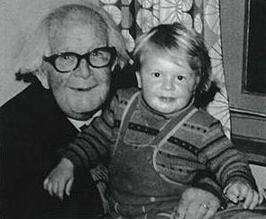
Piaget with child
Piaget overview:
Rap: http://www.youtube.com/watch?v=4kscU0kTNbw

Slide 22
Piaget’s History
Swiss, 1896 - 1980
First published scientific paper at age 10
Doctorate in biology at age 22
Most influential developmental psychologist ever?
        "Piaget, Jean," Microsoft® Encarta® Online Encyclopedia 2000. http://encarta.msn.com ©

Slide 23
Piaget’s Cognitive-Developmental Theory
  Infant as an active constructor of knowledge, always trying to make sense of environment
  Development takes place in qualitatively different stages
  Learning is a process of organizing and integrating knowledge over time
  The origins of intelligence in children, p. 335
Notes:
1896-1980 theory based on observations of own kids
Focused on biological maturation rather than environmental influences
rained in psychometric tradition; focused on children’s errors in reasoning as way of determining current logical systems (& their limitations) underlying thought processes
Intelligence as biological adaptation to environment
Emphasized development of deductive and inductive reasoning

Slide 24
Piaget’s insights
Children don't think like grownups.
Children are not empty vessels to be filled with knowledge
  as traditional pedagogical theory had it
They are active builders of knowledge
  little scientists who are constantly creating and testing their own theories of the world.
        http://www.time.com/time/time100/scientist/profile/piaget.html

Slide 25
Piaget Overview
The development of knowledge takes place as a result of an individual’s interaction with his or her environment.
Children themselves drive cognitive development by actively manipulating and exploring their environment.
  9 month floor-based exploration
      https://www.youtube.com/watch?v=P3mNHcPVOnI

Slide 26
Piaget’s Theory of Cognitive Development
Two universal processes underlie cognitive development
  Organization
    Tendency to look for commonalities and create a higher-order integrated scheme
  Adaptation
    Assimilation
    Accommodation
      Relation to cognitive equilibrium vs. disequilibrium?
Notes:
Organization; tendency towards generalization; examples from prior classes (i.e., development of holistic face processing; statistical learning re: sound blends and word boundaries; habituation/dishabituation) consistent with idea of increasing efficiency with age
**think back to infant perception – as example of primitive ability in infancy re: habituation and dishabituation, statistical learning, sensitive to commonalities
Scheme as structures of knowledge and the building blocks of development and cognition
Assimilation = fitting information from new experiences into existing concepts
Accommodation = changing existing knowledge structures to take account of new information
Schemes govern interactions of the individual with the environment

Slide 27
Adaptation
Assimilation:
  Events in the external world are incorporated into existing schema.
    An infant who sucks on a bottle can adjust to a pacifier with slight modifications.
    Peg goes into pre-existing hole
Accommodation:
  Schema are adjusted or created to produce a better fit with events.
    An infant who sucks on a bottle and pacifier must accommodate in order to learn to drink from a cup.
    Make or find a new whole

Slide 28
Piaget’s Theory of Cognitive Development (cont)
Constellation of similar schemes at a developmental time point = STAGE
Sensorimotor (birth – 2 years)
Preoperational (2 – 7 years)
Concrete-Operations (7 – 11 years)
Formal-Operations (11+ years)
Notes:
Reflexes as innate schemes
Most other schemes are based largely on experience
Schemes = psychological structures
Stages reflect gradual reorganization of basic cognitive processes and operations; stages become progressively more efficient

Slide 29
Sensorimotor Stage
(birth – 2 years)
Sensorimotor Stage (birth – 2 yrs)
    Infants think with their eyes, ears, hands, feet etc.
    Action-based learning
6 substages of sensorimotor stage
  Primary, secondary & tertiary circular reactions
        What changes? How are they different?
Play and imitation
  Relations to schema development?
Notes:
Circular reactions strengthen into a scheme; reactions originate by accident; trial and error used to try to repeat; begin inward focused and become outward focused with increasing intentionality
Circular reactions – what changes? Inward → outward; increasing intentionality
Play consolidates old schems (via rehearsal of current schemes for pleasure) = assimilation
and imitation facilitates development of new schemes (accommodation) imitation = copy and learn behaviors that are not in their inventory of schemes = accommodation
**e.g., Sam reading chapter books**
Play = assimilation
Imitation = accommodation

Slide 30
Sensorimotor Substages
Reflexive Schemes | Birth –1 month | Newborn reflexes
Primary Circular Reactions | 1 – 4 months | Simple motor habits centered around own body
Secondary Circular Reactions | 4 – 8 months | Repeat interesting effects in soundings
Coordination of Secondary Circular Reactions | 8 – 12 months | Intentional, goal-directed behavior; object permanence
Tertiary Circular Reactions | 12 – 18 months | Explore properties of objects through novel actions
Mental Representations | 12 months – 2 years | Internal depictions of objects or events; deferred imitation
http://www.youtube.com/watch?v=ue8y-JVhjS0&feature=related Object permanence
http://www.youtube.com/watch?v=lPJiB-oGMN0&playnext=1&list=PL2DF62A2136D432FE link not working Rovee-Collier
Notes:
Play as assimilation (rehearse current schemes for pleasure
Imitation as accommodation (copy and learn behaviors not in current inventory of schemes)
Mental representations – words as representations of objects; speech explosion between 12 and 24 months when mental representations are beginning to be formed
Rovee Collier video

Slide 31
Sensorimotor sub-stages
1. Reflexive schema
2. Primary circular reactions
3. Secondary circular reactions
4. Coordination of secondary circular reactions
5. Tertiary circular reactions
6. Mental representation

Slide 32
*Reflexive schema
Birth to 1 month
Infant adjusts reflexive behavior in response to different stimuli
Reflexes are building blocks of sensorimotor development.
  Transition to more voluntary activity
Example: Sucking, grasping.
Video?

Slide 33
*Primary circular reactions
Primary = self
Scheme that is repeated because it is interesting and provides opportunity to explore world
Simple motor habits centered around the infant’s own body.
  Action and perception joined
  sucking fist, watching hand open and close.
  More voluntary
1-4 months

Slide 34
*Secondary circular reactions
Secondary = self + object
Activation of schemes resulting in a specific desired outcome
Actions aimed at repeating interesting effects in the surrounding world.
  intentionally hitting a mobile.
  Actions with objects enabled by motor developments:
    sitting up, reaching, grasping.
4-8 months
  Rob0006 video

Slide 35
*Coordination of secondary circular reactions
Means-end behavior
Coordination of secondary circular reactions into new and more complex action sequences.
  Moving aside an obstacle in order to retrieve a visible object.
  Combines swiping with reaching-grasping.
Intentional, goal-directed behavior begins.
  Prior to this stage, actions that led to new schema first occurred by chance. Now infants have mastered enough schema to solve problems deliberately.
8-12 months

Slide 36
*Tertiary circular reactions
Tertiary = repetition of action with variation
Two or more schema are combined to produce novelty and exploration (e.g., trial and error)
Infants are no longer limited to previously mastered schema.
They are now able to alter prior schema to suit a particular situation.
  Using trial-and-error to retrieve a toy with a stick.
12-18 months
  video

Slide 37
Piaget. The origins of intelligence in children.
At 1;4 (5) Laurent is seated before a table and I place a bread crust in front of him, out of reach. Also, to the right of the child I place a stick about 25 cm. long. At first Laurent tries to grasp the bread without paying attention to the instrument, and then he gives up. I then put the stick between him and the bread; it does not touch the objective but nevertheless carries with it an undeniable visual suggestion.
Laurent again looks at the bread, without moving, looks very briefly at the stick, then suddenly grasps it and directs it toward the bread. But he grasped it toward the middle and not at one of its ends so that it is too short to attain the objective.
Laurent then puts it down and resumes stretching out his hand toward the bread. Then, without spending much time on this movement, he takes up the stick again, this time at one of its ends (chance or intention?), and draws the bread to him. He begins by simply touching it, as though contact of the stick with the objective were sufficient to set the latter in motion, but after one or two seconds at most he pushes the crust with real intention. He displaces it gently to the right, then draws it to him without difficulty. Two successive attempts yield the same result.

Slide 38
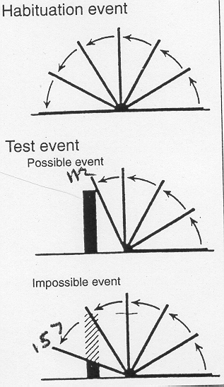
Back to the future
Habituation suggests some knowledge of invisible objects
Another test of object permanence
Drawbridge experiment
  4.5, 5.5, and most 3.5 month olds look longer at impossible event, suggesting they believe the “object” “behind” the drawbridge should really be there.
    Baillargeon et al. (1985)
Baillargeon internal video (DVD
  Different solid object from 1:30. https://www.youtube.com/watch?v=hwgo2O5Vk_g
38

Slide 39
Does baby know where object is?
Object search (A_not_B) says no
  Baby searches in first location
    http://www.youtube.com/watch?v=jZDtfnRB-jI&feature=related http://www.youtube.com/watch?v=lhHkJ3InQOE&feature=related
Drawbridge experiment says yes
  Infants look longer at impossible event
How can this be?

Slide 40
Task analysis
Search task asks for motor action
  Recall memory
Drawbridge task asks for longer looking
  Recognition memory

Slide 41
Experimental resolution
What about a non-search A_not_B task?
  an A_not_B task?
Infants look longer at the impossible event
  Look longer at A
    Even after 15 seconds of delay
Even when they search in the wrong place
  either infants have knowledge but can’t use it
  or the knowledge does not exist in usable form

Slide 42
Put yourself in infant’s place
  Where do you look for your car keys?
  The more times the object was hidden at A, the more the infant is likely to search incorrectly at A
  The longer the delay, the more likely the infant is to search B
  Error may relate to a strongly formed motor pattern

Slide 43
Inhibition
To perform correctly, infants must inhibit a prepotent response
Lesions to dorsolateral prefrontal cortex in monkeys cause iterative A-like search errors
Prefrontal cortex maturation in first year may lead to increasingly successful performance at A-not-B task

Slide 44
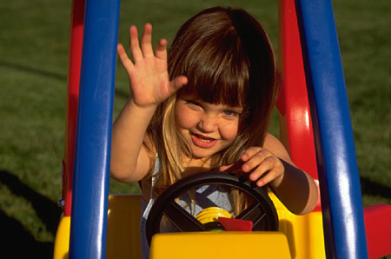

Preoperational Stage
(2 – 7 years)
Rapid increase in representational abilities
  Language
  Pretend Play
    Changes with development?
Thinking and reasoning is still rigid and egocentric
http://www.youtube.com/watch?v=OinqFgsIbh0&feature=related
Notes:
Represent states mentally
Rigid thinking b/c thought is still directly tied to actions, focus exclusively on one aspect of a situation
PLAY changes, more detached from real-life situations, less self-centered, more complex (e.g., sociodramatic play)
Individual differences; high levels of sociodramatic/pretend play associated with increased social competence, imagination and creativity

Slide 45
Concrete-Operational Stage
(7 - 11 years)
Thinking and reasoning becomes more flexible, logical, & organized
Ability to internally manipulate mental representations
  E.g., perspective taking
  E.g., conservation
Thinking/reasoning dependent on concrete information
  not yet extended to abstract information

Slide 46
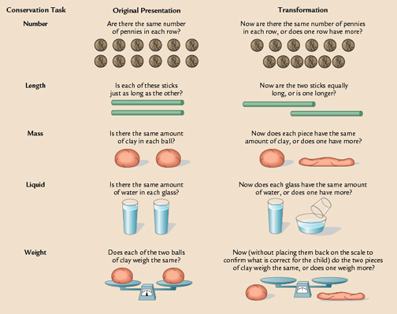
Conservation
Task
Examples
http://www.youtube.com/watch?v=B65EJ6gMmA4&playnext=1&list=PL62740F6BA40AC105

Slide 47
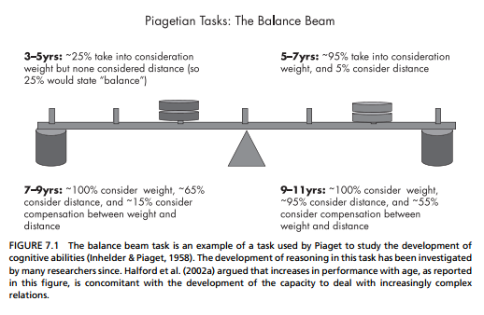
Do the weights balance?

Slide 48
Do the weights balance?

Slide 49
Formal-operational Stage
(11+ years)
Capacity for abstract, scientific thinking
  Ability to operate on operations
Characterized by
  Hypothetico-deductive reasoning
  Propositional thought
May not be a universal stage like previous stages
  Many (well-educated) people do not reach this stage
  Domain specificity based on expertise
  Map examples? Computation examples? Others?
Notes:
HYPOTHETICO-DEDUCTIVE REASONING IS:
a problem-solving strategy
begin with a general theory of all possible factors that could affect an outcome
deduce specific hypotheses
test hypotheses systematically
About 40 to 60 percent of college students fail Piaget’s formal operational problems
Propositional thought = if A then B logic
People are most likely to think abstractly in situations in which they have had extensive experience
In many village and tribal societies, formal operational tasks are not mastered at all
Critics claim that Piaget’s theory is unclear about how individuals make the transition from concrete to formal operational thought

Slide 50
Natural Pedagogy
Gergely Csibra and Gyorgy Gergely
Human communication is specifically adapted to fulfill the function of transmitting generic knowledge
Natural Pedagogy
  The specific aspects of human communication that allow and facilitate transfer of generic knowledge
    We use specific, episodic information to form generalized knowledge

Slide 51

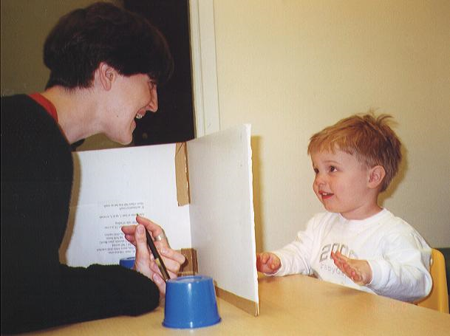
Evidence for natural pedagogy
1. Preferential attention for sources of signals
  Preference for faces with direct gaze
  4-mo infants interpret dyadic eye-gaze as communication
  Preference for “motherese” and “motionese”
2. Referential Expectation
  Gaze-following as communication
    Only follow gaze-shifts when preceded by eye-contact or greeting
  Expectation to find referent/object when follow gaze
3. Interpretation bias for generalizability
  Expectation to learn something generalizable
    Emotions towards object as information about the object
      When communicated ostensively
  Permanent v. transient features
    Attend to features that allows identification of other objects of same kind
    Neglect information about location (transient)
      When communicated ostensively
  A-not-B task
    Error due to expectation of generalizable information
Infants display receptivity to ostensive communication before they show evidence of learning

Slide 52
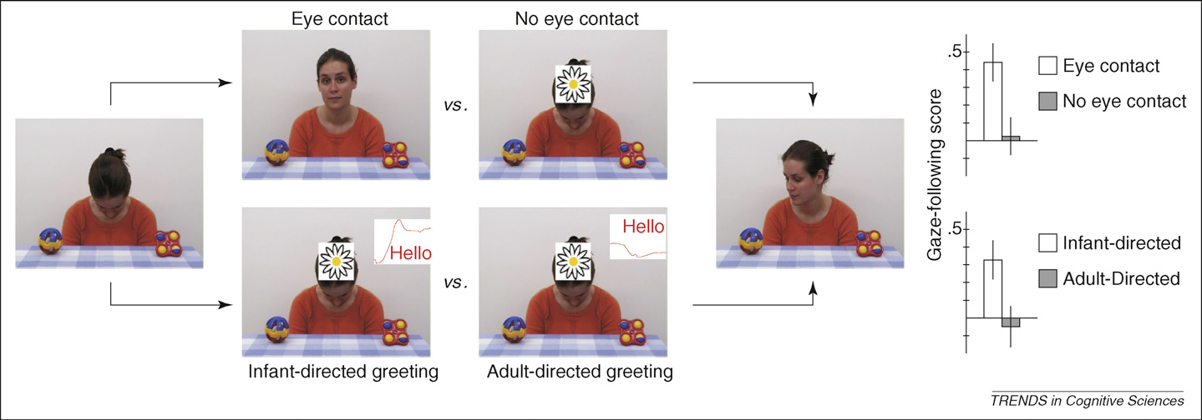
Ostensive signals → Gaze following

Slide 53
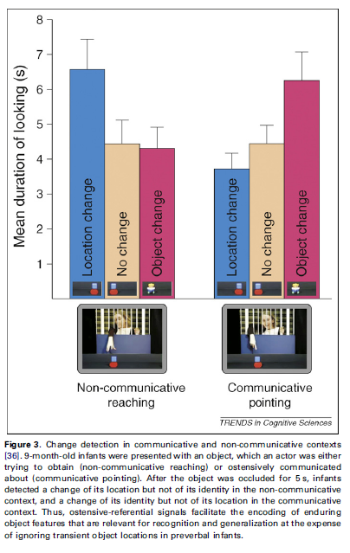
Ostensive signal → Encode object identity

Slide 54
A-not-B caused by ostensive signaling?
Not in this case: http://www.youtube.com/watch?v=lhHkJ3InQOE&feature=related

Slide 55
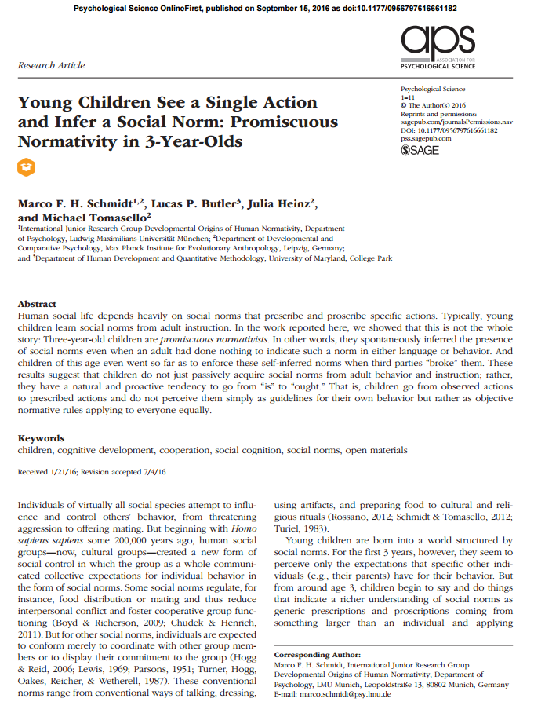
Promsicuous normativity

Slide 56
Uniquely human?
‘Seven long-tailed macaques cleaning the spaces between their teeth in the same manner as humans.
They spent double the amount of time flossing when they were being watched by their infants.’
http://news.bbc.co.uk/2/hi/asia-pacific/7940052.stm

Slide 57
Neo-Piagetian Theory
Case (1998)
  More flexible stage theory
    Sets of competencies develop over period of time
    Change depends on brain development and specific experiences
Notes:
Allows for larger role of experience – a more flexible stage theory
Dynamic systems theory
In framework of working memory development
4 stages; sensorimotor operations; representational operations; logical operations; formal operations

Slide 58
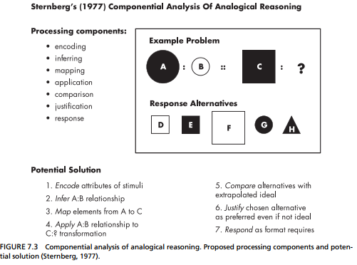
Task analysis

Slide 59
The social basis of cognition – Vygotsky
Cognition originates in social interaction
  Development facilitated by social interaction and collaboration
    Vygotstky’s point
  Intersubjectivity =
  Zone of proximal development =
  Scaffolding =
    How should nature and degree of guidance change over course of learning task?
Notes:
In contrast to Piaget – very focused on social context
Intersubjectivity = process whereby two participants begin a task with different understandings but arrive at a shared understanding
Vygotsky – cognition is gradually internalized
Self-directed speech vs. Piaget

Slide 60
The Psychometric Approach to Defining Intelligence
Intelligence as ability to adapt successfully to one’s environment
Hierarchical nesting of abilities
  General factor “g”
  Differentiable but variously related mental abilities (e.g., verbal vs. visual-spatial)
Cattell (1971)
  Fluid vs. crystallized intelligence
Notes:
Based on correlational approach; primarily a descriptive approach
Used to map the range of different abilities but doesn’t inform understanding of intellectual processes involved
Focus on adaptation to environment is same as Piaget idea
(see Tomasello reading human vs. chimp)
Fluid intelligence = skill in reasoning in novel ways (e.g., Raven’s progressive matrices)
Crystallized = a broad mental ability that develops through the investment of “g” into learning through education and experience (specific learned behaviors)
Intelligence fixed somewhere between 5 & 10 years of age

Slide 61
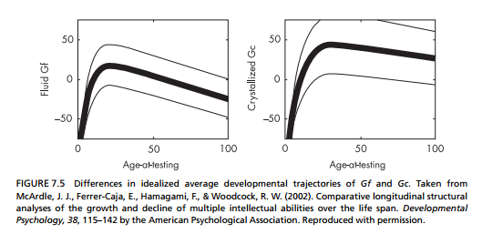
At what point in development is intelligence fixed?

Slide 62
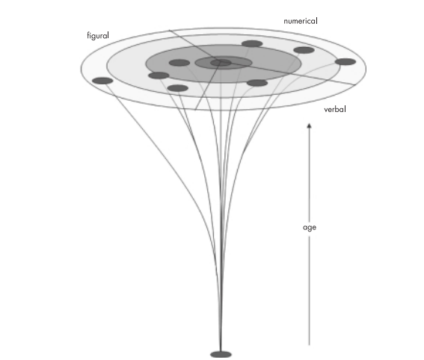
Differentiation of cognitive abilities with age
Notes:
FIGURE 7.6 Concept of differentiation of cognitive abilities with age, as represented by the psychometric
approach. The series of concentric circles represents a canvas on which distinct abilities (dark disks) are
mapped. The closer the disks are to each other, the higher the correlation between abilities. At the center
are abilities tapped by complex reasoning tasks. Toward the outer circles, tasks tend to be less complex and
more content-speciﬁc. Differentiation as it occurs over age is represented by the branching of abilities over
time starting from a generalized cognitive resource. From Birney & Sternberg, 2006, by permission of Oxford
University Press, Inc.

Slide 63
The Psychometric Approach to Defining Intelligence (cont)
Can analytical abilities alone adequately account for individual differences in multiple real-world environments?
  Creative intelligence
  Social intelligence
  Emotional intelligence
Notes:
Example from temperament and social problem solving task
Psychometric approach too narrow to account for variation in real-world performance; many cases of disconnect between IQ and adaptive functioning

Slide 64
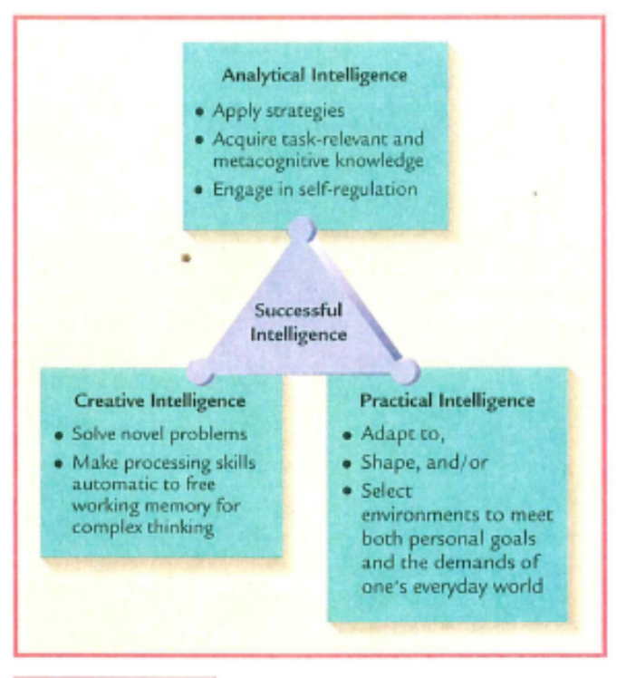
Systems Theories of Intelligence
Sternberg’s developing expertise model
  Triarchic theory of successful intelligence
    Analytical Intelligence
      Adapt, shape, select environments to meet goals
    Practical Intelligence
      General skills → apply strategies, self-regulation
    Creative Intelligence
      Approach to dealing with novel problems
Notes:
Belief that traditional intelligence tests focusing exclusively on analytical abilities don’t capture this complexity
Idea that intelligence can be developed
Success requires balance of all 3

Slide 65
Systems Theories of Intelligence
Gardner’s theory of multiple intelligences
  8 distinct sets of processing operations (intelligences)
  Unique biological bases, developmental course, end-state performances
  Allows for description of profile of skills
    Used for educational and career planning
Notes:
Views the mind as modular
Against the idea of “g”
Profile of skills facilitates educational and career decisions
Has been very difficult to document unique biological bases

Slide 66
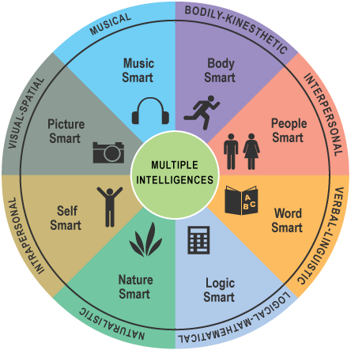
Systems Theories of Intelligence
Gardner’s theory of multiple intelligences (cont)
Notes:
Against the idea of “g”
Profile of skills facilitates educational and career decisions

Slide 67
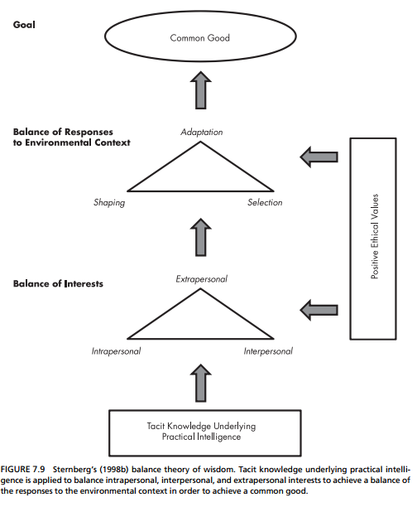
Baltes

