Slide 1
Brain, body, and experience
Daniel Messinger

Slide 2
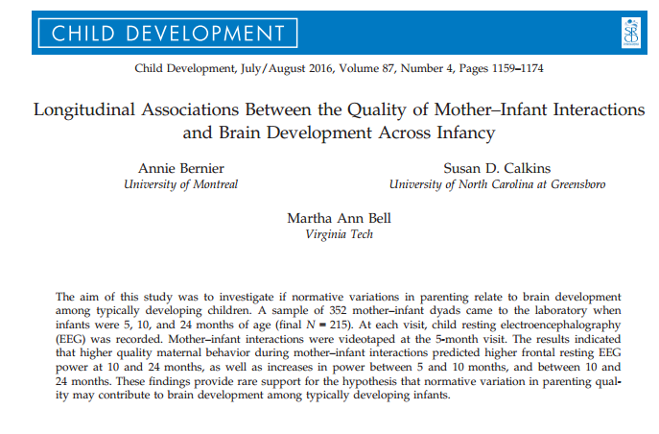
Parenting—>brain?

Slide 3
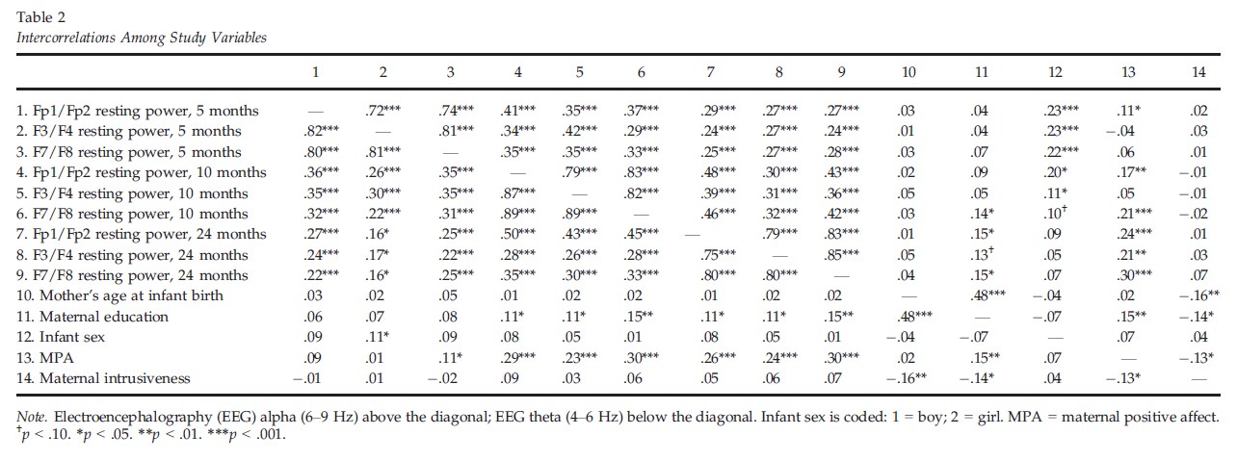
Maternal positive affect and infant EEG activity
Bernier, Calkins & Bell, 2016

Slide 4
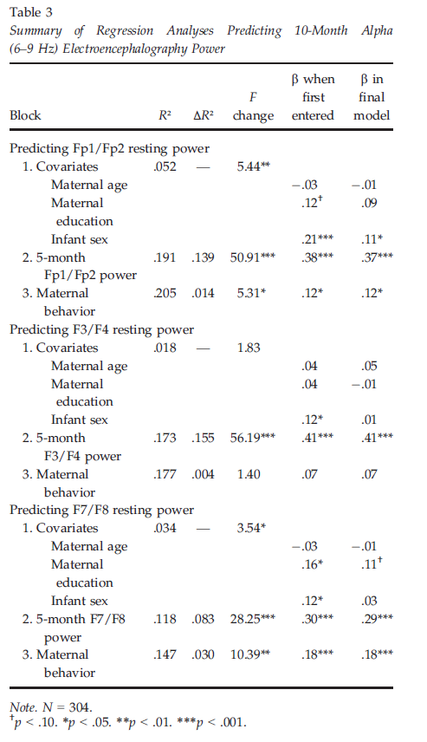
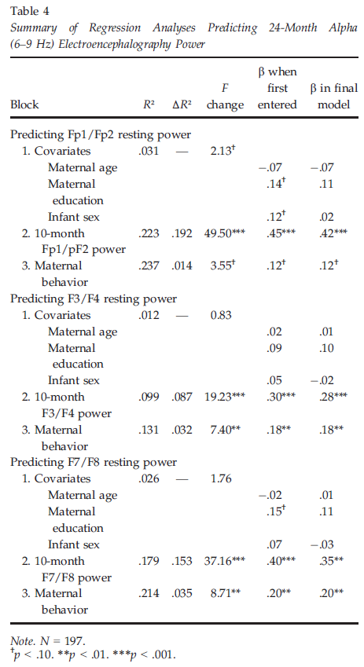
Maternal positive affect and infant EEG activity

Slide 5
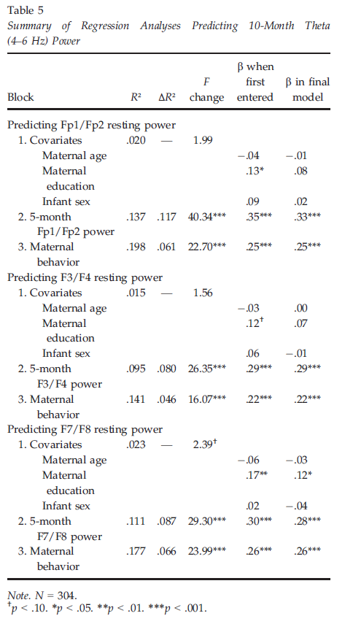
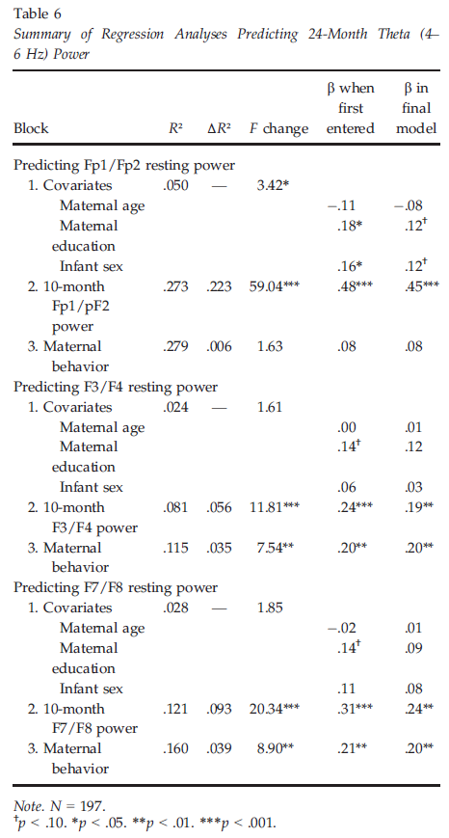
Maternal positive affect and infant EEG activity

Slide 6
True?
Normative variation in parenting quality may contribute to brain development….
Implications if true?
Parenting→brain→behavioral functioning…

Slide 7
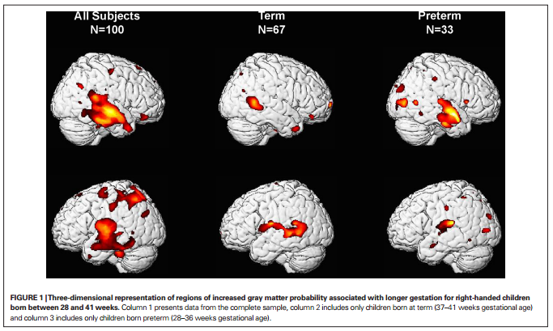

Slide 8
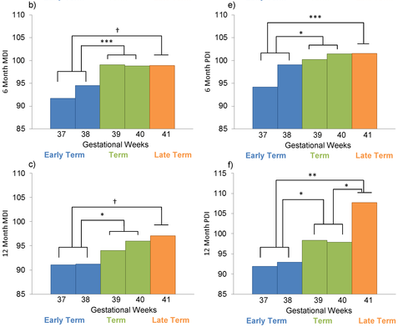
Longer Gestation among Full Terms → Higher Cognitive/Motor functioning
Espel EV, Glynn LM, Sandman CA, Davis EP (2014). PLoS ONE 9(11): e113758. doi:10.1371/journal.pone.0113758
http://127.0.0.1:8081/plosone/article?id=info:doi/10.1371/journal.pone.0113758

Slide 9
Intellectual Ability and Cortical Development (Shaw et al., 2006)
Cortical Thickness
Index of
neuronal density
synaptic connections
myelination
Regional differences in rates of
thickening and thinning over
development

Slide 10
Longitudinal design..
178 participants (58%) had at least two scans; 92 (30%) had three or more scans;
Mean interscan interval was ~2 yr
Superior (121–149), high (109–120), & average intelligence (IQ range 83–108).
http://:
www.nature.com/nature/journal/v440/n7084/extref/nature04513-s1.pdf
Age-appropriate versions of Weschler scales.
Notes:
For longitudinal analyses, subjects were divided into three groups on the basis of full-scale IQ with the primary constraint of attaining a roughly equal number of total scans in each group:

Slide 11
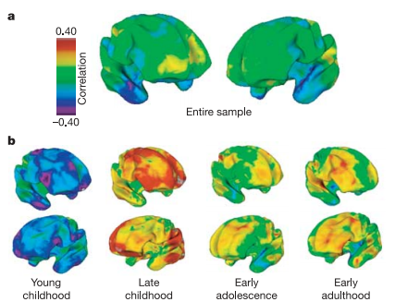
Associations of cortical thickness and IQ
(Shaw et al., 2006)
Across entire sample?
By age group?

Slide 12
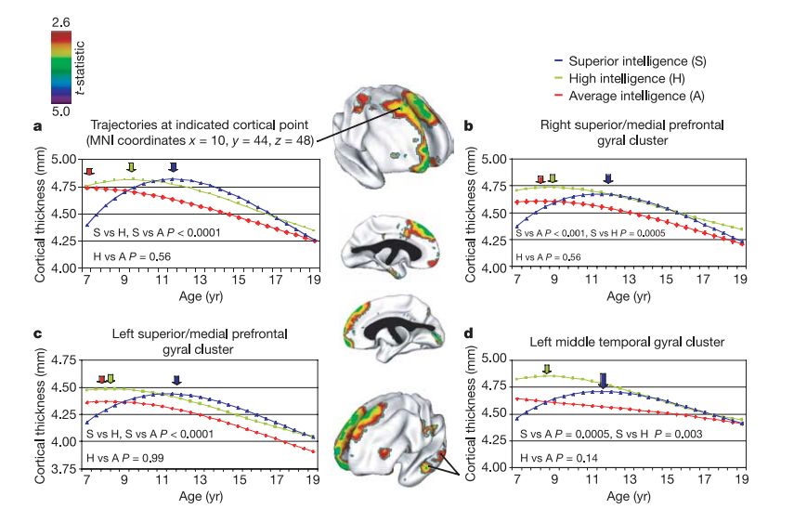
Interaction of IQ and age predict prefrontal cortical thickness growth trajectories
(Shaw et al., 2006)
Notes:
Figure 2 | Trajectories of cortical change. The brain maps (centre panel)
show prominent clusters where the superior and average intelligence groups
differ signiﬁcantly in the trajectories of cortical development (t-statistic
maps show areas of signiﬁcant interaction between these IQ groups and the
cubic age term). a, Graph showing the trajectories at the cortical point of
maximum trajectory difference in the right superior frontal gyrus (point
indicated in upper brain map). b–d, Graphs showing the trajectories of the
mean thickness of all cortical points in the other clusters. The graph in d
relates to the area indicated in the lower brain map. The age of peak cortical
thickness is arrowed and signiﬁcance values of differences in shapes of
trajectories are given on the graphs. MNI, Montreal Neurolog

Slide 13
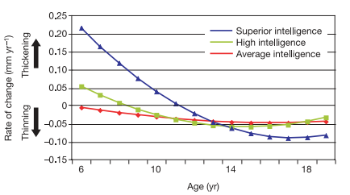
IQ group and rate of change in cortical thickness with age
(Shaw et al., 2006)

Slide 14
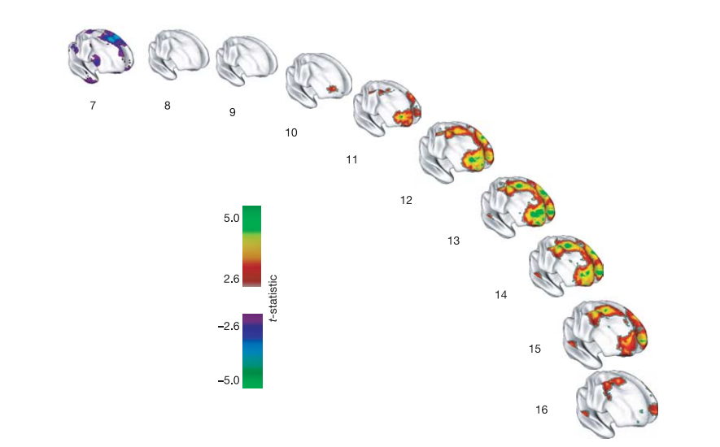
“[I]ntelligence is related to dynamic properties of cortical maturation”
“the superior intelligence
group has a thinner superior prefrontal cortex at the earliest age (purple
regions). There is then a rapid increase in cortical thickness (red, green and
yellow regions) in the superior intelligence group, peaking at age 13 and
waning in late adolescence.”
(Shaw et al., 2006)
Notes:
Figure 4 | Developing differences in cortical thickness between the
superior and average intelligence groups. Group differences are
represented by t-statistics (t . 2.6), and show that the superior intelligence
group has a thinner superior prefrontal cortex at the earliest age (purple
regions). There is then a rapid increase in cortical thickness (red, green and
yellow regions) in the superior intelligence group, peaking at age 13 and
waning in late adolescence.

Slide 15
Adaptiveness/function of prolonged phase of prefrontal gain for IQ?
Benefit of longitudinal design?
“Most previous studies infer developmental processes from purely cross-sectional data, an endeavor fraught with methodological complications” (p. 676)
(Shaw et al., 2006)

Slide 16
Cognitive ability changes and dynamics of cortical thickness (Burgaleta et al., 2014)
Background:
IQ associated with changes in cortical thickness (Ramsden et al., 2011)
Higher IQ associated with greater fluctuations in cortical thickness ;
declines in cortical thickness during late adolescence (Shaw et al., 2006)
Goal:
Better understand structural correlates of changes in IQ for healthy youth over time
Are these changes in cognitive ability or measurement error?
Hypotheses:
Structural change in the brain (e.g., cortical thickness/surface area) positively associated with Verbal IQ, Performance IQ, and Full Scale IQ for children/adolescents over time
Associations in sensorimotor areas

Slide 17
Methods (Burgaleta et al., 2014)
Sample
Multi-site (6 sites), longitudinal study
N= 188, Ages 6-20, Mean age at Time 1: 11.59 + 3.46; assessed at 2 year follow-up
Measures
Cognitive Measures:
WASI (VIQ, PIQ, and FSIQ)
MRI and MRI processing system
Used corticometric methods to represent gray matter change: cortical thickness (CTh) and cortical surface area (CSA)

Slide 18
Analysis (Burgaleta et al., 2014)
As part of pre-post design, computed difference scores for CTh, CSA, and IQ
Change scores represent relative change compared to same-aged peers (not absolute change)
Analyzed change by IQ change group (using 90% CI):
Reliable IQ increases
Reliable IQ decreases
No reliable IQ changes

Slide 19
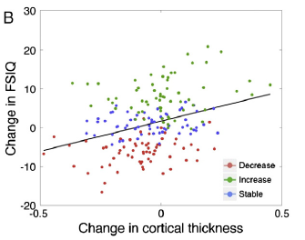
ΔFSIQ associated with Δ CTh, but not Δ CSA
ΔPIQ associated with changes in CTh; trend for ΔVIQ
Burgaleta et al., 2014

Slide 20
ΔCorticalThickness over time
Increase IQ group: non-significant increase in CTh
Decrease IQ group: steepest rates of reduction in CTh
Stable IQ group: smaller decreases in CTh
Burgaleta et al., 2014

Slide 21
Conclusions (Burgaleta et al., 2014)
Consistent with previous literature, individual differences in rate of change in cortical thickness appears to be related to changes in 3 parts of IQ
Results of this study support that relationship over time
CSA does not seem to be associated with changes in IQ
How can we explain these changes in FSIQ/brain structure? Ideas for future directions?

Slide 22
Discussion
Frontoparietal regions previously related to general cognitive ability (Barbey et al., 2012)
Why CTh and not CSA?
CTh = number of neurons, amount of glial and capillary support and level of dendritic arborization
Sensitive to post natal development
Not likely due to changes in number of cortical neurons
Gliogenesis occurs as a consequence of learning and experience (Dong & Greenough, 2004)
CSA = number and spacing of mini-columnar units of cells
Dependent on neurogenesis and neuronal migration (complete by term gestation; Hill et al., 2010)
Synaptic pruning:
Excessive loss of neuronal connections might be behind steeper cortical thinning
J. Rooks

Slide 23
Questions
How do these findings relate to ?
Why no change = decline in CTh?
Is this a critical period (6-20 y/o)? or might we expect similar findings in later life?
What leads to decline during this 2 year period?
J. Rooks

Slide 24
Differential Regional Growth Rates – Adolescence (Casey et al. 2008)
Adolescence associated with increased incidence of:
Unintentional injury
Violence
Alcohol and drug abuse
Risky sexual behavior
Traditionally attributed to protracted development of PFC
Is this explanation sufficient to explain changes in behavior?

Slide 25
Differential Regional Growth Rates – Adolescence (Casey et al. 2008)
“Treating adolescence as a transitional developmental period rather than a single snapshot in time” (p. 63)

Slide 26
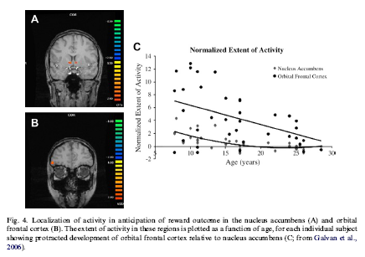
Using neuroimaging to examine developmental changes in
Reward circuitry
Cognitive control
Their developmental interactions

Slide 27
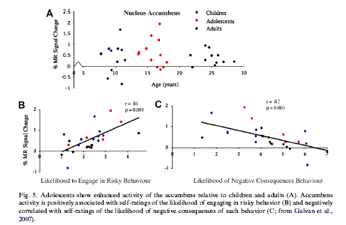
Individual differences and risk susceptibility

Slide 28
Functional significance of developmental mismatch?
Adaptiveness?

Slide 29
Age- and Sex-Specific Structural Connectivity in DTI
Core properties of structural brain connectivity, such as the small-world and modular organization, remain stable during brain maturation by focusing streamline loss to specific types of fiber tracts.
Structural connectivity based on diffusion tensor imaging (DTI) in 121 participants between 4 and 40 years of age.
The number of fiber tracts, small-world topology, and modular organization remained largely stable despite a substantial overall decrease in the number of streamlines with age.
This decrease mainly affected fiber tracts that had a large number of streamlines, were short, within modules and within hemispheres; such connections were affected significantly more often than would be expected given their number of occurrences in the network.
Streamline loss occurred earlier in females than in males.
Decrease in short-range connectivity?
Preferential Detachment During Human Brain Development: Age- and Sex-Specific Structural Connectivity in Diffusion Tensor Imaging (DTI) Data. 2013. Sol Lim1,2, Cheol E. Han1,3⇑, Peter J. Uhlhaas4,5,6 Marcus Kaiser1,2http://cercor.oxfordjournals.org/content/early/2013/12/13/cercor.bht333.full.pdf+html

Slide 30
Reconceptualizing functional brain connectivity in autism from a developmental perspective
Uddin, Supekar & Menon, 2013

Slide 31
Functional Connectivity =
“temporal correlations between remote neurophysiological events”
Analysis:
1) seed region of interest
2) correlating multiple regions
3) mapping areas with shared profiles
Resting State fMRI – reflects history of task-dependent activation
Development and functional connectivity:
Adults have more high level connections
Networks are more diffuse in adult brain

Slide 32
Autism and Connectivity
ASD: social and communication deficits, repetitive and restricted behaviors
Hypo VS. Hyper connectivity theories
Methodology? Conceptual questions? Development?!?!?!
Hypo-Connectivity
Language
Working Memory
Executive Functioning
Visuomotor coordination
Cognitive Control
Hyper-Connectivity
Language
Memory
Emotion Processing
Visual search
Visuomotor coordination

Slide 33
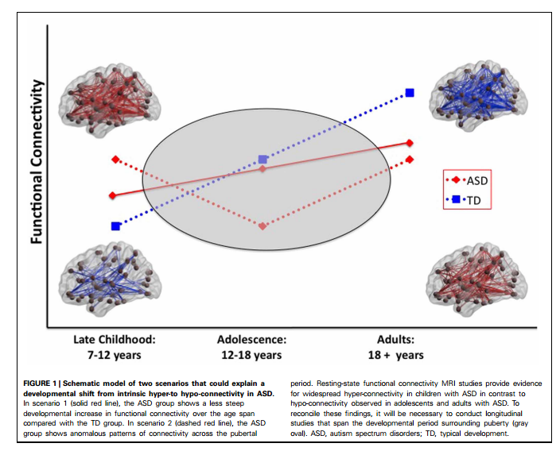
Functional Connectivity and ASD
Pattern of hypo-activity in adults
Hyper-activity in children
Found in children aged 7-12
Possible hormonal role?
Notes:
Direct your attention to Table 1

Slide 34
Possible Issues and Roadblocks
Concerns you have with this theory?
Lack of study
Little understanding of a typical trajectory
No connection between functional connectivity and behavioral outcomes
What would we need to do to test it?
Longitudinal research
Assess pubertal stage of participants (not just age)
Find participants with heterogeneous outcomes
Look at region-specific patterns of activation

Slide 35
Kelly Shaffer

Slide 36
How low SES affects hormonal trajectories
Low SES predictive of disparate risk in multiple domains including
Mental health
Physical health
Academic Achievement
Psychosocial factors alone do not account for the disparities
Alternate pathways?
How does poverty get under our skin?

Slide 37
Background
“Health disparities are a pressing reality of our society”
Low SES
Stress
HPA axis disturbance
Psychiatric & Physical ailments
Vigilance for Threat
Daily Home Chaos
Shaffer | Chen et al., 2009
Notes:
Lower SES more at risk for both mental and physical health problems
Depression, PTSD
Diabetes, obesity
Not random problems, but particularly those related to HPA axis disturbance
Psychological distress impacts body through “fight or flight” system
Chronic stress: chronically activated
First study to longitudinally assess how SES impacts change in physiology (HPA axis function), allowing for better understanding of how SES may produce HPA axis disturbance (and thus increase risk for later disease)
Also allows for study of mediators: HOW SES alters physiology
(1) Vigilance for threat: low SES negative events happen randomly, shown to appraise ambiguous events as more threatening
WHY WOULD THAT HAVE BEARING?
(2) Daily chaos in home environment: low SES more likely to have more crowding, noise, less predictable routines
WHY WOULD THAT HAVE BEARING? Authors didn’t discuss much (adds to stress burden)

Slide 38
Methods
54 healthy children → 50 included in analyses
IV: SES
Family savings
Home ownership
Mediators:
Children’s perception of threat – Cognitive Appraisal and Understanding of Social Events videos
Household chaos – Parent report on Confusion, Hubbub, and Order Scale
DV: Salivary cortisol – total cortisol output
Shaffer | Chen et al., 2009
Notes:
Separate models for 2 types of SES questions
Multiple measures per day – allows to measure both PATTERN (how the system is working) and MAGNITUTE (how MUCH system is working)
Analyses they report is on total system volume

Slide 39
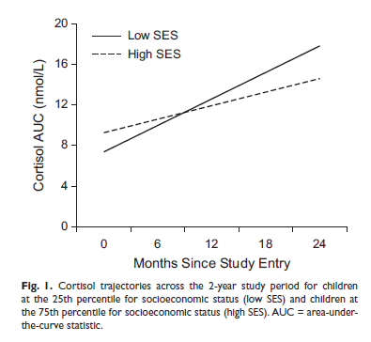
SES and Cortisol
Shaffer | Chen et al., 2009
Notes:
Does anyone want to take whack at interpreting this?
Lower SES households showed steeper increases over time
Predicted significantly by both family savings and home ownership
Intercepts: only home ownership differentiated intercepts
So, both family savings and home ownership are indicators of how much you’ll increase with time, but only home ownership is related to lower starting cortisol
Meaningful in any way?

Slide 40
SES and Cortisol Moderated by Threat Interpretation and Chaos
Low SES
Higher Home Chaos
Greater HPA output
Threat Interpretation
Shaffer | Chen et al., 2009
Notes:
When include both moderators, only home chaos remained as significant mediator

Slide 41
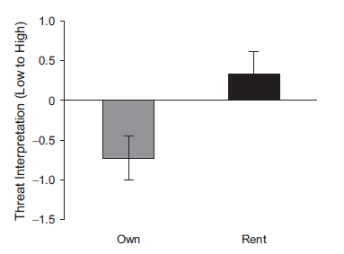
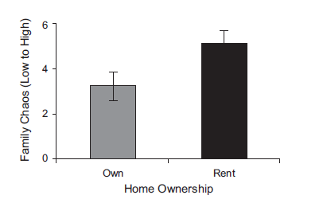
SES and Cortisol Moderated by Threat Interpretation
Shaffer | Chen et al., 2009
Low SES
Higher Threat Interpretation
Greater HPA output
Notes:
Both home ownership and family savings became nonsignificant predictors of total cortisol output when threat interpretation included in model
Reduced effect of SES by about 40%

Slide 42
SES and Cortisol Moderated by Chaos
Low SES
Higher Home Chaos
Greater HPA output
Shaffer | Chen et al., 2009
Notes:
Same findings when Chaos only
Reduced effect of SES by about quarter to a third

Slide 43
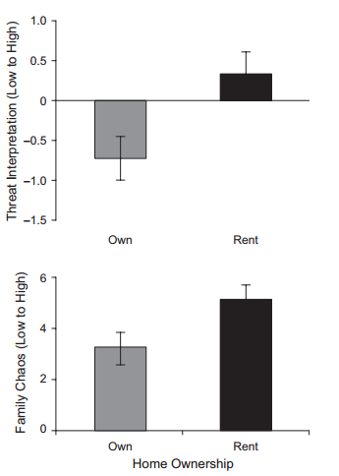
Perceptions of threat as a mediator
‘Less family savings was associated with greater child threat interpretations, r(49) = –.47, p < .01.
Similarly, children living in rented homes made greater threat interpretations, t(47) = 2.88, p < .01 (see Fig. 2).
In turn, greater threat interpretations predicted larger increases in cortisol AUC over time (b = 0.3698, SE = 0.1853, p = .05).’

Slide 44
SES and Cortisol Interactions
Low SES
HPA axis disturbance
Girls > Boys
Post-Puberty > Pre-Puberty
Shaffer | Chen et al., 2009
Notes:
Stronger effect of SES on cortisol among certain subgroups of children
Girls – suggest hormonal system among women may be more impacted by social environment
Post-puberty – suggest SES may take more time to accumulate (those post-puberty had more impact)

Slide 45
(Possible) Limitations
Ethnic composition & setting
Attrition: those lost < family savings
Parent rating of chaos
SES did not relate to cortisol pattern, only cortisol amount
Your recommendations for:
Interventions?
Future Research?
Shaffer | Chen et al., 2009
Notes:
2/3rds white, 1/5 Asian, 15% “other” in Vancouver. Would these findings hold in urban America? Rural America? (very high rates of poverty in rural areas).
Difficulty with longitudinal studies: attrition! – didn’t differ based on demographics or home ownership but yes for family savings. Didn’t mention differences in mediators – PROBLEM?
Parent rating of chaos: demand characteristics? Anyone use?
Health perspective: physical activity ameliorates the effect of psychosocial stress on the HPA axis
PA interventions
Also: do kids in higher SES have more access to outdoors/PA activities? (think lived environment)

