Slide 1
Attachment, parenting, and outcomes
Daniel Messinger, PhD
PSY 620P

Slide 2
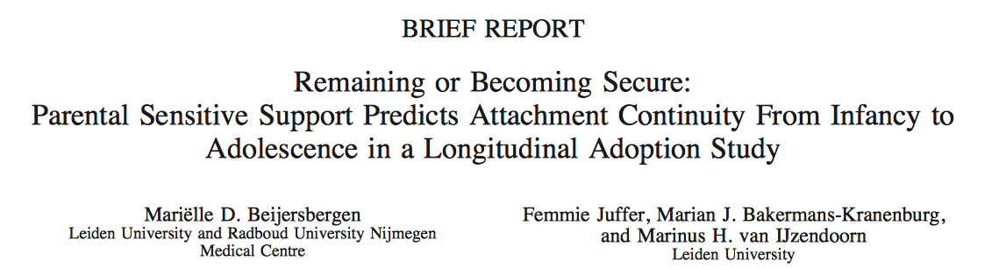

Slide 3
Results
Attachment of Adolescents
  39% showed secure, 61% showed insecure
Sensitive Support
  Mothers of secure adolescents showed more sensitive support at 14 years
Continuity of Attachment was not significant

Slide 4
Results cont’d
Secure-secure vs. secure-insecure
  Continuously secure participants had more sensitive mothers at 12 months and 14 years old
Insecure-insecure vs. insecure-secure
  Insecure-secure group had less supportive mothers at 12 months but more supportive mothers at 14 years old
Stressful life events and temperament did not predict attachment continuity

Slide 5
Discussion
Overall, in adoptive families, continuity of attachment is dependent on continuity of child rearing context
Effect of attachment based intervention?
Different effects if considered disorganized attachment style?

Slide 6
Attachment & emotional development
In 2nd and 3rd yrs, secure children → less angry.
  Higher attachment → less fear and anger at 33 mo
Insecure children's negative emotions increased:
  Avoidant children → fearful
  Resistant children were most fearful / least joyful,
    distress even in episodes designed to elicit joy.
  Disorganized/ unclassifiable children →more angry.
        Kochanska, G. Child Development. 2001, 72 474-490
Notes:
Attachment groups (avoidant, secure, resistant, and disorganized/unclassifiable) differed in the trajectories of emotional development, with the differences first apparent at 14 mo of age.

Slide 7
Attachment and Children's Peer Relations
“Small-to-moderate” association between attachment security to mother and quality of children’s peer relations
  meta-analysis of 63 studies indicates
Effects “higher for studies that focused on children's close friendships rather than on relations with other peers.”
  Effects larger after early childhood
    “Gender & cultural differences … minimal”
      A Quantitative Review (Schneider et al ’2001)

Slide 8
Insecure & disorganized
→ risk of externalizing problems
Disorganized at elevated risk, weaker effects for avoidance & resistance
    Meta-analysis, 69 samples (5,947).
      overall d = 0.31 (95% CI: 0.23, 0.40)
        Larger effects for boys, clinical samples, observation-based outcome assessments, attachment assessments other than the Strange Situation.
    Fearon, R. P., M. J. Bakermans-Kranenburg, et al. (2010). "The significance of insecure attachment and disorganization in the development of children s externalizing behavior: A meta-analytic study." Child Development 81(2): 435-456.

Slide 9
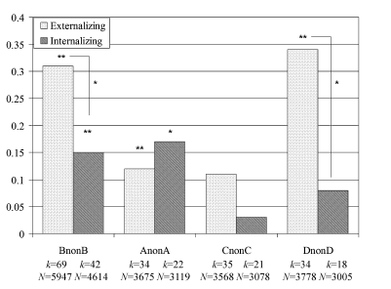
Disorganized/Nonsecure → Internalizing/Externalizing
Disorganized→ externalizing
(Groh, Roisman, van Ijzendoorn, Bakermans-Kranenburg, & Fearon, 2012)
Based on 42 independent samples (N = 4,614),

Slide 10
But insecure attachment may have positive functions
The function of attachment is safety
Avoidance minimizes unfruitful attempts to elicit caregiving
Resistance maximizes attention to separation & minimizes separation
Even disorganization balances exposure to a threatening but needed caregiver
Security may not be the only way to ‘get it right.’
        Crittenden (Dahra Jackson)

Slide 11

Attachment and Maturation
Evolutionary framework
  Does infant attachment change maturation?
  Does attachment signal challenges an infant faces?
Difficult environment
=> Earlier menarche
Belsky, Houts, & Fearon 2010

Slide 12
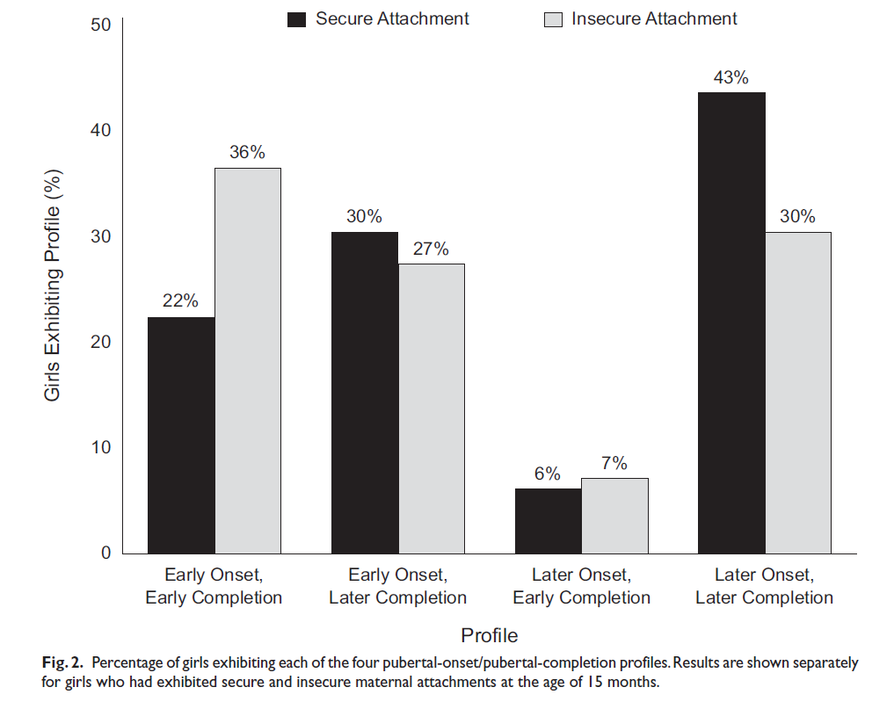
Attachment-Maturation Model
Early menarche: insecure over-represented
Is insecurity a better fit to certain environments?
Belsky, Houts, & Fearon 2010

Slide 13
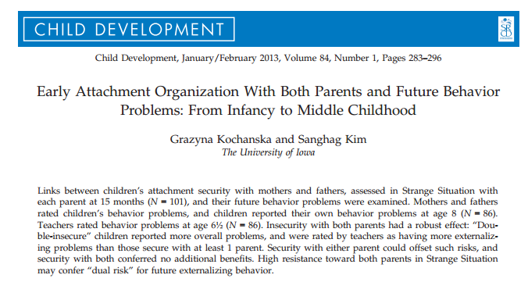
Kochanska & Kim, 2013

Slide 14
Background
How does early attachment predict future mental health?
Few studies have looked at the effects of mother-child and father-child attachment on children’s outcomes
Few studies have gathered clinical data directly from children
Children’s self-report of attachment has been linked to:
  emotional health
  behavior regulation

Slide 15
Research Questions
Does a secure attachment with one parent buffer the adverse effects of insecurity with the other parent, etc.?
  Is there a primary attachment relationship?
What is the relationship between children’s early attachment organization and later behavior problems?
Does attachment organization matter?

Slide 16
Participants
Typically developing infants from traditional two-parent families

Slide 17
Measures
15 month visit
  Strange Situation
6.5 year visit
  Teacher report of Problem Behavior using the Child Symptom Inventory-4
8 year visit
  Parent report of Problem Behavior using the Child Symptom Inventory-4
  Child report of Problem Behaviors using the Dominic-R

Slide 18
Mother & father problem behavior report correlate, but not with teacher or child report

Slide 19
Can 1 secure relationship act as a buffer?
Teachers rated children who were insecurely attached to both parents as having more externalizing behavior problems
Being securely attached to at least one parent has a significant beneficial effect
Teachers perceived children who had insecure attachments with their father at 15- months as having more externalizing behavior problems at 6.5 years old.

Slide 20
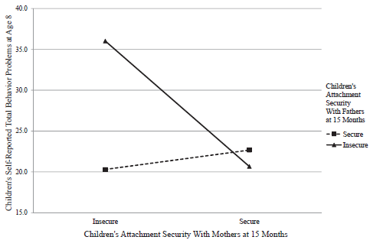
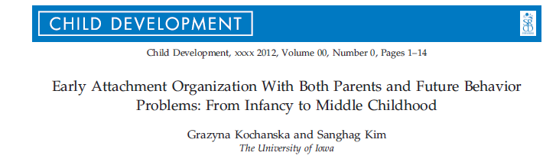
Double insecurity → Behavior problems

Slide 21
Two insecure attachments…
..

Slide 22
Level of resistance
Disorganized attachment with dad at 15 months predicts children’s higher externalizing behavior problems
Child’s resistance with mother and father predicted higher teacher-rated externalizing behavior problems.
Even when children showed high resistance with their father, if the child demonstrated low resistance with mom it served as a protective factor
Low resistance with dad also predicted lower teacher reported behavior problems despite level of resistance with mom

Slide 23
The Big Question
How do early experiences of attachment relationships impact later relationships?
  Early infancy to later infancy
  Infancy to adulthood
  Infancy to childhood
  Infancy to parenthood

Slide 24
Overview
Introduction to the Adult Attachment Interview (AAI)
Correspondence between parents’ security of attachment (from AAI) and their children’s security of attachment
Practice the Adult Attachment Interview (AAI)

Slide 25
A Big Question
Do parents’ representation of their own attachment experiences relate – presumably through their own parenting behaviors – to the attachment classification of their children in the next generation?
To answer such questions, attachment theory has moved to the level of representation.

Slide 26
In adulthood
Internal working models impact attachment behavior
  Mental representations of the availability of the attachment figure
  What to do when the attachment system is activated
Purpose of the Adult Attachment Interview is to classify these internal working models.

Slide 27
Interview
18 questions with follow-up probes, semi-structured, hour-long, transcribed verbatim
  5 adjectives describing each parent with supporting (or contradicting) memories
  what occurred when upset (when the attachment system was activated)
  impact of those experience on current functioning
  current relationship with parents

Slide 28
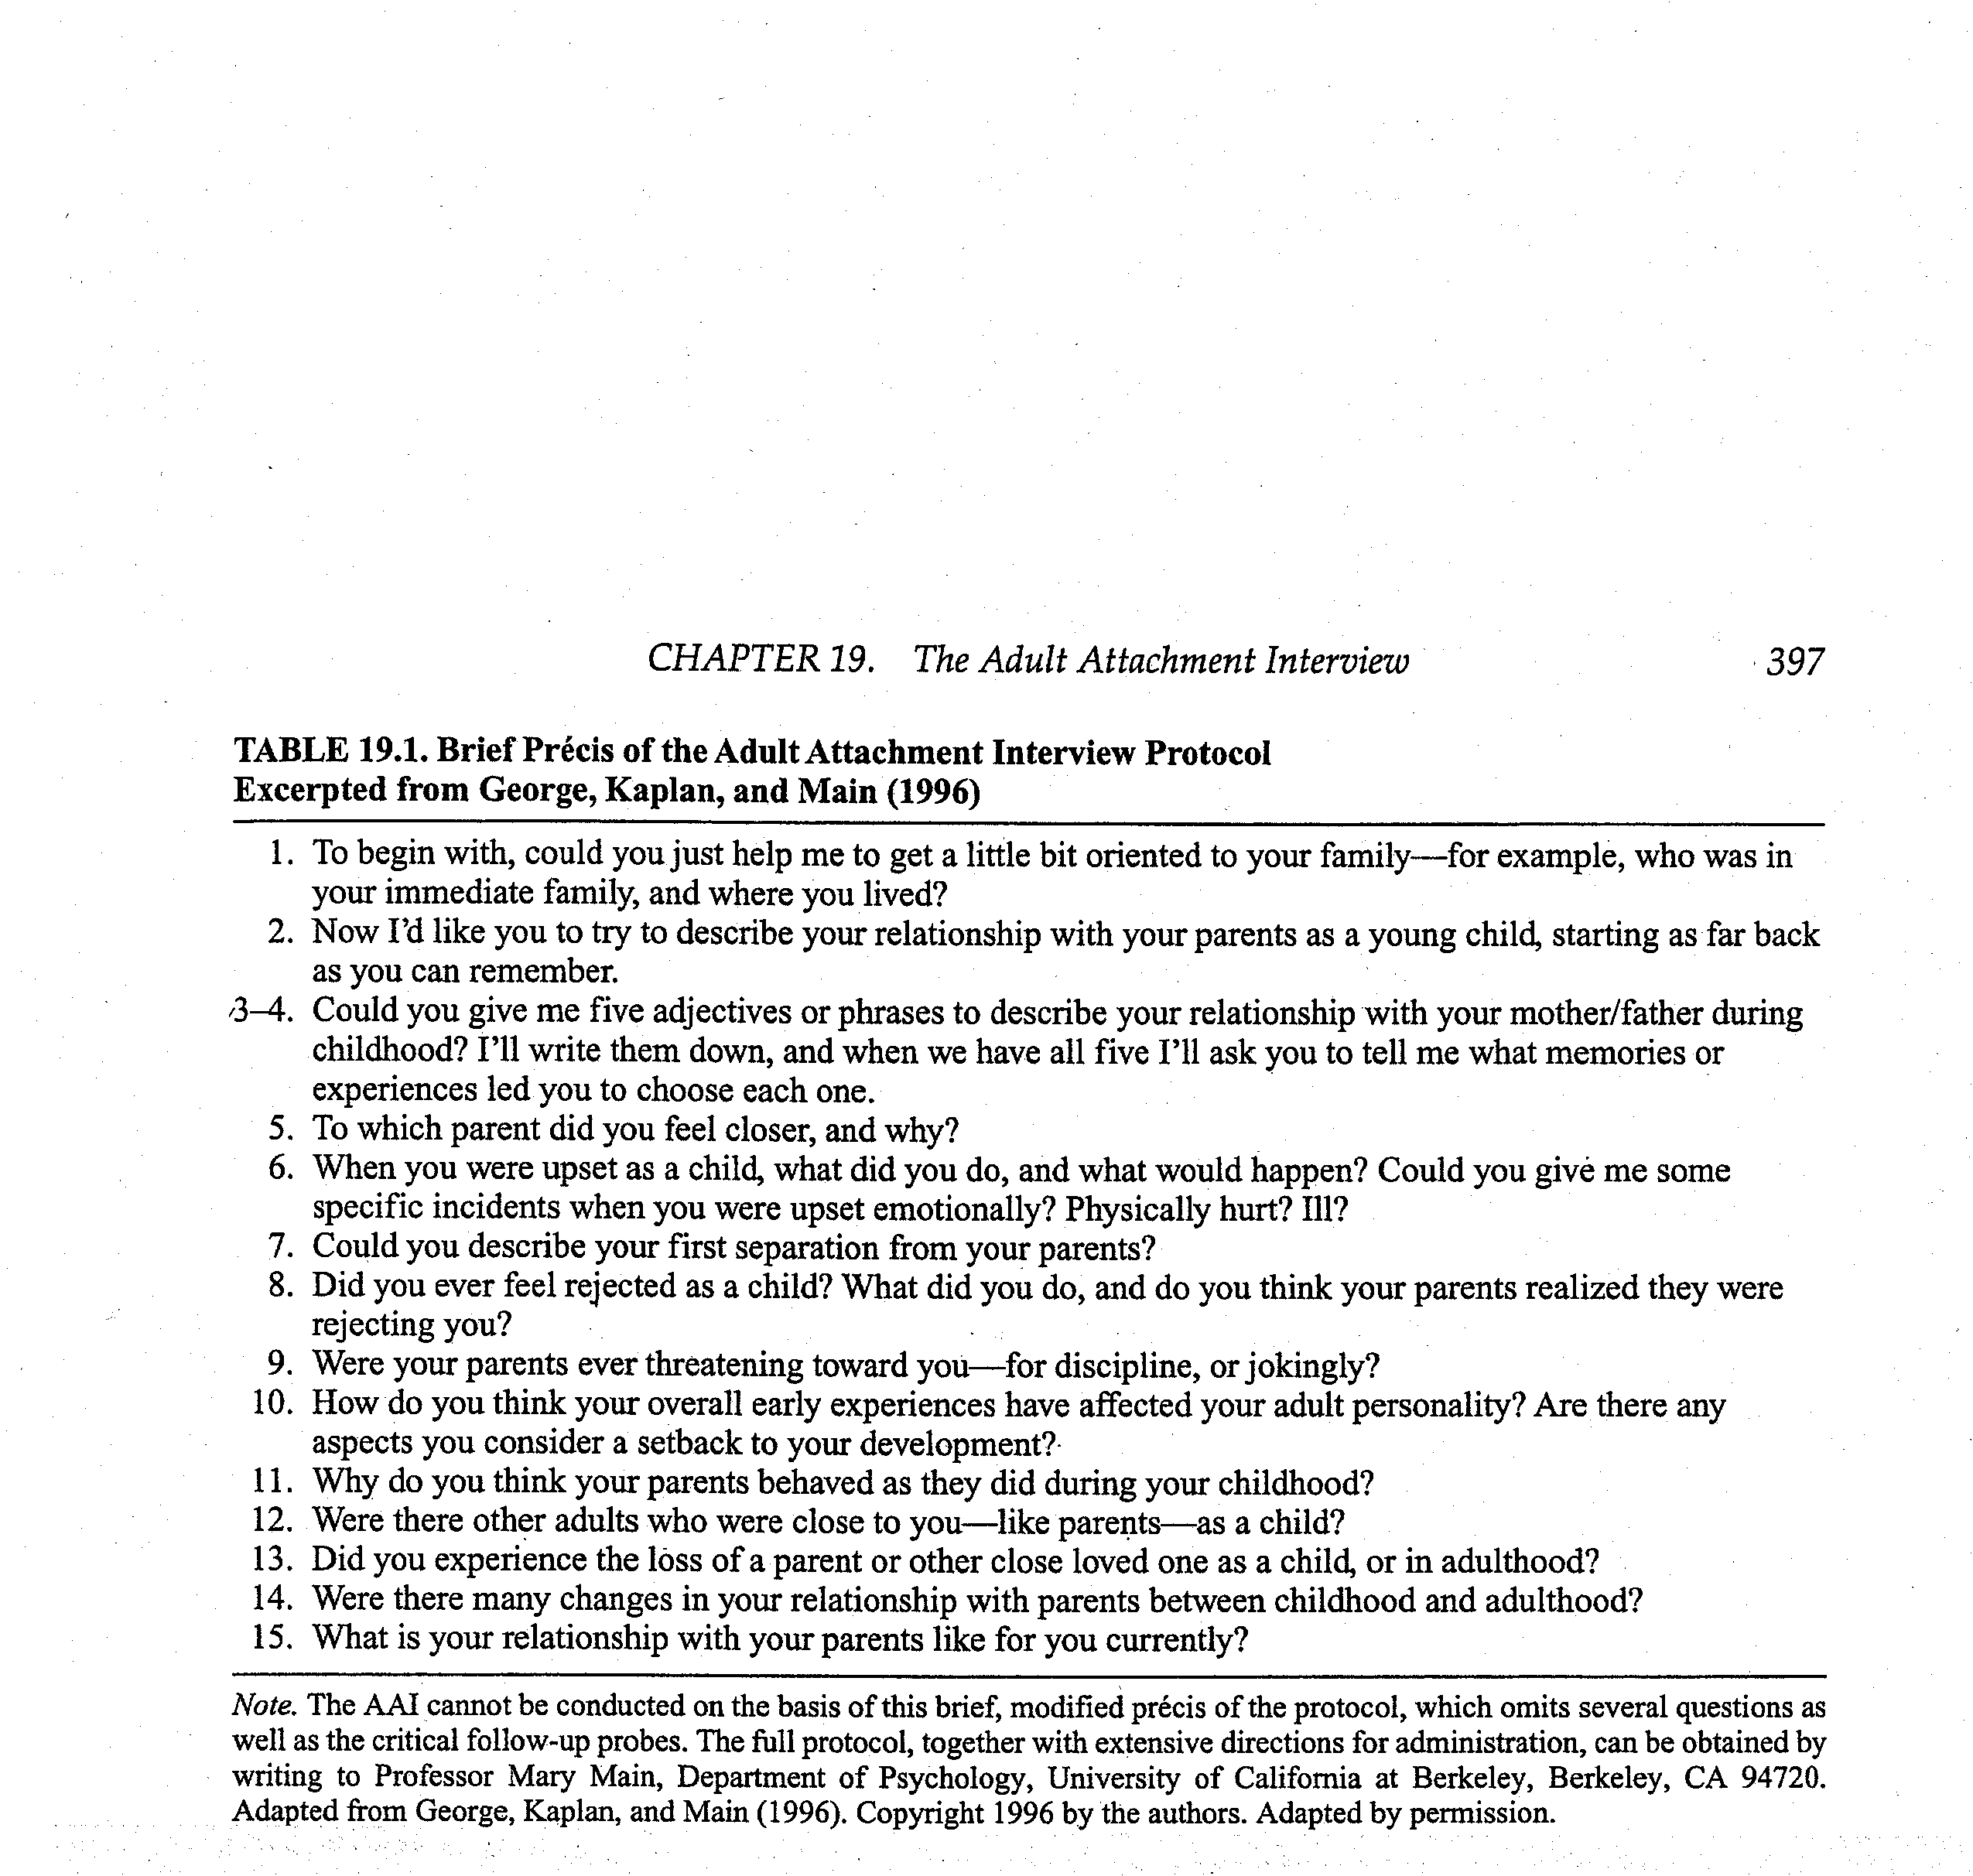
Adult Attachment Interview

Slide 29
How Speakers are Categorized
As Autonomous (secure), Dismissing (avoidant), or Preoccupied (resistant)
  And, independently, as Unresolved/Disorganized
Not based on experiences themselves
But on speaker’s current relationship to the experiences
  how they’ve processed their past
Based on the coherence of their discourse

Slide 30
Discourse coherence
Adherence or violation of Grice’s maxims of coherent discourse
  Quality: Have evidence for what you say.
  Quantity: Be succinct but complete.
  Relation: Be relevant.
  Manner: Be clear and orderly.
Helps categorize speakers as autonomous, dismissing, or preoccupied
  Disorganized categorized in 3 main categories

Slide 31
Specifics of the Hypothesized Link
Autonomous parents are sensitively responsive and promote security
Dismissive parents avoid acknowledging attachment needs of infants
  who respond by minimizing attachment needs and becoming avoidant
Preoccupied parents do not respond to infant attachment needs predictably
  Who respond by chronic attempts to achieve security

Slide 32
Correspondence
Adult state of mind Infant SS behavior
Autonomous
  Coherent narrative
Dismissing
  Generalized normalizing without specific examples
Preoccupied
  Long, entangled narratives
Unresolved
  Lapses in reasoning
Secure -
  Soothed by parent
Avoidant
  Does not make contact with parent or express attachment needs
Resistant
  Not comforted by parent
Disorganized
  No coherent strategy

Slide 33
Autonomous (secure)
“Presentation and evaluation of attachment-related experiences is coherent and consistent and their responses are clear, relevant, and reasonably succinct” whether or not experiences themselves were positive or negative.
        (van IJzendoorn, 1995, p. 388)

Slide 34
Dismissing (Avoidant)
Minimize attachment-related experiences
  Avoid activating attachment system
Describe parents with positive adjectives that are unsupported or contradicted by memories that are recounted
  Violating the quality maxim

Slide 35
Preoccupied (Resistant)
Preoccupied by attachment figures and attachment-related experiences.
  Attachment system chronically activated
Transcripts tend to be lengthy and unfocussed
  Violating the quantity maxim

Slide 36
Unresolved - Disorganized Link
Unresolved parents are frightened or frightening in dealing with attachment issues.
Infants often respond to a parent who is threatening rather than comforting with disorganized attachment behavior
  No clear strategy.

Slide 37
Validity of AAI
Classifications are stable
  2 months, 3 months, 1.5 years
Not related to IQ measures
  6 of 7 studies
Discourse style relates to attachment
  not interviews about job
Machine learning shows some ability to distinguish adult attachment in AAI

Slide 38
Parent-Infant
Attachment Correspondence
Meta-analysis of 13 studies using three major categories
75% secure vs. insecure agreement (K=.49)
70% three-way agreement (K=.46)
  Prebirth AAI show 69% three-way agreement (K=.44)
        Bakermans-kranenburg, M. J. & Vanijzendoorn, M. H. (1993). A Psychometric Study of the Adult Attachment Interview - Reliability and Discriminant Validity. Developmental Psychology, 29, 870-879.

Slide 39
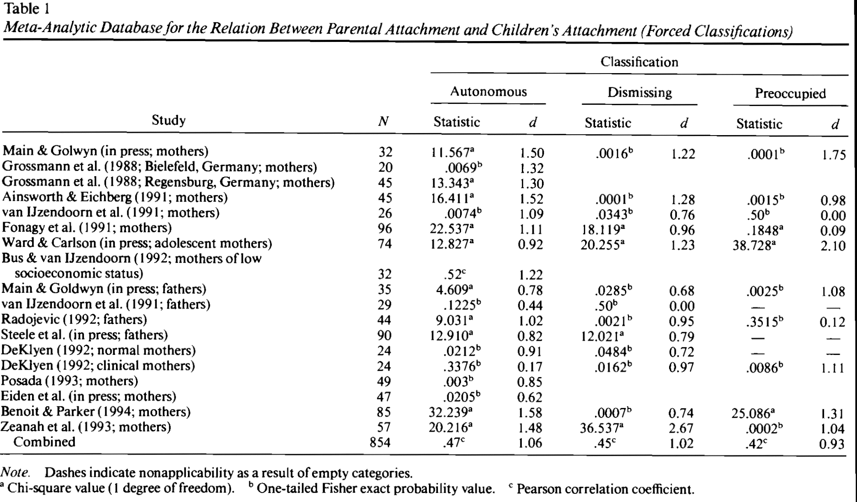
3-way classification (18 studies)
Hypothesis 1
AAI accounted for 22% of variation in children’s attachment.

Slide 40
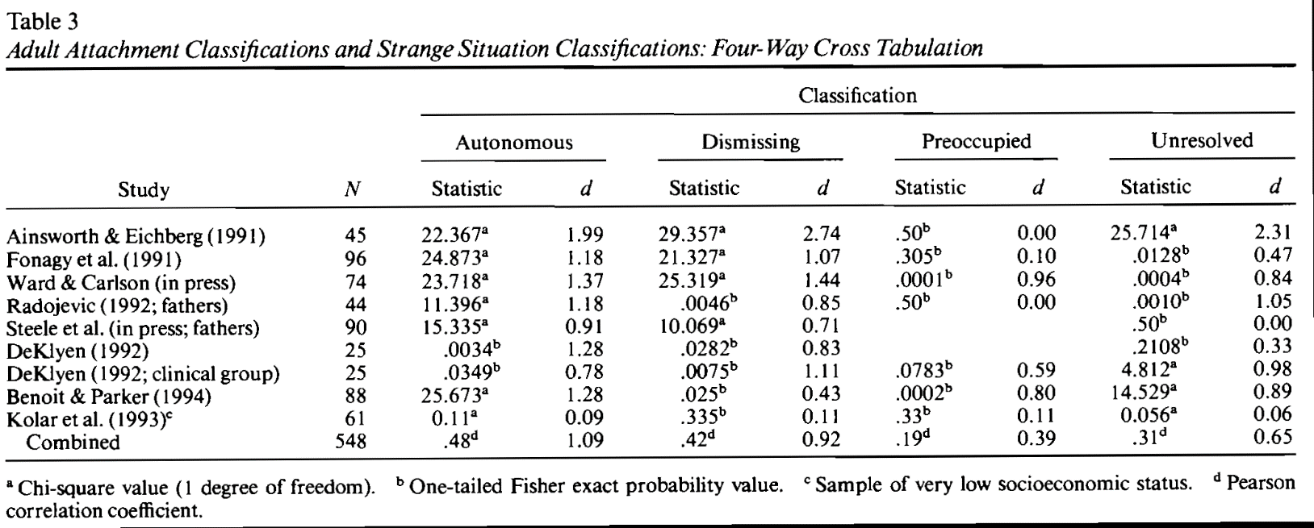
4-way classification (9 studies)
Hypothesis 1

Slide 41
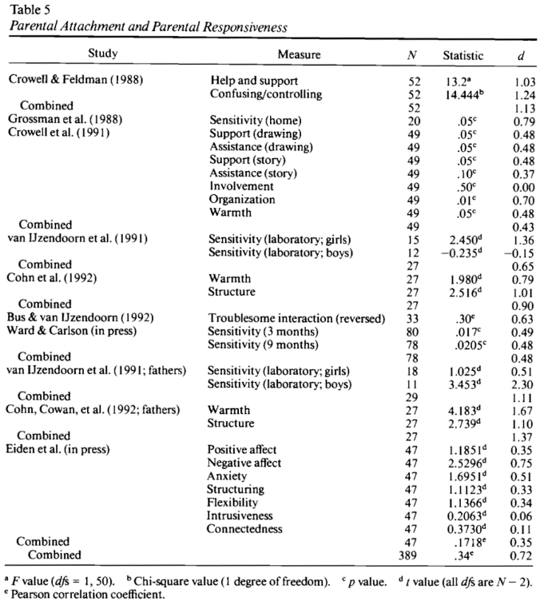
AAI accounted for 12% of variation in parental responsiveness
Hypothesis 2 (10 studies)

Slide 42
Parent-Infant Correspondence

Slide 43
Parent-Infant
Attachment Correspondence
Meta-analysis of 9 studies (k=9, n=548) using four major categories
Secure versus insecure, 74%
Four-way agreement, 63%
  Prebirth AAI show 65% four-way agreement
        Which parent category is not so strong a predictor of infant category?

Slide 44
Parent-Infant Correspondence

Slide 45
Parent-Infant
Attachment Correspondence
Effect Sizes
How well does each of four categories predict corresponding infant classification?
Secure versus insecure, r = .48
Dismiss versus not dismiss, r = .42
Preoccupied versus not preoccupied, r = .19
Unresolved versus not unresolved, r = .31

Slide 46
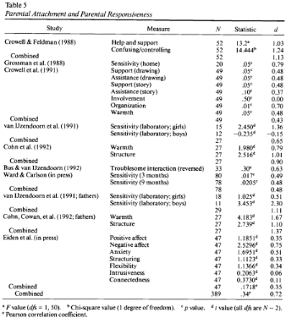
How might link work?
Parental attachment accounted for 12% of variation in observed parental responsiveness
  Meta-analysis of 10 studies (r = .34)
Parental sensitive responsiveness is, in turn, associated with infant attachment security
  van Ijzendoorn meta-analysis (r = .22)

Slide 47
Putting the pieces together
Parent
Internal
Working
Model
Sensitive
Respon-
siveness
r = .34
r = .22
Attachment
Security
.40
Total Observed association, r = .47
(Direct * Direct) + Indirect = Total
(.34 * .22) + .40 = .47

Slide 48
Breaking the Link
Parental attachment is not formed by past experiences but by current orientation to past.
Supportive experiences with a partner, friend or therapist can allow for earned autonomy in the face of experiences that would otherwise be associated with insecurity.

Slide 49
Interview
Interview a partner about one attachment figure focusing on questions 2 through 4
Each person analyzes their own responses
  no comments form partner
Only share what you want to share

Slide 50
Adult Attachment Interview

Slide 51
How to Think About What You’ve Said
Scales associated with autonomous category
  coherence, metacognitive monitoring
Scales associated with dismissing category
  Idealization of attachment figures, insistence on lack of memory for childhood, dismissal of attachment-related experience/relationships
Scales associated with preoccupied category
  anger expressed toward attachment figure, passivity/vagueness in discourse

Slide 52
Longitudinal predictors of adult attachment
Ongoing environmental impacts
  continued parental sensitivity
  social functioning
  friendship

Slide 53
Is security a ‘vaccination’?
Most competent 3-yr-olds have both secure attachment (at 15 mo) & (relatively) high-sensitive mothering (at 24 mo)
  NICHD Study of Early Child Care
        Insecurely attached children who subsequently experienced high-sensitive mothering significantly outperformed secure children who subsequently experienced low-sensitive mothering.
        Belsky, J. and R. M. P. Fearon (2002). "Early attachment security, subsequent maternal sensitivity, and later child development: Does continuity in development depend upon continuity of caregiving?" Attachment & Human Development 4(3): 361-387.

Slide 54
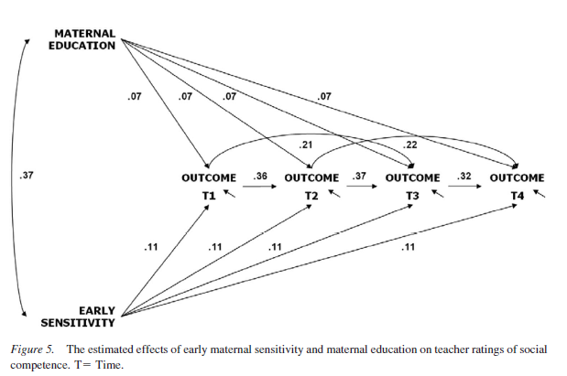
Sensitivity→social competence (beyond attachment)
through age 15
Fraley, R. C., Roisman, G. I., & Haltigan, J. D. (2013). The legacy of early experiences in development: Formalizing alternative models of how early experiences are carried forward over time. Dev Psychol, 49(1), 109-126.

Slide 55
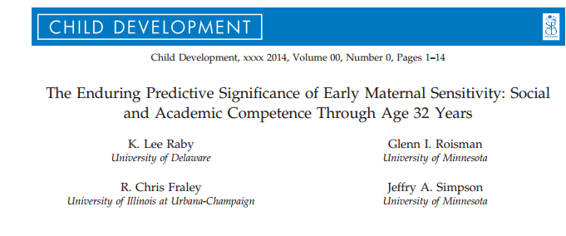
Maternal sensitivity

Slide 56
Background
Are the effects of early relationship experiences on adaptation enduring or merely transient?
  Two competing theoretical models
  Enduring Effects
  Revisionist
  Difference: patterns of association
    Stable across time
    Increasingly smaller association
Notes:
Enduring effects: early relationship experiences organize early developmental adaptation AND continue to shape adjustment across development via mechanisms consolidated during early childhood
Revisionist: early relationship experiences have direct effect on children’s early development but only indirectly associated with subsequent adaptation due to stability of adjustment over time.

Slide 57
Two models
Enduring Effects Model
  Early relationship experiences organize early developmental adaptation and continue to shape adjustment across development
Revisionist Model
  Early relationship experiences directly effect early childhood development but then only indirectly effect subsequent adaptation

Slide 58
Purpose of Study
Duplicate findings of Fraley et al., 2013
  That early maternal sensitivity has lasting effects on children’s social and cognitive development
Extend findings of Fraley et al., 2013
  Does early maternal sensitivity’s effects extend into adulthood?
  Is there a more complex developmental process at work?
  Do covariates account for potential enduring effects?

Slide 59
Minnesota Longitudinal Study of Risk and Adaptation (MLSRA)
N = 243
  45% female, 65% White/Non-Hispanic
Maternal sensitivity
  Feeding observations (3 + 6 mo.)
  Play interactions (6 mo.)
  Problem-solving and Teaching tasks (24 + 42 mo.)

Slide 60
Method
Social Competence
  Teacher-rated competence with peers during
    Kindergarten
    Grades 1-3
    Grade 6
    Age 16
Academic Competence
  Peabody Individual Achievement Test
    Grades 1-3 and 6
  Woodcock-Johnson Tests of Achievement
    Age 16

Slide 61
Method
Competence in Romantic Relationships
  Semi-structured interview regarding recent romantic relationship history
    Ages 23 and 32

Slide 62
Method
Educational Attainment
  6-point scale (no GED or high school diploma – a post-baccalaureate degree)
    Ages 23, 26, 28, and 32

Slide 63
Results
Maternal Sensitivity
0
0
0
0
0
Time 1
Time 2
Time 3
Time 4
Time 5
Time 6
Social and Academic Competence at Different Times

Slide 64
Results: Enduring Effects
Maternal Sensitivity
Social competence:
ΔΧ² = 17.18, p <.001
Academic Competence:
ΔΧ² = 15.03, p <.001
Time 1
Time 2
Time 3
Time 4
Time 5
Time 6
Social and Academic Competence at Different Times

Slide 65
Results: Transactional
Maternal Sensitivity
0
0
0
0
0
Time 1
Time 2
Time 3
Time 4
Time 5
Time 6
Social and Academic Competence at Different Times

Slide 66
Results: Transactional
Maternal Sensitivity
Social competence:
ΔΧ² = 11.54, p <.001
Academic Competence:
ΔΧ² = 9.96, p =.002
Time 1
Time 2
Time 3
Time 4
Time 5
Time 6
Social and Academic Competence at Different Times

Slide 67
Results: Covariates
Maternal Sensitivity
0
0
0
0
0
Social and Academic Competence at Different Times
Time 1
Time 2
Time 3
Time 4
Time 5
Time 6
Covariates
Notes:
Child sex, child ethnicity, maternal education, maternal socioeconomic status

Slide 68
Social competence with Covariates
Maternal Sensitivity
Social competence:
ΔΧ² = 1.72, p = .19
Social and Academic Competence at Different Times
Time 1
Time 2
Time 3
Time 4
Time 5
Time 6
Enduring effects of:
Gender**
Maternal Education**
Socioeconomic Status
Ethnicity
Covariates
Notes:
Child sex, child ethnicity, maternal education, maternal socioeconomic status

Slide 69
Academic competence with covariates
Maternal Sensitivity
Academic Competence:
ΔΧ² = 9.96, p =.002
Social and Academic Competence at Different Times
Time 1
Time 2
Time 3
Time 4
Time 5
Time 6
Enduring effects of:
Gender*
Maternal Education*
Socioeconomic Status*
Ethnicity
Covariates
Notes:
Child sex, child ethnicity, maternal education, maternal socioeconomic status

Slide 70
Social (not significant) with Transactional + Covariates
Maternal Sensitivity
Social Competence:
ΔΧ² = 0.82, p =.37
Social and Academic Competence at Different Times
Time 1
Time 2
Time 3
Time 4
Time 5
Time 6
Enduring effects of:
Gender**
Maternal Education**
Socioeconomic Status
Ethnicity
Covariates
Notes:
Child sex, child ethnicity, maternal education, maternal socioeconomic status

Slide 71
Academic (significant) with Transactional + Covariates
Maternal Sensitivity
Academic Competence:
ΔΧ² = 3.96, p <.05
Social and Academic Competence at Different Times
Time 1
Time 2
Time 3
Time 4
Time 5
Time 6
Enduring effects of:
Gender*
Maternal Education*
Socioeconomic Status
Ethnicity
Covariates
Notes:
Child sex, child ethnicity, maternal education, maternal socioeconomic status

Slide 72
Discussion
The association between early maternal sensitivity and children’s social and academic competence is stable across time
  But this is not fully explained by stability (transactional model)
  Bi-directional relationship between functioning and environment

Slide 73
Discussion
Why the continued association with academic competence but not social competence (with the inclusion of covariates)?
      Gender, maternal education, and socioeconomic status showed enduring associations with children’s competence
      Early maternal sensitivity continue to predict academic competence above these covariates

Slide 74
FRALEY. Attachment implications for adult functioning
But relies on adult self-reported attachment
  Untested core assumption of adult attachment
Follow up of NICHHD-Early Child Care and Youth Development @ age 18
  Maternal sensitivity
  Social competence
  Quality of peer relationships
  Fraley, et al., 2013
Notes:
Infant attachment has important implications for adult functioning – ppl who are relatively secure with respect to attachment are more likely than those who are insecure to experience satisfaction and to report high levels of commitment in their marital and dating relationships
But much of the past research has relied on self-reported attachment styles and assumes that adult attachment style is a function of variation in peoples developmental histories BUT THIS IS LARGELY UNTESTED
Follow up @ age 18 of NICHHD-Early Child Care and Youth Development study which followed children from birth to age 15 → takes a social and personality psych perspective
Social psychologists have emphasized three broad categories of Antecedents to Adult Attachment
Maternal sensitivity and other factors that might affect the quality of the childhood caregiving environment like maternal depression and father absence
Most of the studies examining this in the past have used retrospective reports
finding that adults who recall warm loving relationships with their early attachment figures are more likely to rate themselves as secure in attachment
Early contextual stressor (father absence, low ses) are realted to self-report measure of insecure attachment styles in adulthood
Emerging social competence of the individual
Most of the studies examining SC in association with adult attachment have primarily been investigated concurrently
Secure adults are more empathetically accurate in their relationships
Are better able to seek and provide support during stressful and challenging situations
The quality of the individual’s peer relationships
- Close friends can serve important attachment functions – individuals with higher quality friendships are more likely to be secure in their attachment orientation

Slide 75
Two-dimensional model
(Bartholomew and Horowitz, 1991)
  Attachment-related avoidance
    “avoid emotional closeness &intimacy, do not feel comfortable opening up to /depending on partner, are reluctant to ask partner for comfort, advice, or help.” Picardi, 2010
  Attachment-related anxiety
    preoccupied with romantic relationships, worry about abandonment, desire to be very close to partner, ask the partner for more feeling/commitment.” Picardi, 2010
Global vs. Domain specific
  Romantic relationships
Notes:
The current study investigated those three antecedents to adult attachment within the framework of a two-dimensional model proposed by Bartholomew and Horowitz
The first dimension, Attachment-related avoidance
Represents the extent to which individuals organize their attachment-related thoughts, feelings and behaviors around defensive goals
The second dimension, Attachment-related anxiety
Represents the extent to which individuals are concerned about the availability and repsonsiveness of close others
A secure person within this framework would be low on both dimensions
They also focused on antecedents of both global attachment styles, so about interpersonal relationships in general
As well as attachment styles pertaining to domain specific, or specific relationships contexts like romantic relationships
- They did not focus on parents

Slide 76
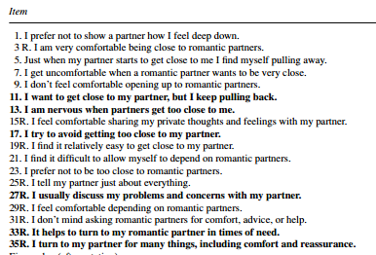
Experiences in Close Relationship Scale
  The ECR (Brennan et al., 1998) 36 5-point items
  “High Avoidance …tend to avoid emotional closeness and intimacy, do not feel comfortable opening up to or depending on their partner, and are reluctant to ask their partner for comfort, advice, or help.
  High Anxiety.. tend to be preoccupied with their romantic relationships, worry about being abandoned, desire to be very close to their partner, and ask the partner for more feeling and commitment. “
    Picardi, et al. 2010
Notes:
The current study investigated those three antecedents to adult attachment within the framework of a two-dimensional model proposed by Bartholomew and Horowitz
The first dimension, Attachment-related avoidance
Represents the extent to which individuals organize their attachment-related thoughts, feelings and behaviors around defensive goals
The second dimension, Attachment-related anxiety
Represents the extent to which individuals are concerned about the availability and repsonsiveness of close others
A secure person within this framework would be low on both dimensions
They also focused on antecedents of both global attachment styles, so about interpersonal relationships in general
As well as attachment styles pertaining to domain specific, or specific relationships contexts like romantic relationships
- They did not focus on parents

Slide 77
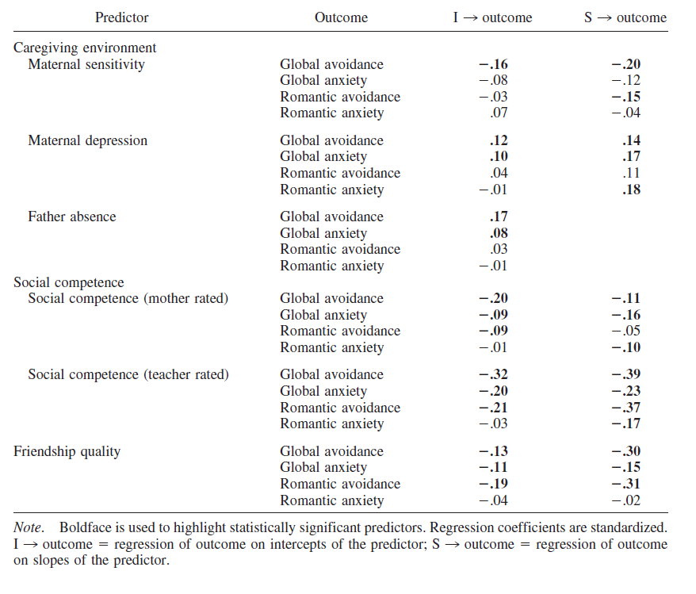
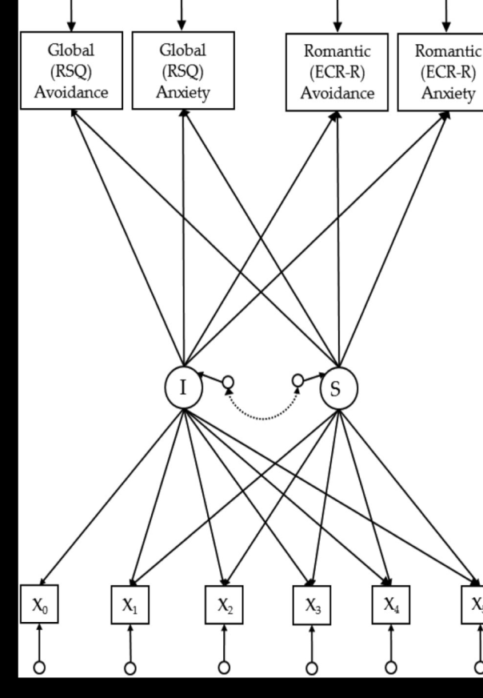
Early care impacts later attachment
  Fraley, et al., 2013
Est. early sensitivity received
Est. change in qual. of care
Social Competence (M)
Father Absence
Friendship Quality
Social Competence (T)
Maternal Sensitivity
Maternal Depression

Slide 78
Regression Findings
Attachment-Related Avoidance
Attachment-Related Anxiety
Global
↑ MS = ↓ Avoidant
↓ Dad = ↑ Avoidant
↑ SC = ↓ Avoidant
↑BFF = ↓ Avoidant
Romantic
↑ Avoidant
  ↓ Parental Sensitivity
  ↓ Social competence
  ↓ BFF’s
Global
↑ MD = ↑ Anxiety
↑ SC = ↓ Anxiety
Romantic
↑ Anxiety
  ↑ Maternal Depression
  ↓ Social competence
  ↑ BFF’s
Weird!
Notes:
In general, the covariates did not predict the romantic avoidance/anxiety of the global avoidance/anxiety
AVOIDANCE:
Global:
Participants who experienced greater maternal sensitivity over time were less avoidant at age 18
Those who did not live consistently with their fathers were more liekly to be avoidant than those who did
Those who exhibited social competence early in childhood or who exhibited increasing levels of social competence were less likely to be avoidant at age 18
Those who had a high-quality best friendship early in childhood or had an increasingly high-quality best friend (if they were BFF’s) were less likely to be avoidant at 18
Romantic:
Those who were relatively avoidant in their attachment concerns at age 18 were
More likley to have experienced decreases in parental sensitivity over time
Decreases in social competence over time
Less likely to have experienced high-quality friendships in early childhood and to have increasingly low-quality friendships over time
ANXIETY
Global:
Those whose mothers reported increasing levels of depressive symptoms over time were more likely to report attachment-related anxiety at age 18
Increases in social competence over time predicted lower ratings of anxiety at age 18
Romantic:
Those who were relatively anxious with respect to attachemnt were
more likely to have mothers who reported more depressive symptoms over time
Less likely to increase in social competence over time
More likely to have friendships that increased in quality of time

Slide 79
Temperamental & Genetic Factors
Temperament
Gene & Gene X Environment
No statistically significant temperamental antecedents of adult attachment styles
No main effects of genetic variables previously studied
C allele of HTR2A (serotonin receptor gene)
Homozygous = ↑ global attachment related anxiety
Notes:
BUT individuals who were homozygous with respect to the C allele of the HTR2A serotonin receptor gene had higher global attachment-related anxiety scores than did individuals who were TT or TC

Slide 80
Father-Child Relationships
(Tamis-LeMonda et al., 2004)
Limitations of prior studies of fathers?
Current focus on active roles of fathers
  Is the content and/or meaning of father-child interactions similar or different than mother-child interactions?

Slide 81
Father-Child Relationships
(Tamis-LeMonda et al., 2004)
Importance of studying fatherhood within the context of networks of family relationships
  Nature of effects of fathers on development
    Direct effects:
    Indirect effects:

Slide 82
Father-Child Relationships
(Tamis-LeMonda et al., 2004)
Method
  Characteristics of Sample?
    Original sample (n=1168) vs. analyzed sample (n=290, n=111)
Measures
  Dyadic Interactions at 24 and 36 months
    Three Box Task
      Coded dimensions: sensitivity, positive regard, cognitive stimulation, intrusiveness, detachment, negative regard
  Cognitive Development (Bayley, PPVT)
  Demographics (education level, employment status, income, father residency)

Slide 83
Mean differences in behaviors?
(Tamis-LeMonda et al., 2004)

Slide 84
Father-Child Relationships
(Tamis-LeMonda et al., 2004)
Results Summary:
  Mom/Dad behaviors correlated at each age
  Dad predicts mom behaviors over time but mom less predictive of dad
  Dad demographics (income/education) predict some aspects of parenting
  Dad and mom supportive parenting independently predict children’s outcomes

Slide 85
Baker et al., 2011
Emotion Socialization Behaviors
Attitudes about Emotion
Child Social Competence

Slide 86
Baker et al., 2011
Study Goals
  Compare mothers and fathers on
    Mean levels of:
      Emotion Attitudes
        Coaching vs. dismissive
      Emotion socialization behaviors
        Reactions to emotion
        Expressiveness
        Coaching during emotion discussion
    Coherence among emotion socialization behaviors within each parent
  Examine correspondence across parents
  Predictors/outcomes/correlates

Slide 87
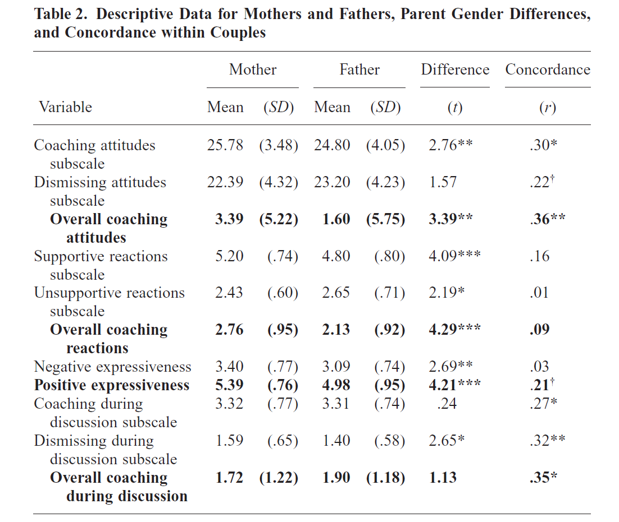
Baker et al., 2011

Slide 88
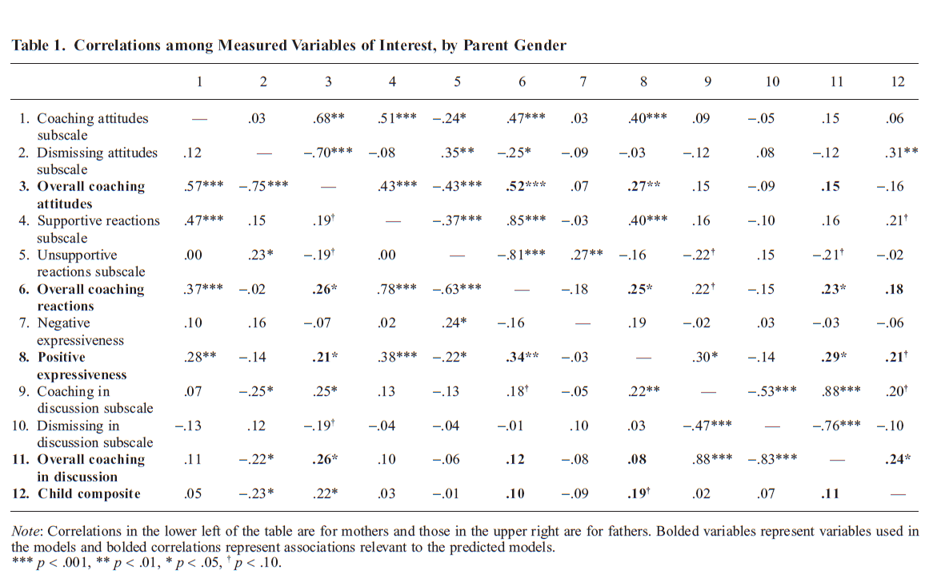
Baker et al., 2011

Slide 89
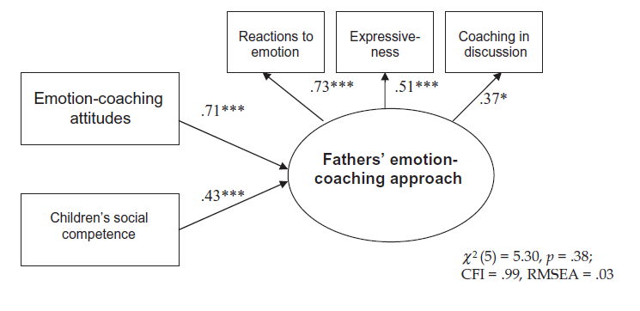
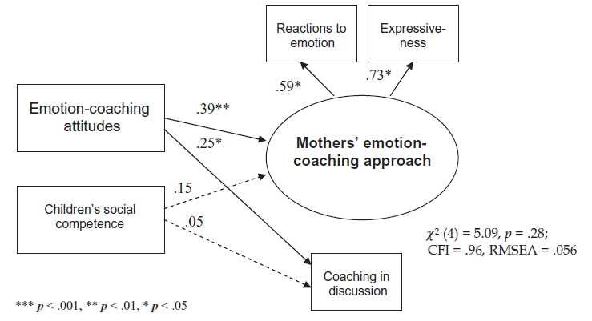
Baker et al., 2011

Slide 90
Baker et al., (2011)
Less coherence between attitudes and behaviors for mothers?
Stronger evidence for child to parent effects than vice versa

Slide 91
Huston & Aronson (2005)
Associations between mothers’ time in employment and mother-child relationship & child development outcomes
Problems with time in out-of-home care as proxy for time with mother?
“Employed women apparently compensate for their absence by spending more time with their children during nonwork hours
  (Easterbrooks & Goldberg, 1985; Hill & Stafford, 1985; Nock & Kingston, 1988; Zaslow, Pederson, Suwalsky, Cain & Fivel, 1985).”
Notes:
“time may not be the cause of maternal
sensitivity and inclination to interact with the child
but may instead be a reflection of these maternal
characteristics.”

Slide 92
Huston & Rosenkrantz Aronson (2005)
Possible deleterious effects of less mother-infant time include:
    Mother-infant interactions
    Quality of home environment
    Attachment security
    Child social behaviors (compliance)
    Cognitive/Language outcomes
Predictors of individual differences in mothers’ time allocation?

Slide 93
Huston & Rosenkrantz Aronson (2005)
Goals:
  Associations between maternal employment and amount of time mothers spend engaged in instrumental care and social interaction with infant
  Demographic and personal characteristics of mothers as predictors of time with children and time in employment
  Associations between time with infants and HOME environment, mother-infant relationship, child outcomes?
    Relative influence of instrumental vs. social interaction

Slide 94
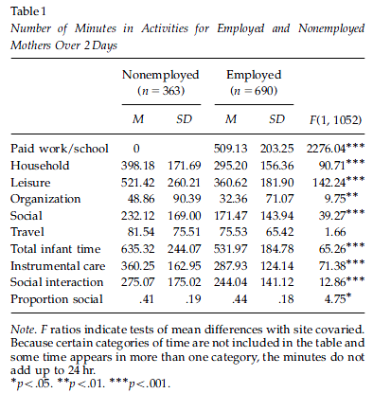
Greater infant time (but not proportion social) for nonemployed)

Slide 95
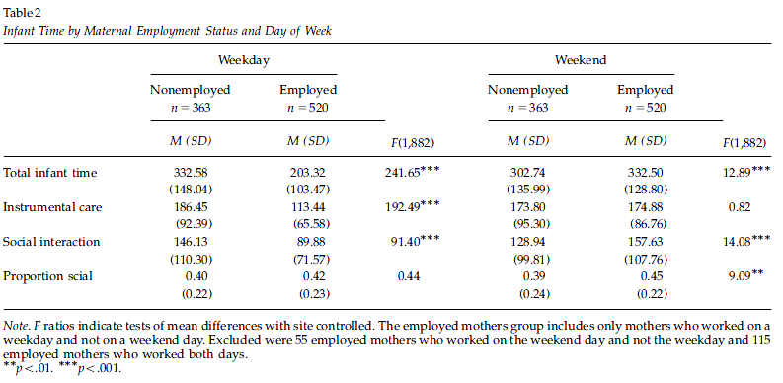
Employed mothers: less time with infant weekdays but more time weekends
Weekday vs. weekend
(what is infant’s experience?)
Huston & Rosenkrantz Aronson (2005)

Slide 96
Maternal characteristics associated with time use
  Mothers who spent more total time with children were:
    Older, White, higher psychological adjustment, had fewer children, lower incomes, high separation anxiety, believed maternal employment was not good for children
  Mothers who spent more available time with children:
    Older, White, higher psychological adjustment, fewer children, high separation anxiety

Slide 97
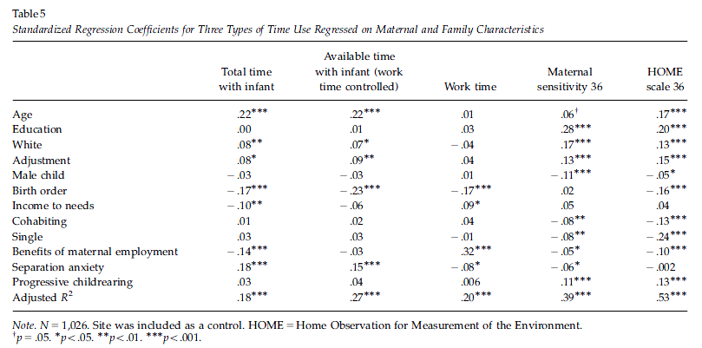
Predicting time use, sensitivity, HOME

Slide 98
Huston & Rosenkrantz Aronson (2005)
Available time spent with infant and developmental outcomes
  Total time predicts sensitivity, HOME
  BUT
  - No documented effects on child or relationship outcomes

Slide 99
Huston & Rosenkrantz Aronson (2005)
Time with infant as indicator of maternal investment rather than a cause of their parenting

Slide 100
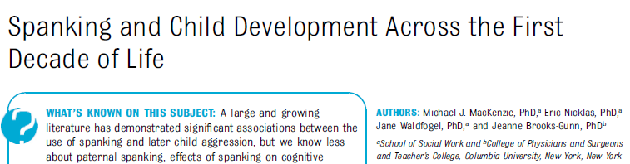
MacKenzie, M. J., Nicklas, E., Waldfogel, J., & Brooks-Gunn, J. (2013). Spanking and Child Development Across the First Decade of Life. Pediatrics. doi: 10.1542/peds.2013-1227
Kelly Shaffer

Slide 101
Background
Spanking: Potentially deleterious to children
  American Academy of Pediatrics recommends against use
Gershoff 2002: Meta-analysis of 88 studies shows spanking related to:
  Moral internalization
  Aggression in childhood and adulthood
  Delinquent/antisocial behavior in childhood (not adulthood)
  Poor parent-child relationship quality
  Poor mental health in childhood and adulthood
  Likelihood of being victim of physical abuse
  Adult abuse of own child or spouse
Shaffer | MacKenzie et al., 2013

Slide 102
Limitations of Prior Research
Few longitudinal studies
Missing measures of stress & SES
No study of paternal spanking
Little study of effects of spanking on children’s cognitive development
Shaffer | MacKenzie et al., 2013
Notes:
Longitudinal: for temporal sequencing of spanking – outcomes
Not extensive inclusion of variables of other stressors, which could account for mixed results relating to spanking and outcomes across ethnicities
No focus on paternal spaking – don’t know whether parents making different parenting decisions or whether they have different effects
Most research on aggressive behavior, little on cognitive development

Slide 103
Methods: Sample
Fragile Families and Child Well-Being Study
1933 families for externalizing behavior analyses
1532 families for receptive vocabulary analyses
Included families: may have more resources and/or be more stable at baseline than excluded families
Shaffer | MacKenzie et al., 2013
Notes:
FFCW: longitudinal birth cohort drawn from 20 cities, representative of children born between 1998-2000 in medium to large US cities
Only included families that had data from the Child Behavior Checklist and Peabody Picture Vocabulary Test at age 9
Those included differed in some ways from those excluded (e.g., excluded more likely to be first child and have low birth weight)
Remained “disadvantaged urban sample”

Slide 104
Methods: Measures – Primary Predictor
Maternal & Paternal Spanking
  “In the past month, have you spanked (child) because (she/he) was misbehaving or acting up?”
0 times
< 1 time/week
> 2 times/week
No spanking
Low Frequency Spanking
High Frequency Spanking
Shaffer | MacKenzie et al., 2013

Slide 105
Methods: Measures – Outcomes
Child Externalizing Behavior
  Age 9: Aggression & Rule-Breaking subscales of CBCL
  Age 3: Aggression & Destructive subscales of CBCL (ctrl)
Child Receptive Vocabulary
  Age 9: Peabody Picture Vocabulary Test (PPVT)
  Age 3: PPVT (ctrl)
Shaffer | MacKenzie et al., 2013

Slide 106
Methods: Measures – Child and Family Control Variables
Category | Variable
Child Risk Factors | Gender; age; low birth weight; if first born; infant temperament
Maternal and Family Characteristics | Maternal age; marital structure; mother’s race/ethnicity; maternal education; household income; mother foreign-born; mother’s residence at age 15; maternal employment, number of adults and children in home
Prenatal Risks | Late onset of prenatal care; risky health behavior; IPV; birth father’s supportiveness
Maternal Risk Factors | Mother’s parenting stress; mother depression or GAD dx; mother’s impulsivity; mother’s cognitive level; mother’s frequency of cognitively stimulating activities with child
Rumper | MacKenzie et al., 2013
Notes:
Four models reported, ascending in rigor of control variables. First model had no control vars, second included these vars for control

Slide 107
Results: Prevalence of Spanking
Age 3
Age 5
Mothers
Spanking child ≥2/week
Spanking child <2/week
No Spanking
Fathers
Shaffer | MacKenzie et al., 2013
Notes:
Use of any spanking in the past month decreased from age 3 to age 5

Slide 108
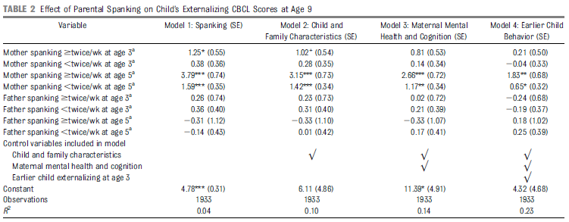
Results: Spanking and Child Externalizing Problems
Shaffer | MacKenzie et al., 2013
Notes:
When only using spanking to predict CBCL outcomes, maternal spanking at 3 and 5 years of age significantly positively related to children’s externalizing problems at age 9
As control variables become more stringent, impact of spanking attenuated, but still significant
Lastly, when early childhood externalizing behavior controlled for in model, maternal spanking at any frequency still significantly relates to later externalizing behavior

Slide 109
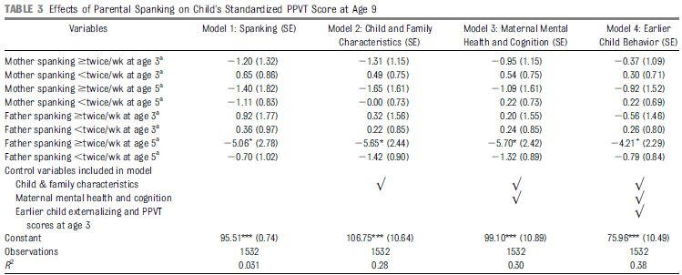
Results: Spanking and Child Receptive Vocabulary
Shaffer | MacKenzie et al., 2013
Notes:
In contrast:
When only using spanking to predict PPVT outcomes, no relationship between spanking and this measure of cognitive development
As control variables become more stringent, father high-frequency spanking inversely related to child receptive vocabulary
Lastly, when early receptive vocabulary controlled for in model, paternal high frequency spanking dropped to only marginal significance.

Slide 110
Conclusions
Maternal spanking at age 5 predicts children’s externalizing behavior at age 9
  Extensive control variables increases confidence in effect
High-frequency paternal spanking at age 5 affects children’s verbal capacity at age 9
Effects hold across genders and race/ethnicity
Rumper| MacKenzie et al., 2013
Notes:
Recall effect of father’s spanking fell to marginal significance when no control vars and again when all control vars added and earlier PPVT score added
Reactions: self, surprised b/c heard evidence of positive outcomes for spanking among AA especially among dangerous neighborhoods.
Some evidence suggests temporal relationship between spanking & temperament (aggression/antisocial behavior) differs b/t European American & African Americans – AA antisocial elicited spanking; EA antisocial elicited & contributed to antisocial behavior (more reciprocal)

Slide 111
Questions
Q) Are there any other variables that should have been included in this analysis?
Q) How do these results hold in comparison to the Lansford et al. article?
Q)How might this study appear in a different population (e.g. middle or high SES)?
Rumper | MacKenzie et al., 2013

Slide 112
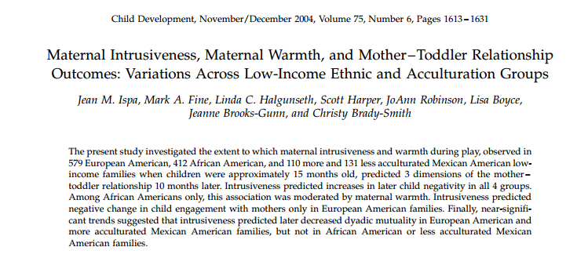

Cultural differences in association between intrusiveness and warmth at 15 months?
(Ispa et al., 2004)

Slide 113

Sensitive Structuring

Slide 114
Control and warmth -- central dimensions of parenting
Intrusiveness =
  a constellation of insensitive, interfering parenting behaviors
  rooted in mothers’ lack of respect for their infants’ autonomy.
Warmth =
  mother’s physical and verbal expressions of love, attentiveness, and respect or admiration for the child.
  Intrusiveness generally associated with negative developmental outcomes
    But mixed findings…..Why?
Ispa et al. (2004)

Slide 115
Maternal control and maternal warmth are central to parenting
How do parenting practices, particularly those engaged in by the mother, affect the nature of the parent-child relationship?
Maternal Intrusiveness
  A constellation of insensitive, interfering parenting behaviors
  Dominates a child’s play agenda so that the child has little or no influence on its content or pace
Maternal Warmth
  A mother’s physical and verbal expressions of love, attentiveness, and respect or admiration for the child

Slide 116
Background
Mixed findings for maternal intrusiveness and mother-child relationship outcomes
Maternal intrusiveness: same or different meaning across cultures?
European American
non-European American
Negative
Neutral
Positive

Slide 117
Goals
Examine the extent to which maternal intrusiveness during play at 15 months affects child negativity, child engagement, and dyadic mutuality at 25 months.
Does maternal warmth moderate the link between maternal intrusiveness and later quality of mother-child relationship?
Do these relationships differ across ethnic groups?
European American, African American, Mexican American (less acculturated), and Mexican American (more acculturated)
Notes:
Child negativity toward mother: measured the degree to which the child showed anger or dislike toward the mother
Child engagement of mother: assessed the extent to which the child interacted with the mother in a positive manner, initiating or maintaining eye contact, approaching her, and responding with positive affect to her initiations.
Dyadic mutuality: measured the mother and child as a unit. High scorers displayed synchrony, comfort, and enjoyment in their interactions with each other. They seemed to share energy, affect, goals, and perspectives.

Slide 118
Hypotheses
Maternal intrusiveness
African American, Mexican American > European American
Mexican American (less acc) > Mexican American (more acc)
Maternal intrusiveness, Maternal warmth (inverse relationship)
European American
No relationship in other ethnic groups
Maternal intrusiveness → Negative changes in relationship
European American
Not predictive in other ethnic groups
Notes:
Because past findings are limited and mixed, we posed no a priori hypotheses regarding whether maternal warmth would moderate the relations among maternal intrusiveness and negative changes in mother – toddler interaction in all ethnic groups.

Slide 119
Measures
  15 & 25 month mother-child play
  Coded dimensions of interest
    15 months
      Intrusiveness
      Warmth
    25 months
      Child negativity
      Child engagement of mother
      Dyadic mutuality between mother and child

Slide 120
Method
Mother-infant pairs: European American (n = 579), African American (n = 412), less acculturated Mexican American (n = 131), more acculturated Mexican American (n=110)
10-min parent-child play sessions (15 months, 25 months)
 | 15 months | 25 months
Maternal intrusiveness | ✔
Maternal warmth | ✔
Child negativity | ✔ | ✔
Child engagement | ✔ | ✔
Dyadic mutuality | ✔ | ✔
Notes:
17 Early Head Start program sites in 16 states (all had incomes at or below the federal poverty level)
Attrition: 25.2% of total sample
AA families more likely to drop out than any of the other ethnic groups, EA more likely to drop out than either MA group
Compared those who remained in the sample at both time points with those who dropped out (to determine whether attrition posed generalizability concern): Mothers who dropped out had lower scores on warmth and were younger than those who remained in the sample. “The evidence thus suggests that attrition was not a major problem”
Mexican-American families were classified by the degree to which they were acculturated, or adapted to mainstream U.S. culture, based on the language they used most and how many generations their families had been in the U.S.
Constructs measured
Maternal intrusiveness: degree to which the mother controlled the child’s play instead of allowing for the child’s preferences.
Maternal warmth: reflected the mother’s physical and verbal expressions of love, attentiveness, and respect or admiration for the child
Child negativity toward mother: measured the degree to which the child showed anger or dislike toward the mother
Child engagement of mother: assessed the extent to which the child interacted with the mother in a positive manner, initiating or maintaining eye contact, approaching her, and responding with positive affect to her initiations.
Dyadic mutuality: measured the mother and child as a unit. High scorers displayed synchrony, comfort, and enjoyment in their interactions with each other. They seemed to share energy, affect, goals, and perspectives.
-- Also obtained a composite measure of maternal stress (to test possible explanations for primary findings)

Slide 121
Results
Group Differences
All analyses controlled for maternal age, partner status, and education
European American mothers had highest depression scores and less acculturated Mexican American mothers had lowest depression scores
European American mothers displayed less intrusiveness and more warmth than mothers in any of the other groups
Notes:
EA mothers had more education, were older, and were more likely to be living with partner than were mothers in at least one of the other groups. All analyses therefore controlled for maternal age, partner status, and education.

Slide 122
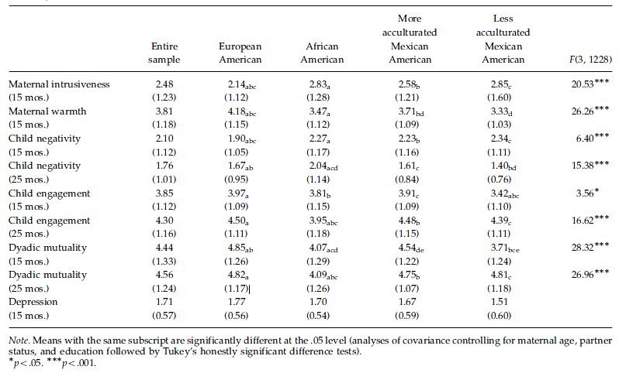
Cultural differences in parent & 15 month-old?

Slide 123
Results
Maternal Intrusiveness predicted child negativity in all ethnic groups.
European American
intrusiveness → negative changes in child engagement
intrusiveness → decreases in dyadic mutuality
African American
  intrusiveness → child negativity [only if low maternal warmth]
More acculturated Mexican American
intrusiveness → decreases in dyadic mutuality

Slide 124
Child Negativity
Predictors of change in child-mother relationship variables between 15 and 25 months?
  Child Negativity
    15 month intrusiveness
    15 month warmth
    Culture*Intrusiveness*Warmth
      EA intrusiveness predicted regardless of warmth
      AA intrusiveness predicted only at low levels of warmth
Notes:
negativity at both low and high levels of warmth
(blow-warmth group5.22, po.05; bhigh-warmth group5.17,
p5.01). However, in African American families, a
moderating impact of warmth was evident. At low
levels of maternal warmth, intrusiveness predicted
25-month child negativity (b5.19, po.05). At high
levels, intrusiveness and child negativity were unrelated
(b5.12, p5.20).

Slide 125
Child Engagement With Mom
Predictors of change in child-mother relationship variables between 15 and 25 months? (cont)
  Child Engagement With Mom
    15 month intrusiveness
    15 month warmth
    Culture*Intrusiveness
      EA intrusiveness negatively predictive
      Non-EA groups, no association

Slide 126
Dyadic Mutuality
Predictors of change in child-mother relationship variables between 15 and 25 months? (cont)
  Dyadic Mutuality
    15 month Warmth
    Culture*Intrusiveness
      EA intrusiveness negatively predictive
      Non-EA groups, no association

Slide 127
Conclusions
Maternal intrusiveness predicted negative changes in two of the three relationship outcomes (negativity and engagement) 10-months-later.
The intrusiveness-negative outcomes link was moderated by ethnicity and, for African Americans, by warmth.

Slide 128
Discussion Questions
Does intrusiveness have the same meaning across cultural groups?
    intrusiveness = a deficit-tinged word?
Operational definition of maternal warmth accurate for all ethnicities or does it better capture the ways European American mothers express love and respect for their children?
    example: inclusion of verbal praise
Any other variables of interest?
Notes:
Positive correlation between intrusiveness and stress only for EA mothers, and a regression analysis indicated that the difference between EA and less acculturated MA mothers in this regard was significant.
Intrusiveness “deficit-tinged word” replaced by directiveness or anticipatory instruction (more neutral terms that might better represent the behavior in question and that might be free from the perspective of US mainstream or middle-class values)?

Slide 129
Normativity of intrusivenes
Post hoc Analyses
  Does intrusiveness have same origins/meaning across cultural groups?
    At 15 months, correlates with stress for EA only
      Only contrast with less acculturated MA survives regression
    Other ways to assess?

Slide 130
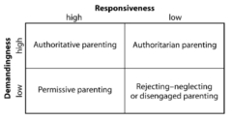
Parenting Styles in Middle
Childhood
Baumrind’s Model of Parenting Styles

