Slide 1
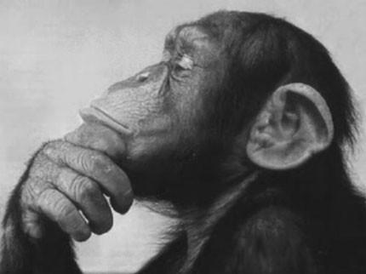
Lieberman, Tooby, & Cosmides (2007)
Humans interact closely with relatives
In-breeding depression
Kin-selection
Humans should be able to:
Show appropriate altruism
Detect genetic similarity in mates
Mattson

Slide 2
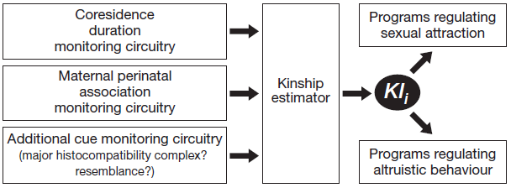
Sibling Detection
Maternal Perinatal Association (MPA)
Co-residence and other factors
Mattson

Slide 3
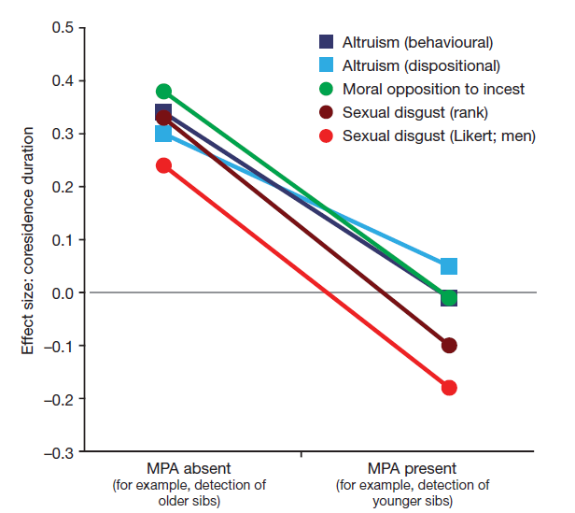
Co-residence and MPA
N=154 at lowest
Self-Report
Men vs. Women
Notable change in effect size
Mattson

Slide 4
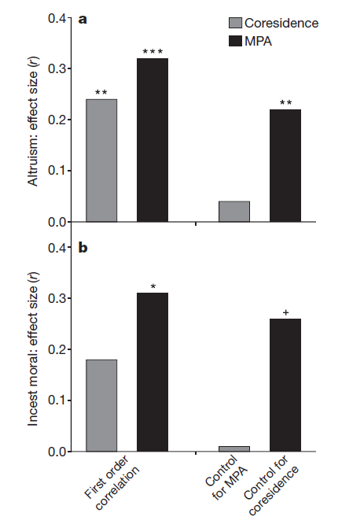
Co-residence and MPA
Effect of MPA vs. Co-residence on
Altruism
Incest
After controlling for MPA
Mattson

Slide 5
Alternatives and Conclusions
Data Artifact?
Moral opposition linked to opposite sex co-residence
Early Imprinting?
Likely due to MPA
Beliefs?
Not predictive compared to co-residence
Correlational
Kinship Index
Hierarchy of Cues
Mattson

